Slide 1
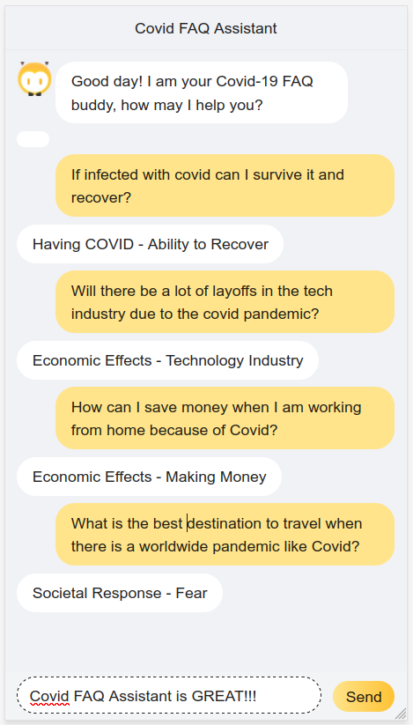
COVID FAQ Assistant

Slide 2
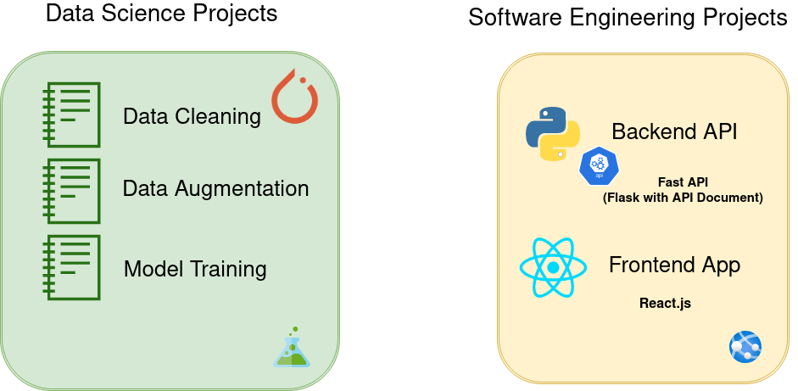
COVID FAQ Assistant – Project Architecture

Slide 3
COVID FAQ Assistant – Techniques in Data Science Projects
For Data Augmentation
1. Back Translation
2. Synonyms Substitution
3. Spelling
For Training Model
1. One Cycle Policy
2. Progressive Model Training
3. Transfer Learning
4. Learning Rate Finding
5. Mixed Precision or Half Precision

Slide 4
Covid FAQ Assistant - Content
1. Final App Demo
2. Data Analysis
3. Issues with the data set
4. Solutions
4.1 Data Cleaning
4.2 Data Augmentation
5. Training Model
6. API
7. Front-end App

Slide 5
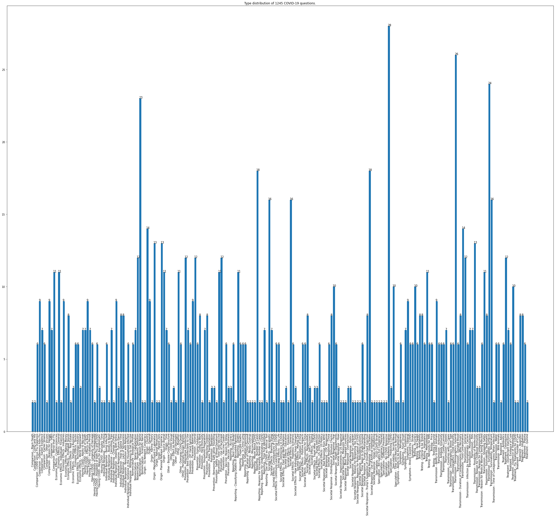
Issues with the data set
Observations
Not enough data
Dirty data

Slide 6
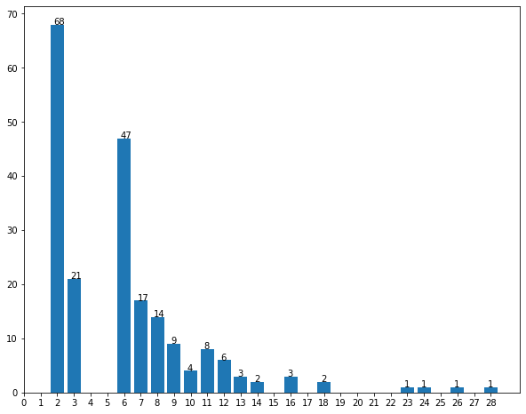
Issues with the data set
Observations
Not enough data
Dirty data
1611 Entire
1245 Dirty
1244 Q&C
208 Categories
32% 2
10% 3
23% 6 …...

Slide 7

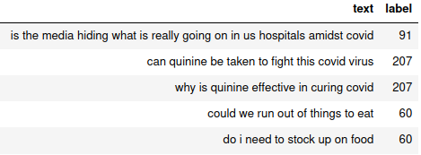
Data Analysis - Solutions
Solution
Data Cleaning
Remove dirty data
Remove non-useful columns
Data Pre-processing
Tokenization
Lower Case
Remove Punctuations
Numeralization
Stopwords
Data Augmentation
Back Translation
Synonyms Substitution
Spelling

Slide 8
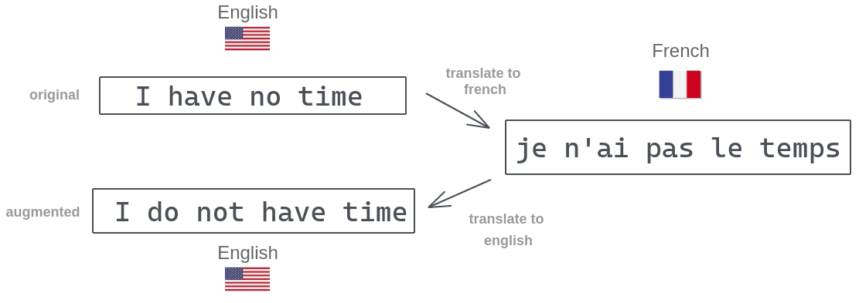
Data Analysis
Solution
Data Augmentation Pipeline
Back Translation(BT)
Synonyms Substitution(SS)
Spelling(SP)
For augmenting 1 question with 10 output:(Improvement)
(SS + SP) VS (BT + SS + SP)
0.004620790481567383 seconds VS 12.24682903289795 seconds
Improvement

Slide 9
Data Analysis
Synonyms Substitution
This article will focus on summarizing data augmentation techniques in NLP.
Solution
Data Cleaning
Data Augmentation
Back Translation
Synonyms Substitution
Spelling
This write-up will focus on summarizing data augmentation methods in NLP.

Slide 10
Data Analysis
Spelling
Solution
Data Cleaning
Data Augmentation
Back Translation
Synonyms Substitution
Spelling
When will Covid end?
When weill Covid end?

Slide 11
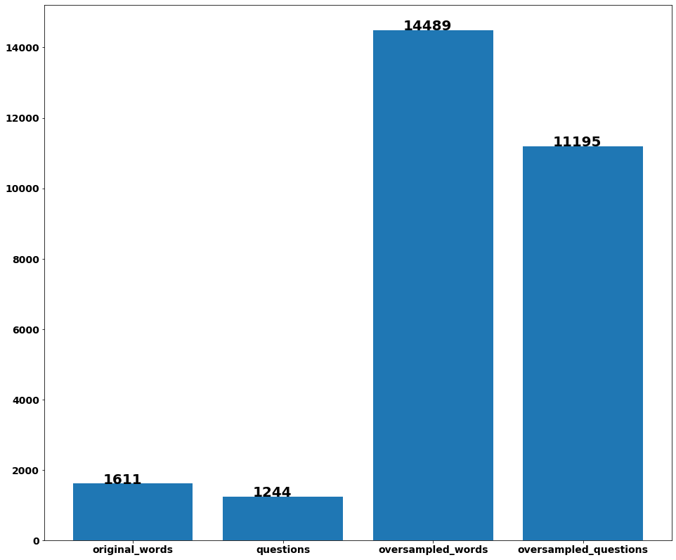
Data Analysis
Oversampling Before v.s. After

Slide 12
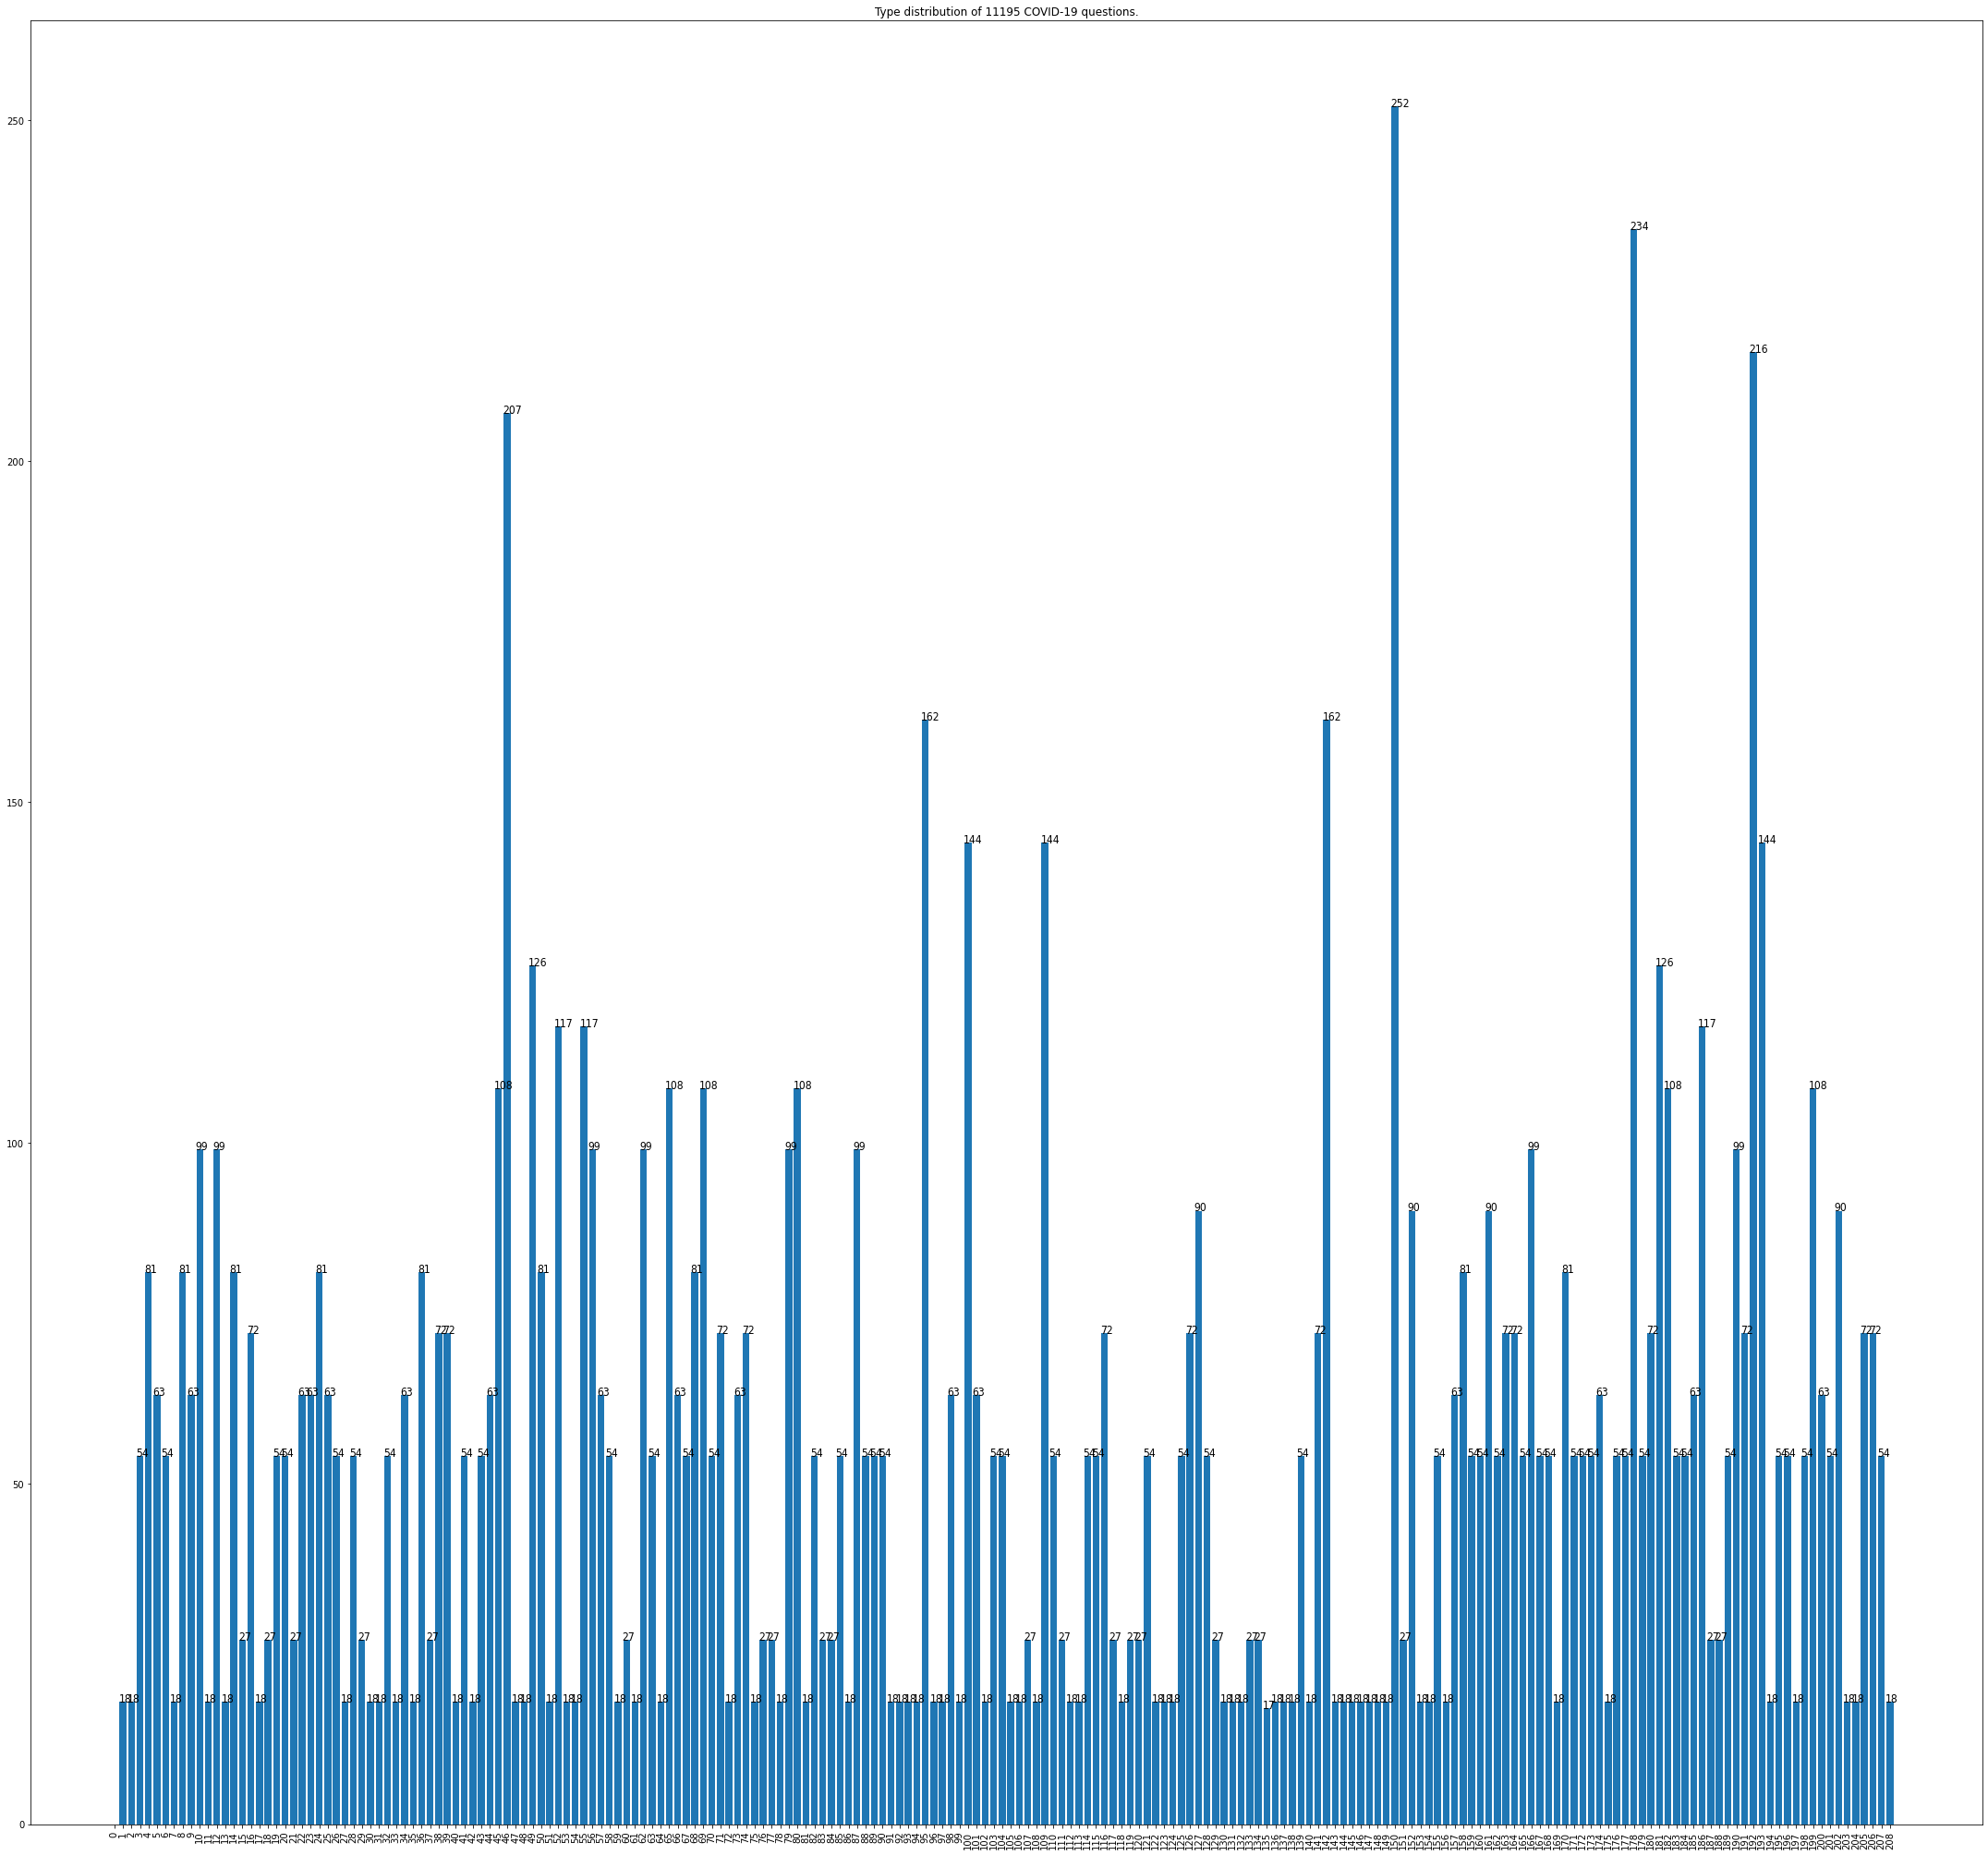
Data Analysis - Oversampling for Questions & Labels
Improvement

Slide 13
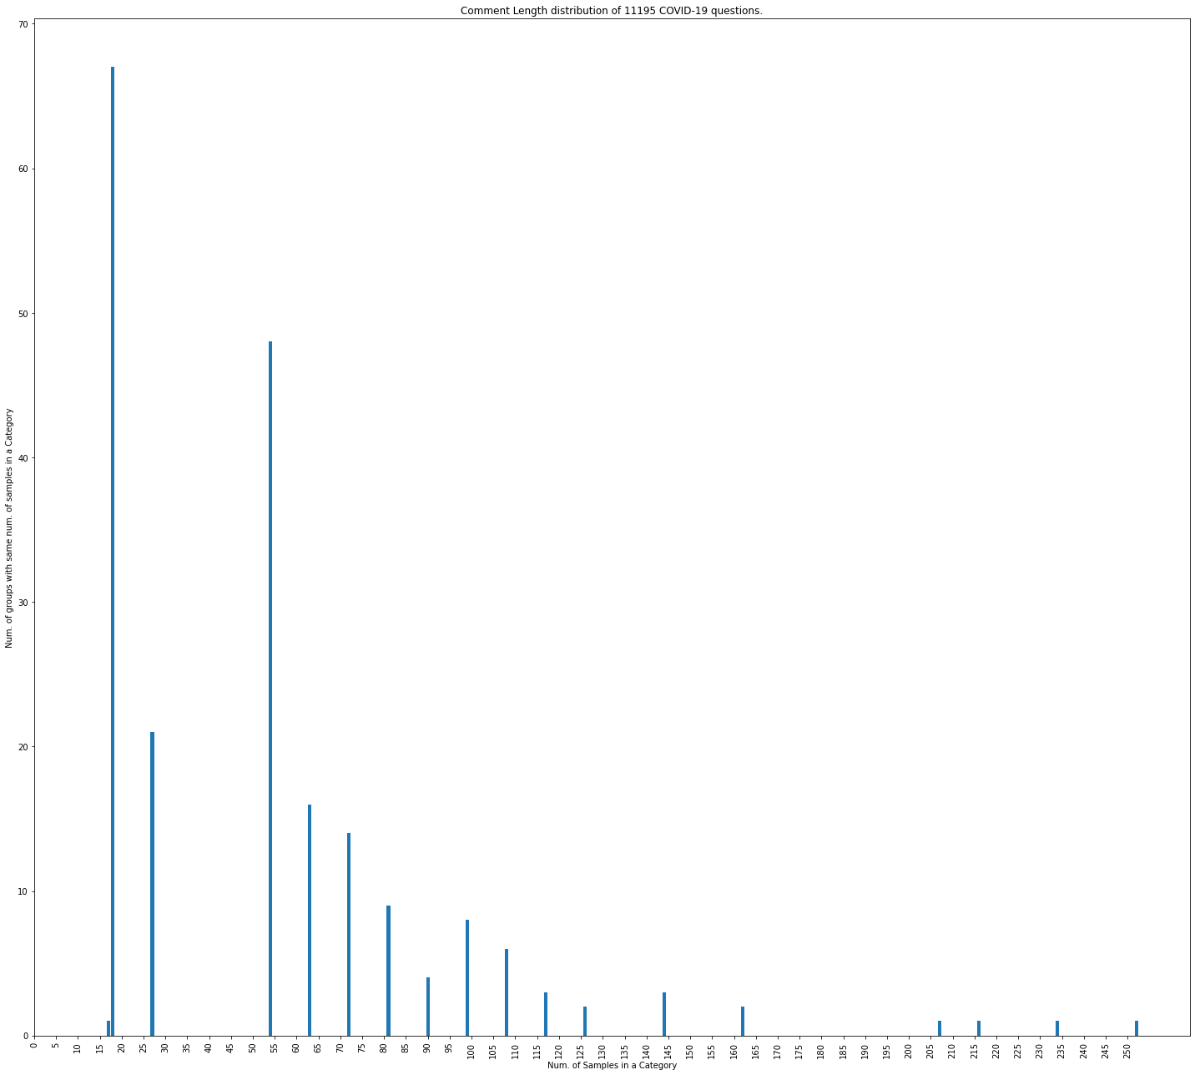
Grouped groups of categories with same number of questions

Slide 14
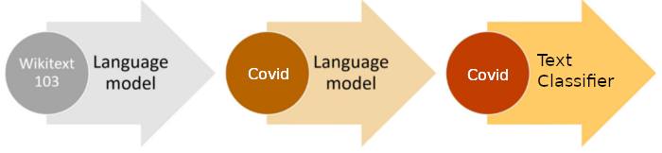
Model Training
Transfer Learning
Language Model
Text Classification
Wiki Corpus + Covid Domain Corpus
We use all questions even without categories to improve accuracy

Slide 15
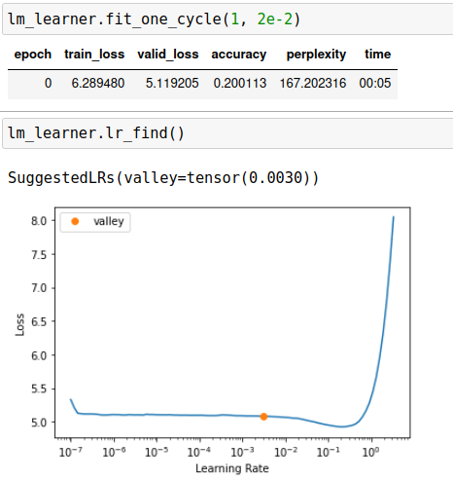
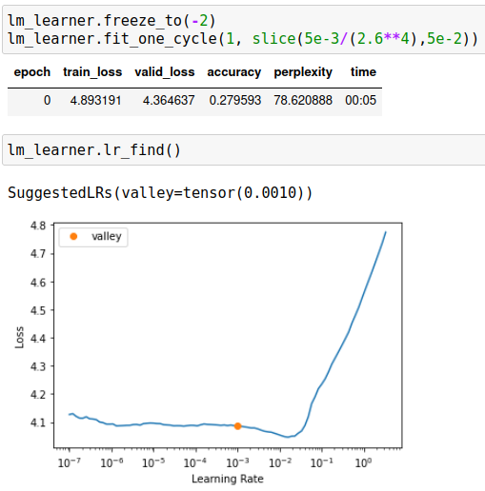
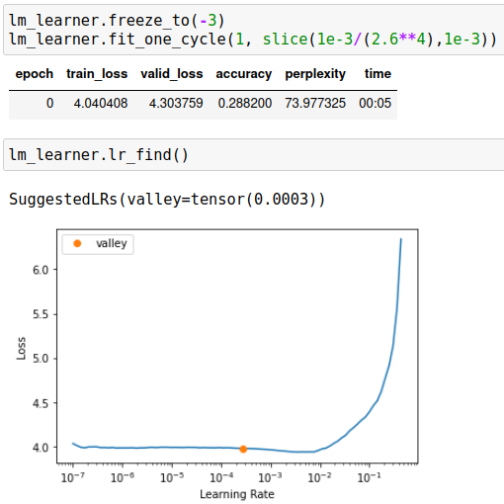
Model Training
Training Language Model
One Cycle Policy – less epoch to train complex models
Progressive Model Training

Slide 16
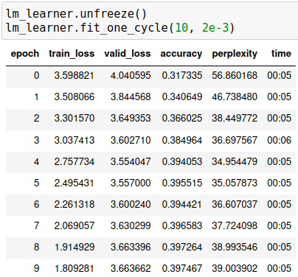
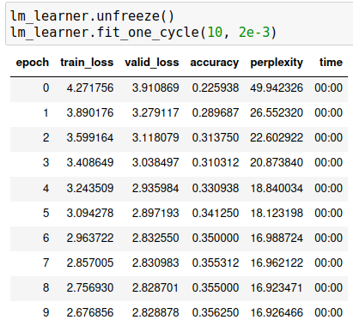
Model Training
Training Language Model
Fit One Cycle
Progressive Model Training
Trained with Over-sampled Data
Trained with Original Data

Slide 17
Model Training
Text Classification Model Training

Slide 18
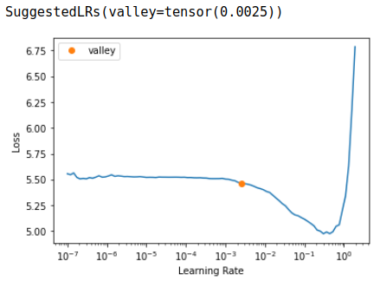
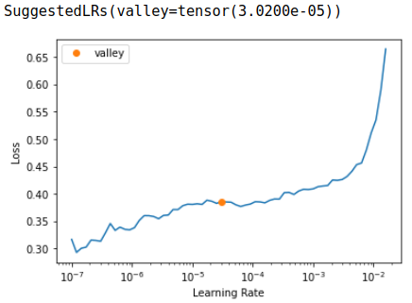
Model Training
Text Classification – Training Model
Same technique
…..

Slide 19
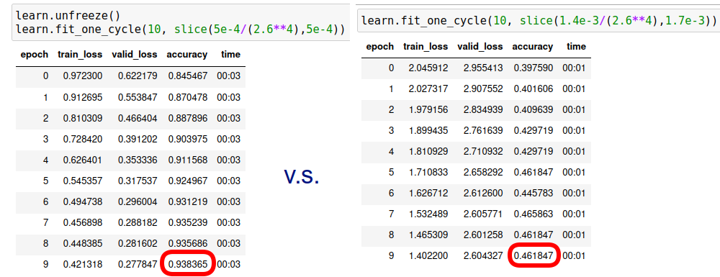
Model Training
Text Classification – Training Model
Trained with Over-sampled Data
Trained with Original Data

