Slide 1
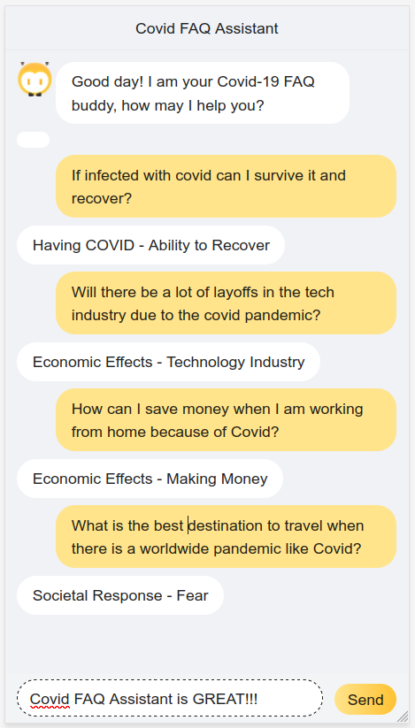
COVID FAQ Assistant

Slide 2
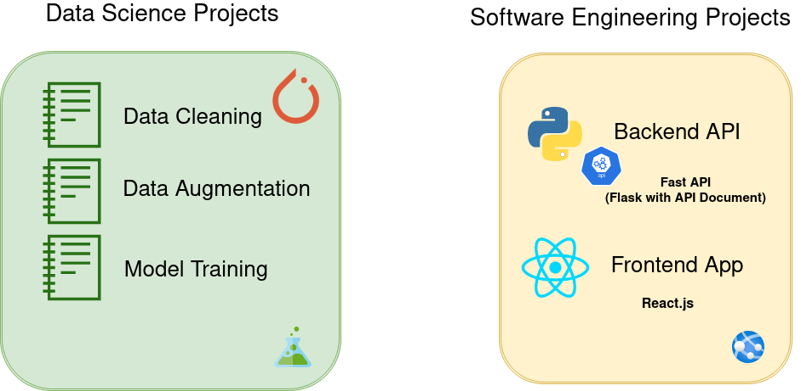
COVID FAQ Assistant – Project Architecture

Slide 3
COVID FAQ Assistant – Techniques in Data Science Projects
For Data Augmentation
1. Back Translation
2. Synonyms Substitution
3. Spelling
For Training Model
1. One Cycle Policy
2. Progressive Model Training
3. Transfer Learning
4. Learning Rate Finding
5. Mixed Precision or Half Precision

Slide 4
Covid FAQ Assistant - Content
1. Final App Demo
2. Data Analysis
3. Issues with the data set
4. Solutions
4.1 Data Cleaning
4.2 Data Augmentation
5. Training Model
6. API
7. Front-end App

Slide 5
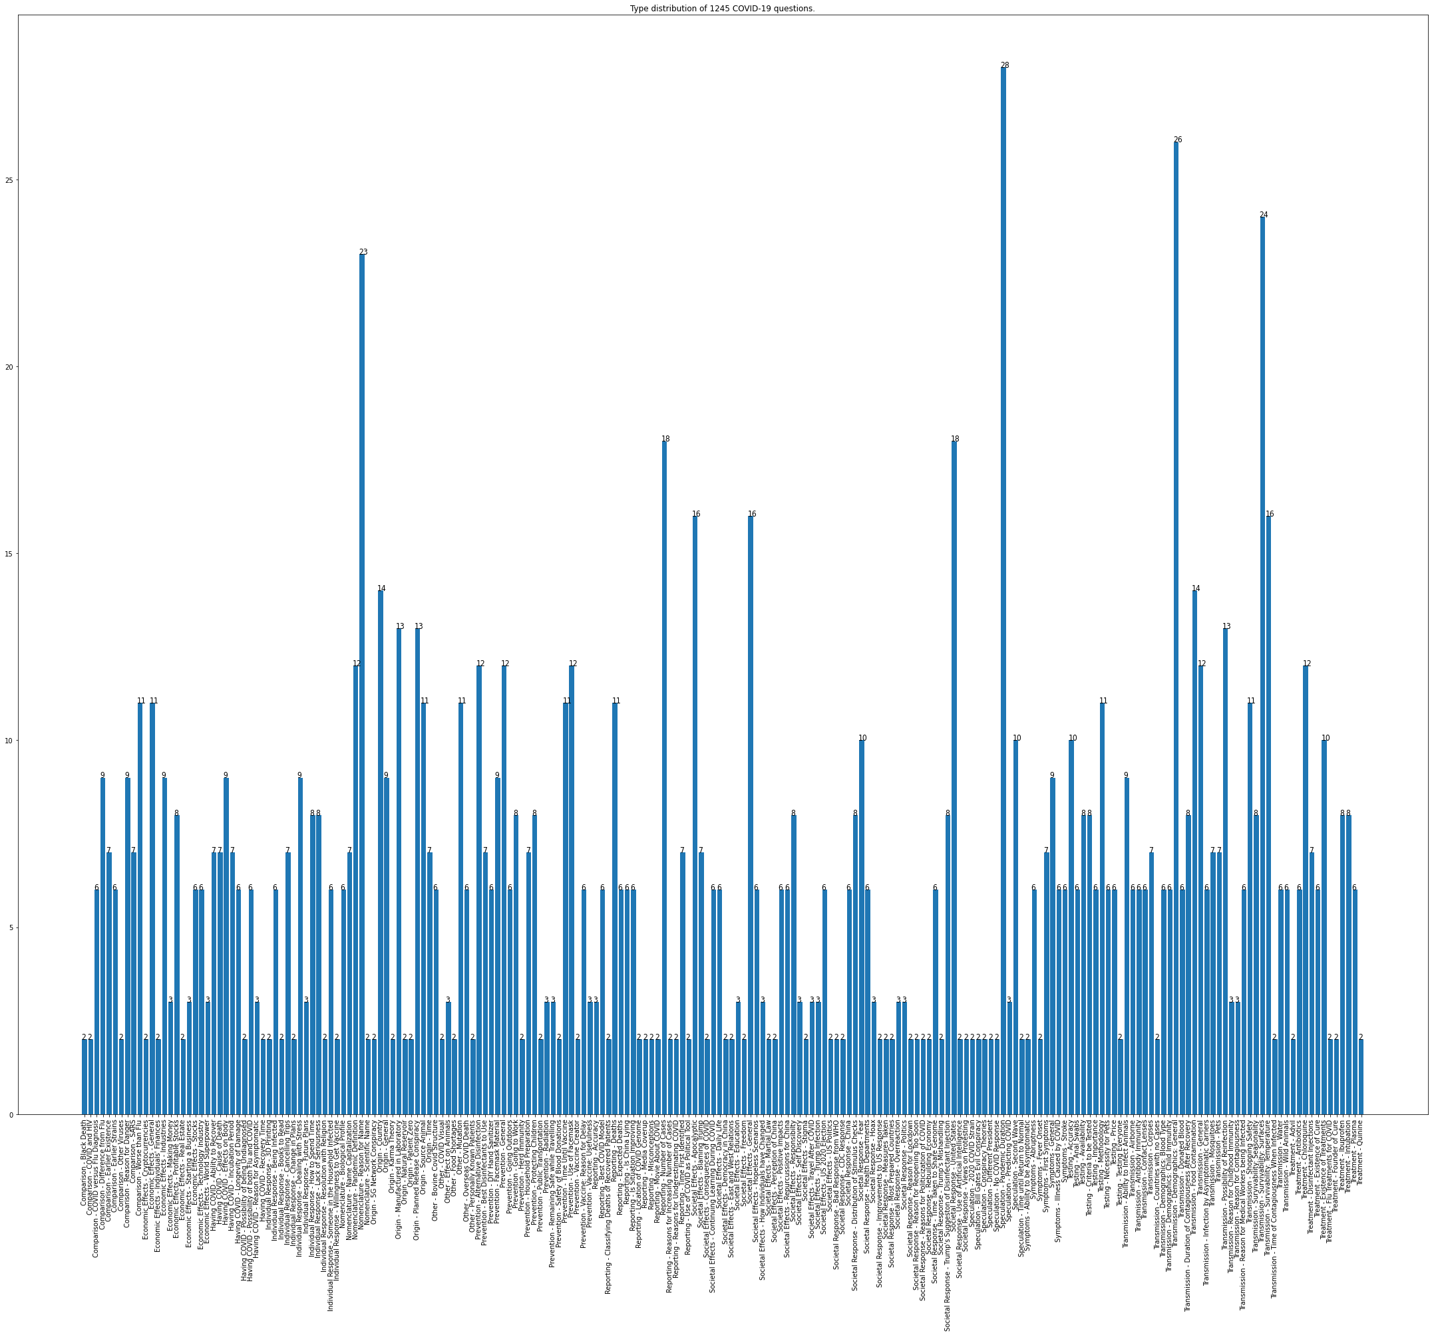
Issues with the data set
Observations
Not enough data
Dirty data

Slide 6
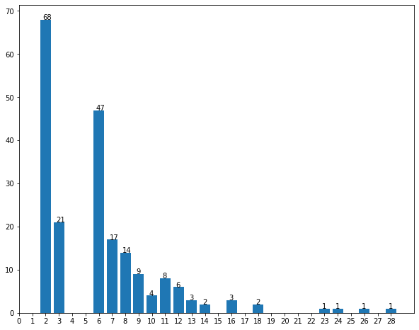
Issues with the data set
Observations
Not enough data
Dirty data
1611 Entire
1245 Dirty
1244 Q&C
208 Categories
32% 2
10% 3
23% 6 …...

Slide 7

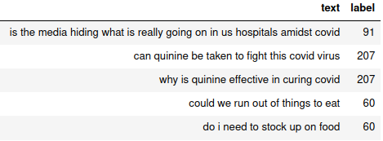
Data Analysis - Solutions
Solution
Data Cleaning
Remove dirty data
Remove non-useful columns
Data Pre-processing
Tokenization
Lower Case
Remove Punctuations
Numeralization
Stopwords
Data Augmentation
Back Translation
Synonyms Substitution
Spelling

Slide 8
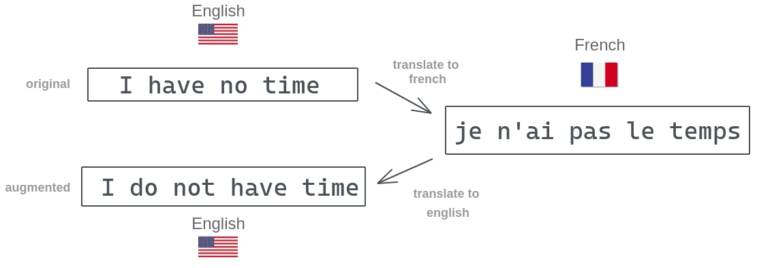
Data Analysis
Solution
Data Augmentation Pipeline
Back Translation(BT)
Synonyms Substitution(SS)
Spelling(SP)
For augmenting 1 question with 10 output:(Improvement)
(SS + SP) VS (BT + SS + SP)
0.004620790481567383 seconds VS 12.24682903289795 seconds
Improvement

Slide 9
Data Analysis
Synonyms Substitution
This article will focus on summarizing data augmentation techniques in NLP.
Solution
Data Cleaning
Data Augmentation
Back Translation
Synonyms Substitution
Spelling
This write-up will focus on summarizing data augmentation methods in NLP.

Slide 10
Data Analysis
Spelling
Solution
Data Cleaning
Data Augmentation
Back Translation
Synonyms Substitution
Spelling
When will Covid end?
When weill Covid end?

Slide 11
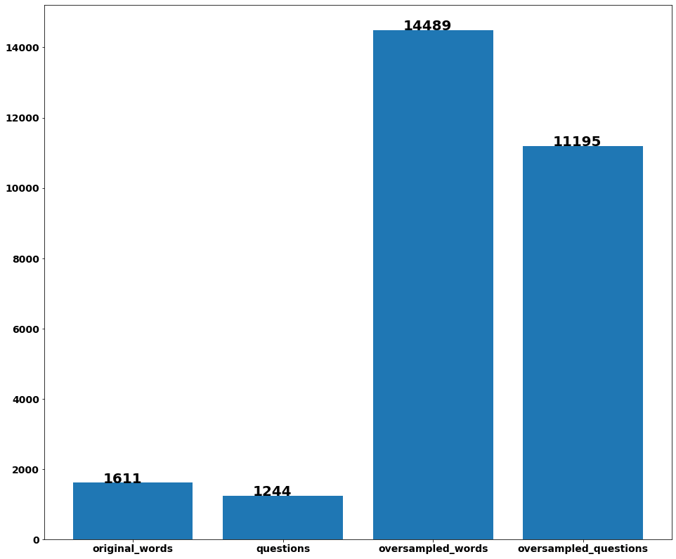
Data Analysis
Oversampling Before v.s. After

Slide 12
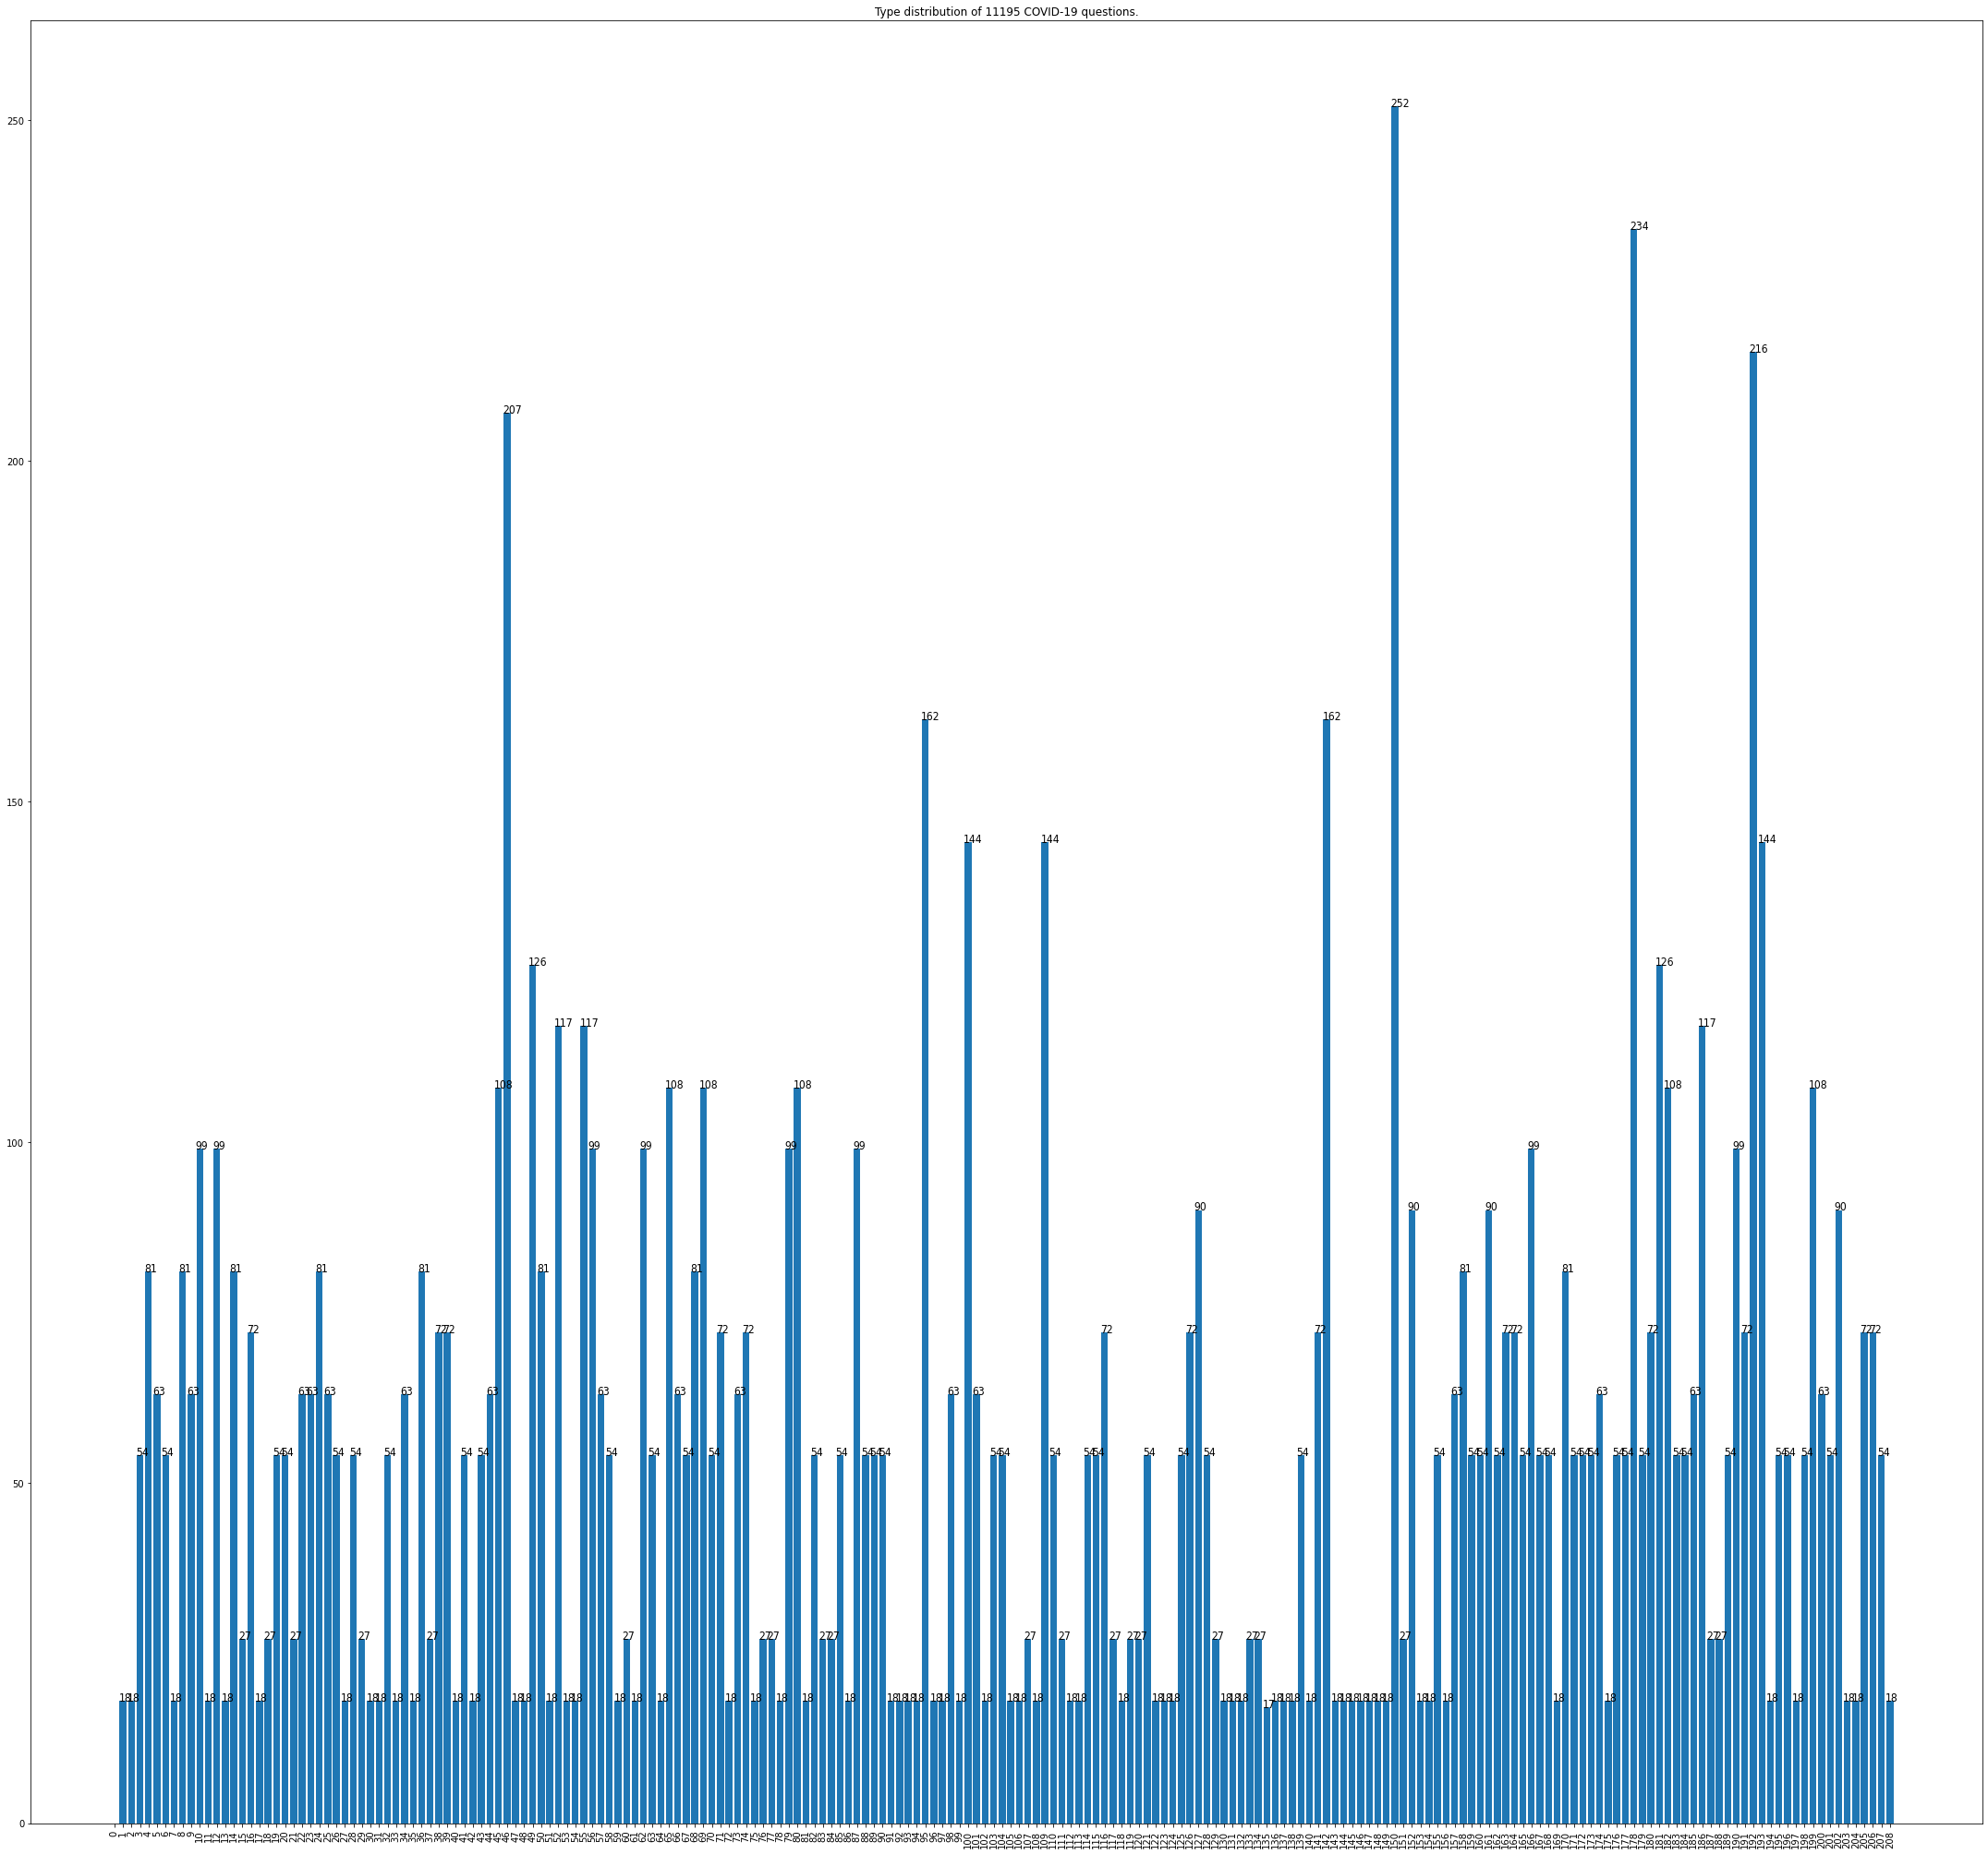
Data Analysis - Oversampling for Questions & Labels
Improvement

Slide 13
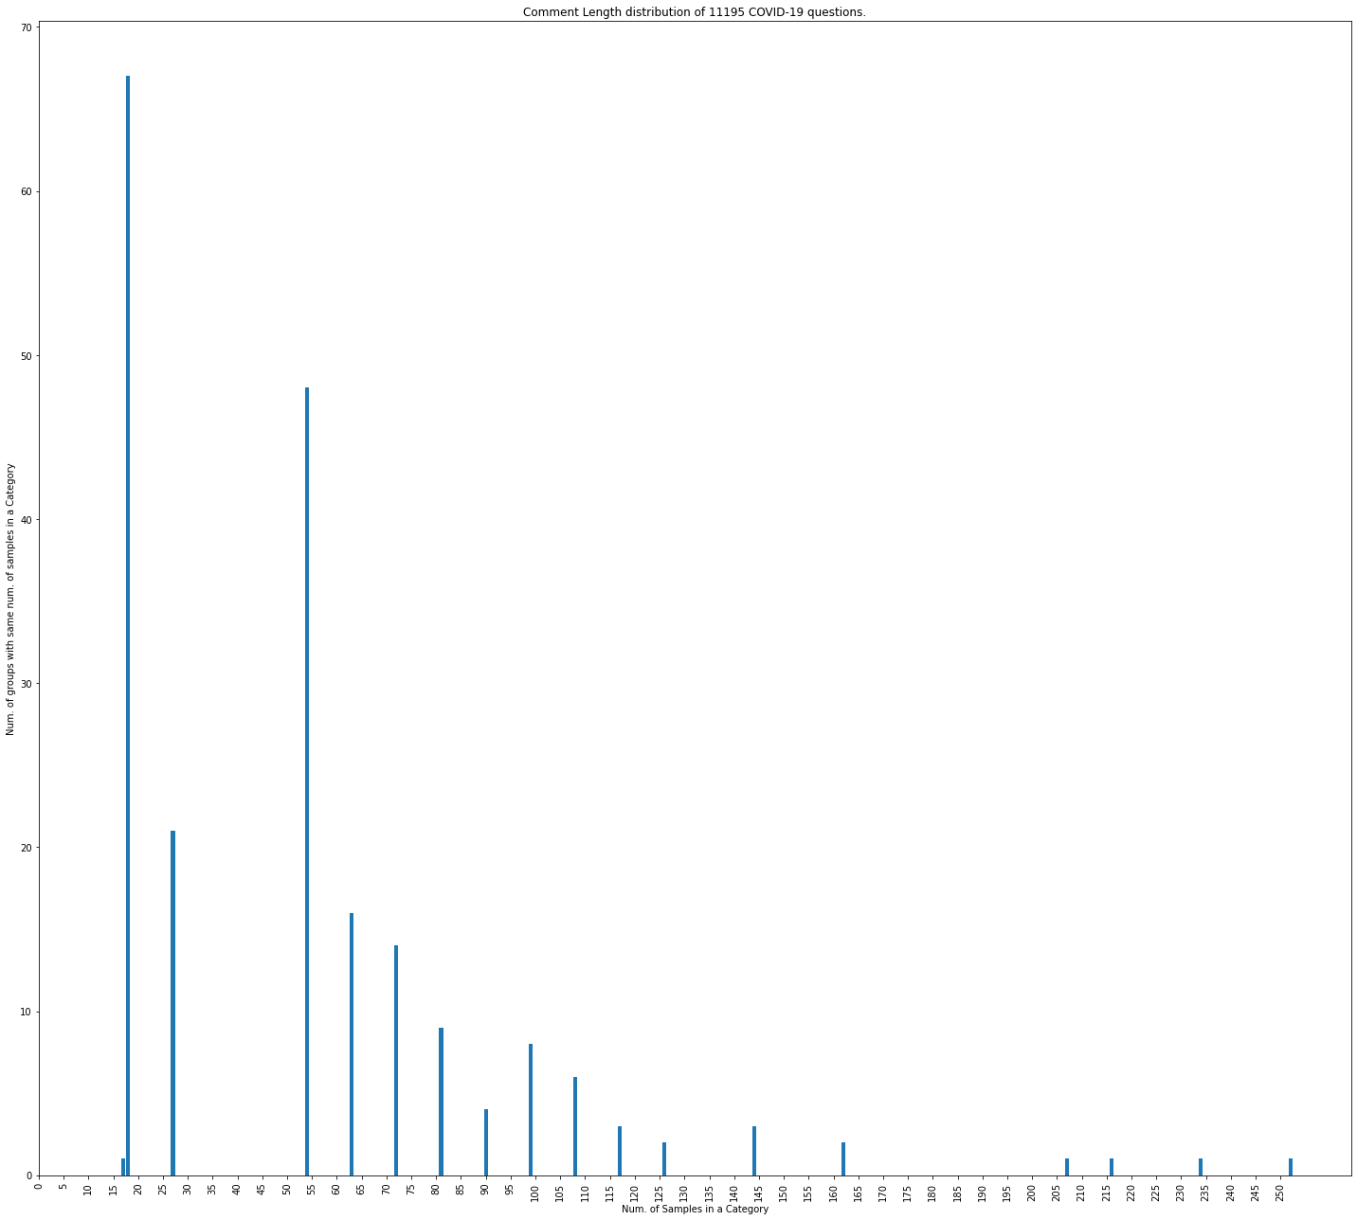
Grouped groups of categories with same number of questions

Slide 14
Another Solution to combat the imbalanced data
Another solution to combat the imbalanced data is to train separated models. We can divide the categories against the number of their sampling data. For example, we could have groups like:
1. Model 30, for all categories which have number of sampling data less than 30
2. Model 90, for all categories which have number of sampling data less than 90 but greater than 30
3. Model 130, for all categories which have number of sampling data less than 130 but greater than 90
4. Model 170, for all categories which have number of sampling data less than 130 but greater than 170
5. Model High, for all the rest of categories
(You can adjust the granularity accordingly, the models above are just for the explanation.)
When classifying a question, we iterate through all models to generate pairs of prediction with probability and pick up the prediction with the highest probability.Due to the time limited, I did not implement this, but this solution can further boost the models' performance

Slide 15
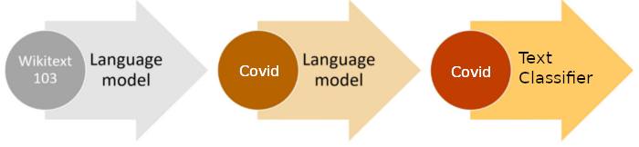
Model Training
Transfer Learning
Language Model
Text Classification
Wiki Corpus + Covid Domain Corpus
We use all questions even without categories to improve accuracy

Slide 16
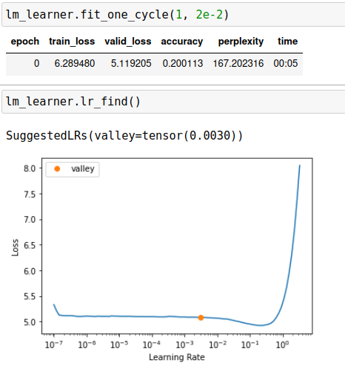
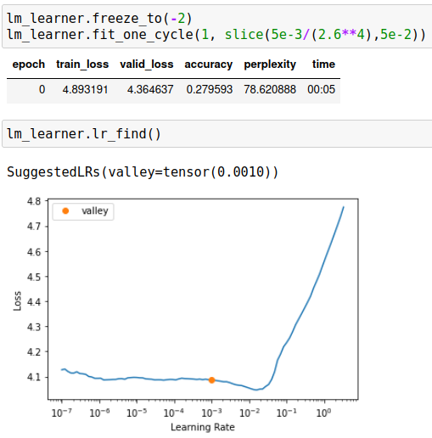
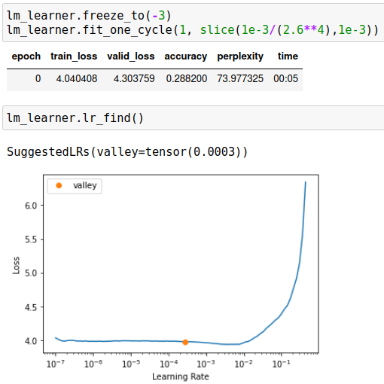
Model Training
Training Language Model
One Cycle Policy – less epoch to train complex models
Progressive Model Training

Slide 17
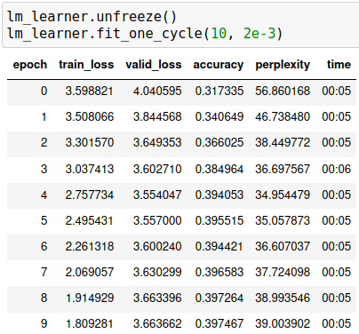
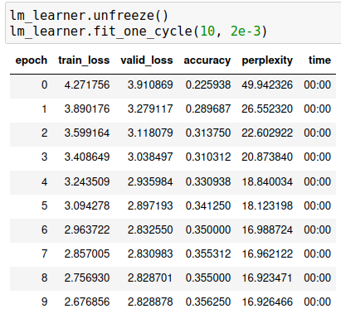
Model Training
Training Language Model
Fit One Cycle
Progressive Model Training
Trained with Over-sampled Data
Trained with Original Data

Slide 18
Model Training
Text Classification Model Training

Slide 19
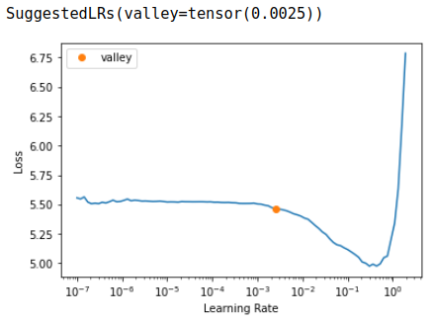
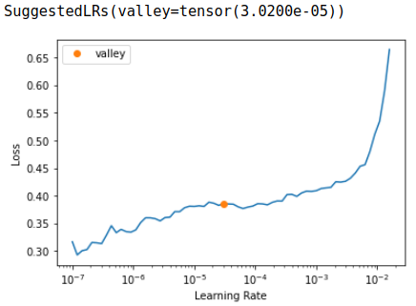
Model Training
Text Classification – Training Model
Same technique
…..

Slide 20
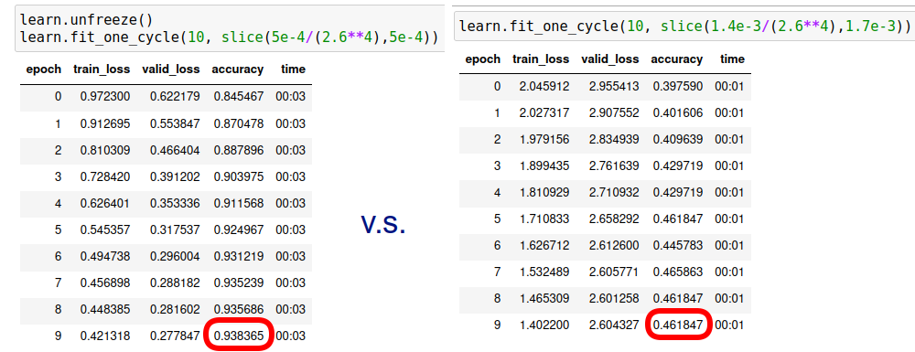
Model Training
Text Classification – Training Model
Trained with Over-sampled Data
Trained with Original Data

