Slide 1
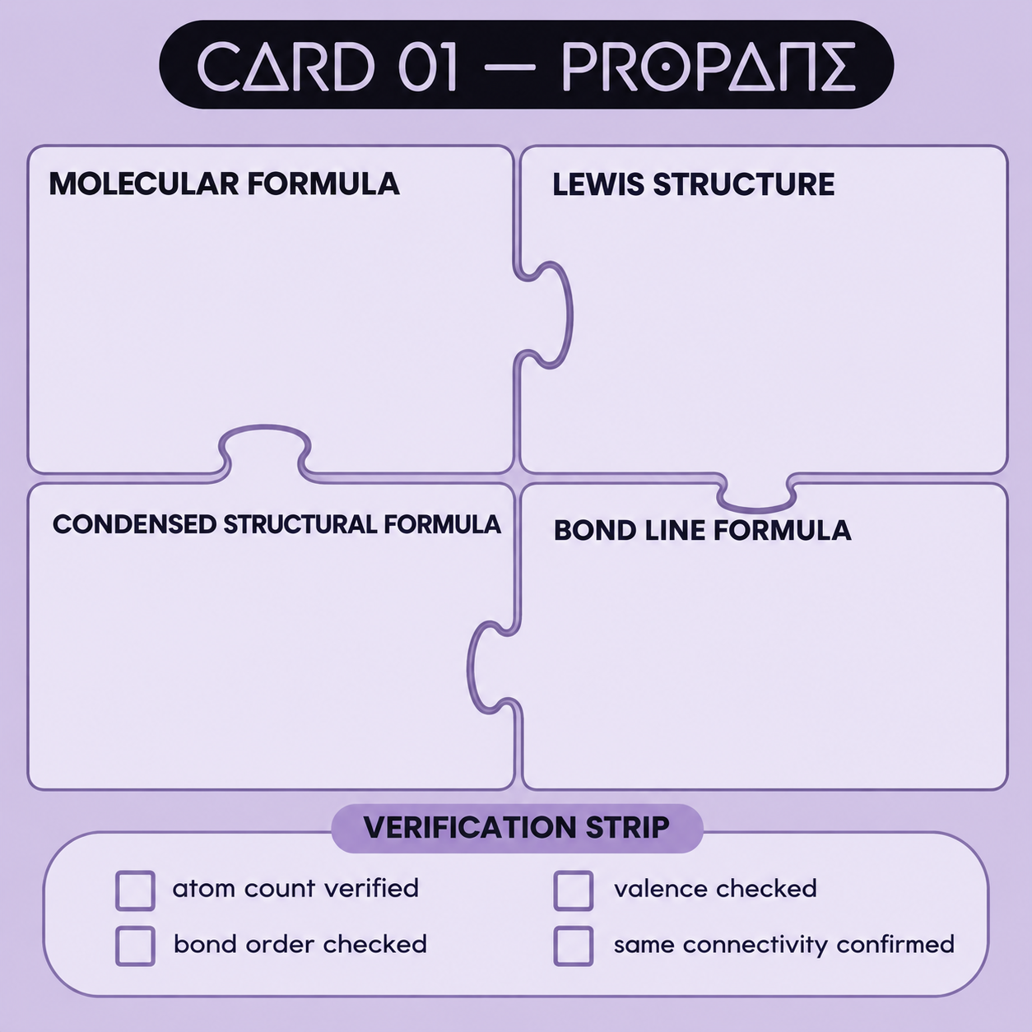
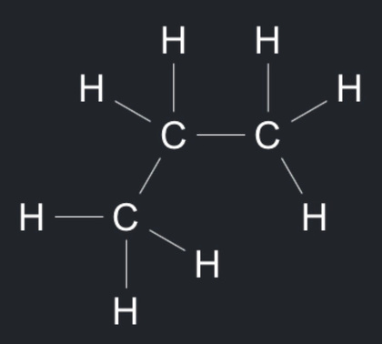
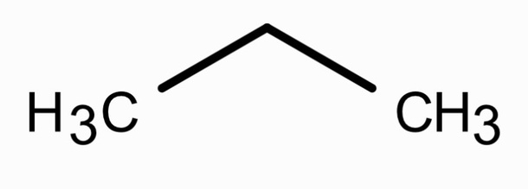


C3H​​​​​​​8
CH3CH2CH3
atom count verified: 3C + 8H
bond orders and heteroatom valences checked
carbon tetravalency checked
same connectivity across all four representations

Slide 2
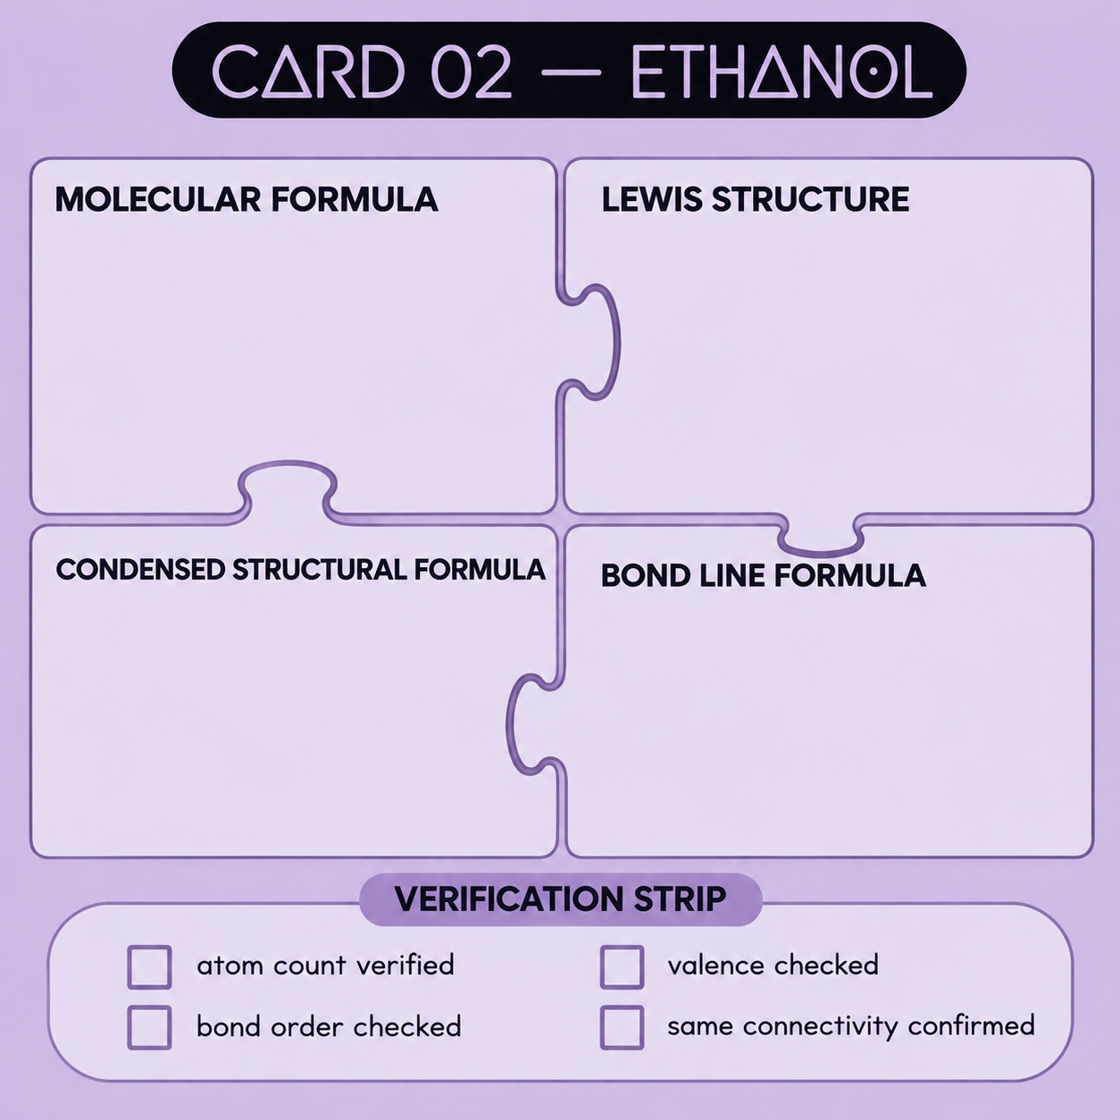
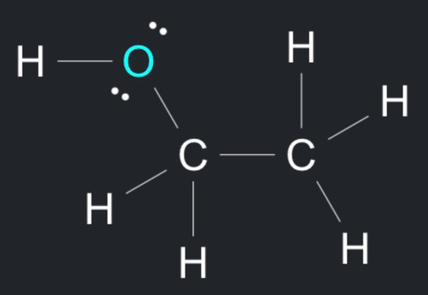
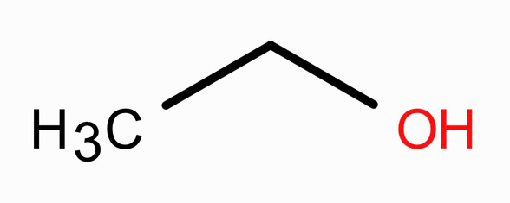

C2H6O
CH₃CH₂OH
atom count verified: 2C + 6H + 1O
bond orders and heteroatom valences checked
carbon tetravalency checked
same connectivity across all four representations

Slide 3
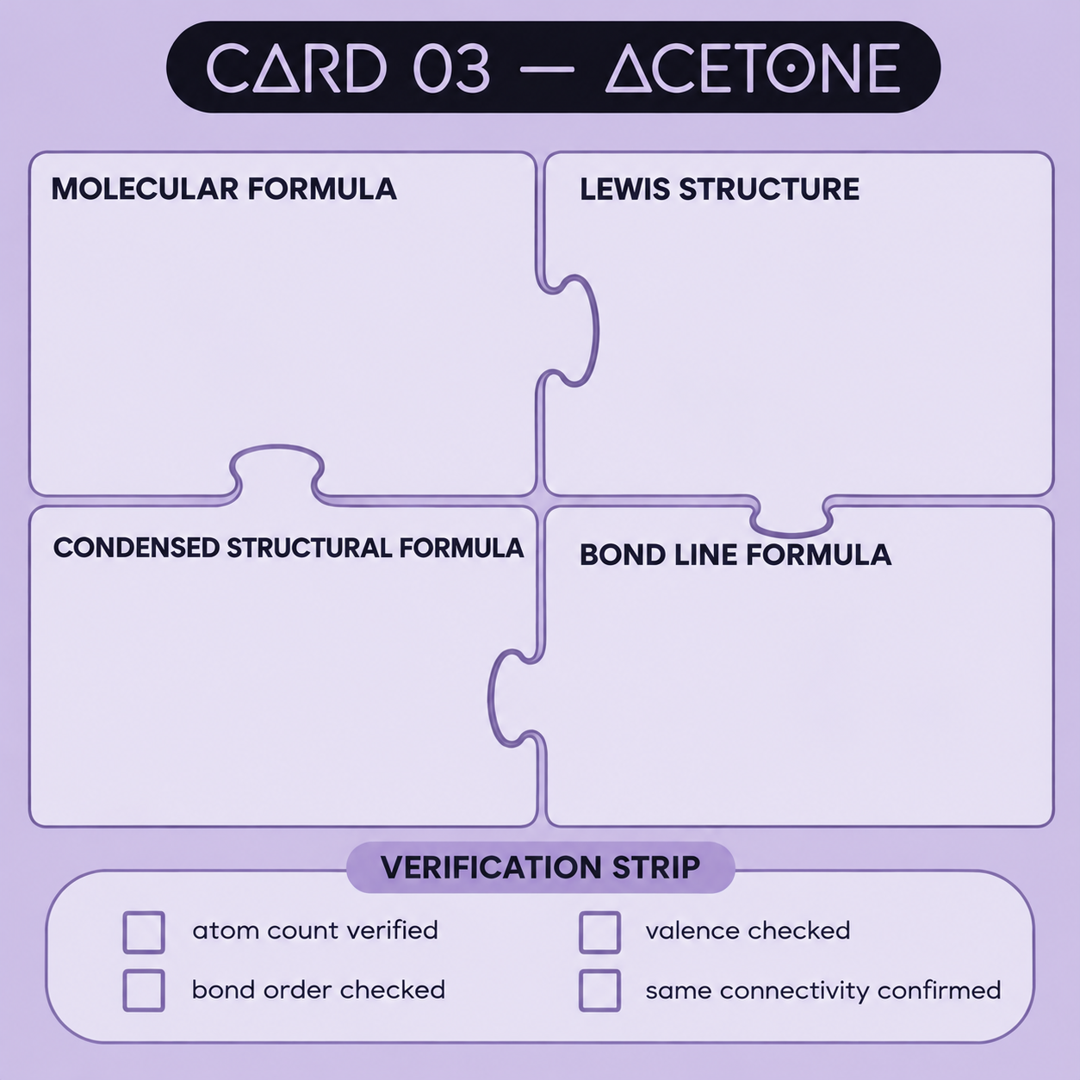
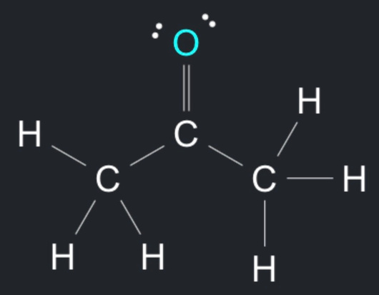
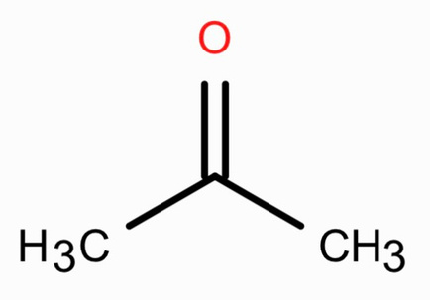

C3H6O
CH₃COCH₃
atom count verified: 3C + 6H + 1O
bond orders and heteroatom valences checked
carbon tetravalency checked
same connectivity across all four representations

Slide 4
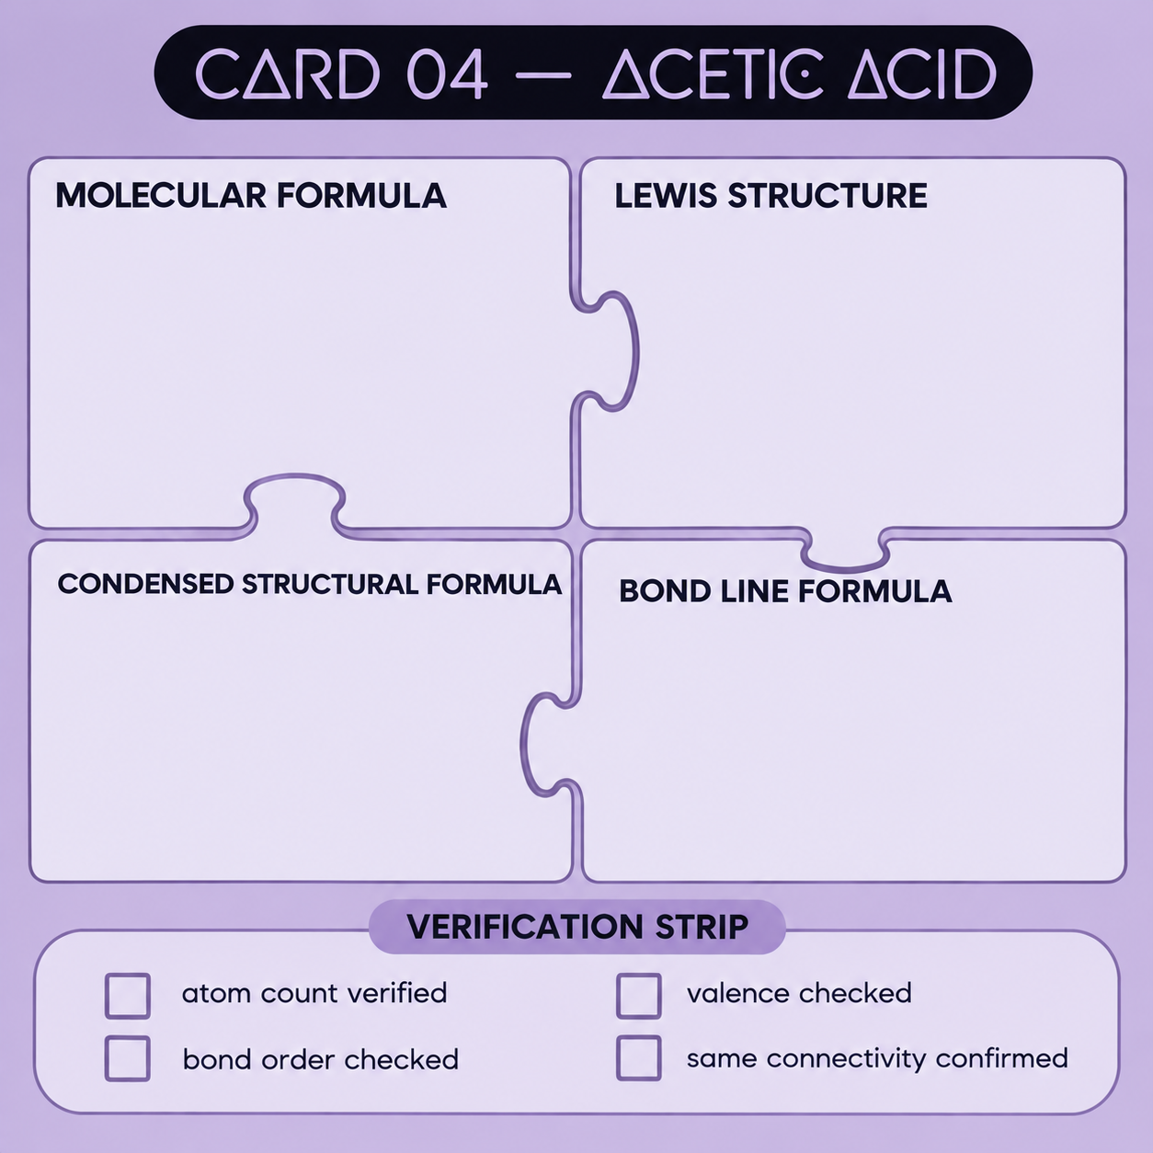
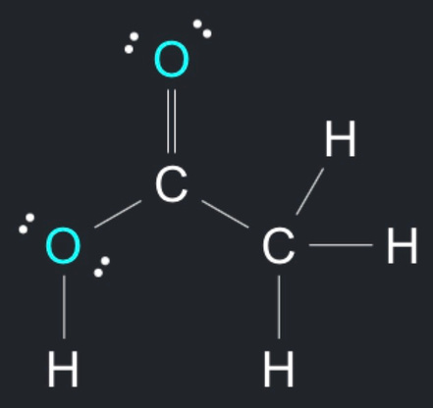
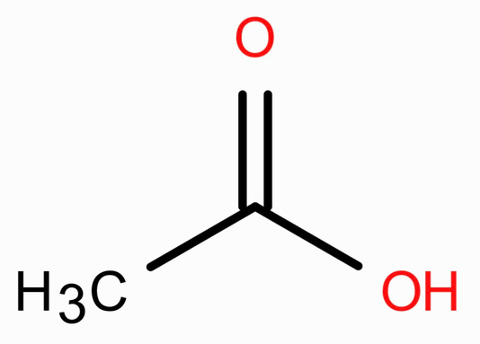

C2H4O2
CH₃COOH
atom count verified: 2C + 4C +2O
bond orders and heteroatom valences checked
carbon tetravalency checked
same connectivity across all four representations

Slide 5
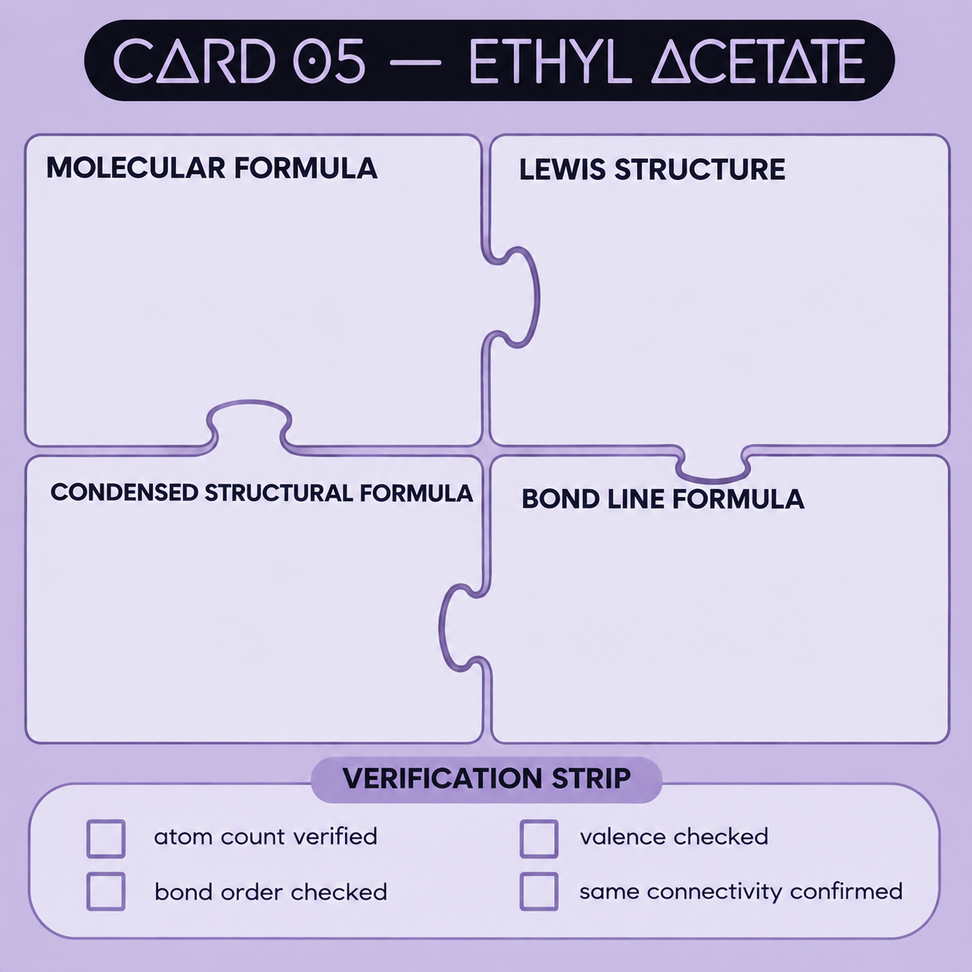
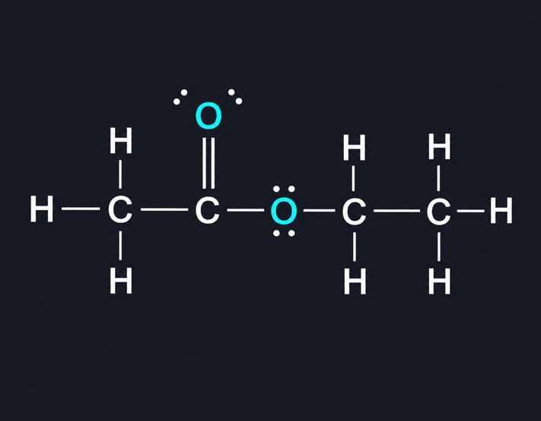
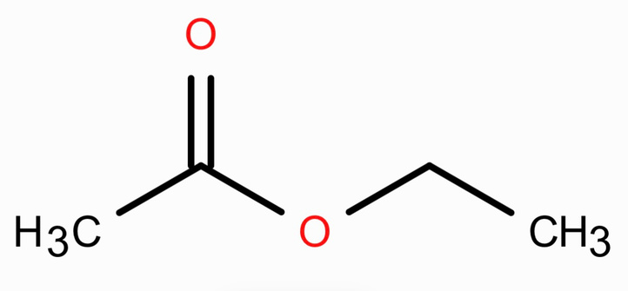

C4H8O2
CH₃COOCH₂CH₃
atom count verified: 4C + 8H + 2O
bond orders and heteroatom valences checked
carbon tetravalency checked
same connectivity across all four representations

Slide 6
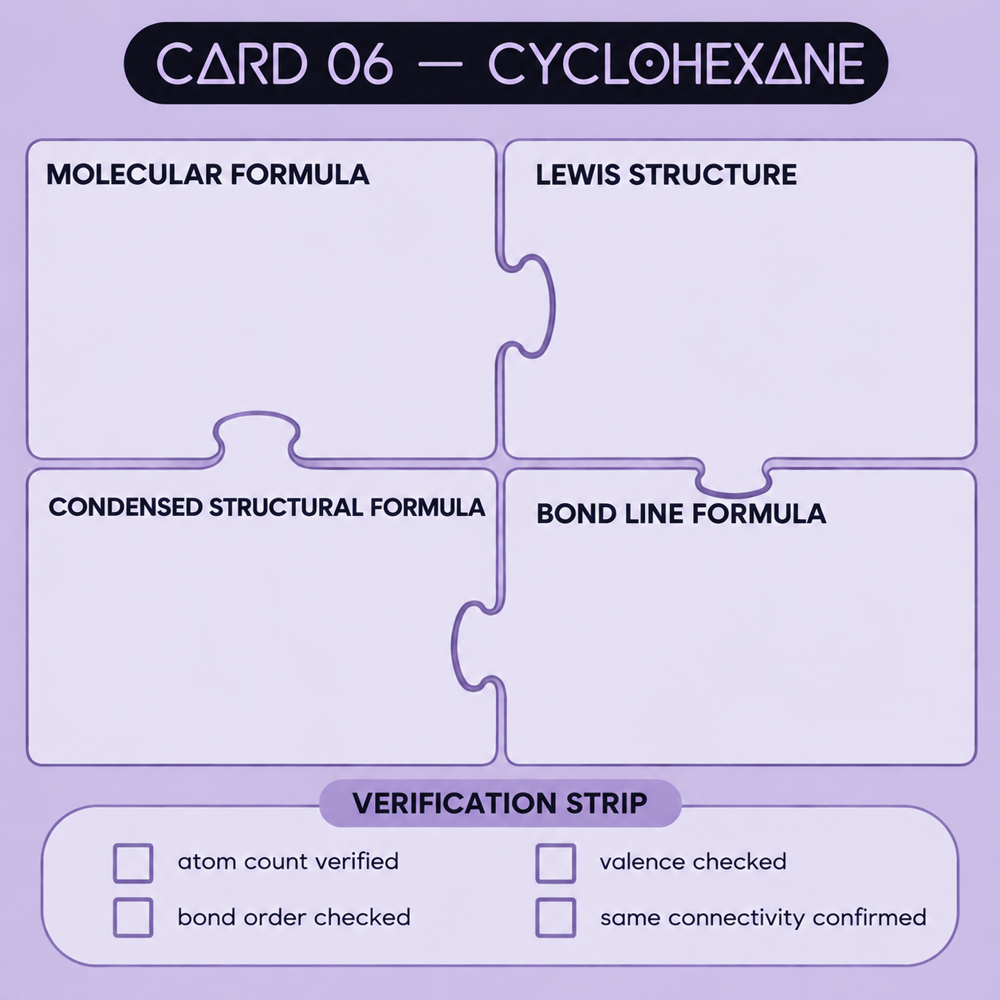
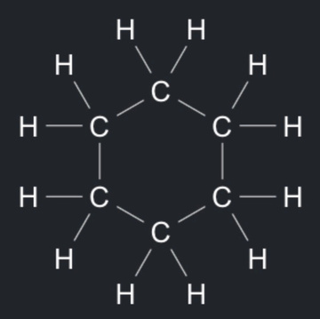
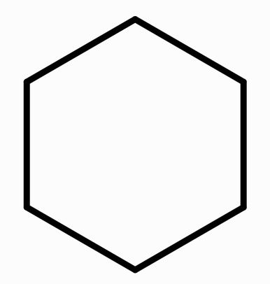

C6H12
(CH₂)₆
atom count verified: 6C + 12H
bond orders and heteroatom valences checked
carbon tetravalency checked
same connectivity across all four representations

Slide 7
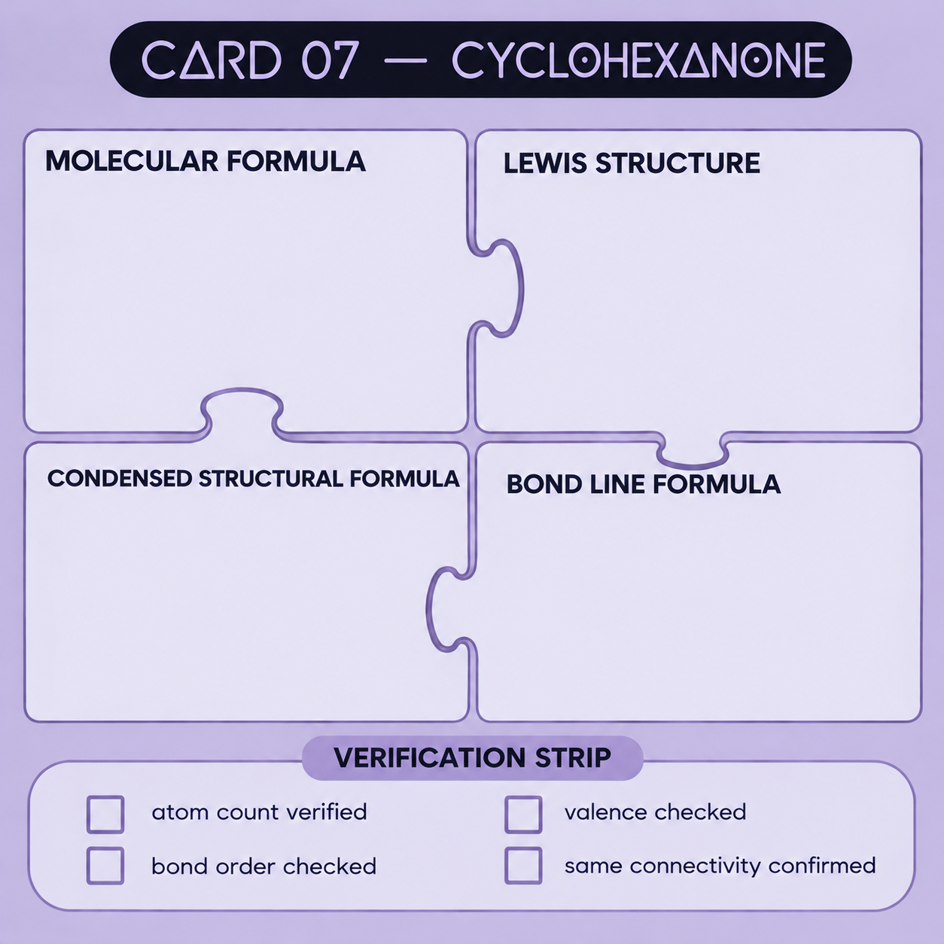
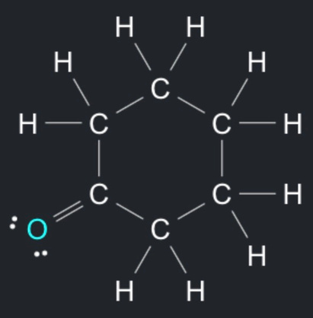
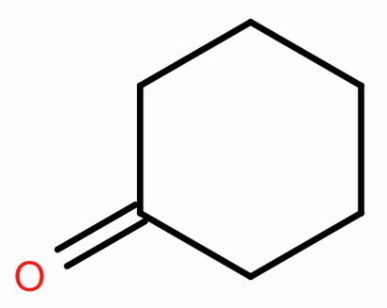

C6H10O
(CH₂)₅CO
atom count verified: 6C + 10H + 1O
bond orders and heteroatom valences checked
carbon tetravalency checked
same connectivity across all four representations

Slide 8
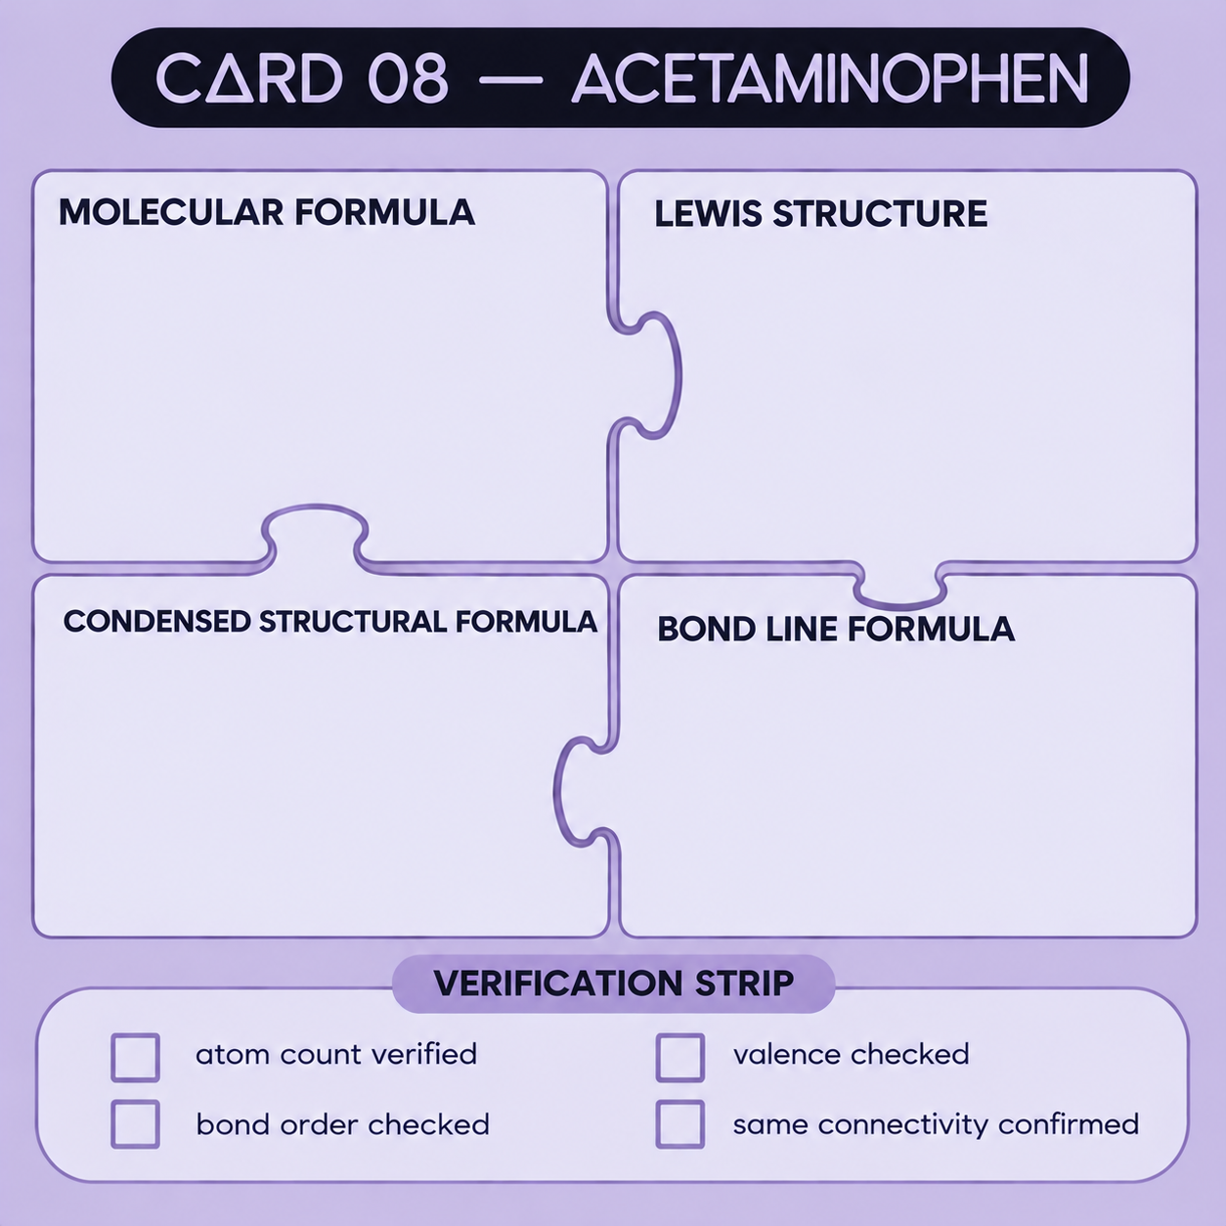
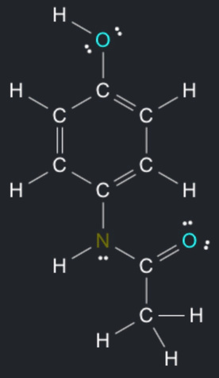
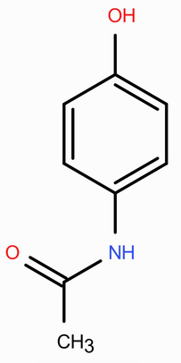

C8H9NO2
HOC₆H₄NHCOCH₃
atom count verified: 8C + 9H + 1N + 2O
bond orders and heteroatom valences checked
carbon tetravalency checked
same connectivity across all four representations

Slide 9
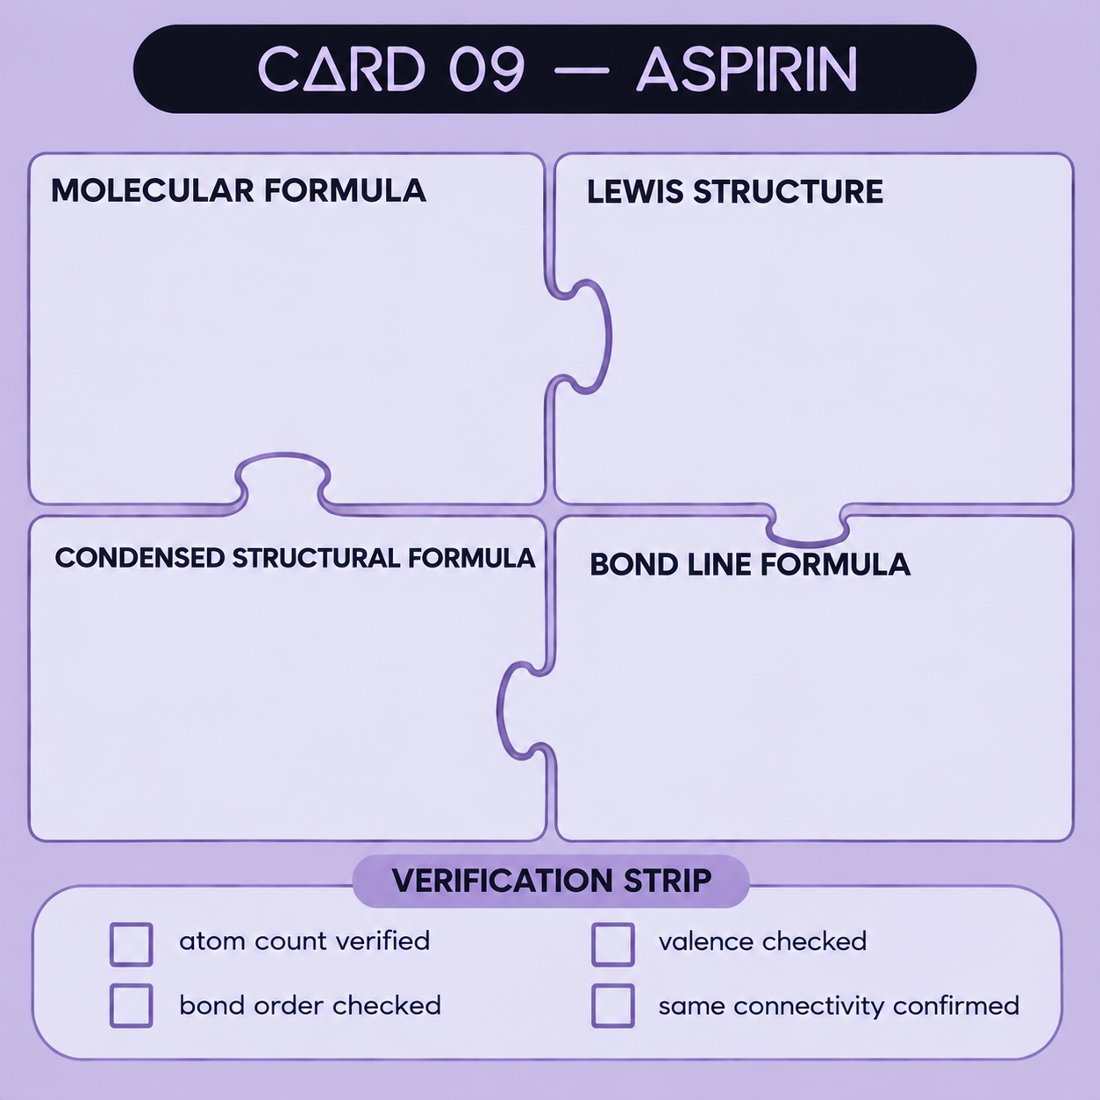
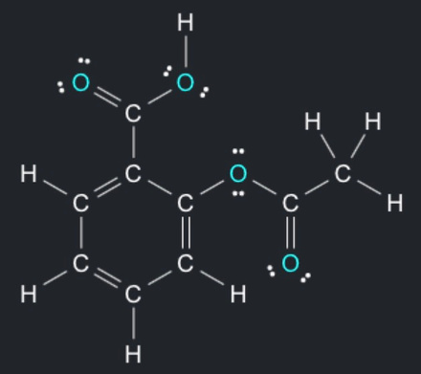
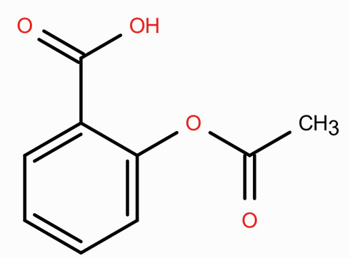
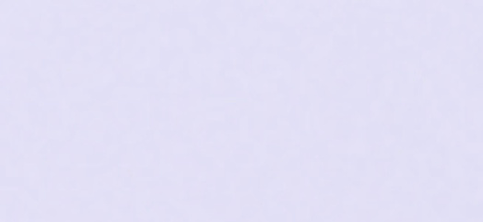
C9H8O4
CH₃COOC₆H₄COOH
atom count verified: 9C + 8H + 4O
bond orders and heteroatom valences checked
carbon tetravalency checked
same connectivity across all four representations

Slide 10
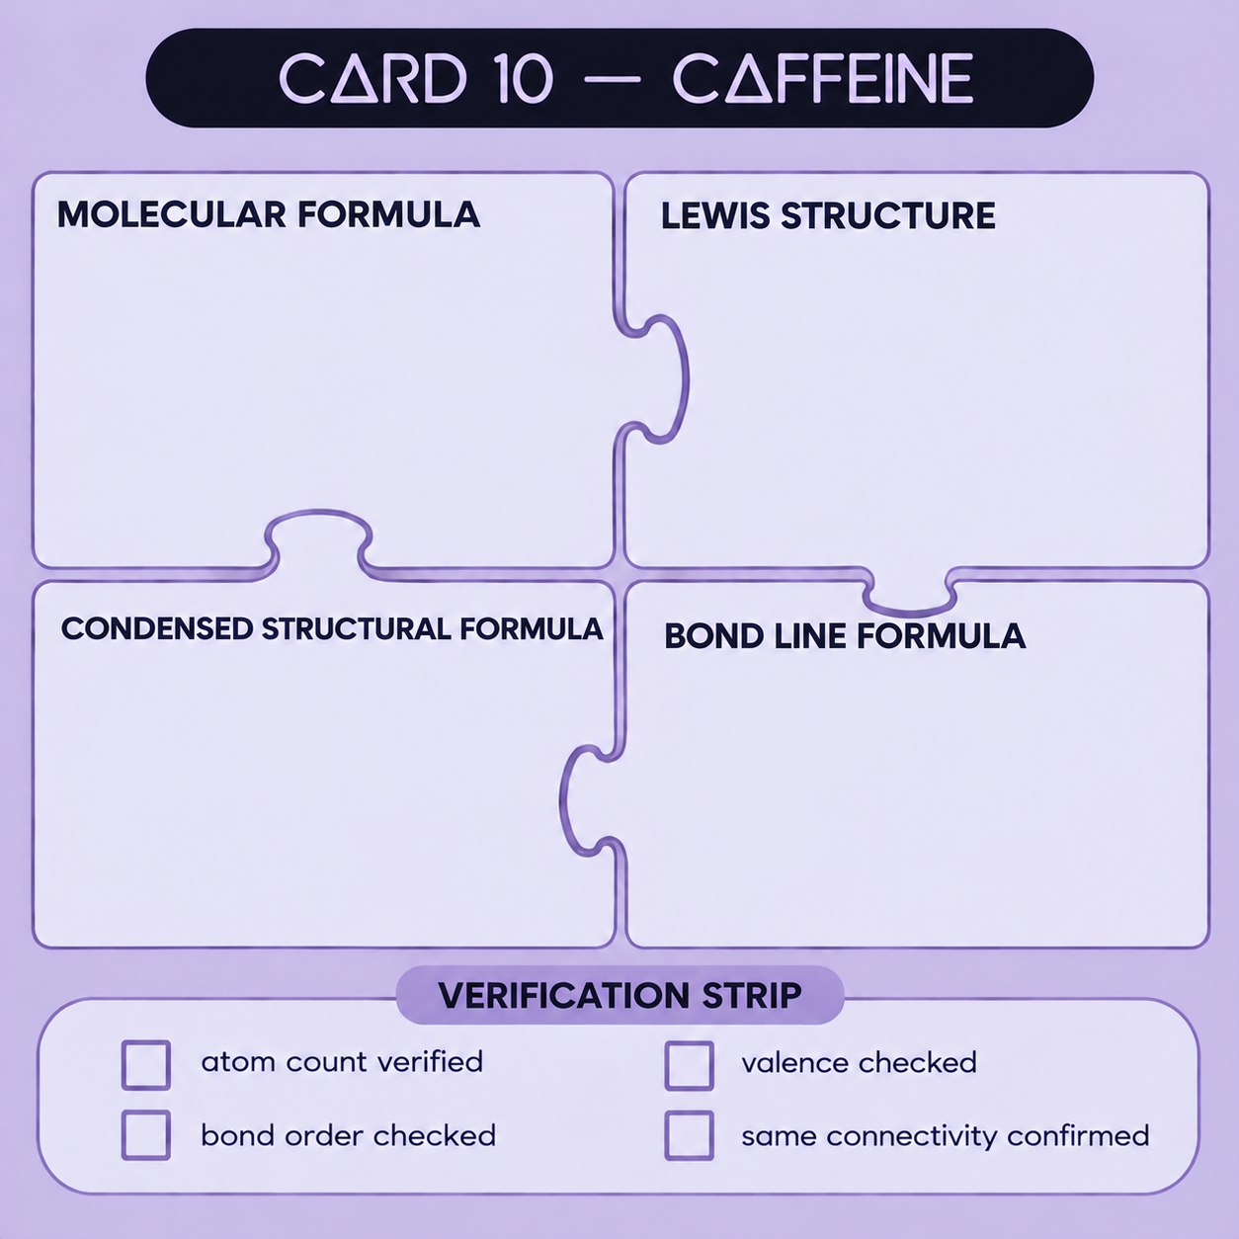
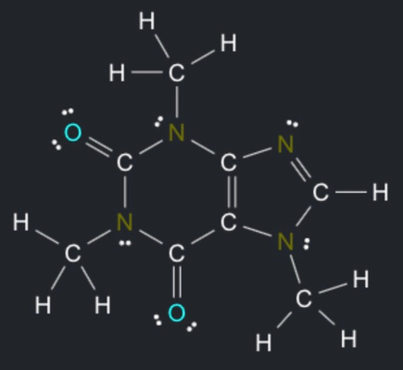
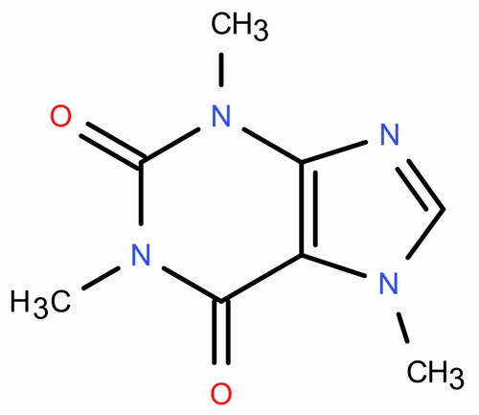

C8H10N4O2
(CH₃)₃C₅HN₄O₂
atom count verified: 8C + 10H + 4N + 2O
bond orders and heteroatom valences checked
carbon tetravalency checked
same connectivity across all four representations

