Slide 1
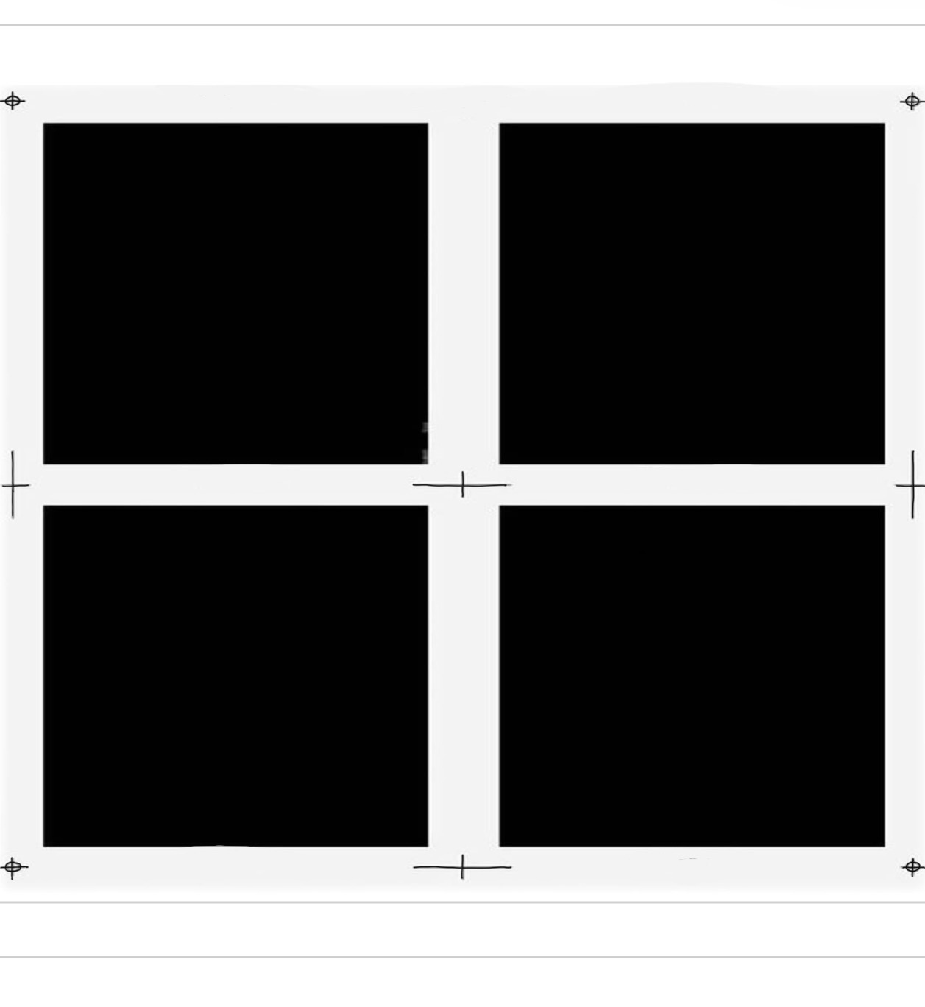

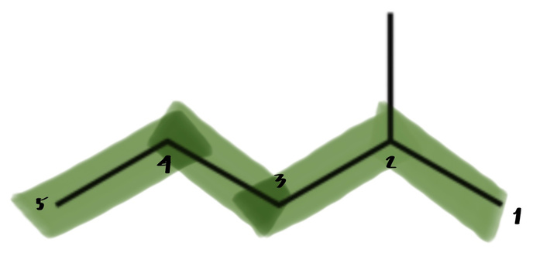
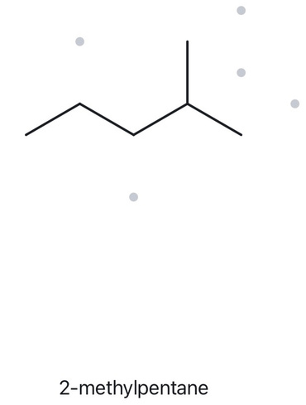

WORKED EXAMPLE A - STRUCTURE → NAME
A01+ FOUNDATION — MOLECULAR FORMULA (counted): C₆H₁₄
  NUMBERED PARENT
  NAMING TRAIL
Parent: Longest chain = 5 C → pentane. The longest continuous chain contains five carbon atoms, with one methyl branch.
Numbering: Left → right gives 4; right → left gives 2. Choose numbering from the right to obtain the lowest possible locant.
Substituents: One methyl group on C2 → 2-methylpentane.
  MY NAME (WRITTEN FIRST)
  THE ALKANE CHECK
2-methylpentane
VERIFICATION STRIP
✔️ longest chain ring ✔️ lowest locants ✔️ alphabetical order
✔️ puctuation ✔️ formula counted

Slide 2
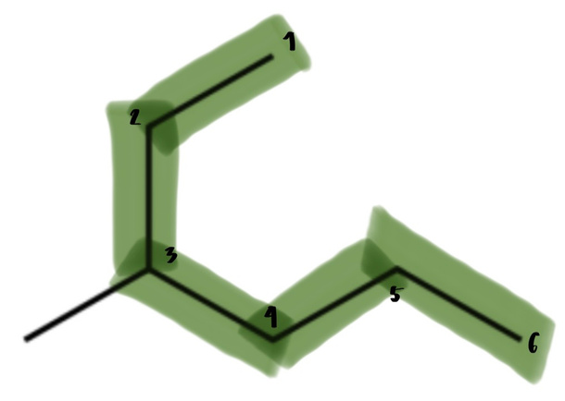
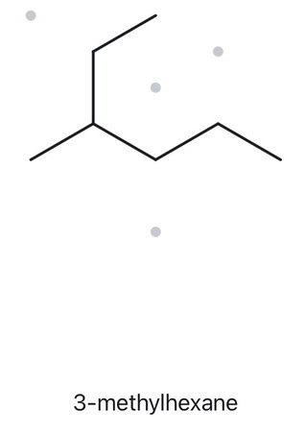
WORKED EXAMPLE A - STRUCTURE → NAME
A02 + FOUNDATION — MOLECULAR FORMULA (counted): C₇H₁₆
  NUMBERED PARENT
  NAMING TRAIL
Parent: Longest chain = 6 C → hexane. The highlighted continuous chain contains six carbon atoms, with one methyl branch attached to the parent chain.
Numbering: Top-right → bottom-left → right gives the methyl substituent at C3. Numbering from the opposite end gives C4. Choose numbering from the top-right to obtain the lowest locant (3 < 4).
Substituents: One methyl group on C3 → 3-methylhexane.
  MY NAME (WRITTEN FIRST)
  THE ALKANE CHECK
3-methylhexane
VERIFICATION STRIP
✔️ longest chain ring ✔️ lowest locants ✔️ alphabetical order
✔️ puctuation ✔️ formula counted

Slide 3
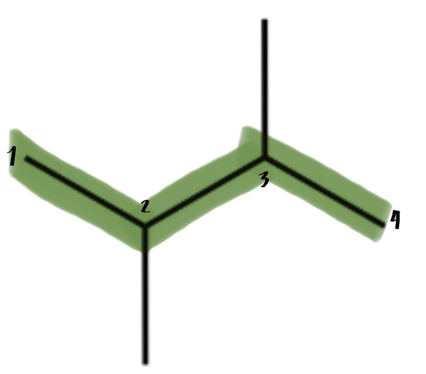
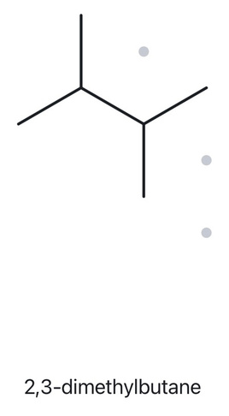
WORKED EXAMPLE A - STRUCTURE → NAME
A03 + FOUNDATION — MOLECULAR FORMULA (counted): C₆H₁₄
  NUMBERED PARENT
  NAMING TRAIL
Parent: Longest chain = 4 C → butane. The highlighted continuous chain contains four carbon atoms, with two methyl branches attached to the parent chain.
Numbering: Left → right gives 2,3; right → left also gives 2,3. Both directions give the same lowest set of locants.
Substituents: Two methyl groups on C2 and C3 → 2,3-dimethylbutane.
  MY NAME (WRITTEN FIRST)
  THE ALKANE CHECK
2,3-dimethylbutane
VERIFICATION STRIP
✔️ longest chain ring ✔️ lowest locants ✔️ alphabetical order
✔️ puctuation ✔️ formula counted

Slide 4
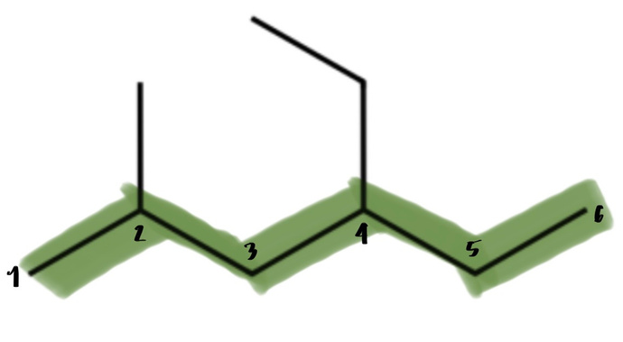
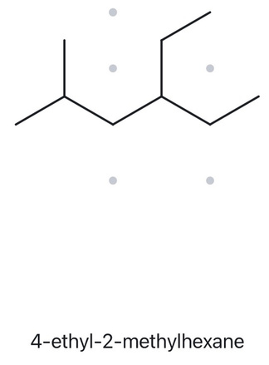
WORKED EXAMPLE A - STRUCTURE → NAME
A04 + DEVELOPING — MOLECULAR FORMULA (counted): C₉H₂₀
  NUMBERED PARENT
  NAMING TRAIL
Parent: Longest chain = 6 C → hexane. The highlighted continuous chain contains six carbon atoms.
Numbering: Left → right gives substituent positions 2,4. Right → left gives 3,5. Choose numbering from the left because 2,4 is the lower set of locants.
Substituents:
Methyl group on C2
Ethyl group on C4
Alphabetical order: Ethyl comes before methyl.
IUPAC Name: 4-ethyl-2-methylhexane
  MY NAME (WRITTEN FIRST)
  THE ALKANE CHECK
4-ethyl-2-methylhexane
VERIFICATION STRIP
✔️ longest chain ring ✔️ lowest locants ✔️ alphabetical order
✔️ puctuation ✔️ formula counted

Slide 5
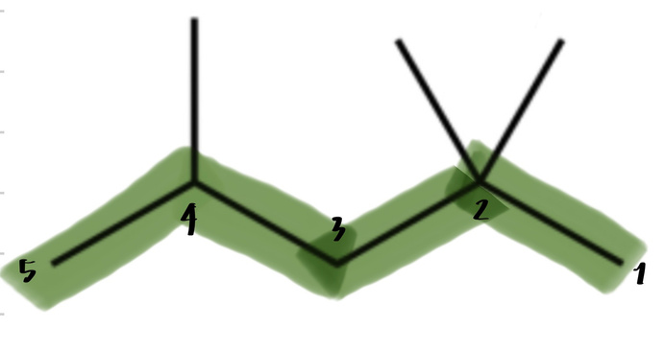
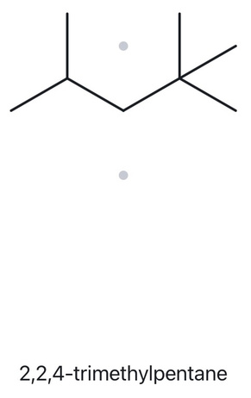
WORKED EXAMPLE A - STRUCTURE → NAME
A05 - DEVELOPING — MOLECULAR FORMULA (counted): C₈H₁₈
  NUMBERED PARENT
  NAMING TRAIL
Parent: Longest chain = 5 C → pentane. The highlighted continuous chain contains five carbon atoms, with three methyl branches attached to the parent chain.
Numbering: Right → left gives 2,2,4. Left → right gives 2,4,4. Choose numbering from the right because 2,2,4 is the lower set of locants.
Substituents:
Two methyl groups on C2
One methyl group on C4
Three methyl groups → trimethyl.
IUPAC Name: 2,2,4-trimethylpentane
  MY NAME (WRITTEN FIRST)
  THE ALKANE CHECK
2,2,4-trimethylpentane
VERIFICATION STRIP
✔️ longest chain ring ✔️ lowest locants ✔️ alphabetical order
✔️ puctuation ✔️ formula counted

Slide 6
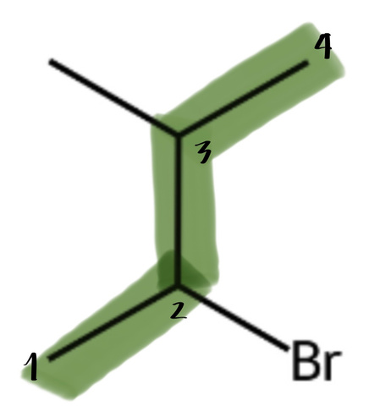
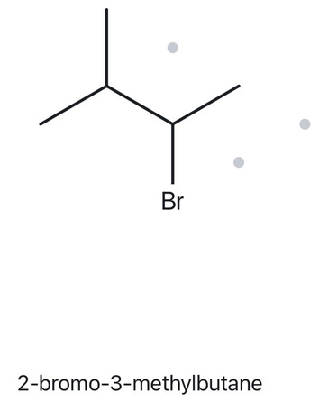
WORKED EXAMPLE A - STRUCTURE → NAME
A06 + DEVELOPING — MOLECULAR FORMULA (counted): C₅H₁₁Br
  NUMBERED PARENT
  NAMING TRAIL
Parent: Longest chain = 4 C → butane. The highlighted continuous chain contains four carbon atoms, with one methyl branch and one bromo substituent.
Numbering:
Bottom-left → top-right gives bromo at C2 and methyl at C3.
Top-right → bottom-left gives methyl at C2 and bromo at C3.
Both give the same locant set (2,3). Apply the alphabetical tie-breaker: bromo comes before methyl, so bromo receives the lower number.
Substituents:
Bromo (Br) on C2
Methyl (CH₃) on C3
IUPAC Name: 2-bromo-3-methylbutane
  MY NAME (WRITTEN FIRST)
  THE ALKANE CHECK
2-bromo-3-methylbutane
VERIFICATION STRIP
✔️ longest chain ring ✔️ lowest locants ✔️ alphabetical order
✔️ puctuation ✔️ formula counted

Slide 7
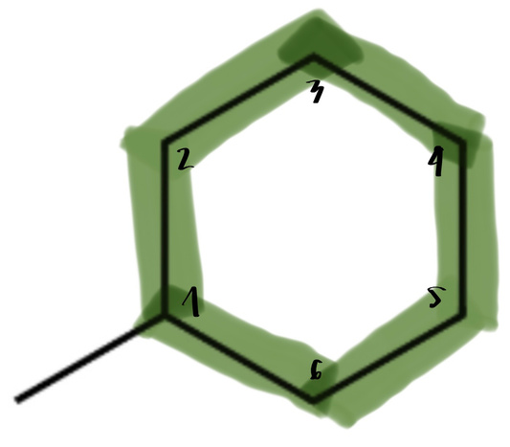
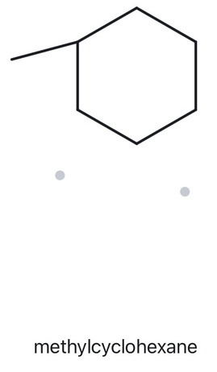
WORKED EXAMPLE A - STRUCTURE → NAME
A07 + DEVELOPING — MOLECULAR FORMULA (counted): C₇H₁₄
  NUMBERED PARENT
  NAMING TRAIL
Parent: Longest continuous ring = 6 C → cyclohexane. The structure contains a six-carbon ring with one methyl substituent.
Numbering: Start numbering at the carbon attached to the methyl group (C1). Since there is only one substituent, numbering can proceed in either direction.
Substituents:
- One methyl group (CH₃) on C1.
IUPAC Name: methylcyclohexane
  MY NAME (WRITTEN FIRST)
  THE ALKANE CHECK
methylcyclohexane
VERIFICATION STRIP
✔️ longest chain ring ✔️ lowest locants ✔️ alphabetical order
✔️ puctuation ✔️ formula counted

Slide 8
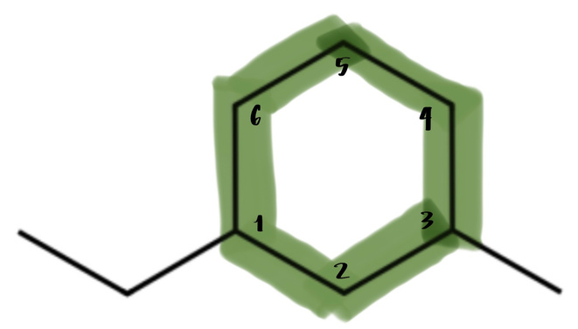
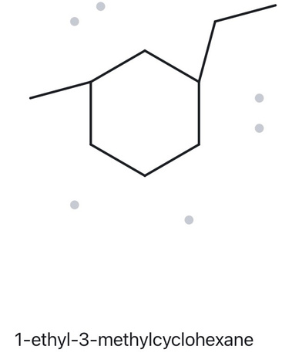
WORKED EXAMPLE A - STRUCTURE → NAME
A08 + CHALLENG — MOLECULAR FORMULA (counted): C₉H₁₈
  NUMBERED PARENT
  NAMING TRAIL
Parent: Longest ring = 6 C → cyclohexane. The structure contains a six-carbon ring with two substituents: one ethyl group and one methyl group.
Numbering:
Starting at the carbon attached to ethyl and numbering toward methyl gives positions 1,3.
Starting at the carbon attached to methyl and numbering toward ethyl also gives positions 1,3.
Since both directions give the same locant set, apply the alphabetical tie-breaker. Ethyl comes before methyl, so ethyl receives C1.
Substituents:
Ethyl group (–CH₂CH₃) on C1
Methyl group (–CH₃) on C3
IUPAC Name: 1-ethyl-3-methylcyclohexane
  MY NAME (WRITTEN FIRST)
  THE ALKANE CHECK
1-ethyl-3-methylcyclohexane
VERIFICATION STRIP
✔️ longest chain ring ✔️ lowest locants ✔️ alphabetical order
✔️ puctuation ✔️ formula counted

Slide 9
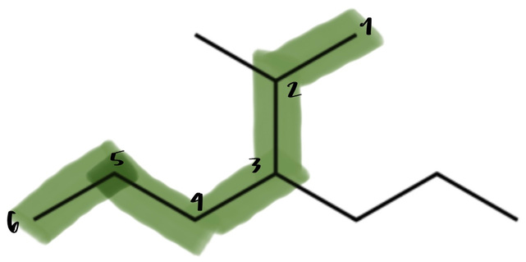
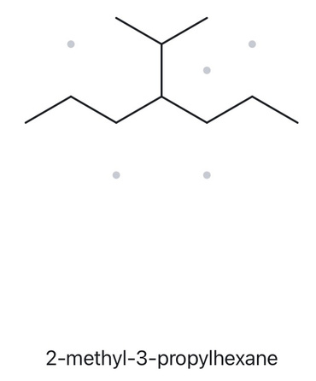
WORKED EXAMPLE A - STRUCTURE → NAME
A09 + CHALLENGE — MOLECULAR FORMULA (counted): C₁₀H₂₂
  NUMBERED PARENT
  NAMING TRAIL
Parent: Selected chain = 6 C → hexane. The highlighted parent chain contains six carbon atoms, with two alkyl substituents attached.
Numbering:
Start from the upper-right endpoint and proceed toward the left.
This gives substituent positions 2 and 3.
Numbering from the opposite direction gives 4 and 5.
Choose 2,3 because it gives the lowest set of locants.
Substituents:
Methyl group (–CH₃) on C2.
Propyl group (–CH₂CH₂CH₃) on C3.
IUPAC Name: 2-methyl-3-propylhexane
  MY NAME (WRITTEN FIRST)
  THE ALKANE CHECK
2-methyl-3-propylhexane
VERIFICATION STRIP
✔️ longest chain ring ✔️ lowest locants ✔️ alphabetical order
✔️ puctuation ✔️ formula counted

Slide 10
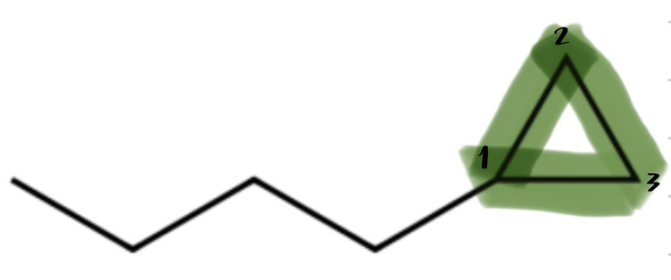
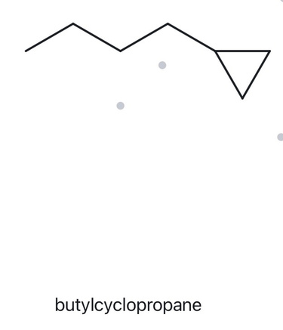
WORKED EXAMPLE A - STRUCTURE → NAME
A10 + CHALLENGE — MOLECULAR FORMULA (counted): C₇H₁₄
  NUMBERED PARENT
  NAMING TRAIL
Parent: Cyclopropane ring = 3 C → cyclopropane. The three-carbon ring is selected as the parent, while the attached four-carbon straight chain is treated as a butyl substituent.
Numbering: Number the cyclopropane ring starting at the carbon attached to the butyl group (C1). Since there is only one substituent, no direction preference is necessary.
Substituents:
- One butyl group (–CH₂–CH₂–CH₂–CH₃) attached to C1.
IUPAC Name: butylcyclopropane
  MY NAME (WRITTEN FIRST)
  THE ALKANE CHECK
butylcyclopropane
VERIFICATION STRIP
✔️ longest chain ring ✔️ lowest locants ✔️ alphabetical order
✔️ puctuation ✔️ formula counted

Slide 11
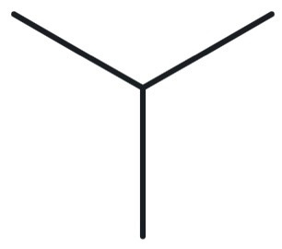
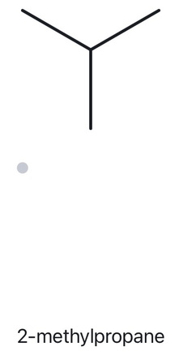
WORKED EXAMPLE B - NAME → STRUCTURE
B01 + FOUNDATION — GIVEN NAME: 2-methylpropane
  NAME DECODED
  BOND LINE STRUCTURE
Parent: propane → a 3-carbon chain.
Substituents: methyl on C2.
Expected formula: 3 + 1 = 4 C; no ring → CₙH₂ₙ₊₂ → C₄H₁₀
  FORMULA CHECK
  BACK CHECK
Counted from the drawing: C₄H₁₀
Using the alkane formula: CₙH₂ₙ₊₂
C₄H₂(₄)+₂ = C₄H₁₀
MATCH ✅
VERIFICATION STRIP
✔️ parent length matches ✔️ substituesnt position match.
✔️ formula agrees ✔️ back-check recorded

Slide 12
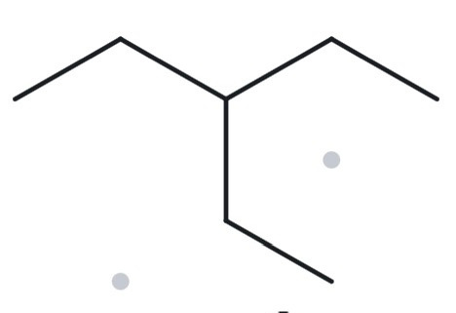
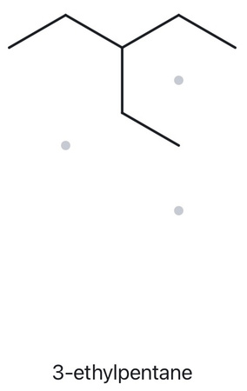
WORKED EXAMPLE B - NAME → STRUCTURE
B02 + FOUNDATION — GIVEN NAME: 3-ethylpentane
  NAME DECODED
  BOND LINE STRUCTURE
Parent: pentane → a 5-carbon chain.
Substituents: ethyl on C3.
Expected formula: 5 + 2 = 7 C; no ring → CₙH₂ₙ₊₂ → C₇H₁₆
  FORMULA CHECK
  BACK CHECK
Counted from the drawing: C₇H₁₆
Using the alkane formula: CₙH₂ₙ₊₂
C₇H₂(₇)+₂ = C₇H₁₆
MATCH ✅
VERIFICATION STRIP
✔️ parent length matches ✔️ substituesnt position match.
✔️ formula agrees ✔️ back-check recorded

Slide 13
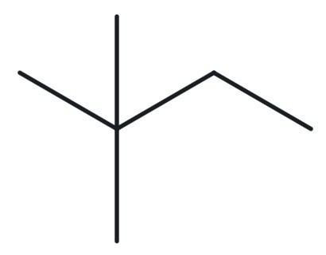
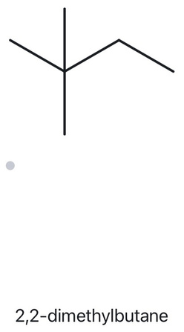
WORKED EXAMPLE B - NAME → STRUCTURE
B03 + FOUNDATION — GIVEN NAME: 2,2-dimethylbutane
  NAME DECODED
  BOND LINE STRUCTURE
Parent: butane → a 4-carbon chain.
Substituents: two methyl groups on C2.
Expected formula: 4 + 2 = 6 C; no ring → CₙH₂ₙ₊₂ → C₆H₁₄
  FORMULA CHECK
  BACK CHECK
Counted from the drawing: C₆H₁₄
Using the alkane formula: CₙH₂ₙ₊₂
C₆H₂(₆)+₂ = C₆H₁₄
MATCH ✅
VERIFICATION STRIP
✔️ parent length matches ✔️ substituesnt position match.
✔️ formula agrees ✔️ back-check recorded

Slide 14
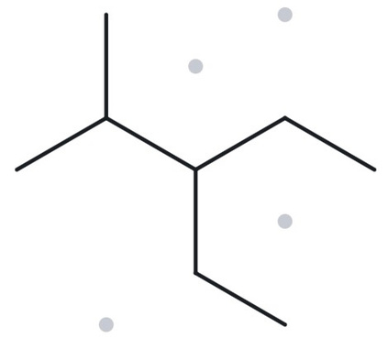
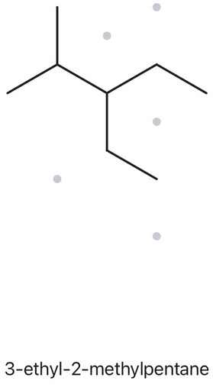
WORKED EXAMPLE B - NAME → STRUCTURE
B04 + DEVELOPING — GIVEN NAME: 3-ethyl-2-methylpentane
  NAME DECODED
  BOND LINE STRUCTURE
Parent: pentane → a 5-carbon chain.
Substituents: methyl on C2; ethyl on C3.
Expected formula: 5 + 1 + 2 = 8 C; no ring → CₙH₂ₙ₊₂ → C₈H₁₈
  FORMULA CHECK
  BACK CHECK
Counted from the drawing: C₈H₁₈
Using the alkane formula: CₙH₂ₙ₊₂
C₈H₂(₈)+₂ = C₈H₁₈
MATCH ✅
VERIFICATION STRIP
✔️ parent length matches ✔️ substituesnt position match.
✔️ formula agrees ✔️ back-check recorded

Slide 15
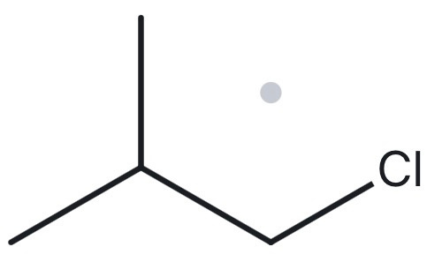
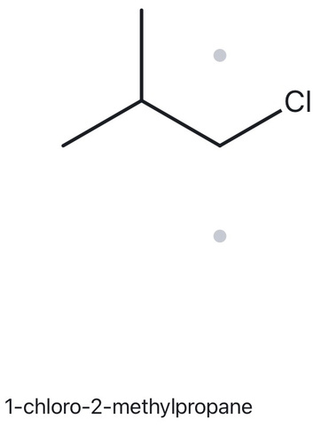
WORKED EXAMPLE B - NAME → STRUCTURE
B05 + DEVELOPING — GIVEN NAME: 1-chloro-2-methylpropane
  NAME DECODED
  BOND LINE STRUCTURE
Parent: propane → a 3-carbon chain.
Substituents: chloro on C1; methyl on C2.
Expected formula: 3 + 1 = 4 C; one chlorine replaces one hydrogen → C₄H₉Cl
  FORMULA CHECK
  BACK CHECK
Counted from the drawing: C₄H₉Cl
Using the alkane formula: CₙH₂ₙ₊₂
C₄H₁₀ − H + Cl = C₄H₉Cl
MATCH ✅
VERIFICATION STRIP
✔️ parent length matches ✔️ substituesnt position match.
✔️ formula agrees ✔️ back-check recorded

Slide 16
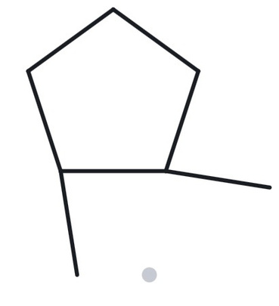
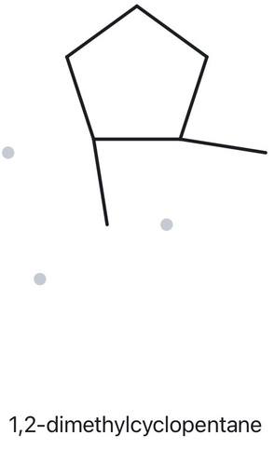
WORKED EXAMPLE B - NAME → STRUCTURE
B06 + DEVELOPING — GIVEN NAME: 1,2-dimethylcyclopentane
  NAME DECODED
  BOND LINE STRUCTURE
Parent: cyclopentane → a 5-carbon ring.
Substituents: two methyl groups on C1 and C2.
Expected formula: 5 + 2 = 7 C; one ring → CₙH₂ₙ → C₇H₁₄
  FORMULA CHECK
  BACK CHECK
Counted from the drawing: C₇H₁₄
Using the cycloalkane formula: CₙH₂ₙ
C₇H₂(₇) = C₇H₁₄
MATCH ✅
VERIFICATION STRIP
✔️ parent length matches ✔️ substituesnt position match.
✔️ formula agrees ✔️ back-check recorded

Slide 17
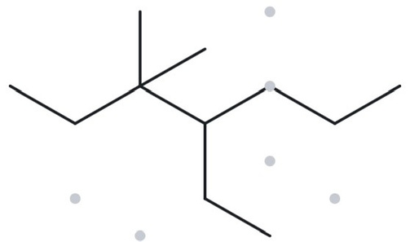
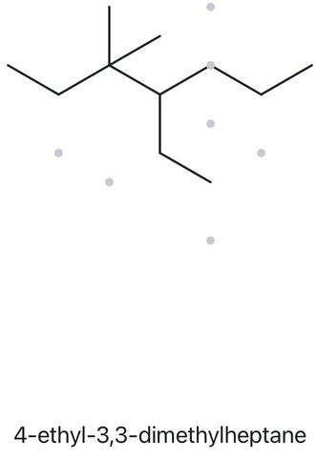
WORKED EXAMPLE B - NAME → STRUCTURE
B07 + DEVELOPING — GIVEN NAME: 4-ethyl-3,3-dimethylheptane
  NAME DECODED
  BOND LINE STRUCTURE
Parent: heptane → a 7-carbon chain.
Substituents: ethyl on C4; two methyl groups on C3.
Expected formula: 7 + 2 + 1 + 1 = 11 C; no ring → CₙH₂ₙ₊₂ → C₁₁H₂₄
  FORMULA CHECK
  BACK CHECK
Counted from the drawing: C₁₁H₂₄
Using the alkane formula: CₙH₂ₙ₊₂
C₁₁H₂(₁₁)+₂ = C₁₁H₂₄
MATCH ✅
VERIFICATION STRIP
✔️ parent length matches ✔️ substituesnt position match.
✔️ formula agrees ✔️ back-check recorded

Slide 18
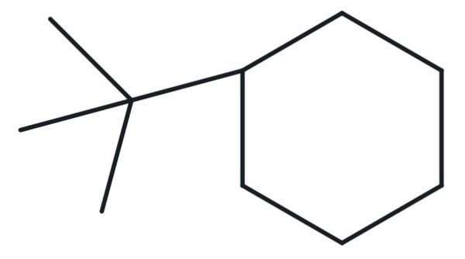
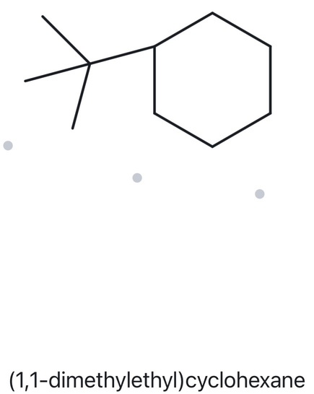
WORKED EXAMPLE B - NAME → STRUCTURE
B08 + CHALLENGE — GIVEN NAME: tert-butylcyclohexane
  NAME DECODED
  BOND LINE STRUCTURE
Parent: cyclohexane → a 6-carbon ring.
Substituents: tert-butyl group attached to C1 of the ring.
Expected formula: 6 + 4 = 10 C; one ring → CₙH₂ₙ → C₁₀H₂₀
  FORMULA CHECK
  BACK CHECK
Counted from the drawing: C₁₀H₂₀
Using the cycloalkane formula: CₙH₂ₙ
C₁₀H₂(₁₀) = C₁₀H₂₀
MATCH ✅
tert-butylcyclohexane is same as (1,1-dimethyl)cyclohexane
VERIFICATION STRIP
✔️ parent length matches ✔️ substituesnt position match.
✔️ formula agrees ✔️ back-check recorded

Slide 19
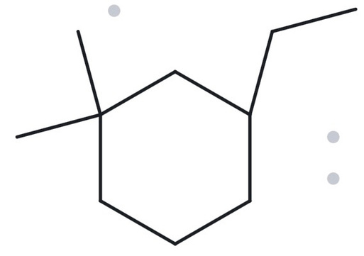
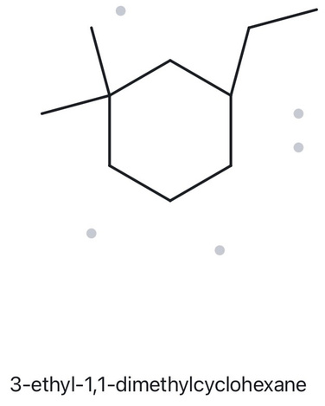
WORKED EXAMPLE B - NAME → STRUCTURE
B09 + CHALLENGE — GIVEN NAME: 3-ethyl-1,1-dimethylcyclohexane
  NAME DECODED
  BOND LINE STRUCTURE
Parent: cyclohexane → a 6-carbon ring.
Substituents: ethyl on C3; two methyl groups on C1.
Expected formula: 6 + 2 + 1 + 1 = 10 C; one ring → CₙH₂ₙ → C₁₀H₂₀
  FORMULA CHECK
  BACK CHECK
Counted from the drawing: C₁₀H₂₀
Using the cycloalkane formula: CₙH₂ₙ
C₁₀H₂(₁₀) = C₁₀H₂₀
MATCH ✅
VERIFICATION STRIP
✔️ parent length matches ✔️ substituesnt position match.
✔️ formula agrees ✔️ back-check recorded

Slide 20
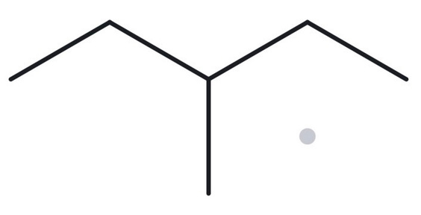
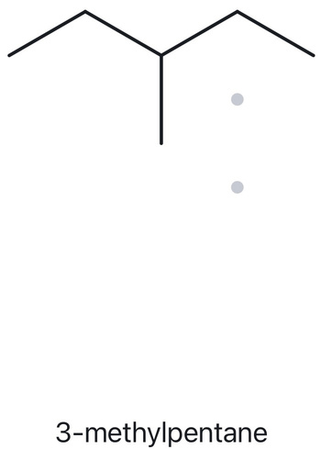
WORKED EXAMPLE B - NAME → STRUCTURE
B10 + CHALLENGE — GIVEN NAME: 2-ethylbutane
  NAME DECODED
  BOND LINE STRUCTURE
Given name: 2-ethylbutane → a 4-carbon parent chain (butane).
Longest chain: 5 consecutive carbon atoms → pentane.
Substituents: methyl on C3.
Correct IUPAC name: 3-methylpentane.
Expected formula: 5 + 1 = 6 C; no ring → CₙH₂ₙ₊₂ → C₆H₁₄
  FORMULA CHECK
  BACK CHECK
Total carbon atoms: 4 + 2 = 6 C.
Using the alkane formula: CₙH₂ₙ₊₂
C₆H₂(₆)+₂ = C₆H₁₄
NOT MATCH ❎
compared to the given name (deliberately incorrect name)
VERIFICATION STRIP
✔️ parent length matches ✔️ substituesnt position match.
✔️ formula agrees ✔️ back-check recorded

