Slide 1
Human Factors and Cognitive Psychology

Slide 2
Learning Objectives
Explain what human factors means in computing
Describe how cognitive processes affect interaction with systems
Identify design problems caused by cognitive overload
Apply psychology-based principles to improve interface design

Slide 3
Why Psychology Matters in HCI
Human Factors + Cognitive Psychology help us design systems that match how people actually think, not how engineers wish they thought.
Notes:
Ask the class: Why do users blame the system instead of themselves when something goes wrong?
Psychology gives us the foundational understanding of human behavior, thinking and emotion needed to design technology that is intuitive, efficient and user-friendly. By applying psychological principles, designers create interfaces that match how people perceive, remember and process information, which reduces cognitive load and prevents frustration.

Slide 4
What Are Human Factors?
Human Factors = designing systems that fit human abilities and limitations
It studies:
Physical abilities (vision, motor skills)
Mental abilities (memory, attention, decision-making)
Emotional responses (stress, frustration, trust)
GOAL
Reduce human error and increase efficiency, safety, and satisfaction.
Notes:
Goal: Reduce human error and increase efficiency, safety, and satisfaction.
Traffic light order is standardized (Red–Yellow–Green)
Imagine if every city used a different order — accidents would skyrocket.
Consistency reduces cognitive load.

Slide 5
Cognitive Psychology
Cognitive psychology focuses on how the mind processes information.
Process | What It Means | Design Impact
Perception | How users interpret visual info | Color, contrast, layout matter
Attention | What users focus on | Avoid clutter
Memory | How users remember info | Don’t overload memory
Learning | How users get better over time | Make systems predictable
Decision-Making | How users choose actions | Clear options reduce errors
Notes:
Cognitive psychology studies how the mind processes information: perception, attention, memory, learning and decision-making.
Each process gives us a design rule. Limited memory: show options instead of making users recall them. Limited attention: avoid clutter. Learning: keep the system predictable so skills carry over.

Slide 6
Human Memory
Type | Duration | Example | HCI Design Tip
Sensory Memory | milliseconds | Seeing a notification flash | Use visual cues effectively
Short-Term (Working) Memory | ~20 seconds, 7±2 items | Remembering a verification code | Keep steps simple
Long-Term Memory | Unlimited | Remembering how to use Facebook | Use familiar patterns

Slide 7
Golden Rule
Don’t make users remember; make them recognize!
Notes:
✔ Good: Showing menu options
❌ Bad: Making users memorize commands

Slide 8
Cognitive Load
Cognitive Load = the total amount of mental effort and working memory resources used at any given time, impacting learning and task performance
3 Types:
Intrinsic Load – Difficulty of the task itself
Extraneous Load – Poor design making things harder
Germane Load – Mental effort that helps learning
Notes:
Intrinsic load is the mental effort required by the nature of the task itself. - break into chunks
Extraneous load – bad effort Extraneous load is "bad" mental effort caused by how information is presented, rather than the material itself. - irrelevant items / distractions/poor instructions
Poor design – more effort for the brain – wasted
Germane load – good effort / explain in own words so brain is not too busy – room for deep thinking
Designers must reduce extraneous load
Why is recognition easier than recall?
What type of memory is overloaded when users must remember many steps?
Which law explains why fewer menu options improve decision speed?
Give one example of a slip vs. a mistake.
Why should important buttons be larger?
Bad Example:
A form that asks for:
Username
ID
Reference Number
Security Code
Email
Reduce extraneous load
Pop-ups
Flashing banners
Fake ads
Moving buttons
Background distractions

Slide 9
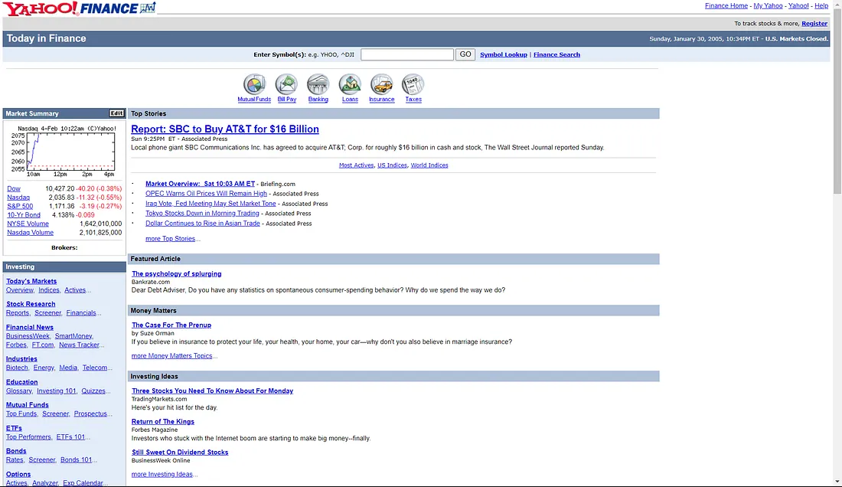
Notes:
You can see a screenshot of the old Yahoo! Finance homepage on Jan 31 2005 and the same day in 2015!

Slide 10
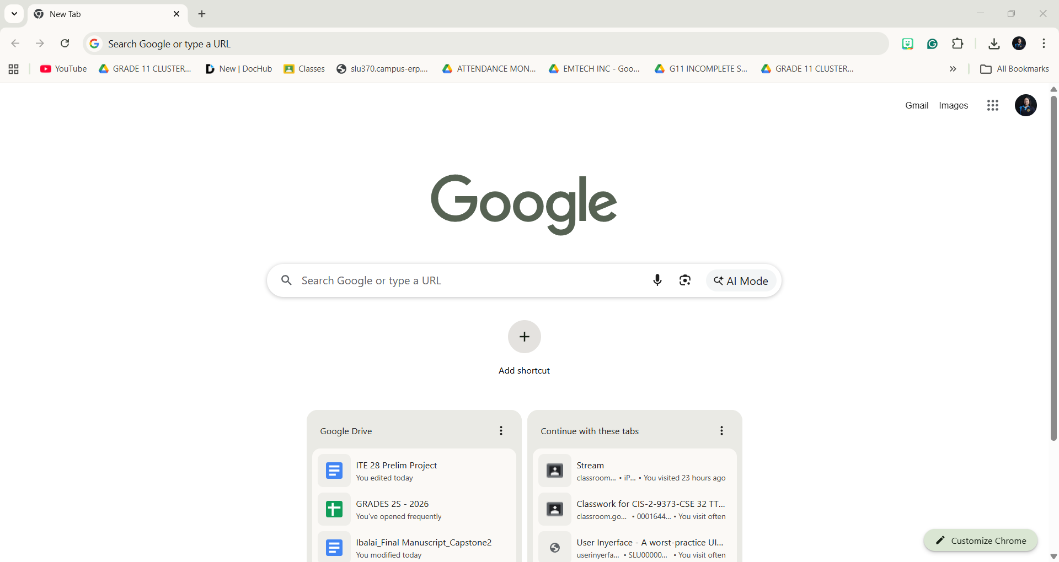

Slide 11
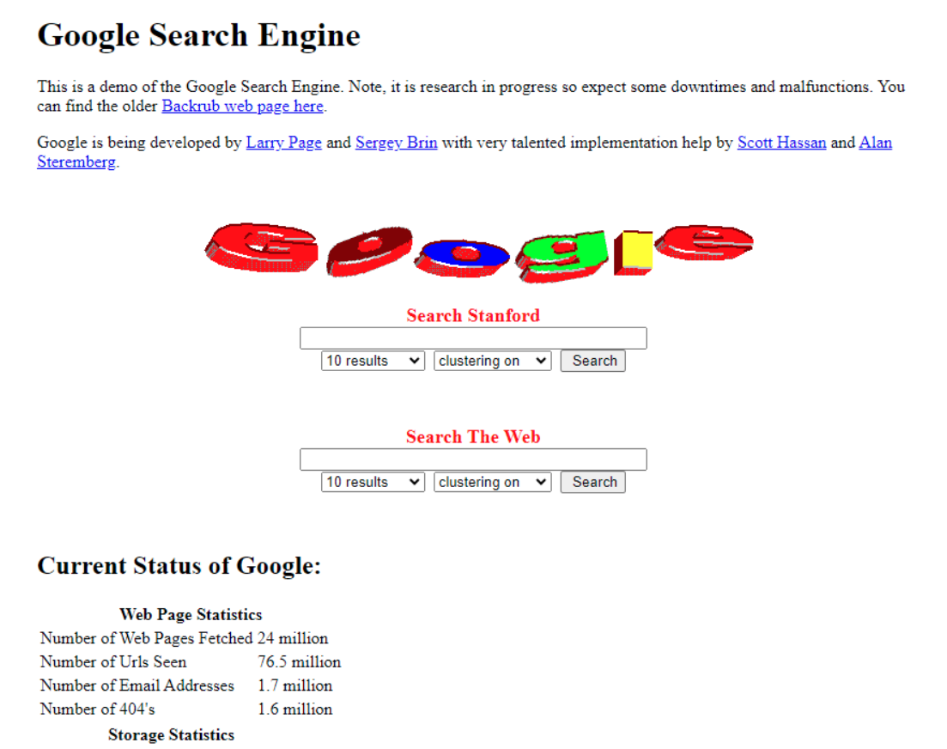
Google in 1998

Slide 12
Attention & Distraction
Humans have limited attention
The brain cannot truly multitask; it just switches rapidly between tasks.
Design Implications:
  Too many popups = missed information
  Flashy ads = reduced task focus
  Cluttered dashboards = slower performance
✔ Use visual hierarchy
✔ Highlight important actions
✔ Remove unnecessary elements

Slide 13


Mental Models
A mental model = how users think a system works
Good design matches user mental models
Bad design forces users to learn new logic

Slide 14
Human Error
Type | Description | Example | Design Solution
Slips | Correct intention, wrong action | Clicking "Delete" instead of "Save" | Undo, confirmation, space risky buttons apart
Mistakes | Wrong understanding | Formatting the wrong drive, thinking it's the USB | Clear labeling, warnings
Notes:
Design should prevent errors, not just show error messages.

Slide 15
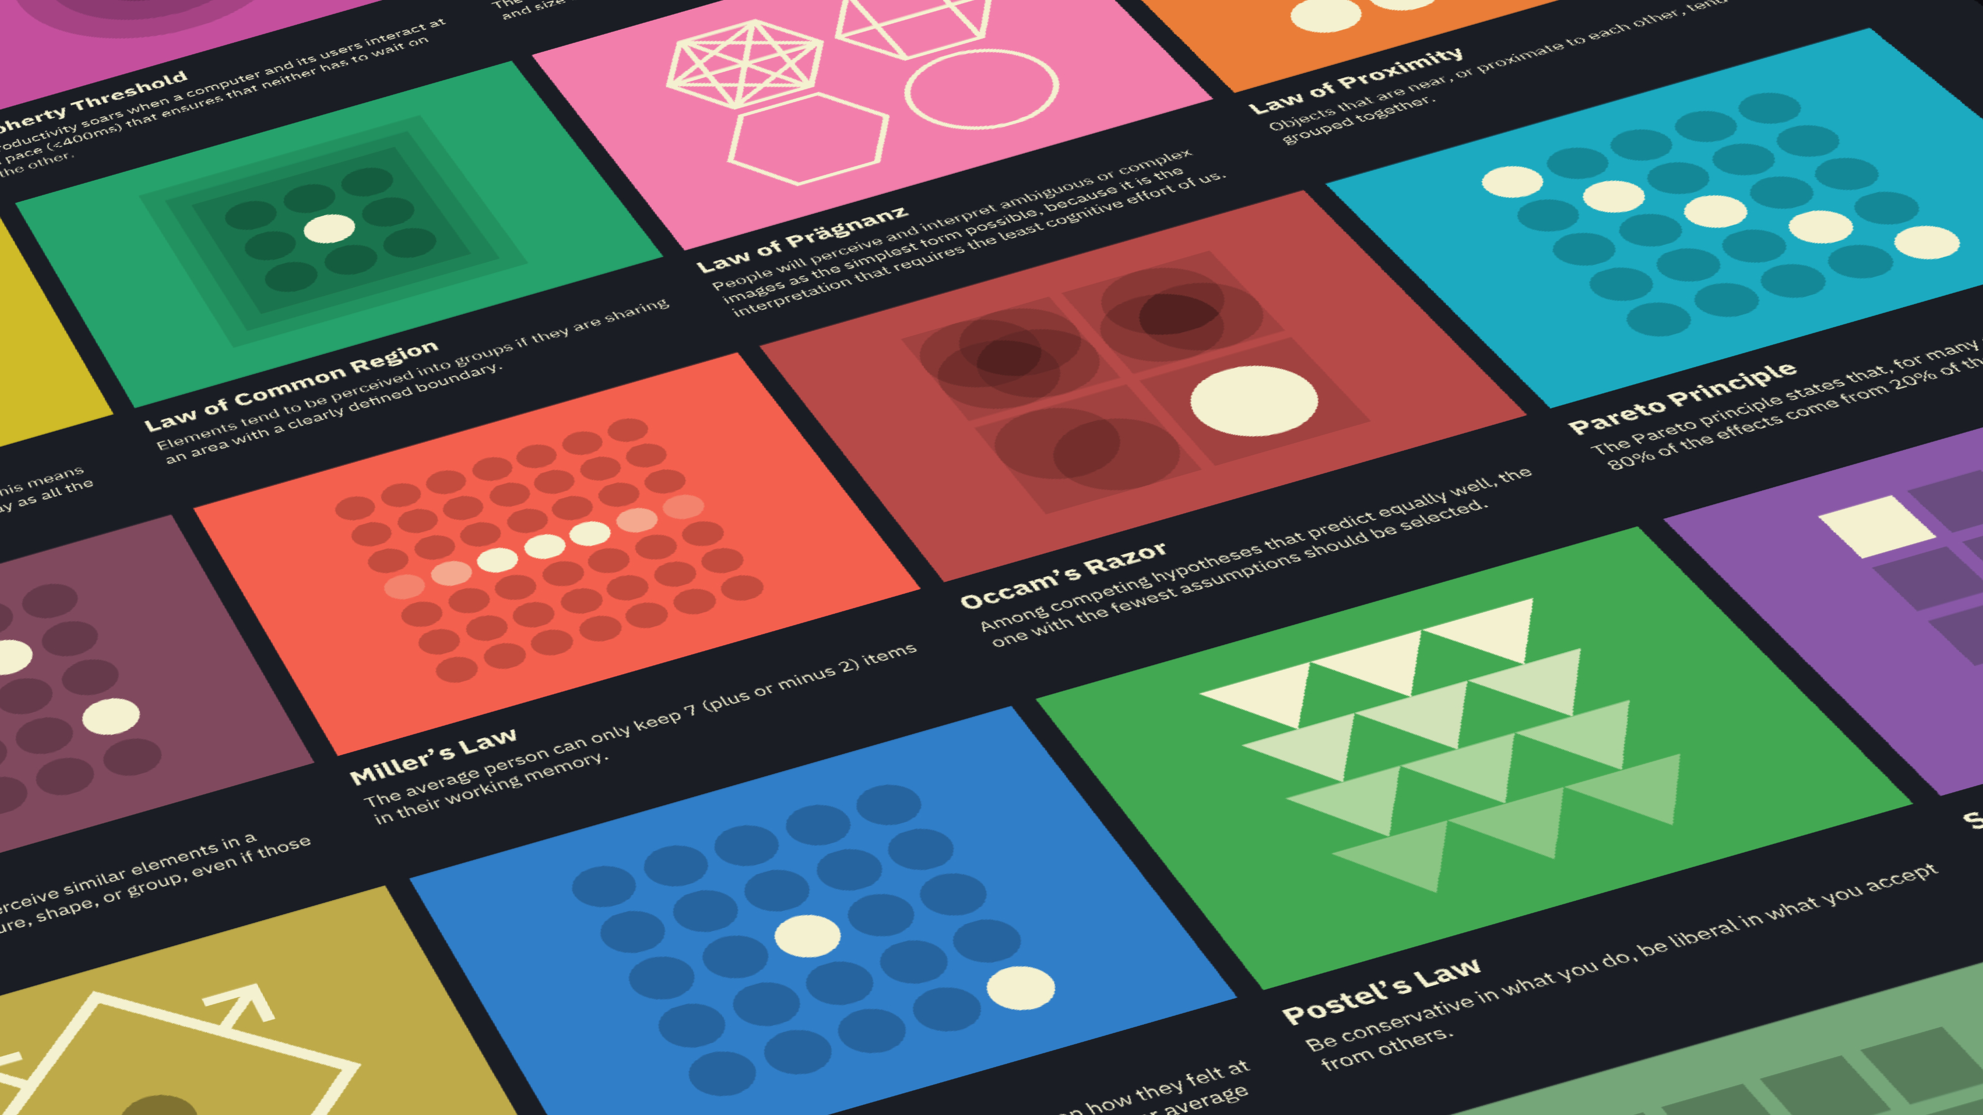
Laws of UX
Designing for Human Behavior
Understanding Cognitive Principles Behind Usable Interfaces

Slide 16
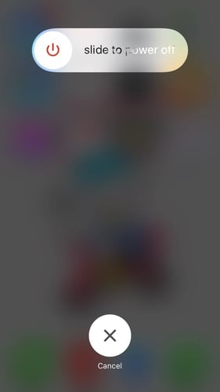

Fitts’s Law (Movement Time)
Time to click = depends on distance + size of target
Notes:
Time to click depends on the distance to the target and its size.
✔ Big buttons = easier interaction
✔ Important actions should be large and within easy reach
Why is the "Skip Ad" button big? Exactly.
To prevent accidental shutdowns, Apple makes users slide a control to power off the phone, but cancelling only takes a tap on a big button. Cancelling has no bad consequence, so Apple makes it the easy target.

Slide 17

Laws of UX
The "Laws of UX" are a collection of psychological principles, behavioral science, data science, and HCI that explain how users interact with digital interfaces
This Photo by Unknown Author is licensed under CC BY-NC
Notes:
A collection of best practices designers can consider when building user interfaces.
The "Laws of UX" are psychological principles and heuristics that explain how people interact with digital interfaces.
They matter because they give a foundational understanding of human behavior, helping designers create interfaces that are more intuitive, efficient and user-friendly. By applying these laws, designers make informed decisions that lead to better products and more satisfying experiences.
Key reasons why the Laws of UX matter:
1. They reduce cognitive load. Miller's Law (chunk information into small pieces) and Fitts's Law (put interactive elements within easy reach) cut the effort a task needs. A user who has to think too hard is more likely to give up.
2. They create consistency. Jakob's Law: users spend most of their time on other apps and sites, so they expect yours to work the same way (e.g., logo top-left, cart icon top-right, Home tab bottom-left). Familiar patterns make a product feel easy from day one.
3. They shape perception. Hick's Law: the more options, the longer the decision, so fewer choices guide users faster. Aesthetic-Usability Effect: people see attractive interfaces as easier to use, even when they aren't.
4. They support accessibility. Gestalt laws such as Common Region and Proximity organize a screen visually, which helps users with different cognitive and visual abilities understand the layout.
Results: better usability and satisfaction, fewer errors, more engagement and conversions.

Slide 18
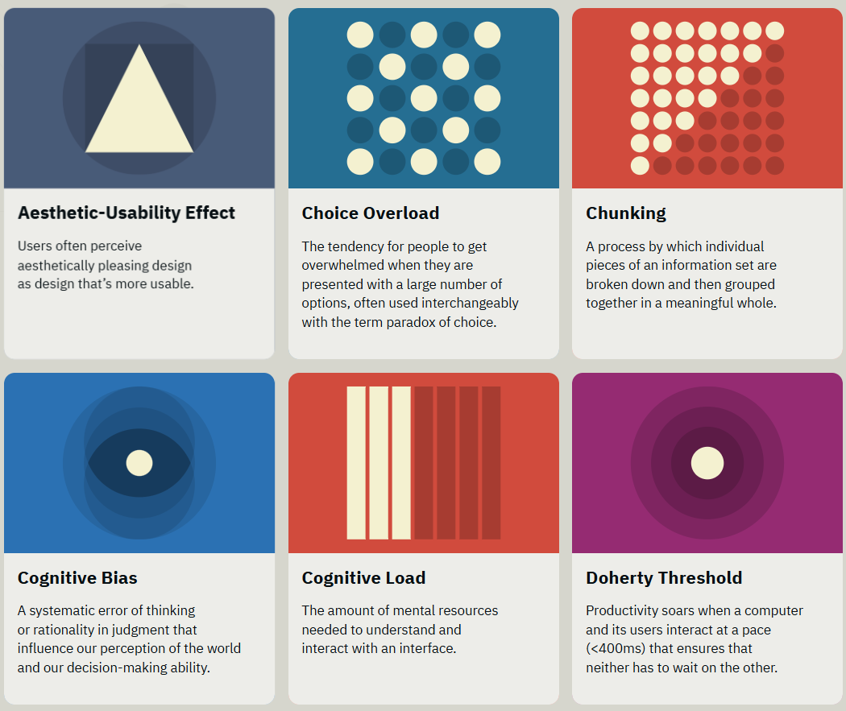

Slide 19
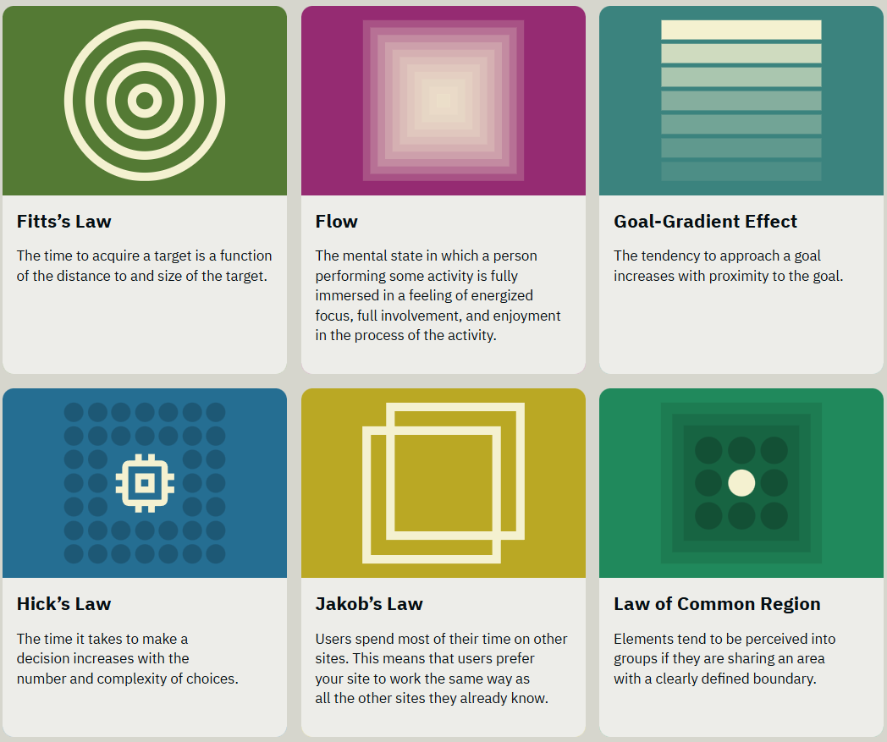

Slide 20
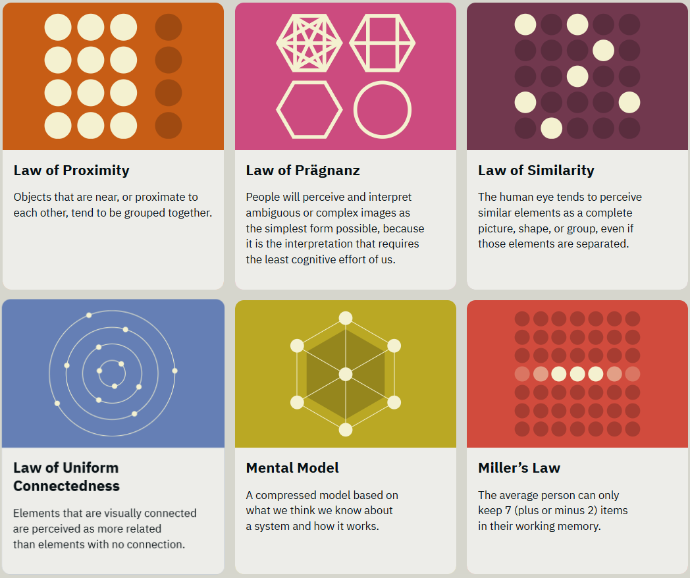

Slide 21
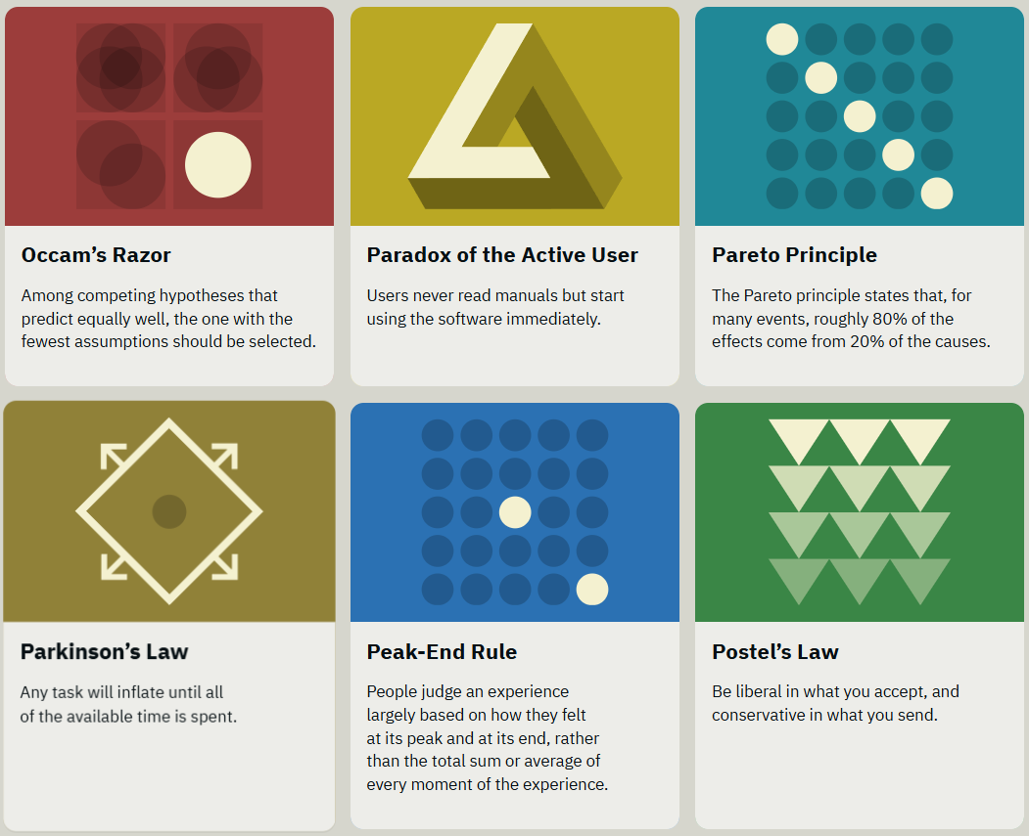

Slide 22
Lesson Objectives
1. Explain key principles of the Laws of UX.
2. Identify real-world examples of UX laws in practice.
3. Apply UX laws to improve interface design.

Slide 23
Introduction
UX designers create experiences based on how humans perceive and interact with interfaces.
Laws of UX combine psychology, design heuristics, and human behavior.

Slide 24
The Laws of UX
Heuristics: These laws include rules of thumb that can help with decision-making and problem-solving.
Gestalt principles: These laws deal with how the human brain organizes and perceives visual elements as unified wholes.
Cognitive biases: These rules are about the ingrained mental tendencies that cause systematic patterns of deviation from rational judgment.
Principles: These include general guidelines and best practices borrowed from disciplines like psychology and design.

Slide 25
The Laws of UX
Heuristics: Parkinson’s Law, Miller’s Law, Hick’s Law, Aesthetic-Usability Effect, Fitts’s Law, Jakob’s Law, Paradox of the Active User, Goal-Gradient Effect
Gestalt principles: Law of Prägnanz, Law of Common Region, Law of Proximity, Law of Similarity, Law of Uniform Connectedness
Cognitive biases: Peak-End Rule, Serial Position Effect, Von Restorff Effect, Zeigarnik Effect
Principles: Doherty Threshold, Occam's Razor, Tesler's Law, Postel's Law

Slide 26
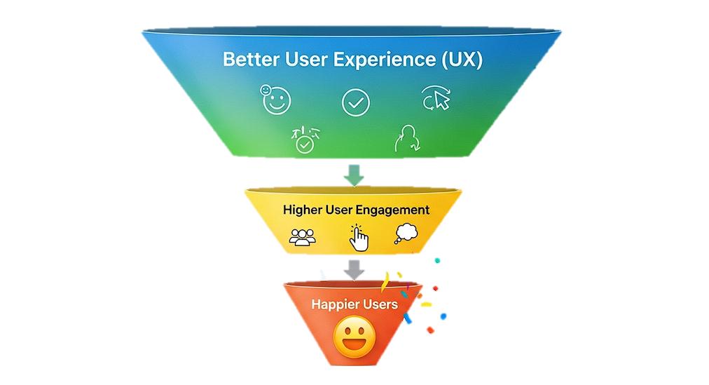
Why Laws of UX Matter
Notes:
They matter because they give a foundational understanding of human behavior, helping designers create interfaces that are more intuitive, efficient and user-friendly. By applying these laws, designers make informed decisions that lead to better products and more satisfying experiences.
Key reasons why the Laws of UX matter:
1. They reduce cognitive load. Miller's Law (chunk information into small pieces) and Fitts's Law (put interactive elements within easy reach) cut the effort a task needs. A user who has to think too hard is more likely to give up.
2. They create consistency. Jakob's Law: users spend most of their time on other apps and sites, so they expect yours to work the same way (e.g., logo top-left, cart icon top-right, Home tab bottom-left). Familiar patterns make a product feel easy from day one.
3. They shape perception. Hick's Law: the more options, the longer the decision, so fewer choices guide users faster. Aesthetic-Usability Effect: people see attractive interfaces as easier to use, even when they aren't.
4. They support accessibility. Gestalt laws such as Common Region and Proximity organize a screen visually, which helps users with different cognitive and visual abilities understand the layout.
Results: better usability and satisfaction, fewer errors, more engagement and conversions.

Slide 27
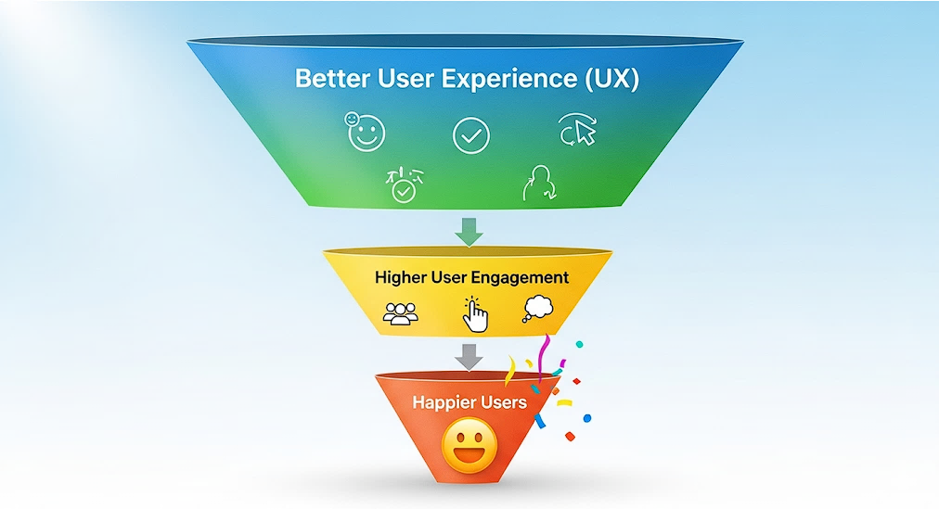
Why Laws of UX Matter
Notes:
They matter because they give a foundational understanding of human behavior, helping designers create interfaces that are more intuitive, efficient and user-friendly. By applying these laws, designers make informed decisions that lead to better products and more satisfying experiences.
Key reasons why the Laws of UX matter:
1. They reduce cognitive load. Miller's Law (chunk information into small pieces) and Fitts's Law (put interactive elements within easy reach) cut the effort a task needs. A user who has to think too hard is more likely to give up.
2. They create consistency. Jakob's Law: users spend most of their time on other apps and sites, so they expect yours to work the same way (e.g., logo top-left, cart icon top-right, Home tab bottom-left). Familiar patterns make a product feel easy from day one.
3. They shape perception. Hick's Law: the more options, the longer the decision, so fewer choices guide users faster. Aesthetic-Usability Effect: people see attractive interfaces as easier to use, even when they aren't.
4. They support accessibility. Gestalt laws such as Common Region and Proximity organize a screen visually, which helps users with different cognitive and visual abilities understand the layout.
Results: better usability and satisfaction, fewer errors, more engagement and conversions.

Slide 28
Why Laws of UX Matter
Notes:
They matter because they give a foundational understanding of human behavior, helping designers create interfaces that are more intuitive, efficient and user-friendly. By applying these laws, designers make informed decisions that lead to better products and more satisfying experiences.
Key reasons why the Laws of UX matter:
1. They reduce cognitive load. Miller's Law (chunk information into small pieces) and Fitts's Law (put interactive elements within easy reach) cut the effort a task needs. A user who has to think too hard is more likely to give up.
2. They create consistency. Jakob's Law: users spend most of their time on other apps and sites, so they expect yours to work the same way (e.g., logo top-left, cart icon top-right, Home tab bottom-left). Familiar patterns make a product feel easy from day one.
3. They shape perception. Hick's Law: the more options, the longer the decision, so fewer choices guide users faster. Aesthetic-Usability Effect: people see attractive interfaces as easier to use, even when they aren't.
4. They support accessibility. Gestalt laws such as Common Region and Proximity organize a screen visually, which helps users with different cognitive and visual abilities understand the layout.
Results: better usability and satisfaction, fewer errors, more engagement and conversions.
Example: if students redesign the GCash payment flow, they might apply:
- Fitts's Law: make the main payment button easy to tap.
- Cognitive load: show the recipient, amount and details clearly.
- Feedback: confirm whether the transaction succeeded or failed.
- Error prevention: help users check the recipient and amount before confirming.

Slide 29
Why Laws of UX Matter
Notes:
They matter because they give a foundational understanding of human behavior, helping designers create interfaces that are more intuitive, efficient and user-friendly. By applying these laws, designers make informed decisions that lead to better products and more satisfying experiences.
Key reasons why the Laws of UX matter:
1. They reduce cognitive load. Miller's Law (chunk information into small pieces) and Fitts's Law (put interactive elements within easy reach) cut the effort a task needs. A user who has to think too hard is more likely to give up.
2. They create consistency. Jakob's Law: users spend most of their time on other apps and sites, so they expect yours to work the same way (e.g., logo top-left, cart icon top-right, Home tab bottom-left). Familiar patterns make a product feel easy from day one.
3. They shape perception. Hick's Law: the more options, the longer the decision, so fewer choices guide users faster. Aesthetic-Usability Effect: people see attractive interfaces as easier to use, even when they aren't.
4. They support accessibility. Gestalt laws such as Common Region and Proximity organize a screen visually, which helps users with different cognitive and visual abilities understand the layout.
Results: better usability and satisfaction, fewer errors, more engagement and conversions.

Slide 30
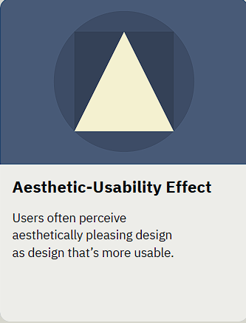
Aesthetic-Usability Effect
People tend to believe that things that look better will work better, even if they aren’t more effective or efficient.
When users have a positive emotional response to visual design, it makes them more tolerant of minor usability issues.
Notes:
Users perceive attractive designs as easier to use. A good-looking interface earns patience: people forgive minor usability problems, but not major ones. This is why a good user experience can't be only functional; visual design shapes how people judge the whole product.
Example: the iPhone. Its interface is simple and uncluttered, consistent across apps, and gives instant, physical-feeling feedback (rubber-band scrolling, icons reacting to a touch). Its looks make it feel easy, even for first-time smartphone users.

Slide 31
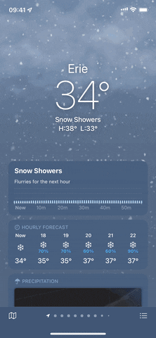
Aesthetic-Usability Effect
Notes:
Users perceive attractive designs as easier to use. A good-looking interface earns patience: people forgive minor usability problems, but not major ones. This is why a good user experience can't be only functional; visual design shapes how people judge the whole product.
Example: the iPhone Weather app. A clean layout, smooth animations and a pleasing style make it feel effortless, even though it holds many options.

Slide 32
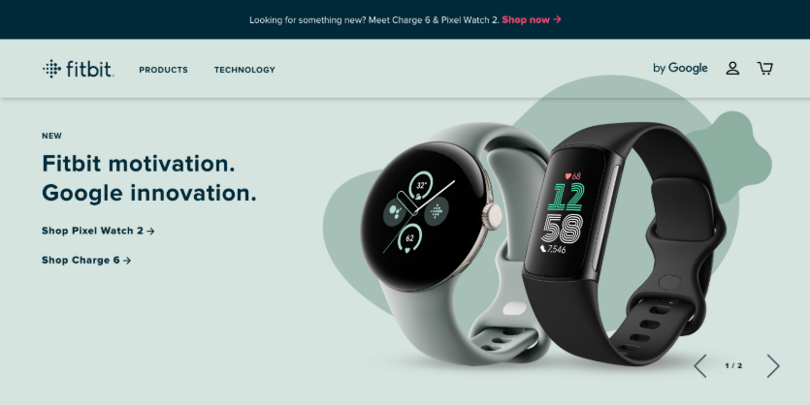
Aesthetic-Usability Effect
Despite encountering many problems while shopping on FitBit’s site, a study participant still rated it highly. When asked for feedback, she commented only about its visual design — hindering the researcher from learning about the design’s problems.
Notes:
Users perceive attractive designs as easier to use. A good-looking interface earns patience: people forgive minor usability problems, but not major ones. This is why a good user experience can't be only functional; visual design shapes how people judge the whole product.
The other side: beauty can hide problems. In a Nielsen Norman Group usability study, a participant struggled with several tasks on Fitbit's site yet still rated it highly, and only commented on its looks. Why?
- People find it easier to comment on visual design than on usability.
- Participants may feel pressure to compliment the product, especially if they think you made it.
- The aesthetic-usability effect makes the problems feel smaller than they are.
Lesson: in usability testing, watch what users do, not only what they say.

Slide 33
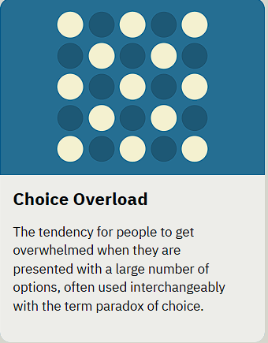
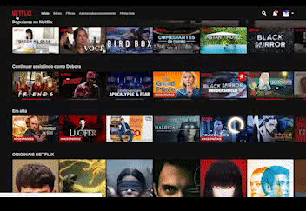
Choice Overload
Notes:
https://uxdesign.cc/decision-fatigue-and-ux-a-case-study-c3efbb985007
Decision Fatigue
TOO MUCH OF A GOOD THING IS TOO MUCH
Booking: filters
Example: Netflix homepage with hundreds of titles.
Too many options can overwhelm users.
The Netflix homepage displays personalized rows of hundreds of movie and TV show titles, including Netflix Originals and licensed content, with a constantly updated and algorithmically-driven selection of content tailored to your viewing habits and personal preferences. While a specific image is not available, the homepage generally features curated sections like "Your Next Watch," genre rows, and recommended titles.

Slide 34
Choice Overload
SCENARIO:
A user visits an online clothing store looking for a pair of jeans. The site presents them with 150 different styles, cuts, and brands.
SOLUTION:
Implement filtering and sorting options to help users narrow down choices based on their preferences. For example, filters for size, brand, color, and price can streamline the decision-making process.
Notes:
Scenario: A user visits an online clothing store looking for a pair of jeans. The site presents them with 150 different styles, cuts, and brands.
Solution: Implement filtering and sorting options to help users narrow down choices based on their preferences. For example, filters for size, brand, color, and price can streamline the decision-making process.
Scenario: A project management tool provides users with 50 different customization settings for their dashboard.
Impact: While customization offers flexibility, too many settings can confuse users, making the onboarding process daunting.
Solution: Provide default settings or recommended configurations based on typical user roles or tasks. Progressive disclosure, where advanced options are only revealed when needed, can help manage the complexity.

Slide 35
Choice Overload
BEST PRACTICES
Limit the number of Options
Utilize Categorization
Implement Decision Aids
Personalization and Recommendation
Progressive Disclosure
Notes:
Display 5- 10 best sellers
Break down by category
comparison tables, reviews, and ratings
Top Picks
Basic to Advance Options – hide if not needed

Slide 36
Choice Overload
Notes:
Scenario: A user visits an online clothing store looking for a pair of jeans. The site presents them with 150 different styles, cuts, and brands.
Solution: Implement filtering and sorting options to help users narrow down choices based on their preferences. For example, filters for size, brand, color, and price can streamline the decision-making process.
Scenario: A project management tool provides users with 50 different customization settings for their dashboard.
Impact: While customization offers flexibility, too many settings can confuse users, making the onboarding process daunting.
Solution: Provide default settings or recommended configurations based on typical user roles or tasks. Progressive disclosure, where advanced options are only revealed when needed, can help manage the complexity.

Slide 37
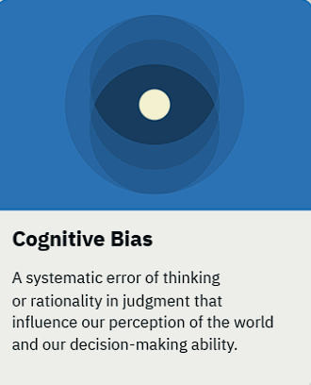
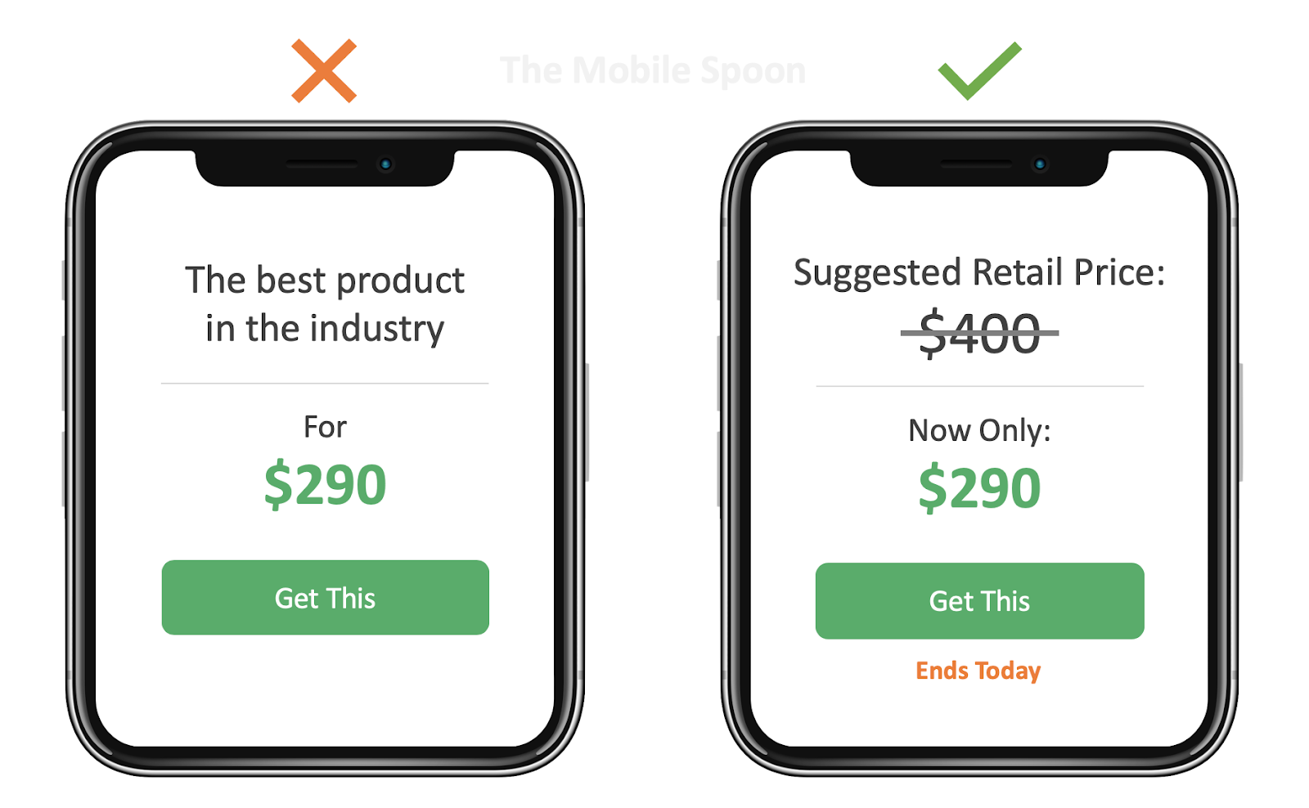
Cognitive Bias
Notes:
A cognitive bias is a mental shortcut or pattern of thinking that affects how people perceive, interpret and decide, often leading to systematic errors. UX designers can use biases to guide behavior, but must do so ethically.
Anchoring: people use the first number they see as a reference point. Showing the original price crossed out next to the sale price makes the sale price feel like a better deal.
Other examples:
- Zeigarnik Effect: Duolingo reminds you of an unfinished lesson or your streak. Unfinished tasks nag at us, so we come back.
- Social proof (bandwagon effect): "Popular with guests" or "1,000+ sold" makes people trust what others already chose.
Tip: show screenshots of real apps using these biases. They stick better than definitions.

Slide 38
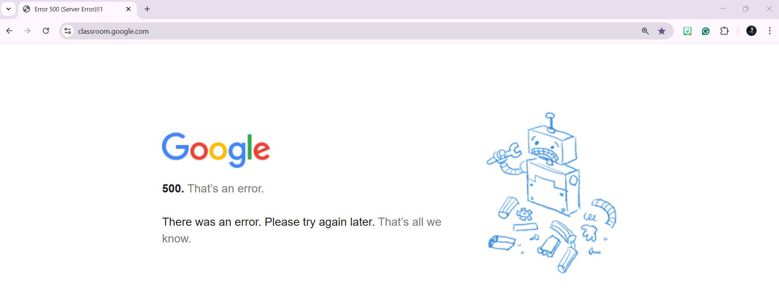

Slide 39
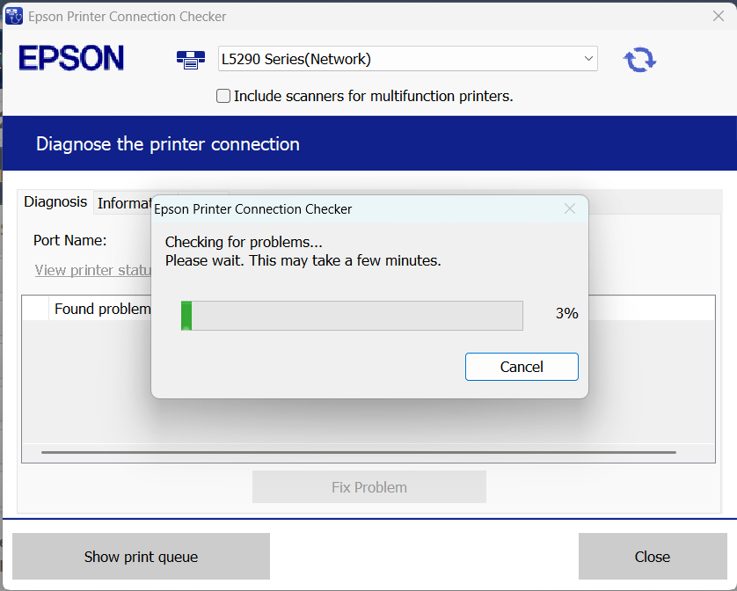

Slide 40
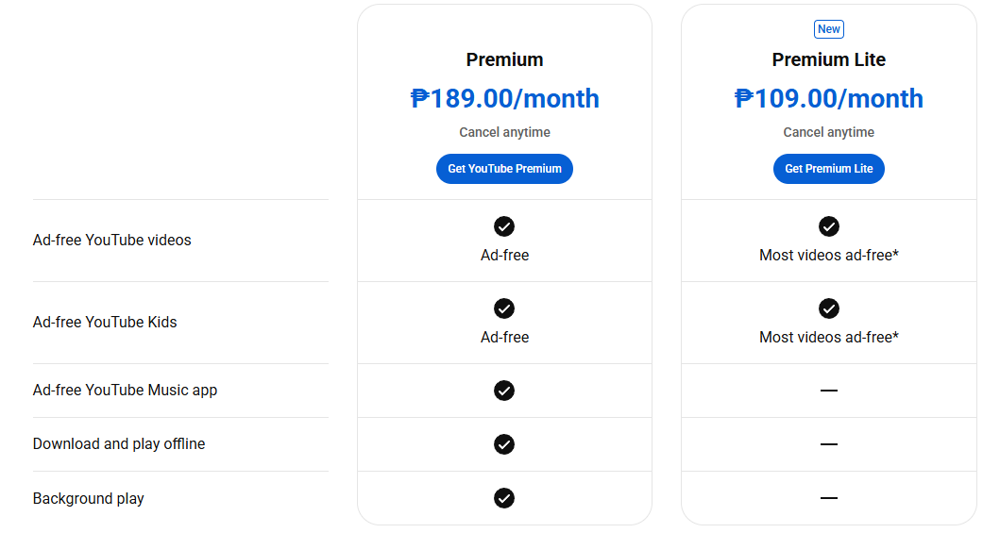
Cognitive Bias
Notes:
A cognitive bias is a mental shortcut or pattern of thinking that affects how people perceive, interpret and decide, often leading to systematic errors. UX designers can use biases to guide behavior, but must do so ethically.
Anchoring: people use the first number they see as a reference point. Showing the original price crossed out next to the sale price makes the sale price feel like a better deal.
Other examples:
- Zeigarnik Effect: Duolingo reminds you of an unfinished lesson or your streak. Unfinished tasks nag at us, so we come back.
- Social proof (bandwagon effect): "Popular with guests" or "1,000+ sold" makes people trust what others already chose.
Tip: show screenshots of real apps using these biases. They stick better than definitions.
On this slide: a pricing table. Putting a more expensive plan next to a cheaper one changes how good a deal each plan seems (anchoring and decoy pricing).

Slide 41
Cognitive Bias
CONFIRMATION BIAS – We notice and trust information that agrees with what we already believe.
FALSE CONSENSUS EFFECT – We assume most people think like us (“surely 90% of users agree with me”).
FRAMING EFFECT – The framing effect is a cognitive bias in which people make decisions based on how the information is presented.
Treatment A has a 90% survival rate
Treatment A has a 10% mortality rate
Notes:
Confirmation bias: we look for, notice and trust information that supports what we already believe. Designers fall into it when they only hear the feedback that agrees with their design.
False consensus effect: we assume other people think like us ("surely 90% of users would do it my way"). This is why we test with real users instead of assuming.
Framing effect: the same fact, presented differently, changes decisions. "90% survival rate" and "10% mortality rate" mean exactly the same thing, yet most people prefer the treatment described as 90% survival. In UX, the wording of buttons, prices and warnings frames the user's choice.

Slide 42
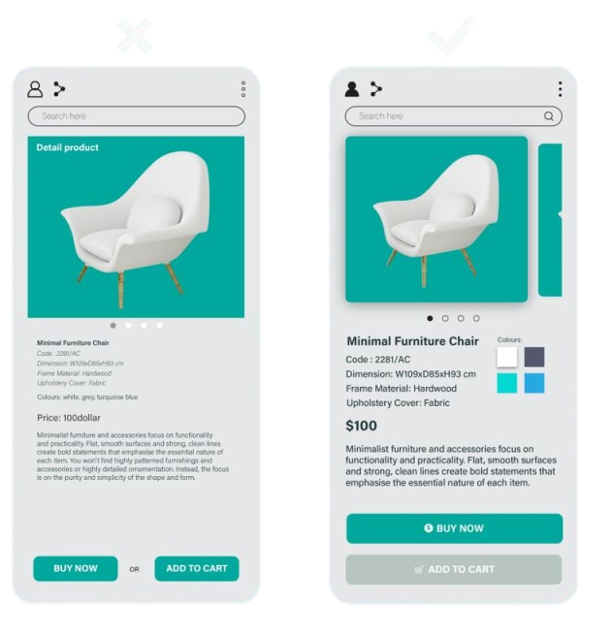
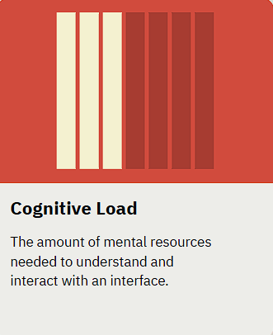
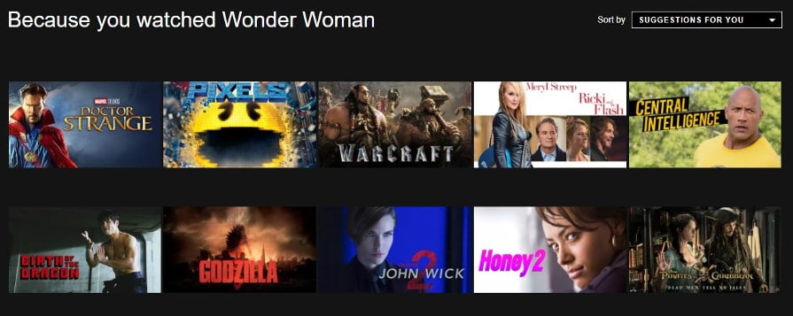
Cognitive Load
X
✓
Notes:
Cognitive load in design is the total amount of mental effort, working memory, and cognitive resources required for a user to understand and operate an interface. Originating from psychology,
Cognitive Load in UX
Definition: Cognitive load is the mental effort required to process information. In UX, minimizing cognitive load means making interfaces simple, predictable, and intuitive, so users don’t get overwhelmed.
GOOGLE SEARCH
1. Hick’s Law
Law of UX: The time it takes to make a decision increases with the number of options.
Cognitive Load Aspect: More choices = more mental effort = slower decision-making.
Example:
App: Netflix
How It Works: Instead of showing every movie at once, it highlights curated categories like “Trending” or “Because you watched…”.
UX Insight: Reduces cognitive load by limiting options at any given moment.
2. Miller’s Law
Law of UX: Humans can hold 7 ± 2 items in working memory at once.
Cognitive Load Aspect: If you overload the user, they forget things quickly.
Example:
App: Apple iPhone settings menu
How It Works: Settings are grouped logically (e.g., Wi-Fi, Bluetooth, Notifications) instead of dumping everything on one screen.
UX Insight: Reduces cognitive load by chunking information.
3. Jakob’s Law
Law of UX: Users prefer your site to work like other sites they already know.
Cognitive Load Aspect: Familiar patterns reduce the brain’s need to learn new behaviors.
Example:
App/Web: Most e-commerce sites place the shopping cart icon on the top-right corner.
UX Insight: Reduces mental effort—users don’t have to figure out where the cart is.
4. Law of Prägnanz (Simplicity)
Law of UX: People perceive and interpret ambiguous or complex images in the simplest form possible.
Cognitive Load Aspect: Simple layouts reduce mental strain.
Example:
App: Google Search homepage
How It Works: Minimal elements on the page: logo, search bar, and a few buttons.
UX Insight: Users focus on the task (searching) rather than figuring out navigation.

Slide 43
Reducing Cognitive Load: What to Do
Reduce Visual Clutter: Remove unnecessary elements to prevent distraction.
Use Existing Mental Models: Follow conventions like placing search bars at the top right or using familiar icons.
Chunk Information: Break down long forms or large amounts of text into smaller, manageable sections.
Offload Tasks: Allow the system to remember information (e.g., autofill, remembering login sessions).

Slide 44
Cognitive Load
X
✓
Notes:
Reduce Visual Clutter: Remove unnecessary elements to prevent distraction.
Use Existing Mental Models: Follow conventions like placing search bars at the top right or using familiar icons.
Chunk Information: Break down long forms or large amounts of text into smaller, manageable sections.
Offload Tasks: Allow the system to remember information (e.g., autofill, remembering login sessions).

Slide 45
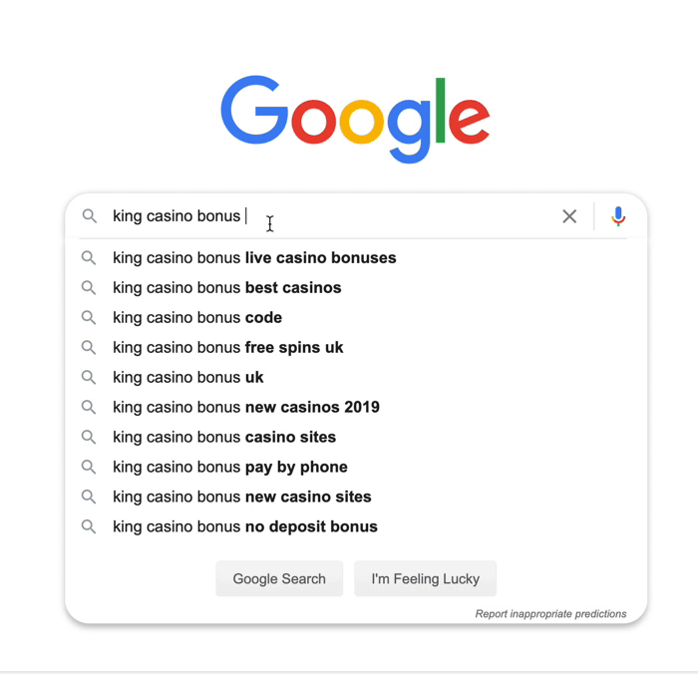
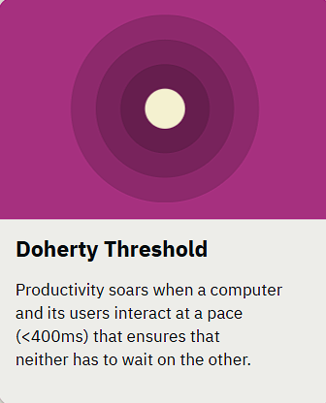
Doherty Threshold
Notes:
In plain terms: if the system responds within about 0.4 seconds, the interaction feels instant and users stay in flow. If it takes longer, users get distracted, frustrated, or think the app is lagging.
Example: Google suggests searches as you type. If the suggestions took 2 to 3 seconds to load, people would ignore them and abandon the feature.

Slide 46

Doherty Threshold
Notes:
In plain terms: if the system responds within about 0.4 seconds, the interaction feels instant and users stay in flow. If it takes longer, users get distracted, frustrated, or think the app is lagging.
When a delay can't be avoided, show that something is happening (loading dots, progress bars, skeleton screens). Waiting feels shorter when you can see progress.

Slide 47
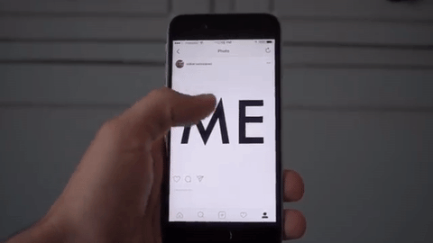
Doherty Threshold
Notes:
In plain terms: if the system responds within about 0.4 seconds, the interaction feels instant and users stay in flow. If it takes longer, users get distracted, frustrated, or think the app is lagging.

Slide 48
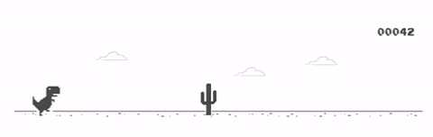
Doherty Threshold
Notes:
In plain terms: if the system responds within about 0.4 seconds, the interaction feels instant and users stay in flow. If it takes longer, users get distracted, frustrated, or think the app is lagging.
Example: when you are offline, Chrome gives you the dinosaur game. A frustrating wait becomes something to do.

Slide 49
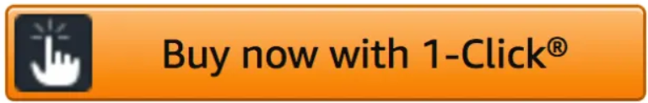
Doherty Threshold
Notes:
In plain terms: if the system responds within about 0.4 seconds, the interaction feels instant and users stay in flow. If it takes longer, users get distracted, frustrated, or think the app is lagging.
Example: Amazon's 1-Click button. Buying takes one tap, with no checkout steps to wait through.

Slide 50
Doherty Threshold
9:41
EVERYDAY EXAMPLE · MESSENGER
Bea
It answers right away
Active now
Quiz is on Thursday right?
Your message shows up the moment you tap Send, and “Sent” follows a split second later.
The typing dots tell you a reply is coming, so waiting never feels like lag.
Yup, Laws of UX
Free later? Review for the UX quiz?
Sure! Library at 3?
Sent
Bea is typing…
How fast should an app respond?
Under 0.4 s:
feels instant
0.4 to 1 s:
noticeable
Over 1 s:
show progress
Aa
Simplified illustration of a familiar app screen, not an actual screenshot.
Notes:
Everyday example: Messenger. When you tap Send, your bubble appears immediately, and "Sent" follows a split second later. The typing dots tell you the other person is replying. Every step answers within a fraction of a second, so the chat feels instant.
Rule of thumb: respond in under 0.4 seconds; if something takes over a second, show progress.
Ask the class: What do you do when an app shows a spinner for 5 seconds or more?

Slide 51
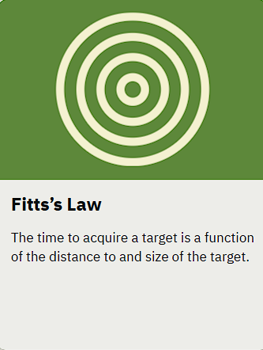
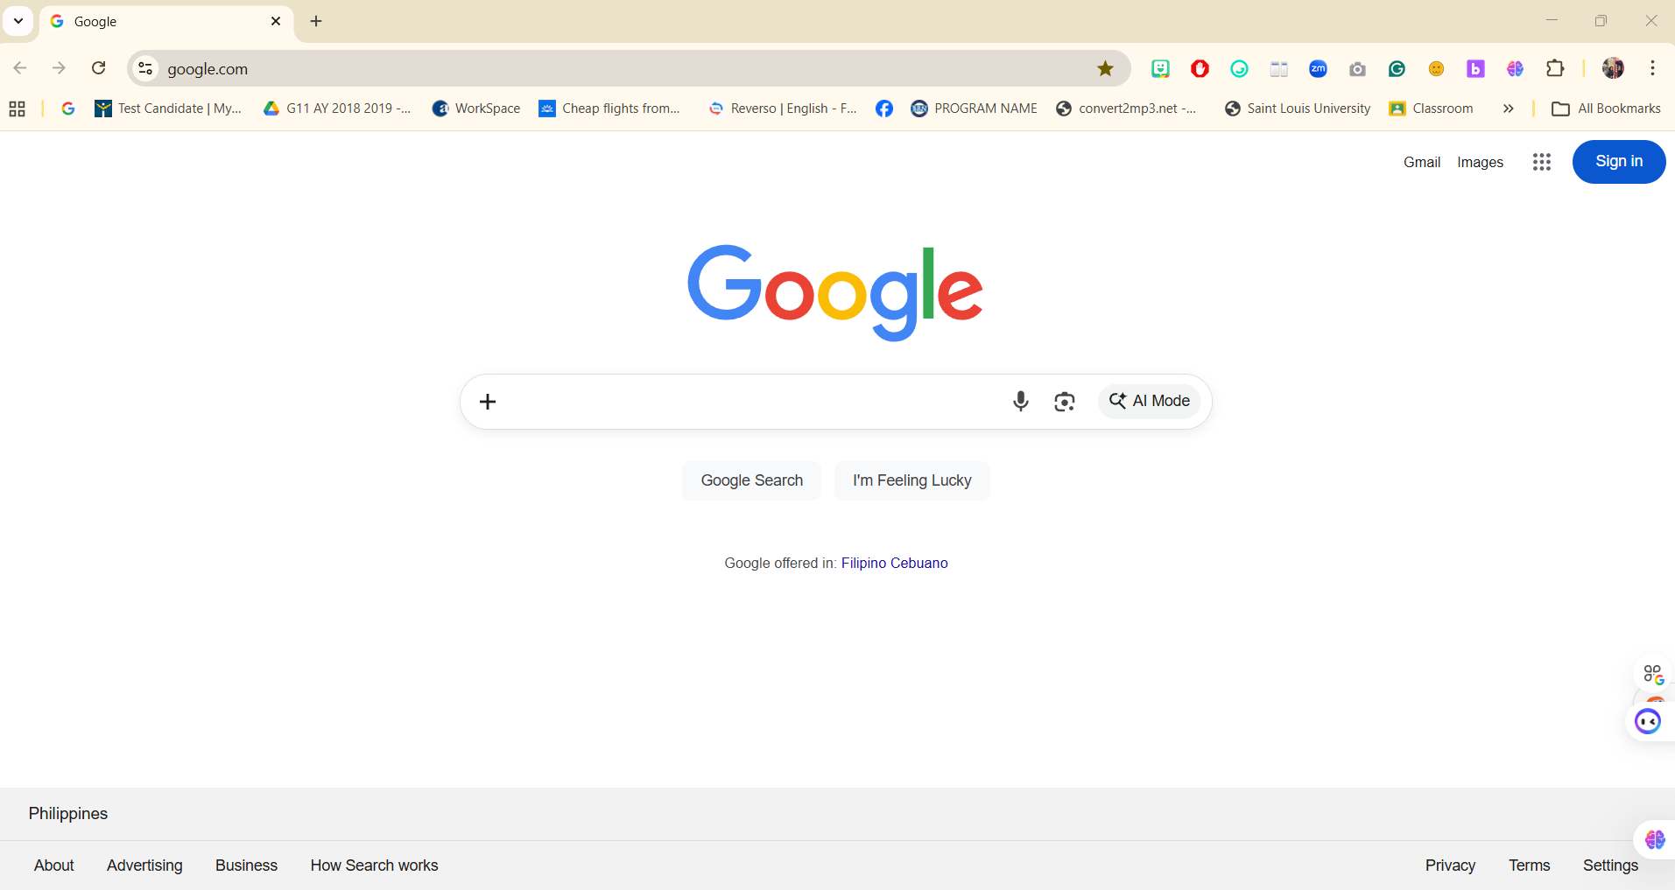
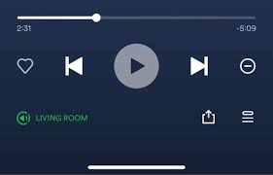
Fitts’s Law
Notes:
Size — UI components need to be distinct, clickable, and clear
Effort — Use prime and magic pixels to your advantage, and make your user interface elements easy to locate and interact with
Distance — Consider the distance between elements, and use size and effort in conjunction with distance to produce a visually appealing and functional experience

Slide 52
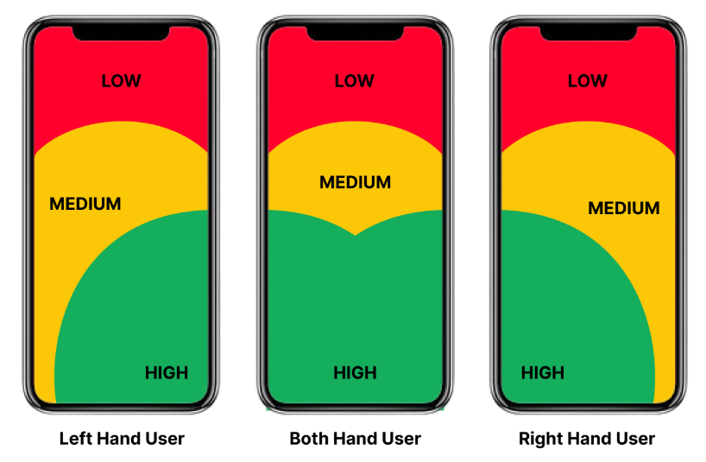
Fitts’s Law
Notes:
UX goal: make important actions easy to hit by making them bigger, closer, or both.
Fitts's Law explains why big, close, frequently used buttons are easy to hit. In UX we don't just make things look nice; we design them to be easy to reach and tap.
Example: the spacebar is the biggest key because we hit it the most.

Slide 53
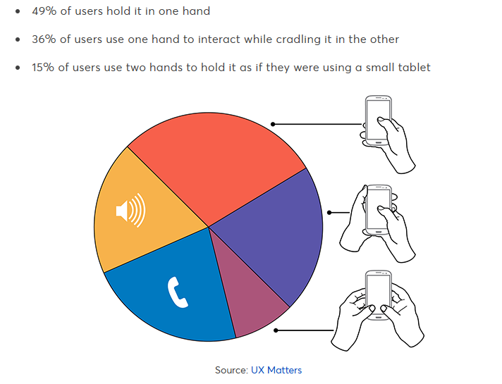
Fitts’s Law
Notes:
UX goal: make important actions easy to hit by making them bigger, closer, or both.
Fitts's Law explains why big, close, frequently used buttons are easy to hit. In UX we don't just make things look nice; we design them to be easy to reach and tap.
Example: the spacebar is the biggest key because we hit it the most.
The chart: Steven Hoober's research found that about 49% of people hold their phone in one hand, 36% cradle it, and 15% use two hands. Put key actions where the thumb can reach.

Slide 54
Fitts’s Law
9:41
EVERYDAY EXAMPLE · INSTAGRAM
Instagram
The whole photo is the button
sagada.trips
To like a post, double-tap anywhere on the photo: a target far bigger than the small heart icon below it.
The main tabs sit in the bottom bar, right where your thumb already rests.
Bigger and closer targets are faster to hit.
Double-tap anywhere
1,204 likes
sagada.trips Sunrise at Kiltepan
Simplified illustration of a familiar app screen, not an actual screenshot.
Notes:
Everyday example: Instagram. To like a post you can double-tap anywhere on the photo, a target far bigger than the small heart icon. The main tabs (Home, Search, Post, Reels, Profile) sit in the bottom bar, the easiest area to reach with one thumb.
Ask the class: Which buttons in your favorite app are hard to reach with one hand?

Slide 55
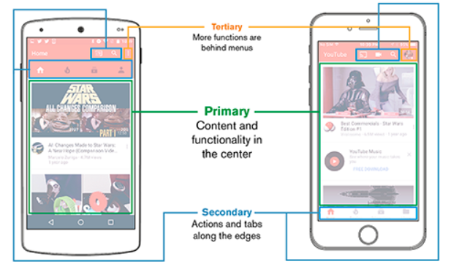
Notes:
Design for Fingers, Touch, and People (Steven Hoober, UXmatters):
https://www.uxmatters.com/mt/archives/2017/03/design-for-fingers-touch-and-people-part-1.php
Primary content and functions go in the center, secondary actions and tabs along the edges, tertiary functions behind menus.

Slide 56
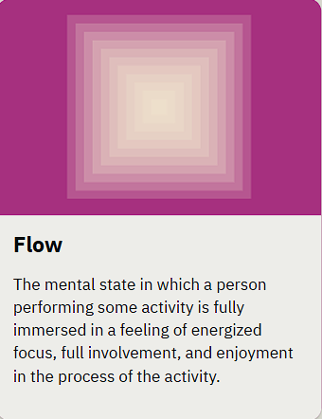
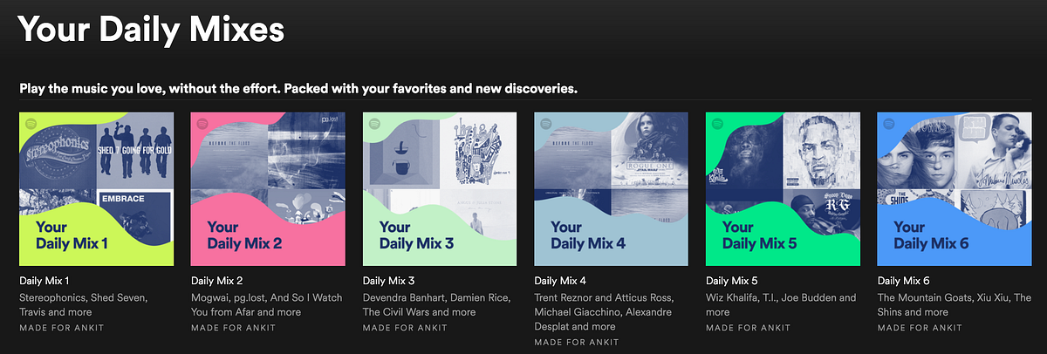
Flow
Notes:
Flow in UX happens when the user is so engaged in an interaction that they move smoothly from one step to another without friction or interruption.
It’s based on Mihály Csíkszentmihályi’s psychology of “flow” — that sweet spot where challenge and skill balance, keeping users immersed.
In UX, this means: no confusing steps, no unnecessary distractions, no cognitive overload.
Netflix – autoplay, skip intro
Flow in UX is about keeping users in the “zone.” Whenever an app feels so smooth you lose track of time, that’s flow working its magic.

Slide 57
Flow
Notes:
Flow in UX happens when the user is so engaged in an interaction that they move smoothly from one step to another without friction or interruption.
It’s based on Mihály Csíkszentmihályi’s psychology of “flow” — that sweet spot where challenge and skill balance, keeping users immersed.
In UX, this means: no confusing steps, no unnecessary distractions, no cognitive overload.
Netflix – autoplay, skip intro
Flow in UX is about keeping users in the “zone.” Whenever an app feels so smooth you lose track of time, that’s flow working its magic.

Slide 58
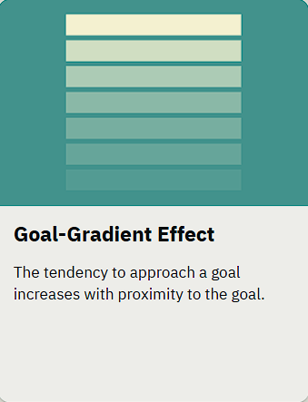
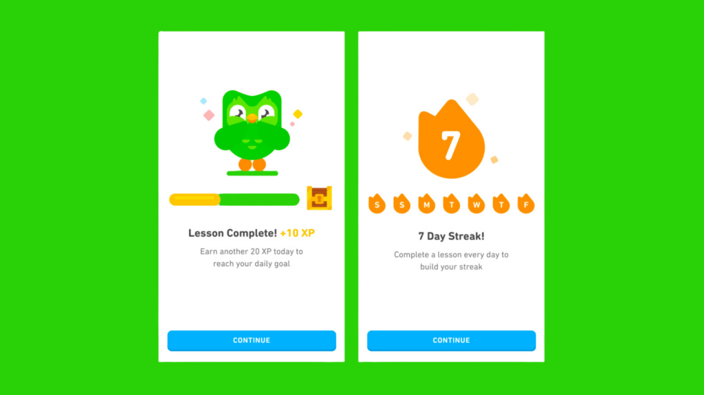
Goal-Gradient Effect
Notes:
How close we are to finish line

Slide 59
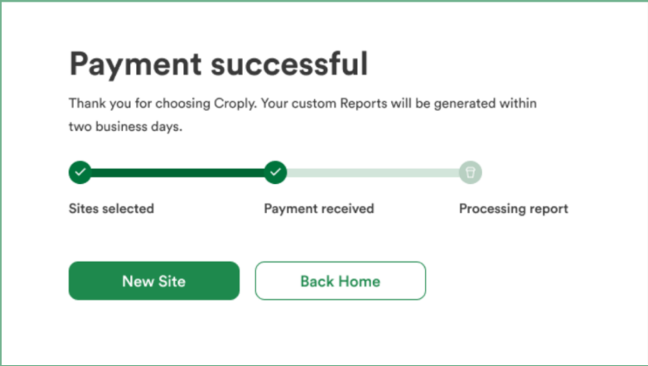
Goal-Gradient Effect
Notes:
Goal-Gradient Effect: people increase effort and motivation as they get closer to a goal. In UX, showing progress toward a target (even small cues) makes users act faster, stick around, and finish tasks.
Think of it as human motivation on espresso: the nearer the finish line, the faster we sprint.
Progress Bars and Visual Indicators: Showing a "90% complete" bar encourages players to finish the remaining 10%.
Achievement/Badge Systems: Clearly displaying missing items for a set (e.g., "Collect 9/10 stars") triggers the desire to finish.
Level Design: Breaking long tasks into smaller, visible steps (e.g., quests, chapters) helps players feel they are constantly getting closer.
Visualizing the Goal: Showing the finish line or the reward in sight increases speed and effort, akin to rats running faster for food in a maze.
Illusion of Progress: Providing a "head start" (e.g., a 10-step loyalty card with 2 stamps already filled) makes the goal feel closer and more attainable.
Benefits of the Goal Gradient Effect:
Higher Engagement: Reduces player drop-off because the nearing goal makes the effort feel worthwhile.
Increased Retention: Regular, small, and visible milestones keep users returning.
Enhanced Motivation: Motivates players to invest more effort, particularly when they see they are close.

Slide 60
Goal-Gradient Effect
9:41
EVERYDAY EXAMPLE · GCASH
Get Fully Verified
Almost there!
Unlock Send, Pay Bills and more
Splitting verification into 3 short steps and showing “2 of 3 steps done” makes the finish line feel close.
The closer people get to a goal, the harder they push to finish it.
2 of 3 steps done
Personal details
Done
Valid ID
Done
3
Selfie
Takes about 1 minute
Continue
Simplified illustration of a familiar app screen, not an actual screenshot.
Notes:
Everyday example: GCash account verification. Breaking it into a few short steps and showing "2 of 3 steps done" makes the finish line feel close, so users push to complete it.
A head start works too: counting a step already done (like the mobile number you signed up with) as progress makes the goal feel nearer.

Slide 61
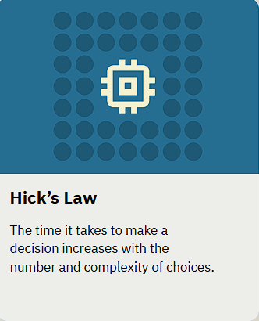
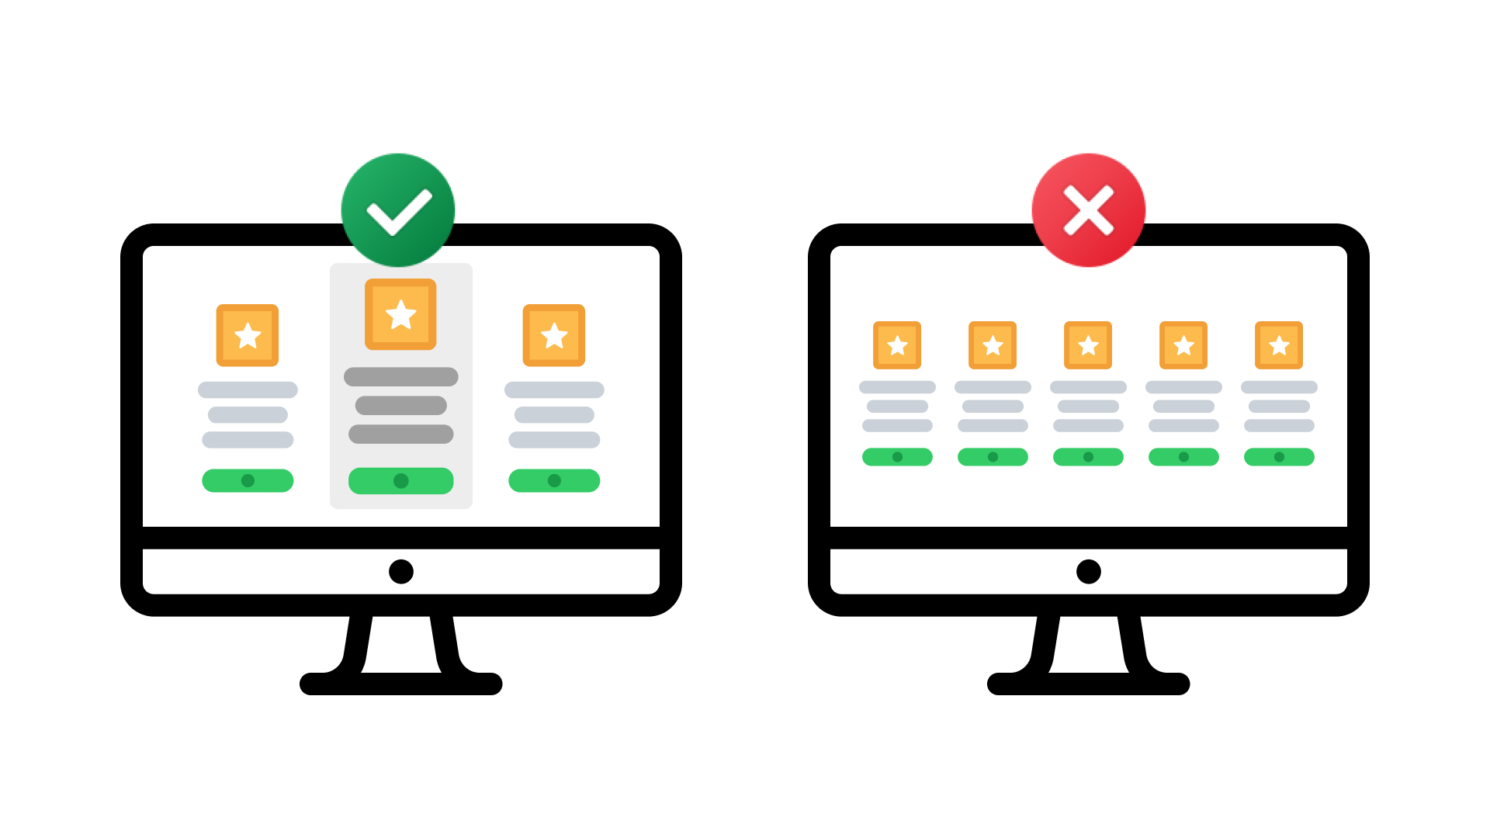
Hick’s Law
Notes:
Definition: The time it takes to make a decision increases with the number and complexity of choices.
Simplified Rule: More options = slower decision-making.
UX Goal: Reduce decision fatigue by limiting, grouping, or prioritizing options so users choose faster.

Slide 62
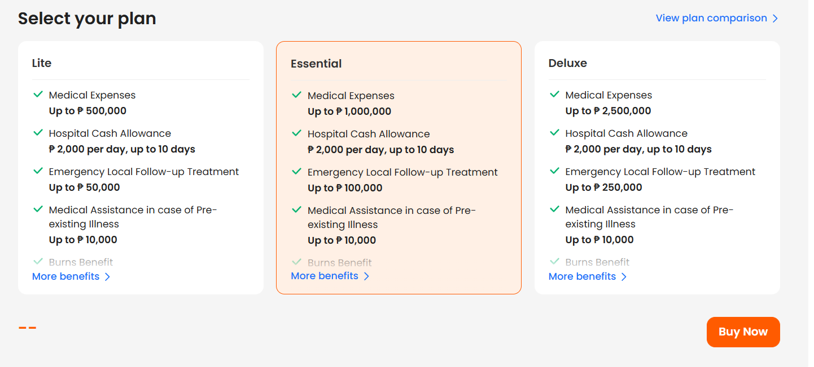
Hick’s Law
Notes:
When response time is critical, keep the number of options small. One to five is a good rule of thumb.
Humans are strange. We like to say we want as much options as possible. When we get them…we get confused and can’t take a decision.

Slide 63
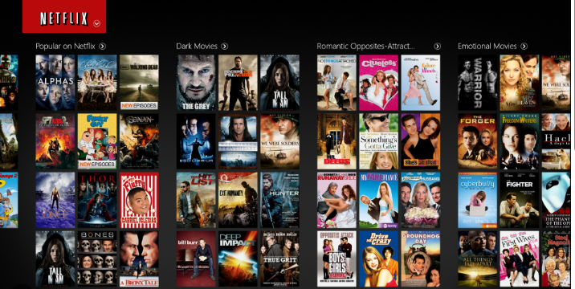
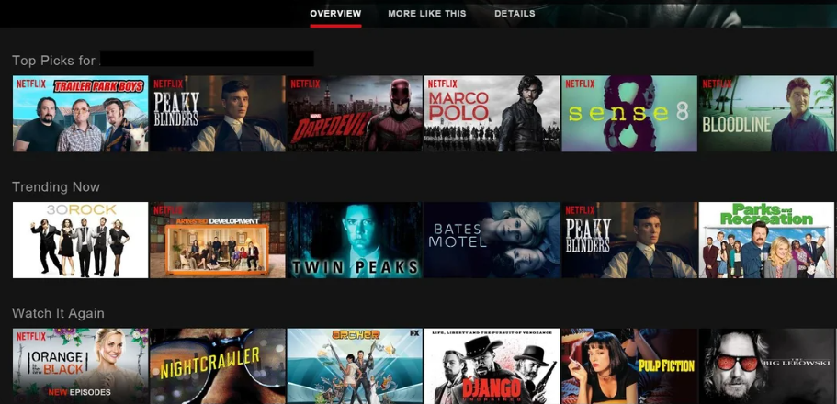
Hick’s Law (Decision Time)
Notes:
Hick’s Law (or the Hick-Hyman Law) states that the more choices a person is presented with, the longer the person will take to reach a decision. Named after psychologists William Edmund Hick and Ray Hyman, Hick’s Law finds frequent application in user experience (UX) design—namely, to avoid overwhelming users with too many choices, thereby keeping them engaged.

Slide 64

Notes:
Hick’s Law Keeps it Simple and Straightforward
When Time is Critical, Decisions Should be Simple
Simplify Tasks by Breaking Them Down

Slide 65
Hick’s Law
9:41
EVERYDAY EXAMPLE · FACEBOOK
Facebook
Only 7 reactions
Ana Reyes
Press and hold Like and you get just 7 choices, not the hundreds of emoji on your keyboard.
Fewer, clearer options let people decide in about a second.
2h
7 reactions
Full emoji keyboard
Like
Comment
Share
Quick to decide
Slow to decide
Simplified illustration of a familiar app screen, not an actual screenshot.
Notes:
Everyday example: Facebook reactions. Pressing and holding Like shows only 7 reactions instead of the full emoji keyboard, so people choose almost instantly. Fewer, clearer choices mean faster decisions.
Ask the class: Where have you seen too many choices slow you down? (Food delivery menus, Netflix, game shops.)

Slide 66
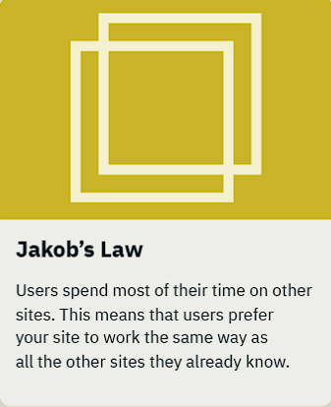
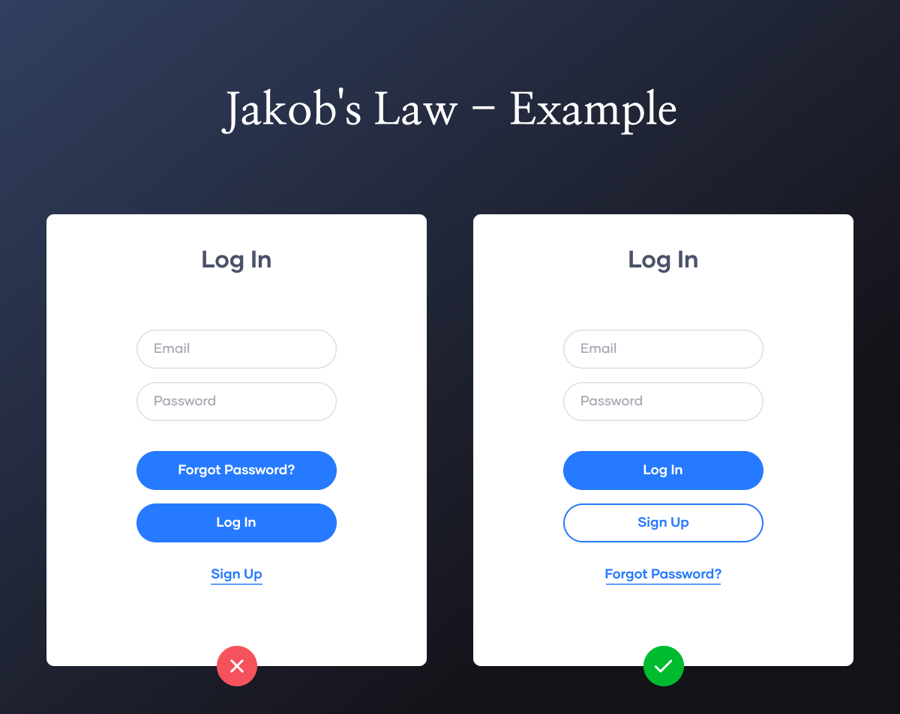
Jakob’s Law
Notes:
Definition: users spend most of their time on other sites and apps, so they expect yours to work the same way as the ones they already know.
Translation: don't reinvent the wheel. Stick to familiar patterns.
1. Consistency is key.
2. Design with the users' mental models in mind.
3. Focus on simplicity; adopt established interaction patterns.
Place buttons where users expect them so they can act without friction, e.g., a navigation bar at the bottom of a mobile app.

Slide 67
Jakob’s Law
9:41
9:41
9:41
9:41
Instagram
Facebook
GCash
Discord
Instagram
Facebook
GCash
Discord
EVERYDAY EXAMPLE · INSTAGRAM, FACEBOOK, GCASH, DISCORD
Same spot, every app
Each app looks different, but Home is always the first tab at the bottom and your profile or menu sits at the far end (circled). You learned this pattern from other apps, so a new app feels familiar on day one.
Simplified illustration of a familiar app screen, not an actual screenshot.
Notes:
Everyday example: bottom navigation. Instagram, Facebook, GCash and Discord look nothing alike, but Home is the first tab and your profile or menu is at the far end. Users learned this pattern from other apps, so they can use a new app without thinking.
Ask the class: Have you ever been confused by an app that put things in an unusual place?

Slide 68
Jakob’s Law: Key Ideas
Expectation-Driven Design: Users bring expectations from other sites; violating these patterns causes frustration.
Familiarity Over Novelty: Users prefer familiar, predictable, and consistent layouts (e.g., logo on the top left, shopping cart icon, search bar).
Reduced Cognitive Load: By using established patterns, you reduce the mental effort required to learn a new interface.
Context: Applicable to websites, apps, and voice interfaces.

Slide 69
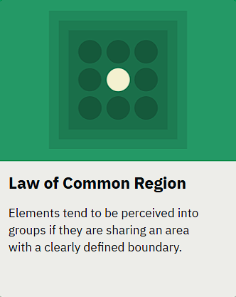
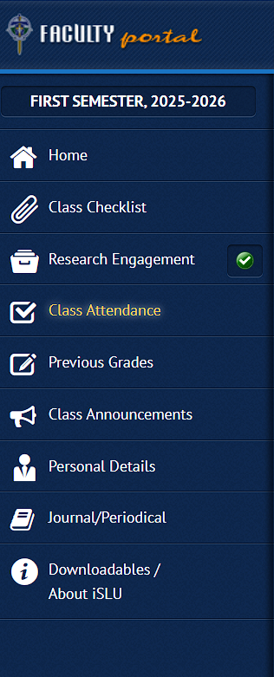
Law of Common Region
Notes:
The Law of Common Region in UX states that elements are perceived as grouped together if they share an area with a clearly defined boundary.
👉 In simple terms: if you put things inside the same "box" or visual container, users will assume they belong together—even if they’re not closest to each other.

Slide 70
Law of Common Region
9:41
EVERYDAY EXAMPLE · FACEBOOK
Facebook
Every post is a card
Ana Reyes
Each post sits on its own white card against a grey background.
Posts are stacked close together, yet the card edges tell you which photo, likes and comments belong together.
2h
Like
Comment
Share
Carlo Santos
5h
Like
Comment
Share
Simplified illustration of a familiar app screen, not an actual screenshot.
Notes:
Everyday example: the Facebook feed. Each post sits on its own white card against a grey background. Even though posts are stacked close together, the card boundary tells you which photo, likes and comments belong together.

Slide 71
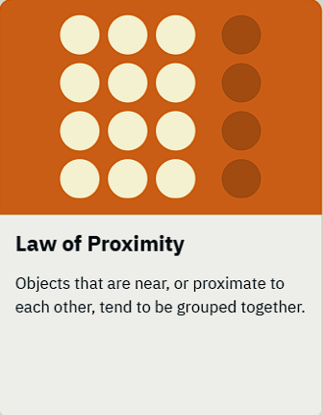

Law of Proximity
Notes:
The Law of Proximity says that objects placed close to each other are perceived as related or belonging to the same group, even without borders or colors.

Slide 72
Law of Proximity
9:41
EVERYDAY EXAMPLE · INSTAGRAM
Instagram
Spacing does the labeling
sagada.trips
Like, Comment and Share sit together on the left (green): all ways to interact with other people.
Save sits alone on the right (orange) because it is just for you.
No labels needed. The gaps tell you what belongs together.
1,204 likes
sagada.trips Sunrise at Kiltepan
Simplified illustration of a familiar app screen, not an actual screenshot.
Notes:
Everyday example: Instagram. Like, Comment and Share are grouped on the left; Save sits alone on the right. The spacing tells you, without labels, that the first three are about interacting with others and Save is just for you. The like count and caption sit right under the photo they describe.

Slide 73


Law of Prägnanz
Notes:
The Law of Prägnanz (also called the Law of Good Figure or Law of Simplicity) is one of the most important Gestalt principles.
The human brain perceives complex or ambiguous images in the simplest, most stable and orderly form possible. This reduces cognitive load: we see a simple circle instead of a fragmented polygon, or animals and faces in clouds.
"Prägnanz" is German for "pithiness" or "conciseness": the mind organizes what it sees into "good figures" that are easy to interpret.

Slide 74

Law of Prägnanz
Notes:
The Law of Prägnanz (also called the Law of Good Figure or Law of Simplicity) is one of the most important Gestalt principles.
The human brain perceives complex or ambiguous images in the simplest, most stable and orderly form possible. This reduces cognitive load: we see a simple circle instead of a fragmented polygon, or animals and faces in clouds.
"Prägnanz" is German for "pithiness" or "conciseness": the mind organizes what it sees into "good figures" that are easy to interpret.

Slide 75
Prägnanz and Related Gestalt Principles
Closure: The mind fills in the blanks in shapes, making a whole even when some components are absent. This is seen in design when a part of an image is left up to the viewer's meaning in logos or icons.
Symmetry: People tend to view symmetrical forms as more harmonious and stable. Symmetry is a tool that UX designers frequently use to balance layouts and appeal to users' sense of order.
Continuity: Objects arranged in a flowing or continuous line are thought to be more related. This idea is applied when creating user flows or navigation menus to guarantee a seamless combined experience.
Similarity: We group elements that look alike. This principle highlights related elements' similarities and sets them apart from other elements in UX design, helping to create a visual hierarchy.

Slide 76
Law of Prägnanz: Key Ideas
Key Aspects and Applications:
Fundamental Principle: It serves as a foundation for other Gestalt laws, including closure, similarity, and proximity.
Definition: "Prägnanz" is German for "pithiness" or "conciseness," implying that the mind organizes visual input into "good figures" (e.g., shapes, patterns) that are easy to interpret.
UX/UI Design: Designers use this to create minimalist, intuitive interfaces (e.g., Google’s homepage is little more than a logo and a search bar), reducing user confusion, and improving memorability.
Examples:
  Logos: Nike's swoosh or Apple's logo are instantly recognized because they are simple, organized shapes.
  Visuals: Perceiving five separate Olympic rings as a unified, simple symbol rather than a complex arrangement of lines.
Core Benefit: It minimizes the mental effort required to interpret visual information.

Slide 77


Law of Similarity
Notes:
The Law of Similarity says that objects that look alike (color, shape, size, font or style) are perceived as belonging together, even if they're not physically close.

Slide 78

Law of Similarity
Notes:
The Law of Similarity says that objects that look alike (color, shape, size, font or style) are perceived as belonging together, even if they're not physically close.

Slide 79

Law of Similarity
Notes:
The Law of Similarity says that objects that look alike (color, shape, size, font or style) are perceived as belonging together, even if they're not physically close.

Slide 80
Law of Similarity
9:41
EVERYDAY EXAMPLE · MESSENGER
Mika
Blue = you, grey = them
Active 2m ago
Did you finish the UX reviewer?
You never read names in a chat. The color and side of each bubble tell you who said what.
Things that look alike are seen as one group, even when they are far apart.
Almost! Stuck on Hick's Law
Fewer choices = faster decisions
Ohh that makes sense
Thanks!!
Good luck tomorrow!
Aa
Simplified illustration of a familiar app screen, not an actual screenshot.
Notes:
The Law of Similarity says that objects that look alike (color, shape, size, font or style) are perceived as belonging together, even if they're not physically close.
Everyday example: Messenger. Your messages are blue bubbles on the right and your friend's are grey bubbles on the left. You never read names; color and position tell you who said what.

Slide 81


Law of Uniform Connectedness
Notes:
Group functions of a similar nature so they are visually connected via colors, lines, frames, or other shapes.
Alternately, you can use a tangible connecting reference (line, arrow, etc) from one element to the next to also create a visual connection.
Use uniform connectedness to show context or to emphasize the relationship between similar items.

Slide 82


Mental Model
Notes:
Related to Jakob’s Law
We form a working model in our minds around what we think we know about a system, especially about how it works, and then we apply that model to new situations where the system is similar.
Match designs to the users’ mental models to improve their experience. This enables them to easily transfer their knowledge from one product or experience to another, without the need to first take the time to understand how the new system works.
Good user experiences are made possible when the design of a product or service is in alignment with the user’s mental model. Take for example e-commerce websites, which use consistent patterns and conventions such product cards, virtual carts and checkout flows in order to conform to users’ expectations.
The task of shrinking the gap between our own mental models and those of the users is one of the biggest challenges we face, and to achieve this goal we use a variety of user research methods (e.g. user interviews, personas, journey maps, empathy maps).

Slide 83


Miller’s Law
Notes:
Miller's Law: the average person can keep about 7 (plus or minus 2) items in working memory. Later research suggests the real limit is closer to 4 chunks.
Use it as a reason to chunk information, not as a strict rule on how many menu items you may have.

Slide 84
Miller’s Law
9:41
EVERYDAY EXAMPLE · GCASH
Send Money
Numbers in small chunks
Mobile number
A long number is easier to read, check and remember when it is split into small groups.
Chunking helps people spot a wrong digit before they send money to the wrong person.
0917 123 4567
Amount
PHP 500.00
Recent
Juan D.
0917 123 4567
Bea S.
Hard to check
Easy to check
0998 765 4321
09171234567
0917 123 4567
Next
Simplified illustration of a familiar app screen, not an actual screenshot.
Notes:
Everyday example: phone and reference numbers. 0917 123 4567 is much easier to read, check and remember than 09171234567. Chunking long numbers helps people catch a wrong digit before they send money to the wrong person.
Other examples: OTP codes, card numbers, student numbers.

Slide 85


Occam’s Razor
Notes:
Occam's Razor: among competing hypotheses that predict equally well, the one with the fewest assumptions should be selected. Named after the medieval philosopher William of Ockham: when there are several explanations, the simplest one is usually right.
In interface design, simplicity reigns. Avoid cluttered menus and convoluted navigation, keep steps and choices to a minimum, and remove anything that doesn't help the user's goal. Google and Airbnb use clean, straightforward interfaces that let users find what they need with little effort.

Slide 86

Paradox of the Active User
9:41
EVERYDAY EXAMPLE · DISCORD
# welcome
Help right where you are
Welcome to Study Group!
Nobody reads a manual before they start chatting. A new Discord server shows a short checklist inside the server itself.
People learn by doing, with help placed exactly where they need it.
Here are some steps to help you get started.
Invite your friends
›
Personalize your server with an icon
›
Send your first message
›
Add your first app
›
Message #welcome
Simplified illustration of a familiar app screen, not an actual screenshot.
Notes:
Users never read manuals; they start using the software immediately. They want to finish their task now, so they skip tutorials, even though learning the system would save them time later.
Ask the class: How many apps you signed up for had a guided tour? How many tours did you actually finish?
Takeaways:
- Make the interface self-explanatory: clear labels, visual cues, familiar patterns.
- Put help inside the experience, where and when it's needed (tooltips, inline tips, checklists), instead of in a manual.
Everyday example: a new Discord server shows a short "get started" checklist right inside the server, so people learn while doing.

Slide 87

Pareto Principle
9:41
EVERYDAY EXAMPLE · INSTAGRAM
juan.delacruz
Focus on what most people do
12
340
280
posts
followers
following
Most time on Instagram goes to a few things: scrolling, searching, posting, Reels and your profile. Those five get the bottom tabs (green).
Dozens of settings matter to fewer people, so they sit behind the menu (orange).
Juan Dela Cruz
Edit profile
Simplified illustration of a familiar app screen, not an actual screenshot.
Notes:
The Pareto principle states that, for many events, roughly 80% of the effects come from 20% of the causes. In UX: a small set of features gets most of the use, so make those fast and visible, and tuck the rest away.
Everyday example: Instagram. Most time goes to scrolling, searching, posting, Reels and your profile, so those five get the bottom tabs. The dozens of settings are behind the menu.

Slide 88

Parkinson’s Law
9:41
EVERYDAY EXAMPLE · FACEBOOK
One tap instead of a form
Facebook
People expect logging in to take a while: an email, a password, maybe a code.
Remembering the account and autofilling details turns it into one tap, so the task never drags on.
J
Juan Dela Cruz
Continue as Juan
Log in to another account
Create new account
Simplified illustration of a familiar app screen, not an actual screenshot.
Notes:
Parkinson's Law: any task will inflate until all of the available time is spent.
In UX: keep a task within the time users expect, or shorter. Autofill, saved logins and remembered details shrink the task so it never drags.
Everyday example: Facebook remembers your account, so logging back in can be one tap instead of typing an email and password.

Slide 89

Peak-End Rule
9:41
EVERYDAY EXAMPLE · GCASH
End on a high note
People remember a payment by its most intense moment and by how it ended.
A clear, friendly success screen with the amount, recipient and reference number makes the whole transaction feel smooth.
Sent!
PHP 500.00
To
Juan D.
Mobile no.
0917 123 4567
Ref. No.
1012 345 678912
How the payment felt
Date
Oct 18, 2026
End
Done
Peak (worst)
Open
Number
Amount
OTP wait
Sent!
Simplified illustration of a familiar app screen, not an actual screenshot.
Notes:
Peak-End Rule: people judge an experience largely by how they felt at its peak (most intense moment) and at its end, rather than by the average of every moment.
Design the most intense moment and the final moment with care. A payment that ends with a clear, friendly success screen (amount, recipient, reference number) feels smooth even if one step was slow.
When things go wrong, the error screen becomes the "end" users remember, so make it helpful.

Slide 90

Postel’s Law
What people type
What the app uses
0917 123 4567
Send Money
+63 917 123 4567
Juan D.
+63 917 123 4567
917-123-4567
Valid number
EVERYDAY EXAMPLE · GCASH-STYLE SEND FORM
Accept any format
People type mobile numbers in many ways. A forgiving form accepts all of them and quietly converts them to one standard format.
Be liberal in what you accept: show “Invalid number” only when the number truly can’t be understood.
Simplified illustration, not an actual app screenshot.
Notes:
Postel's Law (the robustness principle): be liberal in what you accept, and conservative in what you send. Accept many kinds of input, then give back clean, consistent output.
Example: a send-money form should accept 0917 123 4567, +63 917 123 4567 or 917-123-4567 and quietly convert them to one format, instead of showing "Invalid number".

Slide 91

Selective Attention
9:41
EVERYDAY EXAMPLE · FACEBOOK
Facebook
Banner blindness
Ana Reyes
We learn to ignore anything that looks like an ad. Posts marked “Sponsored” often get scrolled past without being read.
Attention locks onto what serves our goal (friends’ posts) and filters out the rest. Never make important information look like an ad.
2h
Like
Comment
Share
LazaShop PH
Sponsored
Most people scroll right past
lazashop.ph
Shop now
Simplified illustration of a familiar app screen, not an actual screenshot.
Notes:
Selective attention: the process of focusing our attention on only a subset of stimuli in an environment, usually those related to our goals.
Banner blindness: users learn to ignore anything that looks like an ad. On Facebook, posts marked "Sponsored" are often scrolled past without being read.
Design lesson: don't make important content look like an ad, and don't fight for attention with flashing elements; guide it with clear visual hierarchy.

Slide 92

Serial Position Effect
Memorize this list of items.
Apple
Churro
Racket
Lawn mover
Basket
Pen
Flask
Notes:
Close your eyes and try to remember. Chances are, you'll remember the first few items and the last few items better than the ones in the middle.

Slide 93


Tesler’s Law
Notes:
Tesler's Law (Law of Conservation of Complexity): every system has a certain amount of complexity that cannot be removed. The only question is who deals with it: the user or the system.
Good design moves complexity to the system, e.g., tax software asks simple questions and does the calculations itself.

Slide 94
Tesler’s Law
9:41
EVERYDAY EXAMPLE · GCASH
Scan QR
The app takes on the hard part
Paying a store by typing its account number, bank and exact name is slow and easy to get wrong.
A QR code still carries all of that, but the app reads it for you. The complexity did not vanish; it moved from the user to the system.
Point your camera at a QR code
Upload QR
Simplified illustration of a familiar app screen, not an actual screenshot.
Notes:
Everyday example: paying with a QR code. The account number, bank and merchant name are still needed, but the app reads them from the code instead of making the user type them. The complexity didn't disappear; it moved from the user to the system.

Slide 95


Von Restorff Effect
Notes:
The Von Restorff Effect (isolation effect): when several similar objects are present, the one that differs from the rest is most likely to be remembered.
Use it to make the key action or information stand out, but sparingly: if everything is highlighted, nothing stands out. Don't rely on color alone (some users are color-blind); also use size, shape or a label.

Slide 96
Von Restorff Effect
9:41
EVERYDAY EXAMPLE · DISCORD
BSIT 2A
The red badge stands out
TEXT CHANNELS
# general
In a column of grey servers and channels, the red badge is what your eye goes to first, and what you remember.
It works because Discord uses red sparingly. If everything were red, nothing would stand out.
# announcements
2
# random
3
# memes
# ux-reviewer
# lab-schedule
# music
Simplified illustration of a familiar app screen, not an actual screenshot.
Notes:
Everyday example: Discord. In a long list of grey servers and channels, the one with a red badge pops out, so you notice it first. Discord keeps red for mentions and unread counts, which keeps it meaningful.

Slide 97

Working Memory
9:41
EVERYDAY EXAMPLE · DISCORD
# ux-reviewer
Let the screen remember
Bea Today at 9:12 PM
What time is the UX quiz tomorrow?
By the time you reply, the question may have scrolled away. Discord shows it right above your answer (green).
Working memory is small and fades in seconds, so show people what they need instead of making them recall it.
Carlo Today at 9:12 PM
anyone have the reviewer link?
Mika Today at 9:12 PM
sent it in #general
Carlo Today at 9:12 PM
thanks!!
@Bea What time is the UX quiz…
You Today at 9:12 PM
10:30, same room as last week
Replying to Bea
Message #ux-reviewer
Simplified illustration of a familiar app screen, not an actual screenshot.
Notes:
Working memory: a cognitive system that temporarily holds and manipulates the information needed to complete a task. It is small and fades within seconds.
Design so users don't have to keep things in their heads: show what they need, where they need it (recognition over recall).
Everyday example: replying to a message in Discord or Messenger shows the original message right above your reply.

Slide 98

Zeigarnik Effect
9:41
EVERYDAY EXAMPLE · INSTAGRAM
Instagram
Unfinished tasks stick with us
Leave a post halfway and Instagram keeps it as a draft, waiting for you.
An unfinished task nags at us more than a finished one, so people come back to complete it.
Your story
mika
carlo
bea
Finish your post?
Your draft is saved
Continue editing
carlo
Simplified illustration of a familiar app screen, not an actual screenshot.
Notes:
Zeigarnik Effect: people remember uncompleted or interrupted tasks better than completed ones.
Takeaways:
- Invite content discovery with clear signs of more content.
- Artificial progress toward a goal makes users more motivated to complete it.
- Show clear progress to motivate users to finish tasks.
Everyday examples:
- Instagram keeps an unfinished post as a draft, waiting for you.
- TV shows end on cliffhangers so viewers come back for the next episode.
- To-do lists: you remember unfinished tasks more than finished ones.
- Games: an unfinished level sticks in your mind.

Slide 99
SUMMARY
Law | Definition | Design Implication | Concrete Example (UI/UX)
Aesthetic-Usability Effect | Users perceive attractive interfaces as easier to use. | Make design visually appealing to build trust. | Apple’s product pages: clean, beautiful layouts that feel “usable” even before interaction.
Doherty Threshold | Productivity improves when system response time is under 400ms. | Keep interactions snappy; show feedback if delay. | Google search autocomplete updates instantly as you type.
Fitts’s Law | The time to reach a target depends on size and distance. | Bigger, closer targets = easier interaction. | Large “Send” button on mobile at thumb’s reach.

Slide 100
SUMMARY
Law | Definition | Design Implication | Concrete Example (UI/UX)
Goal-Gradient Effect | Users work harder to complete a goal as they get closer. | Use progress bars or completion trackers. | Duolingo shows % progress toward daily streak goal.
Hick’s Law | Decision time increases with number/complexity of choices. | Reduce visible options; use categories. | Netflix shows top categories (“Trending Now”) instead of dumping all movies.
Jakob’s Law | Users expect your design to work like familiar ones. | Follow common conventions. | Shopping cart icon universally used for e-commerce.

Slide 101
SUMMARY
Law | Definition | Design Implication | Concrete Example (UI/UX)
Law of Common Region | Elements within a boundary are perceived as related. | Use cards, boxes, containers for grouping. | Google Drive groups files within shaded cards.
Law of Prägnanz (Simplicity) | People perceive complex images in the simplest form possible. | Use simple, clear visuals; avoid clutter. | Logo designs like WWF panda — minimal yet recognizable.
Law of Proximity | Objects close together are seen as related. | Place related buttons and labels near each other. | Form fields grouped with their labels right above them.

Slide 102
SUMMARY
Law | Definition | Design Implication | Concrete Example (UI/UX)
Law of Similarity | Similar-looking items are perceived as related. | Use consistent styles for categories. | Spotify playlists use same card style, different images.
Law of Uniform Connectedness | Elements connected by lines/visuals are related. | Use connectors to guide relationships. | Flowcharts in UI builders (Figma auto-connect lines).
Miller’s Law | People can hold ~7±2 items in working memory. | Don’t overload with options; chunk info. | Menu with 5–7 items max on navigation bar.

Slide 103
SUMMARY
Law | Definition | Design Implication | Example (UI/UX)
Occam’s Razor | Simpler solutions are preferable to complex ones. | Don’t over-design features. | Google homepage; one search box, nothing else.
Pareto Principle (80/20 Rule) | 80% of effects come from 20% of causes. | Focus on key user tasks. | Instagram emphasizes posting & scrolling, not settings.
Parkinson’s Law | Work expands to fill time available. | Give realistic deadlines/time limits. | Time-limited promo banners on e-commerce (“Ends in 2h”).

Slide 104
SUMMARY
Law | Definition | Design Implication | Example (UI/UX)
Peak-End Rule | People judge experiences by peak & final moments. | Make last steps pleasant; reduce checkout friction. | Uber: smooth booking flow + positive “Thanks” screen.
Postel’s Law (Robustness Principle) | Be liberal in what you accept, strict in what you send. | Accept varied user input, return clear output. | Search box allows typos (“iphon” → iPhone).
Serial Position Effect | Users remember first & last items best. | Place key options at start/end. | Amazon puts “Sign In” and “Cart” at edges of nav bar.

Slide 105
SUMMARY
Law | Definition | Design Implication | Example (UI/UX)
Tesler’s Law (Conservation of Complexity) | Complexity can’t be eliminated, only shifted. | Hide unnecessary complexity from user. | Tax software hides calculations, just asks simple Q&A.
Von Restorff Effect (Isolation Effect) | Unique items stand out & are remembered. | Highlight key actions. | Red “Delete Account” button stands out from grey options.
Zeigarnik Effect | People remember incomplete tasks better. | Show progress to encourage return. | LinkedIn profile “You’re 80% complete; add skills!”

Slide 106
SUMMARY
Law | Definition | Design Implication | Example (UI/UX)
Cognitive Load | Too much info strains user processing. | Keep tasks simple, reduce steps. | Auto-fill address forms in checkout.
Chunking | Break down info into smaller units. | Easier comprehension & memory. | Credit card numbers grouped into 4-digit blocks.
Cognitive Bias | Users’ judgments are skewed by biases. | Design ethically, avoid manipulative tactics. | Social proof (“1,000+ bought today”) affects perception.
Flow | Users enjoy uninterrupted immersion in tasks. | Reduce friction, distractions. | Medium’s reading mode hides UI clutter while reading.

Slide 107
Applying UX Laws
Use these laws to evaluate and improve interfaces.
Checklist: Reduce choices, group items, ensure visual clarity.

Slide 108
Interactive Activity
Analyze an app you use every day (e.g., GCash, Instagram, Facebook, Discord) and identify at least 5 UX laws in action.
Suggest improvements.

Slide 109
Discussion Questions
- Which UX law surprised you most?
- How can these laws be applied to our university portal or e-commerce apps?
- Can aesthetics sometimes compromise usability?

Slide 110
References / Further Reading
- https://lawsofux.com/
- Jon Yablonski, Laws of UX Book
- UX design blogs and research articles

