Slide 1

Analysis of Metadata and Topic Modeling for Academic Articles - MIS Quarterly Journal
By Jigar Mehta
May 12th, 2016
GRA Work Report Submission
Spring 2016
Under the Supervision: Dr. Arun Rai

Slide 2
Results and Insights – MIS Quarterly Journal– Descriptive Stats
#Articles published per year has increased two fold over 20 years
Avg. #Keywords per article has doubled over 20 years
82% of Articles belong to two dominant categories : Research Article/Note (60%) and Special Issue (20%)
Avg. length of articles (number of pages) per year has witnessed a three fold increase over last 20 years
Avg. Abstract length per article was higher in ’05-’10 but has been consistent since then (~1500 characters)
No significant trend in Avg Title length (~100 characters) per article except for small variations by year
For last 5 years: Avg #Tables per article ranges from 7 to 8; whereas Avg #Figures per article is around 4
For last 5 years: Avg #References per article per year has seen a small increase (Avg ~ 85 references)
On an average there are two authors per article

Slide 3
Results and Insights – MIS Quarterly Journal– Content Analysis
Based on Topic Modeling on only Abstracts for last 20 years, these 8 topics are widely discussed by authors:
User/ customer centric – approach and attributes
Ethics and legal issues
Project outsourcing, teams and offshoring
Scientific studies, analysis methods and models
Firms investments, working and capabilities
Decision support systems and framework
Organizational process development and framework
Product/service attributes
Increasing Trend of Topics :
product/service attributes,
user-centric focused approach,
firms investment & capability alignment
Decreasing Trend of Topics :
Ethics and legal issues
Project outsourcing
Consistent Trend of Topic:
Organizational processes dev
Scientific studies and models
Decision support systems

Slide 4
Visualizing Work Progress
Project Objective and Framework Discussion
MISQ Journal - Data Fetch
Python Script to create Metadata and Other tables
Final Results
R code for Word Clouds and Keywords Trend Analysis
Topic Modeling -
R code, results and Presentation
Topic Modeling - Trend Analysis and Presentation
Python Script for Base Table Preparation for Analysis
Topic Modeling -Multiple iterations & Tableau
Academic Papers Descriptive Analysis - Code and Results
May 4th
Apr 19th
Apr 5th
Mar 22th
Mar 8th
Mar 1st
Feb 16th
Feb 2th
Jan 19th
Jan 12th

Slide 5
Keywords Trend Analysis –
Comparison of Word Clouds across different Time horizons

Slide 6
Top Keywords by trend behavior
Growing
security
privacy
Online
social
software
design
data
web
product
statistics
mobile
user-behavior
trust
quality
Persistent
business
knowledge
development
outsourcing
innovation
performance
model
science
network
process
analysis
value
Shrinking
cognitive
agility
support
management
electronic
costs
risk
empirical
longitudinal
manufacturing
auctions

Slide 7
Textual Analysis – Topic Modeling on Abstracts of Papers
Documents and words can be directly observed, topics are latent

Slide 8
Assumptions
Documents
A Document is a mix of topics
Topics
To find topics that are as much distinct as each other
Single document can consist of many topics, but to different proportions
A Topic is a mix of word
Two documents with the same topics will have overlap in words
To highlight the most heavily discussed topic(s) in each paper
Keeping α low will lead to sparse topic distribution
Keeping β low will lead to topics having less common words
Use statistics to find latent topics represented by groups of words

Slide 9
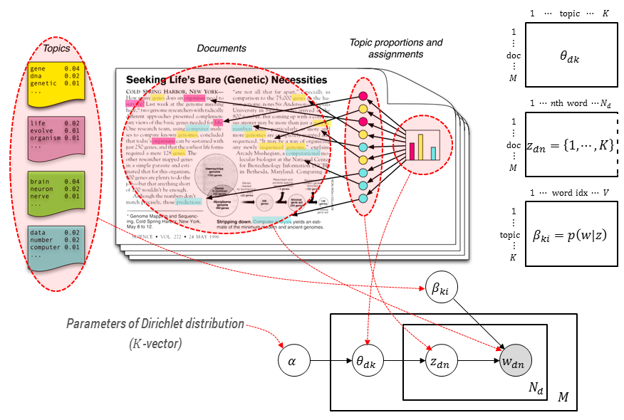
Topic Modeling – Understanding LDA and latent parameters

Slide 10
Understanding Alpha and Beta parameters
α
β
Impact on Content
A high alpha-value means that each document is likely to contain a mixture of most of the topics, and not any single topic specifically
A low alpha value puts less such constraints on documents and means that it is more likely that a document may contain mixture of just a few, or even only one, of the topics.
A high beta-value means that each topic is likely to contain a mixture of most of the words, and not any word specifically, while
A low value means that a topic may contain a mixture of just a few of the words.
In practice, A high alpha-value will lead to documents being more similar in terms of what topics they contain.
A high beta-value will similarly lead to topics being more similar in terms of what words they contain.

Slide 11
Multiple Iterations – Tuning α, β, K and N – 60 Topic Models
Insights
As α increases, topics are more evenly distributed in terms of proportion of documents they hold. Low values causes Sparse topic distribution, High value causes topics to have common themes and hence, overlap.
As β increases, topics are more similar in terms of the words they are made up and end up being more similar topics. Low values causes unique topics, High values causes topic to be similar and overlap.
As K increases, more topics are discovered. Low values causes significant topics to be missed and and higher value can cause overlapping and similar topics.
As N increases, topics discovery becomes stable and guarantees convergence. Low values indicated unstable and unreliable topics discovery.

Slide 12
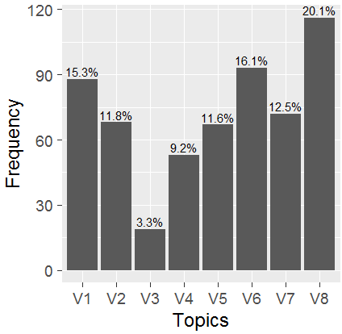
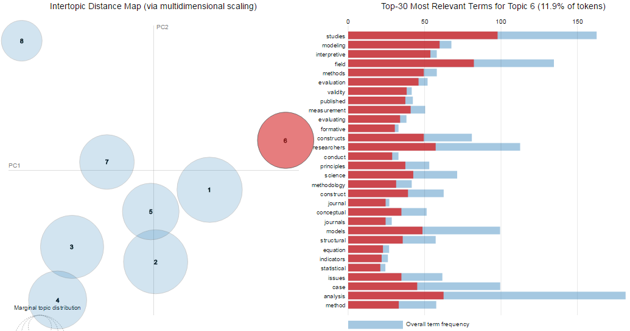
Topic Model Result 1 (Topics= 8, Iterations = 1800, alpha = 0.61, beta = 0.4)

Slide 13
Topic Trend over years and Top words for each Topic
User – centric behavior | Product/ Service attributes | Epistemological perspectives in IS | IS development/ Project management (outsourcing/offshoring) | Research Design and Methods | IT Strategy/ Business Value | Changing nature of computing | Organizational processes
user | product | work | project | studies | firm | decision | development
influence | service | theories | task | field | firms | support | innovation
adoption | quality | managers | time | analysis | strategic | making | organizations
users | trust | professionals | communication | modeling | strategy | virtual | practice
perceived | privacy | quandaries | projects | researchers | risk | effectiveness | technologies
usage | price | deception | groups | interpretive | alignment | complexity | analysis
factors | consumer | ethical | group | constructs | resource | problem | develop
intention | electronic | term | media | methods | capability | usersã | context
security | markets | increase | team | models | resources | tools | work
behaviors | perceived | stakeholder | teams | evaluation | investments | effects | change
behavior | products | normative | members | case | capabilities | search | understanding
training | impact | challenges | differences | science | level | user | action
individual | content | managerial | control | measurement | significant | approach | practices
acceptance | Market | explored | client | construct | investment | world | theoretical
relationship | effects | resolve | tasks | approach | outsourcing | develop | framework
affect | uncertainty | law | development | validity | benefits | explanations | case
support | consumers | conflict | cultural | statistical | industry | present | processes
efficacy | internet | turnover | offshore | principles | findings | framework | concept
implementation | sales | reported | offshoring | structural | network | existing | developing
computer | find | ethics | learning | issues | governance | important | role
beliefs | feedback | violating | support | techniques | agility | interface | mechanisms
satisfaction | transparency | standards | collaboration | empirical |  |  | culture

Slide 14
Pearson Correlation (Linear) amongst the topics
Topics | User – centric behavior | Product/ Service attributes | Epistemological perspectives in IS | IS development/ Project management (outsourcing/offshoring) | Research Design and Methods | IT Strategy/ Business Value | Changing nature of computing | Organizational processes
User – centric behavior | 1.00 | -0.45 | 0.08 | 0.13 | -0.12 | -0.47 | -0.49 | 0.12
Product/ Service attributes | -0.45 | 1.00 | -0.54 | -0.27 | 0.22 | 0.21 | 0.04 | -0.23
Epistemological perspectives in IS | 0.08 | -0.54 | 1.00 | 0.20 | -0.24 | -0.27 | 0.47 | -0.20
IS development/ Project management (outsourcing/offshoring) | 0.13 | -0.27 | 0.20 | 1.00 | -0.17 | -0.48 | -0.06 | -0.17
Research Design and Methods | -0.12 | 0.22 | -0.24 | -0.17 | 1.00 | -0.04 | -0.10 | -0.38
IT Strategy/ Business Value | -0.47 | 0.21 | -0.27 | -0.48 | -0.04 | 1.00 | 0.15 | -0.17
Changing nature of computing | -0.49 | 0.04 | 0.47 | -0.06 | -0.10 | 0.15 | 1.00 | -0.49
Organizational processes | 0.12 | -0.23 | -0.20 | -0.17 | -0.38 | -0.17 | -0.49 | 1.00

Slide 15
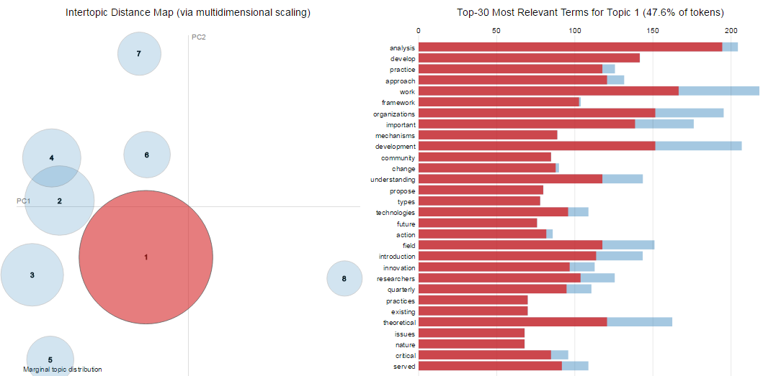
Topic Model Result 2 (Topics = 8, Iterations =1500, alpha = 0.02, beta = 0.02)

Slide 16
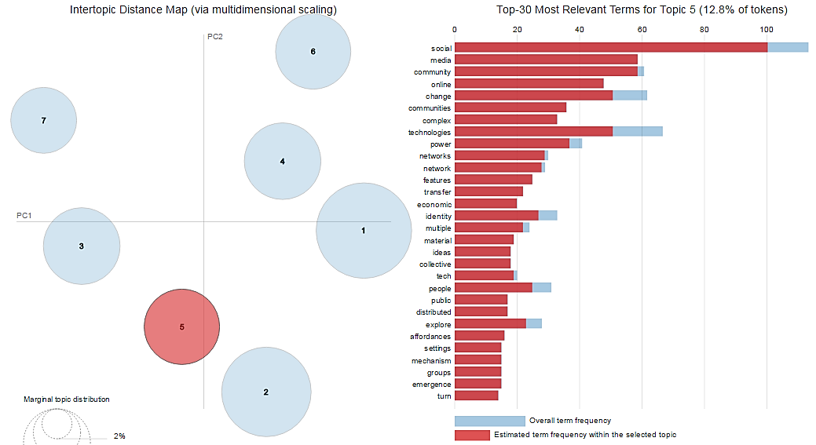
Hierarchical Topic Distribution of Major Topic
Top Keywords
Social Media Topic

Slide 17
T1 | T2 | T3 | T4 | T5 | T6 | T7 | T8
privacy | virtual | firm | field | acceptance | quandaries | Product | support
security | task | service | interpretive | constructs | theories | Price | analysis
user | media | firms | science | measurement | ethical | Decision | work
efficacy | groups | project | principles | adoption | managers | Trust | understanding
users | communication | strategic | case | usage | stakeholder | Products | develop
influence | time | projects | studies | models | fraud | markets | theoretical
behaviors | teams | risk | evaluation | cultural | ethics | content | quarterly
resistance | tasks | alignment | evaluating | culture | resolve | perceived | suggest
work | training | capability | published | modeling | explored | consumer | innovation
computer | group | investments | journals | construct | normative | consumers | introduction
affect | team | firmã | articles | perceived | violating | market | practice
compliance | members | outsourcing | methods | differences | detection | uncertainty | level
intention | minute | strategy | journal | formative | deception | commerce | important
professionals | partitioned | client | discipline | structural | managerial | electronic | approach
usersã | support | resource | critical | behavioral | related | user | potential
employees | presented | cost | researchers | validity | increase | quality | framework
individuals | worlds | resources | academic | behavior | real | auctions | change
attitudes | periods | enterprise | methodology | intention | world | sales | associate
personal | ideas | investment | rationale | ease | actions | search | action
cognitive | differences | level | issues | usefulness | balancing | feedback | community
T1 | T2 | T3 | T4 | T5 | T6 | T7
field | business | decision | social | model | innovation | design
action | strategy | work | media | theoretical | digital | software
issues | creation | served | community | communication | critical | process
theories | strategic | task | online | empirical | human | learning
practice | firms | implementation | change | analysis | service | world
researchers | performance | group | technologies | behaviors | context | support
address | term | associate | communities | future | construct | science
discipline | competitive | virtual | power | review | innovations | problem
studies | industry | explanations | complex | culture | conceptual | expertise
methods | internet | team | practice | framework | modeling | types
academic | strategies | reviewers | networks | case | technological | specific
tools | advantage | teams | network | data | base | project
argue | alignment | context | analysis | level | artifacts | experience
conducted | case | findings | features | researchers | infrastructure | traditional
health | framework | computer | identity | implications | path | approach
problems | investment | support | transfer | privacy | phenomena | control
principles | product | users | people | contexts | dominant | dimensions
present | sustainability | professionals | time | impact | developing | effectiveness
core | firm | conditions | practices | studies | lead | elements
published | level | making | mechanisms | develop | realism | search

Slide 18
StopWords used in Topic Modeling
'knowledge','information','system','research','paper','study','based','literature','article','tion',
'gss','cid','146','pls','font','misq','text','open','pp','vol','1px','post','number',
'quaterly','www','http',
'website','org','appendencies','border','systems','senior','accepting','2',
'theory',
'editor','keywords','?','1','mis','oss','technology','organization','management','knowledge',
'organization','organizations','organizational','development'

Slide 19
Appendix

Slide 20
Semantic Relatedness and TF-IDF
Reduce high-dimensional term vector space to low-dimensional 'latent' topic space
Two words co-occurring in a text
signal that they are related
document frequency determines strength of signal
co-occurrence index
TF: Term Frequency
terms more frequently in document are more important
IDF: Inverted Document Frequency
terms in fewer documents are more specific
TF * IDF indicates importance of term relative to the document
Semantic Analysis
TF-IDF
Dimen-sionality Reduction

Slide 21
Topic Modeling Process – LDA Implementation Steps (Part 1)
Preprocessing
Tokenization
Lemmatization
Stopwords Removal
Vector Space
Bag of-words
Dictionaries
Model
LDA
Bag-of-Words
Dictionaries
Tuning Parameters
Topics and their Words
Cleaned the abstracts from as much noise as possible and lowercase all the abstract
Replace all special characters and do n-gram tokenizing
Lemmatizing - reducing words to their root form, e.g., “reviews” and “reviewing to “review”
Removing numbers (e.g., “2014”) and removing HTML tags and symbols,
Create Dictionaries, Corpus of Bag-of-Words
Pass through LDA Algorithm and Evaluate

Slide 22
Topic Modeling Generative Process LDA Implementation Steps (Part 2)
Step 1: Select β
The term distribution β is determined for each topic by β ∼ Dirichlet (δ).
Step 2:
Select α
The proportions θ of the topic distribution for the document w are determined by: θ ∼ Dirichlet (α).
Step 3:
Iterate
For each of the N words wi
(a) Choose a topic zi ∼ Multinomial(θ).
(b) Choose a word wi from a multinomial probability distribution conditioned on the topic
zi : p(wi|zi, β).
For LDA the generative model consists of the following three steps :
* β is the term distribution of topics and contains the probability of a word occurring in a given topic.
* The process is purely based on frequency and co-occurrence of words

Slide 23
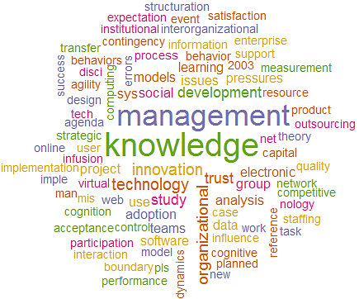
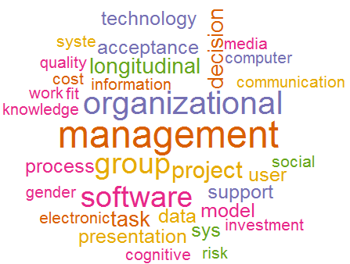
1996-2000
2001-2005

Slide 24
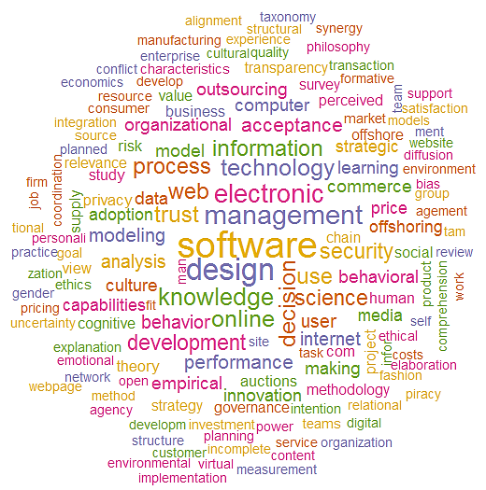
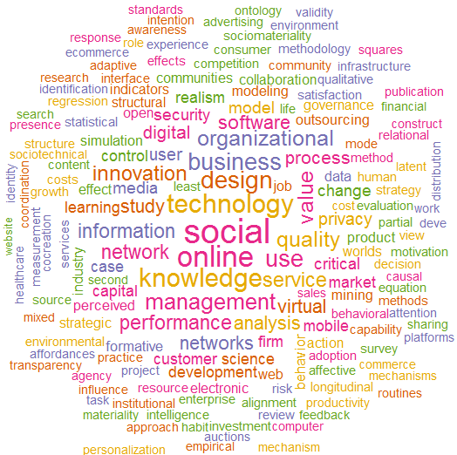
2006-2010
2011-2015

Slide 25
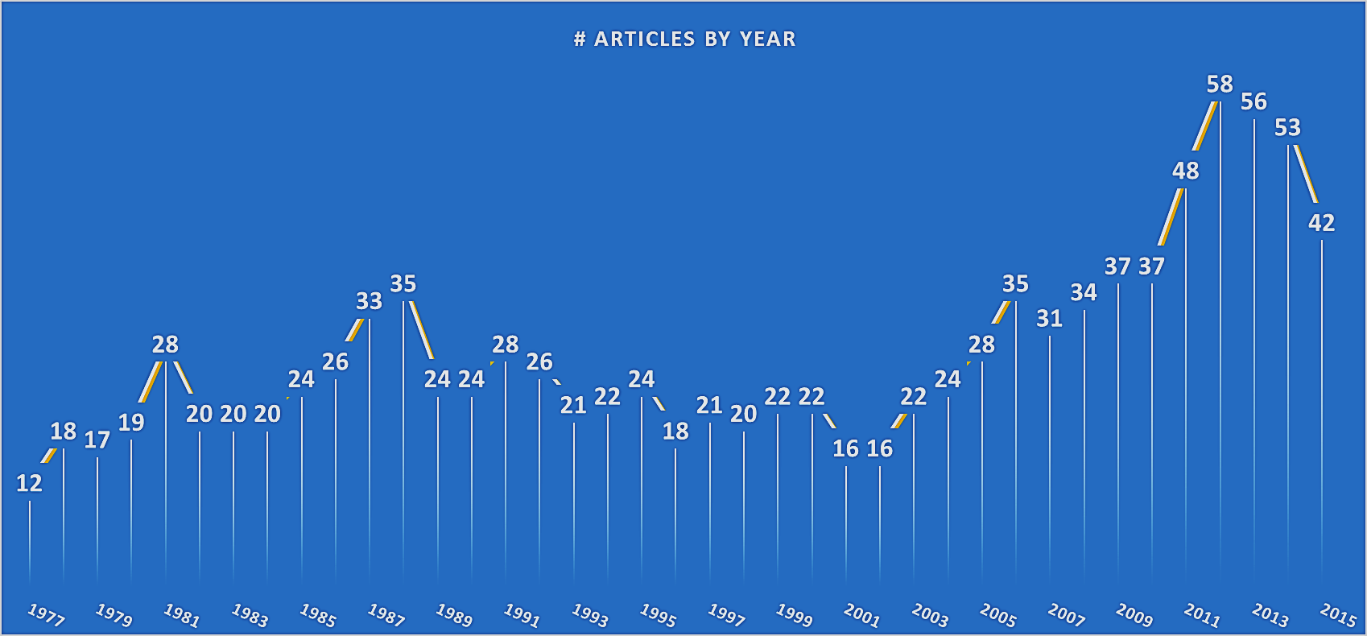
Number of Articles Published by the Year of Publication (1977 – 2015)
Total Papers = 1081

Slide 26
Number of Articles Published by the Category of Paper (2000-2015)
Total Papers = 551

Slide 27
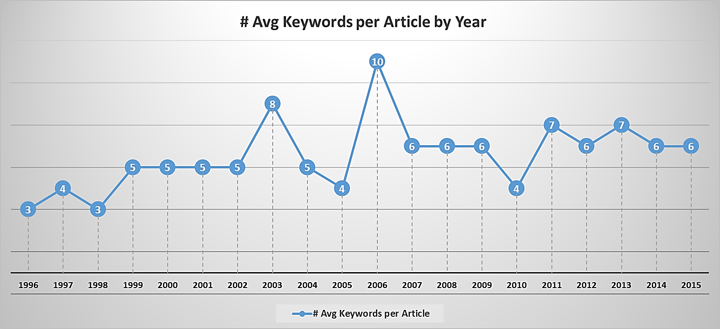
Trend of Average # Keywords Per Article by Year (1996 – 2015)
Avg. #Keywords per article have doubled over 20 years
Total Papers = 584

Slide 28
Trend of Average Abstract length per Article by Year (1996 – 2015)
Total Papers = 584

Slide 29
Trend of Average Title length per Article by Year (2000 – 2015)
Total Papers = 551

Slide 30
Article Size – # Pages Per Article v/s Avg File Size (KBs)
Total Papers = 1,081

