Slide 1







“Free”
Free / Subscription
Advertising Space
Funding
Advertising Price
Editorial Content
Editorial Content
Eyeballs
Advertiser
Eyeballs
Public
Institution
Indirect Network Effects

Slide 2
“Free”
Free / Subscription
Advertising Space
Funding
Advertising Price
Editorial Content
Editorial Content
Eyeballs
Advertiser
Eyeballs
Public
Institution
Indirect Network Effects

Slide 3
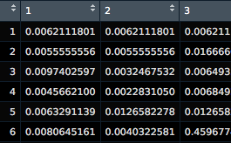
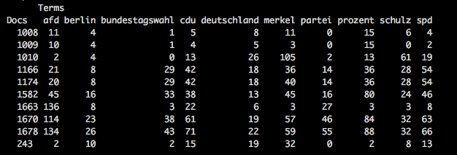


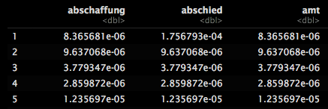

Corpus
(German online news articles)
Data Pre-Processing
Document-
Term Matrix
Generative Process
Probabilities and Classification
Estimation
Bayrischer Innenminister will keine Altersgrenze mehr - »Verfassungsschutz soll Kinder beobachten - Bild.de
Includes the following steps:
Remove common words (Stopwords), punctuation, numbers and non-alphanumerical terms.
Stemming words to root words
The document term matrix is simply a mapping of how often each word appears in a particular article.
The algorithm analyzes the occurrences and attempts to identify the latent topics.
The output of the model is a set of probabilities mapping words to topics, and documents (news articles) to topics
We estimate the conditional expectation of topic prevalence for given document characteristics.
Topic-document
distribution 𝜃
SPD: Bundestagswahl: Kandidat Schulz stellt Pläne zu Innerer Sicherheit vor - FOCUS Online
$$p\left[θ_{i}|x_{i}\right]$$
Linke-Parteitag in Hannover: Bedingt gesprächsbereit - SPIEGEL ONLINE
Term-topic distribution 𝜙
Wagenknecht sieht kaum Chancen für Rot-Rot-Grün – stern.de
Klare Mehrheit: Bundestag will Einheitsdenkmal bis 2019 – welt.de
Generative Model: Latent Dirichlet allocation, where the prior distributions with globally shared mean parameters are replaced with means parameterized by a linear function of observed covariates.
Covariates: News Agency, Month
Algorithm: Gibbs Sampling
Anschlag in Kabul: Schulz will Abschiebungen nach Afghanistan aussetzen – Zeit Online

Slide 4
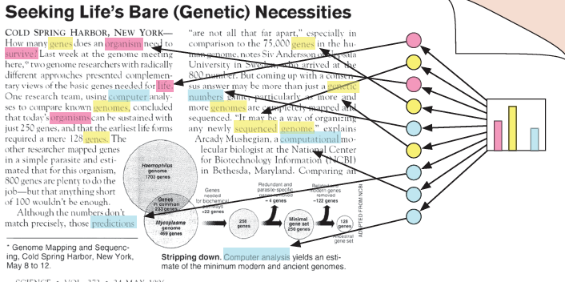

Corpus
Data Pre-Processing
Document-
Term Matrix
Generative Process
Probabilities/ Classification
Estimation
Bayrischer Innenminister will keine Altersgrenze mehr - »Verfassungsschutz soll Kinder beobachten - Bild.de
Topic-document
distribution 𝜃
$$p\left[θ_{i}|x_{i}\right]$$
SPD: Bundestagswahl: Kandidat Schulz stellt Pläne zu Innerer Sicherheit vor - FOCUS Online
Linke-Parteitag in Hannover: Bedingt gesprächsbereit - SPIEGEL ONLINE
Wagenknecht sieht kaum Chancen für Rot-Rot-Grün – stern.de
Klare Mehrheit: Bundestag will Einheitsdenkmal bis 2019 – welt.de
Term-topic distribution 𝜙
Anschlag in Kabul: Schulz will Abschiebungen nach Afghanistan aussetzen – Zeit Online

Slide 5


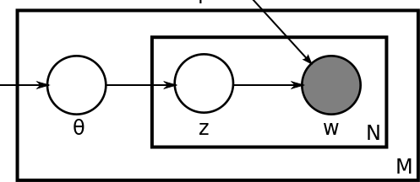
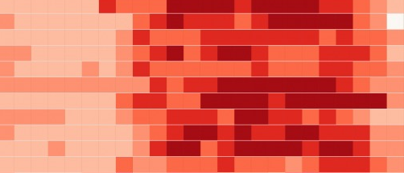
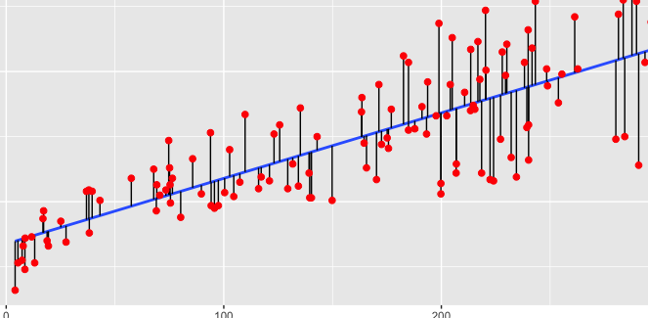
Knowledge & Question
Data
Make assumptions
Discover patterns
Predict & Explore

Slide 6
