Slide 1
Allegro CL GTK+ Interface
Charles A. Cox
January 2002

Slide 2
Outline
Introduction.
Other Work.
Allegro CL GTK+ Interface Philosophy.
Screen Shot Examples.
Code Examples.
Implementation.
Gtk directory organization.
Conclusion.

Slide 3
Introduction
Part of Unix Common Graphics Project.

Slide 4
Introduction (cont.)
Description [From gtk.org]:
  GTK+ is a multi-platform toolkit for creating graphical user interfaces, primarily designed for the X Window System.
  GTK+ is free software and part of the GNU Project. However, the licensing terms for GTK+, the GNU LGPL, allow it to be used by all developers, even those developing proprietary software, without any license fees or royalties.

Slide 5
Introduction (cont.)
Description (cont.):
  GTK+ has a C-based object-oriented architecture that allows for maximum flexibility, and consists of the following component libraries:
    GLib - Provides many useful data types, macros, type conversions, string utilities and a lexical scanner.
    GDK - A wrapper for low-level windowing functions.
    GTK - An advanced widget set.

Slide 6
Introduction (cont.)
Current GTK Release: 1.2, which is at least 2 years old.

Slide 7
Other Work
cl-gtk
  Gilbert Baumann (Germany)
  Talks down a pipe to a program written in C that knows GTK. Similar to CLM (Motif).
  Available with GNU Common Lisp.

Slide 8
Other Work (cont.)
clg
  Espen Johnsen (Norway)
  GTK Lisp bindings for CMUCL and CLISP.
    Hides FFI from programmer who uses Lisp functions with, e.g., Lisp keywords.
  “Built in” to the Lisp. Binds directly to the GTK event loop via FFI.

Slide 9
Other Work (cont.)
cl-glade
  Translates XML files produced by Glade (a GTK Gui editor) to Common Lisp functions.
  Reportedly works in Allegro CL.
Xemacs/GTK
  A version of Xemacs (21.1.12) which uses GTK for GUI. GTK widgets can be created from Xemacs Lisp.

Slide 10
Allegro CL GTK+ Interface Philosophy
Vision:
  GTK+ interface support will be about the same as Windows API support, i.e., available to programmers but used mainly as a bed for Common Graphics.
  Not necessarily guaranteeing complete GTK+ coverage.

Slide 11
Allegro CL GTK+ Interface Philosophy (cont.)
Vision (cont.):
  Interface is a very thin layer primarily consisting of FFI def-foreign-calls and macros expanding to those calls. No effort made to hide/cover C objects.
Interface largely generated by Cbind (more on this later). Some hand work needed to fill in gaps left by Cbind (macros).

Slide 12
Allegro CL GTK+ Interface Philosophy (cont.)
Other than filling in gaps left by Cbind, the only fresh Lisp code is a simple event-handler which operates with Unix Allegro CL Multi-Processing.
Work done using Allegro CL 6.2 development versions.

Slide 13
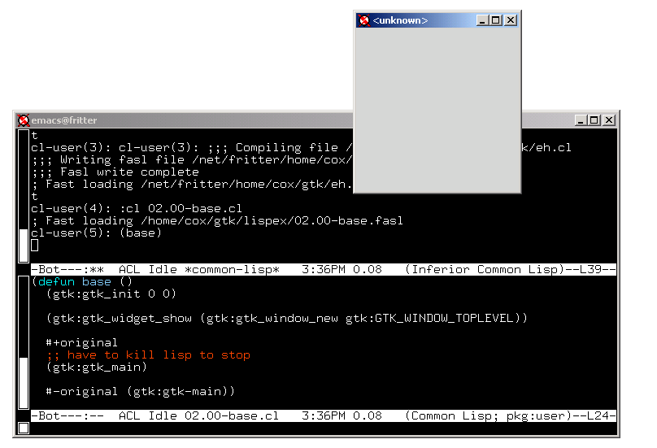
Screen Shot Examples.
base

Slide 14
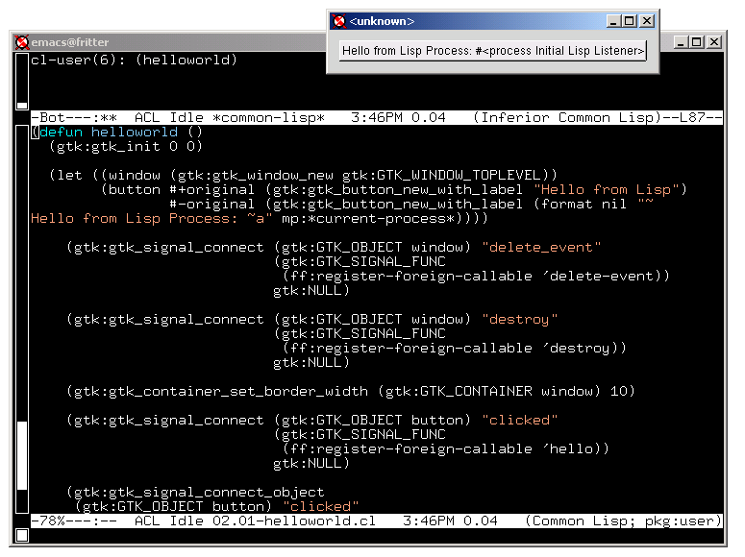
Screen Shot Examples
helloworld

Slide 15
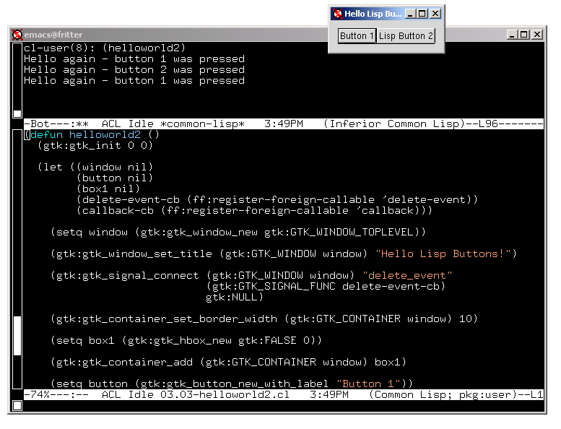
Screen Shot Examples
helloworld2

Slide 16
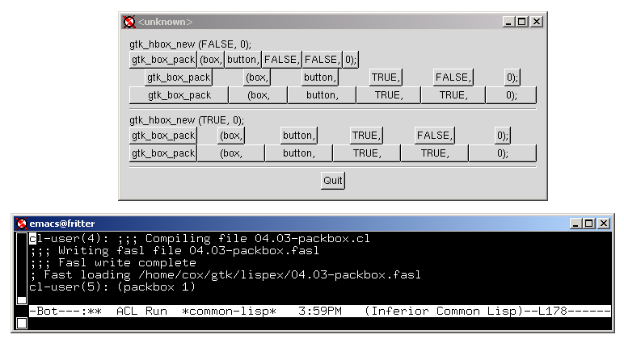
Screen Shot Examples
packbox

Slide 17
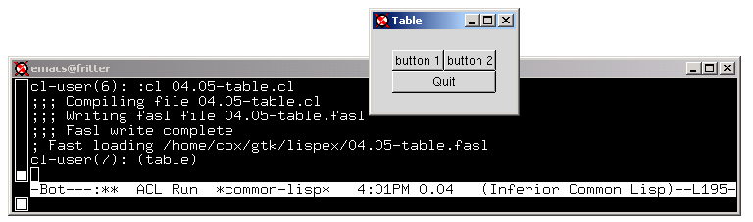
Screen Shot Examples
table

Slide 18
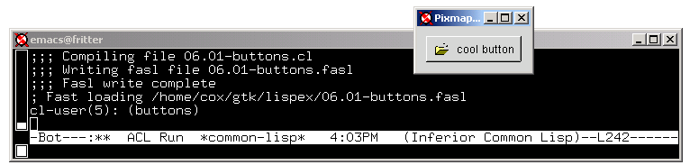
Screen Shot Examples
buttons

Slide 19
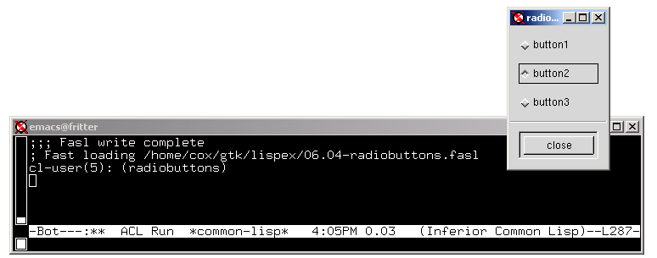
Screen Shot Examples
radiobuttons

Slide 20
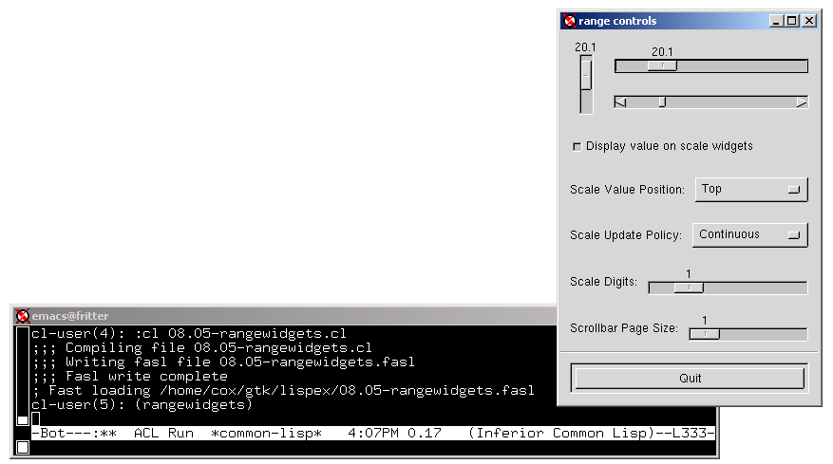
Screen Shot Examples
rangewidgets

Slide 21
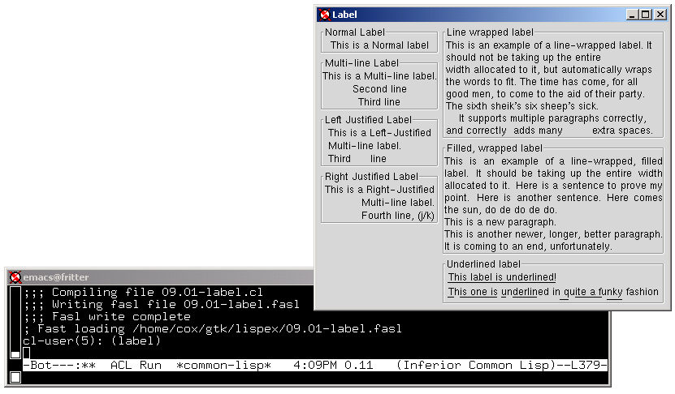
Screen Shot Examples
label

Slide 22
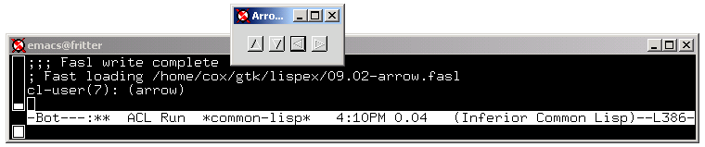
Screen Shot Examples
arrow

Slide 23
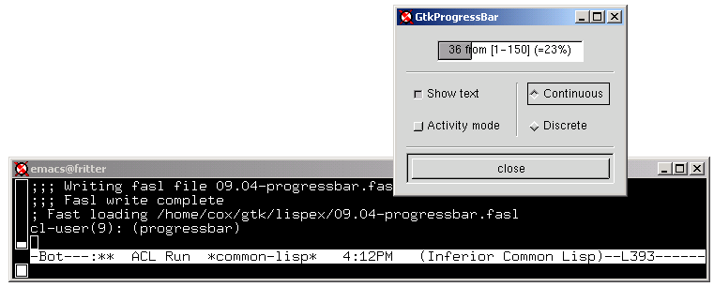
Screen Shot Examples
progressbar

Slide 24
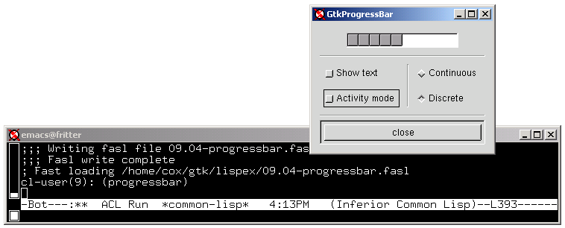
Screen Shot Examples
progressbar (cont.)

Slide 25
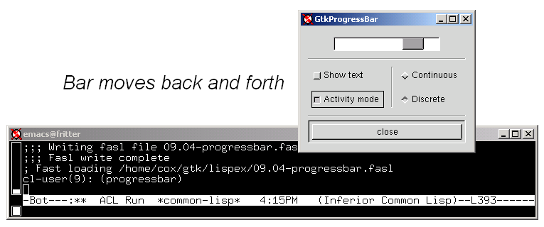
Screen Shot Examples
progressbar (cont.)

Slide 26
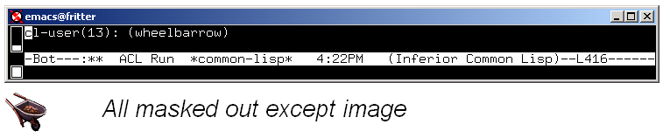
Screen Shot Examples
wheelbarrow

Slide 27
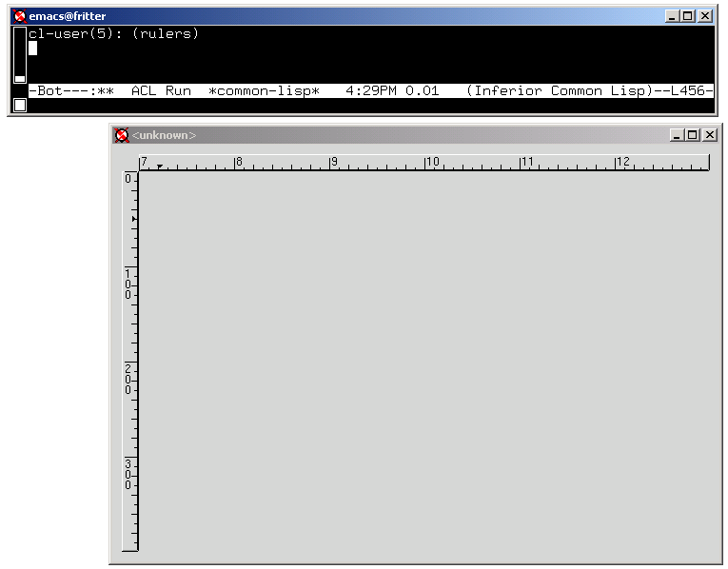
Screen Shot Examples
rulers
Mouse location

Slide 28
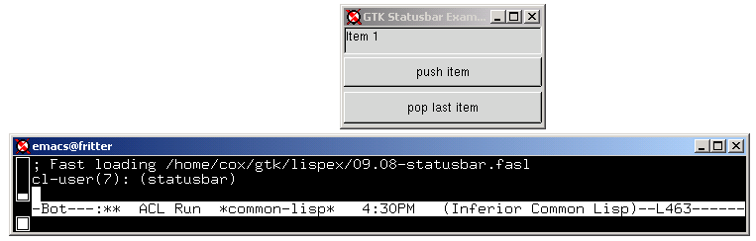
Screen Shot Examples
statusbar

Slide 29
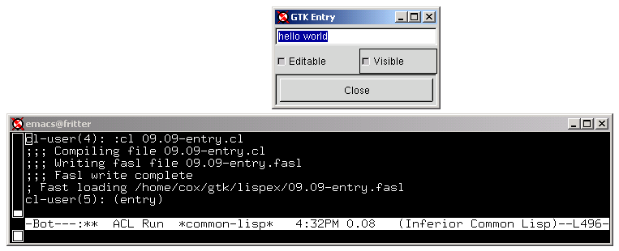
Screen Shot Examples
entry

Slide 30
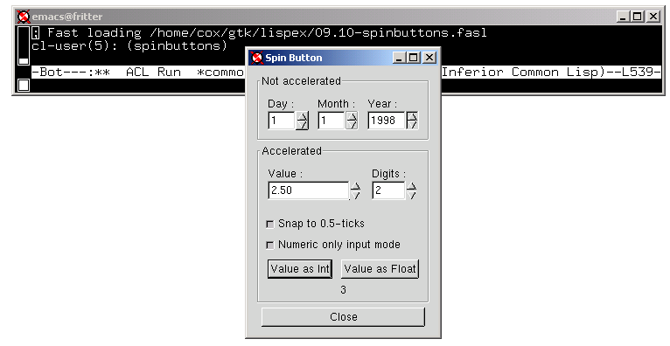
Screen Shot Examples
spinbuttons

Slide 31
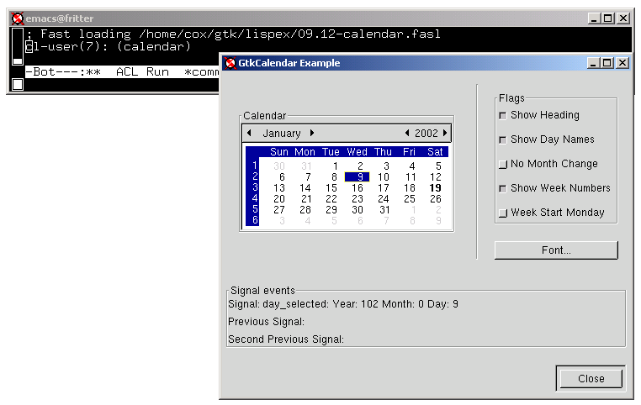
Screen Shot Examples
calendar

Slide 32
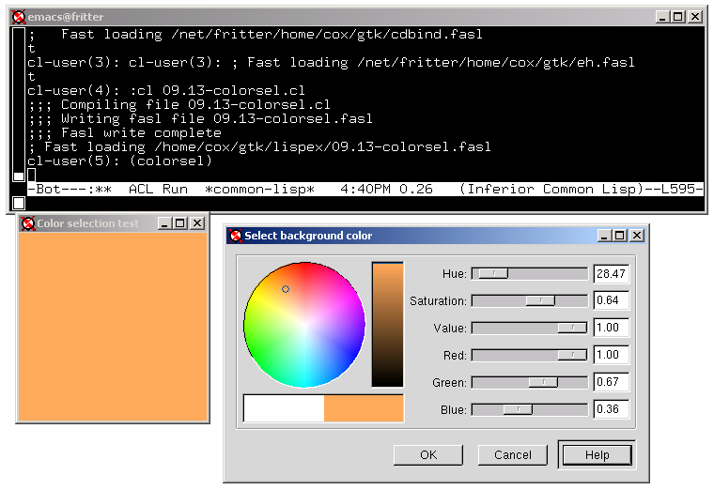
Screen Shot Examples
colorsel

Slide 33
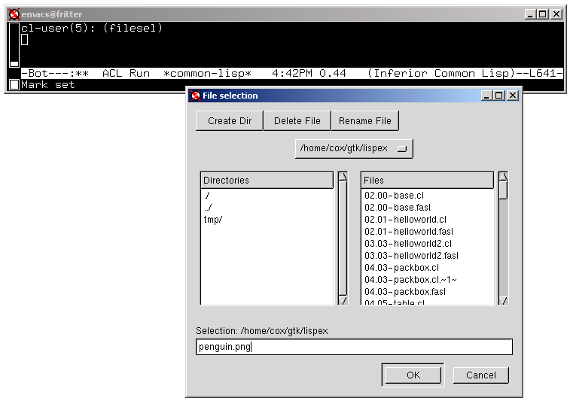
Screen Shot Examples
filesel

Slide 34
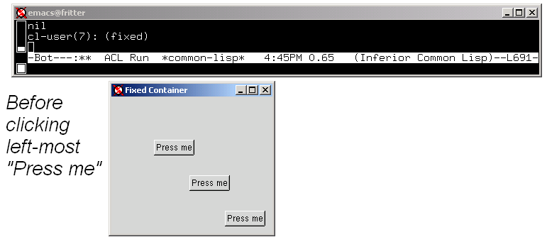
Screen Shot Examples
fixed

Slide 35
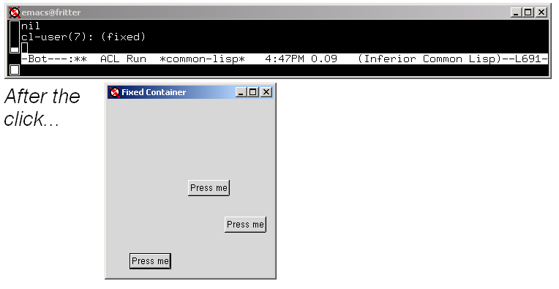
Screen Shot Examples
fixed (cont.)

Slide 36
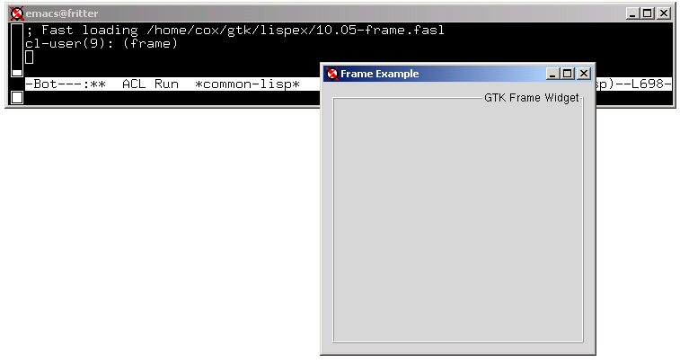
Screen Shot Examples
frame

Slide 37
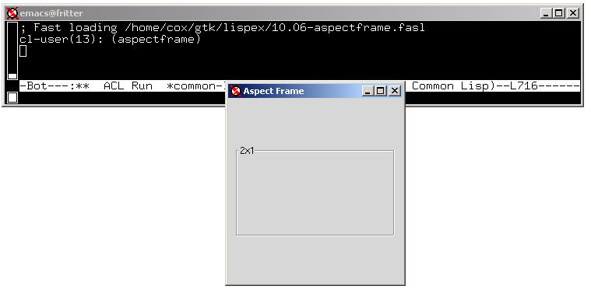
Screen Shot Examples
aspectframe

Slide 38
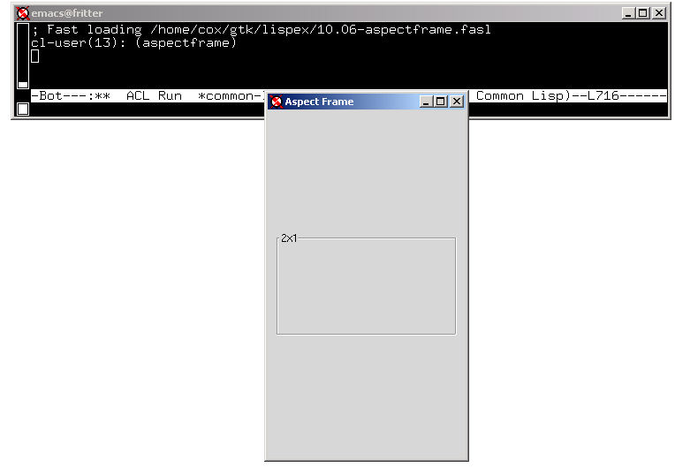
Screen Shot Examples
aspectframe (cont.)

Slide 39
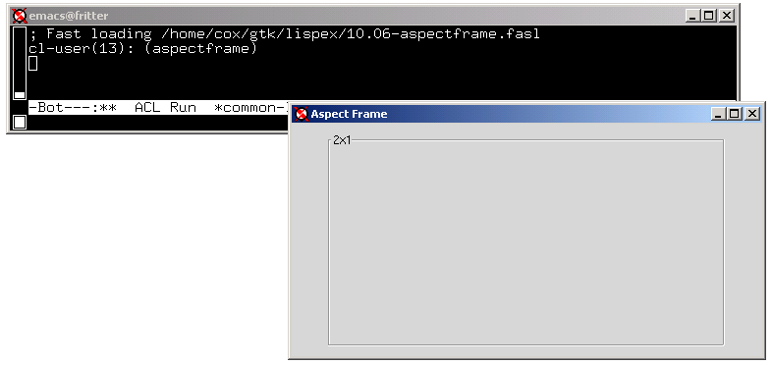
Screen Shot Examples
aspectframe (cont.)

Slide 40
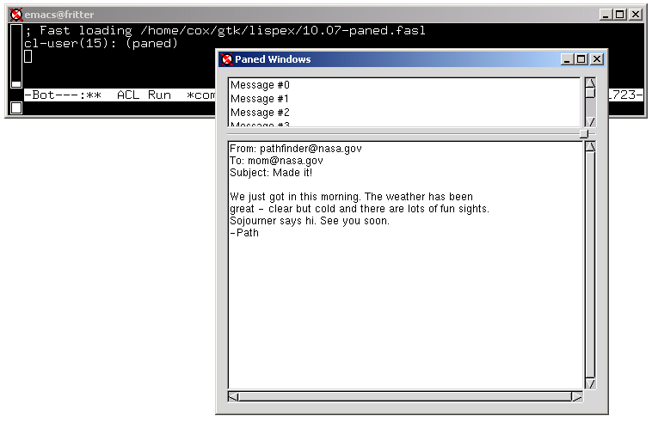
Screen Shot Examples
paned

Slide 41
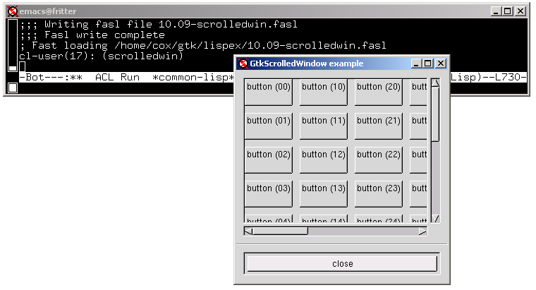
Screen Shot Examples
scrolledwin

Slide 42
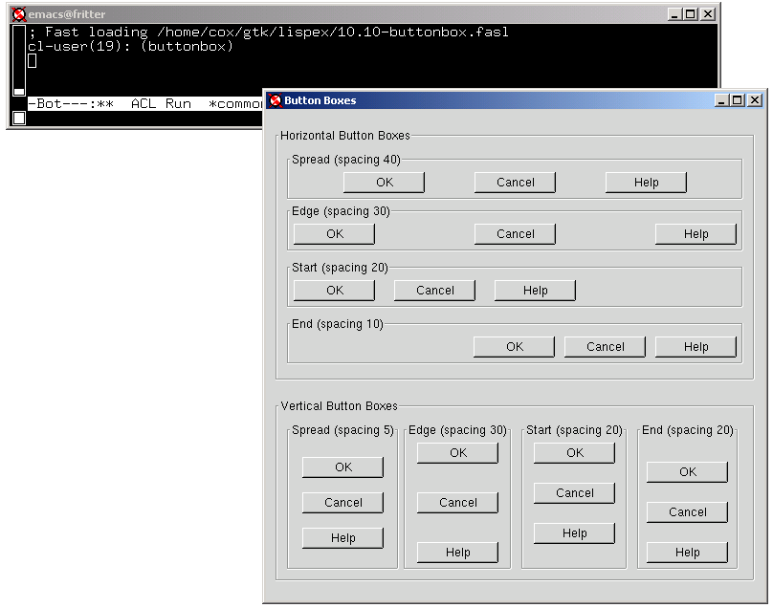
Screen Shot Examples
buttonbox

Slide 43
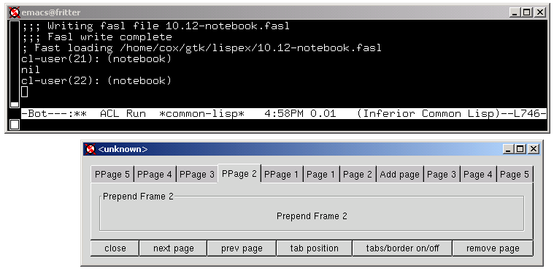
Screen Shot Examples
notebook

Slide 44
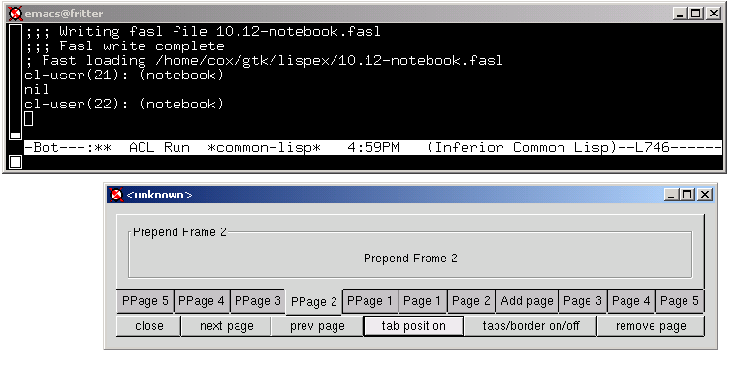
Screen Shot Examples
notebook (cont.)

Slide 45
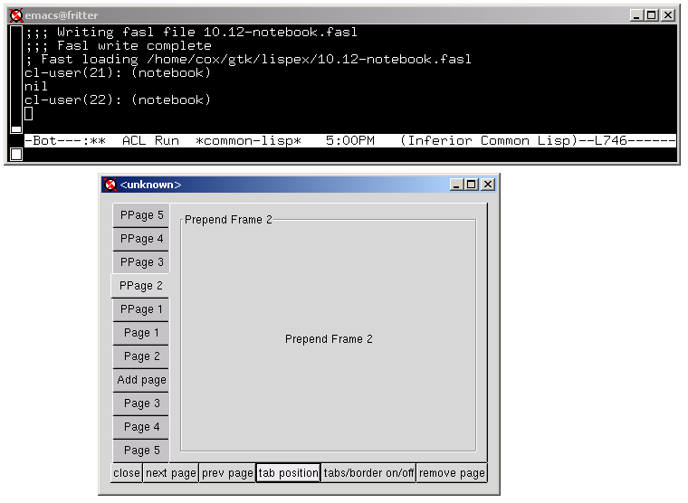
Screen Shot Examples
notebook (cont.)

Slide 46
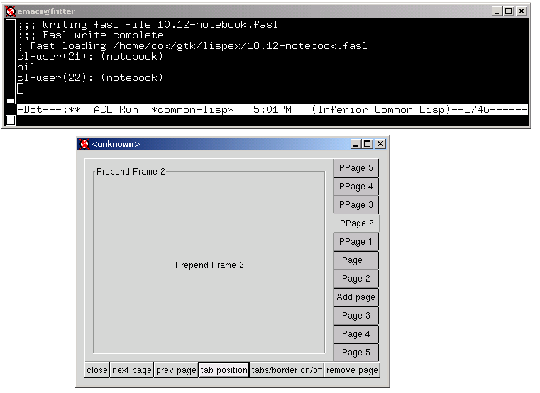
Screen Shot Examples
notebook (cont.)

Slide 47
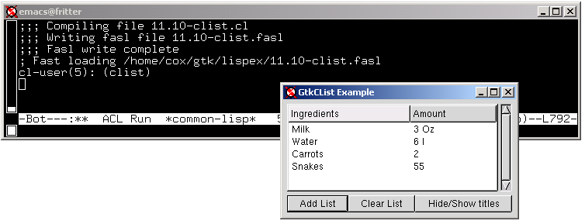
Screen Shot Examples
clist
  Lisp example contains list → clist convertor.

Slide 48
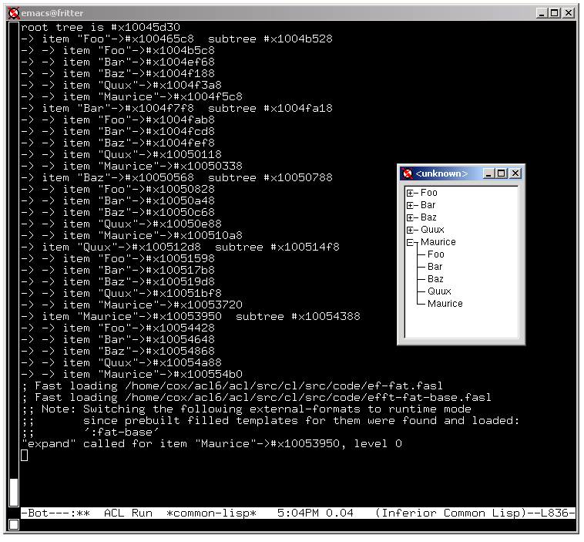
Screen Shot Examples
tree

Slide 49
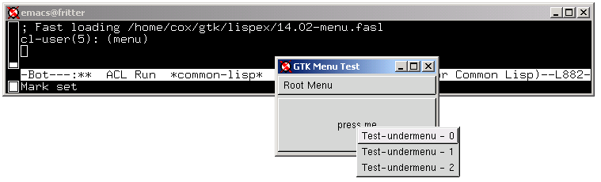
Screen Shot Examples
menu

Slide 50
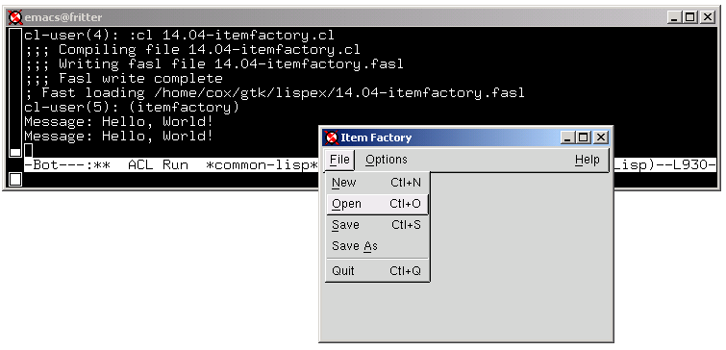
Screen Shot Examples
itemfactory

Slide 51
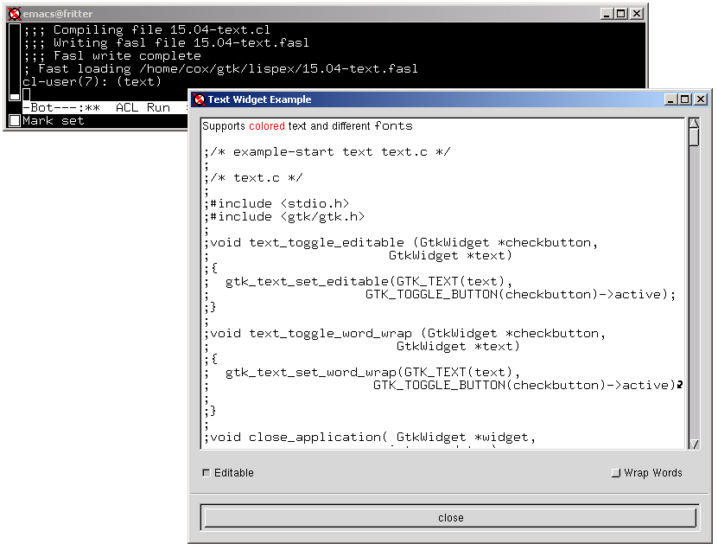
Screen Shot Examples
text

Slide 52
Code Example: base
base.c
#include <gtk/gtk.h>
int main( int argc,
char *argv[] )
{
GtkWidget *window;
gtk_init (&argc, &argv);
window = gtk_window_new (GTK_WINDOW_TOPLEVEL);
gtk_widget_show (window);
gtk_main ();
return(0);
}
base.cl
(defun base ()
(gtk:gtk_init 0 0)
(gtk:gtk_widget_show (gtk:gtk_window_new
gtk:GTK_WINDOW_TOPLEVEL))
#+original
;; have to kill lisp to stop
(gtk:gtk_main)
#-original (gtk:gtk-main))

Slide 53
Code Example: helloworld [excerpts]
Callback:
gint delete_event(GtkWidget *widget,
GdkEvent *event,
gpointer data)
{
g_print ("delete event occurred\n");
/* When FALSE, main window destroyed */
return(TRUE);
}
(ff:defun-foreign-callable delete-event
((widget (* gtk:GtkWidget))
(event (* gtk:GdkEvent))
(data (* gtk:gpointer)))
(declare (ignore widget event data))
(format t "~&Delete Event Called~%")
gtk:FALSE)

Slide 54
Code Example: Callback (cont.)
helloworld.c
[...]
gtk_signal_connect (GTK_OBJECT (window), "delete_event",
GTK_SIGNAL_FUNC (delete_event), NULL);
[...]
helloworld.cl
[...]
(gtk:gtk_signal_connect
(gtk:GTK_OBJECT window)
"delete_event"
(gtk:GTK_SIGNAL_FUNC
(ff:register-foreign-callable 'delete-event))
gtk:NULL)
[...]

Slide 55
Implementation
Three files:
  gtk.so
  gtk.cl (.fasl)
  eh.cl (.fasl)
Steps to use Allegro CL GTK+ interface in fresh lisp:
  (load "gtk.so")
  (load (compile-file-if-needed "gtk.cl"))
  (load (compile-file-if-needed "eh.cl"))

Slide 56
gtk.so
A stub shared-library object file used to pull GTK+ routines into Lisp.
Generation:
  Solaris:
    ld -G -o gtk.so `gtk-config --libs`
  Linux:
    ld -shared -o gtk.so `gtk-config --libs | \ sed -e 's/-rdynamic//'`

Slide 57
gtk.so (cont.)
Generation (cont.):
  LD_LIBRARY_PATH needs to be correct to find gtk libraries.
    Linux usually has GTK+ installed, so not normally a problem.

Slide 58
gtk.cl
Originally, this is the Lisp output file from Cbind.
Heavily modified to include macros and other definitions not handled by Cbind.
An entire copy of the original Cbind Lisp output is included at the end of gtk.cl as a comment.
  To be used as a possible comparison base if Cbind is run again.

Slide 59
gtk.cl (cont.)
Generation with Cbind:
  Using C file, base.c, which has #include <gtk/gtk.h>
(ff:build-c-binding
"base.c"
;; c-args is 'gtk-config --cflags' output
:c-args "-I.../gtk-1.2 -I.../glib-1.2 -I.../lib/glib/include ..."
:lisp-out "base-lisp-out.cl"
:c-out "base-c-out.c"
:package (find-package :gtk))

Slide 60
gtk.cl (cont.)
Generation with Cbind (cont.):
  Many hundreds of macros in gtk.h. Fortunately, many follow patterns; so I was able to use emacs to generate Lisp versions for most macros.
  gtk.h includes glib.h.
    Glib is a general C library.
    GTK+ uses some structures from Glib (e.g., clists).
    Most glib C macros remain untranslated for Lisp. Those required by GTK+ (e.g., clists), have been translated on an as-needed basis.

Slide 61
gtk.cl (cont.)
Filed bugs:
  [bug11046] cbind dummy forward-struct
    Fixed by mm.
    Pre-fix workaround is still being used in gtk.cl
  [bug11329] defun-foreign-callable - allow or forbid :int arg type
    Dispatched to Duane. I have a workaround in Lisp.
    Bug needs to be fixed or workaround must be installed for some examples to run.

Slide 62
gtk.cl (cont.)
Filed bugs (cont.):
  [bug11472] callbacks mishandle (* :char)
    Dispatched to Duane. I have workaround in Lisp.
    Bug needs to be fixed or workaround must be installed for some examples to run.

Slide 63
eh.cl
Provide support for Allegro CL Multiprocessing.
Unlike Windows, where event-handlers can run in separate OS threads, waiting for GTK+ events on Unix can freeze entire Lisp.
  Sigio technique used by xcw appears not to be applicable to GTK+.
By looking at GTK+ source code, I’ve found a C global variable which holds the file descriptor for X events.
  Only “internal” part of GTK+ to which I’ve referred.

Slide 64
eh.cl (cont.)
;; gtk:gtk-main is meant to be a substitute for gtk:gtk_main.
;; gtk:gtk-main-quit is meant to be a substitute for
;; gtk:gtk_main_quit.
(defun gtk-events-pending ()
(not (eq gtk:NULL (gtk:gtk_events_pending))))
(let ((.gtk-main-counter. 0))
(defun gtk-main ()
(let ((gtk-main-counter (incf .gtk-main-counter.)))
(loop
(if* (gtk-events-pending)
then (gtk:gtk_main_iteration_do gtk:NULL)
elseif (<= gtk-main-counter .gtk-main-counter.)
then (mp:wait-for-input-available (ff:fslot-value-typed
'gtk:GPollFD :c
(ff:get-entry-point
"event_poll_fd")
'gtk::fd))
else (return-from gtk-main)))))
(defun gtk-main-quit ()
(decf .gtk-main-counter.)))

Slide 65
Gtk directory organization.
Original Cbind output files:
  base-c-out.c
  base-lisp-out.cl
Cbind runtime support files:
  cdbind.cl
Original GTK+ downloads:
  download/

Slide 66
Gtk directory organization (cont.)
GTK+ Runtime Support:
  eh.cl
  gtk.cl
Platform-specific directories
  fox/
  fritter/
  spot/
  […]

Slide 67
Gtk directory organization (cont.)
Notes on building GTK+
  gtk-build.txt
Example Screen Shots
  gtk-screen-shots.zip
GTK+ Lisp Examples:
  lispex/

Slide 68
Gtk directory organization (cont.)
Hand Notes Files:
  notes.txt
  report.txt
  gtk.ppt
GTK Build support files:
  setup.template

Slide 69
Conclusion
On to Ken...

