Slide 1
Lattice QCD for Novices
A C++ Project to Provide Solutions to the article “Lattice QCD for Novices”, by G.P. Lepage

Slide 2
1D Path Integrals
Theoretical background, Montecarlo Method, Exercises Solutions

Slide 3
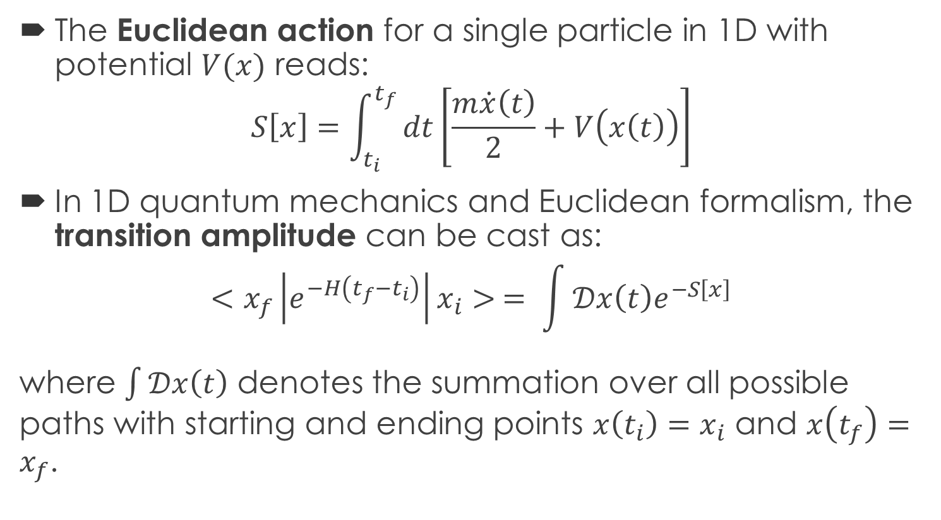
1D Quantum Mechanics: Path Integration
The Euclidean action for a single particle in 1D with potential $V(x)$ reads:
$$S\left[x\right]=\int_{t_{i}}^{t_{f}}{dt\left[\frac{m\dot{x}\left(t\right)}{2}+V\left(x\left(t\right)\right)\right]}$$
In 1D quantum mechanics and Euclidean formalism, the transition amplitude can be cast as:
$$<x_{f}\left|e^{−H\left(t_{f}−t_{i}\right)}\right|x_{i}> = \int{𝒟x\left(t\right)e^{−S\left[x\right]}}$$
where $\int{𝒟x\left(t\right)}$ denotes the summation over all possible paths with starting and ending points $x\left(t_{i}\right)=x_{i}$ and $x\left(t_{f}\right)=x_{f}$.

Slide 4
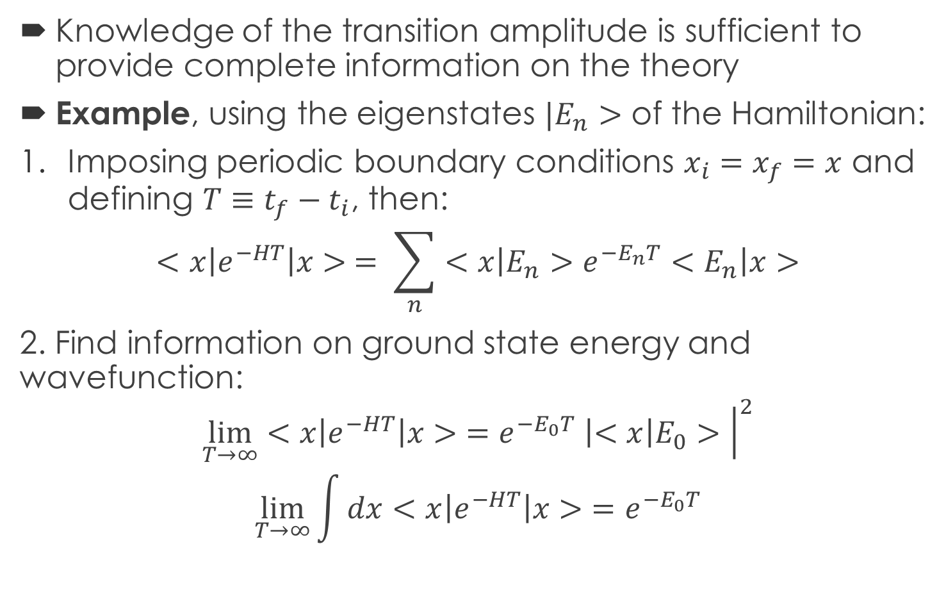
1D QM: Path Integration
Knowledge of the transition amplitude is sufficient to provide complete information on the theory
Example, using the eigenstates $|E_{n}>$ of the Hamiltonian:
Imposing periodic boundary conditions $x_{i}=x_{f}=x$ and defining $T≡t_{f}−t_{i}$, then:
$$<x\left|e^{−HT}\right|x> = \sum_{n}{<x\left|E_{n}>e^{−E_{n}T}<E_{n}\right|x>}$$
2. Find information on ground state energy and wavefunction:
$$\lim_{T→∞}{<x\left|e^{−HT}\right|x>}=e^{−E_{0}T} \left|<x\right|E_{0}>{\left.​\right|}^{2}$$
$$\lim_{T→∞}{\int{dx}<x\left|e^{−HT}\right|x>}=e^{−E_{0}T}$$

Slide 5
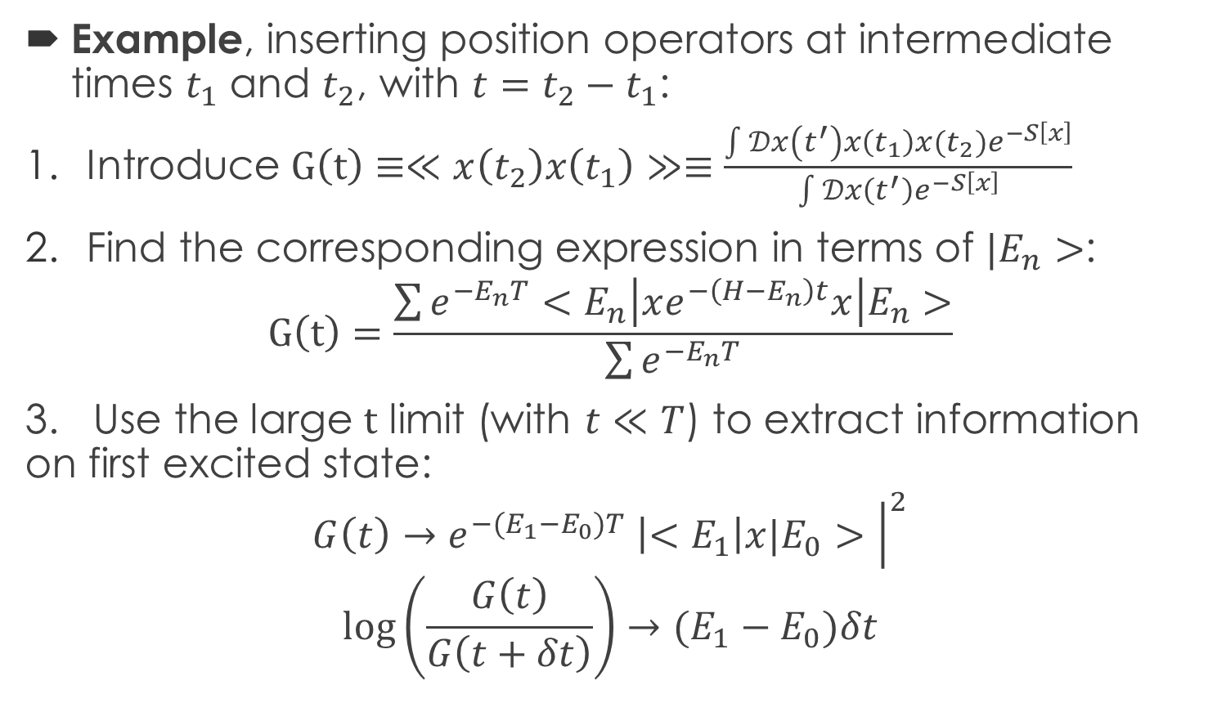
1D QM: Path Integration
Example, inserting position operators at intermediate times $t_{1}$ and $t_{2}$, with $t=t_{2}−t_{1}$:
Introduce $G\left(t\right)≡≪x\left(t_{2}\right)x\left(t_{1}\right)≫≡\frac{\int{𝒟x\left(t^{′}\right){x\left(t_{1}\right)x(t_{2})e}^{−S\left[x\right]}}}{\int{𝒟x\left(t^{′}\right)e^{−S\left[x\right]}}}$
Find the corresponding expression in terms of $|E_{n}>$:
$$G\left(t\right)=\frac{\sum{e^{−E_{n}T}}<E_{n}\left|xe^{−\left(H−E_{n}\right)t}x\right|E_{n}>}{\sum{e^{−E_{n}T}}}$$
3. Use the large $t$ limit (with $t≪T$) to extract information on first excited state:
$$G\left(t\right)→e^{−{(E_{1}−E}_{0})T} \left|<E_{1}\right|x|E_{0}>{\left.​\right|}^{2}$$
$$\log\left(\frac{G\left(t\right)}{G\left(t+δt\right)}\right)→(E_{1}−E_{0})δt$$

Slide 6
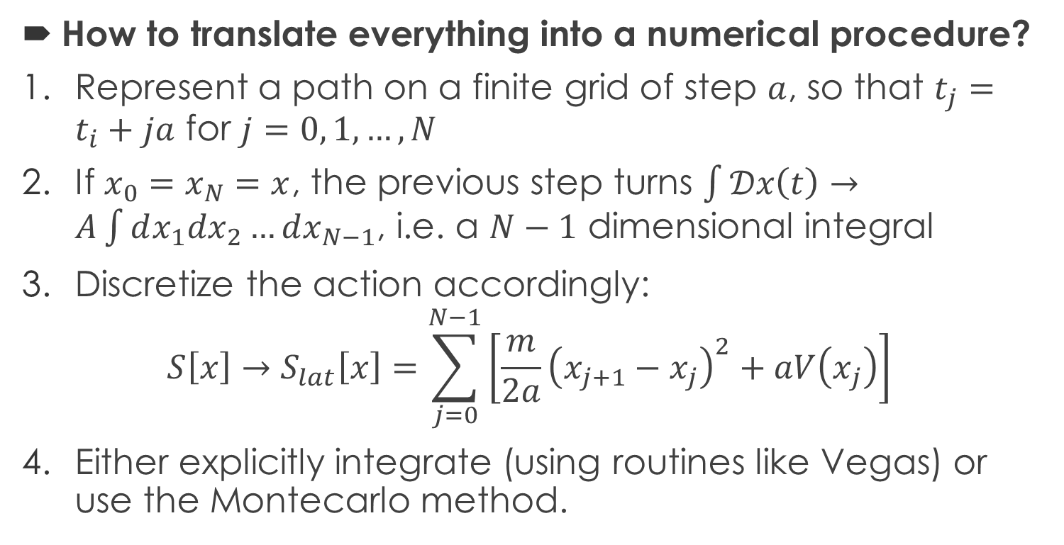
1D QM: Path Integration
How to translate everything into a numerical procedure?
Represent a path on a finite grid of step $a$, so that $t_{j}=t_{i}+ja$ for $j=0, 1,…,N$
If $x_{0}=x_{N}=x$, the previous step turns $\int{𝒟x\left(t\right)}→A\int{dx_{1}dx_{2}…dx_{N−1}}$, i.e. a $N−1$ dimensional integral
Discretize the action accordingly:
$$S\left[x\right]→S_{lat}\left[x\right]=\sum_{j=0}^{N−1}{\left[\frac{m}{2a}{\left(x_{j+1}−x_{j}\right)}^{2}+aV\left(x_{j}\right)\right]}$$
Either explicitly integrate (using routines like Vegas) or use the Montecarlo method.

Slide 7
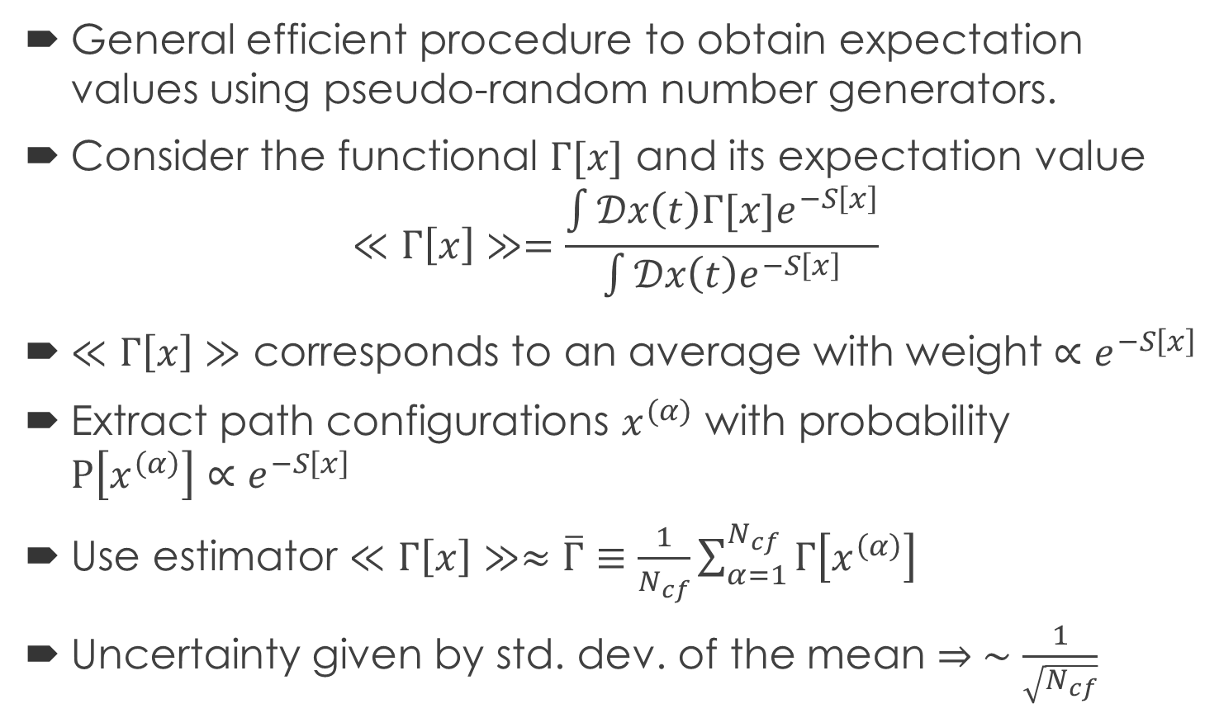
1D QM: Montecarlo Method
General efficient procedure to obtain expectation values using pseudo-random number generators.
Consider the functional $Γ[x]$ and its expectation value
$$≪Γ\left[x\right]≫=\frac{\int{𝒟x\left(t\right){Γ[x]e}^{−S\left[x\right]}}}{\int{𝒟x\left(t\right)e^{−S\left[x\right]}}}$$
$≪Γ\left[x\right]≫$ corresponds to an average with weight $∝e^{−S\left[x\right]}$
Extract path configurations $x^{(α)}$ with probability $P\left[x^{\left(α\right)}\right]{∝e}^{−S\left[x\right]}$
Use estimator $≪Γ\left[x\right]≫≈\overline{Γ}≡\frac{1}{N_{cf}}\sum_{α=1}^{N_{cf}}{Γ\left[x^{\left(α\right)}\right]}$
Uncertainty given by std. dev. of the mean $⇒ ∼\frac{1}{\sqrt{N_{cf}}}$

Slide 8


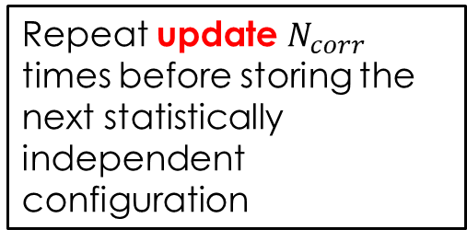

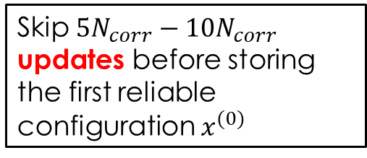




1D QM: Metropolis Algorithm
Start from arbitrary path configuration $x^{(start)}$
Generate $ζ∼Uni\left(−ε,ε\right)$ with $ε$ constant typical update size
Skip $5N_{corr}−10N_{corr}$ updates before storing the first reliable configuration $x^{(0)}$
Repeat for every site in the lattice
Replace $x_{j}→x_{j}+ζ$, compute action change $ΔS$
$$ΔS<0$$
Repeat update $N_{corr}$ times before storing the next statistically independent configuration
True
Accept
False
generate $η\sim Uni(0,1)$
True
Accept
Lattice update to get next configuration
$$e^{−ΔS}>η$$
Do $N_{cf}−1$ times
False
Reject
End

Slide 9
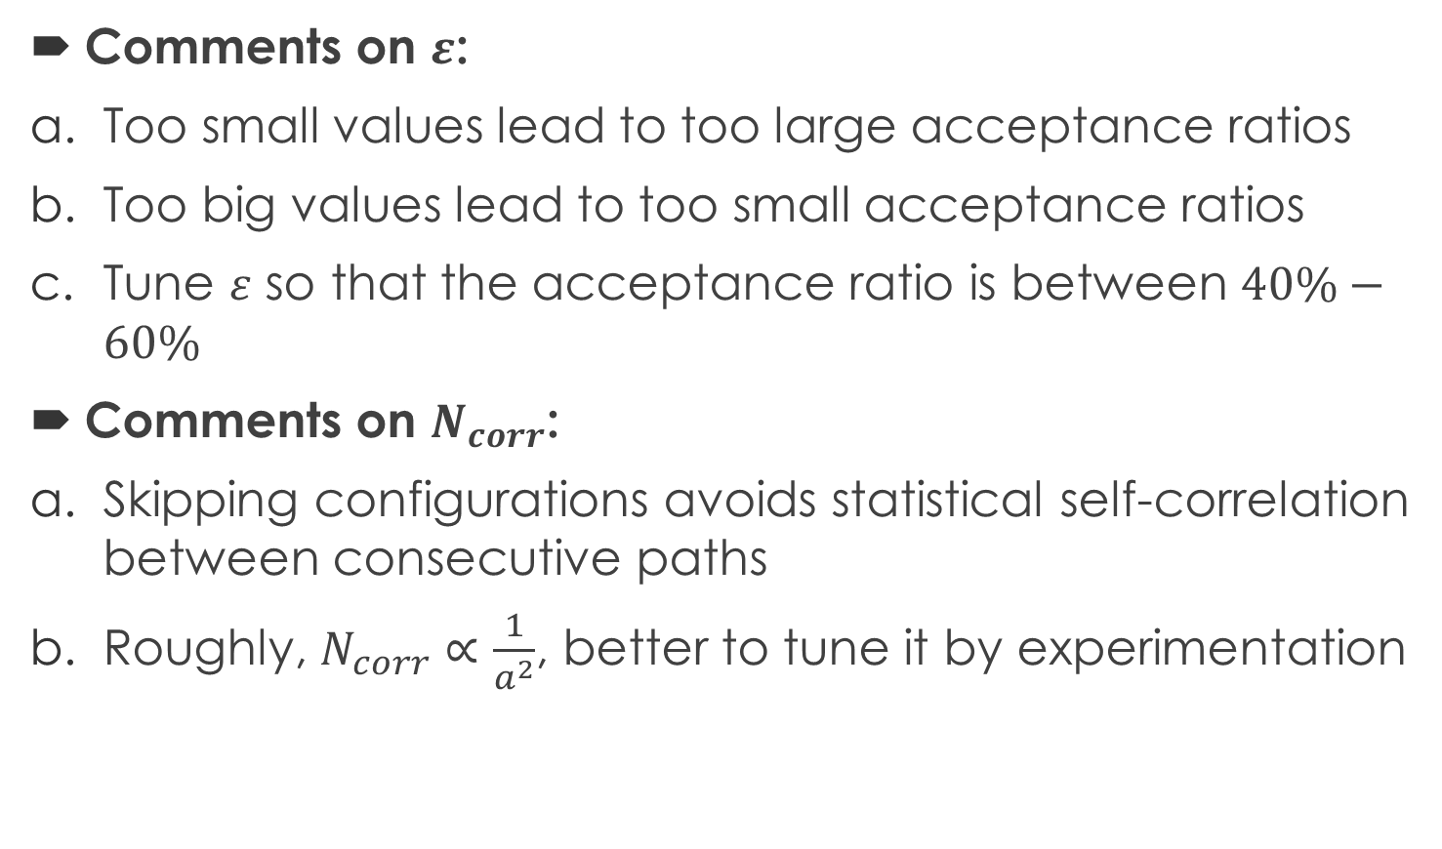
1D QM: Metropolis Algorithm
Comments on $ε$:
Too small values lead to too large acceptance ratios
Too big values lead to too small acceptance ratios
Tune $ε$ so that the acceptance ratio is between $40\%−60\%$
Comments on $N_{corr}$:
Skipping configurations avoids statistical self-correlation between consecutive paths
Roughly, $N_{corr}∝\frac{1}{a^{2}}$, better to tune it by experimentation

Slide 10
1D QM: Statistical Bootstrap
How to provide estimates of statistical errors?
Either repeat the whole experiment multiple times
OR
Use the statistical bootstrap:
Build a copy of the set of configurations by randomly picking paths from the original set (allow for repetitions and omissions)
Build a set of bootstrap copies in this way
Evaluate variance of the observables among the different bootstrap copies

Slide 11
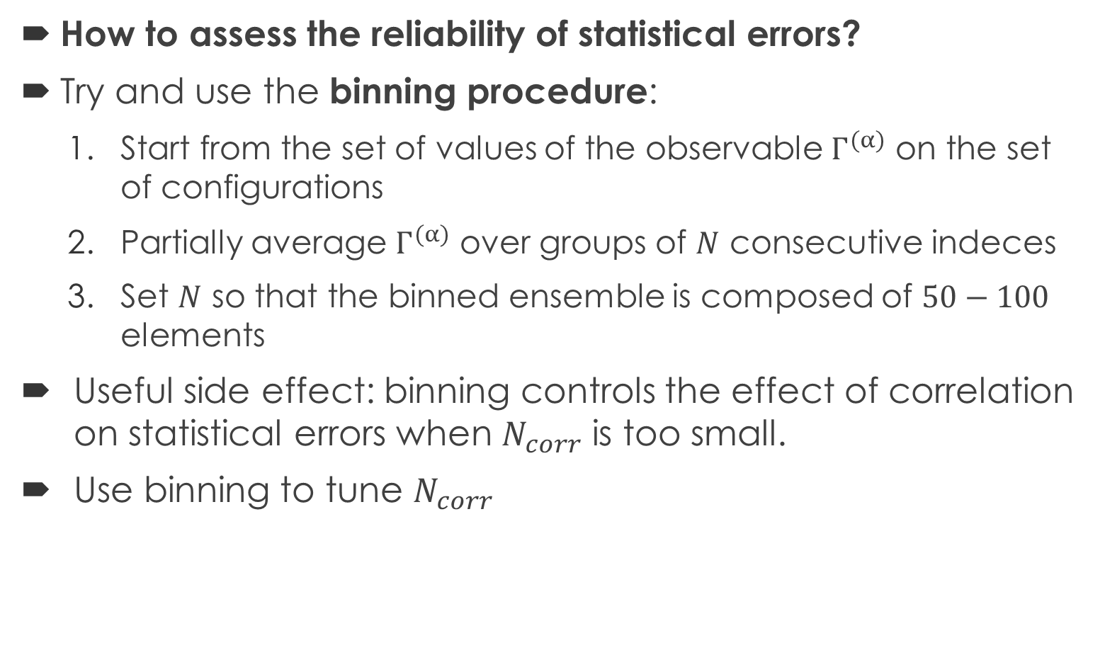
1D QM: Binning Procedure
How to assess the reliability of statistical errors?
Try and use the binning procedure:
Start from the set of values of the observable $Γ^{(α)}$ on the set of configurations
Partially average $Γ^{(α)}$ over groups of $N$ consecutive indeces
Set $N$ so that the binned ensemble is composed of $50−100$ elements
Useful side effect: binning controls the effect of correlation on statistical errors when $N_{corr}$ is too small.
Use binning to tune $N_{corr}$

Slide 12
1D QM Exercise: Vegas Integration
C++ code to reproduce first exercise of the article and explicitly path integrate a quantum 1D system:
C++ provides high performances
C++ was the best choice for later QCD applications, so useful to practice in a simpler context
Library for integration: GSL, using the Vegas routine
See the code documentation: HTML_Documentation
Routine to produce plots: Python and Root

Slide 13
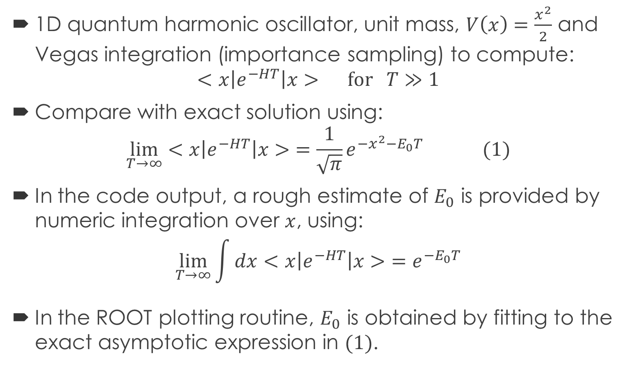
1D QM Exercise: Vegas Integration
1D quantum harmonic oscillator, unit mass, $V\left(x\right)=\frac{x^{2}}{2}$ and Vegas integration (importance sampling) to compute:
$$<x\left|e^{−HT}\right|x> for T≫1$$
Compare with exact solution using:
$$\lim_{T→∞}{<x\left|e^{−HT}\right|x>}=\frac{1}{\sqrt{π}}e^{−x^{2}−E_{0}T} (1)$$
In the code output, a rough estimate of $E_{0}$ is provided by numeric integration over $x$, using:
$$\lim_{T→∞}{\int{dx}<x\left|e^{−HT}\right|x>}=e^{−E_{0}T}$$
In the ROOT plotting routine, $E_{0}$ is obtained by fitting to the exact asymptotic expression in $(1)$.

Slide 14
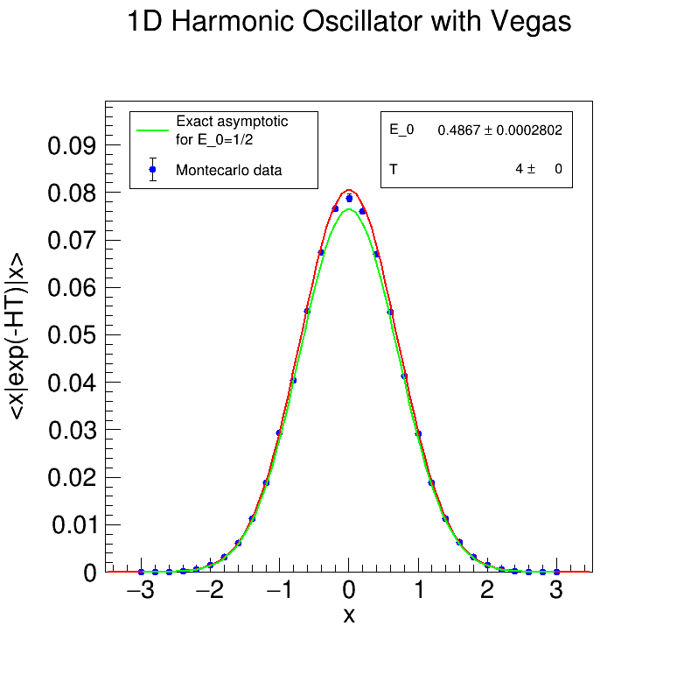
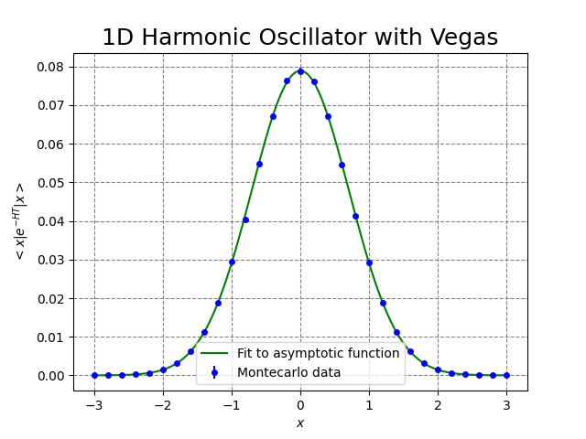
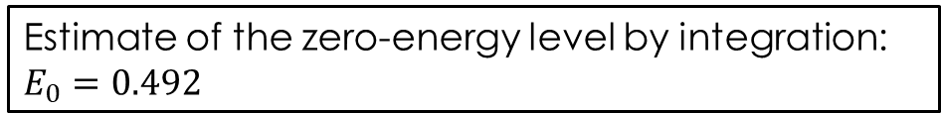
Root plot
Python plot
Reference directory:
/Experiments/Vegas_Integration/1D_Harmonic_Oscillator
Estimate of the zero-energy level by integration: $E_{0}=0.492$

Slide 15
1D QM Exercise: Metropolis Algorithm
C++ code to reproduce the second excercise in the article
1D quantum system is path integrated using the Montecarlo algorithm to provide estimates of first excited state energy gap.
C++ provides high performances
C++ was the best choice for later QCD applications, so useful to practice in a simpler context: building the Metropolis class
See the code documentation: HTML_Documentation
Routine to produce plots: Python and Root

Slide 16
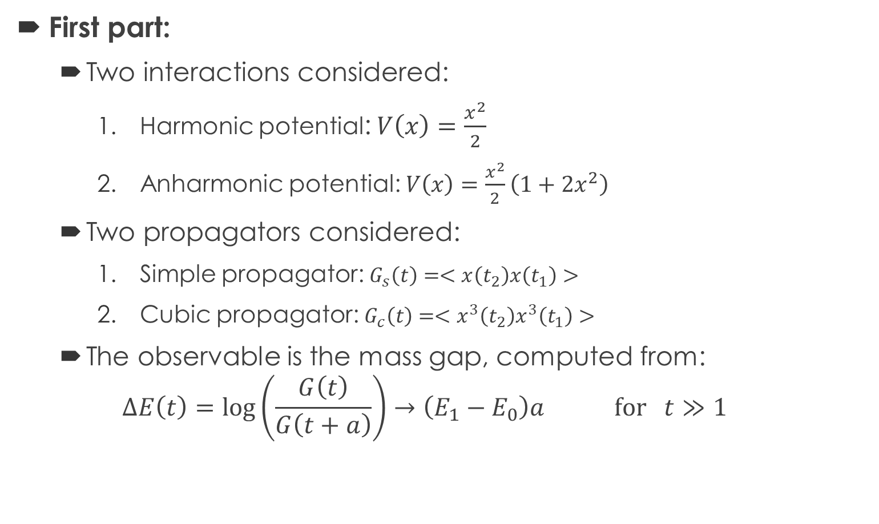
1D QM Exercise: Metropolis Algorithm
First part:
Two interactions considered:
Harmonic potential: $V\left(x\right)=\frac{x^{2}}{2}$
Anharmonic potential: $V\left(x\right)=\frac{x^{2}}{2}\left(1+2x^{2}\right)$
Two propagators considered:
Simple propagator: $G_{s}\left(t\right)=<x\left(t_{2}\right)x\left(t_{1}\right)>$
Cubic propagator: $G_{c}\left(t\right)=<x^{3}\left(t_{2}\right)x^{3}\left(t_{1}\right)>$
The observable is the mass gap, computed from:
$$∆E\left(t\right)=\log\left(\frac{G\left(t\right)}{G\left(t+a\right)}\right)→\left(E_{1}−E_{0}\right)a for t≫1$$
Reference directories:
/Experiments/1D_Path_Integral/Harmonic_*
/Experiments/1D_Path_Integral/Anharmonic_*

Slide 17
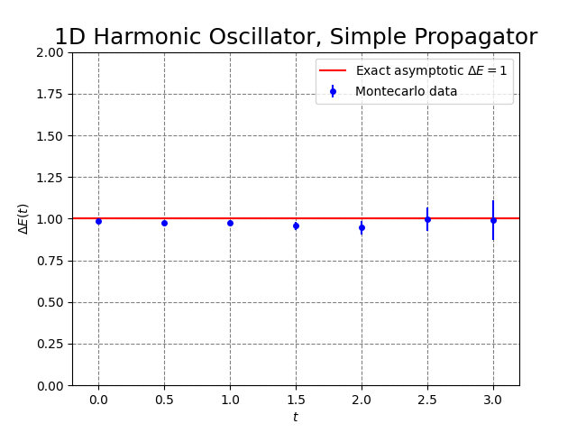
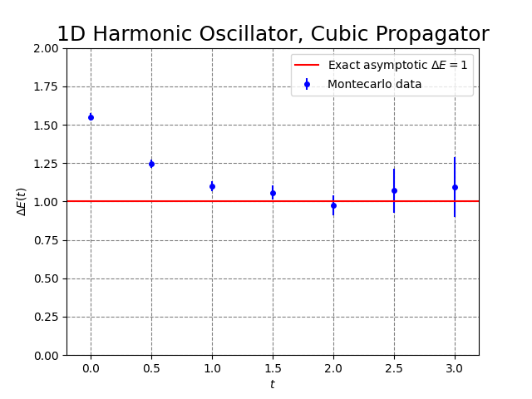
Simple propagator:
Slower convergence
Approaching the asymptotic value from above
Cubic propagator:
Slower convergence
Approaching the asymptotic value from above

Slide 18
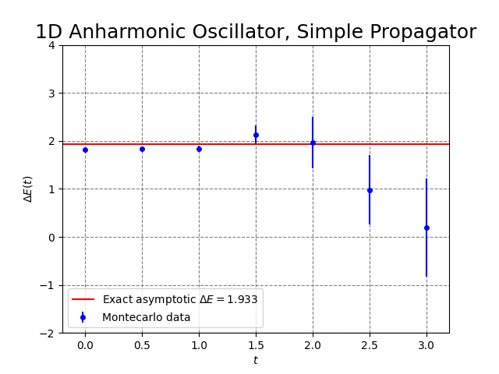
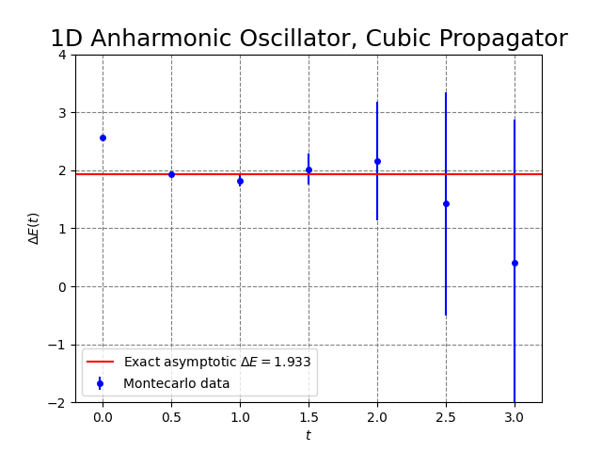
Simple propagator
Cubic propagator

Slide 19
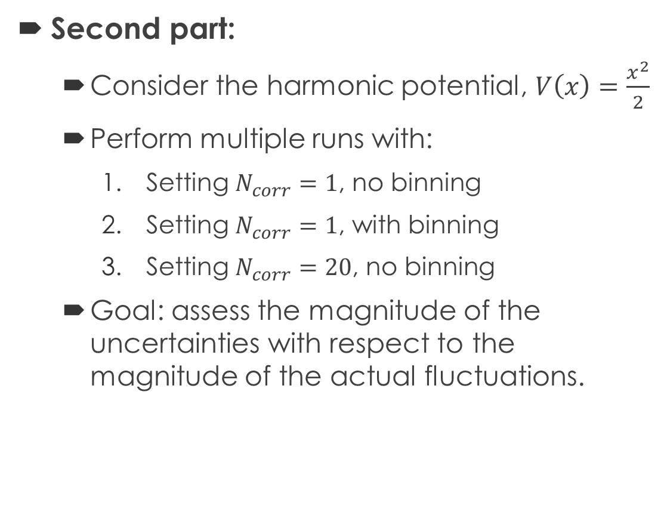
1D QM Exercise: Metropolis Algorithm
Second part:
Consider the harmonic potential, $V\left(x\right)=\frac{x^{2}}{2}$
Perform multiple runs with:
Setting $N_{corr}=1$, no binning
Setting $N_{corr}=1$, with binning
Setting $N_{corr}=20$, no binning
Goal: assess the magnitude of the uncertainties with respect to the magnitude of the actual fluctuations.
Reference directories:
/Experiments/1D_Path_Integral/MultipleRun_1Ncorr_*
/Experiments/1D_Path_Integral/MultipleRun_20Ncorr_Harmonic_SimplePropagator

Slide 20



$N_{corr}=1$, no binning
$N_{corr}=1$, binning
$N_{corr}=20$, no binning

Slide 21
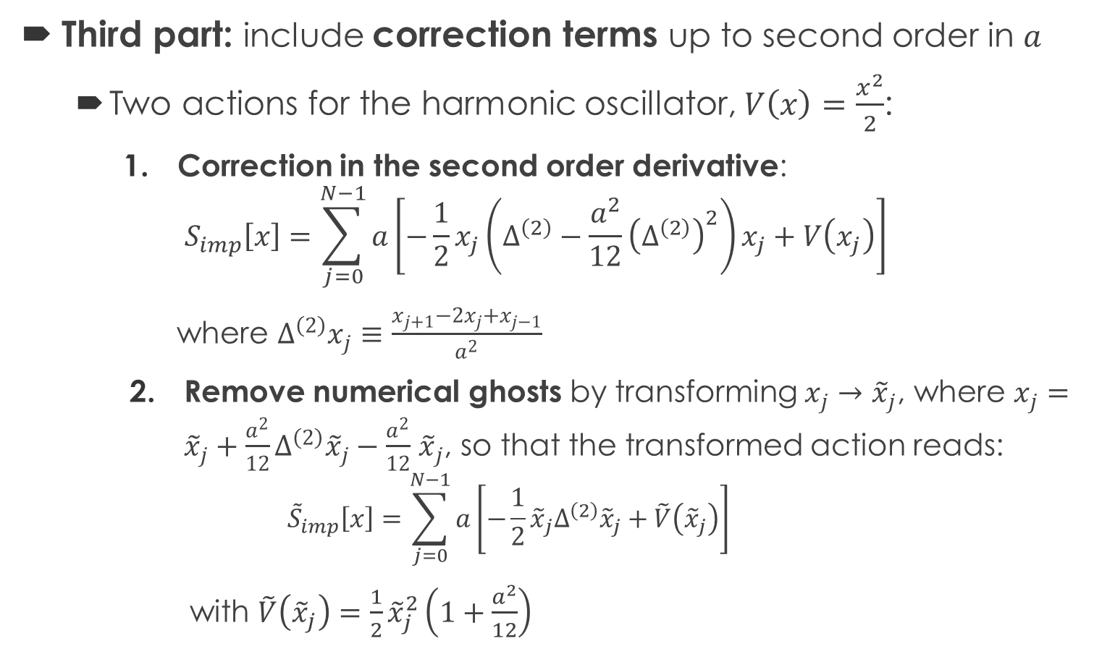
1D QM Exercise: Metropolis Algorithm
Third part: include correction terms up to second order in $a$
Two actions for the harmonic oscillator, $V\left(x\right)=\frac{x^{2}}{2}$:
Correction in the second order derivative:
$$S_{imp}\left[x\right]=\sum_{j=0}^{N−1}{a\left[−\frac{1}{2}x_{j}\left(Δ^{\left(2\right)}−\frac{a^{2}}{12}{\left(Δ^{\left(2\right)}\right)}^{2}\right)x_{j}+V\left(x_{j}\right)\right]}$$
where $Δ^{\left(2\right)}x_{j}≡\frac{x_{j+1}−2x_{j}+x_{j−1}}{a^{2}}$
Remove numerical ghosts by transforming $x_{j}→{\tilde{x}}_{j}$, where $x_{j}={\tilde{x}}_{j}+\frac{a^{2}}{12}Δ^{\left(2\right)}{\tilde{x}}_{j}−\frac{a^{2}}{12}$ ${\tilde{x}}_{j}$, so that the transformed action reads:
$${\tilde{S}}_{imp}\left[x\right]=\sum_{j=0}^{N−1}{a\left[−\frac{1}{2}{\tilde{x}}_{j}Δ^{\left(2\right)}{\tilde{x}}_{j}+\tilde{V}\left({\tilde{x}}_{j}\right)\right]}$$
with $\tilde{V}\left({\tilde{x}}_{j}\right)=\frac{1}{2}{\tilde{x}}_{j}^{2}\left(1+\frac{a^{2}}{12}\right)$
Numerical ghosts

Slide 22
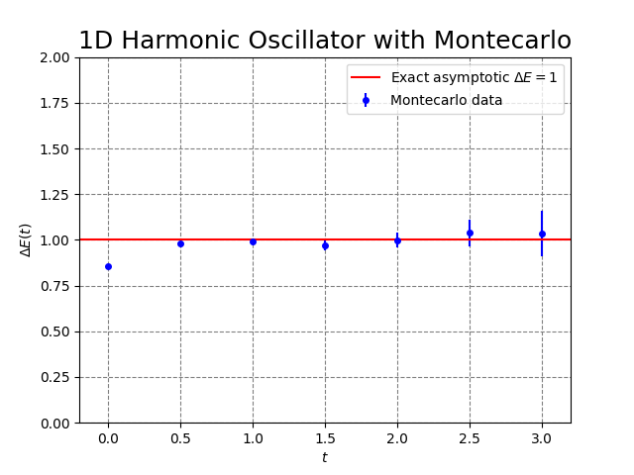
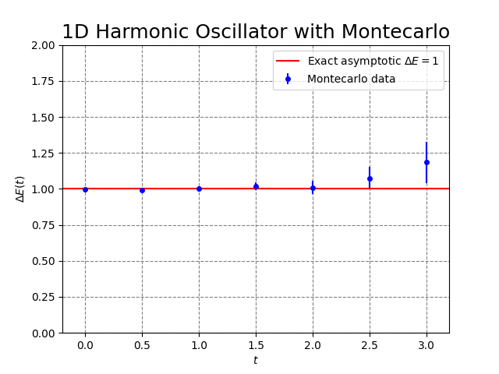
Reference directories:
/Experiments/1D_Path_Integral/ImpHarmonic_Ghosts
/Experiments/1D_Path_Integral/ImpHarmonic_NoGhosts
Improved second derivative:
Numerical ghost
Convergence from below
Ghost removed:
No numerical ghost
Still second order discretization

Slide 23
Lattice QCD
Theoretical Background, Exercises Solutions

Slide 24
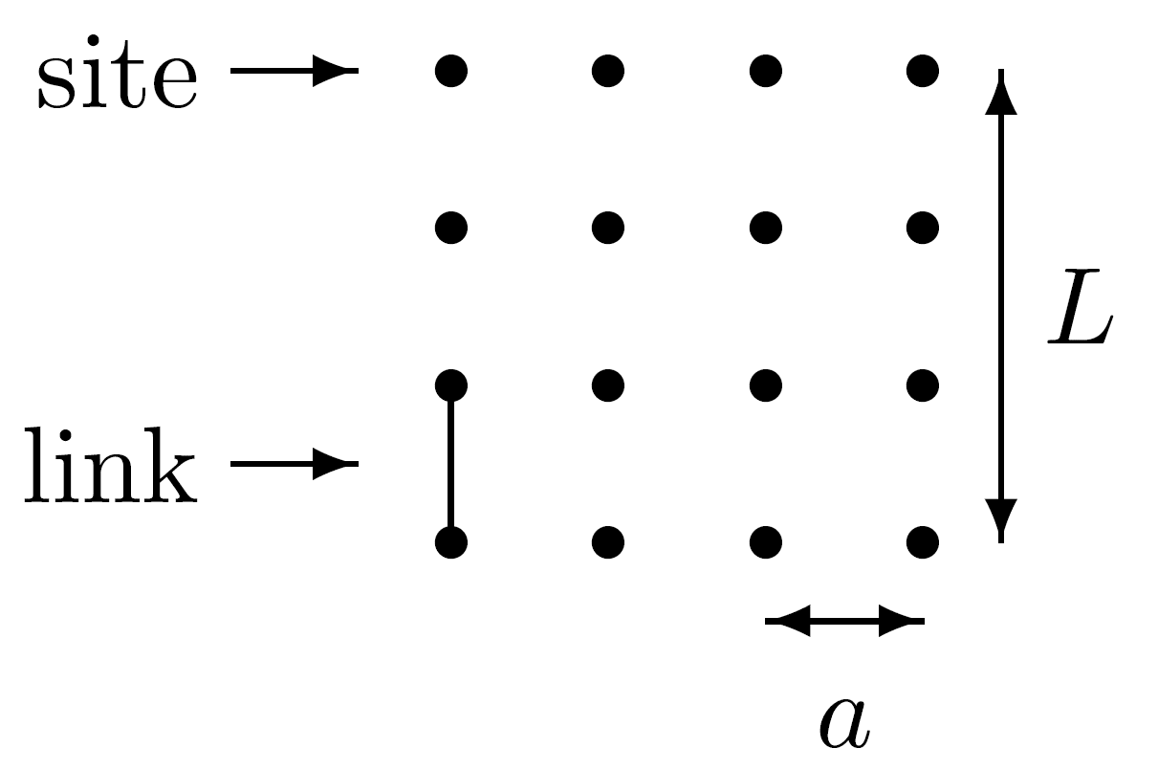
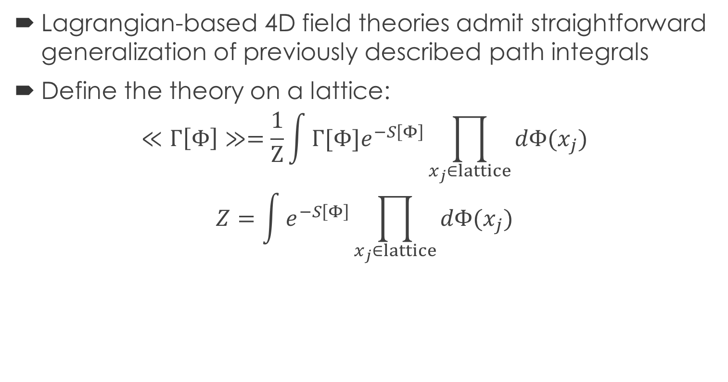
Lattice Field Theories: Path Integration
Lagrangian-based 4D field theories admit straightforward generalization of previously described path integrals
Define the theory on a lattice:
$$≪Γ\left[Φ\right]≫=\frac{1}{Z}\int{{Γ[Φ]e}^{−S\left[Φ\right]}\prod_{x_{j}∈lattice}{dΦ(x_{j})}}$$
$$Z=\int{e^{−S\left[Φ\right]}\prod_{x_{j}∈lattice}{dΦ(x_{j})}}$$
The Montecarlo method and the Metropolis algorithm, both generalize, too
Fig. from “Lattice QCD for Novices, G.P. Lepage (see Bibliography)

Slide 25

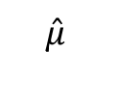
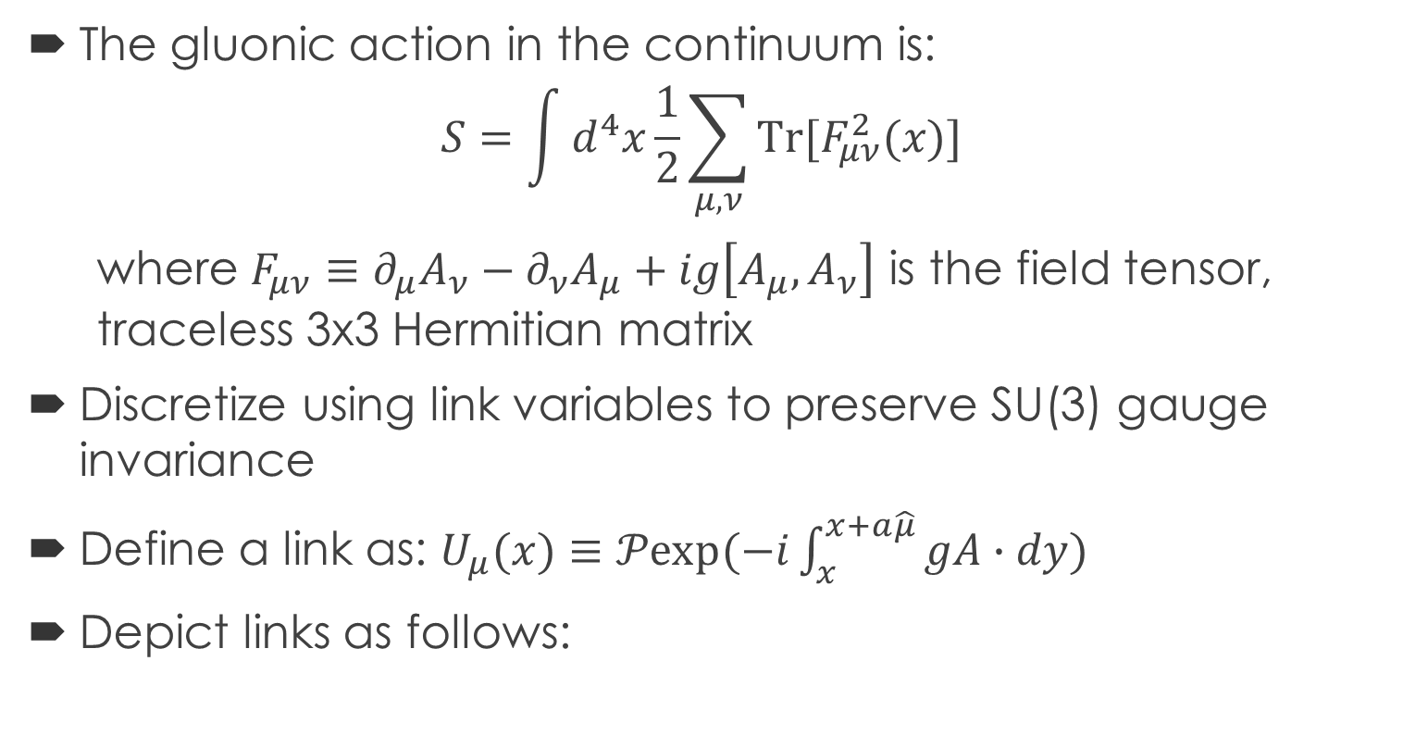



Lattice QCD: Lagrangian
The gluonic action in the continuum is:
$$S=\int{d^{4}x\frac{1}{2}\sum_{μ,ν}{Tr[F_{μν}^{2}(x)]}}$$
where $F_{μν}≡∂_{μ}A_{ν}−∂_{ν}A_{μ}+ig\left[A_{μ},A_{ν}\right]$ is the field tensor, traceless 3x3 Hermitian matrix
Discretize using link variables to preserve SU(3) gauge invariance
Define a link as: $U_{μ}(x)≡𝒫exp⁡(−i\int_{x}^{x+a\hat{μ}}{gA∙dy})$
Depict links as follows:
$$x_{2}$$
$$U_{μ}^{†}\left(x_{2}\right)$$
$$\hat{μ}$$
$$x_{1}$$
$$U_{μ}\left(x_{1}\right)$$

Slide 26


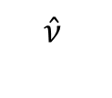
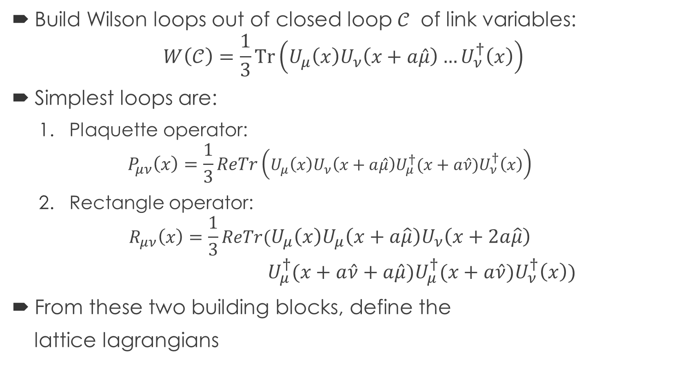
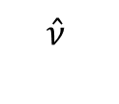
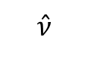
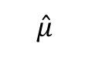
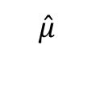
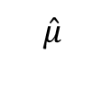
Lattice QCD: Lagrangian
Build Wilson loops out of closed loop $𝒞$ of link variables:
$$W\left(𝒞\right)=\frac{1}{3}Tr\left(U_{μ}\left(x\right)U_{ν}\left(x+a\hat{μ}\right)…U_{ν}^{†}\left(x\right)\right)$$
Simplest loops are:
Plaquette operator:
$$P_{μν}\left(x\right)=\frac{1}{3}ReTr\left(U_{μ}\left(x\right)U_{ν}\left(x+a\hat{μ}\right)U_{μ}^{†}(x+a\hat{ν})U_{ν}^{†}\left(x\right)\right)$$
Rectangle operator:
$$R_{μν}\left(x\right)=\frac{1}{3}ReTr(U_{μ}\left(x\right)U_{μ}\left(x+a\hat{μ}\right)U_{ν}\left(x+2a\hat{μ}\right)$$
$$U_{μ}^{†}(x+a\hat{ν}+a\hat{μ})U_{μ}^{†}(x+a\hat{ν})U_{ν}^{†}\left(x\right))$$
From these two building blocks, define the
lattice lagrangians
Plaquette
$$\hat{ν}$$
$$x$$
$$\hat{μ}$$
Rectangle
$$\hat{ν}$$
$$\hat{ν}$$
$$x$$
$$\hat{μ}$$
$$\hat{μ}$$

Slide 27
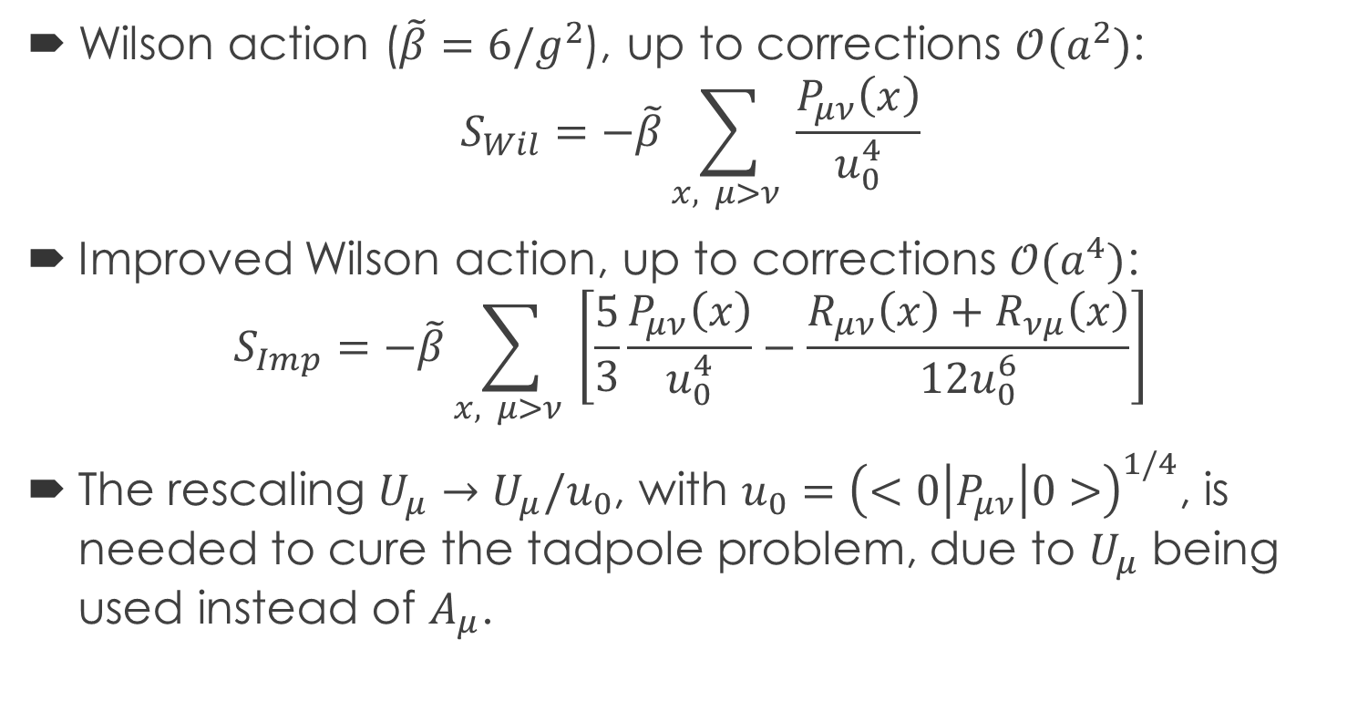
Lattice QCD: Lagrangian
Wilson action ($\tilde{β}=6/g^{2}$), up to corrections $𝒪(a^{2})$:
$$S_{Wil}=−\tilde{β}\sum_{x, μ>ν }{\frac{P_{μν}\left(x\right)}{u_{0}^{4}}}$$
Improved Wilson action, up to corrections $𝒪(a^{4})$:
$$S_{Imp}=−\tilde{β}\sum_{x, μ>ν }{\left[\frac{5}{3}\frac{P_{μν}\left(x\right)}{u_{0}^{4}}−\frac{R_{μν}\left(x\right)+R_{νμ}\left(x\right)}{12u_{0}^{6}}\right]}$$
The rescaling $U_{μ}→U_{μ}/u_{0}$, with $u_{0}={\left(<0\left|P_{μν}\right|0>\right)}^{1/4}$, is needed to cure the tadpole problem, due to $U_{μ}$ being used instead of $A_{μ}$.

Slide 28
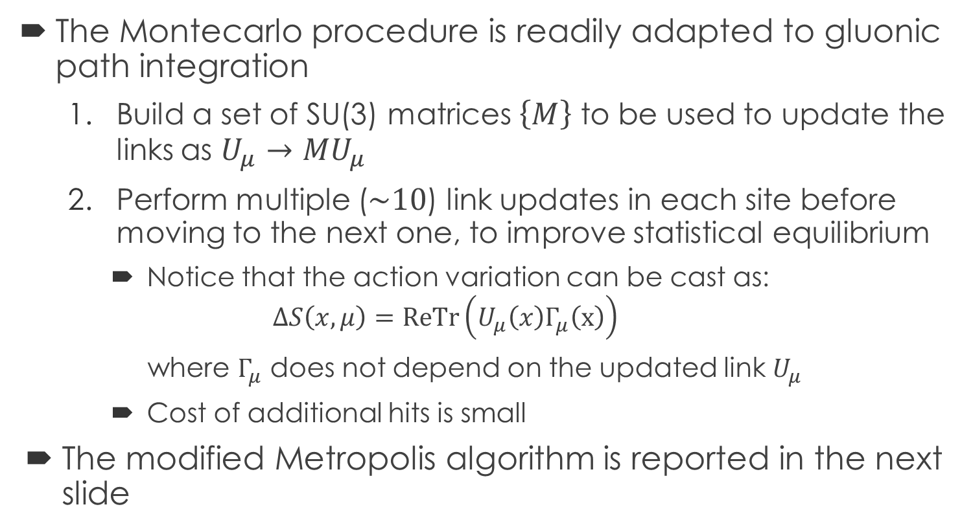
Lattice QCD: Montecarlo Method
The Montecarlo procedure is readily adapted to gluonic path integration
Build a set of SU(3) matrices $\left\{M\right\}$ to be used to update the links as $U_{μ}→{MU}_{μ}$
Perform multiple ($\sim 10$) link updates in each site before moving to the next one, to improve statistical equilibrium
Notice that the action variation can be cast as:
$$ΔS\left(x,μ\right)=ReTr\left(U_{μ}\left(x\right)Γ_{μ}\left(x\right)\right)$$
where $Γ_{μ}$ does not depend on the updated link $U_{μ}$
Cost of additional hits is small
The modified Metropolis algorithm is reported in the next slide

Slide 29


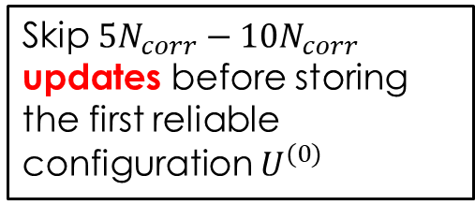


Lattice QCD: Metropolis Algorithm
Start from arbitrary lattice configuration $U^{(start)}$
Extract a SU(3) matrix $M$ from the set of random matrices
Skip $5N_{corr}−10N_{corr}$ updates before storing the first reliable configuration $U^{(0)}$
Repeat for every site and polarization in the lattice
Replace $U_{μ}→{MU}_{μ}$, compute action change $ΔS$
$$ΔS<0$$
Repeat update $N_{corr}$ times before storing the next statistically independent configuration
True
Accept
False
generate $η\sim Uni(0,1)$
True
Accept
Lattice update to get next configuration
$$e^{−ΔS}>η$$
Do $N_{cf}−1$ times
False
Reject
End

Slide 30
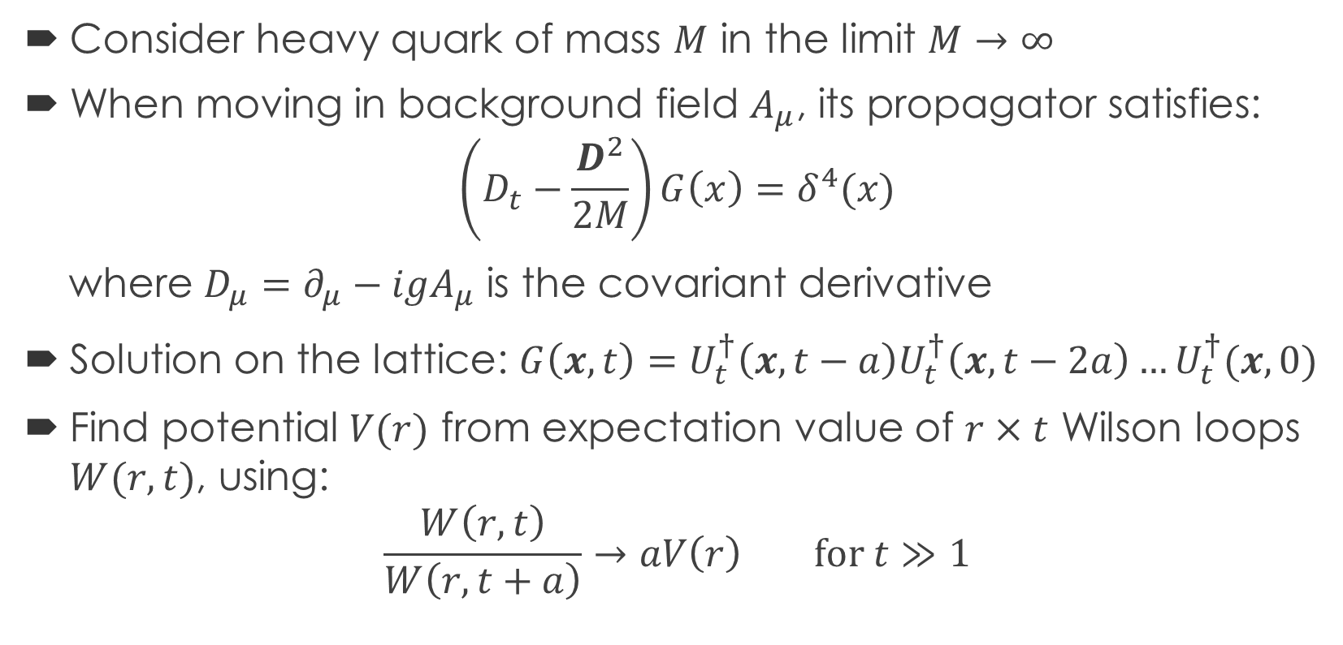
Lattice QCD: Static Quark Potential
Consider heavy quark of mass $M$ in the limit $M→∞$
When moving in background field $A_{μ}$, its propagator satisfies:
$$\left(D_{t}−\frac{D^{2}}{2M}\right)G\left(x\right)=δ^{4}(x)$$
where $D_{μ}=∂_{μ}−igA_{μ}$ is the covariant derivative
Solution on the lattice: $G\left(x,t\right)=U_{t}^{†}\left(x,t−a\right)U_{t}^{†}\left(x,t−2a\right)…U_{t}^{†}(x,0)$
Find potential $V(r)$ from expectation value of $r×t$ Wilson loops $W(r,t)$, using:
$$\frac{W\left(r,t\right)}{W\left(r,t+a\right)}→aV\left(r\right) for t≫1$$

Slide 31
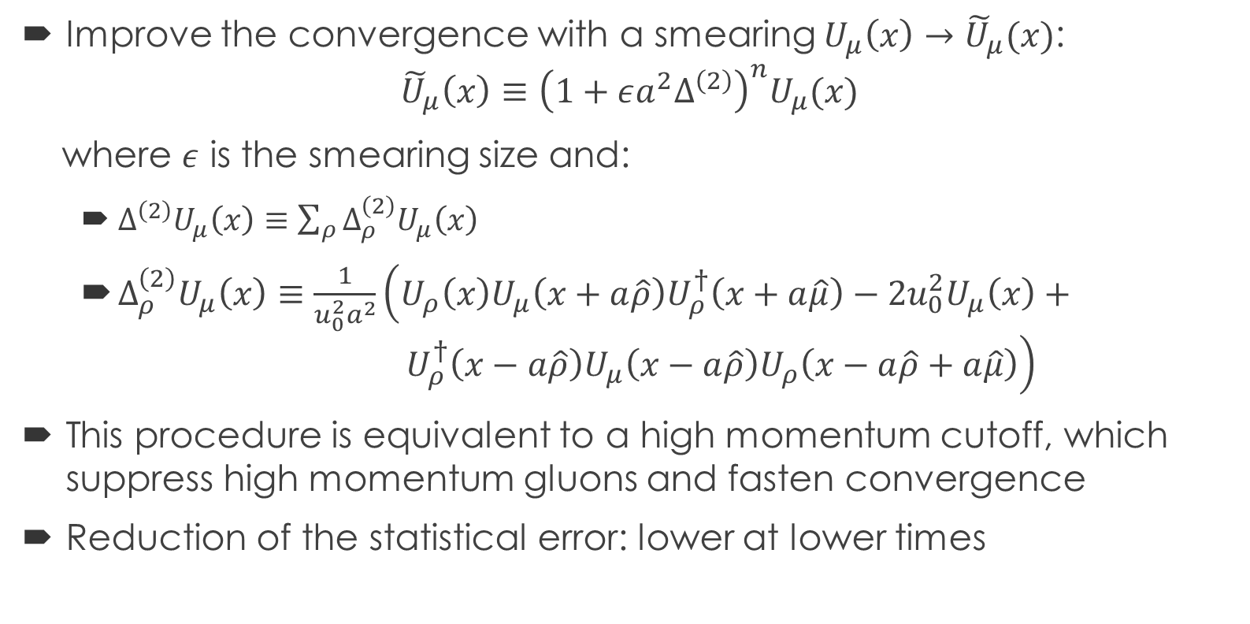
Lattice QCD: Static Quark Potential
Improve the convergence with a smearing $U_{μ}\left(x\right)→{\tilde{U}}_{μ}(x)$:
$${\tilde{U}}_{μ}\left(x\right)≡{\left(1+εa^{2}Δ^{\left(2\right)}\right)}^{n}U_{μ}(x)$$
where $ε$ is the smearing size and:
$Δ^{\left(2\right)}U_{μ}\left(x\right)≡\sum_{ρ}{Δ_{ρ}^{\left(2\right)}U_{μ}\left(x\right)}$
$Δ_{ρ}^{\left(2\right)}U_{μ}\left(x\right)≡\frac{1}{u_{0}^{2}a^{2}}\left(U_{ρ}\left(x\right)U_{μ}\left(x+a\hat{ρ}\right)U_{ρ}^{†}\left(x+a\hat{μ}\right)−2u_{0}^{2}U_{μ}\left(x\right)+ U_{ρ}^{†}\left(x−a\hat{ρ}\right)U_{μ}\left(x−a\hat{ρ}\right)U_{ρ}\left(x−a\hat{ρ}+a\hat{μ}\right)\right)$
This procedure is equivalent to a high momentum cutoff, which suppress high momentum gluons and fasten convergence
Reduction of the statistical error: lower at lower times

Slide 32
Lattice QCD Exercise: General Code Features
C++ code to reproduce the second excercise in the article
Gluonic system is path integrated using the Metropolis algorithm:
C++ provides high performances
Definition of the my4Vector and Path classes to intrinsically implement boundary conditions and to improve code readability
Reuse and adaptation of the Metropolis class
I/O of Montecarlo lattice configurations to allow for splitting of configuration generation and statistical analysis
See the code documentation: HTML_DOCUMENTATION
Routine to produce plots: Python and Root

Slide 33
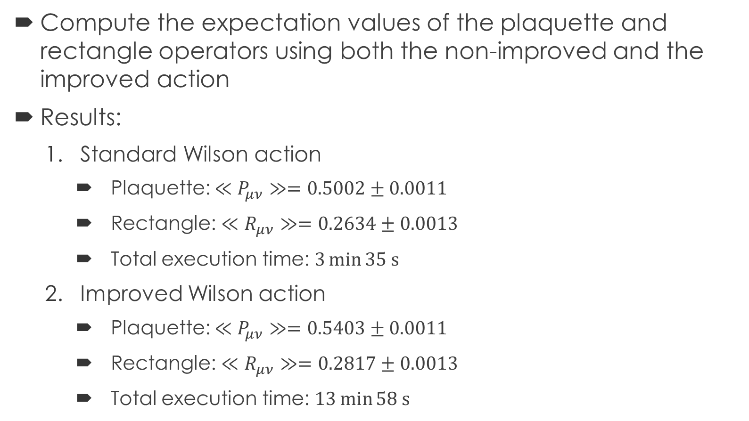
Lattice QCD Exercise: First Part
Compute the expectation values of the plaquette and rectangle operators using both the non-improved and the improved action
Results:
Standard Wilson action
Plaquette: $≪P_{μν}≫=0.5002±0.0011$
Rectangle: $≪R_{μν}≫=0.2634±0.0013$
Total execution time: $3\min{35 s}$
Improved Wilson action
Plaquette: $≪P_{μν}≫=0.5403±0.0011$
Rectangle: $≪R_{μν}≫=0.2817±0.0013$
Total execution time: $13\min{58 s}$
Reference directories:
/Experiments/QCD/Plaquette_Rectangle_NotImproved
/Experiments/QCD/Plaquette_Rectangle_Improved

Slide 34
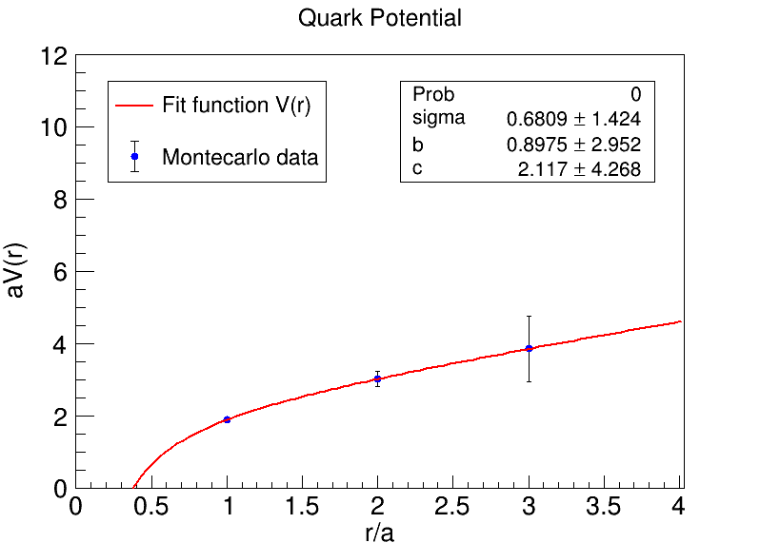
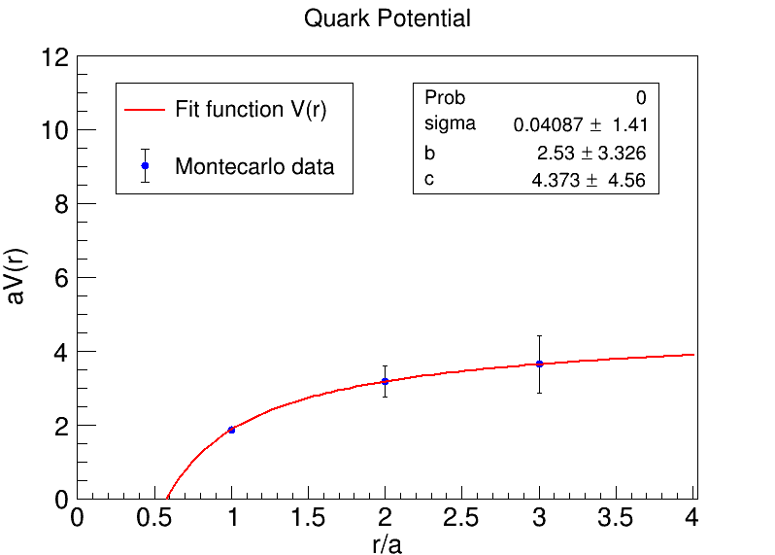
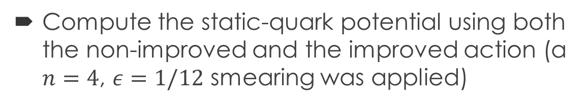
Lattice QCD Exercise: Second Part
Compute the static-quark potential using both the non-improved and the improved action (a $n=4$, $ε=1/12$ smearing was applied)
Reference directories:
/Experiments/QCD/QuarkPotential_NotImproved
/Experiments/QCD/QuarkPotential_Improved
Standard Wilson action
Improved Wilson action

Slide 35
Bibliography
G.P. Lepage, “Lattice QCD for Novices”, Proceedings of HUGS 98, https://doi.org/10.48550/arXiv.hep-lat/0506036

Slide 36
Thank you for your attention!

