Slide 1
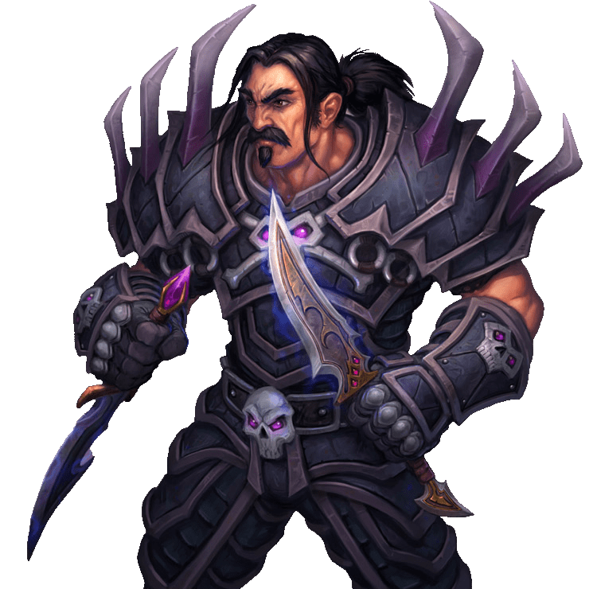
Rogue Mansion
Turn based combat game
Team 8 - Early
Notes:
© Copyright PresentationGO.com – The free PowerPoint and Google Slides template library

Slide 2
Game features
Challenge anyone in lobby and fight
Chance to win rewards every fight or every season for undisputed king
Combat is Turn based using spells and inflicting damage to opponent
In game marketplace to trade game items (future)
Notes:
© Copyright PresentationGO.com – The free PowerPoint and Google Slides template library

Slide 3
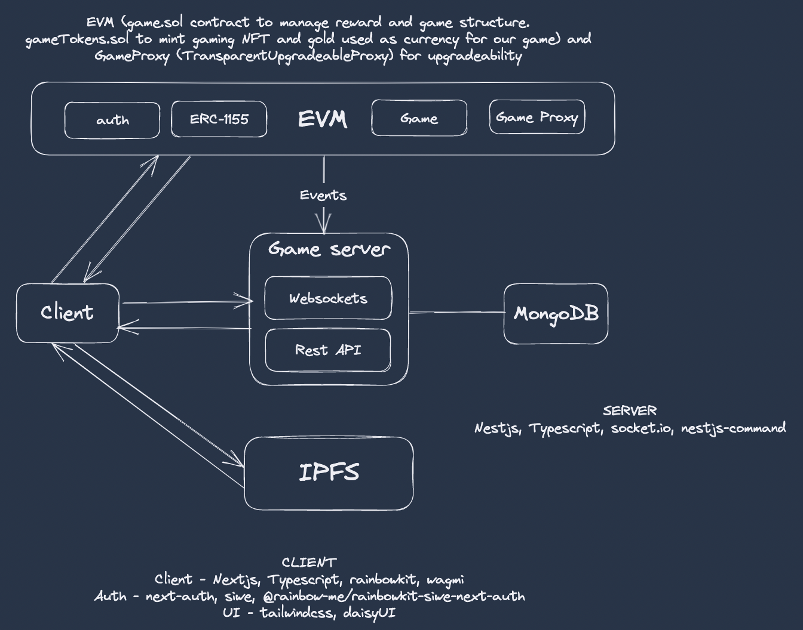
Architecture
Notes:
dasdas das da

Slide 4
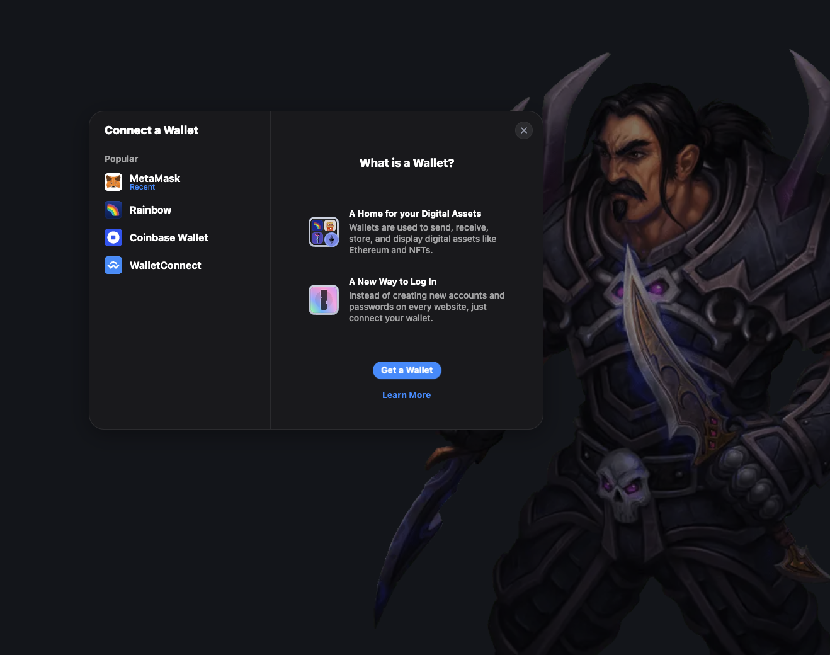
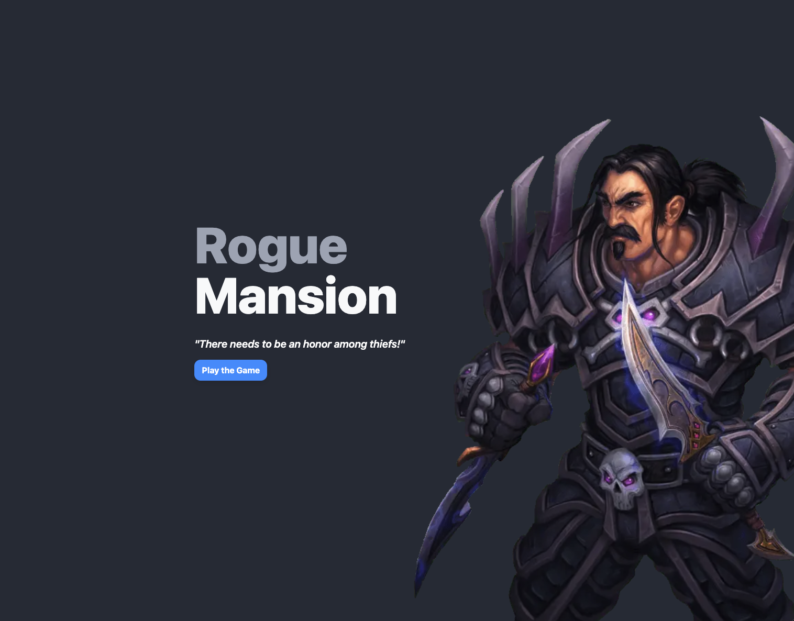
Login page

Slide 5
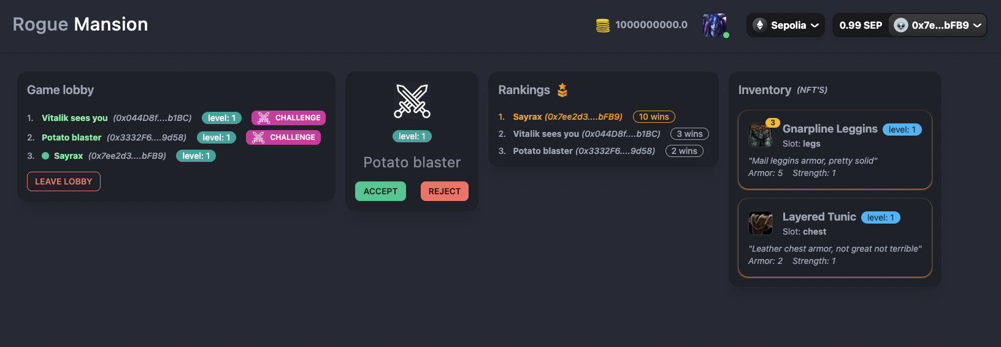
Dashboard

Slide 6
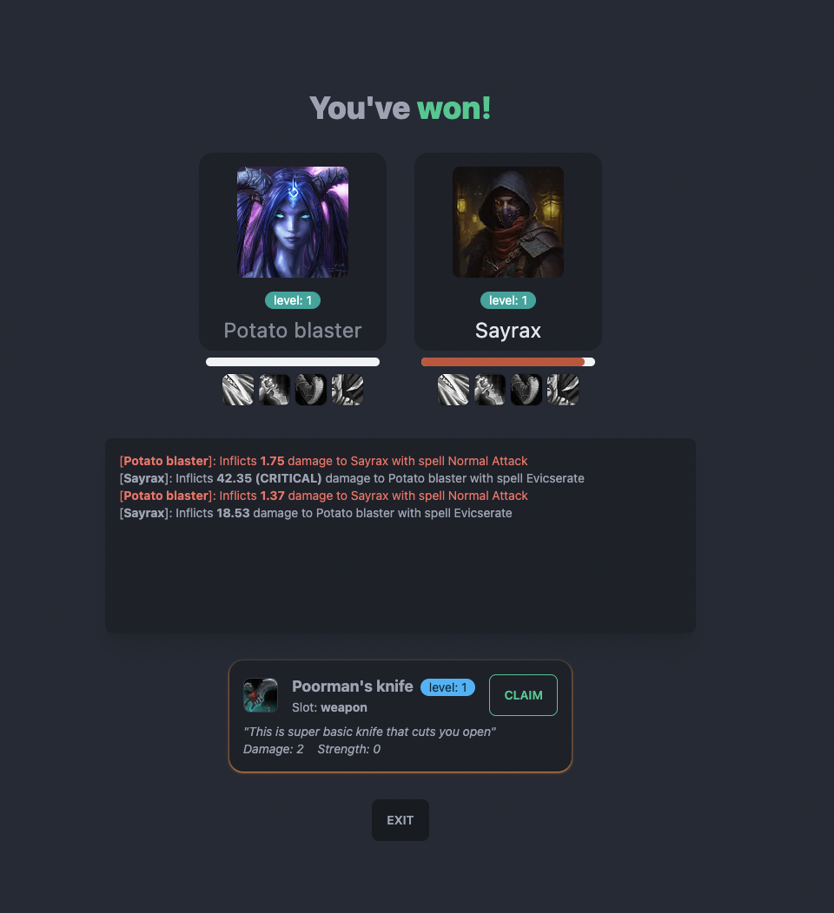
Fight
User can cast spell on his turn
Log shows
Damage
Spell
Critical / non-lethal
Game item reward

Slide 7
Live Demo
01
Notes:
© Copyright PresentationGO.com – The free PowerPoint and Google Slides template library

Slide 8
Smart contracts
Game: users, battles, and seasons + ensures winner receives prize that is secretely specified during creation of a battle
GameTokens: ERC1155 openzeppelin contract for "Gold" (ERC20-like) and "NFT" (ERC721-like) tokens
GameProxy: a proxy contract
GameUpgradeTest: used for testing Upgradeability
Notes:
© Copyright PresentationGO.com – The free PowerPoint and Google Slides template library

Slide 9
Game.sol
Commit-reveal option of PRNG to assign NFT id in a secret way while adding a battle
Upgradeable, implements steps required for logic contracts for use in GameProxy contract
ERC1155 compatible, receives and transfers ERC1155 tokens emitting events and keeping track of nftIds
AccessControl to access contract's functions
Notes:
© Copyright PresentationGO.com – The free PowerPoint and Google Slides template library

Slide 10
Game.sol:
Battle Prize
Write into storage:
battles[battleId] = Battle(...)
struct Battle {
Prize prize;
…,
address[2] players;
address winner;
address controller;
}
struct Prize {
uint goldAmount;
uint nftIdRevealed;
bytes4 nftIdCommittedBytes;
}
mapping(
address => mapping(
bytes4 => bool
)
) private nftIdCommittedBytesRegistry
msg(keccak256(“nftId”))
prvKey
msgSignature
Game.addBattle(., msgSignature)
Verify:
1. msgSingature[0:4] == battle.prize.nftIdCommittedBytes
2. ecdsa(msgDigest, v, r, s) == msg.sender
msgDigest = abi.encodePacked(
"\x19Ethereum Signed Message:\n32",
keccak256(“nftId”)
)
battle.prize.nftIdRevealed = nftId
Transfer prize
Game.assignWinner
(., nftId, msgSignature)
From storage
Notes:
© Copyright PresentationGO.com – The free PowerPoint and Google Slides template library

Slide 11
GameTokens.sol
GameProxy.sol
Upgradeable, AccessControl
Id=0 for Gold, and id>0 for NFTids
Id>0 can only mint/mintBatch 1 NFT
Upon deployment passes calldata to invoke “logic” contract’s “initialize” methods
Notes:
© Copyright PresentationGO.com – The free PowerPoint and Google Slides template library

Slide 12
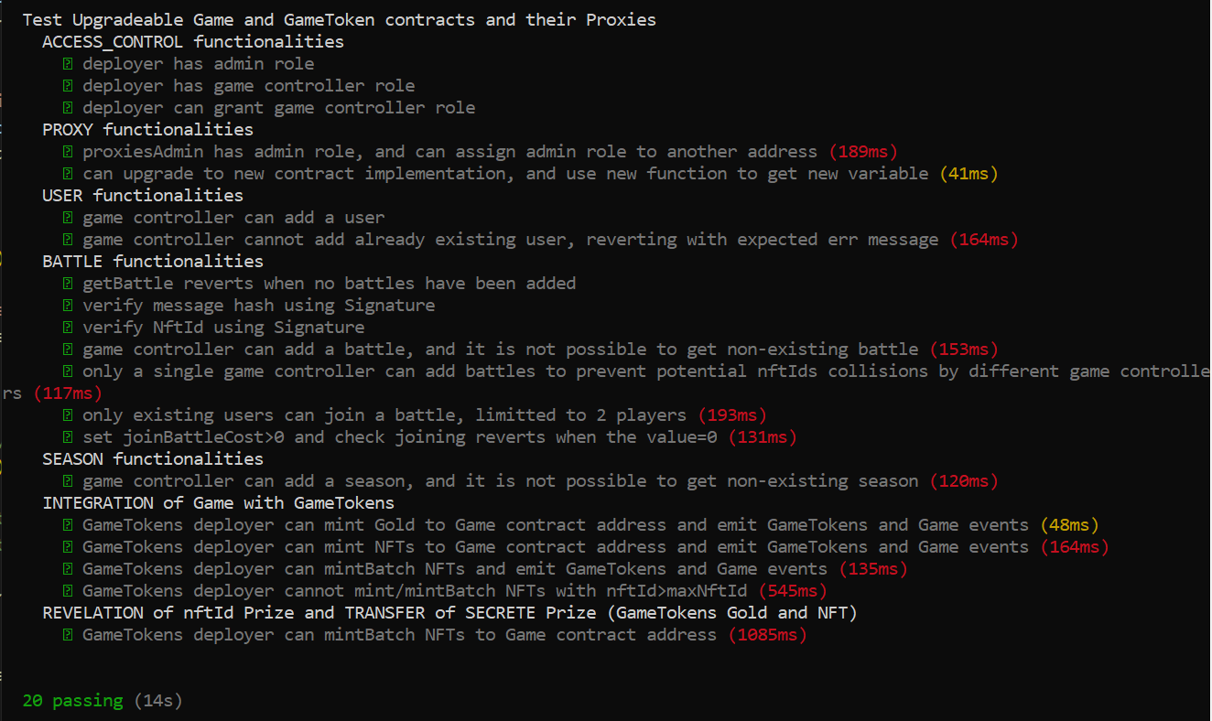
Notes:
© Copyright PresentationGO.com – The free PowerPoint and Google Slides template library

Slide 13
NFT.storage API
NFTs auto generated from base.jpg files, and uploaded as a single directory => single CID: “ipfs:/CID/images/nftId.jpg”
Json metada generated for each nftId, and uploaded as a single directory
=> single CID: “ipfs:/CID/metadata/nftId.json”
Notes:
© Copyright PresentationGO.com – The free PowerPoint and Google Slides template library

