Slide 1
AKE Franz-Arnold
Master 2 Bioinformatique
Université Paris Diderot / Paris 7
Projet Court Python
A MONTE CARLO ALGORITHM FOR SIMPLIFIED PROTEIN MODEL FOLDING
Based on the article, A replica exchange Monte Carlo algorithm for protein folding in the HP model, BMC Bioinformatics 2007
Chris Thachuk, Alena Shmygelska and Holger H

Slide 2
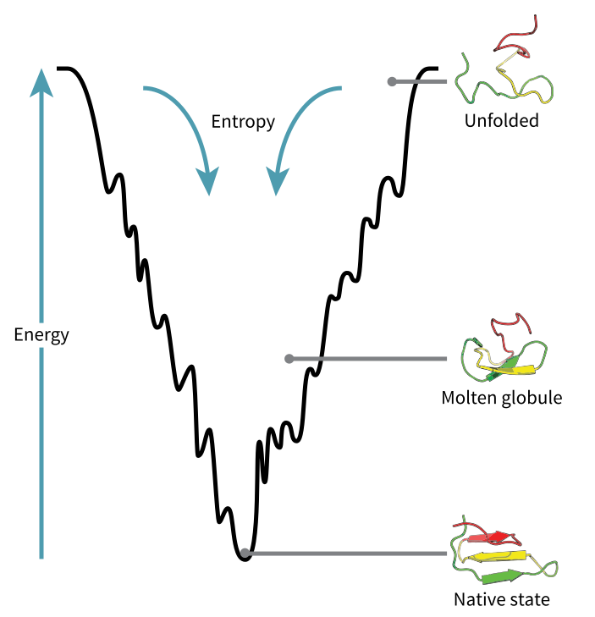
Introduction
Ab initio Protein folding problem
  Predicting protein tertiary structure from given amino acid sequence
Ab initio protein folding problem is NP-HARD
Approximation and Heuristique Methods

Slide 3
State of the Art
Somes approaches to solving the prediction of protein folds
  Chain growth algorithm
    PERM (Monte Carlo based)
  Ant colony optimization
    ACO-HPPF3 (Population based stochasticed search)

Slide 4
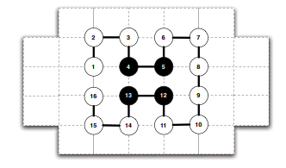
Sequences HP and lattice representation
Hydrophobic Polar (HP) Model
    Ex : sequence ~ P3H2P6H2P3
  Energy of conformation is determined by the number oh H-H contacts between topological neighbours

Slide 5
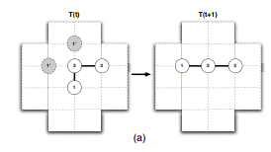
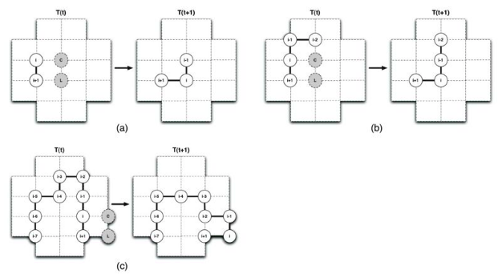
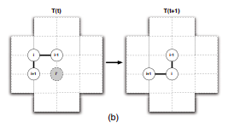
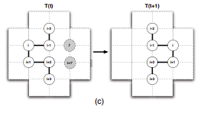
Moves Types
VHSD Moves
Pull Moves
~ end moves
~ corner moves
~ crankshaft moves

Slide 6
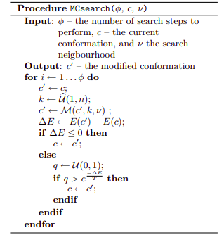
Algorithme de recherche de monte carlo
Random selection of a residue k among the sequence
  Make the moves specified for residue k
  Check the difference beetween the new conformation and the old
Save the conformation if the energy decrease or if a random uniform selection of a q number is greater than a certain parameter (temp ; energy variation)
Repeat the operation n steps

Slide 7
Python Implementation
Conformation class
Ordered Dict of Residue object
Energy (int)
& functions
Grille class
Taille (int)
& functions
Residue class
Type the Residue (String)
Coord X, Y (int)
& functions
Pull class
& functions
pull_mouvement function
vhsd class
& functions
end_mouvement
corner_mouvement
crankshaft_mouvement

Slide 8
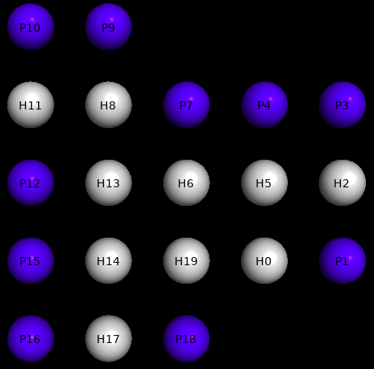
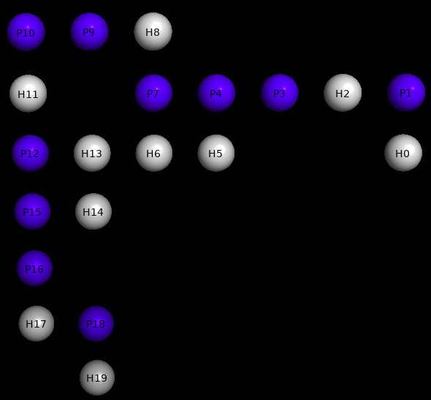
Benchmark
nb_steps = 500
« VHSD »
Temp = 160
Time ~ 0m1,079s
Input sequence : HPHPPHHPHPPHPHHPPHPH
Start energy : -9
Output sequence : HPHPPHHPHPPHPHHPPHPH
Final energy : -1

Slide 9
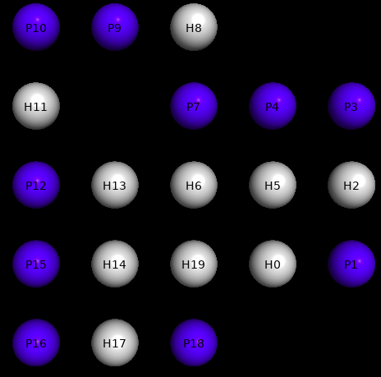
Benchmark
nb_steps = 500
« Pull »
Temp = 160
Time ~ 0m1,672s
Input sequence : HPHPPHHPHPPHPHHPPHPH
Start energy : -9
Output sequence : HPHPPHHPHPPHPHHPPHPH
Final energy : -7

Slide 10
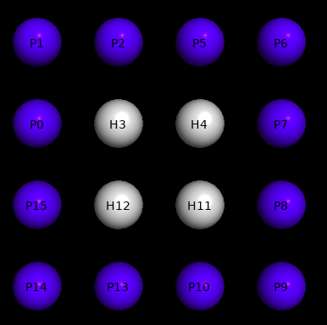
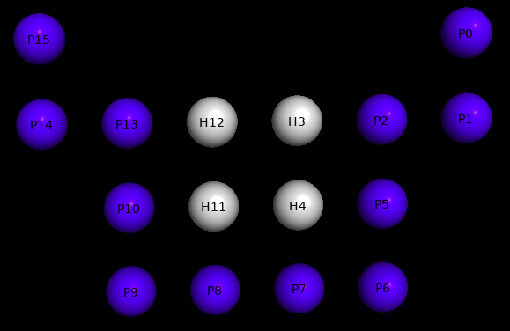
Benchmark
nb_steps = 500
« VHSD »
Temp = 160
Time ~ 0m0,869s
Input sequence : PPPHHPPPPPPHHPPP
Start energy : -2
Output sequence : PPPHHPPPPPPHHPPP
Final energy : -2

Slide 11
Conclusion
Bad performances for minimise the energy of conformation
Bad performances on protein with hydrophobic cores

