Slide 1
Solving Three-Phase Distribution OPF
with Nonlinear Programming
Frederik Geth, François Pacaud, Rahmat Heidari
University of Queensland · Mines Paris-PSL
128
3
2
LV Networks
Formulations
NLP Solvers
PSCC 2026 · Limassol, Cyprus · June 2026

Slide 2
Why Is Distribution OPF Different?
Transmission OPF
Distribution OPF
Single-phase (positive sequence)
Three-phase with 3×3 impedances (not diagonalizable in general), no grounded terminals
Power-polar voltage (SVP) formulation is best
Unbalanced loads + untransposed lines
Interior point method converges easily
Mutual coupling between phases means less sparse system of equations
Sparse, well-conditioned Jacobian
3× more variables → new challenges
Key question: which nonlinear formulation works best for distribution networks, up to 3-wire?

Slide 3
Three Distribution OPF Formulations Under Study
IVR
SVR
SVP
Current–Voltage
Rectangular
Power–Voltage
Rectangular
Power–Voltage
Polar
Quadratic constraints
Quadratic constraints
Trig functions (sin/cos/tan)
No automatic differentiation overhead
No automatic differentiation overhead
Heavy automatic differentiation overhead
Most variables (n=1758)
Fewer variables (n=1062)
Fewer variables (n=1062)
Near-singular Hessian (κ≈10¹⁴)
Well-conditioned (κ≈10⁷)
Well-conditioned (κ≈10⁷)
Transmission consensus: power-polar-voltage is best. What about distribution?

Slide 4
Practical Pitfalls: What Can Go Wrong
⚠
Wrong Phase Initialization
✓
Add Angle Difference Constraints
Zero or negative-sequence start causes high failure rates. Always use positive-sequence: 1∠0°, 1∠−120°, 1∠+120°
Constrain inter-phase angles near ±120°. Improves robustness with no significant runtime cost.
⚠
Power Base Too Large
✓
Merge Degree-2 Buses
Transmission standard (100 MVA) causes numerical inaccuracy. Use ≤1000 kW for distribution networks.
Superfluous pass-through buses inflate problem size. Merging branches in series speeds up solution.
⚠
Degenerate Angle Reference
✓
Add Realistic Current Limits
Without a voltage angle reference, all angles can shift freely — the problem becomes degenerate.
Missing current bounds widen the feasible set. Add limits correlated with conductor cross-section.

Slide 5
Benchmark data set: 128 LV Networks from UK (ENWL)
Dataset & Setup
Options Tested
128 single-grounded UK LV network models
Formulations:
IVR, SVR, SVP
All three-phase lines, single-phase loads
Voltage source:
Realistic current limits added
3vm3vafix, 3vafix, vafix, vafixvadiff, vafixseq
Degree-2 buses eliminated
Angle init:
pos, neg, zero
Dispatchable generators with linear cost
Sequence bounds:
on / off
Julia 1.11 + JuMP / ExaModels
Angle diff bounds:
IPOPT 3.14 + HSL MA27
on / off
KNITRO 15.0 for comparison
Power base:
10 → 1,000,000 kW
V. Rigoni, L. F. Ochoa, G. Chicco, A. Navarro-Espinosa and T. Gozel, "Representative Residential LV Feeders: A Case Study for the North West of England," in IEEE Transactions on Power Systems, vol. 31, no. 1, pp. 348-360, Jan. 2016, doi: 10.1109/TPWRS.2015.2403252.

Slide 6
Main Result: Best Formulation Depends on Solver
IPOPT → IVR wins
24.8s total
Filter line-search handles IVR well despite near-singular Hessian
KNITRO → SVR wins
22.1s total
Trust-region algorithm avoids IVR degeneracy, SVR wins
Power polar voltage is slowest for both solvers — contrary to transmission OPF!

Slide 7
Why Is SVP Slower in Distribution?
01
02
Automatic Differentiation Overhead
Harder Newton Linear Systems
Power polar voltage uses sin, cos, tan — requires automatic differentiation to compute derivatives. With 3× more constraints than single-phase OPF, automatic differentiation cost dominates.
The 3-phase model makes Newton systems denser and harder to factor. More time per iteration in the sparse linear solver.
03
04
ExaModels Helps — But Not Enough
IVR & SVR Are Automatic Differentiation-Free
Replacing JuMP with ExaModels halves power-polar voltage time (128s → 65s with IPOPT). Still 2.6× slower than IVR.
Quadratic formulations: derivatives are computed analytically. No automatic differentiation bottleneck, lower overhead per iteration.
Bottom line: 3-phase complexity punishes SVP more than IVR/SVR

Slide 8
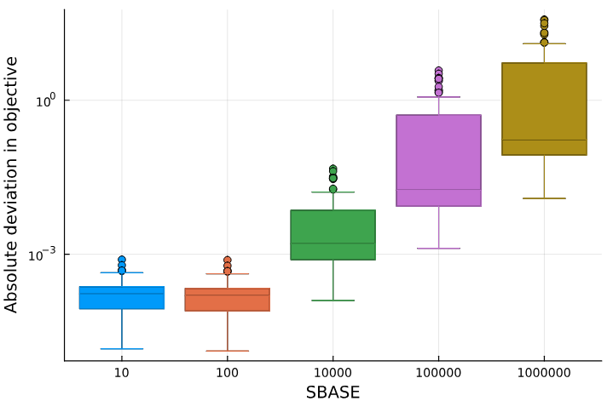
Numerical Scaling: Choose Your Power Base Carefully
✓ Safe zone
sbase ≤ 1000 MVA
Negligible numerical error
✗ Danger zone
sbase = 100 MVA
Transmission standard → avoidable inaccuracy in distribution!
The per-unit power base is a modeler's choice — make it ≤ 1000 MVA for these LV distribution feeders.

Slide 9
Practical Guide: Do's and Don'ts
✓ DO
✗ DON'T
Use IVR with IPOPT, SVR with KNITRO
Assume SVP is best (it's not — unlike in transmission)
Set power base ≤ 1000 kW (never 100 MVA)
Use 100 MVA as power base for distribution
Fix at least one voltage angle reference
Omit voltage angle reference (problem degenerates)
Add inter-phase angle difference constraints
Use KNITRO expecting IVR to be fastest
Merge degree-2 buses before solving
Leave redundant data in the network model
Add realistic branch current limits
Forget current limits (inflates feasible set)
Use positive-sequence initialization: 1∠0°, 1∠−120°, 1∠+120°
Use zero or negative-sequence initialization

Slide 10
Conclusions
→
IVR is fastest with IPOPT; SVR is fastest with KNITRO. SVP is slowest for both — opposite of transmission OPF.
→
Initialization matters: always use positive-sequence. Zero/negative sequence causes failures.
→
Power base must be ≤ 1000 kW. The 100 MVA transmission standard causes numerical inaccuracy.
→
Angle difference constraints improve robustness at negligible computational cost.
→
Data preprocessing (merging buses, adding limits) is essential for a well-posed problem, needs more efforts.
Future: GPU acceleration · SDP relaxations · Multiperiod OPF
github.com/hei06j/PMDlab.jl

