Slide 1
A* algorithm
Single-thread and Multi-thread implementation of A* optimal path-searching algorithm
Group members:
Paoli Leonardi Francesco (s297078)
Pasqualini Federico (s296488)
System and Device Programming course project (a.a. 2021/2022)

Slide 2
Project outline
1
Graph data structures
2
Graph algorithms design and implementation
3
A* algorithms design and implementation
4
A* performance comparison

Slide 3
Graph data structures

Slide 4
Graph node structure
// set of links (and corresponding weights) that connect a node with its neighbors
typedef std::unordered_map<unsigned int, unsigned int> link_weight_umap;
...
/******************** Graph's nodes structure ********************/
class Node {
public:
/* copy control features definition */
...
/* overloaded operators */
...
/* getters and setters */
...
private:
unsigned int id; // node's ID
int x; // node's coordinate along x axis
int y; // node's coordinate along y axis
std::unique_ptr<link_weight_umap> neighbor; // node's links to neighbor nodes
};
Highlighted implementation choices:
Copy-control features, overloaded operators and getters/setters for better interface to Node objects.
Pointer to link_weight_umap to have constant Node size.
Links-weights hash map for constant random-access complexity.

Slide 5
Graph path structure
// set of nodes in a graph's path (the order in which the nodes must be traversed is given by the key of the hash map)
typedef std::unordered_map<unsigned int, Node> path_umap;
...
/******************** Path (i.e. sequence of nodes) of the graph ********************/
typedef struct graph_path_s {
std::unique_ptr<path_umap> path_ptr; // path itself
unsigned int path_num_nodes; // number of nodes contained in the path
std::atomic<int> path_cost; // path's overall cost
} graph_path_t;
Highlighted implementation choices:
Atomic path’s overall cost to guarantee mutual exclusion without any mutex.
Pointer to path_umap to have constant graph_path_t size.
Path nodes sequence hash map for constant random-access complexity.
It will store the information of best path found by A* (concurrently modified by running threads, so we consider it as a critical section).

Slide 6
Graph algorithms design and implementation

Slide 7
Graph generation and storage
First accomplished task was the implementation of functions for:
Generating of a random graph (with given number of nodes).
Storing of the generated graph in long-term memory.
Highlighted implementation choices:
Graphs up to millions of nodes, so we implemented both single and multi-thread algorithms.
C pthread_mutext and sem_t and C++ std::mutex used for synchronization (e.g. access mutually exclusive critical sections, implementation of thread barriers).
Graph divided in partitions for efficient multi-thread graph generation and storage.
Managed by C++ std::atomic_flag::test_and_set (<<std::mutex::try_lock method is allowed to fail spuriously>>^{[1]}).
[1] https://en.cppreference.com/w/cpp/thread/mutex/try_lock

Slide 8
Nodes generation
The graph gets divided as a 2D squared grid, where is grid cell is a graph partition.
Each graph partition gets filled up of nodes by the first thread that locks it (critical section).
Each node has x-y coordinates generated randomly within its partition coordinates bound.
Highlighted implementation choices:
The number of graph partitions is quite larger than the number of threads.
Fastest threads can fill up more partitions.
Avoid bottleneck of slowest thread.
Each partition needs to be visited only once.
C++ std::atomic_flag::test_and_set was used to avoid useless thread waits.

Slide 9
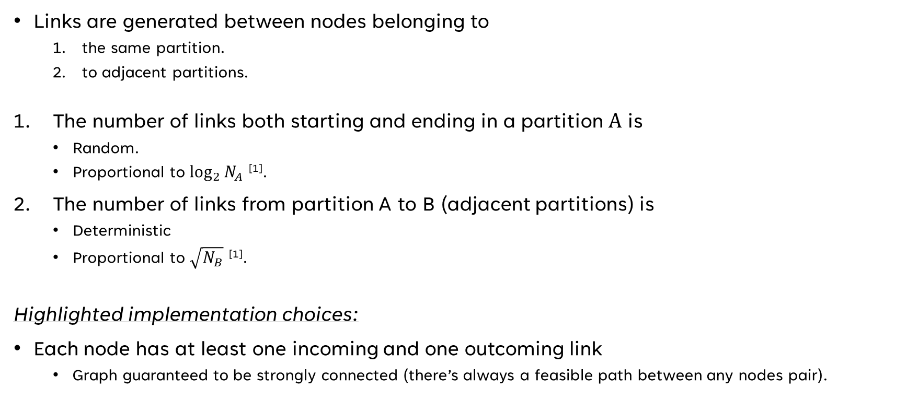
links generation
Links are generated between nodes belonging to
the same partition.
to adjacent partitions.
The number of links both starting and ending in a partition A is
Random.
Proportional to $\log_{2}{N_{A}}$ ^{[1]}.
The number of links from partition A to B (adjacent partitions) is
Deterministic
Proportional to $\sqrt{N_{B}}$ ^{[1]}.
Highlighted implementation choices:
Each node has at least one incoming and one outcoming link
Graph guaranteed to be strongly connected (there’s always a feasible path between any nodes pair).
[1] $N_{A}$ and $N_{B}$ are the number of nodes belonging to partition A and B, respectively.

Slide 10
Graph storage in long-term memory
After the graph generation, the nodes and links information are serialized in a file (specified by the user) from which it can be retrieved when needed.
Ad-hoc serialization protocol:
12 bytes (3 unsigned int) for
Number of generated nodes.
Number of generated links.
Number of generated graph partitions.
For each graph partition, 4 bytes (1 unsigned int) for the number of links inside that partition.
For each graph partition, 12 bytes (3 unsigned int) for information regarding the nodes of that partition:
ID of the node.
x coordinate of the node.
y coordinate of the node.
For each graph partition, 12 bytes (3 unsigned int) for the information regarding the links of that partition:
ID of the starting node.
ID of the ending node.
Link’s weight.

Slide 11
Graph storage in long-term memory
Highlighted implementation choices:
Graph data get serialized in binary format.
Occupy less disk space.
The graph storing procedure gets performed in parallel (with proper synchronization strategies).
Each thread performs file locking of the file region it is about to write on.
Guarantees that two or more threads never write on the same file region at the same time.
After each file write, threads check that the number of actually written bytes is what they expect.

Slide 12
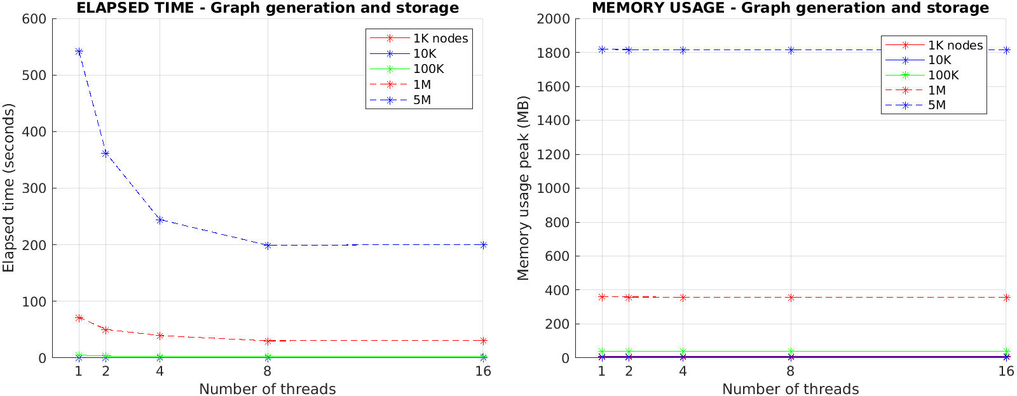
Graph generation and storage performance

Slide 13
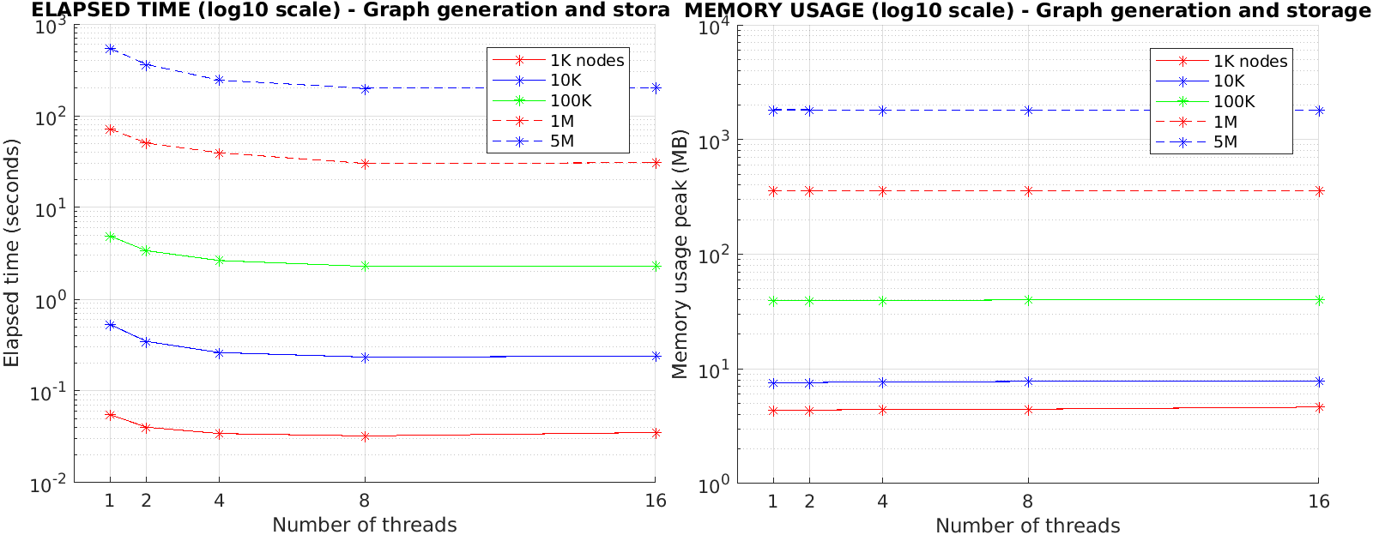
Graph generation and storage performance

Slide 14
Graph loading from long-term memory
Following the same serialization protocol used for graph storage, a graph previously generated can be retrieved from disk, deserialized and used to run A* on it.
Highlighted implementation choices:
The graph loading procedure gets performed in parallel (with proper synchronization strategies).
After each file read, threads check that the number of actually read bytes is what they expect.

Slide 15
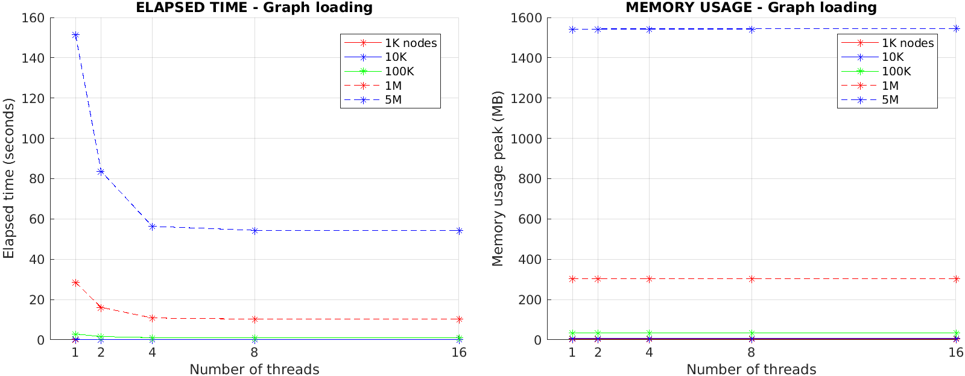
Graph loading performance

Slide 16
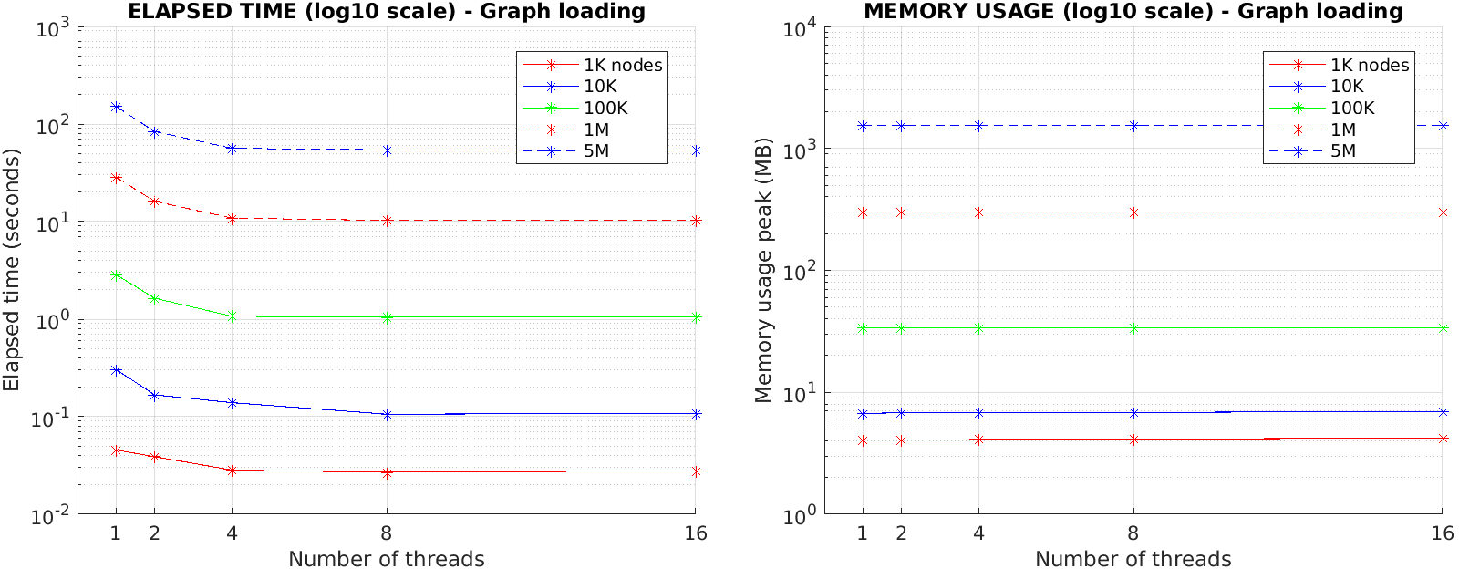
Graph loading performance

Slide 17
Graph generation, storage and loading observations
Elapsed time during graph generation, storage and loading procedures decreases significantly with a higher number of threads.
Memory usage remains approximately constant and independent on the number of threads.
The memory needed to run a new thread is negligible with respect to the memory needed to generate/store/load a graph.

Slide 18
A* algorithms design and implementation

Slide 19
A* algorithm versions
3 different versions have been implemented:
Sequential A*: classic A* algorithm running on a single thread.
Centralized A*: runs on multiple threads and all the data structures are shared between them and protected by appropriate synchronization primitives.
Decentralized A*: highly optimized parallel version where each thread has its own data structures, so that locks and resources shared among all threads are reduced as much as possible.
Through the provided user interface (menu.cpp/.h), the user can choose the A* version to run and its parameters:
Name of the file storing the graph.
Number of threads to launch.
Start and stop nodes between which A* has to find a path.
Hash-type (for Decentralized A*).

Slide 20
Sequential A* data structures
The Sequential A* version mainly exploits the following data structures:
g_{cost}: cost of traversing the currently best path found from start node to the current node.
h_{cost}: estimation of the cost to arrive from the current node to the stop node.
f_{cost}: estimated overall path cost passing through the current node (f_{cost} = g_{cost} + h_{cost}).
open list: keep track of the nodes that still need to be expanded, together with their f_{cost} and h_{cost}.
closed list: keep track of the nodes already expanded.
from list: for each graph node, keep track of its current parent (i.e., the node that, along the current best path, immediately precedes it).
cost list: keep track of the current best cost (i.e., g_{cost}) of each node.

Slide 21
Sequential A* data structures
Highlighted implementation choices:
open list is a C++ std::priority_queue
Allows fast insertion and fast removal of the lower cost node (O(1) and O(logN) complexity, respectively).
Doesn’t allow random-access but it is not needed.
closed, from and cost lists are C++ std::unordered_map
Allow random-access with constant complexity.
The heuristic h_{cost} is the Euclidean norm distance because it is:
Admissible, i.e., it never overestimates the real distance of stop node from the current node.
Consistent, i.e., it satisfies the triangle inequality.
This guarantees that the first path found by Sequential A* is always the globally optimal one (not true for Centralized and Decentralized A*).

Slide 22
Sequential A* algorithm (outline)
Extract from open list the node with the lowest cost.
Check if already in closed list:
If yes, discard it (we already visited it with a lower cost).
If no, expand it and continue.
Check if the expanded node is stop:
If yes, the algorithm terminates and the path from start to stop nodes gets rebuilt.
If no, continue.
For each neighbor of the expanded, check if the neighbor is worth expanding too:
If yes, add it to the open list.
If no, discard it.
Loop through the steps 1-4.

Slide 23
Centralized A*
Data structures:
Same as Sequential A*.
Synchronization primitives to access thread-shared data.
Algorithm implementation:
Similar to Sequential A*.
Managing of critical sections.
Ad-hoc termination detection algorithm.
Advantages given by an admissible and consistent heuristic are not valid for multi-thread A*.

Slide 24
Centralized A* termination detection
A thread can stay idle if at least one of the following conditions is met:
open list is empty.
The node with lower cost still has a higher cost than the current best path to stop node.
At every iteration, each thread checks both conditions for itself.
If both are false, continue.
If at least one is true, check them also for every other thread.
If, during their last check, every thread satisfied at least one of the above conditions, then the Centralized A* can terminate.
Otherwise, continue.

Slide 25
Decentralized a*
Decentralized A* optimizes thread parallelization by
Removing shared data structures (except few necessary ones).
Assigning nodes to threads
Each node is “owned” by only one thread, which will be responsible for expanding it.
Implementing thread communication through messages.
The Decentralized A* have been implemented as HDA* (Hash Distributed A*).
Nodes are assigned to threads by a hash function.
Highlighted implementation choices:
The possibility of assigning nodes randomly to threads was discarded in the first place.
To avoid useless duplication of nodes expansion, nodes must be assigned to threads in a deterministic way.

Slide 26
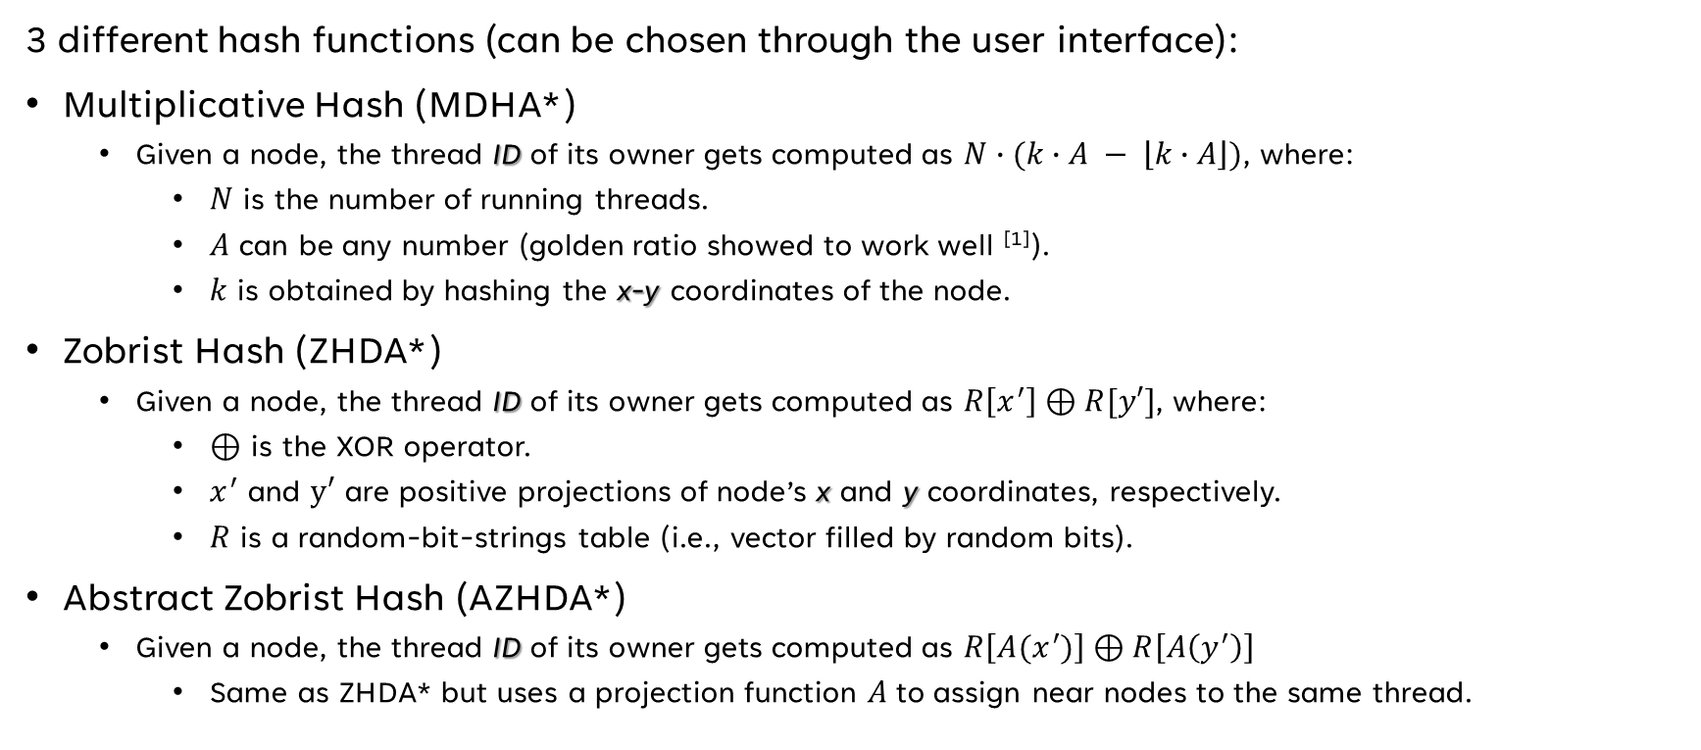
Decentralized a* hash methods
3 different hash functions (can be chosen through the user interface):
Multiplicative Hash (MDHA*)
Given a node, the thread ID of its owner gets computed as $N∙(k∙A − \left\lfloor k∙A\right\rfloor )$, where:
$N$ is the number of running threads.
$A$ can be any number (golden ratio showed to work well ^{[1]}).
$k$ is obtained by hashing the x-y coordinates of the node.
Zobrist Hash (ZHDA*)
Given a node, the thread ID of its owner gets computed as $R\left[x^{′}\right]⊕R[y′]$, where:
$⊕$ is the XOR operator.
$x^{′}$ and $y′$ are positive projections of node’s x and y coordinates, respectively.
$R$ is a random-bit-strings table (i.e., vector filled by random bits).
Abstract Zobrist Hash (AZHDA*)
Given a node, the thread ID of its owner gets computed as $R\left[A(x^{′})\right]⊕R\left[A\left(y^{′}\right)\right]$
Same as ZHDA* but uses a projection function $A$ to assign near nodes to the same thread.
[1] “A Survey of Parallel A*”. Alex Fukunaga, Adi Botea, Yuu Jinnai, Akihiro Kishimoto. August 18, 2017.

Slide 27

Decentralized a* hash methods
Multiplicative Hash (MDHA*)
Zobrist Hash (ZHDA*)
Abstract Zobrist Hash (AZHDA*)
Pros:
Simple.
Doesn’t need to fill $R$ vector.
Cons:
Highly relies on a good hash function to compute $k$ (not trivial).
Pros:
Almost perfect work balance distribution.
Cons:
Non-negligible overhead due to thread communication.
Pros:
Uses a projection function to reduce thread communication overhead.
Still almost perfect work balance distribution.

Slide 28
deCentralized A* data structures
Data structures:
Same as Sequential A*.
Synchronization primitives to manage best path information (critical section).
Thread messages for information exchange and path rebuild:
// message exchanged between threads in multi-threaded Decentralized A* algorithm (the tuple contains node N, cost g(N) and parent(N))
typedef std::tuple<Node, double, Node> msg_t;
// buffer of messages
typedef std::queue<msg_t> msg_buffer_t;
/* parent request message (key-value are, respectively, the node of which it is requested to know the parent and the flag that represents
if a new parent request arrived or not) */
typedef std::pair<Node, bool> parent_request_t;
/* parent reply message (key-value are, respectively, the requested parent node and the flag that represents if a new parent reply is available or not) */
typedef std::pair<Node, bool> parent_reply_t;

Slide 29
deCentralized A* algorithm
Algorithm implementation:
Same idea of Sequential A*, but multi-thread.
Graph knowledge is distributed among all threads.
When a new node gets discovered, send it to its owner thread.
To rebuild the best path, it is needed the knowledge of multiple threads.
Parent requests.
Termination detection algorithm.
Vector counters algorithm ^{[1]}.
Advantages given by an admissible and consistent heuristic are not valid for multi-thread A*.
[1] “Algorithms for distributed termination detection”. Friedemann Mattern. 1987.

Slide 30
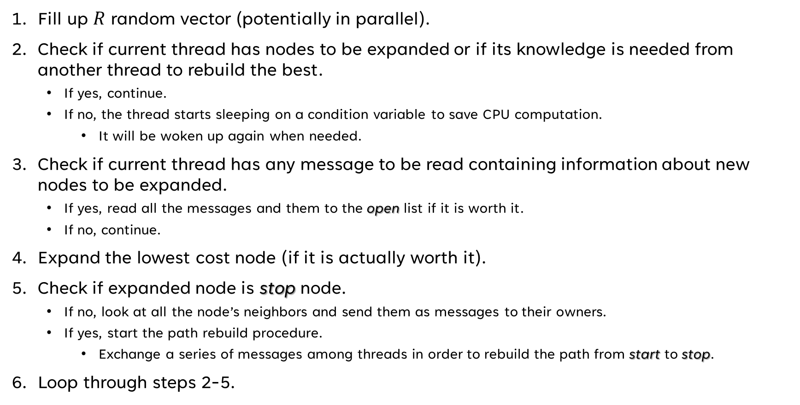
deCentralized A* algorithm (outline)
Fill up $R$ random vector (potentially in parallel).
Check if current thread has nodes to be expanded or if its knowledge is needed from another thread to rebuild the best.
If yes, continue.
If no, the thread starts sleeping on a condition variable to save CPU computation.
It will be woken up again when needed.
Check if current thread has any message to be read containing information about new nodes to be expanded.
If yes, read all the messages and them to the open list if it is worth it.
If no, continue.
Expand the lowest cost node (if it is actually worth it).
Check if expanded node is stop node.
If no, look at all the node’s neighbors and send them as messages to their owners.
If yes, start the path rebuild procedure.
Exchange a series of messages among threads in order to rebuild the path from start to stop.
Loop through steps 2-5.

Slide 31
deCentralized A* termination detection
Each thread manages:
A local counter vector containing counters of messages sent/received to/by other threads.
An additional acc_msg_counter vector that
Holds the overall count of every thread-local vector.
Goes from one thread to another in a circular way.
When a thread receives acc_msg_counter:
Add the local counter vector to acc_msg_counter.
Send it to next thread.
If acc_msg_counter completes a cycle of all threads being full of 0s for the whole time then the A* can terminate, otherwise continue.

Slide 32
A* performance comparison

Slide 33
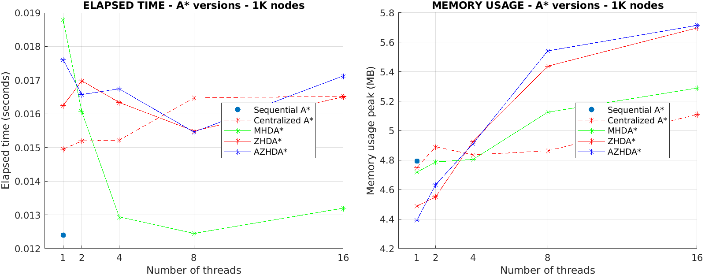
A* performance – 1K nodes

Slide 34
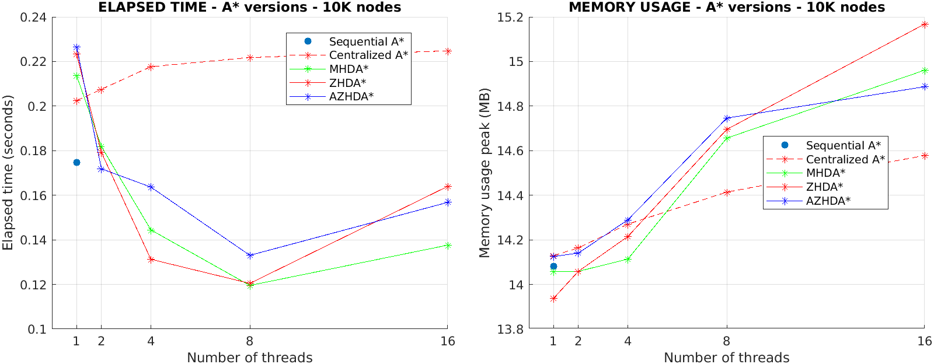
A* performance – 10K nodes

Slide 35
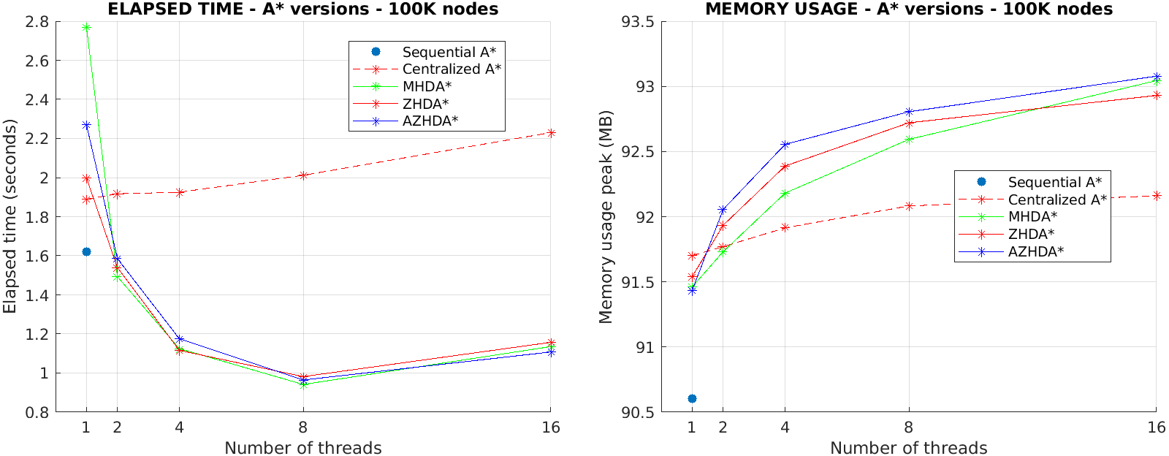
A* performance – 100K nodes

Slide 36
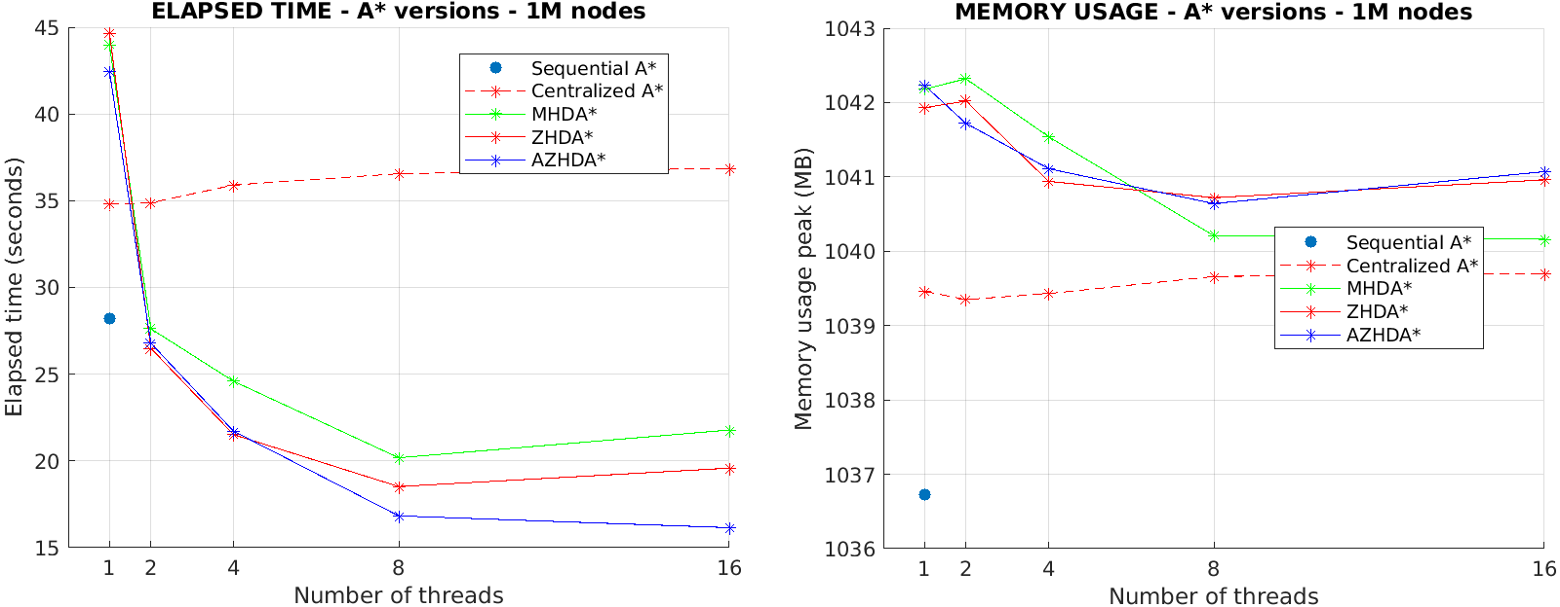
A* performance – 1m nodes

Slide 37
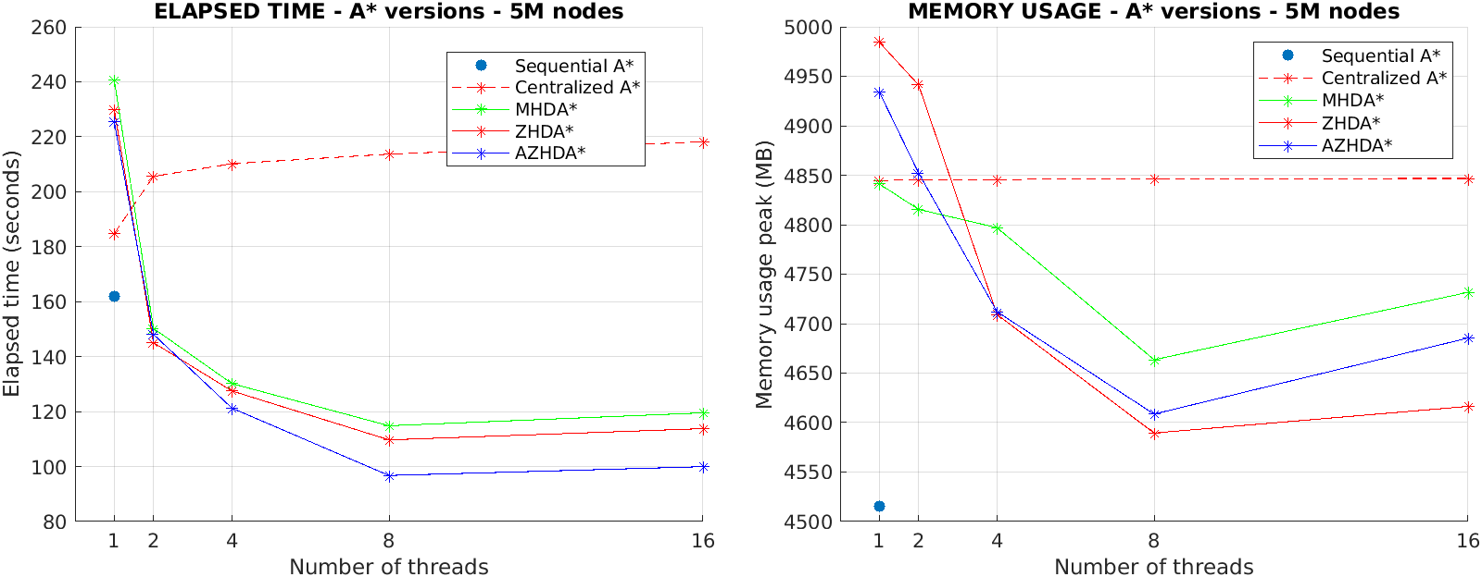
A* performance – 5m nodes

Slide 38
A* performance conclusions
Elapsed time:
Sequential A* performs better than Centralized and Decentralized A* in single thread mode.
With small graphs, Centralized and Decentralized A* have too much overhead.
Decentralized A* scales very well with the number of threads.
AZHDA* has better performance than ZHDA* and MHDA*
The former combines the advantages of the two latter.
There is a platoon at 8 threads
Tests have been conducted on an 8 core CPU.
Centralized A* scales bad with the number of threads.
Access to open list is bottleneck
Negligible with respect to expanding a node.
Memory usage:
For small graphs, more threads means more memory.
Memory needed for actual A* is little.
Adding a new thread has a non-negligible impact.
For big graphs, more threads means less memory.
Less execution time.

Slide 39
A* performance conclusions
Let’s try to compare the A* versions with a 1 millisecond delay in every node expansion…

Slide 40
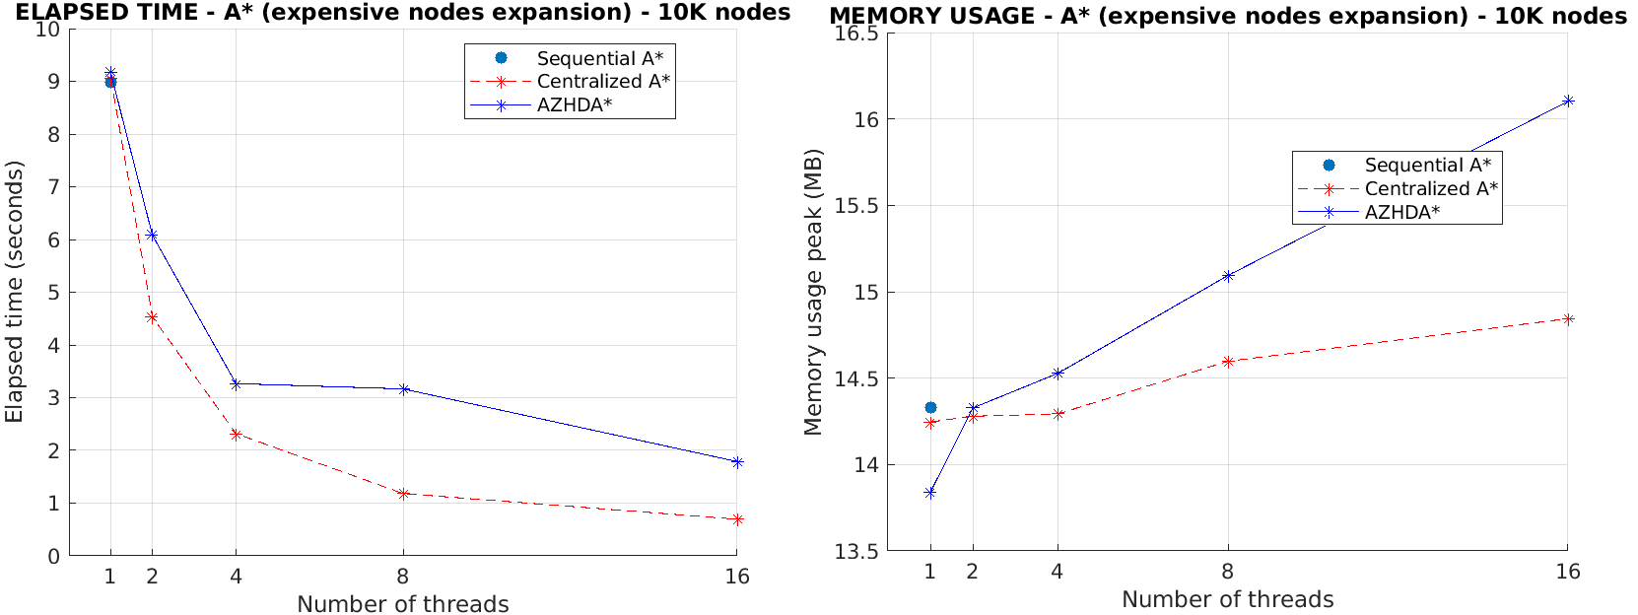
A* performance conclusions
No more bottleneck of open list access for Centralized A*

