Slide 1
Academic year 2019/2020 University ‘La Sapienza’, Rome
NBD LABWORK
Francesco Pezone 1913202
Alessio Sampieri 1765522
Lucia Testa 1764018

Slide 2
Initial file: Differences
UDP
TCP
Packet (Length: 482) Layer ETH: Destination: 00:31:46:64:ec:bf Address: 00:31:46:64:ec:bf .... ..0. .... .... .... .... = LG bit: Globally unique address (factory default) .... ...0 .... .... .... .... = IG bit: Individual address (unicast) Source: 00:12:e2:c0:3f:08 Type: IPv4 (0x0800) Address: 00:12:e2:c0:3f:08 .... ..0. .... .... .... .... = LG bit: Globally unique address (factory default) .... ...0 .... .... .... .... = IG bit: Individual address (unicast) Layer IP: 0100 .... = Version: 4 .... 0101 = Header Length: 20 bytes (5) Differentiated Services Field: 0xc0 (DSCP: CS6, ECN: Not-ECT) 1100 00.. = Differentiated Services Codepoint: Class Selector 6 (48) .... ..00 = Explicit Congestion Notification: Not ECN-Capable Transport (0) Total Length: 468 Identification: 0x050b (1291) Flags: 0x4000, Don't fragment 0... .... .... .... = Reserved bit: Not set .1.. .... .... .... = Don't fragment: Set ..0. .... .... .... = More fragments: Not set ...0 0000 0000 0000 = Fragment offset: 0 Time to live: 59 Protocol: UDP (17) Header checksum: 0xc041 [validation disabled] Header checksum status: Unverified Source: 202.23.216.124 Destination: 95.37.118.83 Layer UDP: Source Port: 123 Destination Port: 54136 Length: 448 Checksum: 0x785e [unverified] Checksum Status: Unverified Stream index: 0 Layer _WS.SHORT:
Packet (Length: 1514)
Layer ETH:
Destination: 00:12:e2:c0:3f:08
Address: 00:12:e2:c0:3f:08
.... ..0. .... .... .... .... = LG bit: Globally unique address (factory default)
.... ...0 .... .... .... .... = IG bit: Individual address (unicast)
Source: 40:ce:24:0d:68:db
Type: IPv4 (0x0800)
Address: 40:ce:24:0d:68:db
.... ..0. .... .... .... .... = LG bit: Globally unique address (factory default)
.... ...0 .... .... .... .... = IG bit: Individual address (unicast)
Layer IP:
0100 .... = Version: 4
.... 0101 = Header Length: 20 bytes (5)
Differentiated Services Field: 0x00 (DSCP: CS0, ECN: Not-ECT)
0000 00.. = Differentiated Services Codepoint: Default (0)
.... ..00 = Explicit Congestion Notification: Not ECN-Capable Transport (0)
Total Length: 1500
Identification: 0x46b8 (18104)
Flags: 0x4000, Don't fragment
0... .... .... .... = Reserved bit: Not set
.1.. .... .... .... = Don't fragment: Set
..0. .... .... .... = More fragments: Not set
...0 0000 0000 0000 = Fragment offset: 0
Time to live: 56
Protocol: TCP (6)
Header checksum: 0x94e8 [validation disabled]
Header checksum status: Unverified
Source: 117.169.2.215
Destination: 150.70.82.181
Layer TCP:
Source Port: 443
Destination Port: 2620
Stream index: 0
TCP Segment Len: 1460
Sequence number: 1 (relative sequence number)
Next sequence number: 1461 (relative sequence number)
Acknowledgment number: 1 (relative ack number)
0101 .... = Header Length: 20 bytes (5)
Flags: 0x010 (ACK)
000. .... .... = Reserved: Not set
...0 .... .... = Nonce: Not set
.... 0... .... = Congestion Window Reduced (CWR): Not set
.... .0.. .... = ECN-Echo: Not set
.... ..0. .... = Urgent: Not set
.... ...1 .... = Acknowledgment: Set
.... .... 0... = Push: Not set
.... .... .0.. = Reset: Not set
.... .... ..0. = Syn: Not set
.... .... ...0 = Fin: Not set
TCP Flags: \xc2\xb7\xc2\xb7\xc2\xb7\xc2\xb7\xc2\xb7\xc2\xb7\xc2\xb7A\xc2\xb7\xc2\xb7\xc2\xb7\xc2\xb7
Window size value: 163
Calculated window size: 163
Window size scaling factor: -1 (unknown)
Checksum: 0xd575 [unverified]
Checksum Status: Unverified
Urgent pointer: 0
SEQ/ACK analysis
Bytes in flight: 1460
Bytes sent since last PSH flag: 1460
Timestamps
Time since first frame in this TCP stream: 0.000000000 seconds
Time since previous frame in this TCP stream: 0.000000000 seconds

Slide 3
Divide et Impera
15 minutes
514036110 Packets
30 seconds
17134537 Packets
30 seconds
17134537 Packets
30 seconds
17134537 Packets
30 seconds
17134537 Packets
. . .

Slide 4
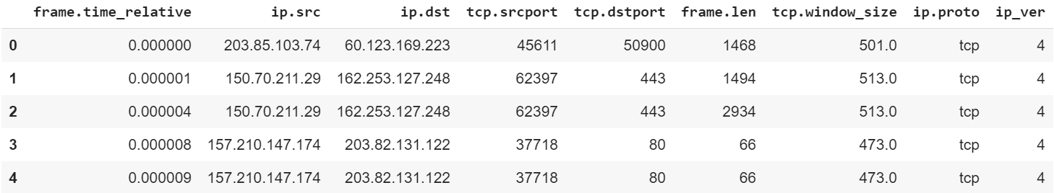
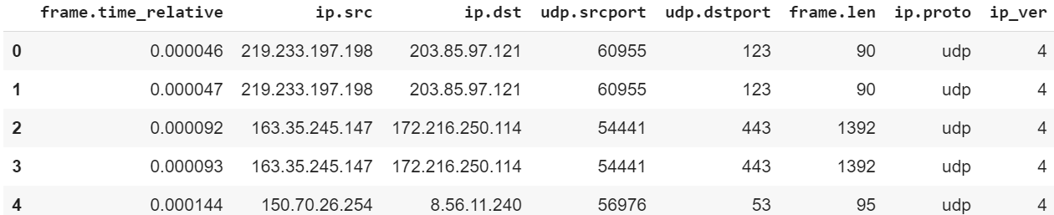
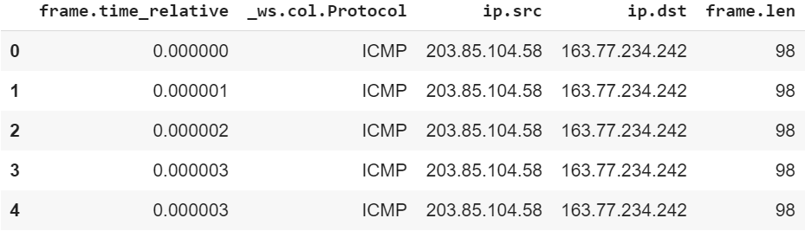
Our Data
TCP
UDP
Other

Slide 5
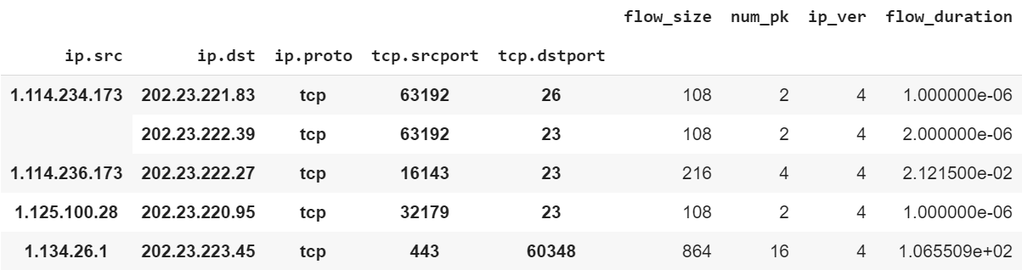
Packets to Flows

Slide 6
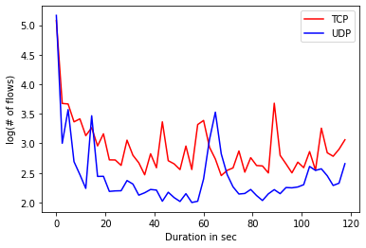
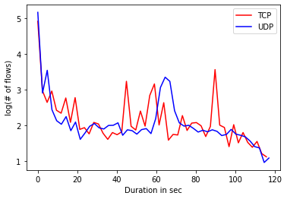
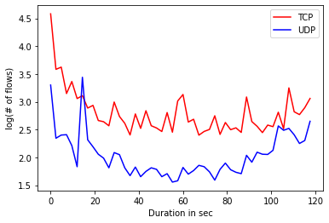
Flows duration
All flows
Less than 10pkts
More than 10pkts

Slide 7
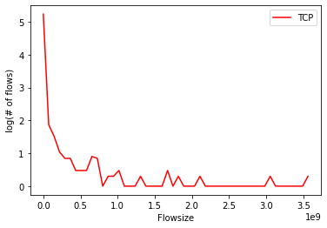
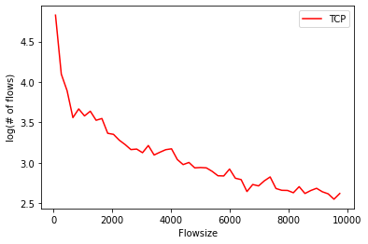
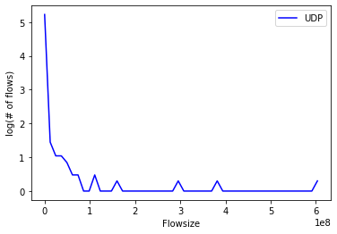
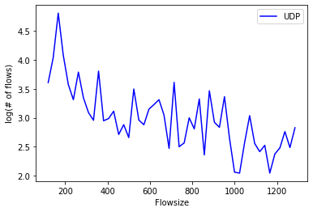
Flow size
All flows
No outliers
TCP
UDP

Slide 8
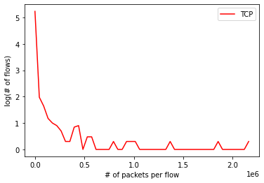
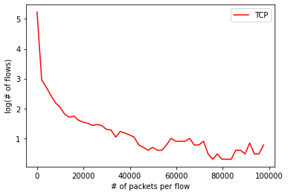
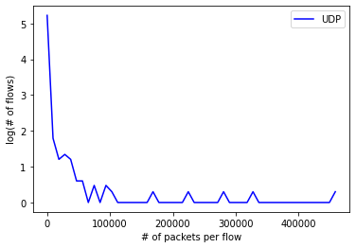
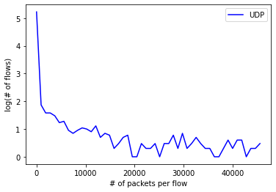
Packets for flow
All flows
No outliers
TCP
UDP

Slide 9
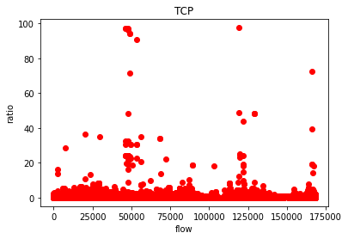
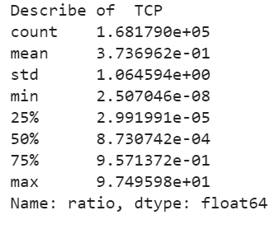
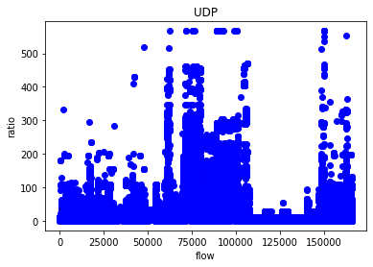
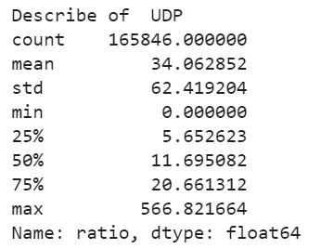
Ratio (size/duraion)
Ipv4: 965
TCP
975 outliers
Ipv6: 10
Ipv4: 31182
TCP
31182 outliers
Ipv6: 0

Slide 10
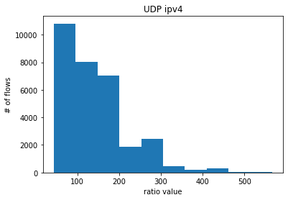
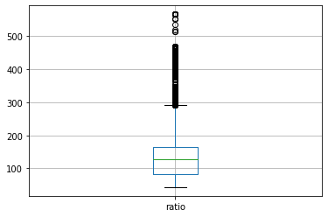
Analysis: UPD ipv4
Outliers distribution
Boxplot
We take in consideration outliers of outliers for our analysis

Slide 11
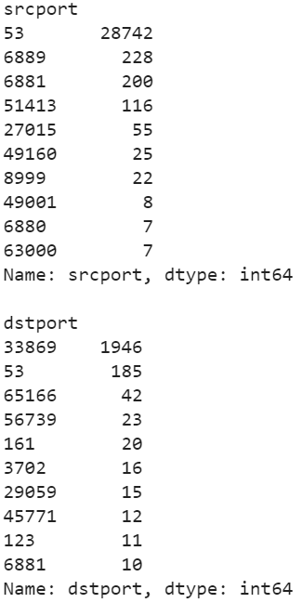
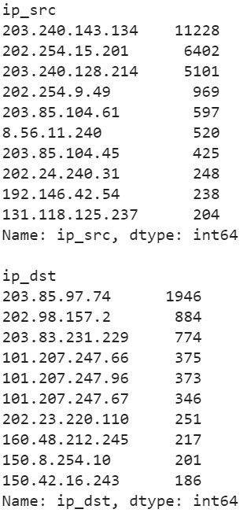
Analysis: UPD ipv4
Counter
For what concern the ip sources with an higher count we can see that:
203.240.128.0/19 belongs to a
telecommunication company
(Sejong telecom)
202.254.0.0/19 belong to Hyogo University of Teacher Education
203.85.102.0/23 belong to a telecommunication company (CITIC telecommunication)
So as we can see the highest number of flows with a huge level of bit per sec comes from telecommunication company or from research department.

Slide 12
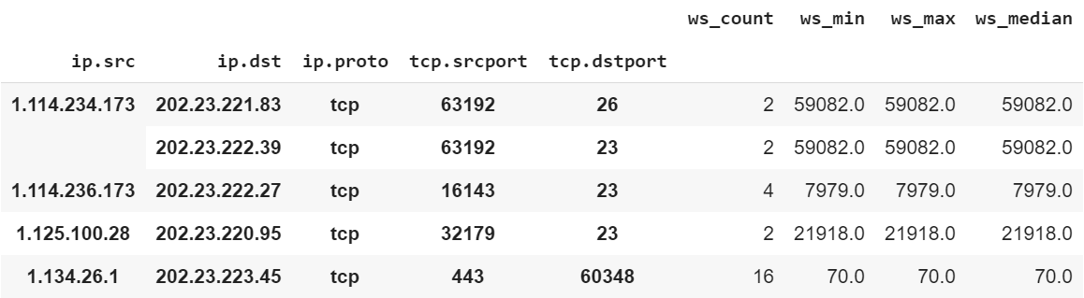
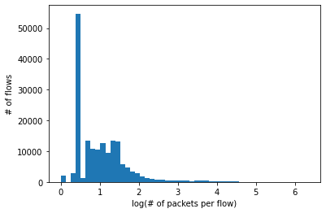
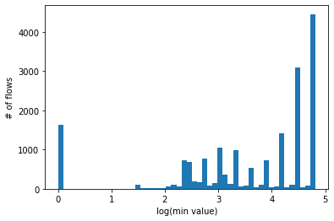
PART2: Window Size
Our flows
Number of flow packets
Packets for flows that go to windows size 0 (at least once)

Slide 13
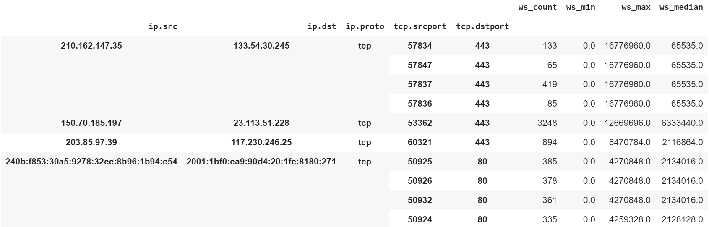
PART2: Windows Size
It is possible to notice how sometimes the median is much lower than the maximum windows size. For this reason it is possible to think that these flows zero their windows size many times.
The ip sources that present this particular behavior are mainly from APNIC (Asia-Pacific Network Information Centre) and NTT (Nippon Telegraph and Telephone)

Slide 14
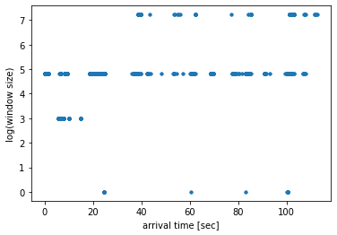
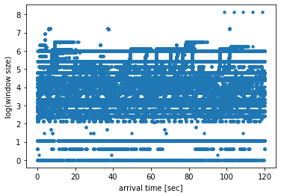
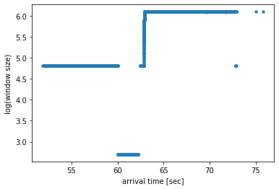
PART2: Windows Size
NTT
APNIC (203.85.0.0/16)
Mainly horizontal lines are present but sometimes it is possible to identify fast step growth behaviors (always linear)

Slide 15
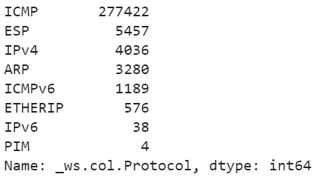
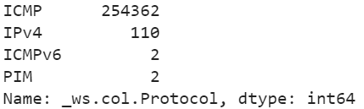
PART2: ‘Other’ flows
Protocol distribution
Protocol distribution: APNIC
APNIC manages 87.1% of the packages,
and 91.6% of ICMP

