Slide 1

Security Automation in next-generation Networks and Cloud environments
F. Pizzato, D. Bringhenti, R. Sisto, F. Valenza
NOMS, 9th May 2024

Slide 2

“Cloud computing is a model for enabling ubiquitous, convenient, on-demand network access to a shared pool of configurable computing resources that can be rapidly provisioned and released with minimal management effort or service provider interaction.”
1/11

Slide 3
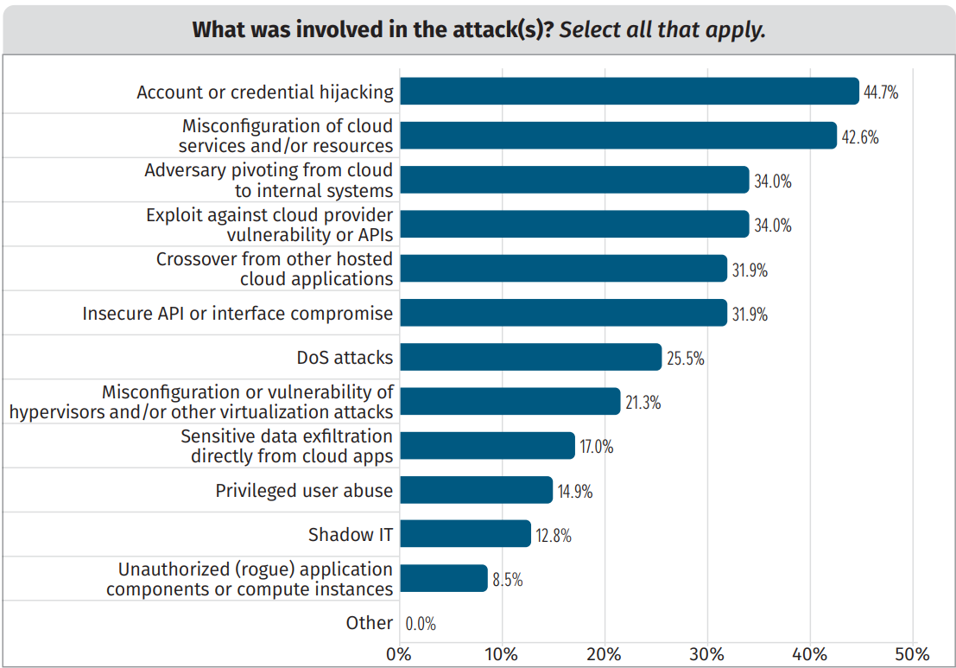
Cloud Computing Security
Misconfiguration of cloud services and resources is the second most common factor involved in attacks (42.6%)^{[1]}
For 59% of interviewed professionals, misconfiguration is No.1 threat requiring larger portion of security experts’ effort ^{[2]}
[1] SANS, “Cloud Security Survey”, 2022, Available: https://www.sans.org/white-papers/sans-2022-cloud-security-survey
[2] Fortinet, “Cloud Security Report”, 2023, Available: https://global.fortinet.com/emea-lp-en-2023cloudsecurityreport
2/11

Slide 4

Ph.D. research goal
Advance the state of the art of security automation and optimization in next-generation networks and cloud-based systems
The key features should be:
Support to high-level declarative intents
Full process automation
Optimization to reduce resource utilization
Formally verified
Dynamic (reactive defense approach)
3/11

Slide 5
Current research directions
Development of novel automated and intent-based approaches for security enforcement in cloud environments, ensuring formal correctness and optimization.
Study the state-of-the-art of cloud security automation
Intent-based security orchestrator for network isolation in Kubernetes
Researching new solutions for the design of security reaction mechanisms for modern networks in response to network attacks
Optimized approach for automatic reconfiguration of firewalls to satisfy a new set of network security requirements
Integration of the automated tools with IDS systems
4/11

Slide 6
Cloud Security Automation – state of the art
In literature, no solution exists to automatically generate the configuration of cloud security services starting from high-level intents.
Few papers adopts automation and formal models in Kubernetes.
Some papers are using formal modeling and automated tools to verify different security features on a given cloud system configuration (e.g., public exposure of S3 buckets, reachability queries, verification of access control rules)
Other works are considering the verification of general security best-practice by analyzing enriched-graph models that are extracted by parsing IaC and/or configuration files.
5/11

Slide 7
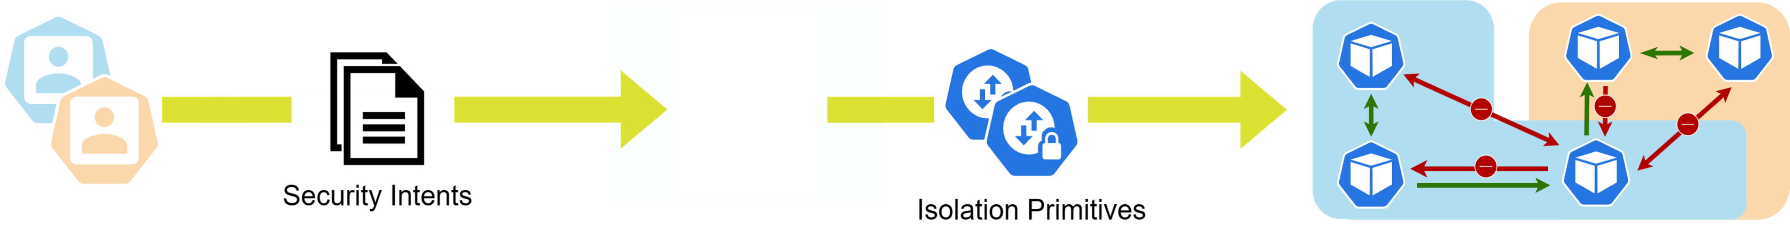

An intent-based solution for network isolation in Kubernetes
Security orchestrator to automate the configuration of network isolation primitives across a multi-domain and multi-tenant cloud environment.
Intent-driven declarative solution, i.e., users define their requirements in terms of prohibited and desired network communications through a user-friendly language.
Ongoing work within EU-founded project, FLUIDOS. Preliminary results will be presented soon at SecSoft 2024.
6/11

Slide 8
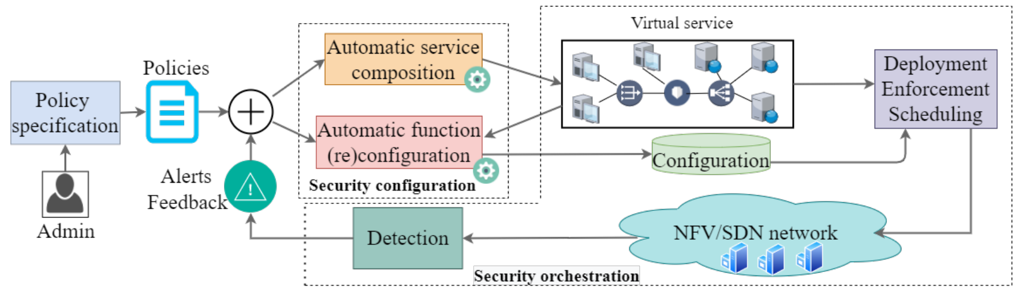
Reactive security mechanisms
Automated approaches should collaborate with monitoring agents and, whenever a cyber attack is identified, an automated mitigation process should be triggered.
7/11

Slide 9

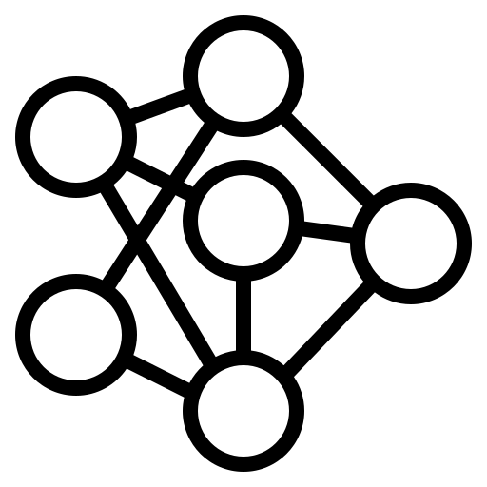


Automated and optimal firewall reconfiguration
Automated approach for the optimal reconfiguration of distributed firewalls, within a short computation time, and (formally) satisfying a new set of Network Security Requirements.
Obtained better scalability and performance with respect to state-of-the-art approaches.
INITIAL SET
TARGET SET
NETWORK TOPOLOGY
UPDATED NETWORK TOPOLOGY
8/11

Slide 10
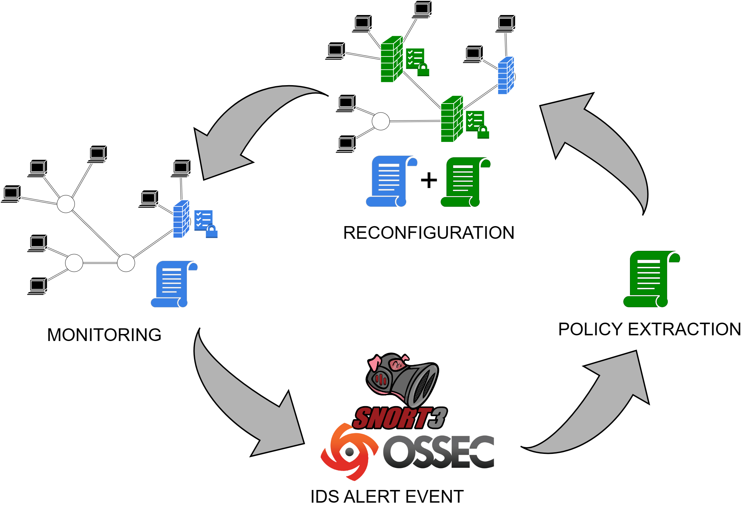
Reactive security framework
Exploit IDS alerts as real-time input to a network security automation approach, obtaining a reactive solution able to dynamically reconfigure the network’s security posture to face network attacks.
Different parsers are needed to efficiently process alerts generated by various IDS (e.g., SNORT3, OSSEC).
After policy extraction, the new requirements are merged to the current set and the network is reconfigured.
9/11

Slide 11
Future research directions
Design of an approach for the automatic and optimal enforcement of access control in Kubernetes using an intent-based workflow.
access control has a very important role in the security hardening of a system, and it is an area where similar approaches have already been employed in traditional and virtualized networks.
Further research towards the design of the reactive security framework.
investigate potential ways to integrate a similar framework within Kubernetes
focus on enhancing a critical aspect of this kind of systems, the policy extraction engine, that is currently carried out in a simplistic manner, and there is potential for improvement to optimize this process.
10/11

Slide 12
Thanks for your attention!
Francesco Pizzato
<francesco.pizzato@polito.it>
11/11

