Slide 1

2025 International Conference of Network and Service Management (CNSM), Bologna, IT, 27-31 October 2025
A demonstration of an autonomous
approach for cyberattack mitigation
Francesco Pizzato, Daniele Bringhenti, Fulvio Valenza, Riccardo Sisto

Slide 2

State of the Art and Motivation
In literature, automatic approaches were proposed to mitigate cyberattacks with firewall reconfiguration, but with excessive manual interaction:
to analyze Intrusion Detection System (IDS) logs and extract security policies;
to issue all low-level reconfiguration commands which are automatically computed.
These still manual operations are not only slow,
but also prone to decision-making errors.
1

Slide 3
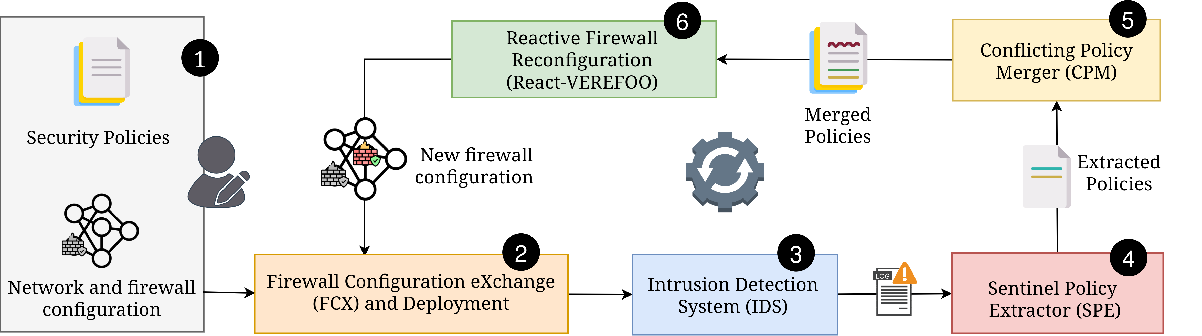
The proposed solution: Automated Mitigation
The proposed solution consists in an autonomous, optimized and provably correct process to mitigate cyberattacks by reconfiguring distributed firewalls.
2

Slide 4
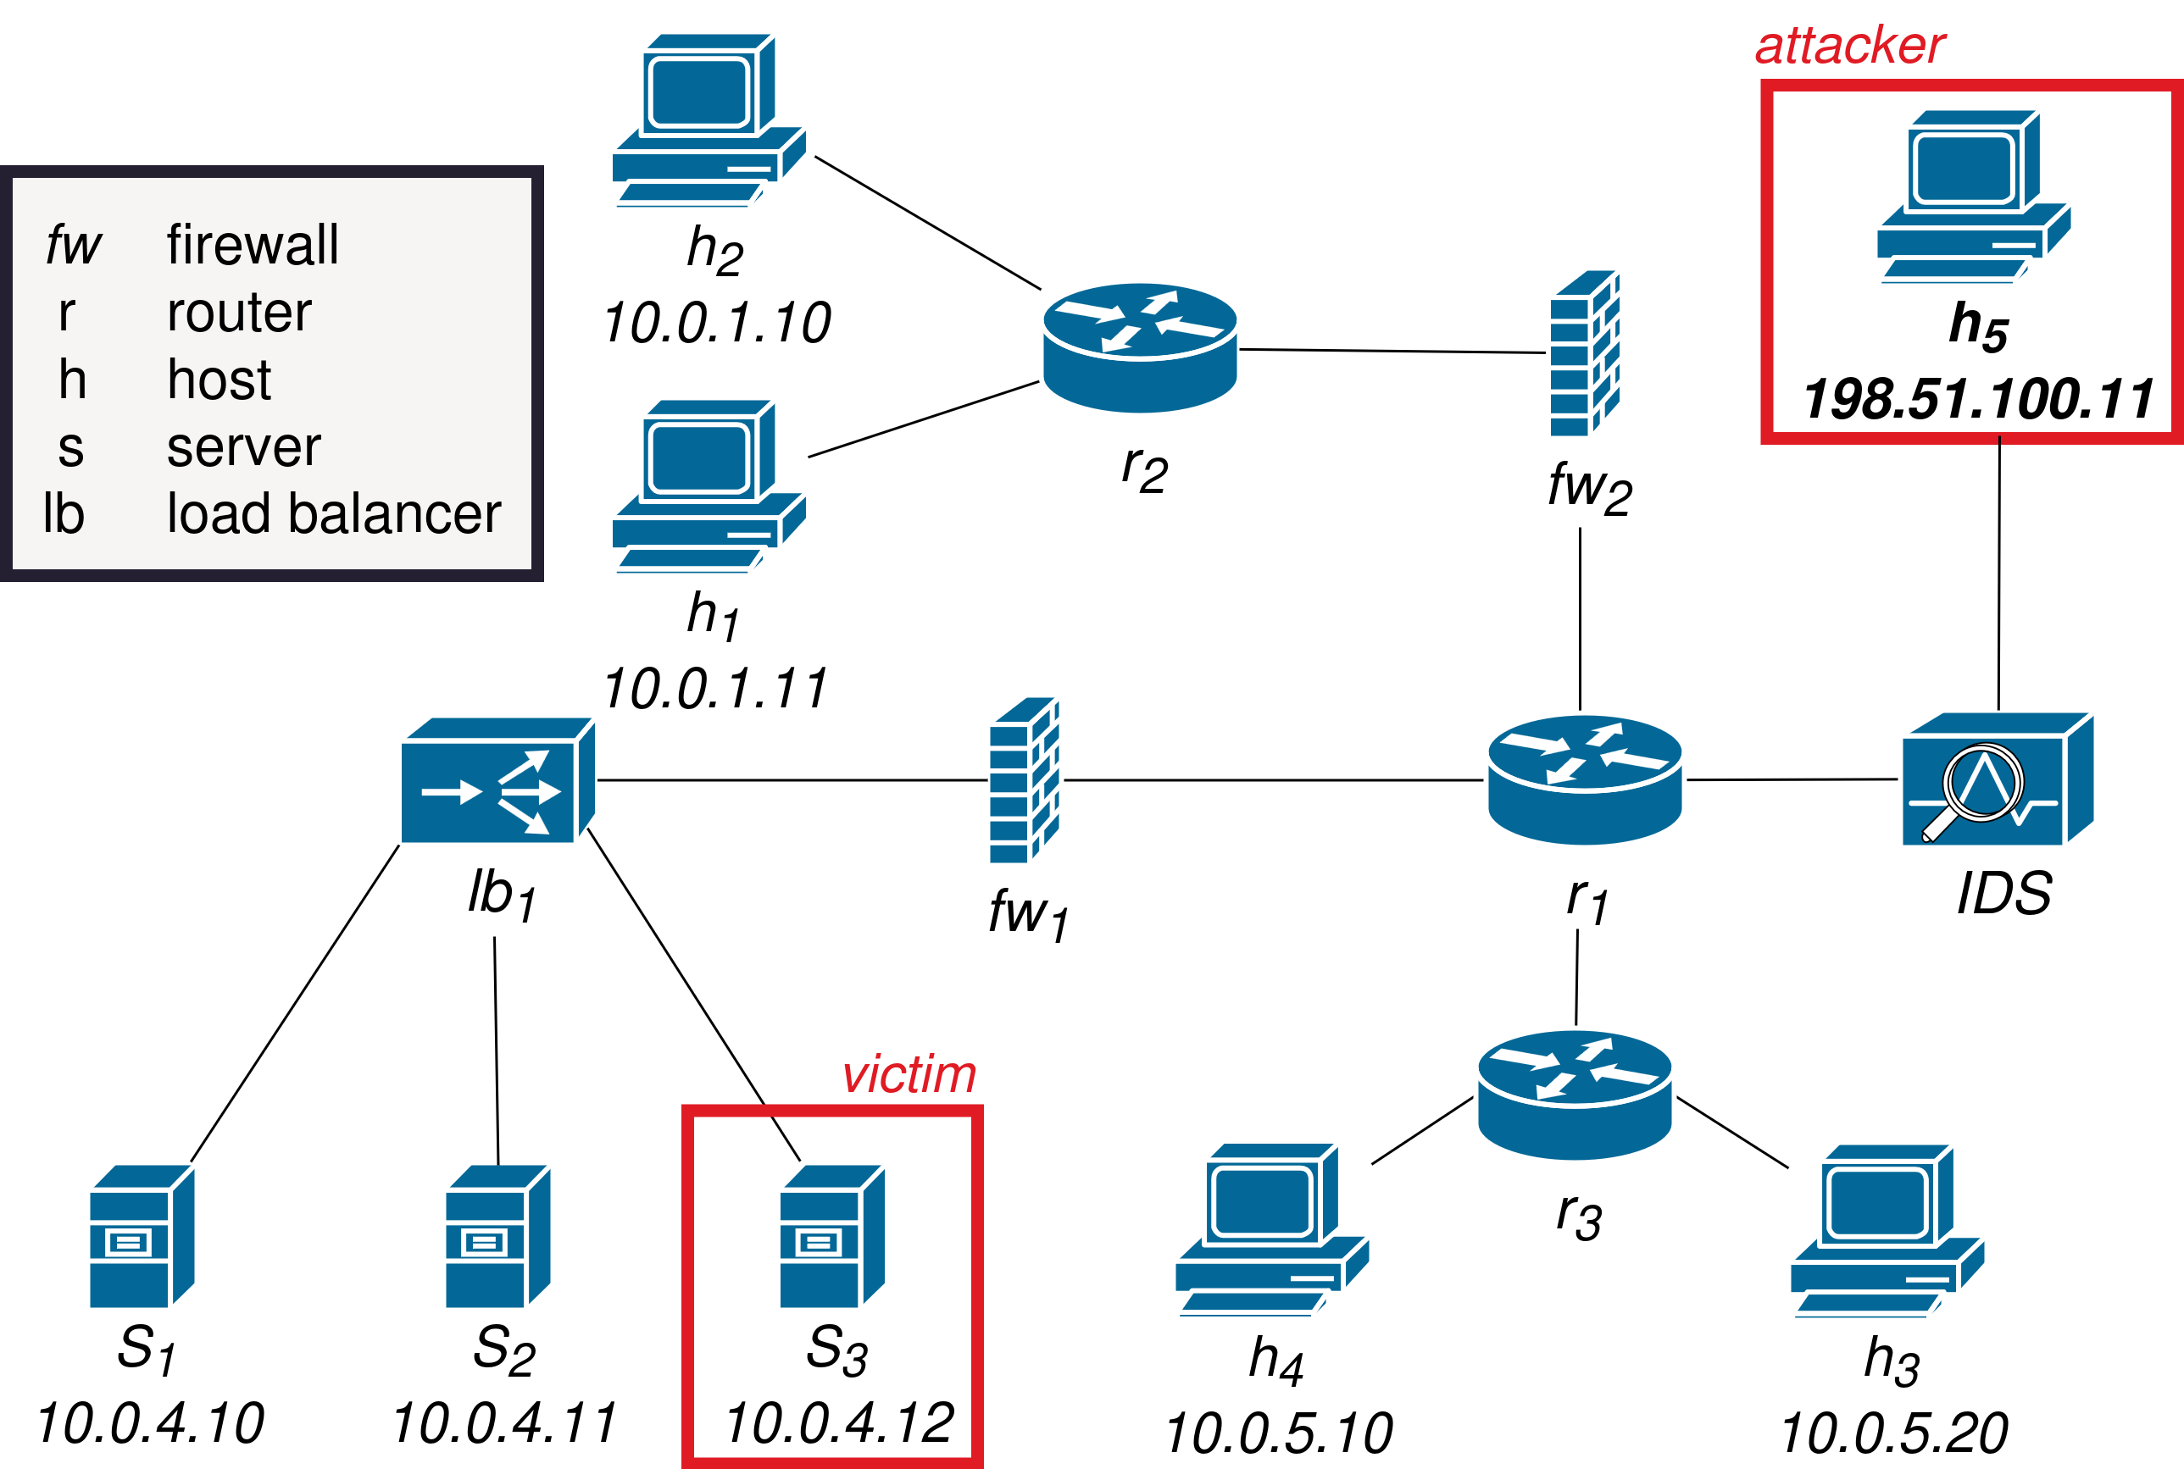

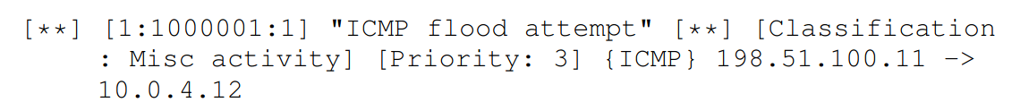

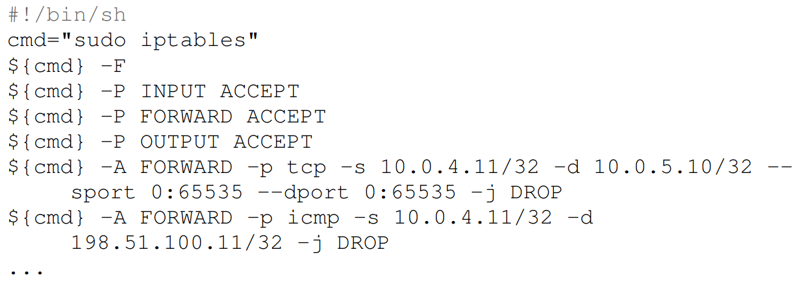

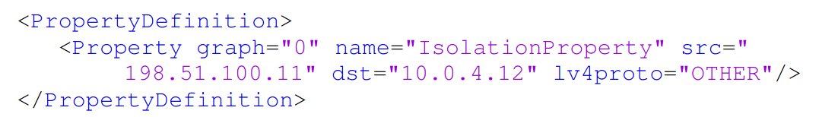

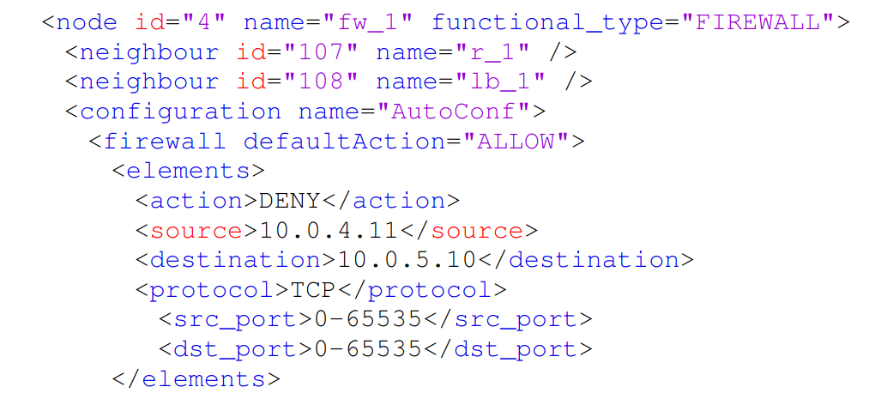


Validation: Mitigation of a flooding DoS attack
4/16
3

Slide 5

Thanks for your attention!
Francesco Pizzato
<francesco.pizzato@polito.it>
GitHub (VEREFOO):
D. Bringhenti, F. Pizzato, R. Sisto, F. Valenza, "A looping process for cyberattack mitigation", IEEE International Conference on Cyber Security and Resilience, London, UK, 2-4 September 2024. 10.1109/CSR61664.2024.10679501
D. Bringhenti, F. Pizzato, R. Sisto, F. Valenza, "Autonomous attack mitigation through firewall reconfiguration", International Journal of Network Management, 2024. 10.1002/nem.2307
F. Pizzato, D. Bringhenti, R. Sisto, F. Valenza, “Automatic and optimized firewall reconfiguration“, in IEEE Network Operations and Management Symposium (NOMS 2024), Seoul, South Korea, 6–10 May 2024. 10.1109/NOMS59830.2024.10575212

Slide 6
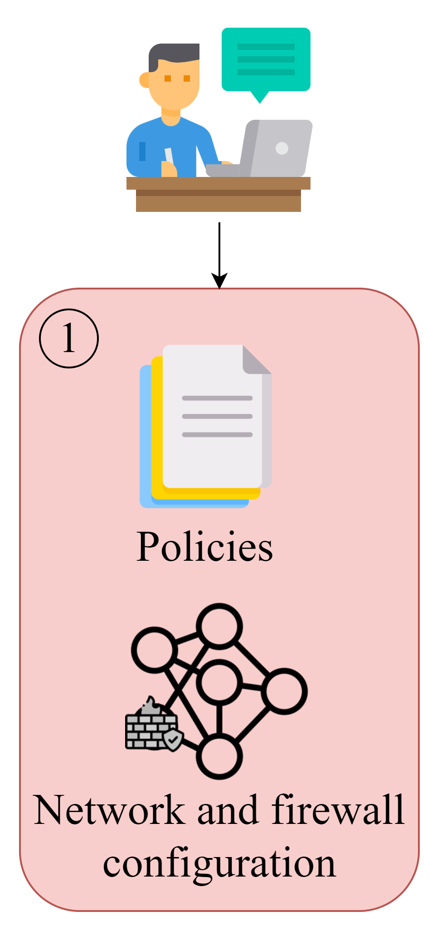
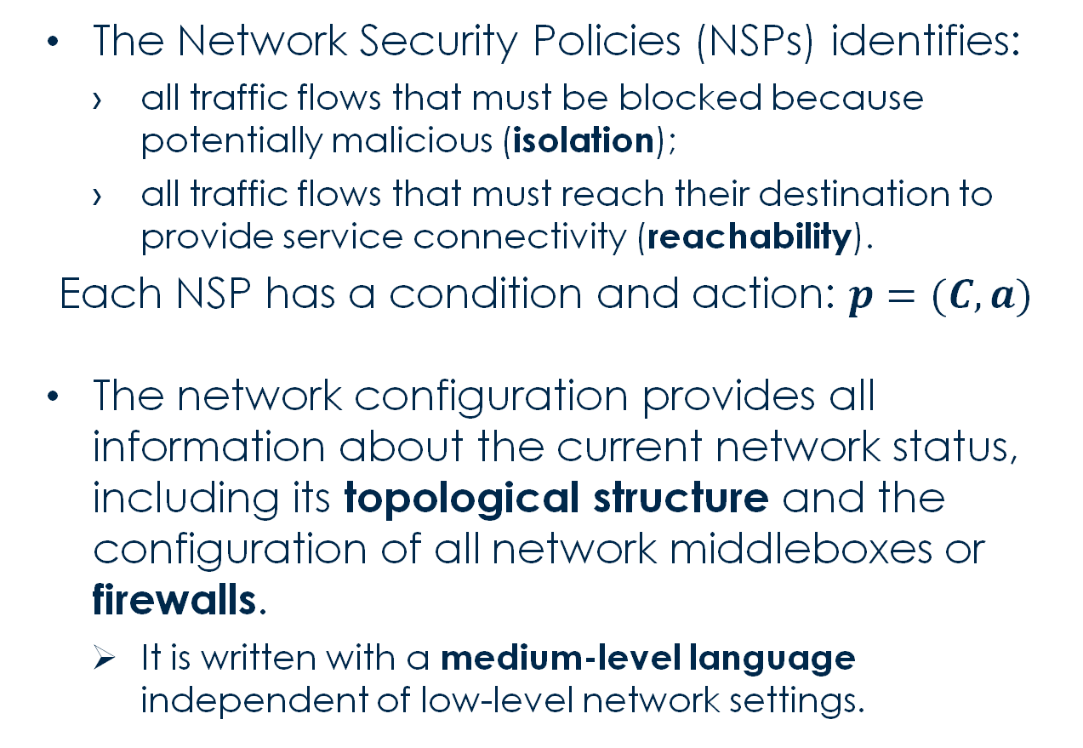
Input Preparation
The Network Security Policies (NSPs) identifies:
all traffic flows that must be blocked because potentially malicious (isolation);
all traffic flows that must reach their destination to provide service connectivity (reachability).
Each NSP has a condition and action: $p=(C,a)$
The network configuration provides all information about the current network status, including its topological structure and the configuration of all network middleboxes or firewalls.
It is written with a medium-level language independent of low-level network settings.
4

Slide 7
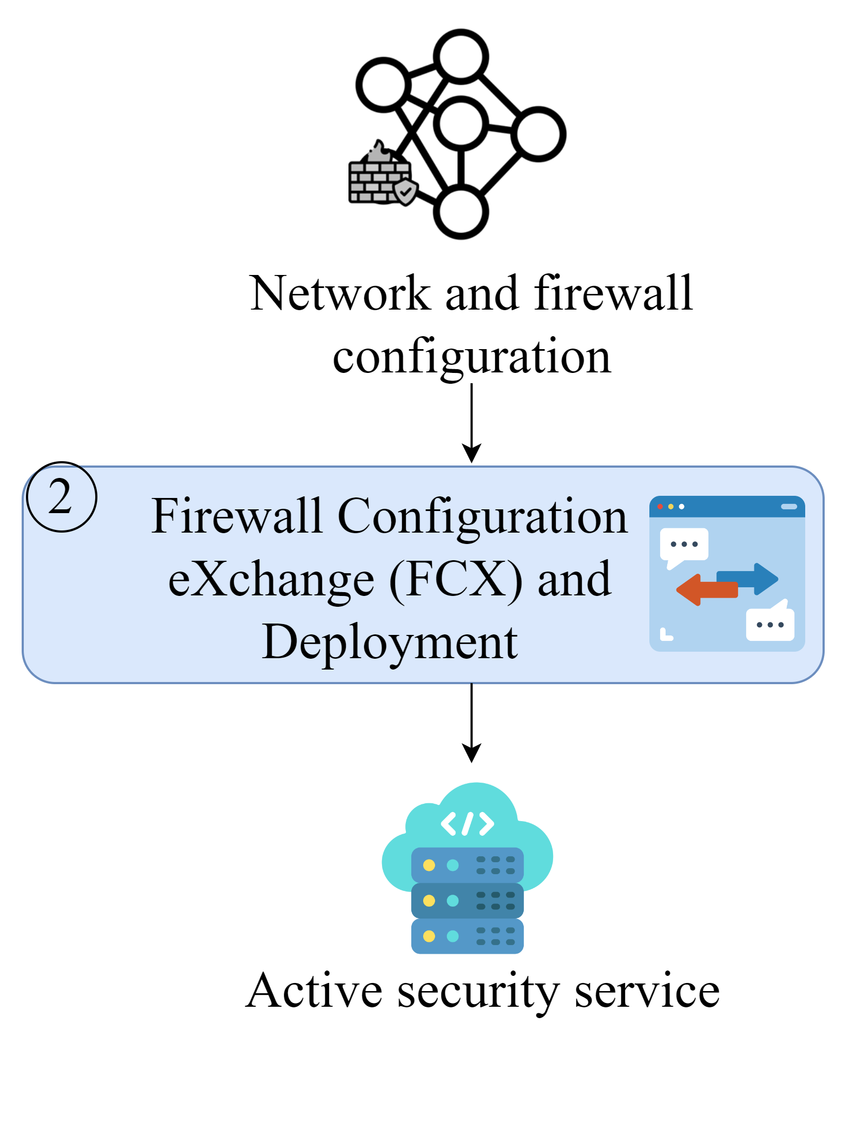
Firewall Configuration Translation and Deployment
A translating agent named Firewall Configuration eXchange (FCX) converts XML/JSON files into the specific commands of different firewalls.
This agent already supports the most common firewall technologies (e.g., iptables, eBPF firewall)
It is flexible enough to support other types.
After this translation, the configuration settings are passed on to the network orchestrator, which can thus apply them to the firewalling virtual functions.
5

Slide 8
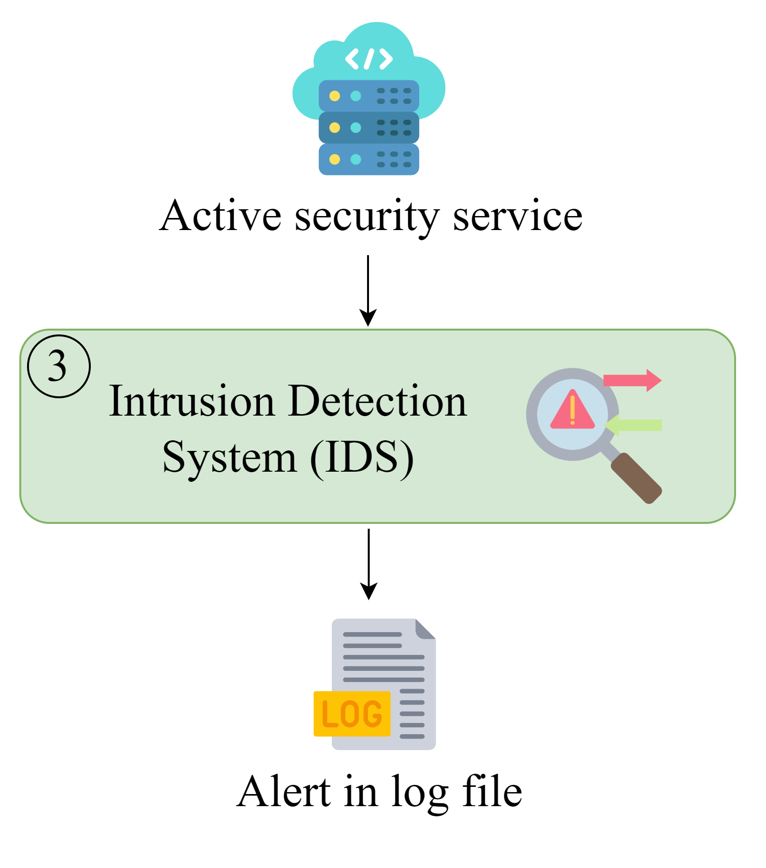
Attack Detection
The IDS detection engine is used to evaluate the network and identify possible attacks.
When an attack is detected, the IDS triggers an alert by creating a new entry in its log file, describing all the information deduced about the attack.
The literature is rich in proposals about intelligent strategies for attack detection.
Our study is not interested in researching a new one, but our approach can support any IDS technology if the IDS produces a log file.
6

Slide 9
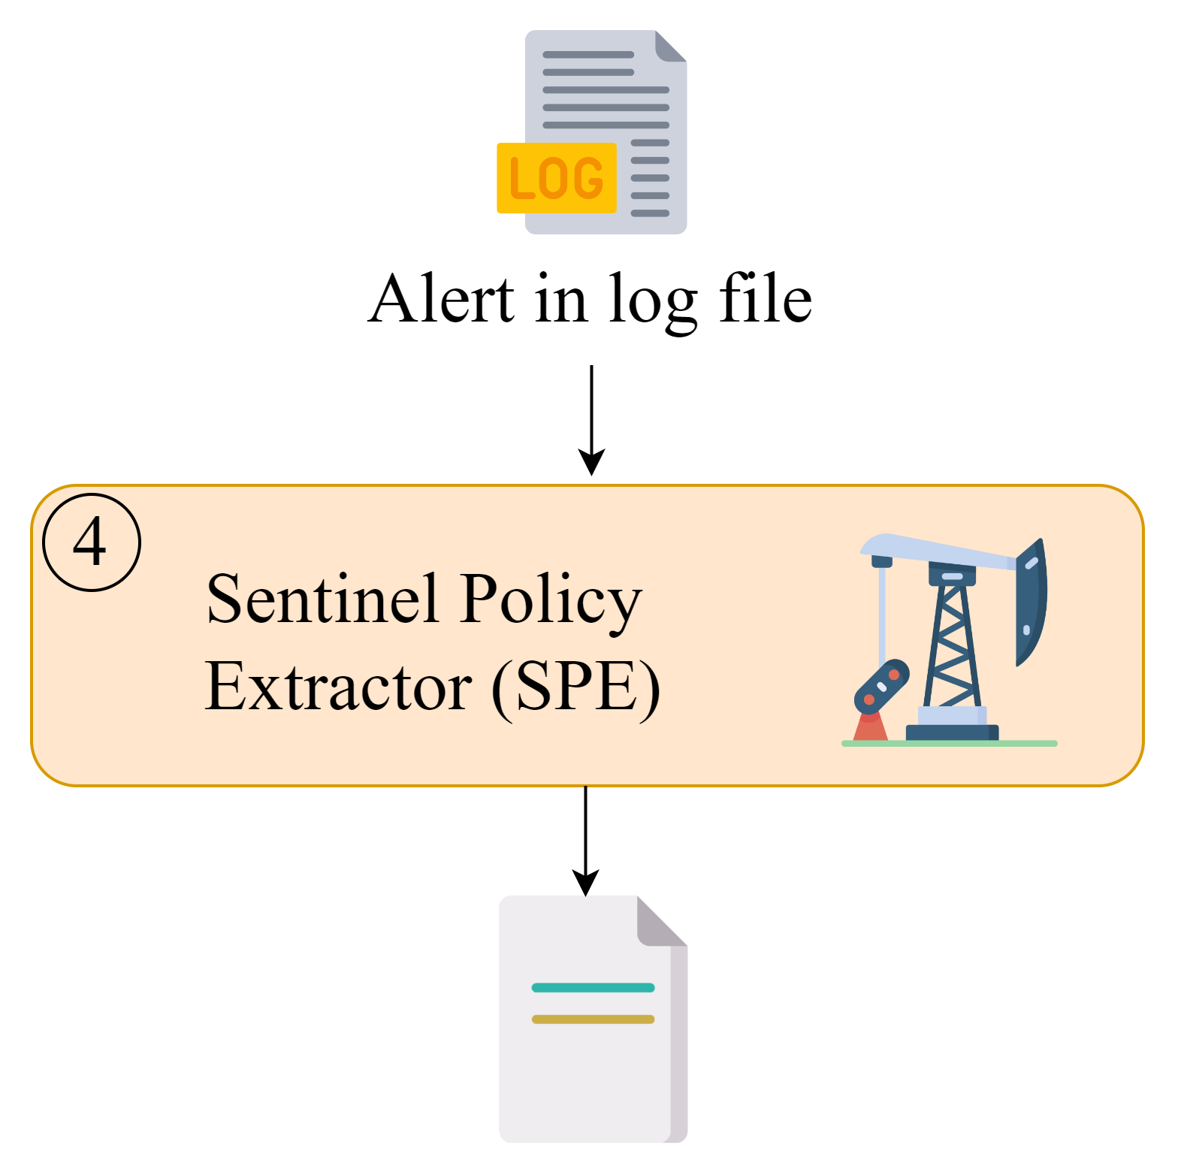
Policy Extraction
A vigilant agent, named Sentinel Policy Extractor (SPE), is granted read permission to IDS log files.
It periodically checks them to search for new entries related to attack detection.
Whenever such an entry is detected, the SPE extracts crucial information and produces a set of NSPs that should correctly stop the attack.
7

Slide 10
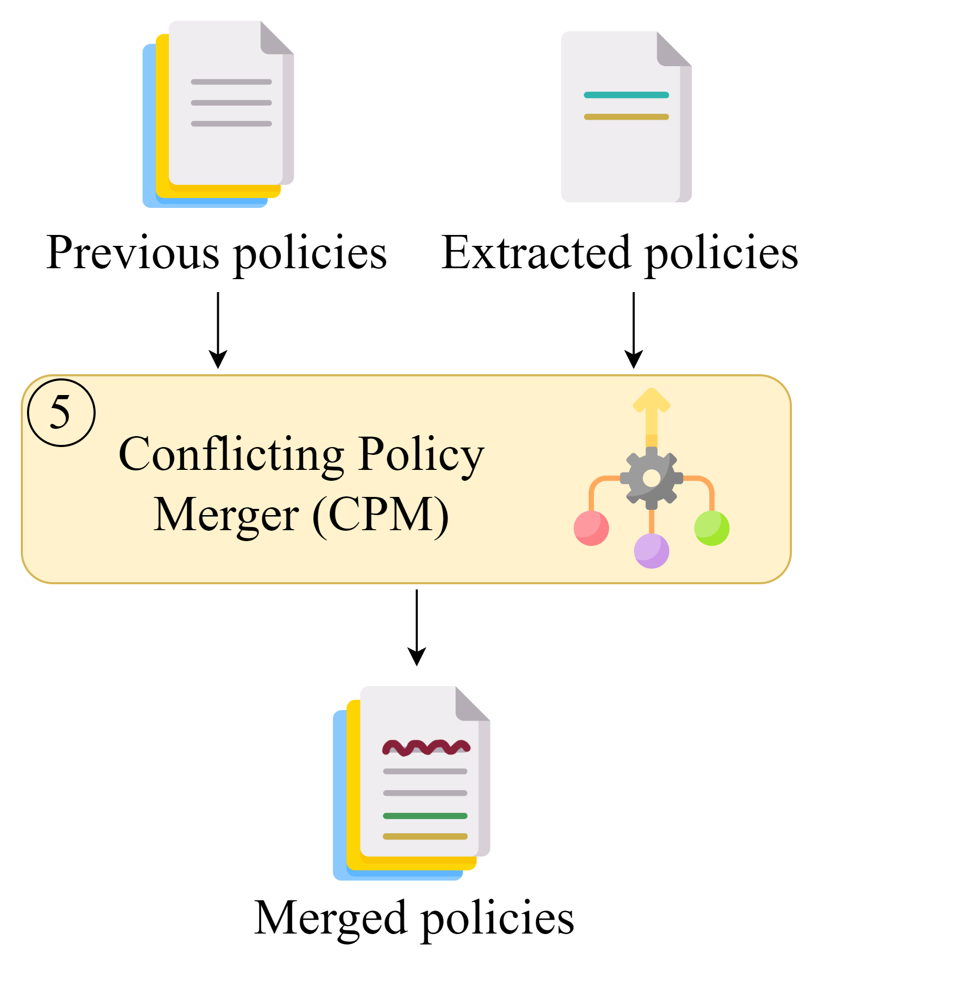
Policy Extraction
Another agent, named Conflicting Policy Merger (CPM), creates a merged NSP set, using the previous NSPs and the extracted ones.
Some extracted NSPs may conflict with the previous ones (e.g., they have the same condition, but opposite actions).
For each conflicting policy of the previous NSP set, the CPM modifies its conditions so that it does not include the overlapped part anymore.
8

Slide 11
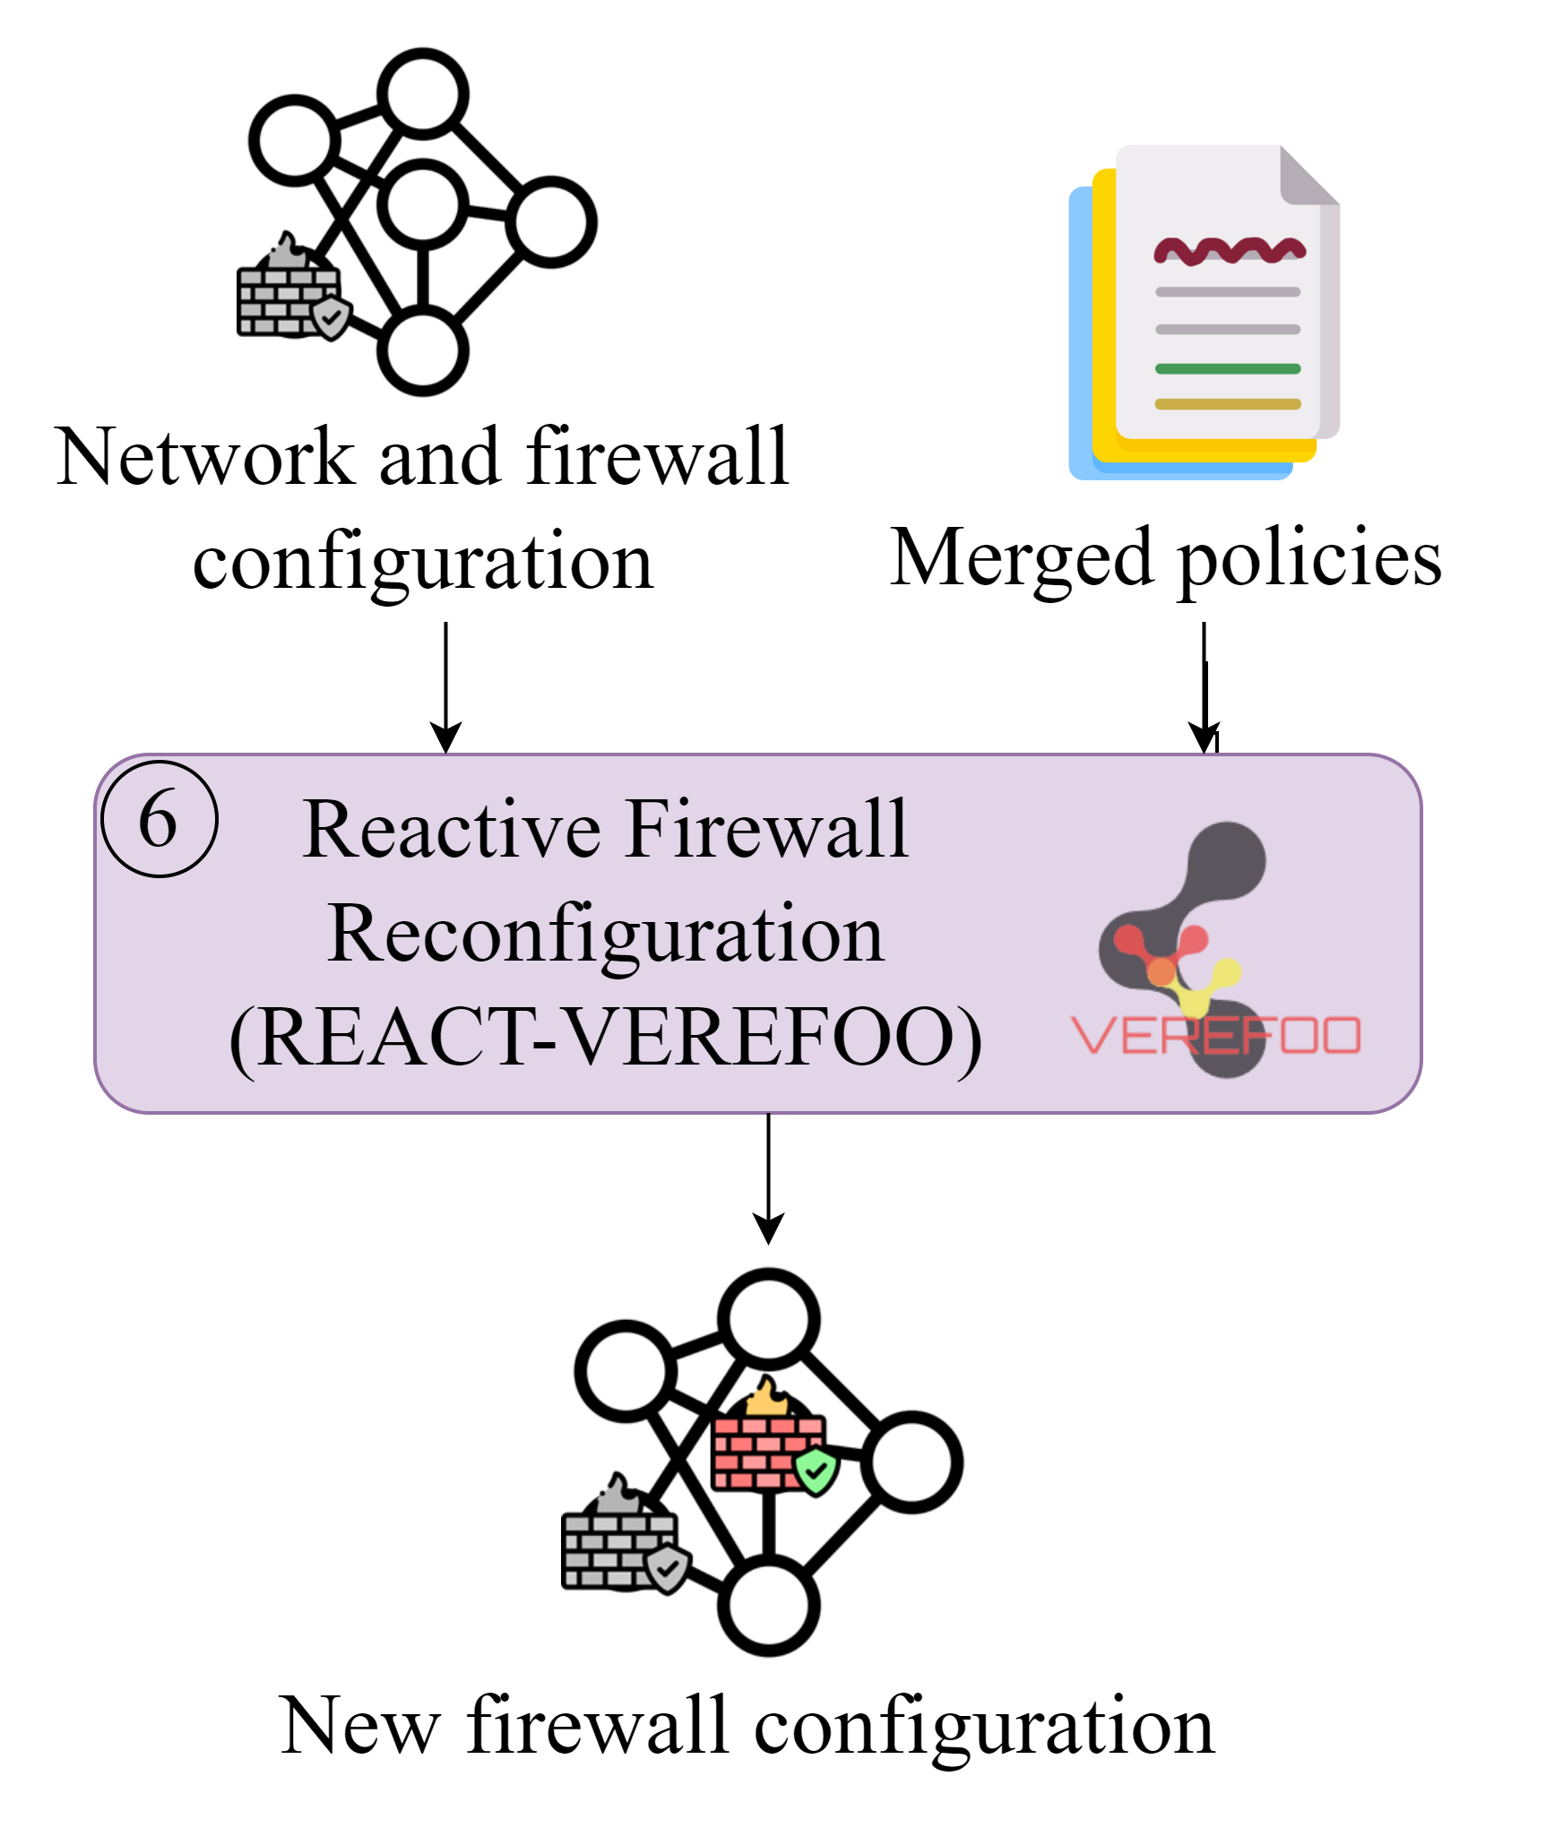
Firewall Reconfiguration Computation
The new firewall configuration (composed of its new allocation scheme and rule set) is computed with React-VEREFOO:
it combines automation, formal verification and optimization;
it formulates the problem with Maximum Satisfiability Modulo Theories (MaxSMT);
it modifies the firewall configuration while keeping the current one as much as possible.
The new configuration is translated by the FCX agent.. and the loop repeats.
9

Slide 12
Implementation
Prototype implementations, with their interfaces, have been developed for the agents.
the FCX agent (Java) can produce low-level settings for iptables, ipfirewall, Open vSwitch, and eBPF firewall;
the SPE (python3) parses log files produced by Snort3 and OSSEC3.7;
the CPE agent (pythons3) works with XML/JSON documents.
10

