Slide 1
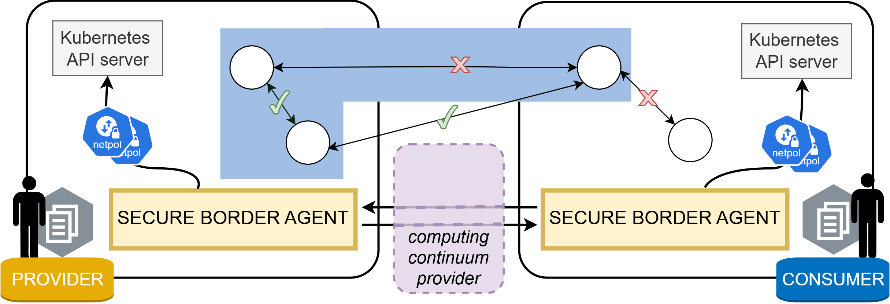
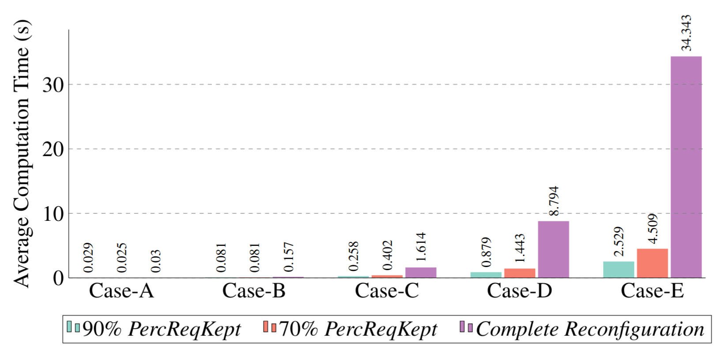
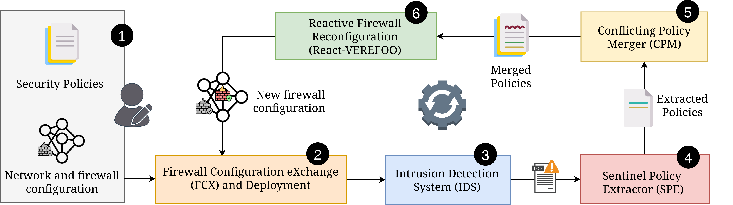
Security Automation and Optimization in Cloud Environment
Supervisor
Prof. Fulvio Valenza
Prof. Riccardo Sisto
XXXIX cycle
Francesco PIZZATO
Email: francesco.pizzato@polito.it
Introduction
Cloud and next-generation networks are large-scale, dynamic systems composed of ephemeral and heterogeneous components. These features makes security management very challenging, as it often relies on manual configuration and human expertise. As a result, security processes are time-consuming, unoptimized, and prone to errors, with misconfiguration being a leading cause of security incidents.
Goal
Design novel solutions for the management of security services in cloud and next-generation networks. The research focuses on using automation and formal methods to simplify the configuration of (cloud) security services, e.g., Network Policies and RBAC, reducing manual effort and minimizing errors. Complementary, it investigates optimizing reconfiguration scenarios and designing reactive defense systems to further limit human involvement.
Method
The research goal is achieved through:
Investigation of user-friendly approaches to simplify security service configuration in complex could environments using high-level intents [1].
Application of formal methods to automate and optimize the refinement of high-level intents into low-level configurations, designing parallelization and reconfiguration strategies improving scalability and computation time [2].
Developing of novel approaches to integrate monitoring agents, such as Intrusion Detection Systems (IDS), with security automation, enabling self-reconfiguring systems able to correctly react upon attack detection [3].
Analyzing cloud security and researching techniques to formally model it, with the scope of enabling automatic verification and validation of configuration automatically and formally verify it.
Results
Intent-based approach to configure network isolation primitives (e.g., Kubernetes Network Policy) across cloud computing continuum, creating secure borders between workloads.
Optimized approach for the reconfiguration of distributed FWs achieving faster computation times and formal satisfaction of a new set of Network Security Requirements (NSRs).
Integration of IDS systems as real-time input to automated tools to dynamically reconfigure security posture in response to an attack.
Ongoing: applying Information Flow Control (IFC) for serverless authorization, formal cloud verification, and parallel refinement for distributed firewalls.
References
F. Pizzato, D. Bringhenti, R. Sisto and F. Valenza, "An intent-based solution for network isolation in Kubernetes." IEEE Int. Conf. on Network Softwarization (NetSoft), Saint Louis, MO, USA, 2024.
F. Pizzato, D. Bringhenti, R. Sisto and F. Valenza, "Automatic and optimized firewall reconfiguration." IEEE Network Operations and Management Symposium (NOMS), Seoul, Korea, Republic of, 2024.
F. Pizzato, D. Bringhenti, R. Sisto and F. Valenza, "Autonomous Attack Mitigation Through Firewall Reconfiguration." International Journal of Network Management, 2025.

