Slide 1

Minhash/lsh
and duckdb
Pugnaloni Francesco
Massimini Angelo

Slide 2
Introduction
The task: to apply Minhash/LSH to a table inside a DuckDB database
Why: currently there isn’t a built in fucntion to compute LSH in duckdb
Tools: Python and DuckDB
Cooperation method: pair programming
Artifacts produced: short report, power point presentation, colab notebook

Slide 3
Structure of presentation
Minhash/LSH introduction
DuckDB introduction
Project overview
Tests performed
Conclusion

Slide 4
Minhash/LSH
Shingling: technique to tokenize documents
Minhash: technique to compress shingle rapresentation mantaining Jaccard similarity
LSH: combined use of buckets and banding to minimize the time of comparisons and reduce false negatives

Slide 5
Duckdb
Open source RDBMS
Easy to use and to embed
Columnar database
Vectorized data processing to optimize cache usage
OLAP friendly
Fully ACID compliant with MVCC

Slide 6
Project overview
Program structure: divided in two parts, the first is the minhash block, the second is the LSH block.
The first one (Minhash) is optional.
Let’s analyze the structure in details

Slide 7
Project overview
Minhash block:
DuckDB file creation from a csv file: if there isn’t an existent one
Indexed table creation: to identify the tuples in a standardized way
Text view creation: to has easy access to the important data
Shingling: creation of a compressed shingle matrix
Minhashing: creation of a minhash numpy matrix
Minhashes writing: minhash writing to persist the minhashes in the DuckDB database

Slide 8
Project overview
LSH block:
Numpy python LSH computation
SQL DuckDB LSH computation
Output writing on DuckDB: as couple of indexes
Output visualization: the number of couples found or the couple themselves

Slide 9
Project overview
Program’s usage: the ‘’lsh’’ function
Parameters:
3 mandatory: database_name, table_name, column_list
12 optional, the most important ones are: compute_minhash, bands, k_shingle_lenght, threshold, csv_name, drop_blanks, minhashing_threshold, drop_shingles_threshold

Slide 10
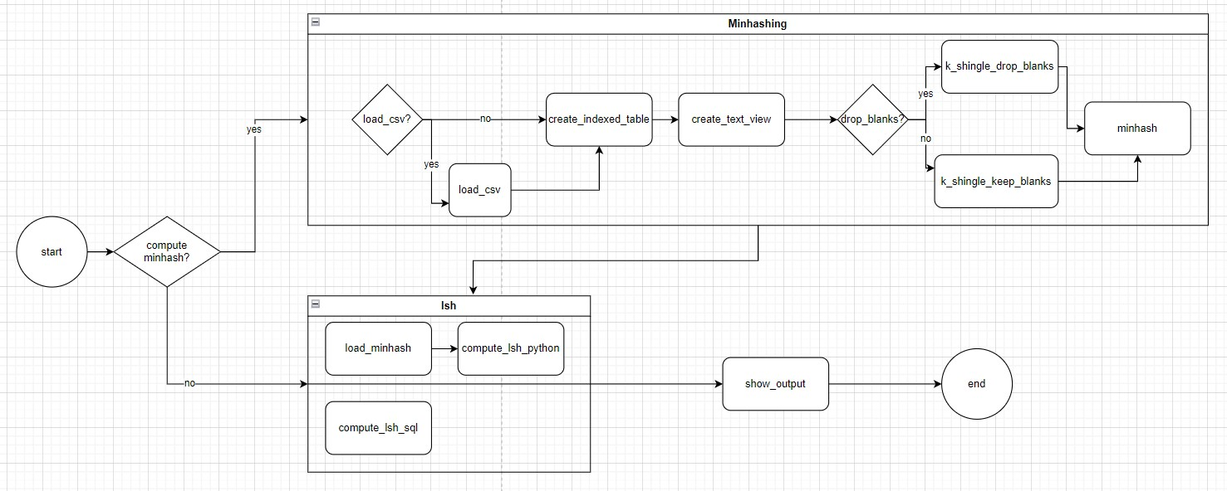
Project overview

Slide 11
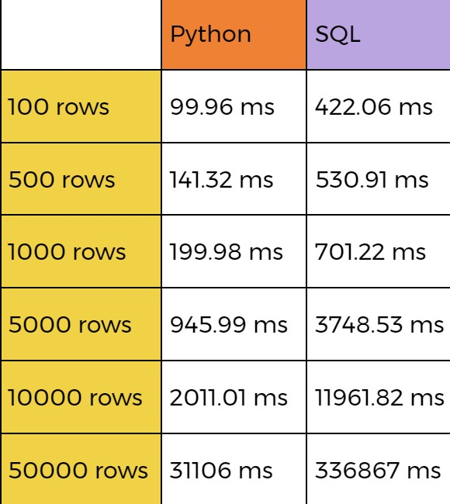
Tests performed
Dataset used: https://www.kaggle.com/datasets/jdobrow/57000- books-with-metadata-and-blurbs, containing data about 57000 books and their blurbs.
Columns analyzed: title, blurb
Tests: computation of LSH in both versions over an increasing number of rows keeping the other parameters constant
Fixed parameters values: threshold=0.7, bands=16, k_shingle_length=5

Slide 12
Conclusion
Features:
Fast to deploy and easy to use
Hybrid SQL queries using dataframes and relations together
Possibility to convert a relational table in a dictionary of numpy arrays
Performances:
Python uses the optimized numpy arrays
DuckDB optimization aren’t expolited in best possible way in this task, because we are not working with few columns

Slide 13
Thanks for the attention

