Slide 1
On Percolation Centrality as a New Centrality Measure

Slide 2
Overview
Summary of the paper
Simulations and reproduction
Limitations and extensions

Slide 3
Overview
Summary of the paper
Simulations and reproduction
Limitations and extensions

Slide 4

Summary of the Paper
Background
Percolation on a generic network with node states representing infection statuses
Infection states can be given by discrete values (Susceptible, Infected, Recovered) or continuous infection percentages
Want to quantify the importance of any node in the network
Previous Centrality Measures
Degree Centrality
Closeness Centrality
Betweenness Centrality:
Need a way to dynamically update our measure as percolation spreads in the network!

Slide 5
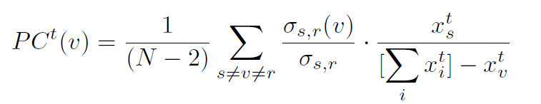

Summary of the Paper
Contribution: Percolation Centrality
= percolation state of node i at time t (in [0, 1])
Weight term accounting for potential percolation of each path
If all nodes have the same percolation state, PC = BC
Alternative version accounting also for target nodes

Slide 6
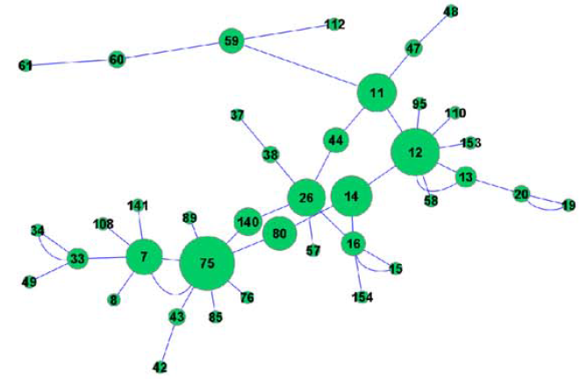
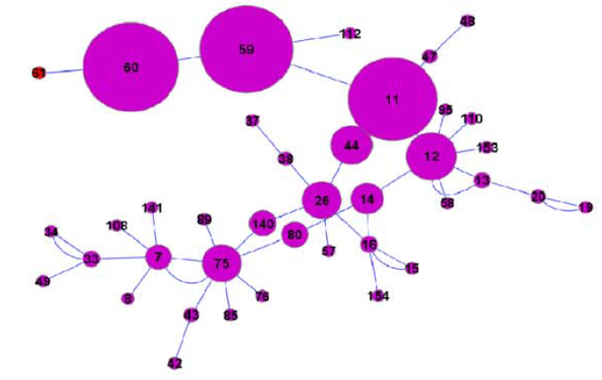
Summary of the Paper
PC showcase
BC
PC, T = 1

Slide 7
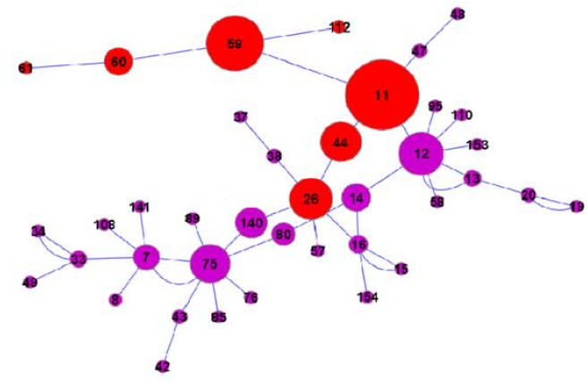
Summary of the Paper
PC showcase
BC
PC, T = 7

Slide 8
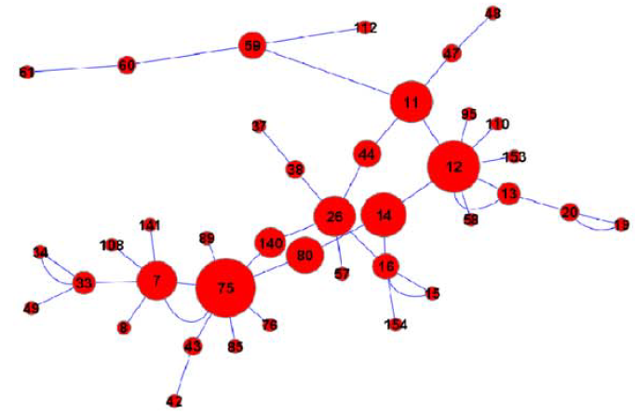
Summary of the Paper
PC showcase
BC
PC, T = 20

Slide 9
Overview
Summary of the paper
Simulations and reproduction
Limitations and extensions

Slide 10
Simulations
Setup
Random graph with N=500 and one initial infected node
Infection with fixed percolation probability p = 0.2
After 𝛼% of nodes are infected, the top ꞵ% are immunized, removing them from the network
Nodes ranked by PC, BC or Hop Distance, i.e. the distance to the closest infected node.
Time until saturation is observed

Slide 11
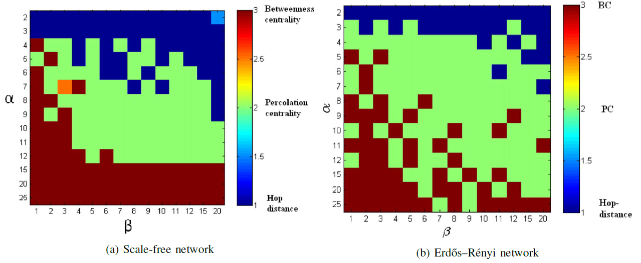
Results
Small 𝛼/ꞵ: Hop Distance
High 𝛼/ꞵ: Betweenness Centrality
Medium 𝛼/ꞵ: Percolation Centrality

Slide 12
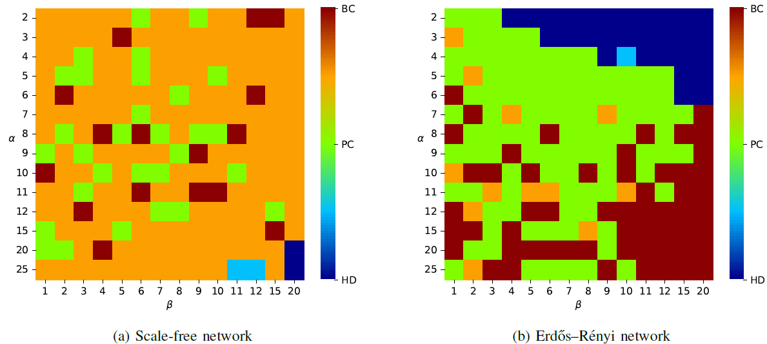
Reproduction
Erdős–Rényi: similar results, especially for small and medium 𝛼/ꞵ
Scale-free: ??

Slide 13
Simulations
Discussion
Possible explanations:
One specific real-world scale-free network (log-normal instead of power law?)
Specific parameters, possibly cherry-picked
The models and parameters used for simulations are not specified!
Simple strategy does not seem to generalize to all networks

Slide 14
Overview
Summary of the paper
Simulations and reproduction
Limitations and extensions

Slide 15
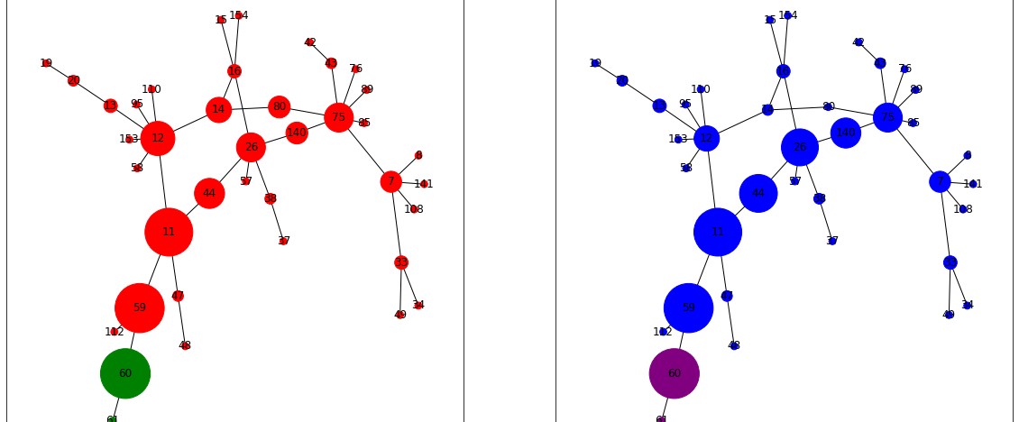
Limitations and extensions
What happens when percolation probabilities differ throughout the network?
We consider a weighted shortest paths calculation, where edge weights correspond inversely to the probability of percolating
Analogous to weighted BC
Up to experimentation how to best set the edge weights
We run a small network percolation with edge weights set to the inverse of the percolation probability into and out of a node:

Slide 16
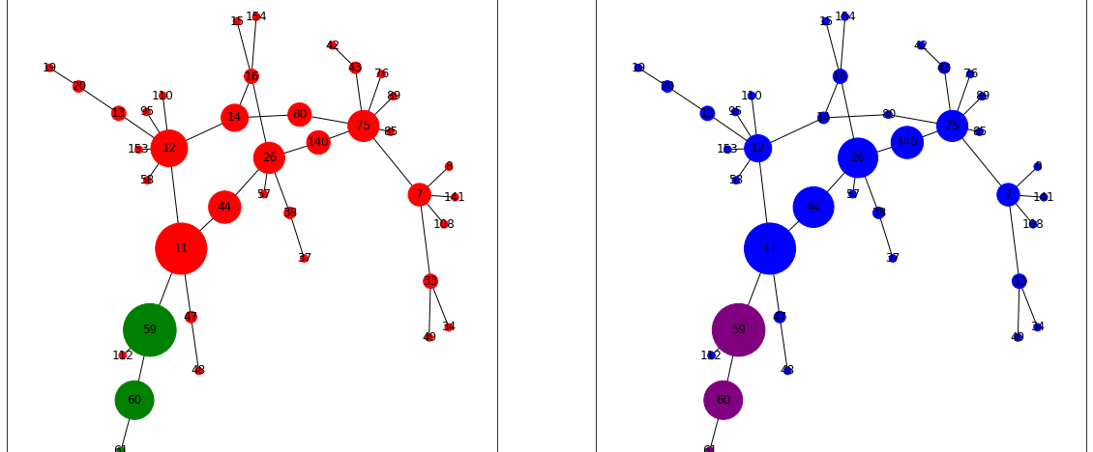
Limitations and extensions
What happens when percolation probabilities differ throughout the network?
We consider a weighted shortest paths calculation, where edge weights correspond inversely to the probability of percolating
Analogous to weighted BC
Up to experimentation how to best set the edge weights
We run a small network percolation with edge weights set to the inverse of the percolation probability into and out of a node:

Slide 17
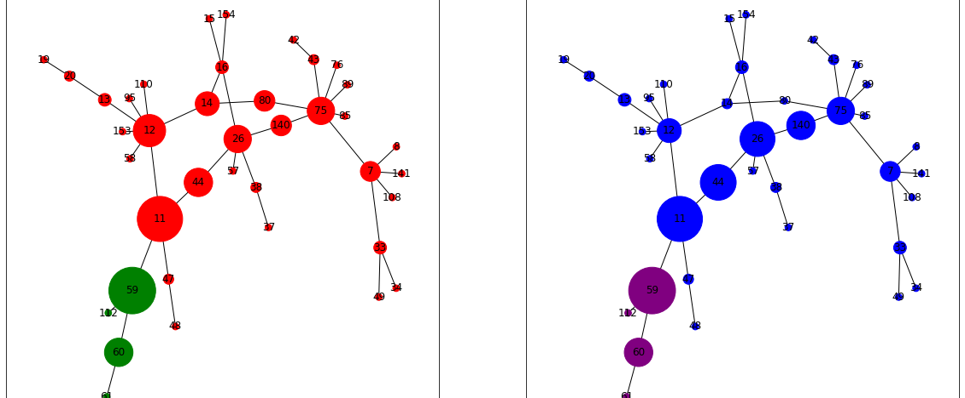
Limitations and extensions
What happens when percolation probabilities differ throughout the network?
We consider a weighted shortest paths calculation, where edge weights correspond inversely to the probability of percolating
Analogous to weighted BC
Up to experimentation how to best set the edge weights
We run a small network percolation with edge weights set to the inverse of the percolation probability into and out of a node:

Slide 18
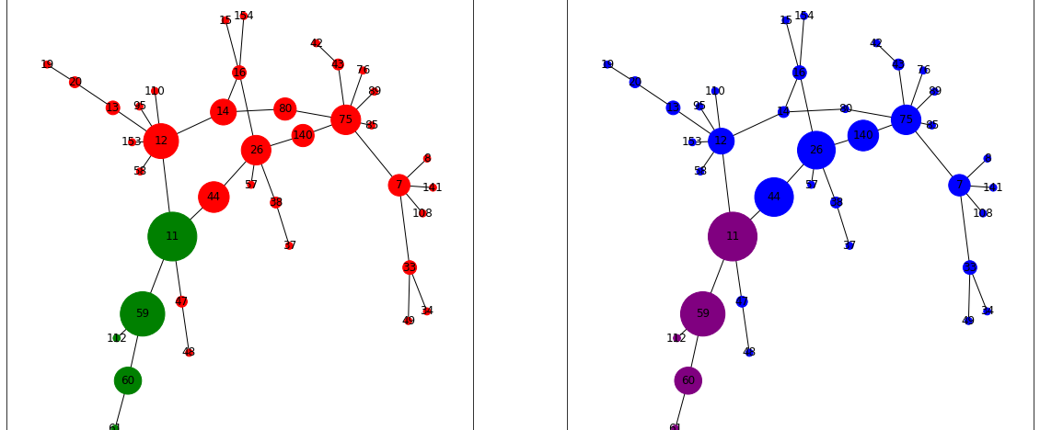
Limitations and extensions
What happens when percolation probabilities differ throughout the network?
We consider a weighted shortest paths calculation, where edge weights correspond inversely to the probability of percolating
Analogous to weighted BC
Up to experimentation how to best set the edge weights
We run a small network percolation with edge weights set to the inverse of the percolation probability into and out of a node:

Slide 19
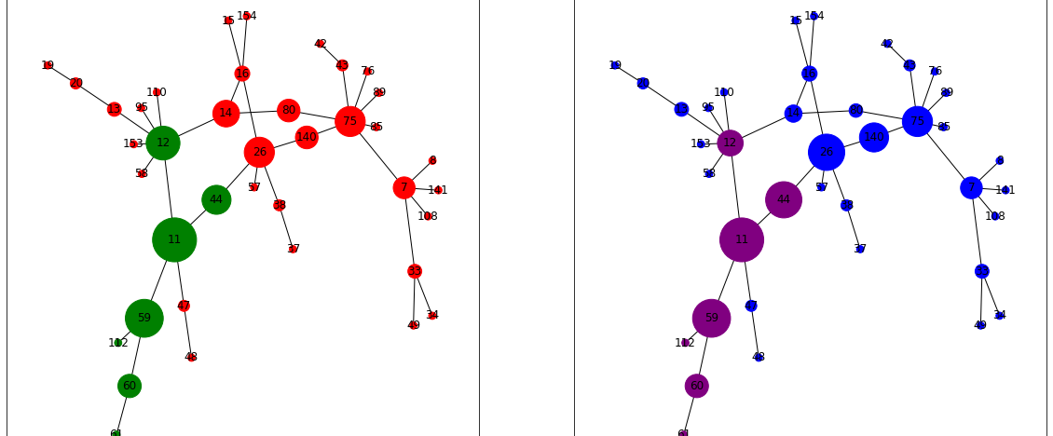
Limitations and extensions
What happens when percolation probabilities differ throughout the network?
We consider a weighted shortest paths calculation, where edge weights correspond inversely to the probability of percolating
Analogous to weighted BC
Up to experimentation how to best set the edge weights
We run a small network percolation with edge weights set to the inverse of the percolation probability into and out of a node:

Slide 20
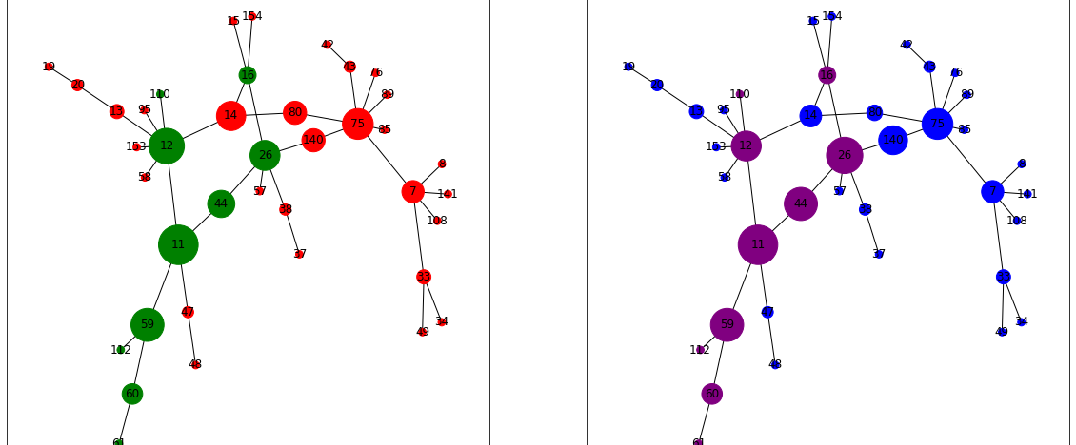
Limitations and extensions
What happens when percolation probabilities differ throughout the network?
We consider a weighted shortest paths calculation, where edge weights correspond inversely to the probability of percolating
Analogous to weighted BC
Up to experimentation how to best set the edge weights
We run a small network percolation with edge weights set to the inverse of the percolation probability into and out of a node:

Slide 21
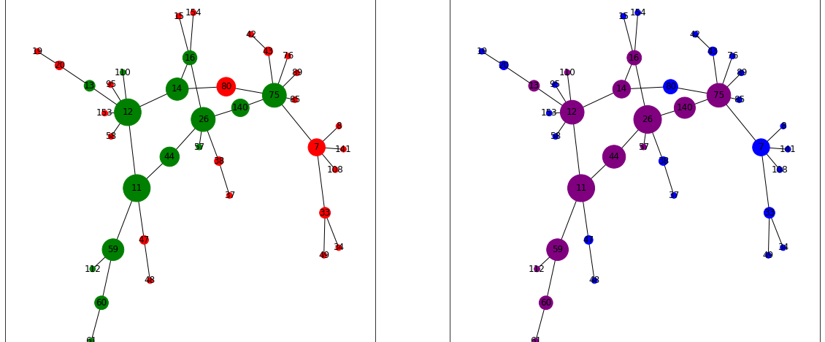
Limitations and extensions
What happens when percolation probabilities differ throughout the network?
We consider a weighted shortest paths calculation, where edge weights correspond inversely to the probability of percolating
Analogous to weighted BC
Up to experimentation how to best set the edge weights
We run a small network percolation with edge weights set to the inverse of the percolation probability into and out of a node:

Slide 22
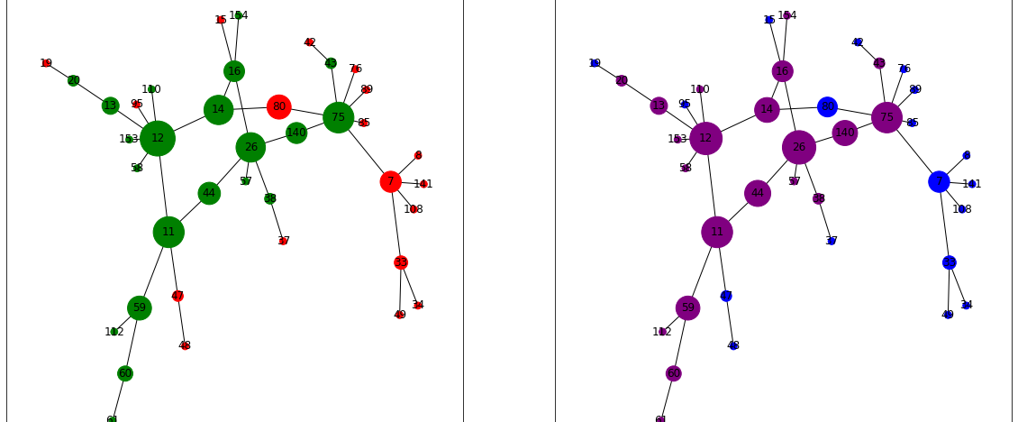
Limitations and extensions
What happens when percolation probabilities differ throughout the network?
We consider a weighted shortest paths calculation, where edge weights correspond inversely to the probability of percolating
Analogous to weighted BC
Up to experimentation how to best set the edge weights
We run a small network percolation with edge weights set to the inverse of the percolation probability into and out of a node:

Slide 23

Limitations and extensions
What happens when percolation probabilities differ throughout the network?
We consider a weighted shortest paths calculation, where edge weights correspond inversely to the probability of percolating
Analogous to weighted BC
Up to experimentation how to best set the edge weights
We run a small network percolation with edge weights set to the inverse of the percolation probability into and out of a node:

Slide 24
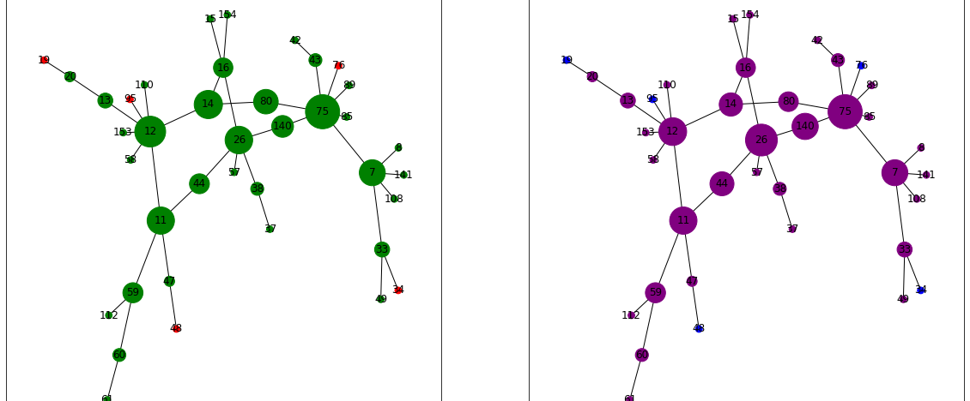
Limitations and extensions
What happens when percolation probabilities differ throughout the network?
We consider a weighted shortest paths calculation, where edge weights correspond inversely to the probability of percolating
Analogous to weighted BC
Up to experimentation how to best set the edge weights
We run a small network percolation with edge weights set to the inverse of the percolation probability into and out of a node:

Slide 25
Limitations and extensions
Other limitations of the generic PC metric:
Computational complexity O(N*M) without accounting for target node states, complexity O(N^3) when accounting for target node state
Recent improvements made with randomized approximation algorithms that perform based on the diameter of the graph
Approximate centralities in O(N log(M) log(diam(G))
Reliance on shortest path as the only paths of infection that contribute to a node’s centrality
In practice, an infection may spread randomly, and not only through a shortest paths
Extensions have been studied with random walk constructions of the centrality measure
Overall, PC is helpful though!
Viral marketing campaigns
Swarm intelligence in a bee colony
Evolution of beta-amyloid plaques in the brain

Slide 26
Thanks for the attention!

Slide 27
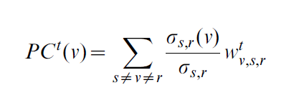
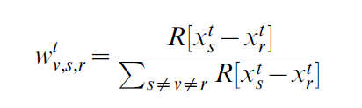

Backup
Percolation centrality with target nodes
is the ramp function (ReLU)

Slide 28
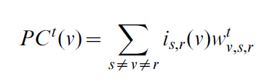

Backup
Percolation centrality with random walks
is the current’ that flows through node v when the unit current is pumped between nodes s and r and all links are considered to have unit resistance.

Slide 29
