Slide 1
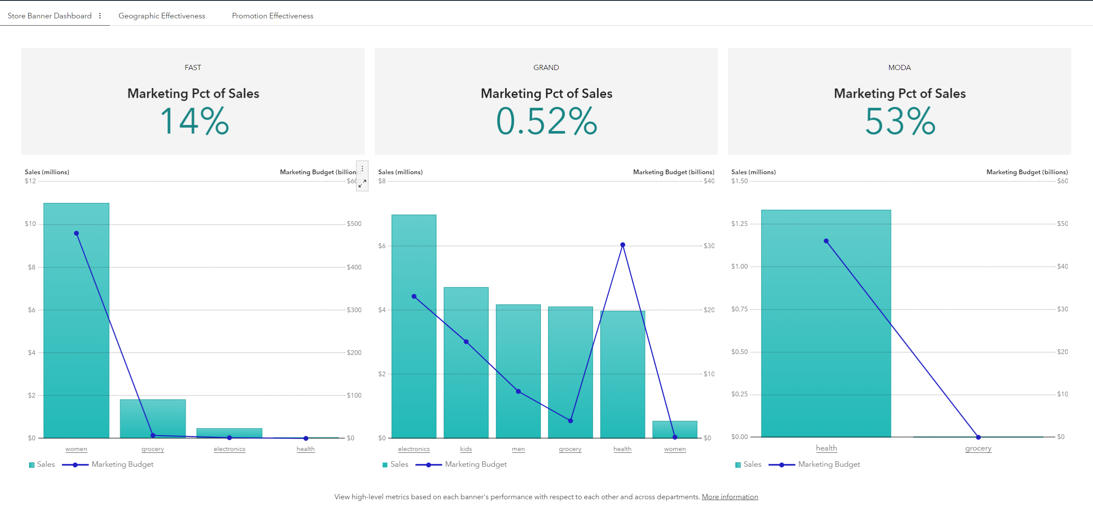
SAS Viya server
Save his own copy of report
1
Detect last saved reports in the current day and generate PNG and PPT file in the home directory of the user
End-user
Visual Analytics report
allowXCMD=false
3
genPPTfromLastSavedVAReport.sas
Call the job (unique url for all users) from any application (ex : visual analytics report specific section)
2
Download the exported powerpoint from sas drive
User home directory
4
.pptx file

