Slide 1

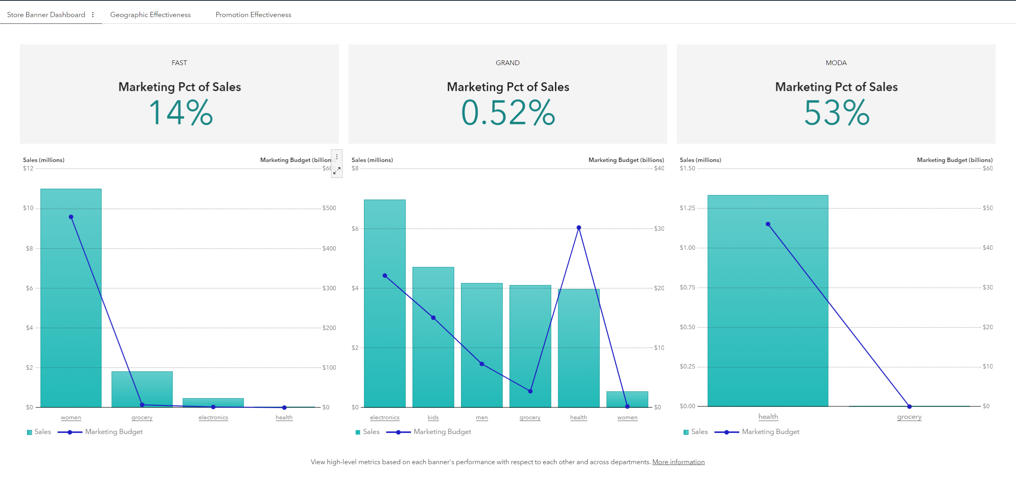
SAS Viya server
Save his own copy of report
1
Detect last saved reports in the current day and generate svg images in a server directory
End-user
Visual Analytics report
allowXCMD=false
3
001_job_viya35_user_va_export_svg.sas
Call the job (unique url for all users) from any application (ex : visual analytics report specific section)
Security boundary
Scheduled job with on a specific compute context (with allowCMD=true) with a service account
External Linux tool : inkscape
Reads all generated svg images and generate png (with inkscape tool) powerpoint for each user/report
2
allowXCMD=true
Calls
002_job_viya35_admin_gen_ppt.sas
4
5
Push the powerpoint files to a dedicated SAS content directory by user, using the original report name with a pptx extension
Download the exported powerpoint from sas drive
SAS Viya Content
Temp Filesystem
.pptx files
.png files
.svg files
6
.pptx files

