Slide 1
igor-ci, the ghastly CI system

Slide 2
common theme at CI miniconf

Slide 3
configuring jenkins sucks,
use tools to manage config

Slide 4
jenkins also huge, monolithic, hungry

Slide 5
(not very unixy)

Slide 6
introducing igor-ci

Slide 7
“Igor, $(git fetch brains)!”

Slide 8
build specs stored in git

Slide 9
build reports stored in git

Slide 10
cool switching-yard graphs

Slide 11
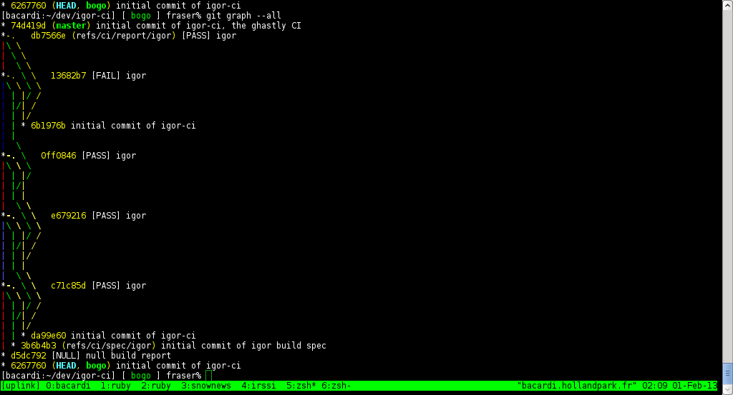

Slide 12
oh my God...
it's full of SHAs!

Slide 13
easily diff build specs, env, transcripts

Slide 14
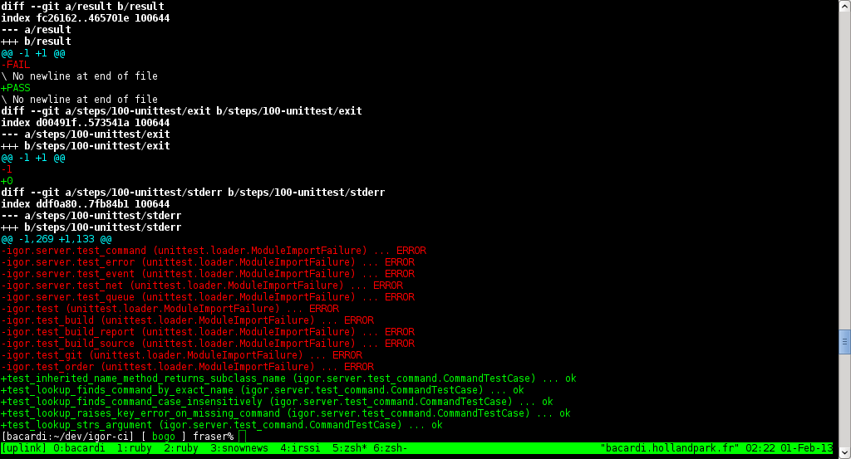

Slide 15
unixy

Slide 16
small, separate processes:
triggers, notifiers, workers, queue/event mgr

Slide 17
CURRENT CAPABILITIES

Slide 18
build from git
push reports
worker parallelism
manually trigger builds

Slide 19
TODO

Slide 20
gerrit trigger
security
notifiers
web ui

Slide 21
any documentation at all

Slide 22
FUTURE

Slide 23
more VCSen
artifacts
.travis.yml support

Slide 24
OPEN PROBLEMS

Slide 25
multi-platform builds
spec includes / inheritance
naïve broker implementation
“multi-master”

Slide 26
CAVEATS

Slide 27
Python 3.3
libgit2, pygit2 dev branches
bugs in Git

Slide 28
no nice packaging or installer

Slide 29
Affero GPL

Slide 30
Fraser Tweedale <frase@frase.id.au>
@hackuador
0x4111E1E2
https://github.com/frasertweedale/igor-ci

