Slide 1
FreeIPA
Open Source identity management
Fraser Tweedale
Software Engineer, Red Hat
2015-01-16

Slide 2
About me
Developer at Red Hat, Inc.
Identity management team.
  Dogtag PKI (certificate authority)
  FreeIPA
Blog: http://blog-ftweedal.rhcloud.com/
Twitter: @hackuador

Slide 3
This talk
Introduction to identity management
Introduction to FreeIPA
  Features
  Deployment
Architecture overview
Roadmap

Slide 4

Identity Management

Slide 5
Definition
“Identity management (IdM) describes the management of individual principals, their authentication, authorization, and privileges within or across system and enterprise boundaries with the goal of increasing security and productivity while decreasing cost, downtime and repetitive tasks.”
Wikipedia

Slide 6
Concerns
Identities: users, services, hosts, groups
Authentication: passwords, 2FA, SSO
Authorisation: identity-related policies
Management: how to manage these concerns in a large organisation (thousands of users/machines)?

Slide 7
Related technologies
LDAP (directory services)
Kerberos (authentication)
X.509 (digital certificates, public key infrastructure)
DNS
NFS (Network File System)

Slide 8


Slide 9
FreeIPA
Identity, Policy, Audit
Centralised identity management suite
Simple web UI and CLI
  Hides complexity, user self-service.
Simple deployment
  How simple? One command!
Active Directory integration

Slide 10
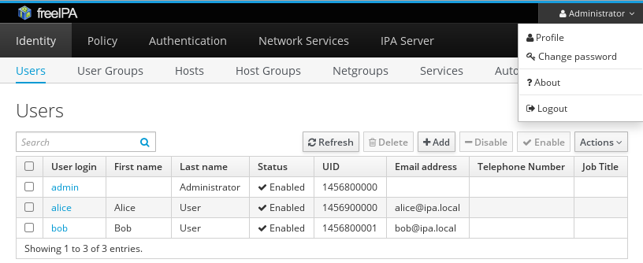
FreeIPA – Web UI

Slide 11




Components (server)
389 Directory Server
  Main database for other services
MIT Kerberos KDC
Dogtag Certificate System
  Other external CAs are supported
Apache httpd
  Web UI and API
BIND
  DNS

Slide 12

Features - authentication
Password policies
Kerberos ticket policies
Kerberos over HTTP (MS-KKDCP)
One-time password (OTP)
  Native HOTP/TOTP or external via RADIUS proxy
  FreeOTP app for Android / iOS
  Yubikey
SSH authorized_keys management

Slide 13
Features – users and groups
Automatic group membership rules
Sudo integration
  commands, command groups and rules
SELinux user roles
Automount
Role-based access control (RBAC)

Slide 14
Features – hosts, host groups and netgroups
One-command host enrolment (ipa-client-install)
Automatic DNS record
  DNSSEC support in FreeIPA 4.1
Host-based access control (HBAC)
Automatic host group membership rules
SSH known_hosts management

Slide 15
Features – services
Services are first-class identities
Kerberos keytab management
Certificate provisioning via Certmonger
  Automatic renewal

Slide 16

Features – SSSD (client)
SSSD: System Security Services Daemon
Connects UNIX client to central identity store(s)
  Available on most Linux distros + FreeBSD
  Supports FreeIPA, AD, bare LDAP
Credential and offline support (replaces nscd, nslcd)
PAM and NSS modules
D-Bus API

Slide 17
Features – Active Directory integration
Cross-realm trust
Manage users in AD, hosts/services/groups in FreeIPA
AD users can access resources in FreeIPA domain
  POSIX attributes: stored in AD or use views
Simple configuration
  No AD-specific host/service configuration
  No data synchronisation between domains
  No additional software needed on AD domain controller

Slide 18
Features – legacy client compatibility tree
Old systems may not have SSSD with AD support
  Cannot connect to AD and FreeIPA at same time
Compatibility LDAP tree
  Managed by slapi-nis plugin
  For FreeIPA user: bind against FreeIPA LDAP tree
  For AD user: authenticate to AD via SSSD

Slide 19
Server deployment
Supported on Fedora, RHEL, CentOS
  Available but less supported on Debian, Ubuntu
One command: ipa-server-install
  Answer some questions, wait a few minutes, done!
Slightly more work to set up replica

Slide 20
Client enrolment
One command: ipa-client-install
  Answer some questions, wait a few minutes, done!
  Options for unattended install
  Configures SSSD and related services.
Provisioning system integration:
  Satellite / Spacewalk
  OpenLMI / realmd
  Foreman smart proxy

Slide 21
FreeIPA Architecture

Slide 22
Architecture – high level
PKI
KDC
HTTP
LDAP
CLI/UI
NTP
DNS
Active Directory
Kerberos Cross-Realm Trust
Web UI
CLI
JSON
FreeIPA
Admin
identity
authentication
policies
certificates
SSSD
SSSD

Slide 23
Architecture – SSSD
Network
Boundary
Identity Server
Client
SSSD
NSS
Responder
Domain
Provider
Identity
Provider
Client
Cache
Authentication
Server
Client
PAM
Responder
Auth
Provider

Slide 24
Architecture – detail
IdM Core
Authentication
Managed host
(client)
Users, Groups,
Netgroups, HBAC
SSSD
NTP
MIT
Kerberos
KDC
Name lookups
and service
discovery
ipa-client
CA
(Dogtag)
389
Directory
Server
Certmonger
Cert tracking &
provisioning
DNS
(BIND)
nss_ldap
Other maps
Enrollment & un-enrollment
Management
framework
Management Station
CLI
Browser
Management
WEBUI

Slide 25
Roadmap

Slide 26
Roadmap – short term efforts
DNSSEC
CA certificate renewal
Backup and restore scripts
Updated web UI
Improved permissions; fine-grained read access
Integration with Red Hat Support Portal
Available in SSSD 1.12.* and FreeIPA 4.1.*
  Being considered for RHEL 7.1

Slide 27
Roadmap – longer term efforts
Enforce stronger authentication for select services
  Kerberos CAMMAC / Authentication Indicator
Kerberos authentication for mobile devices
DNSSEC improvements
SSSD Smart Card login
Customisable X.509 certificate profiles
User certificate provisioning
Password Vault: secure key and secret store
  FreeIPA front-end to Dogtag Key Recovery Manager

Slide 28
Integration efforts
CloudForms
Docker: SSSD and FreeIPA in containers
OpenStack (IaaS)
  Keystone (authorisation)
  Barbican (secret store)
  Designate (DNS)
OpenShift Origin (PaaS)
Calamari (Ceph management platform)
<your project>? Start the conversation!

Slide 29
Adoption
GNOME Infrastructure is now powered by FreeIPA
  Blog post: http://is.gd/lSFwSy
Other projects or communities with proliferation of identity silos?
  FreeIPA might help. Let's talk!
Demo: http://www.freeipa.org/page/Demo

Slide 30


Slide 31
Conclusion
FreeIPA is advanced, open source, enterprise IdM
Ease of deployment and administration
  Reduce cost of management
Active Directory integration
  Avoid duplication; cost-effective IdM infrastructure
Integrate with FreeIPA
Adopt FreeIPA?

Slide 32
Resources
FreeIPA: http://www.freeipa.org/
  http://www.freeipa.org/page/Web_App_Authentication
  Mailing lists:
    freeipa-interest@redhat.com (announcements; low traffic)
    freeipa-users@redhat.com (general help and discussion)
    freeipa-devel@redhat.com (development discussion and patches)
  IRC: #freeipa on Freenode
  Blogs: http://planet.freeipa.org/
SSSD: https://fedorahosted.org/sssd/
  Lists: sssd-{users,devel}@lists.fedorahosted.org
  IRC: #sssd on Freenode

Slide 33
Attribution and license
Architecture diagrams by Dmitri Pal, Martin Kosek
AD trust diagram © 2012 Red Hat, Inc. (GFDL)
Copyright 2015 Red Hat, Inc.
This work is licensed under the Creative Commons Attribution 4.0 International License. To view a copy of this license, visit http://creativecommons.org/licenses/by/4.0/.

Slide 34
Questions?

