Slide 1
Sheet 1

Slide 2
Question 1
Pojo was used
The event class and epl statement was similar to the documentation
Logged were timestamps and log message
That info contains all relevant info

Slide 3
Question 2
We use a near identical epl statement and java class
We chose java for sorting since it has a considerably lower barrier of entry
Upon recieving a log even we checked if the statement matches and raise a completely new event

Slide 4
Question 3
We create a new event with java if the event matches our parameters
We keep track of amount of failed logins in an analyticsmanager singleton class
We set the limiting variable in that singleton class
We check for amounts of failed logins on recieving a new failed login

Slide 5
Question 4
Line by line read via buffer from the journalctl as individual json
Use Gson to extract "Message" and "SYSLOG_TIMESTAMP"
Using "GenericLogObject" as intermediate Class
That create specific event "SSHLogMessageEvent"
From here on out the data stays the same

Slide 6
Question 5
I used an UpdateListener for each type of event
In the updateListener function I used sysout
I used ANSI color to represenet severity depending on the event type
Short
I handle the event creation
The CEP engien does handle the event processing
I handle the IO with default java sysout

Slide 7
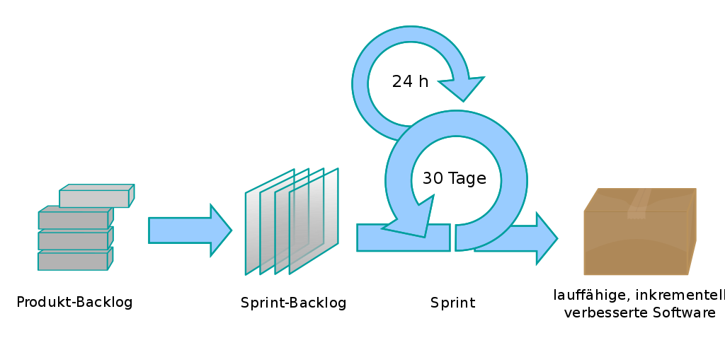
Question 6
Working out user stories (minimal)
Use backlog to work your next release over a sprint (14/30days)
Daily standup meetings
Short, focused and communicative
Regularly delivering quality release kandidate grade new version

Slide 8
Sources
Esper Docs
Q6 Image https://de.wikipedia.org/wiki/Scrum#/media/Datei:Scrum_process-de.svg

