Slide 1
IEEE TECHNICOKNOCKDOWN 2021(TKD-21)
(Online Mode)
Student National Conference
May 30, 2021
Theme: Green Technology
In Association with IEEE Bombay section and IETE ISF,
Pune section Supported by IEEE SITSB and IETE SIT, Lonavala
Paper ID and Track
AI & ML-12
Title of Paper
Ozone level Prediction Using Machine Learning
Author Name
Frason Francis
Krishna More

Slide 2
Contents
Introduction
Objective
Data Description
Methodology
  Data Processing
  Heat map
  Comparison of wind and temperature against frequency
  Evaluation of different ML models
Result
Conclusion

Slide 3
Introduction:
Air pollution is one of the most serious hazards to humans health nowadays, it is an invisible killer that takes many humans lives every year.
There are many pollutants existing in the atmosphere today, Ozone being one of the most threatening pollutants.
The dataset used in this research was derived from the UCI Website, containing various environmental factors in Houston, Galveston and Brazoria area that could possibly affect the occurrence of ozone pollution.
Using this algorithm, ozone levels can now be predicted with higher accuracy than before and can be implemented efficiently in local areas with the help of ozone monitors.

Slide 4
Objective:
Detecting the Ozone level concentration at an early phase will result in less harm to people with asthma, children, older adults, and people who are active outdoors, especially outdoor workers.
Machine learning techniques used in benefitting the environment is of greater importance as we can predict the level of Air Quality pollution with having sufficient amount of data. Which can be gathered through Ozone monitors, sensors and Detectors.
Therefore, Early and accurate prediction of Ozone is very significant for efficient monitoring of pollution towards constituting advanced early alarm systems.

Slide 5
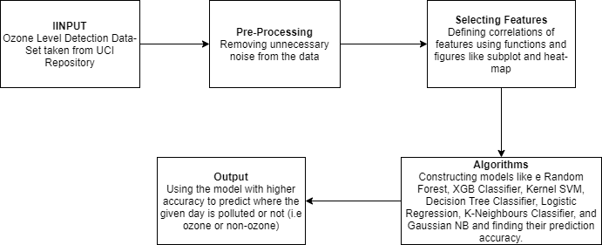
Proposed Model:
Block Diagram for proposed model

Slide 6
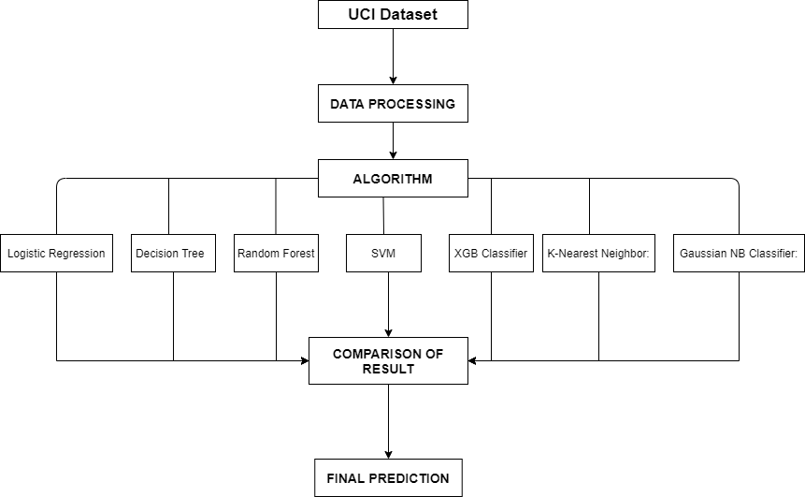
Methodology:

Slide 7
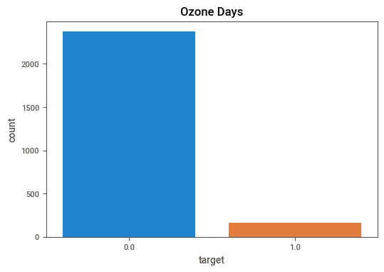
Data Processing:
In this dataset 2300 set of occurrences is classified as non-ozone days and 200 as ozone days this result in imbalanced and bias towards ozone-days.
This problem was tackled by under sampling the target columns so as to correlate it with the feature columns in the dataset.
Since, our dataset contain large portion of missing values and low-ozone day proportion, adding missing values were chosen instead of deleting all rows directly through the mean average imputer method.

Slide 8
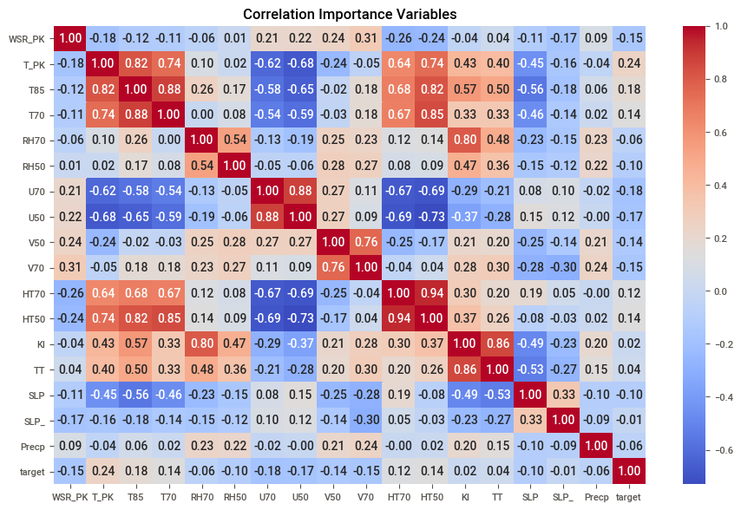
Heat map:

Slide 9
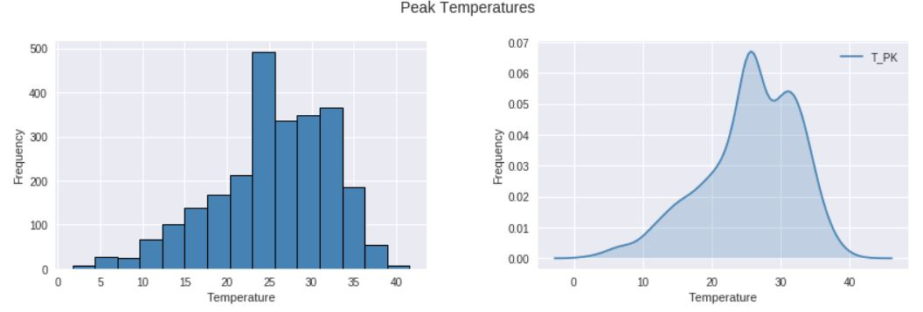
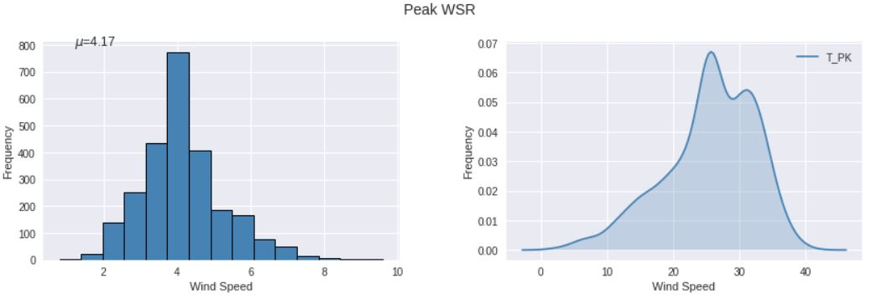
Experimental Analysis:
The avg. temperature in one day has freq. gradually increasing from 0 to 25 degrees, and dropping between from 26 to 40.
The mean average wind speed in 1 day has max freq. of 4 and low freq. as the speed gets low than 4.

Slide 10
ALGORITHMS
Logistic Regression:
  Logistic Regression is an appropriate type of regression model when we are sure that our dependent variable is of binary type. Logistic Regression is used to find the relationship between one independent variable (Which is binary in nature) and one or more independent variable.
Decision Tree:
  Decision tree is a structure where each inner node represent a test on an attribute (e.g. whether a coin flip comes p heads or tails), each branch represent the outcome of the test, and each leaf node represents a class label (decision taken after computing all attributes).
K-Nearest Neighbour:
  KNN is a non-parametric and lazy learning algorithm. Where we are given a dataset with different classes of test data by calculating the distance between the test data and all the training points. It then selects the ‘K’ ( k=5 in our case) points closest to the test data. The value of k affects the k-NN Classifier drastically as the flexibility of the model decreases with the increasing value of ‘K.’ Once the points are selected, the algorithm calculates the probability of the classes of the training points, and the class with the highest probability is set.

Slide 11
ALGORITHMS
Support vector Machine
  A Support Vector Machine (SVM) is a supervised machine learning algorithm that can be employed for both classification and regression purposes. SVMs are based on the idea of finding a hyperplane that best divides a dataset into two classes. The region between the support vector and the hyperplane is called max-margin. In the one-dimensional (1D) space, this classifier is called a point. In two-dimensional (2D) space, this classifier is called a line. In three-dimensional (3D) space, this classifier is called a plane. In four-dimensional (4D) or more space, this classifier is called a hyperplane.
XGB Classifier
  In this algorithm, decision trees are created in sequential form. Weights play an important role in XGBoost. Weights are assigned to all the independent variables which are then fed into the decision tree which predicts results. Weight of variables predicted wrong by the tree is increased and these the variables are then fed to the second decision tree. These individual classifiers/predictors then ensemble to give a strong and more precise model. It can work on regression, classification, ranking, and user-defined prediction problems.

Slide 12
ALGORITHMS
Random Forest:
  Random forest is an algorithm that integrates multiple trees through the idea of ensemble learning. The intuition behind RF is several weak learners are combined to provide a string learner. On each tree, each tie a split is considered, a random sample of ‘m’ predictors is chosen as a split candidate, out of ‘p’ predictors. While ensuring the classification performance of a single tree, it reduces the correlation between the classification trees, reduces the impact of noise, reduces the possibility of over-fitting, and improves the performance of the combined classifier.
Gaussian NB Classifier:
  A Gaussian Naïve Bayes is one of the supervised machine learning classification algorithms. It can be used to predict the likelihood that an event will occur, given evidence that’s present in your data. It mainly deals with the high dimensional dataset. There are three types of Naïve Bayes Models. A multinomial model is good when your features are continuous or categorical. It describes discrete frequency counts. Bernoulli model is suitable for predicting binary features. And Gaussian model is for predicting the normally distributed feature. The predictors are independent of each other. Some of the applications are Real-time Prediction, Multi-class Prediction and Text classification.

Slide 13
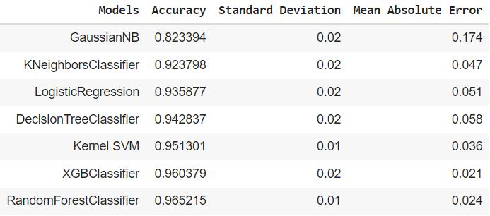
Result:
Various ML models were compared to evaluate the binary classification.
After comparing different ML model our research came to a conclusion that Random Forest Classifier was the best fitted winner for our dataset giving us the high accuracy of 96.52% and an AUC/ ROC score of 0.958
We also can see that the predicted result of Random Forest classifier shows the smallest error rate as compared to other model.
Table above shows accuracy comparison score for seven machine learning models.

Slide 14
Conclusion:
We implemented seven machine learning algorithms namely Random Forest, XGB Classifier, Kernel SVM, Decision Tree Classifier, Logistic Regression, K-Neighbours Classifier, and Gaussian NB for prediction of Ozone level, and compare the accuracy between each model to find the best model suited for the prediction.
We came to know that Random Forest Classifier is the best suited- algorithm for prediction as by using it we had almost pinpointed prediction accuracy [on “Ozone Level prediction Data Set”].
Hence, given the features according to the dataset, we can predict the depletion of ozone layer in the following ozone concentrated area (Houston, Galveston and Brazoria).
Lastly, this algorithm could also be used to find accurate correlation with other pollutants and to analyze the Air Quality Index data effectively.

Slide 15


