Slide 1

MoCA: a Monte Carlo Code for
accretion
Francesco Tamborra
Giorgio Matt
Stefano Bianchi
many thanks for the help also to: Michal Dovciak, René Goosmann and Michal Bursa
6th FERO meeting – 30th and 31st of August, Prague

Slide 2
Outline
scientific motivation
the model
the code
preliminary results (just the spectra)
future developments

Slide 3
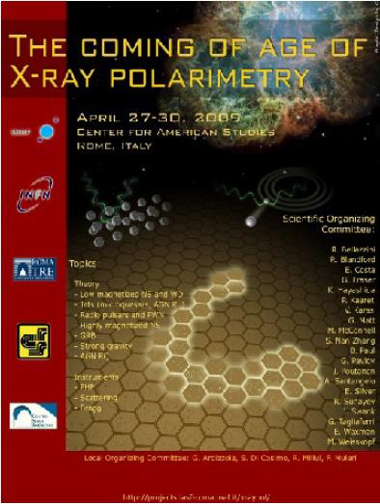
Scientific motivation
MoCA is a fully special relativistic code for studying the spectrum and the polarization signal in accreting sources
Why polarimetry?
Since the birth of X-ray astronomy, spectral, spatial and timing observation improved dramatically, procuring a wealth of information on the majority of the classes of the celestial sources. Polarimetry, instead, remained basically unprobed. X-ray polarimetry promises to provide additional information procuring two new observable quantities, the degree and the angle of polarization. [cit. Enrico Costa]
…unfortunately ALL the large and medium missions with an X-ray polarimeter on board have been cancelled or unselected.

Slide 4
the model
- the corona -
Disc parameters
R_{in} = 6 rg
R_{out} = 48 rg
emits in the UV
SPHERICAL corona parameters
R_{Cin} = 6 rg
R_{Cout} = 24 rg
SMBH
SLABBY corona parameters
H_{C} = 6 rg
L_{C} = 48 rg

Slide 5
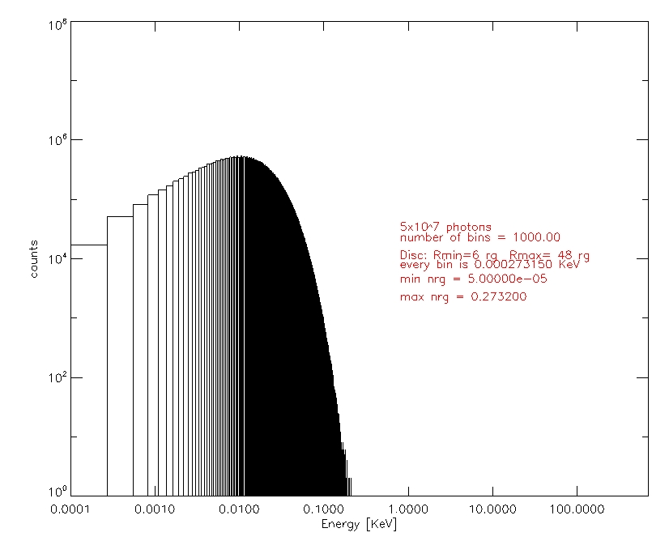
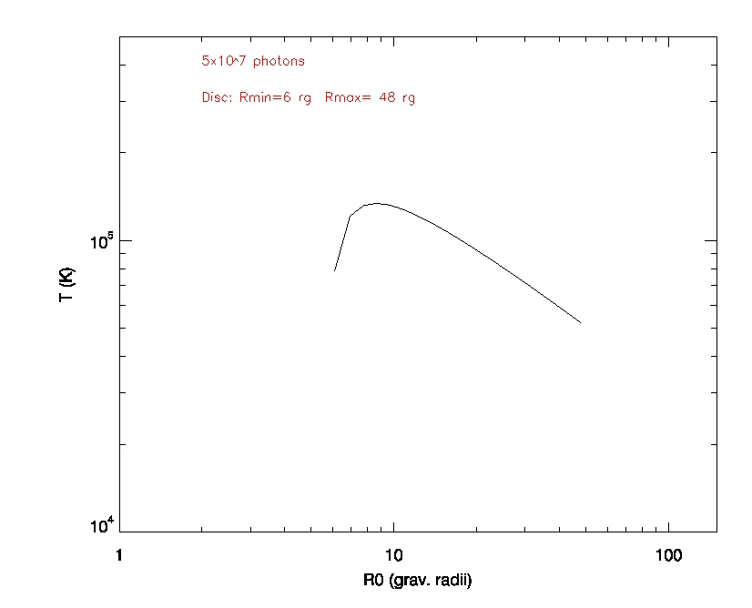
the model
- the emission -
emission from the disc (MTBB)
for both the geometries the thermal energy of the corona is kT= 100 KeV
Iron line @ 6.4 KeV (unpolarized)
for both the geometries the thermal energyof the corona is kT= 2,5,8 KeV

Slide 6
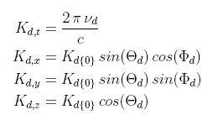
the code
The code is written in IDL, an interactive and vectorized language, and it’s modular, fully special relativistic, and extremely time consuming!!
The approach is to follow every photon during its journey from the disc to the observer, switching between the RF of the Disc and the RF of the electron
seed photon = { R₀, θ_{d}(=90°), φ_{d}, K _{d}(hν_{d})}
emissivity law weighted both on σ_{SB}T_{D} and on R₀dR (for disc emission)
limb darkening on Θ_{d}

Slide 7
the code
The P_{d} vector (electric field) of the seed photon is randomly chosen on the polarization plane for unpolarized radiation OR linearly polarized (up to 11%) on the direction parallel to the plane of the disc (Chandrasekhar, 1960).
P_{d}
K_{d}
Q_{j}
U_{j}
Matt et al. 1996
OUTPUT: hν, Θ, Φ, Q_{j}, U_{j}, #sc

Slide 8

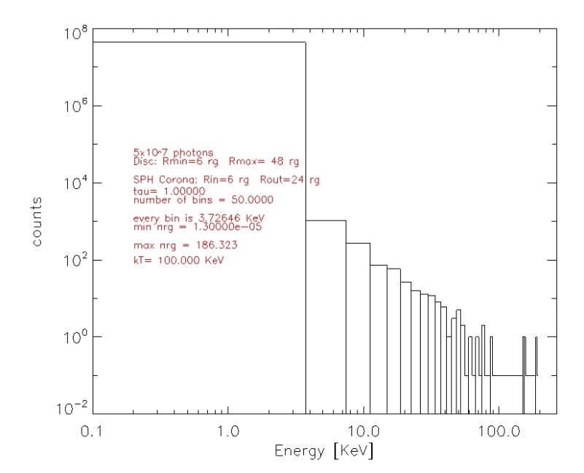
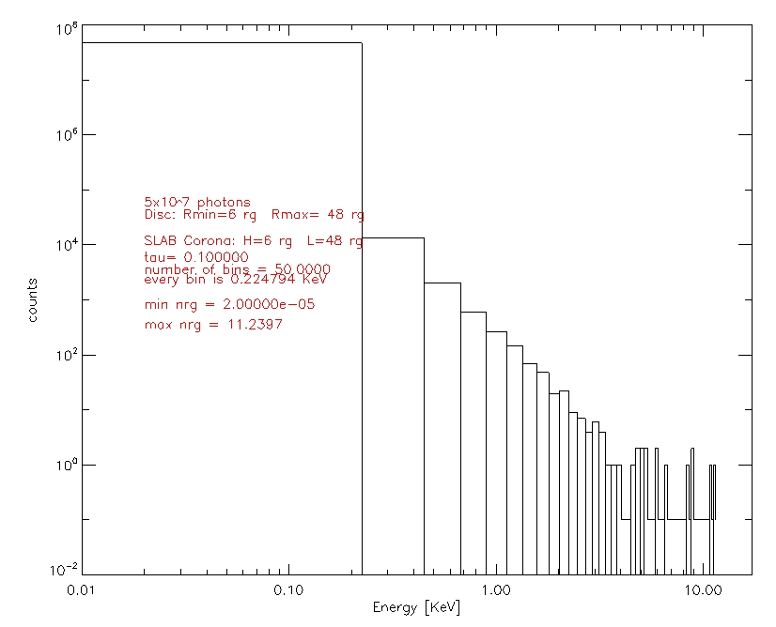
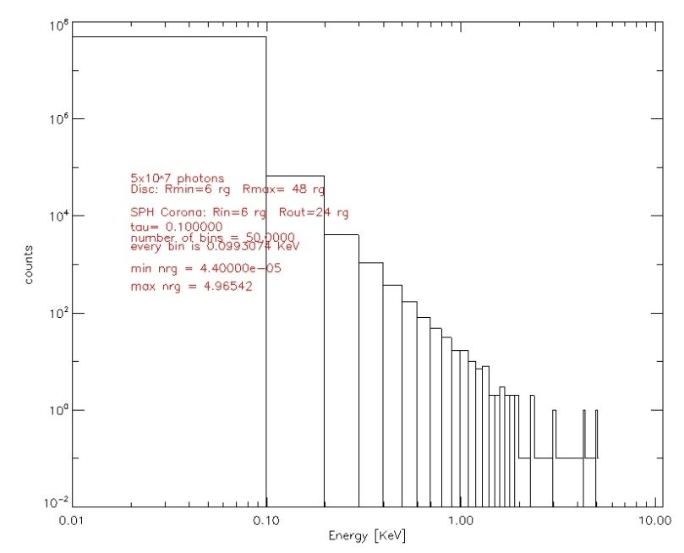
the spectra
SPHERE, τ = 1
kT = 100 KeV
5x10⁷ photons
SLAB, τ = 0.1
SPHERE, τ = 0.1

Slide 9
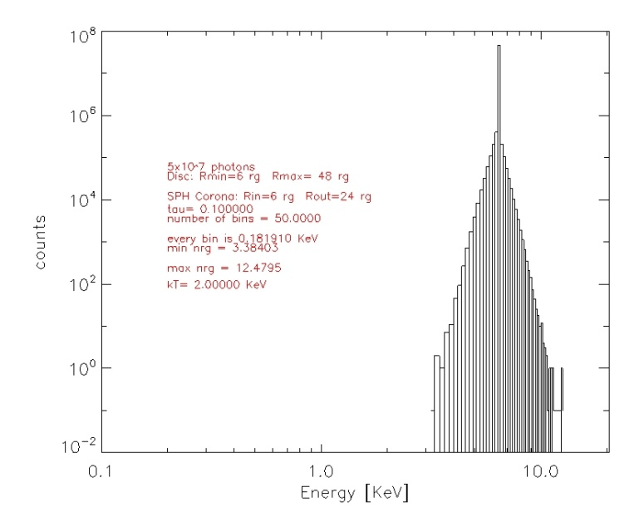
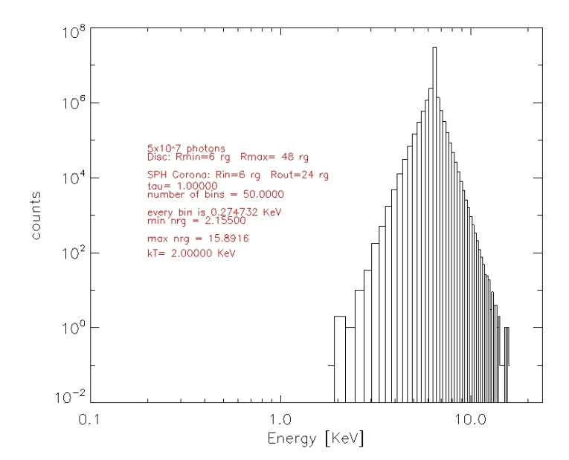
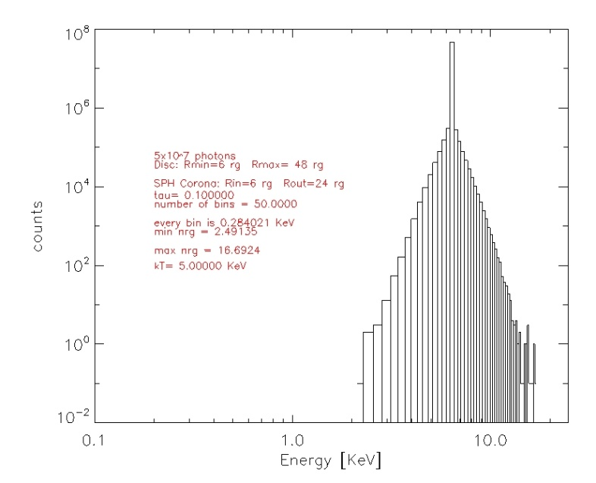
the spectra
kT = 2 KeV
τ = 0.1
kT = 2 KeV
τ = 1
kT = 5 KeV
τ = 0.1
input energy = 6.4 KeV (unpolarized)
SPHERICAL corona

Slide 10
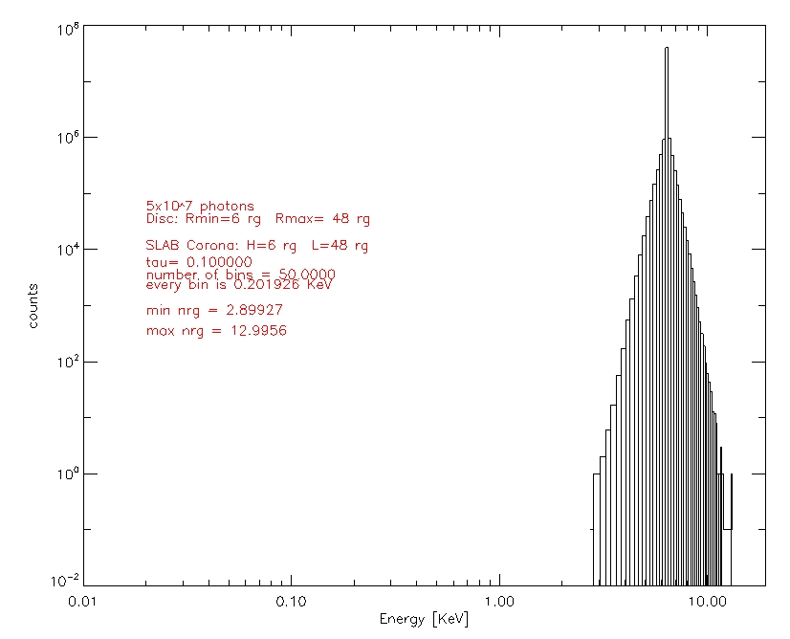
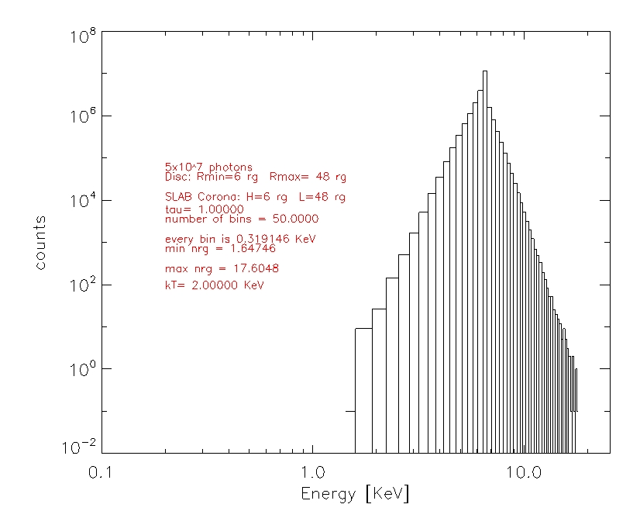

the spectra
kT = 2 KeV
τ = 0.1
kT = 2 KeV
τ = 1
1.6
17.6
input energy = 6.4 KeV (unpolarized)
SLAB corona
SPHERE
kT = 2 KeV
τ = 1
2.1
15.9

Slide 11
future developments
increase the statistics!!
include GR (thanks to Michal Bursa ray tracing routine)
include reflection
apply the code to the iron line to dicriminate between a scattering or a relativistic broadening in NS

