Slide 1
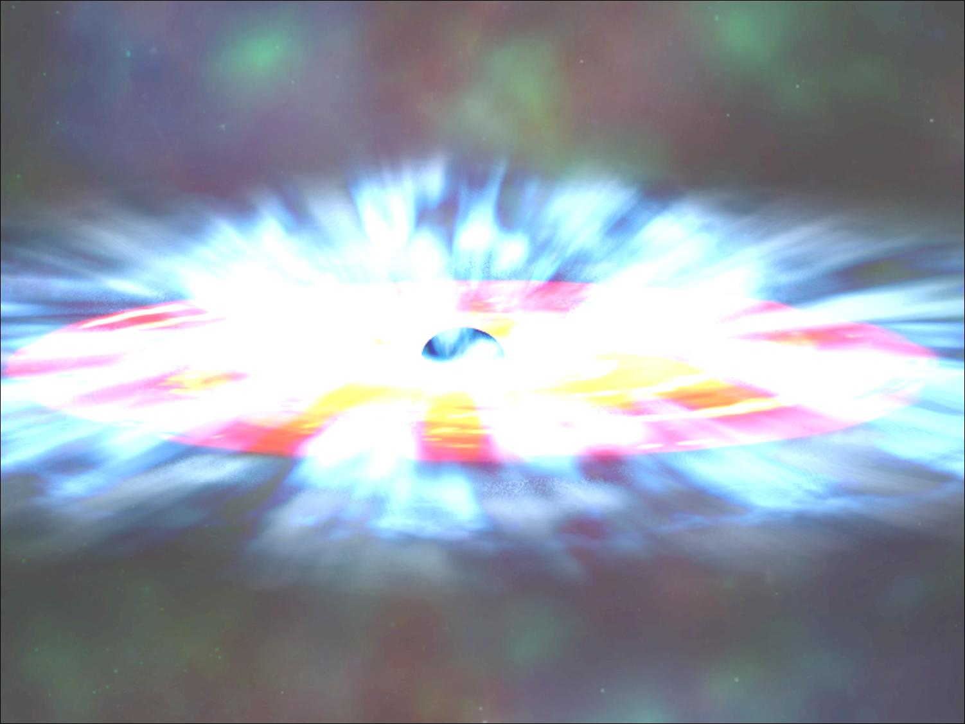
A Monte Carlo code for
accreting sources
Francesco Tamborra
Giorgio Matt
Stefano Bianchi

Slide 2
Outline
the project
scientific goals
the model
the code
future developments
WORK IN PROGRESS

Slide 3
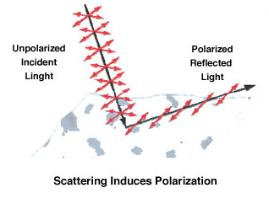
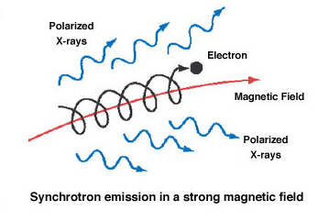
The project
Fully relativistic (special + general) code + polarimetry
Polarization probes both
the emission geometry
and the emission mechanism
of processes characterized by high temperature and magnetic field.

Slide 4
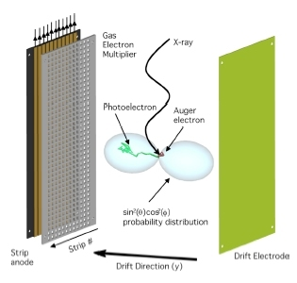
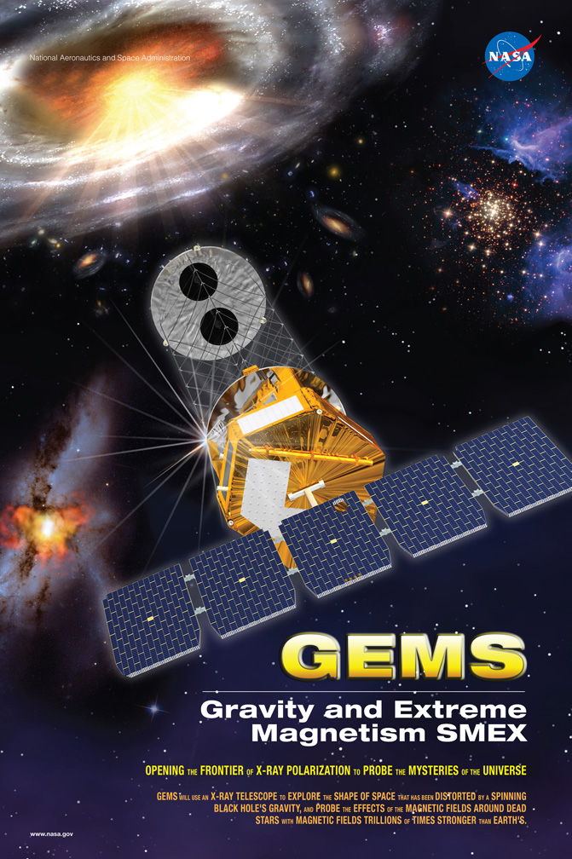
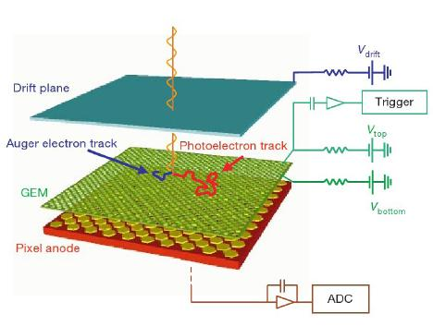
launch scheduled in 2014
Time Projection Chamber
(see Fabio’s talk!)
Gas Pixel Detector

Slide 5
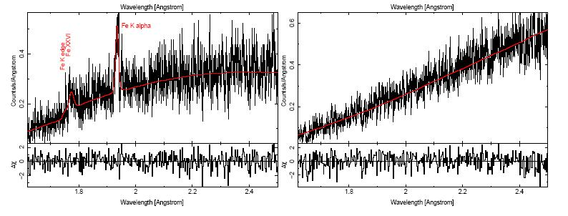
First scientific goals
Galactic BHs & AGN:
property of the scattering medium: geometry, density, thermal energy
property of the compact object: spin (see Michal’s talk!)
LMXRBs
nature of broad in iron lines

Slide 6
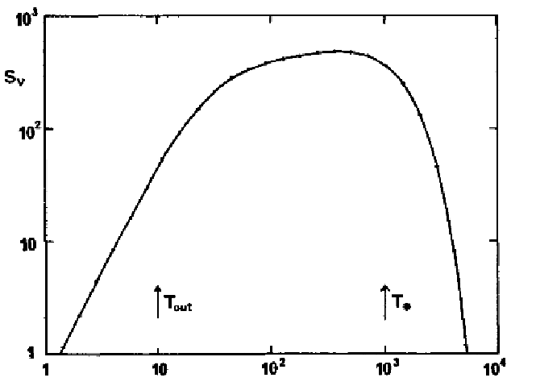
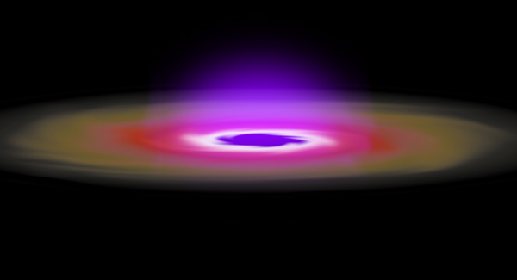
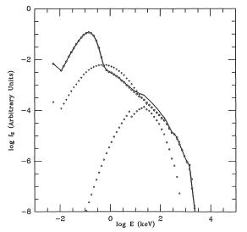
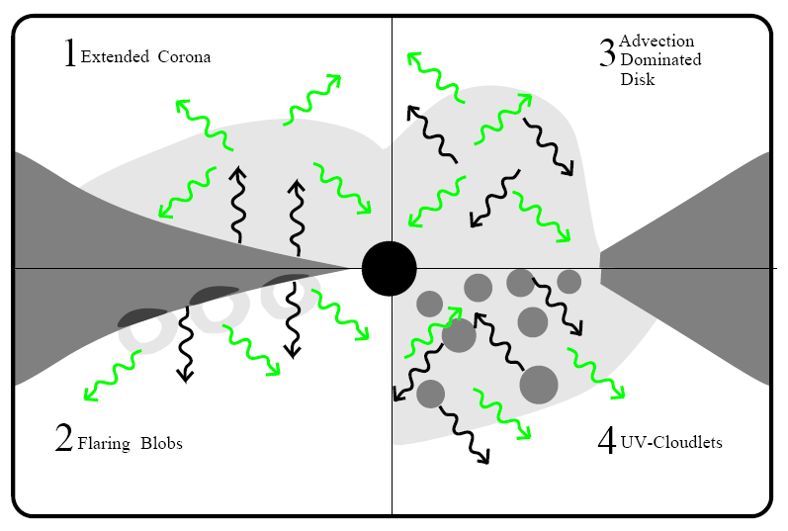
The model behind the MC
Optically thick, geometrically thin α-disc
Shakura & Sunyaev, 1973
Haardt & Maraschi, 1991

Slide 7

The code
main.pro
vector oriented, image processing
ShakSun.pro
Planck.pro
Chandra.pro
Init_Direction.pro
Renorm.pro
Stokes.pro
MFP.pro
Controllers.pro
MaxBoltz.pro
Lorentz.pro
CrossSec.pro
InvComp.pro
Sdriection.pro

Slide 8
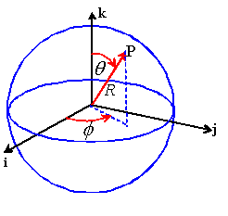
The code
Input parameters:
Black Hole:
Mass, Mdot
Disc:
Inner radius, Outer radius
Corona:
Geometry, tau (n_{e})
Initial position
φ_{0(d)} є [0, 2π]
random
θ_{0(d)} = π/2
fixed
R_{0(d)} є [R_{min}, R_{max}]
emissivity law
(α R⁻¹)
Initial direction
φ_{(d)} є [0, 2π]
random
μ=cos(θ_{(d)}) є [0, 1]
according to
Chandrasekhar, 1960

Slide 9
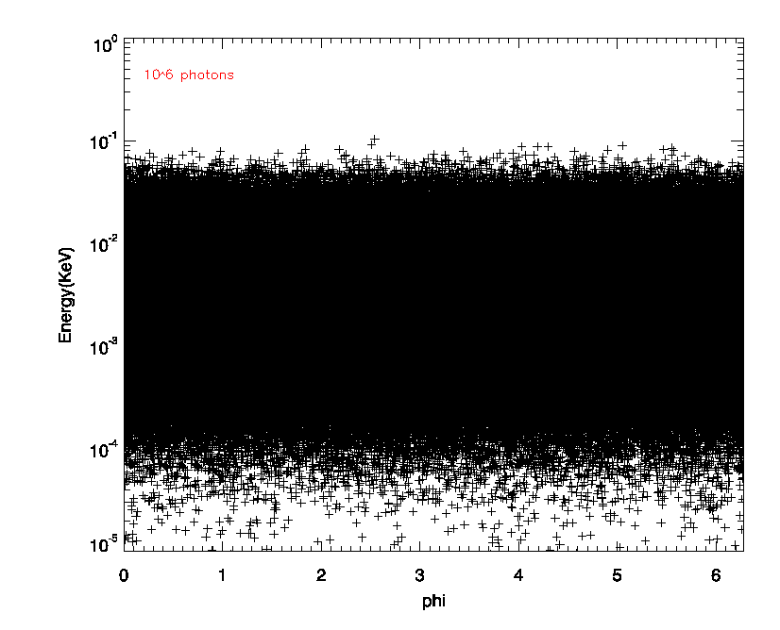
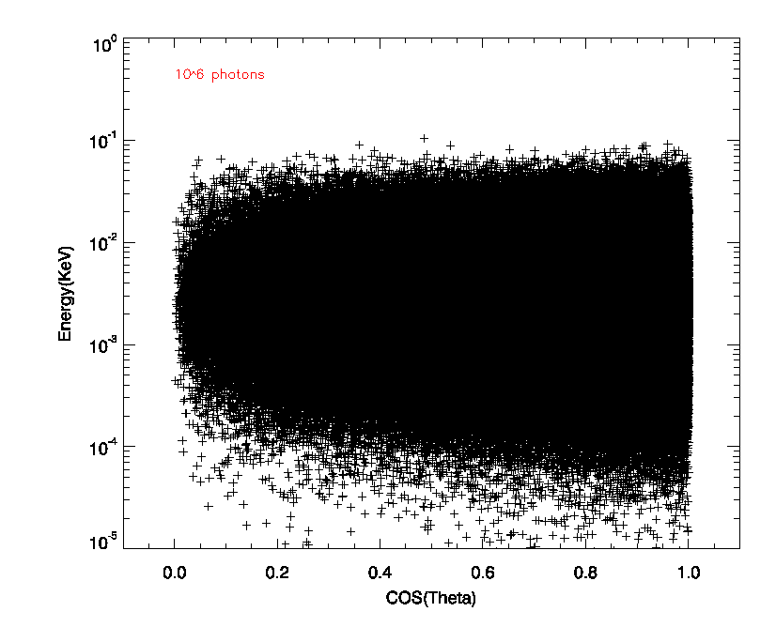
Initial angular distribution
isotropic
limb darkening

Slide 10
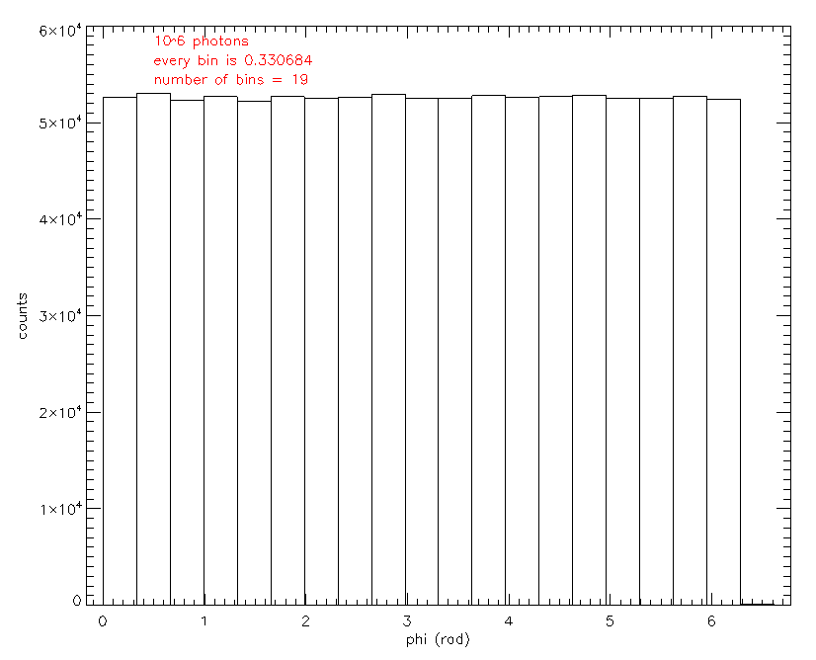
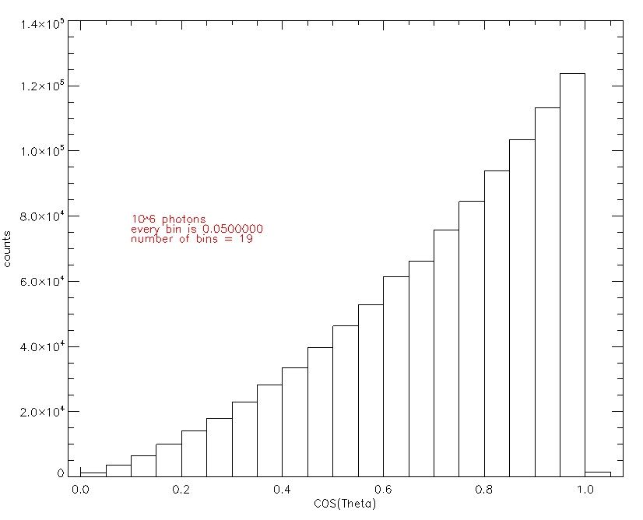
Initial angular distribution
Binned

Slide 11
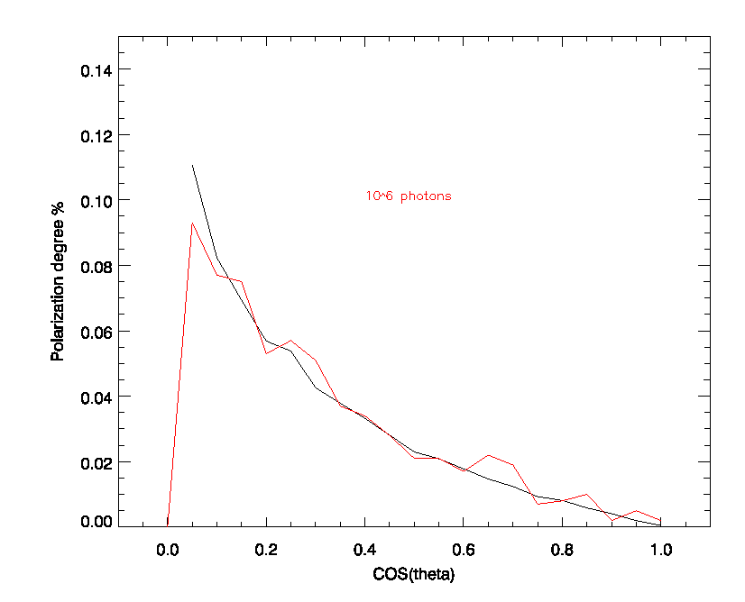
Initial degree of polarization
Chandrasekhar, 1960

Slide 12
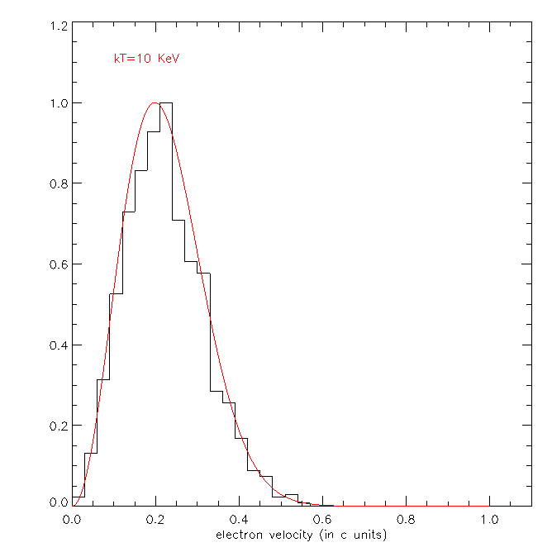
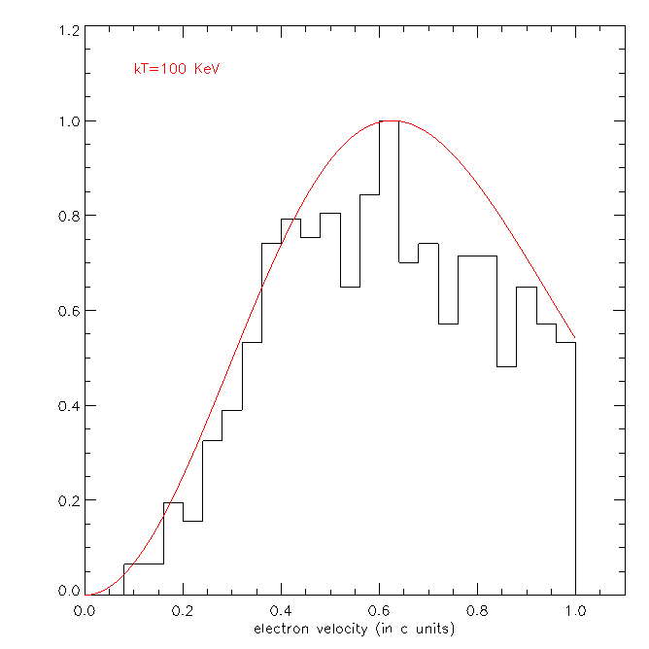
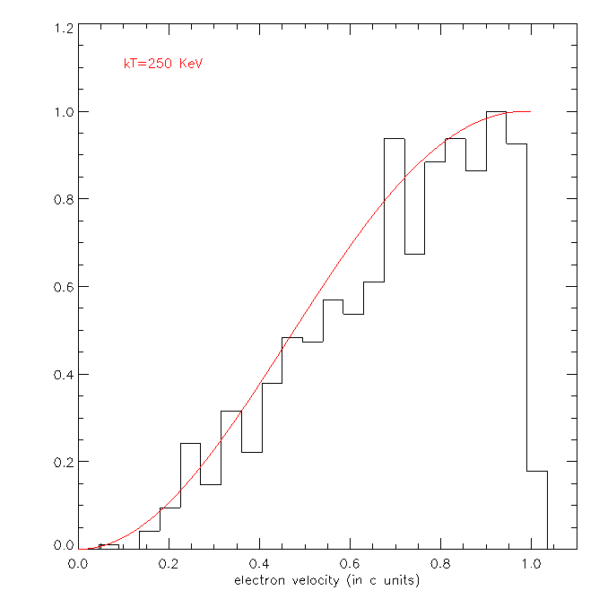
The scattering
MFP
potential point of interaction
The velocity of an hot, but thermal, electron is extracted…
…but the Maxwell-Boltzmann distribution cannot be used above 100KeV!
k_{B}T=
10 KeV
100 KeV
250 KeV
the proper distribution should be the Maxwell-Juttner one!

Slide 13
The scattering
Lorentz boost transformation
Lorentz boost transformation
Check if the scattering
happens
K’_{(e)}
P’_{(e)}
ν’_{(e)}
K’_{(d)}
P’_{(d)}
ν’_{(d)}
yes
K_{0(d)}
P_{0(d)}
ν_{0(d)}
K_{0(e)}
P_{0(e)}
ν_{0(e)}
σ_{KN}
no
K_{0(e)}
P_{0(e)}
ν_{0(e)}
K_{0(d)}
P_{0(d)}
ν_{0(d)}
energy, phi, theta, Stokes parameters of the photon are saved (and binned)

Slide 14
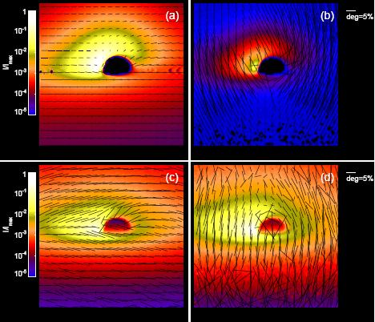
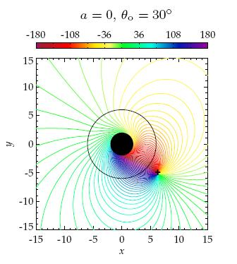
Previous works
Schnittman & Krolik, 2009
٧
Polarization
General relativity
Thomson scattering
Maxwell-Boltzmann distribution (?)
٧
X
X
Schnittman, Krolik 2010
Future developments
finish it! (at the end of this summer)
solve MB issue
include general relativity (spin)
ray-tracing code
include reflection from the disc

