Slide 1
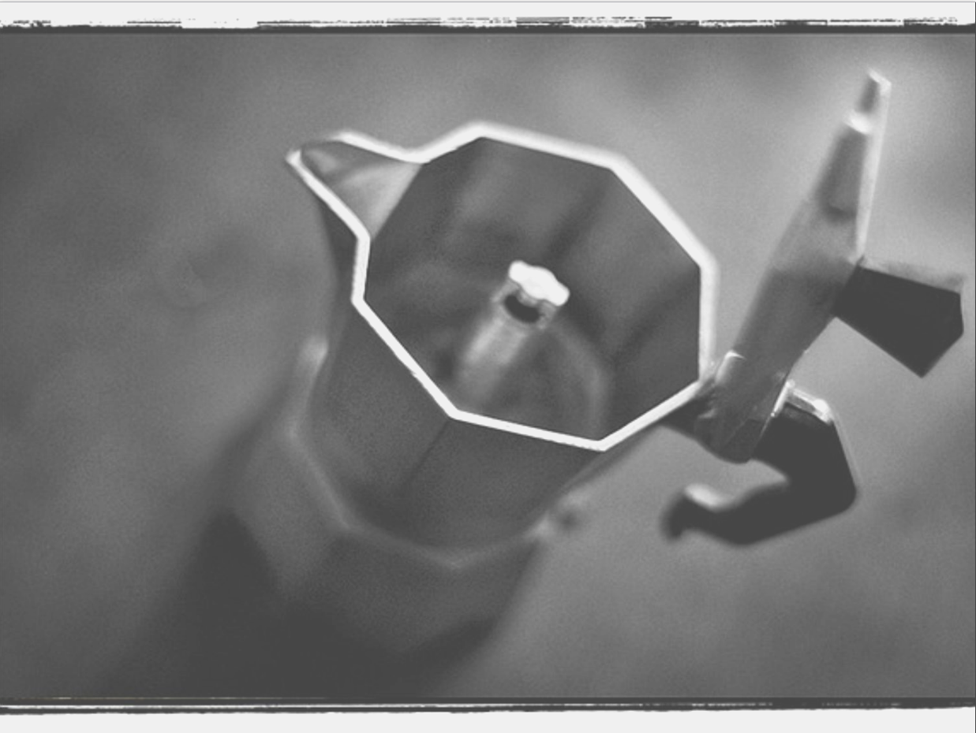


MoCA: a Monte Carlo code for accretion in Astrophysics
Francesco Tamborra ^{1,2}
Giorgio Matt ²
Stefano Bianchi ²
Collaborators: Rene Goosman ², Michal Dovciak ³
¹ Astronomical Observatory of Strasbourg
² University of Rome“Roma Tre”
³ Astronomical Institute of the Academy of Science (Prague)
From the Dolomites to the event horizon: sledging down the black hole potential well
15-19 July 2013

Slide 2


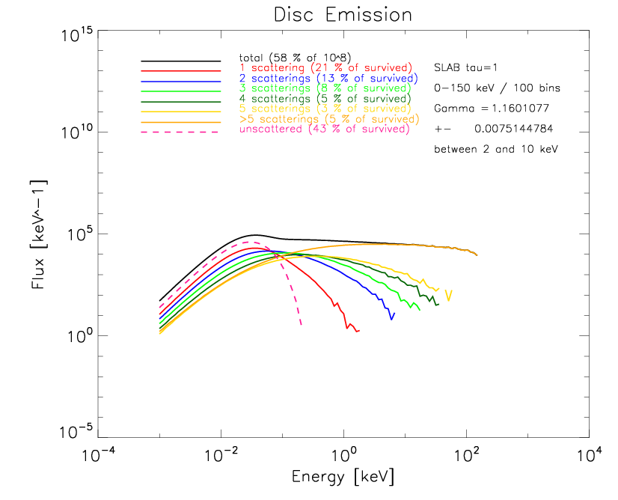
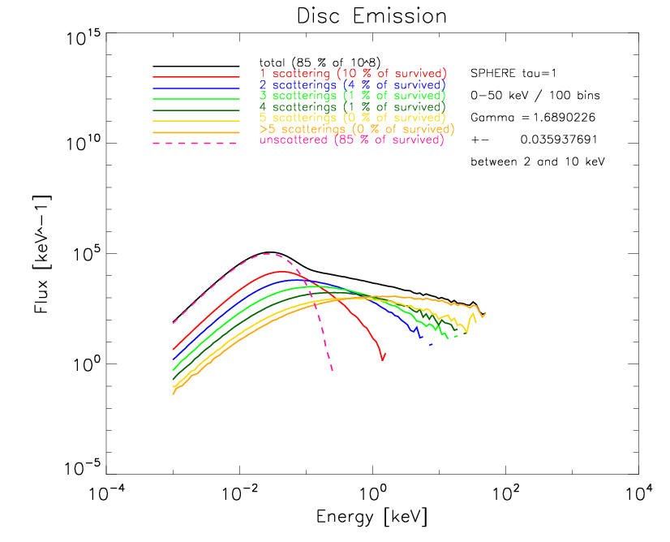
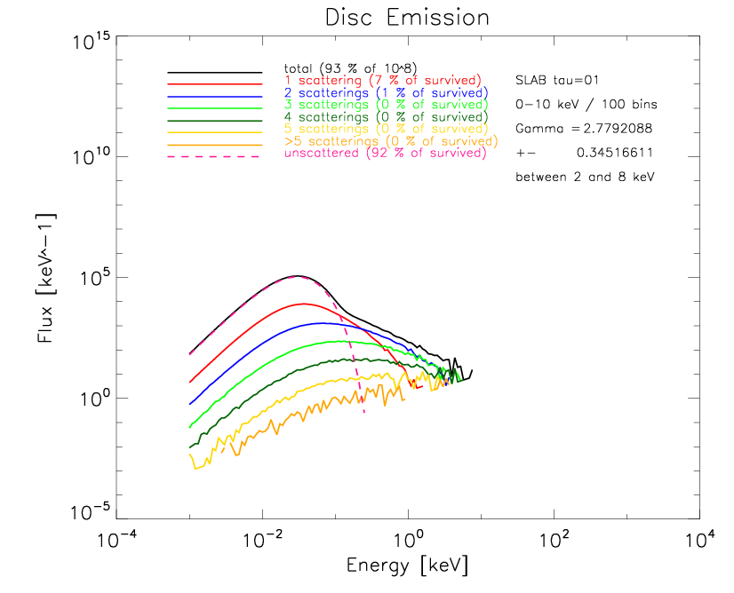
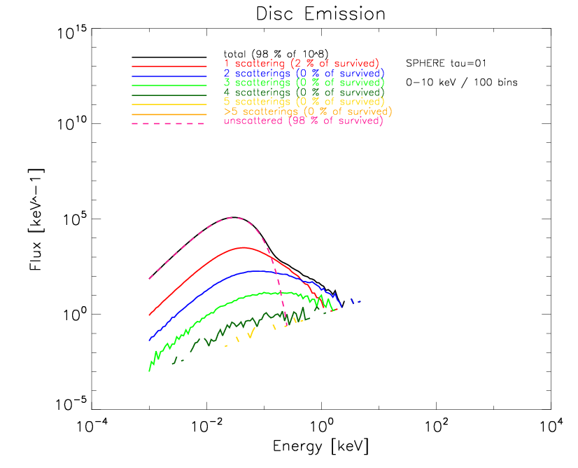
Results
- spectra -
SLAB
SPHERE
KT= 100 keV
tau = 1
tau = 0.1

Slide 3
Comments on spectra
General
X-ray spectra produced by the two corona geometries for both the optical depth regimes are shown. A linear fit between 2 and 10 keV (when possible) gives the Gamma index of the power law distribution.
In pink unscattered photons produced by the disc (multitemperature BB emission in the UV). Photons which scatters most are more energetic.
Reflection and (depolarizing) GR effects are not included.
tau = 1
The optically thick slab corona produces a spectrum up to few undreds keV steeper than expected (Gamma index expected: between 1.5 and 2.5)
The optically thick sphere is less efficient in terms of scatterings and produces less energetic photons (< 100 keV) but the spectrum is steeper.
Scattered photons experiences only 1 or 2 scattering (see the percentages in the legenda). The contribution of photons which experienced more than 2 scatterings is negligible, < 2% (important for later)
tau = 0.1
Both the geometries, in optically thin regime, cannot produce energetic X-ray photons.
With the slab, up to 8 keV photons are produced and the distribution is very steep.
The sphere cannot produce photons more energetic than 3 keV.

Slide 4
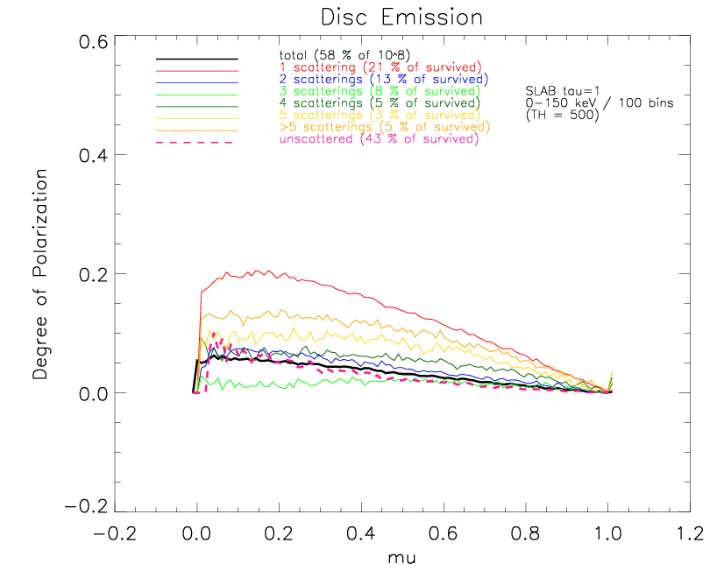
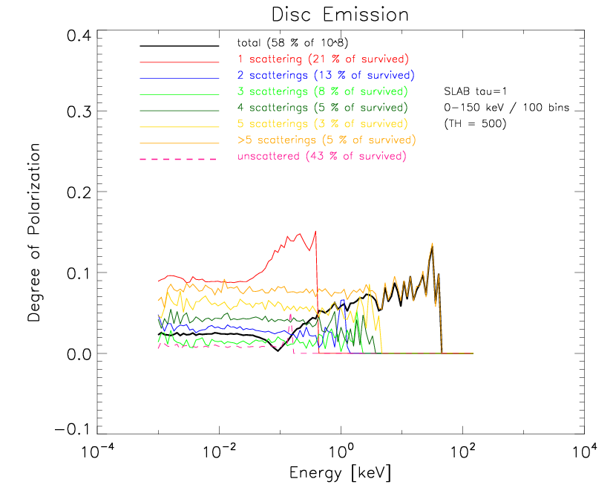
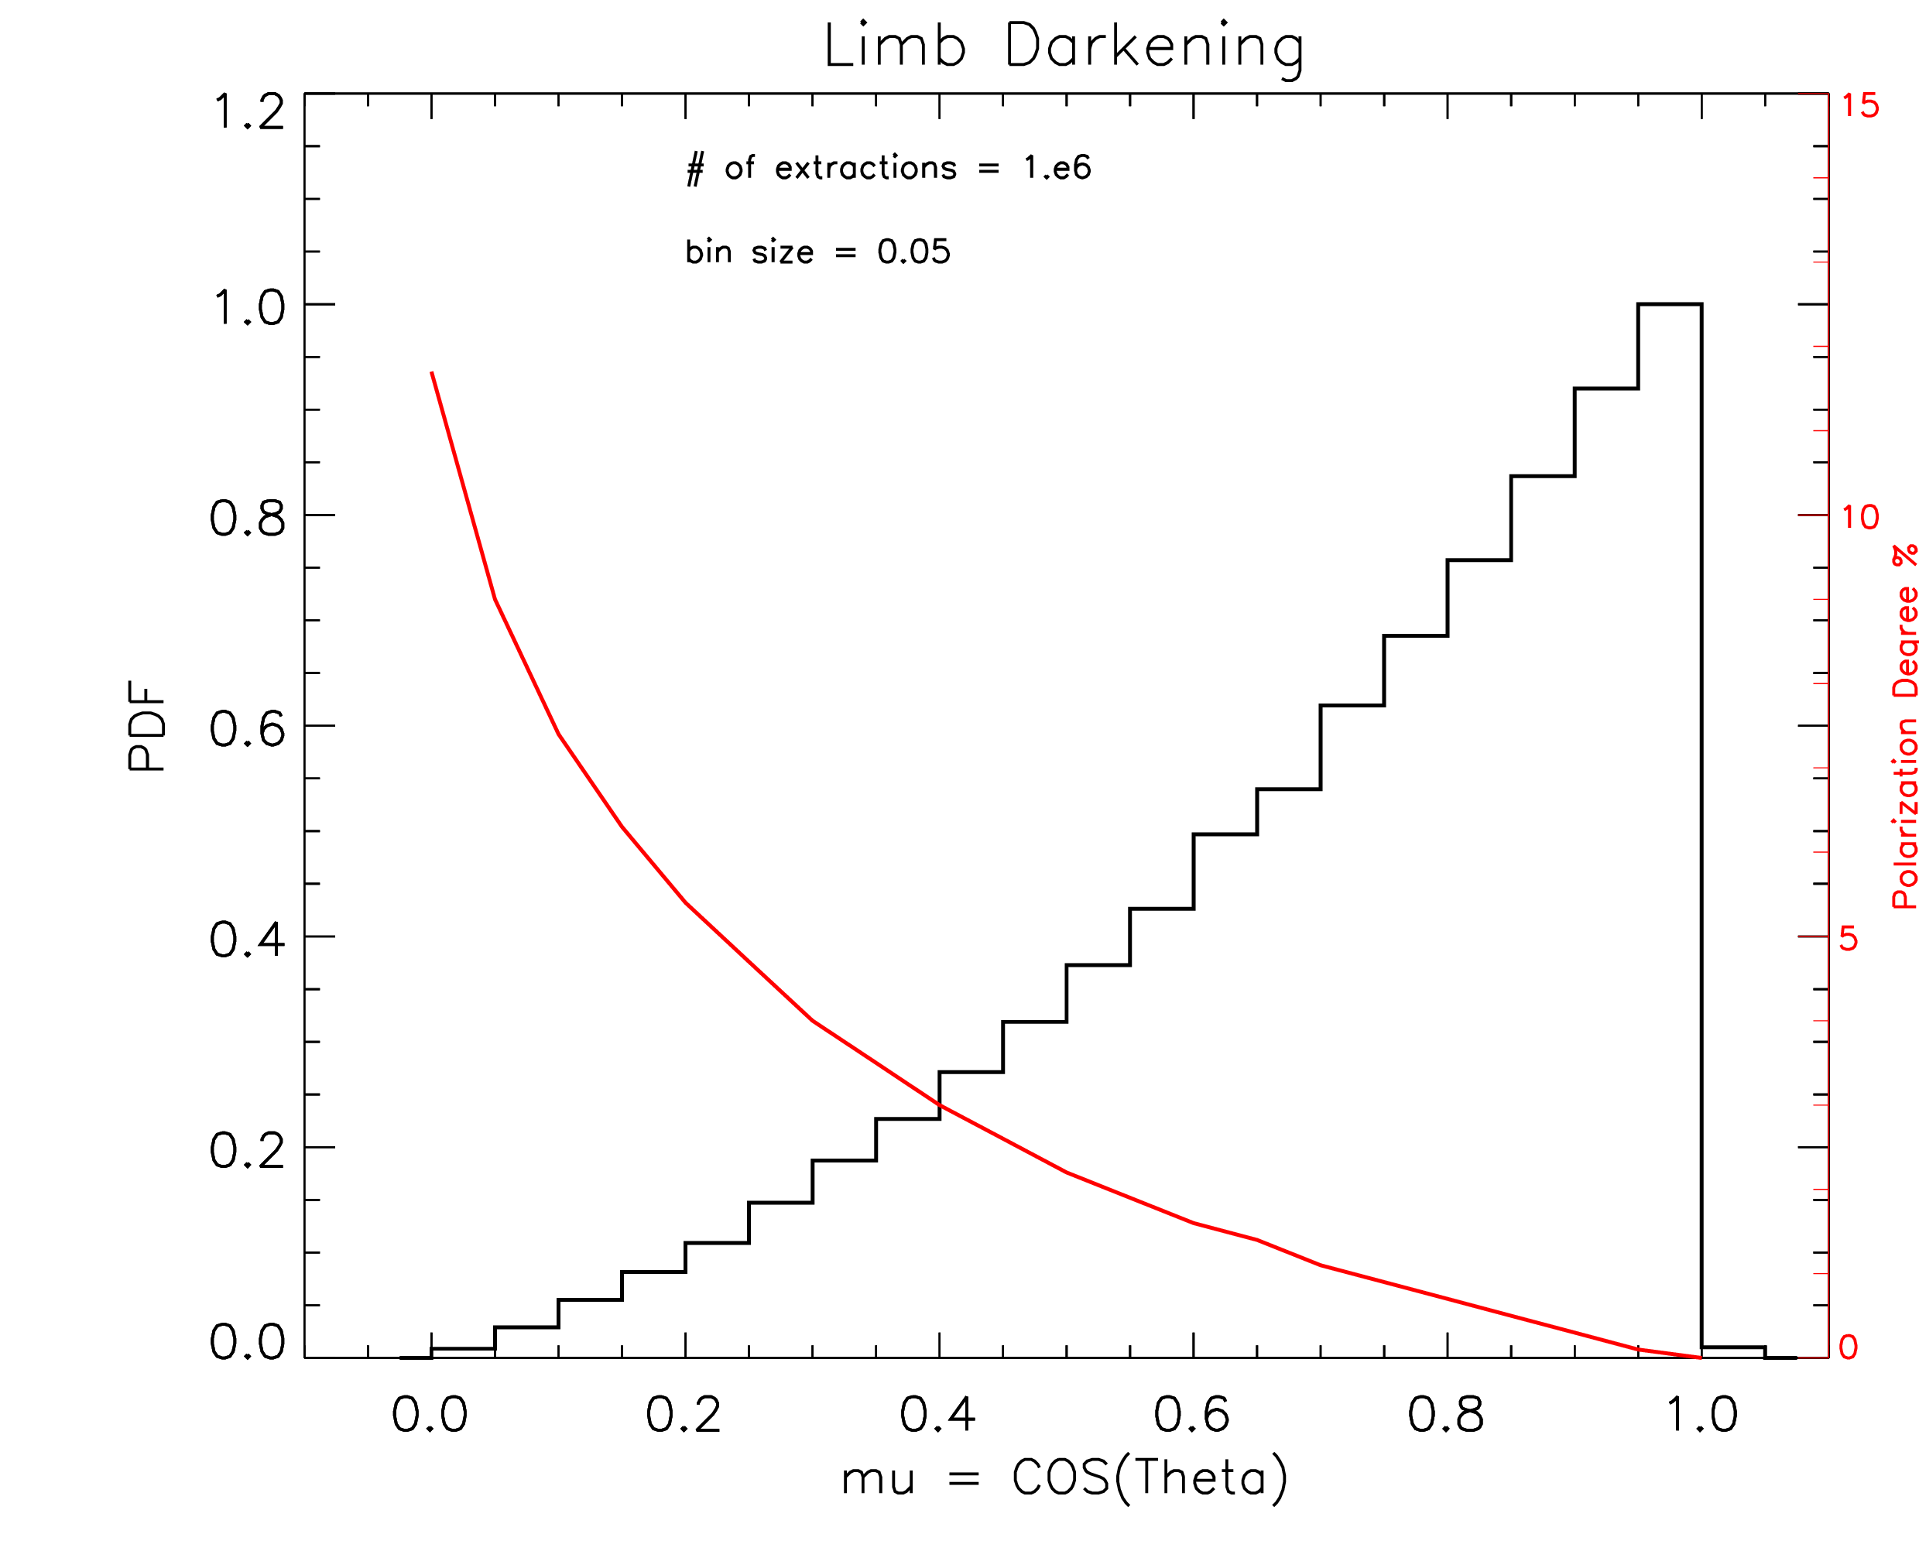


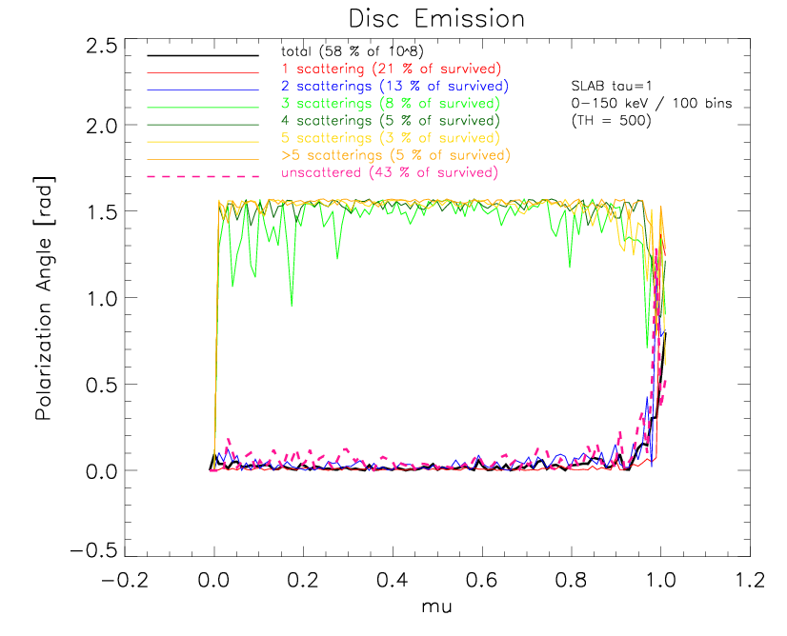
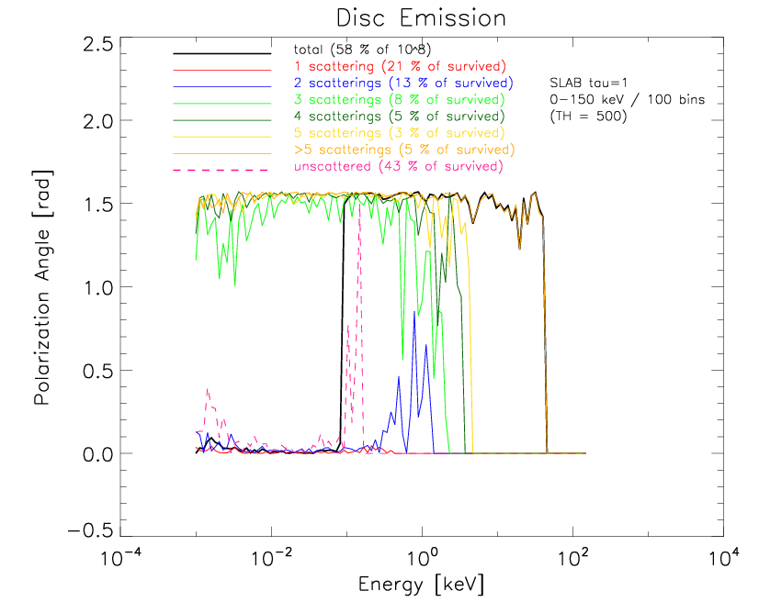
Results
- polarization -
SLAB
tau = 1

Slide 5
Comments on polarizaton (SLAB)
General
Left column: polarization degree (Pie) and angle (Chi) binned in the cosine of the polar angle, mu=cos(theta) (theta = angle of view). Righ column: binned in energy.
When Pie is 0, Chi has no meaning. For every geometry, when the source is observed face on (mu=1) Pie is 0, as expected by the symmetry. Chi = 0 means that the projection of electric field is parallel to the plane of the disc (horizontal) while Chi= 1.57 rad (= 90 deg) means that it is perpendicular (vertical).
When there are less than 500 photons in one bin both Pie and Chi are automatically set to 0.
Mu binning
Photons produced by the disc (see unscattered, pink) are initially horizontally polarized up to 11% for mu=0 according to Chandrasekhar (mini plot with limb darkening and corresponding initial polarization).
Photons which experienced 1 or 2 scattering (red and blue) remains horizontally polarized and after 3 scattering (green and orange) the polarization is vertical, according to what expected for a SLAB geometry. During the switching the polarization degree drops to zero and then increase again.
Energy binning
This is what a polarimeter observed but the signal is integrated on every angle of view so represents an average (the signal increase for edge on end decrease to zero for face on aov).
Here the switching is evident with Pie dropping to zero and then increase and Chi titling from horizontal to vertical (black line = total).
Below 0.1 keV being the contribution of the disc and above the contribution of the corona (i.e. scattered photons)

Slide 6
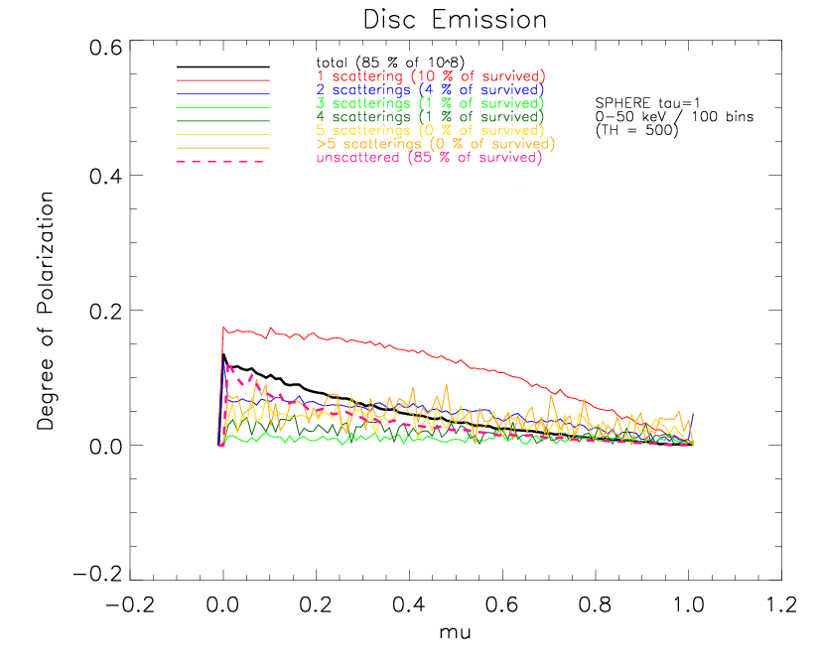
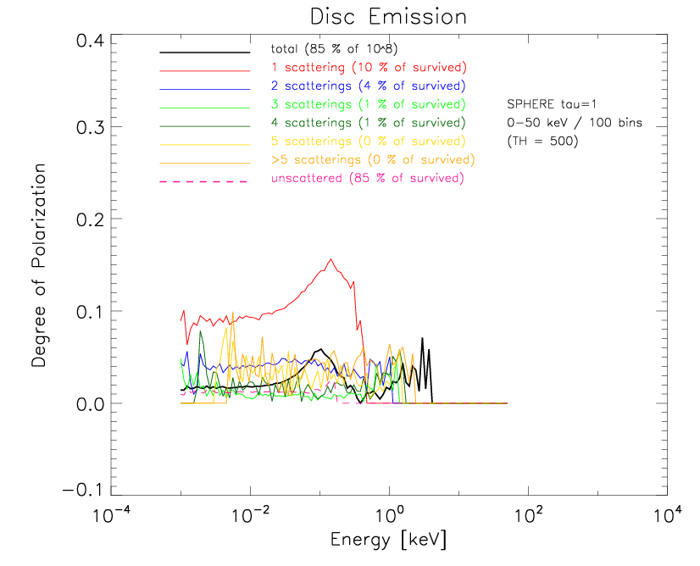
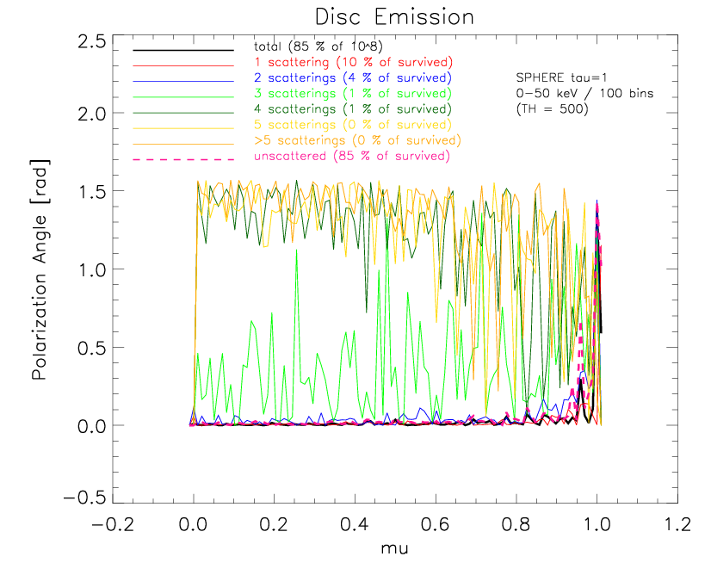
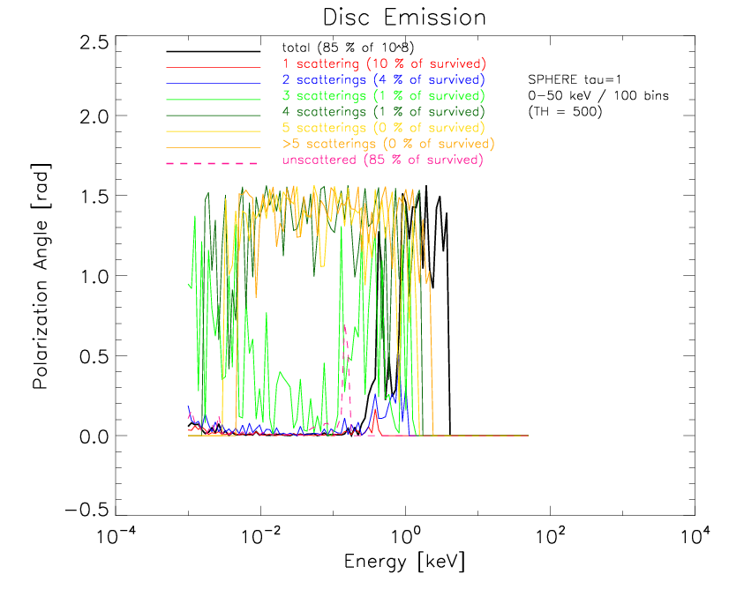
Results
- polarization -
SPHERE
tau = 1

Slide 7
Comments on polarizaton (SPHERE)
General
The sphere is too much symmetric so we expect a weak polarization signal.
Mu binning
Signal produced by scattered photons is dominated by those which experienced 1 or 2 scatterings. The polarization angle remains horizontal and the polarization degree is substantially Chandrasekhar.
Energy binning
In energy, above 0.1 keV we should see the contribution of the corona but the signal is weak (a loto of spikes) and the transition is not clear. This is due to the poor statistic of scattered photons (and mainly 1-2 scatterings) with the spherical corona but also to the high symmetry of it.
For the optically thin corona the results are qualitatively similar but the statistics is too low an the polarization signal is noise dominated.

Slide 8
Conclusions
Spectra
An optically thick corona seems to be required for producing high energy X-rays.
The slab geometry produce a steeper spectrum with respect to the spherical corona but the difference is not striking...
Polarization
...however, polarimetric analysis allows to discriminate between the 2 geometries.
The slab geometry, being axisymmetric, produces a vertical polarization degree up to 10% in X-ray band.
The spherical geometry is not efficient in polarizing and the signal is weak, as expected.

Slide 9


Future developments
MoCA is part of 2 European projects and fundings and it will be developed in the next years.
short term improvements
translate the code in C/C++ (next month) in order to:
- perform parallelization
- include ray-tracing routine
future applications
timing analysis
spectro(polari)metric comparison with data (NuSTAR)
long term projects
merge/combine MoCA with “STOKES +” → multiwavelenght simulations from infrared to hard X-rays

