Slide 1





The perspectives of X-ray polarimetry on accreting sources
(with MoCA: a Monte Carlo code for Comptonization in Astrophysics)
FP7
Strong Gravity Project
WP4 “Comptonization models:
spectra and polarization”
Francesco Tamborra ^{1,2}
Giorgio Matt ²
Stefano Bianchi ²
Collaborators: Rene W. Goosmann ², Michal Dovciak ³
¹ Astronomical Observatory of Strasbourg
² University of Rome“Roma Tre”
³ Astronomical Institute of the Academy of Science (Prague)
X-ray polarisation in Astrophysics – August 25th -28th Stockholm 2014

Slide 2
Outline
Scientific Motivation
The model
The continuum emission in AGN
The Iron line broadening in NS
Conclusions & observational perspectives

Slide 3
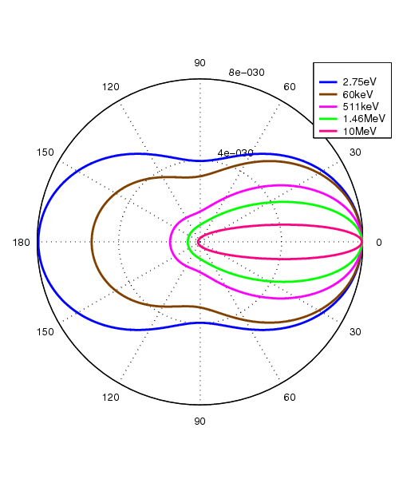
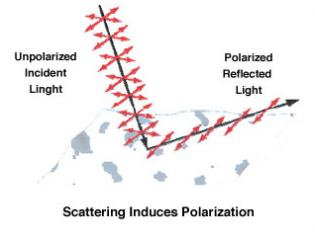
Scientific Motivation
Why another code?
Except for a few cases
- no Klein-Nishina cross-section
- no polarization
MoCA includes both
Why polarimetry?
Observational astronomy is manly made through EM radiation using 3 observables: wavelength, time and space
(i.e. spectroscopy, timing and imaging)
polarimetry adds 2 more indipendent observables which are very sensitive to geometry and inclination
Notes:
EM radiation tells us about its emission process and how it interacted with matter.
Information is usually exploited as a function of wavelenght, space and time...

Slide 4
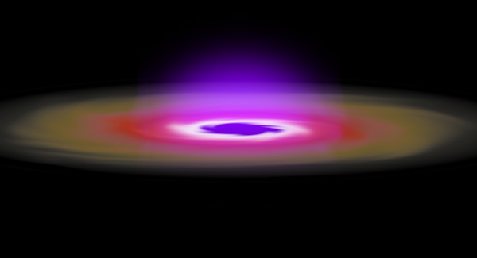
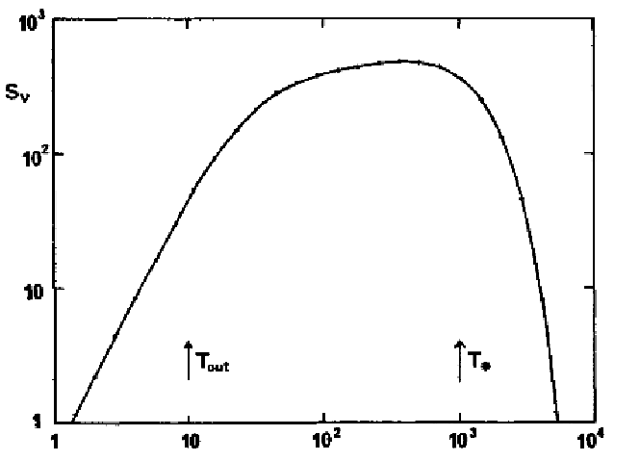
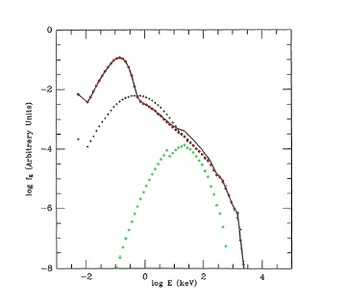
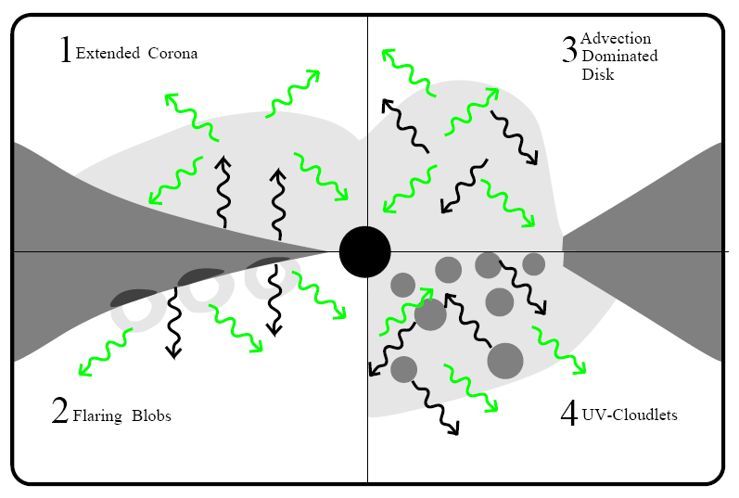
Comptonization
Multi-temperature BB emission
v, T > v, T
BH
Galactic BHs (10 M⊙) → soft X-rays
SMBHs (10⁸ M⊙) → UV
Steady, geometrically thin & optically thick disc
(Shakura-Sunyaev 1973)
Comptonization by relativistic (thermal) electrons
Two-phase disc (Haardt-Maraschi 1991)
The parameters of the corona are
basically unknown !
Notes:
..we know some kind of “corona” is needed for producing hard X-rays bth in AGN and XRB but what we don't really know are the physical parameters of it

Slide 5
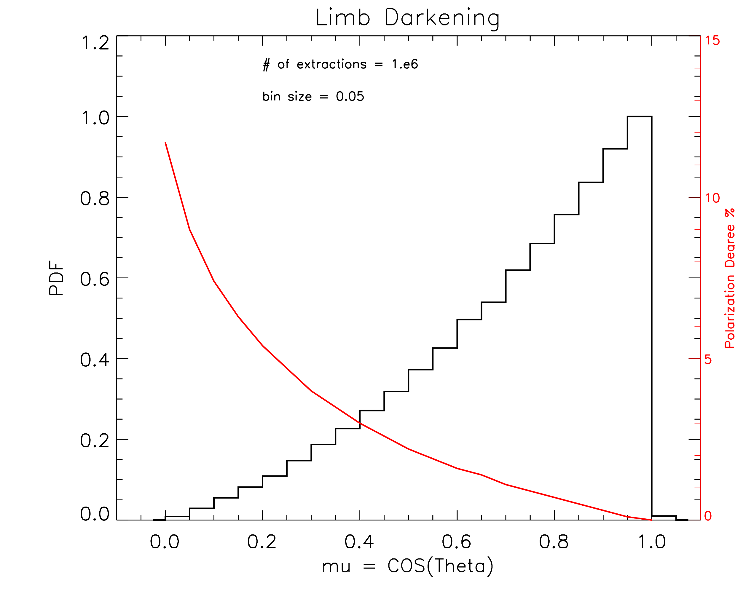
The Model
Seed photons:
- limb darkening
- horizontal (i.e. 0°) polarization
HEMISPHERICAL corona
(τ is defined radially)
Inner radius at ISCO (6 rg)
Schwarzschild SMBH (10⁸ Msun)
SLABBY corona
(Chandrasekhar 1960)
(τ is defined vertically)
Corona parameters:
- thermal energy (kT = 100 keV)
- optical depth (τ = 0.1, 1)

Slide 6
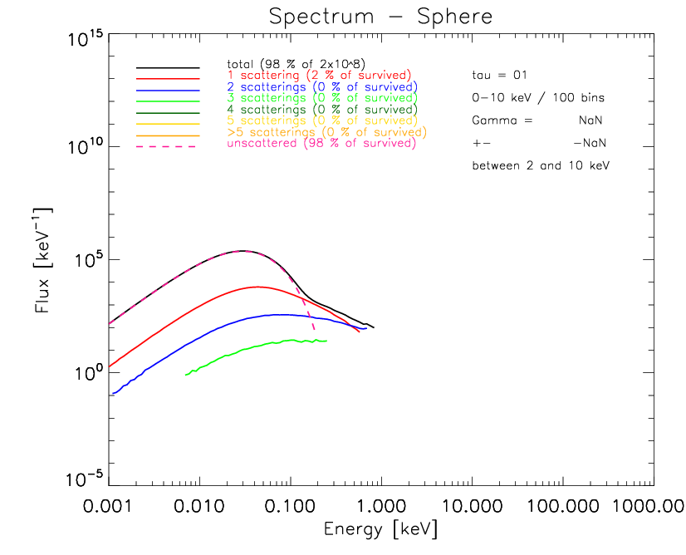
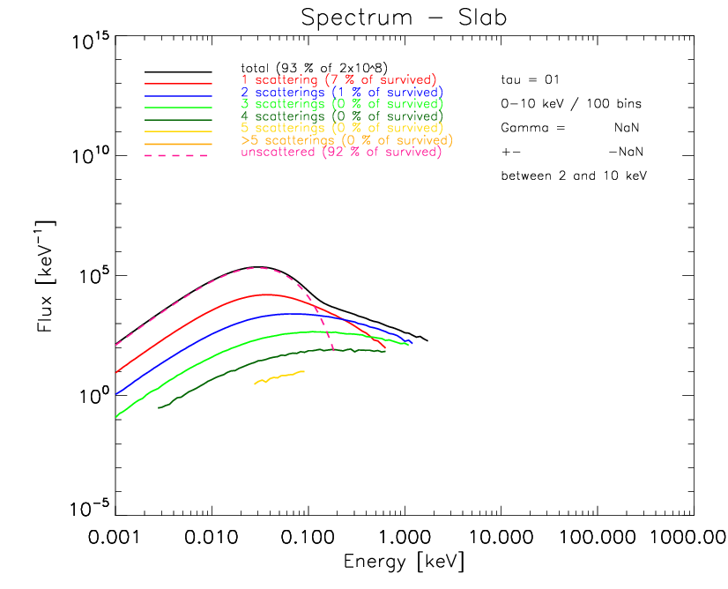
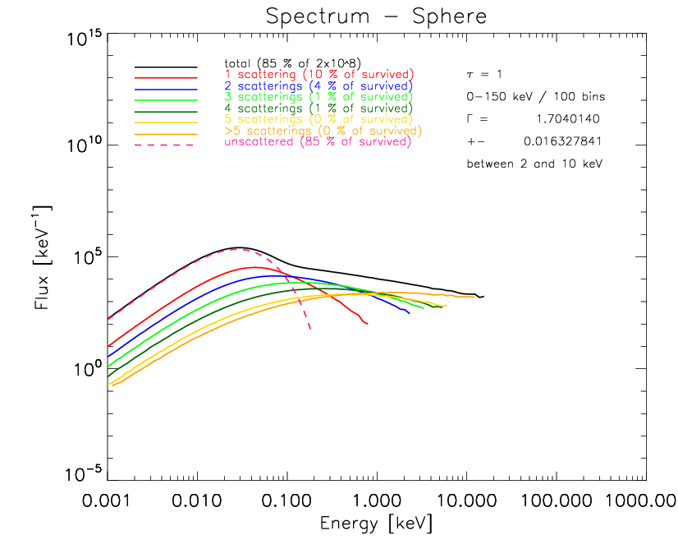
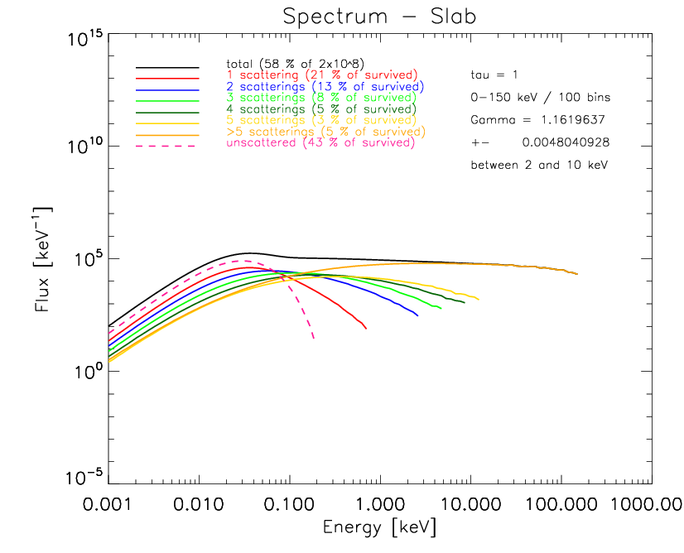
AGN Spectra
SPHERE
SLAB
τ = 0.1
τ = 1
Gamma = 1.7
(CompTT = 1.9)
Gamma = 1.16
(CompTT = 1.3)
Notes:
10 eV → Disk
< 100 eV → 1-2 scattered components
> 100 eV → corona

Slide 7
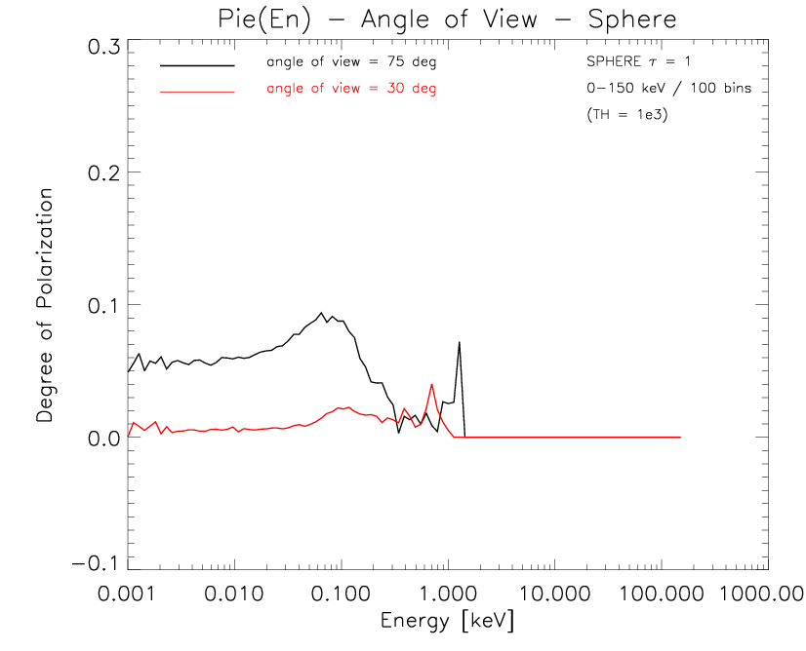
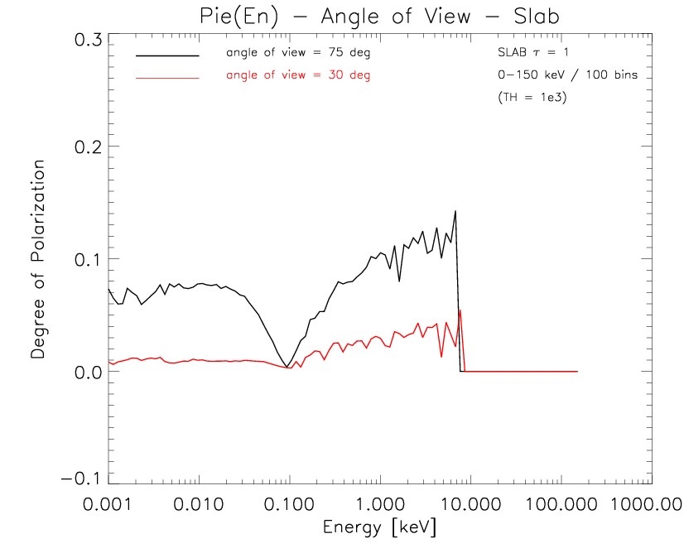
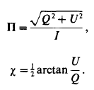
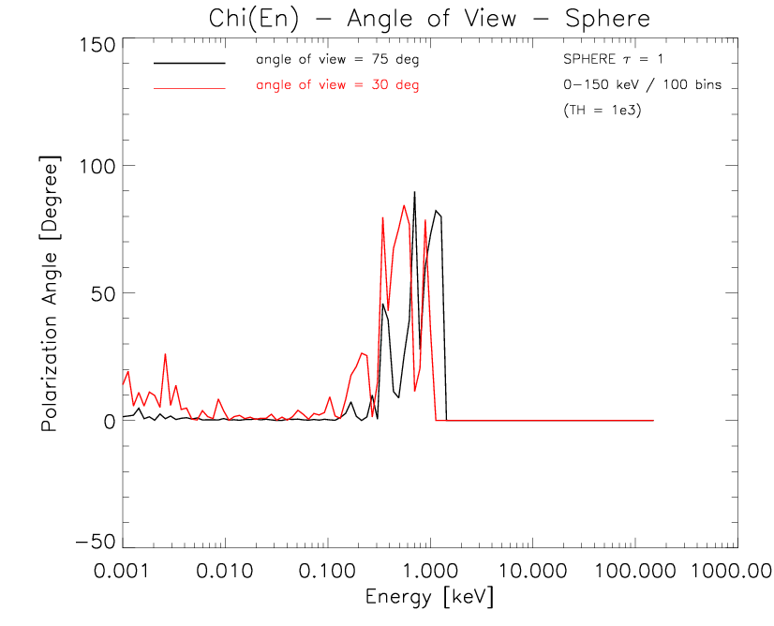
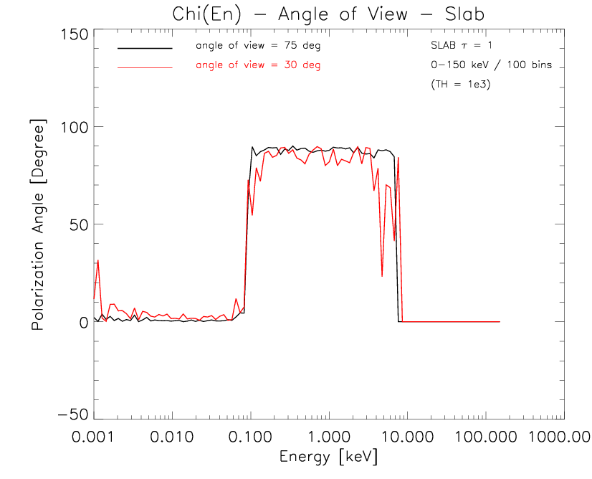
AGN Polarization
SPHERE
τ = 1
SLAB
τ = 1
Treshold
(if counts <1000 then set to 0)

Slide 8
AGN Polarization
SLAB
τ = 1
1-2 scattered photons
multi-scattered photons

Slide 9
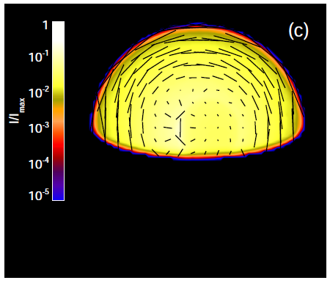
AGN Polarization
SPHERE
τ = 1
(picture from Schnittman+ 2009)
Notes:
with a better statistics we expect the polarization being vertical for multiscattered radiation but the polarization degree will be always lower than for the slab

Slide 10
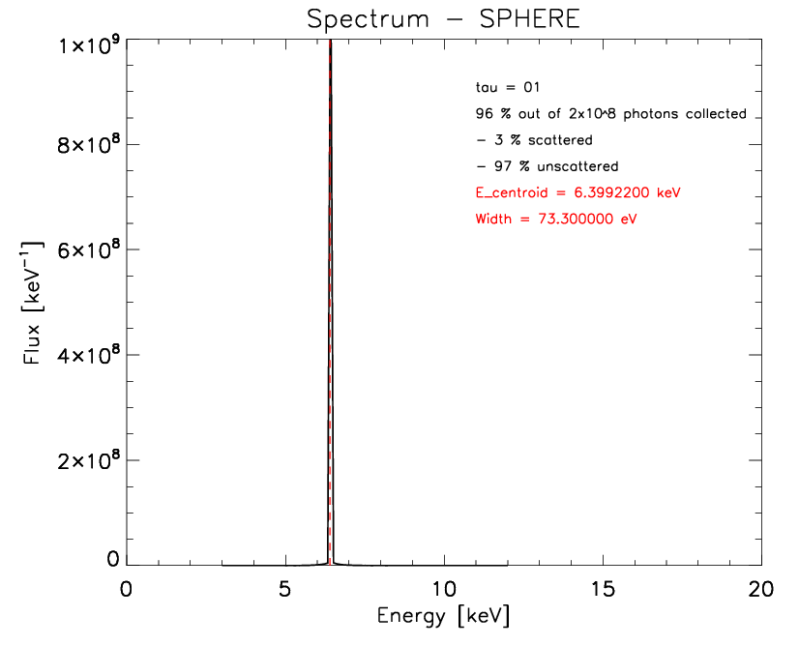
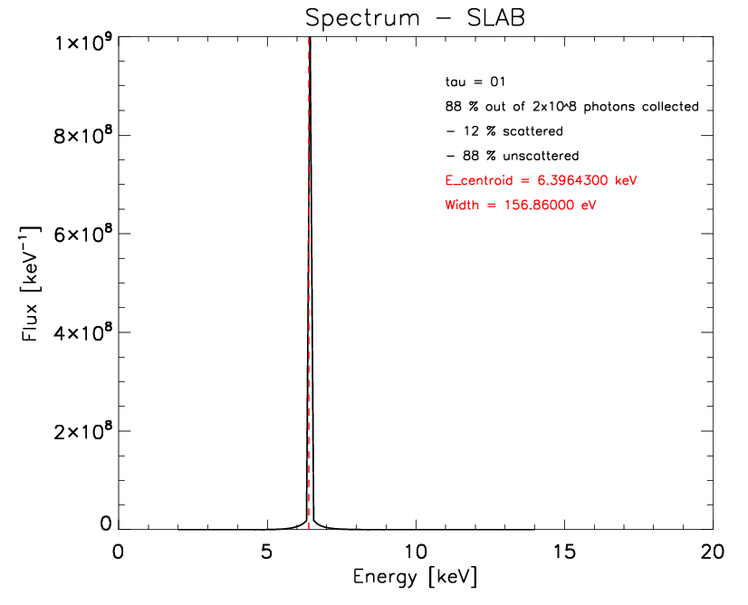
Iron line broadening in XRBs with NS
Relativistic Broadening or just Compton (down-)scattering?
Seed photons:
- monocromatic @ 6.4 keV
- unpolarized
di Salvo+ 2009
D’Ai+ 2009
Cackett+ 2010
Egron+ 2011-13
?
Ng+ 2010
Corona parameters:
- thermal energy (kT = 2 keV)
- optical depth (τ = 0.1, 1, 3)
SPHERE
τ = 0.1
SLAB
τ = 0.1

Slide 11

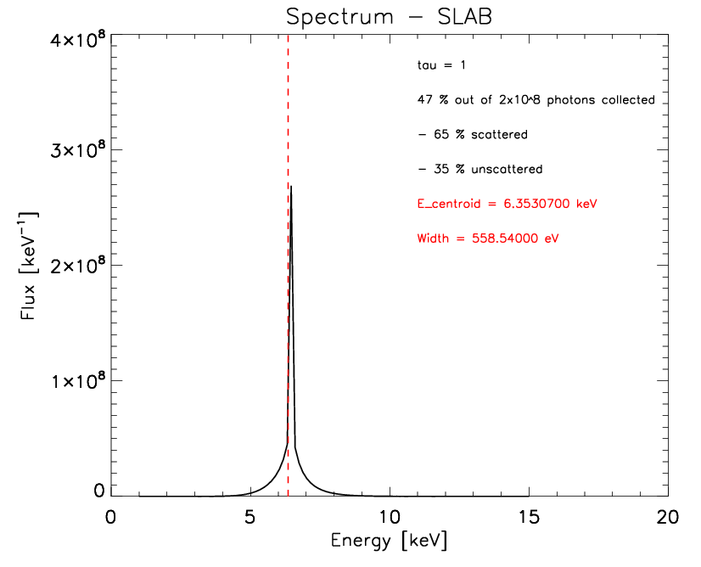
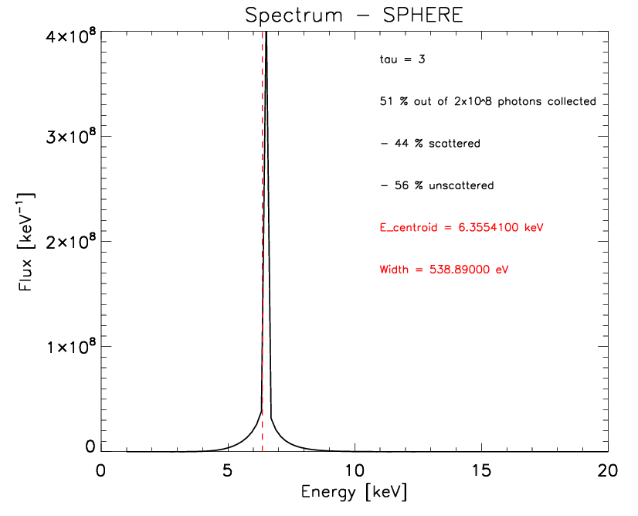
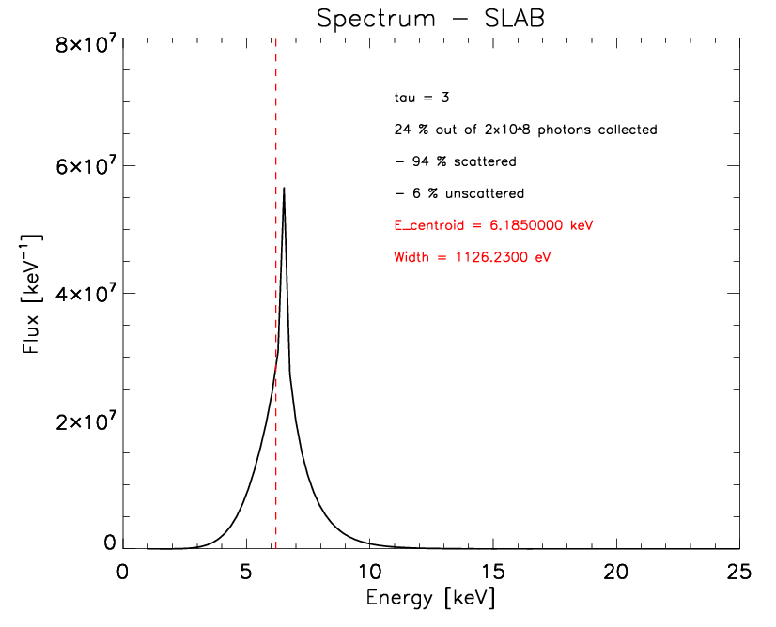
Line profile
SPHERE
SLAB
τ = 1
τ = 3
Notes:
this is not the EW because there's no continuum below.
The width is measured as dispersion from the line centroid

Slide 12
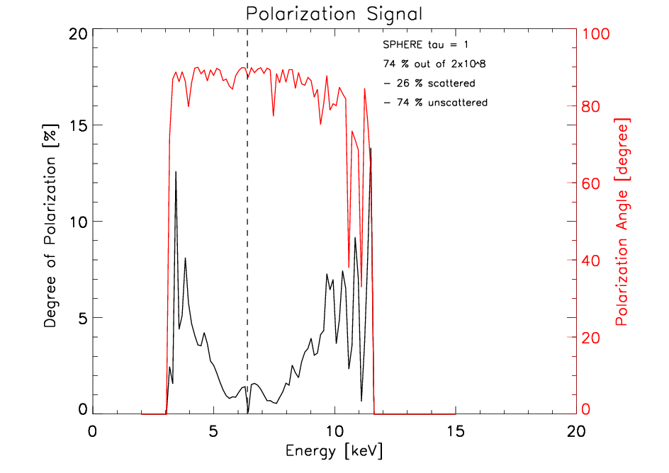
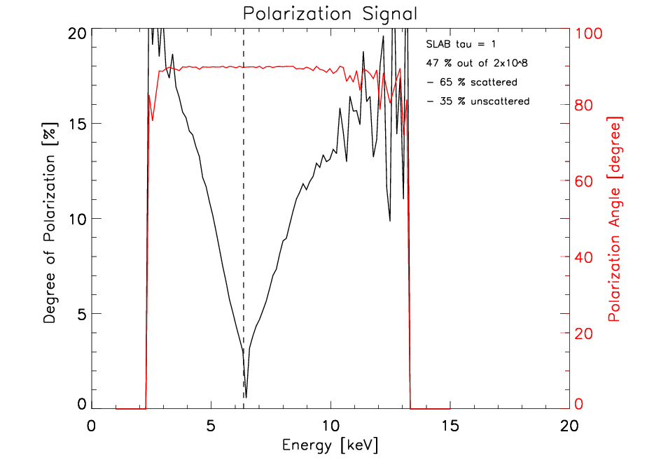
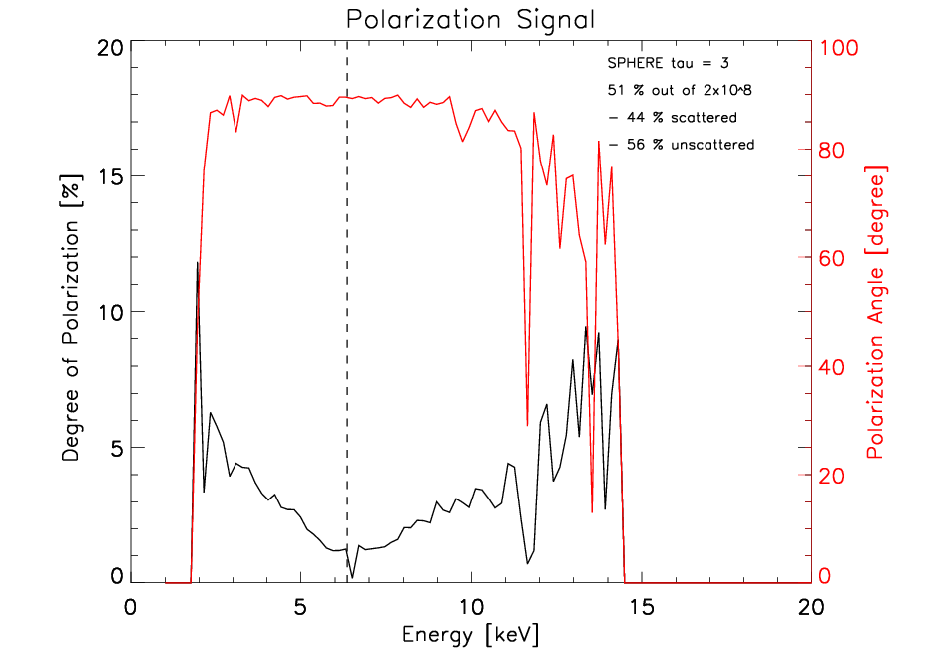
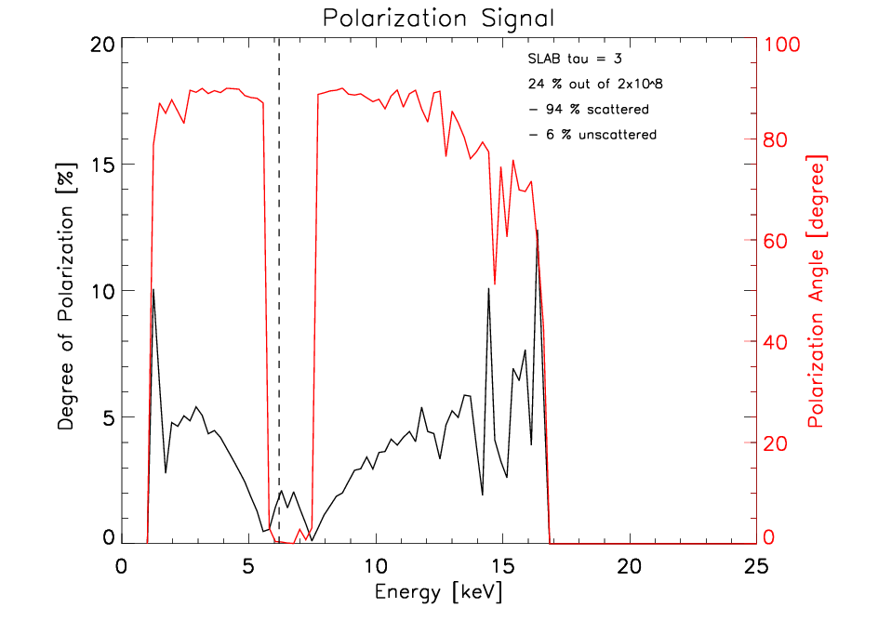
Line polarization
SPHERE
SLAB
τ = 1
Treshold 100 counts
τ = 3
Notes:
the treshold here is 100: much noiser but we can see the signal in the wings
for the sphere the polarization is vertical because the radiation in this case is originally unpolarized so it “instantly” reflects the only asymmetry present which is the base of the hemisphere (and also the radiation comes from an axysimmetric source)
For the slab with tau=3 we start to see Chandrasekhar.
Photons with few scattering can only come if they travel vertically in the slab.
Only multiscattered photon can travel horizontally and produce a vertical polarization.

Slide 13
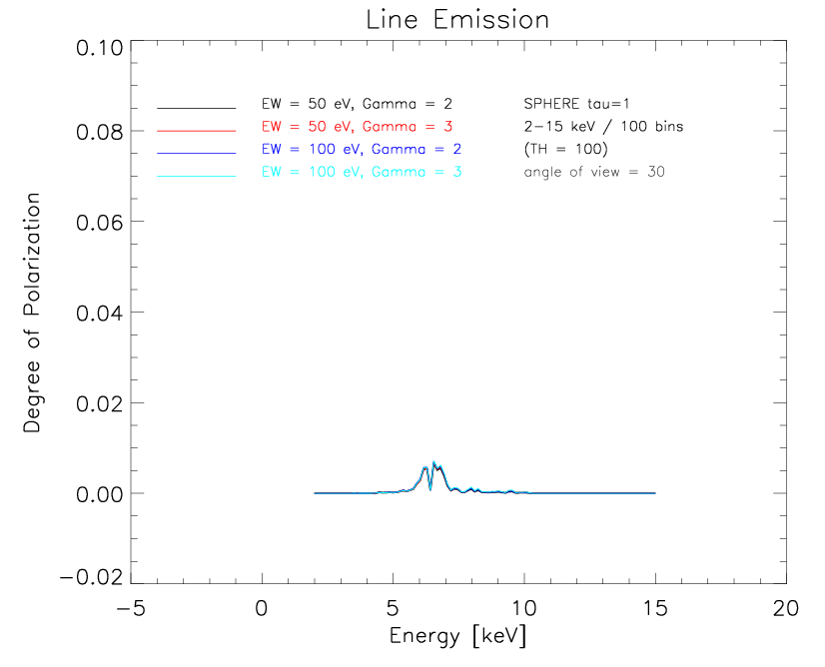
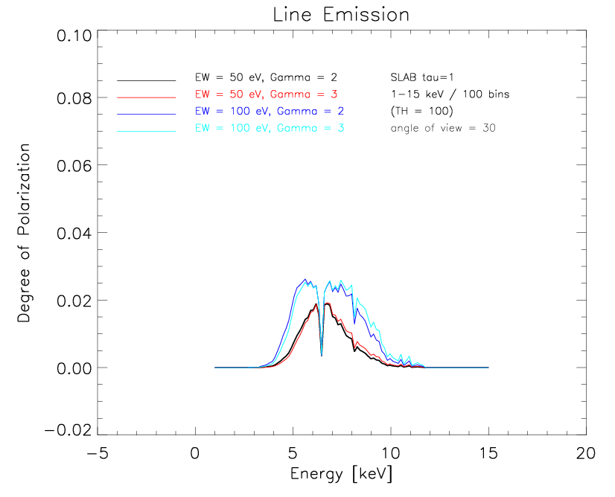
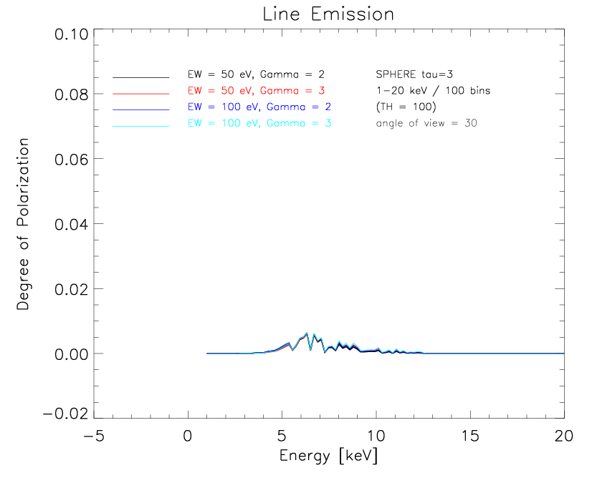
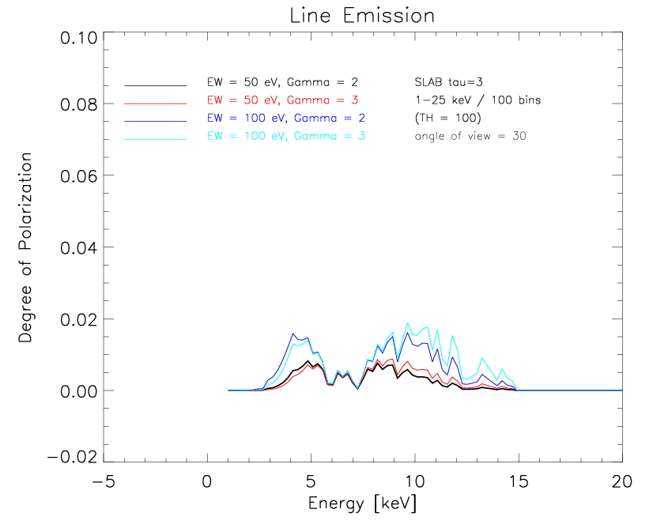
Net Polarization Degree – 30°
SPHERE
SLAB
τ = 1
τ = 3
Notes:
consider that 1% is measurable
(roughly with 3 mCrab source and 100 Ks)

Slide 14
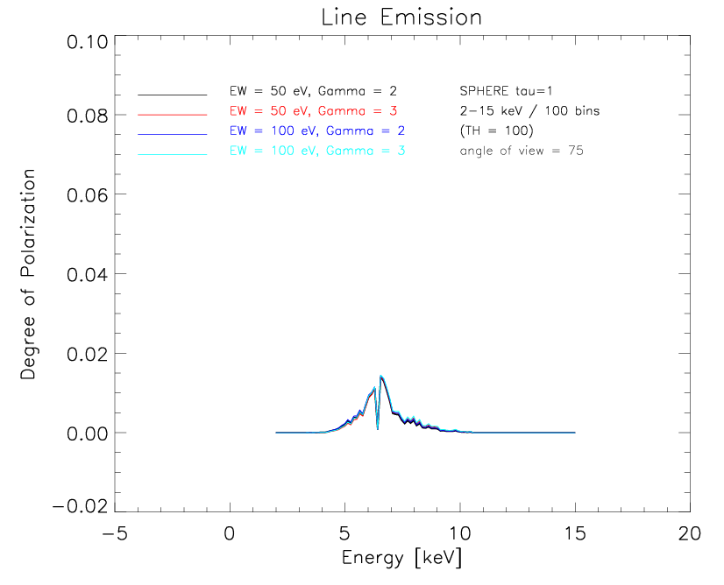
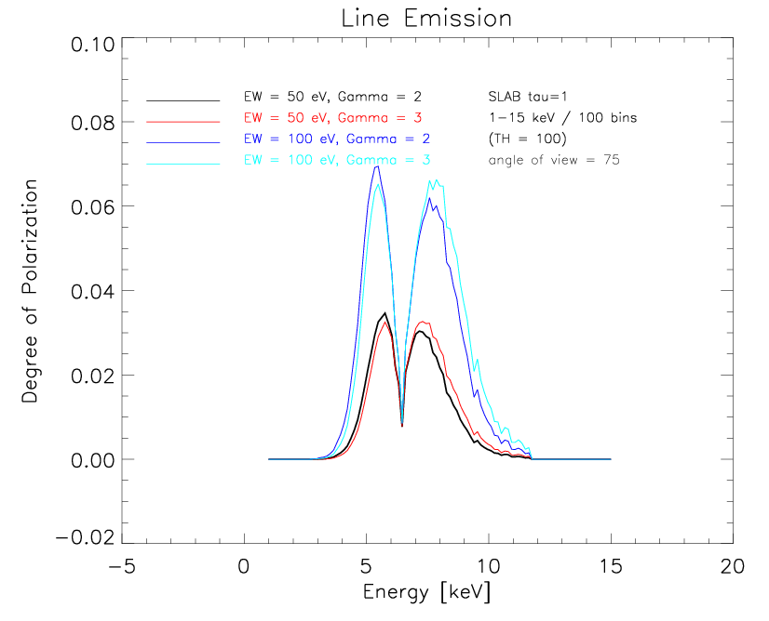
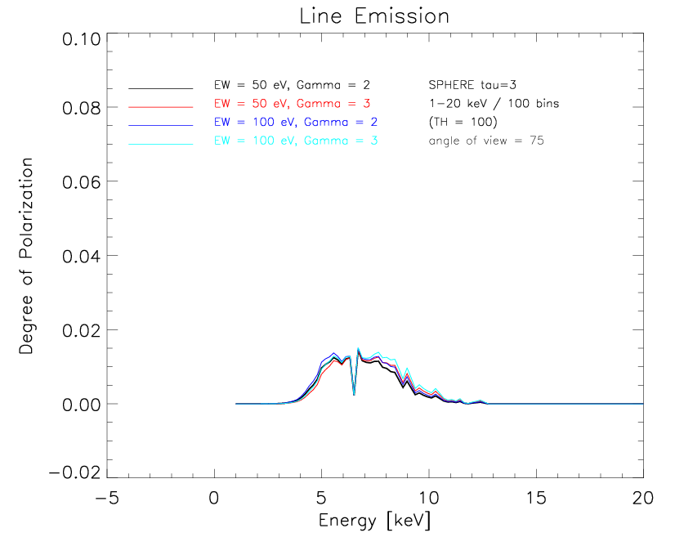
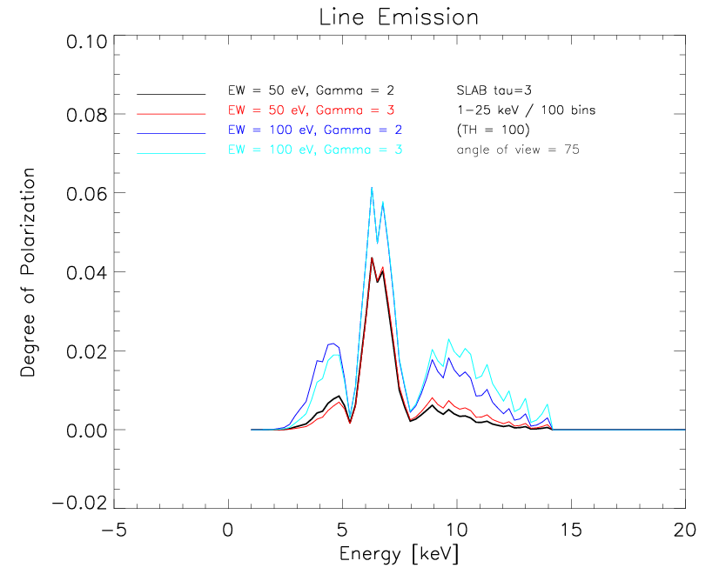
Net Polarization Degree - 75°
SPHERE
SLAB
τ = 1
τ = 3
Notes:
slab tau 3: the peak are the photons which travelled vertically and then scattered at 90 degrees towards the observer edge on

Slide 15
Conclusions
Polarized radiation is expected in many sources being produced by scatterings, magnetic fields and general relativity
Polarimetry offers 2 new independent observables (which is the opposite of adding more parameters!)
These observables are extremely sensitive to geometry & angle of view if polarization is produced via scattering

Slide 16
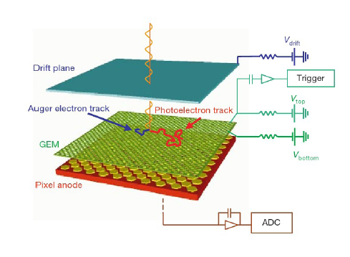
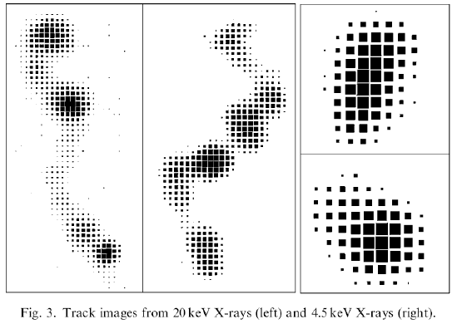
Observational perspectives...none, yet!
Costa et al. (2001), Bellazzini et al.(2009), Muleri et al. (2009)
...but the technology is ready, well tested and perfectly fits a small mission (as we will see tomorrow afternoon).

Slide 17
Observational perspectives...none, yet!
Costa et al. (2001), Bellazzini et al.(2009), Muleri et al. (2009)
...but the technology is ready, well tested and perfectly fits a small mission.(as we will see tomorrow afternoon).
So let's open this window because:
“Even if the open windows of science at first make us shiver after the cozy indoor warmth of traditional humanizing myths, in the end the fresh air brings vigor, and the great spaces have a splendor of their own.”
[Bertrand Russell]

