Slide 1

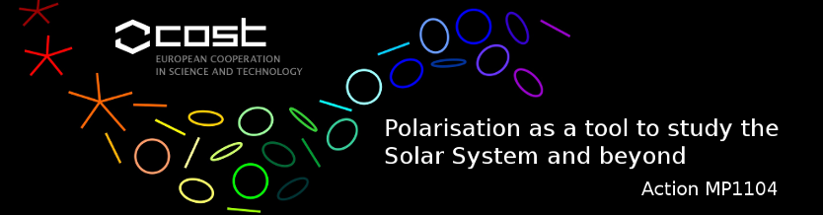
Modeling relativistic X-ray polarization signals in AGN
(with MoCA)
Tamborra F.
Matt G.
Bianchi S.
Goosmann R., Dovciak M., Bursa M.
The 2nd COST workshop on Polarization and Active Galactic Nuclei
11-12 May 2015, Strasbourg

Slide 2
Outline
A brief introduction
Description of the model and the code
Some results on AGN
Conclusion, future work and observational perspectives

Slide 3
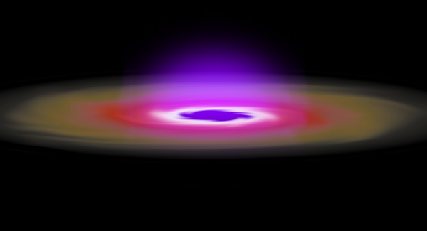
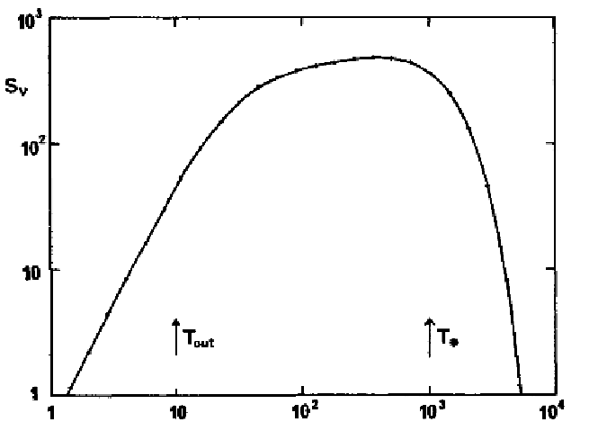
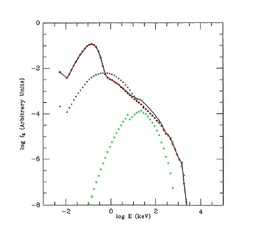
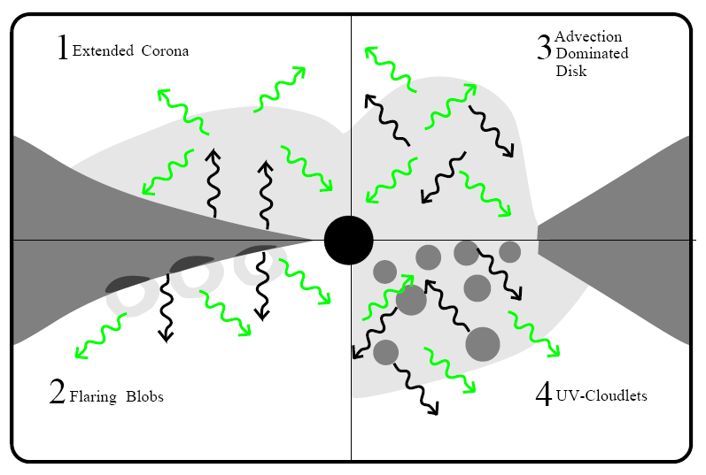
A Brief Introduction
Multi-temperature BB emission
v, T > v, T
BH
Galactic BHs (10 M⊙) → soft X-rays
SMBHs (10⁸ M⊙) → UV
Steady, geometrically thin & optically thick disc
(Shakura-Sunyaev 1973)
Comptonization by relativistic (thermal) electrons
Two-phase disc (Haardt-Maraschi 1991)
The parameters of the corona are
basically unknown !

Slide 4
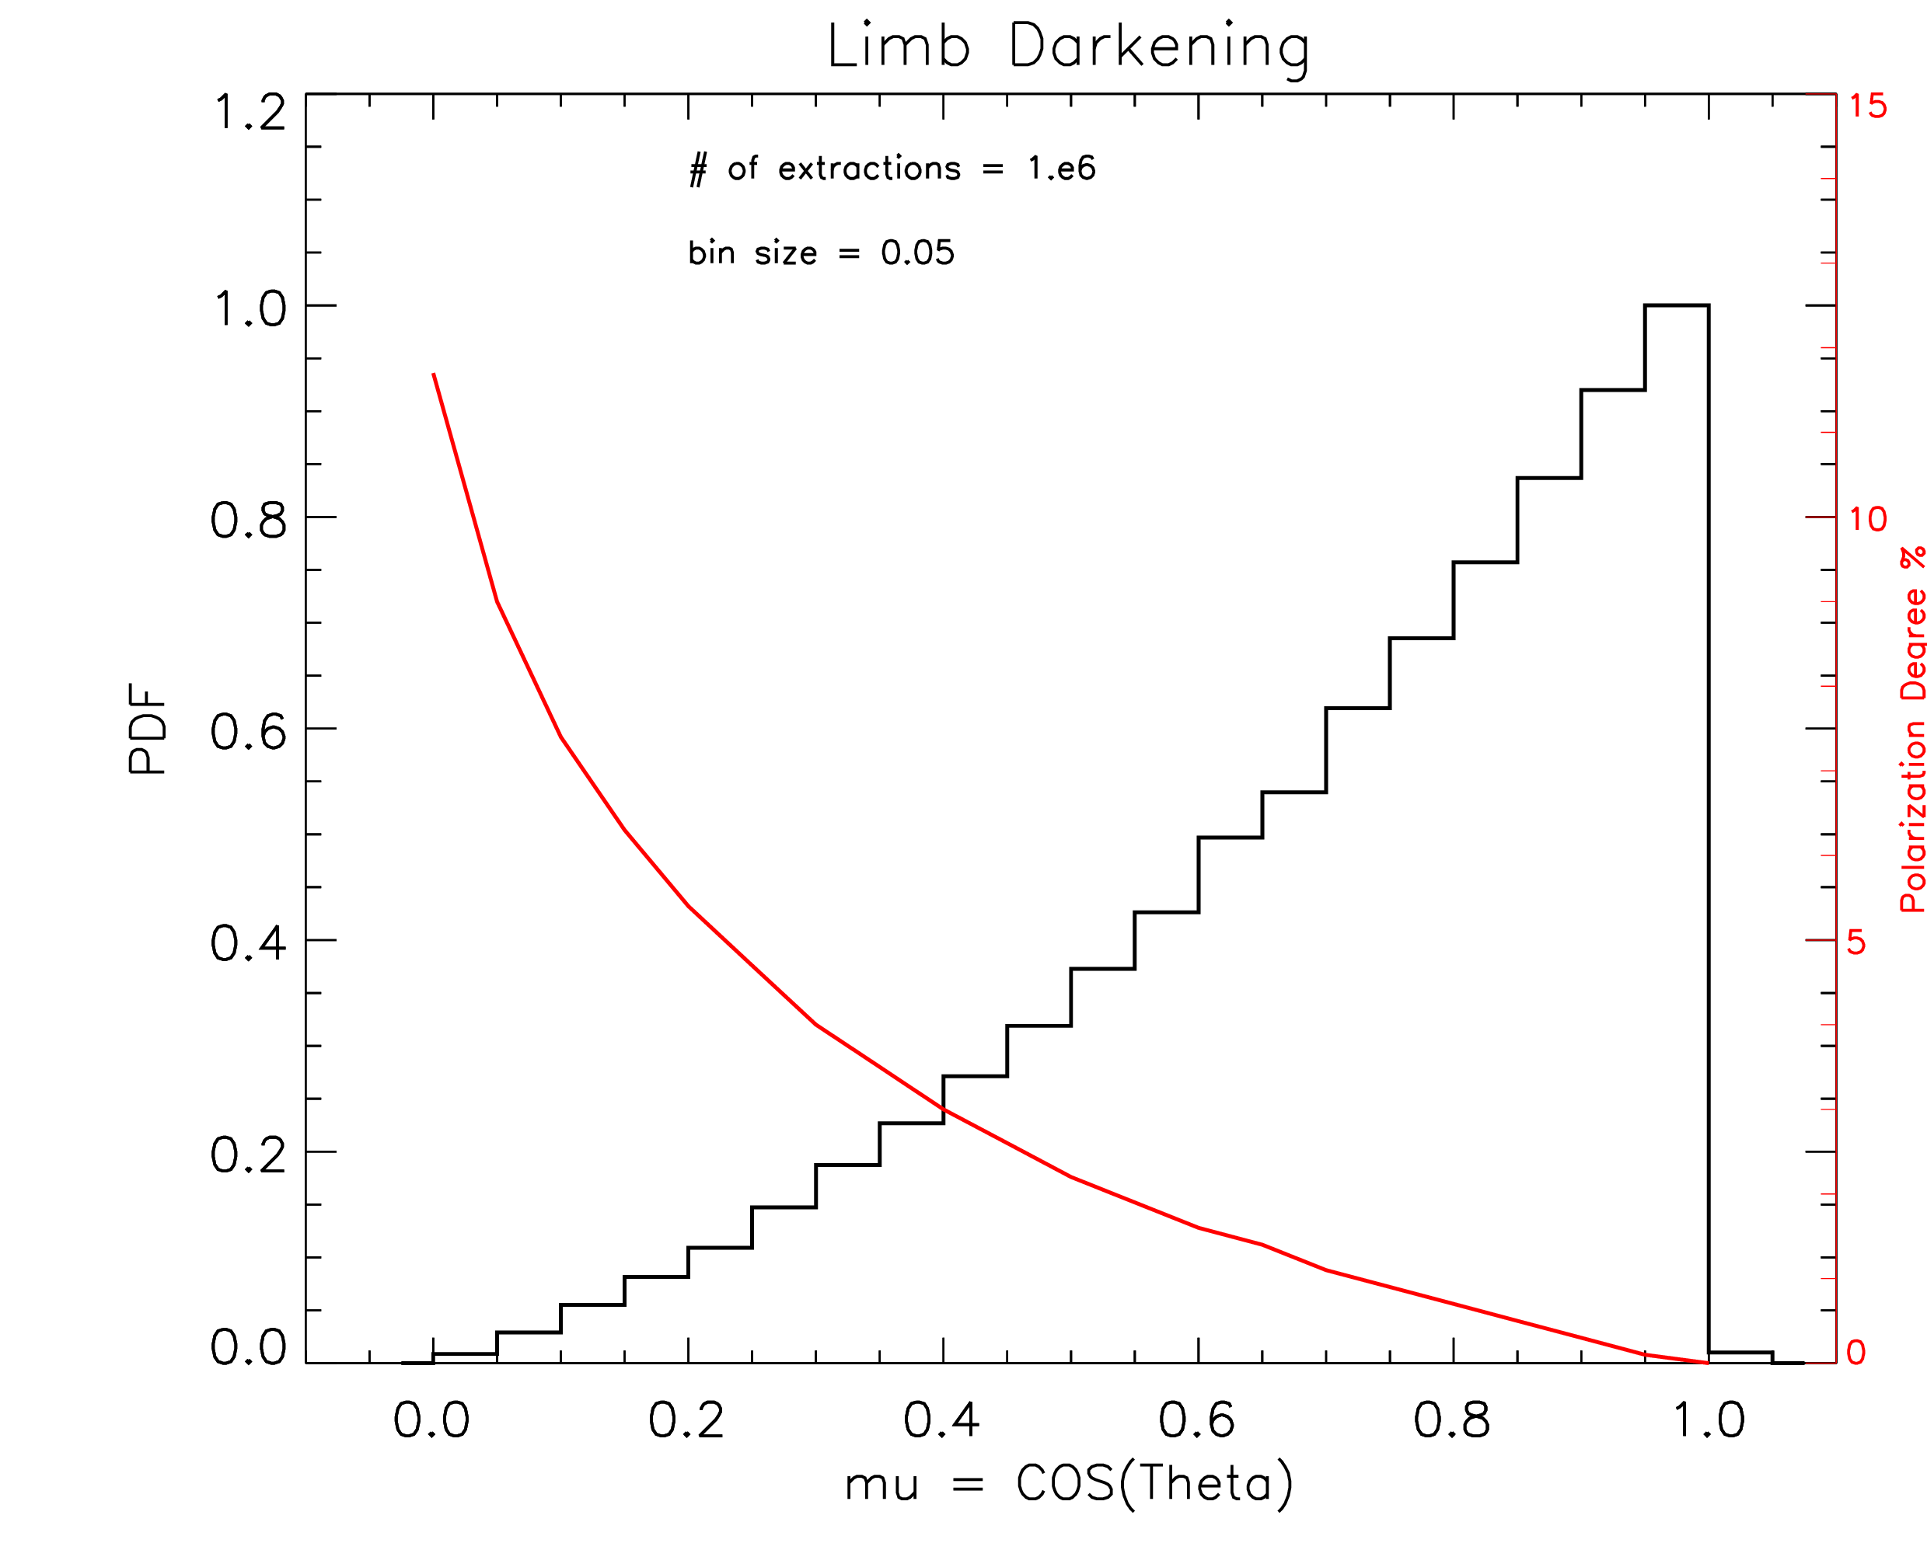
Description of the model
HEMISPHERICAL corona
Seed photons:
- limb darkening
- horizontal (i.e. 0°) polarization
(τ is defined radially)
Inner radius at ISCO (6 rg)
Schwarzschild SMBH (10⁸ Msun)
SLAB corona
(τ is defined vertically)
(Chandrasekhar 1960)
Corona parameters:
- thermal energy (kT = 100 keV)
- optical depth (τ = 0.1, 1)

Slide 5
Description of the code
MoCA: a Monte Carlo code for Comptonization in Astrophysics
Main feature:
Fully special relativistic (K-N cross-section, Maxwell-Juttner distribution) – GR will be included soon!
Modular (different corona geometries and compact object)
Include polarization

Slide 6
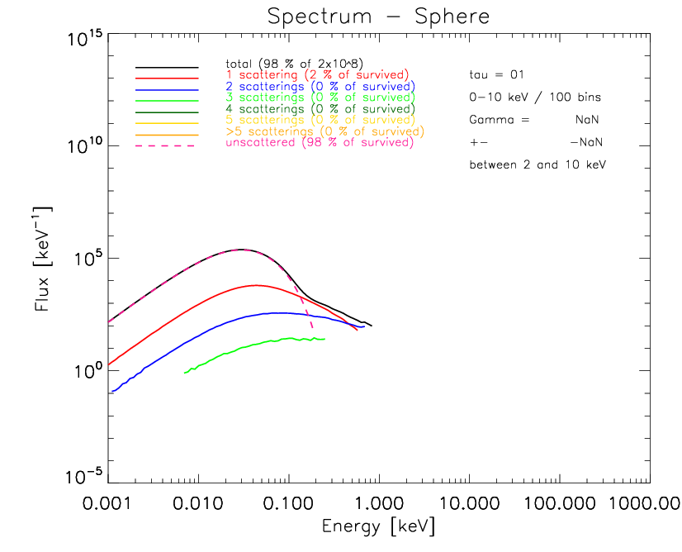
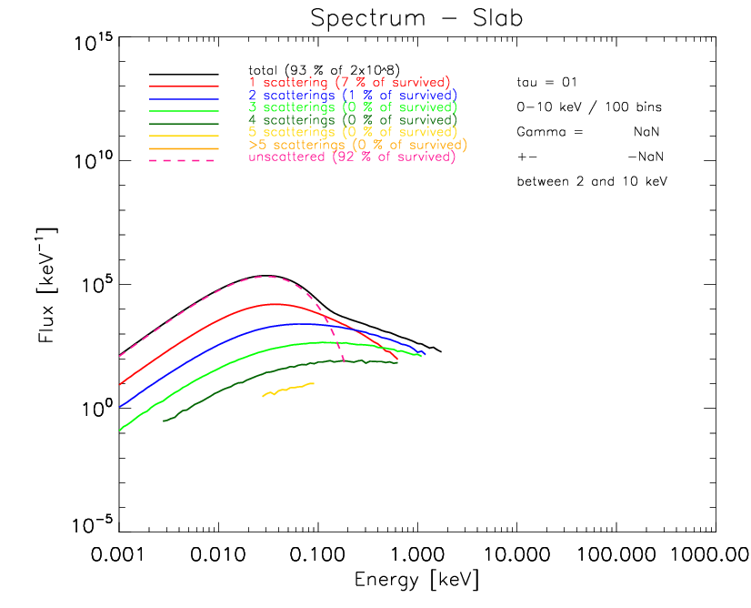
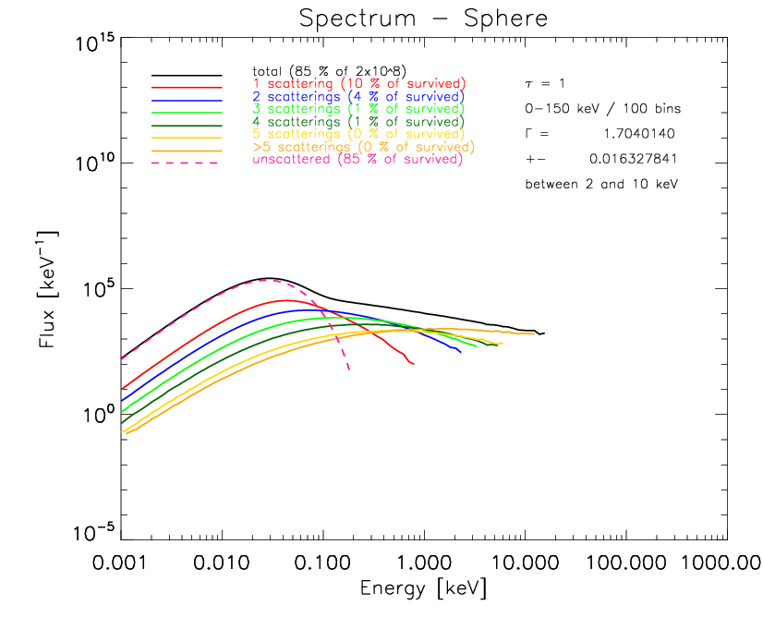
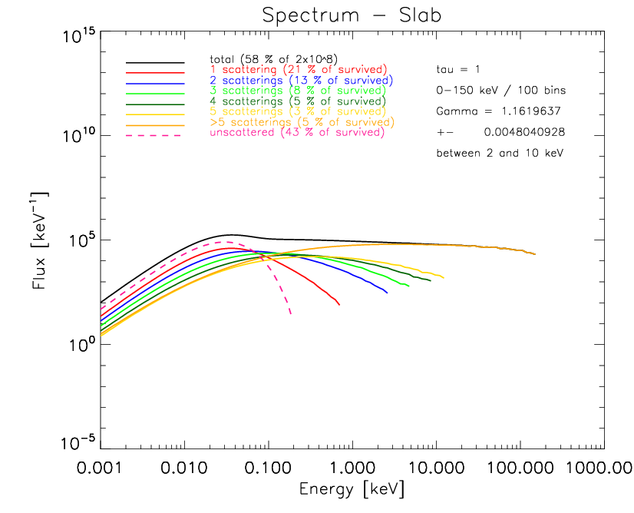
Result
- the spectra -
tau = 0.1
tau = 1

Slide 7
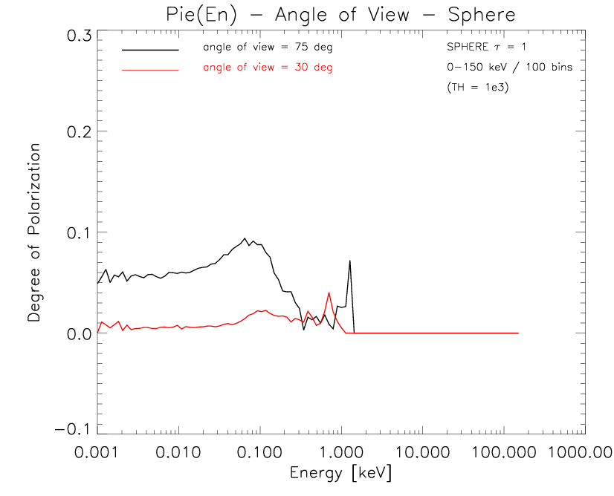
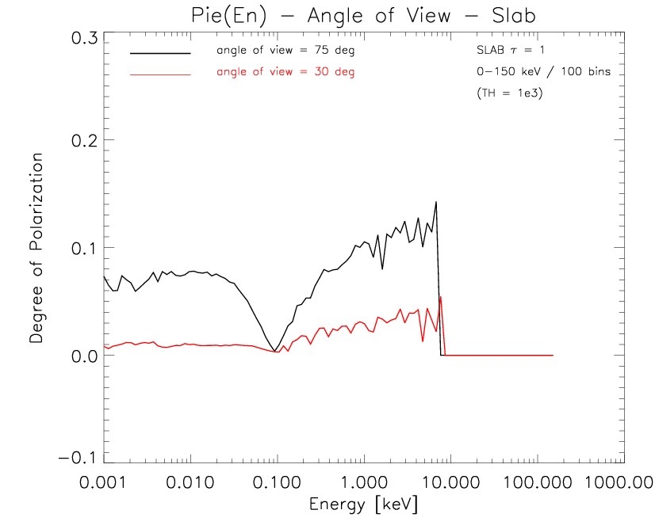
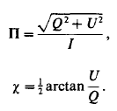
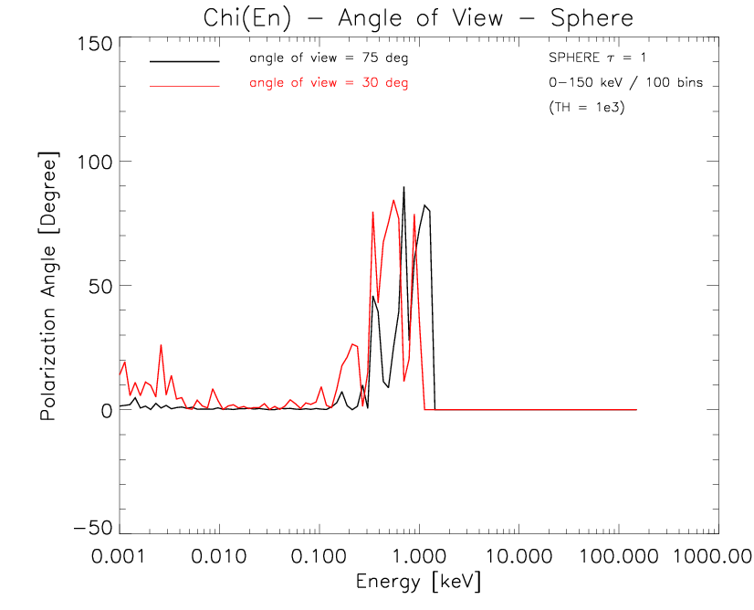
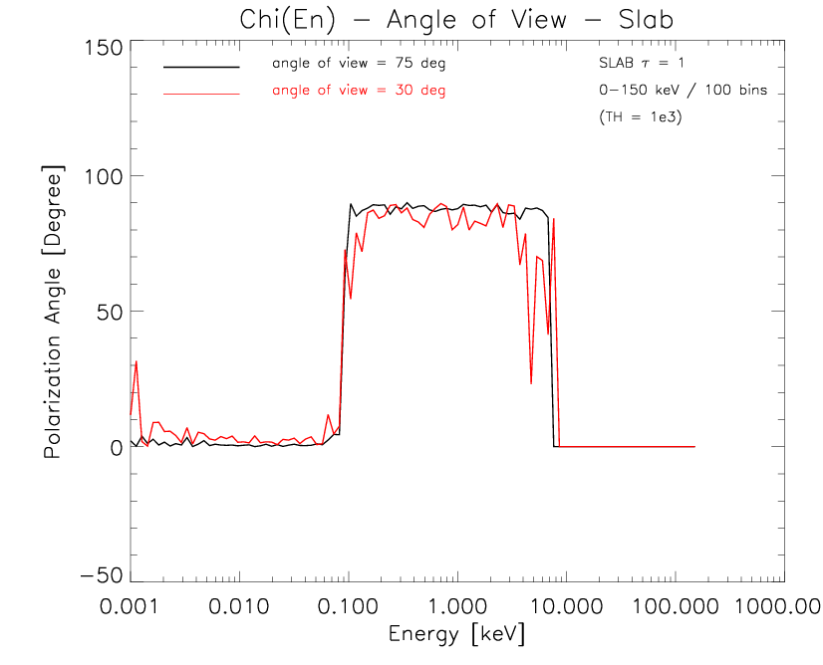
Result
- the polarization -
Sphere / tau = 1
Slab / tau = 1
Treshold
effect

Slide 8
Result
- the polarization -
SLAB
τ = 1
1-2 scattered photons
multi-scattered photons

Slide 9
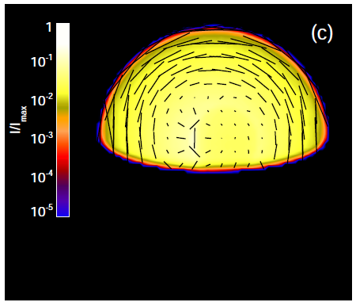
Result
- the polarization -
SPHERE
τ = 1
(picture from Schnittman+ 2009)

Slide 10
Conclusion
Polarized x-ray radiation is expected in AGN due to Comptonization and can reach ~10% of observed flux in the best scenario (without GR effects)
Polarimetry offers 2 new independent observables which are complementary to specral analysis
These observables are extremely sensitive to geometry & angle of view

Slide 11
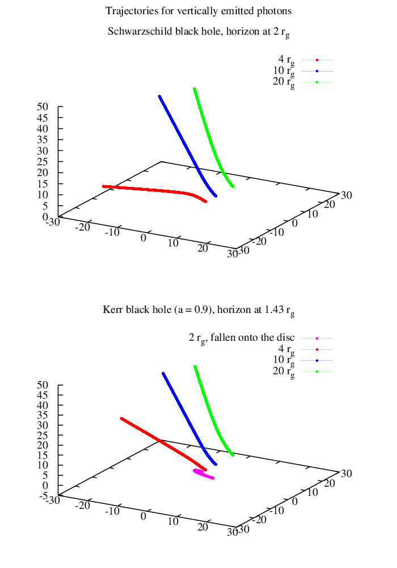
Future Work
Light bending de-polarizes polarized radiation (and polarizes unpolarized radiation)
Include GR
Even more flexibility (turn on/off GR and polarization)

Slide 12
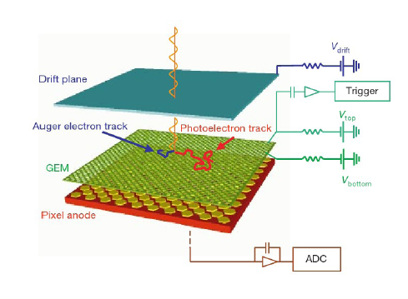
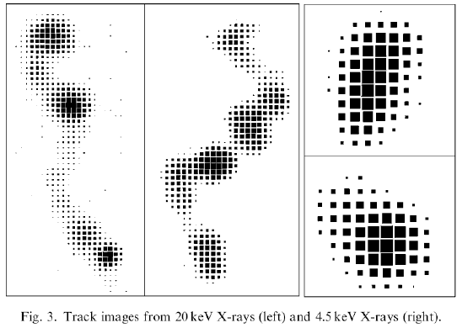
Observational Perspectives
...none yet
Costa et al. (2001), Bellazzini et al.(2009), Muleri et al. (2009), Soffitta et al. (2012 - 2013)
...but the technology is ready and well tested (yesterday's talk by Paolo Soffitta on XIPE / IXPE)

