Slide 1

Strong Gravity EU FP7-SPACE Research Project
WP4
Comptonization models: Spectra and Polarization
UNIROMA3 (G. Matt, S. Bianchi)
CNRS (F. Tamborra)
AsU (M. Bursa, M. Dovciak)

Slide 2
Outline
WP4 goals and timeline
Results
Where we are
Future work

Slide 3
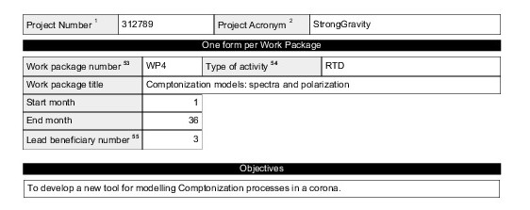
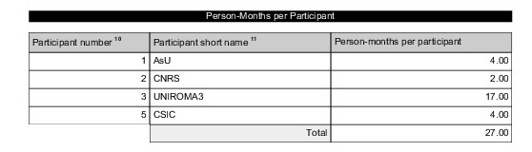
WP4 goals and timeline

Slide 4
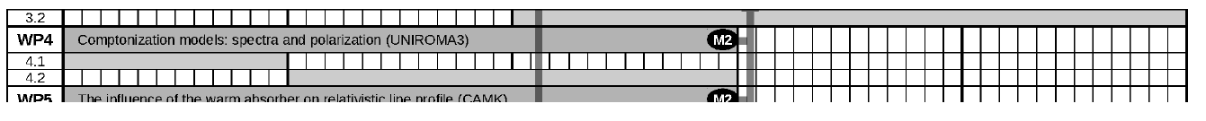
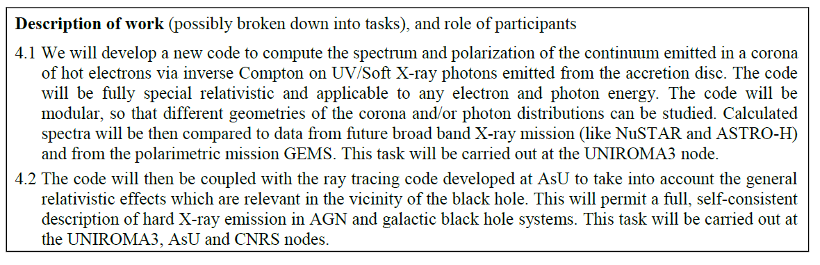
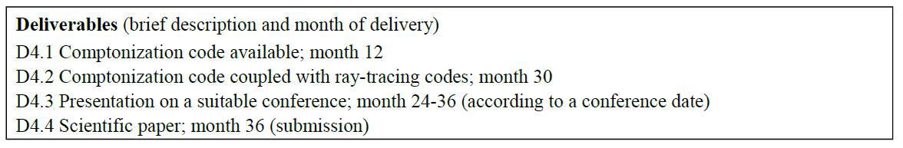
WP4 goals and timeline

Slide 5


Results
MoCA: a Monte Carlo code for Comptonization in Astrophysics (IDL)
Main feature:
Fully special relativistic (K-N cross-section, Maxwell-Juttner distribution)
Modular (different corona geometries and compact object)
Include polarization
Source
MTBB disc emission including
- limb darkening effect
- initial polarization
Monochromatic emission
SLAB
SPHERE

Slide 6
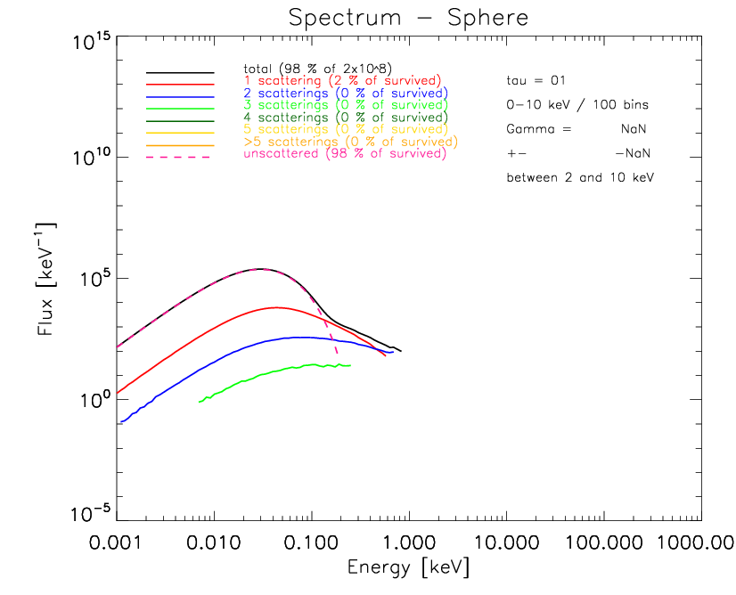
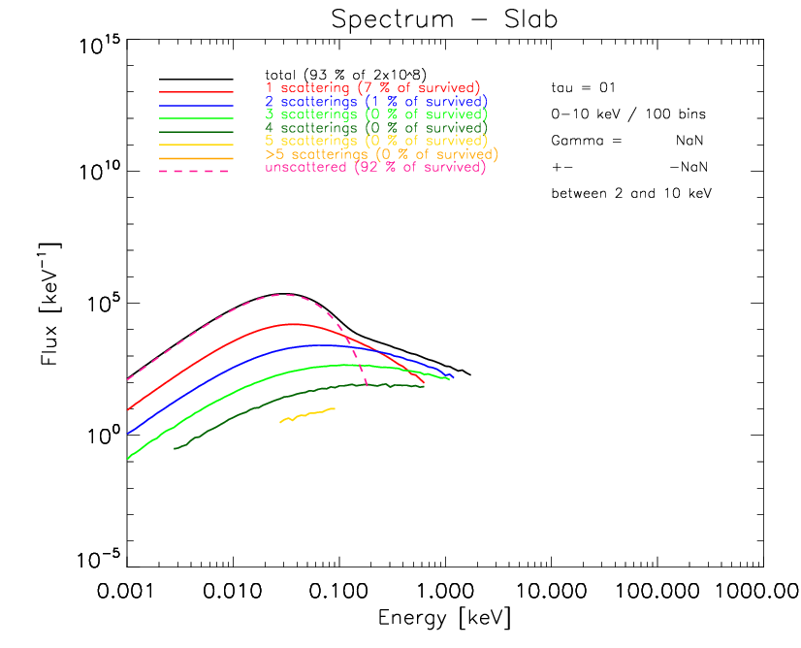
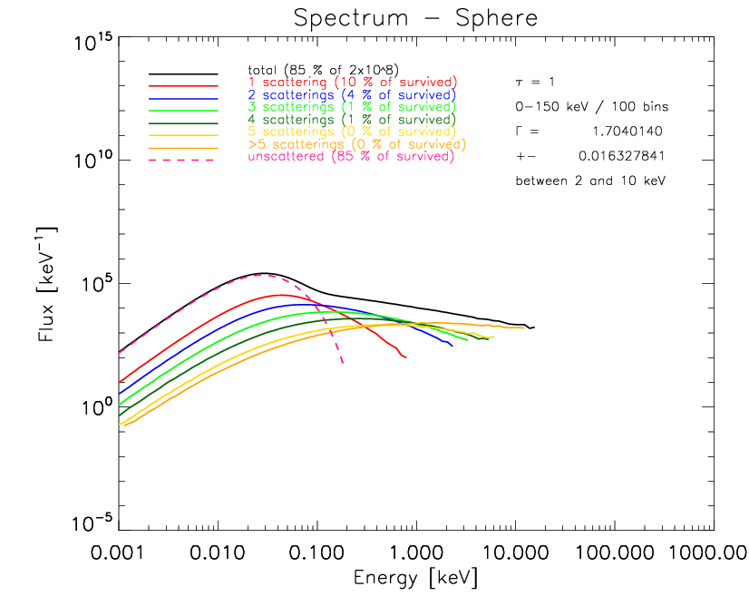
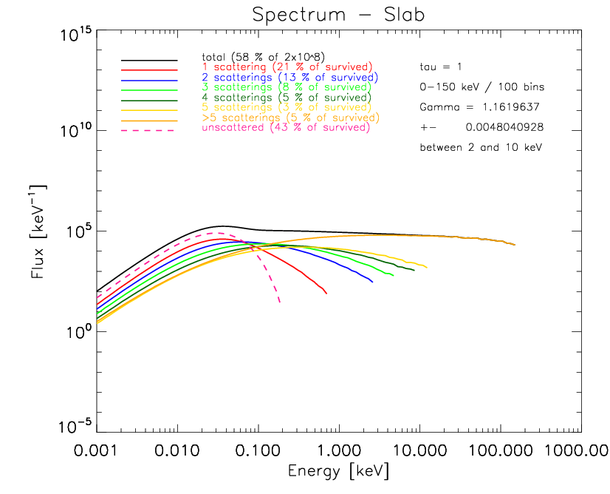
Results
- spectra -
tau = 0.1
tau = 1

Slide 7
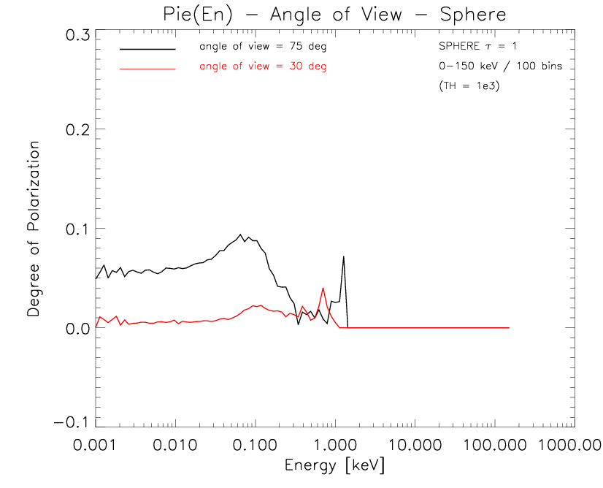
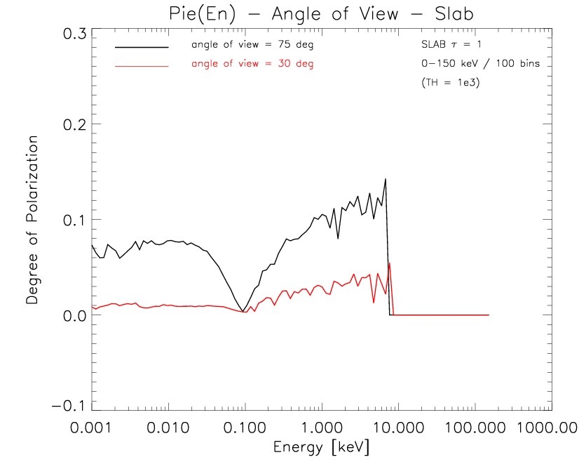
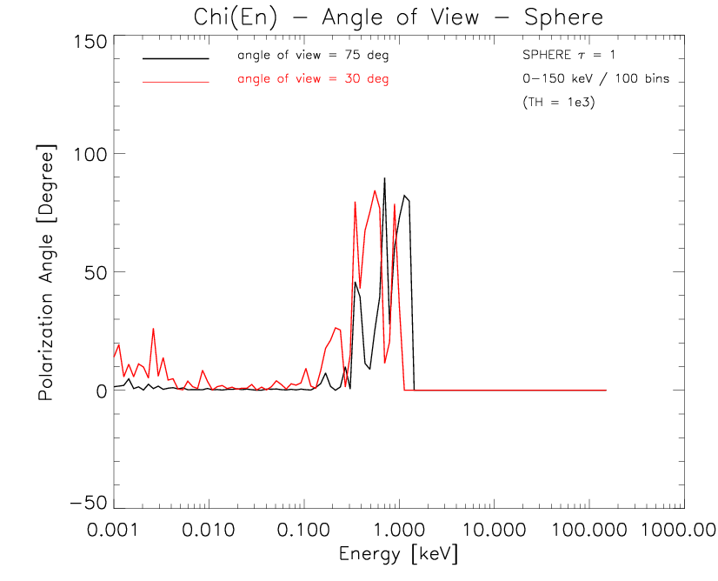
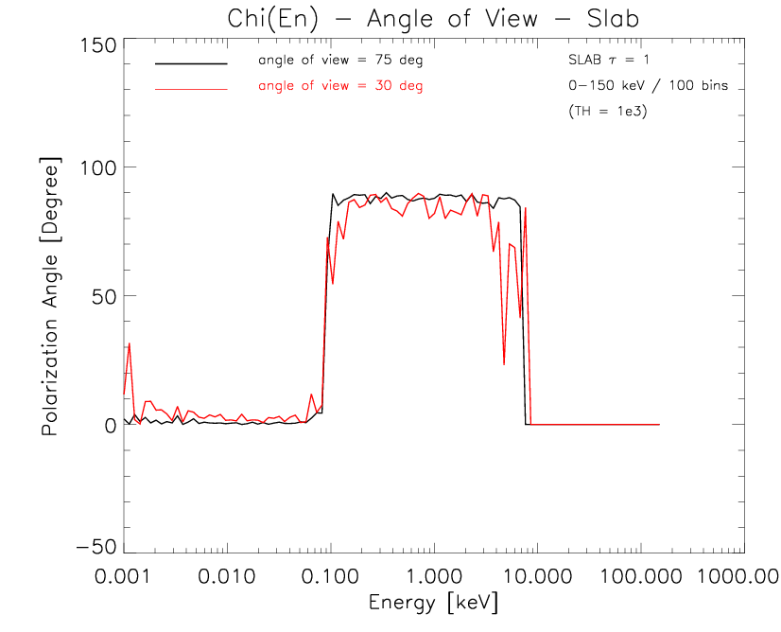
Results
- polarization -
Sphere / tau = 1
Slab / tau = 1

Slide 8
Where we are
Componization code delivered in month 12, as planned.
Problems encountered: the code is very slow
Measure taken: code translated from IDL to Fortran
Next step (coupling with a GR ray tracing code) well under way.

Slide 9
Where we are
In order to include the ray tracing routine several upgrades and changes has been introduced :
the code has been translated from IDL to Fortran 90: it is ~10x faster (binary compilation + licence-free for parallelization) and contains an interface to call photon trace C routine
the source can be point-like and the emission can be a power law (useful for testing polarization and comptonization)
Polarization can be turned on/off
The whole RFs system has changed: global (Boyer-Linquist), local and electron
The flight time of the photon can be registered (for time lags simulations)
Keplerian rotation of the disc
The new scattering approach allows the corona to rotate and be inhomogeneous

Slide 10
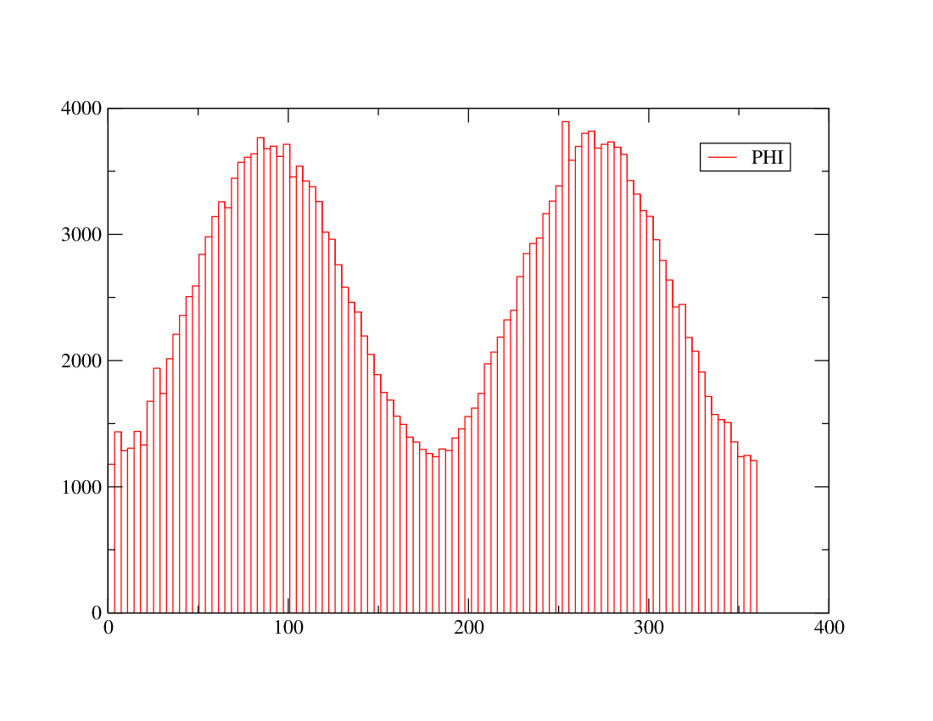
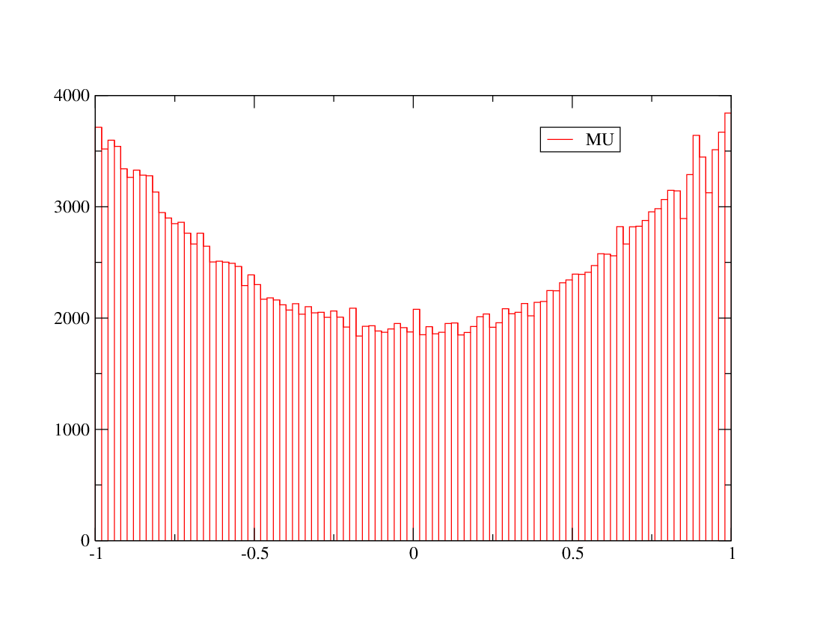
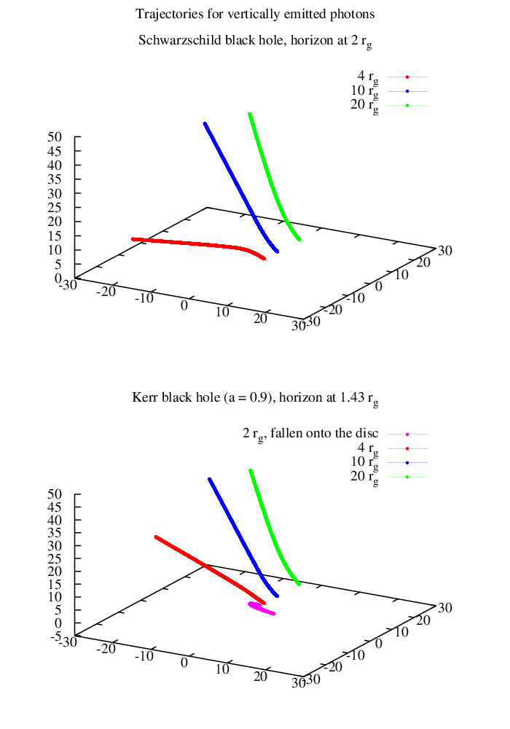
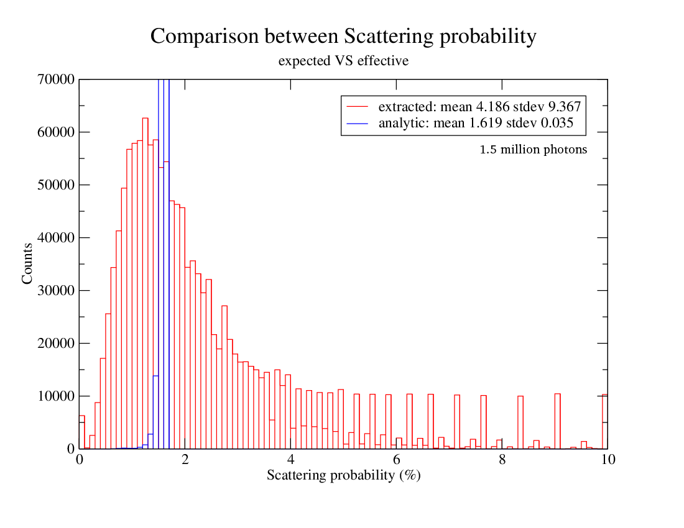
Where we are
The photon trace routine seems to work properly:
As well as the new scattering approach:
More statistics needed !

Slide 11
Future work
Include parallel transportation of the polarization vector in photon trace routine (by Michal Bursa)
Modify photon trace routine to turn on/off General Relativity
F. Tamborra will spend 2 months in Prague in order to complete the tasks mentioned above.
The second deliverable is expected to be produced by month 30, as planned.

