Slide 1
A search for RIAFs in LLAGNs
Francesco Tamborra
“Roma Tre” University
Andrea Marinucci
“Roma Tre” University
CfA
X-Ray Astronomy School, Cambridge – 2011 August

Slide 2
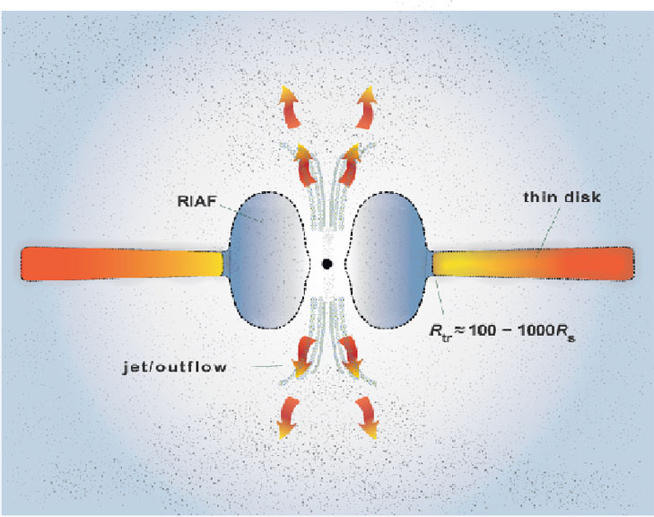
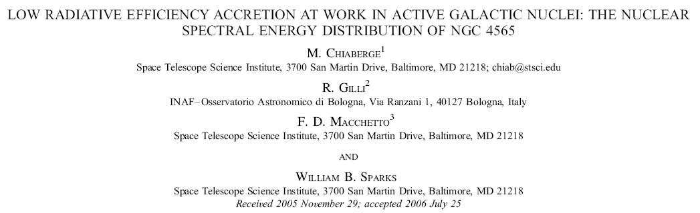
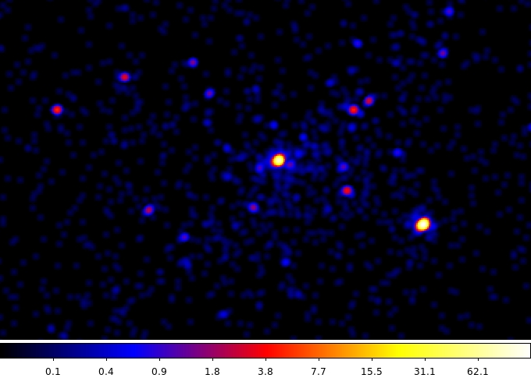
Chiaberge et al. 2006
Sample
NGC 3245
NGC 3414
NGC 3718
NGC 3998
NGC 4143
NGC 4203
NGC 4565
NGC 4736

Slide 3
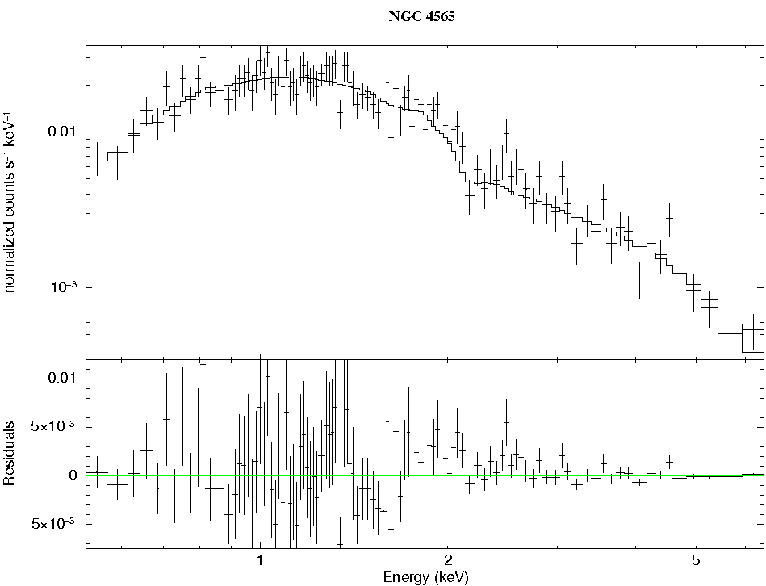
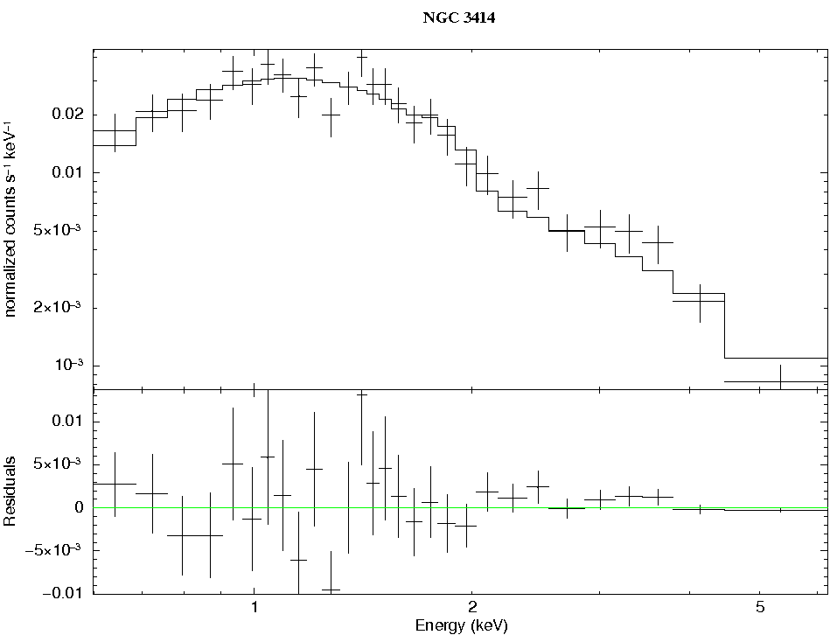
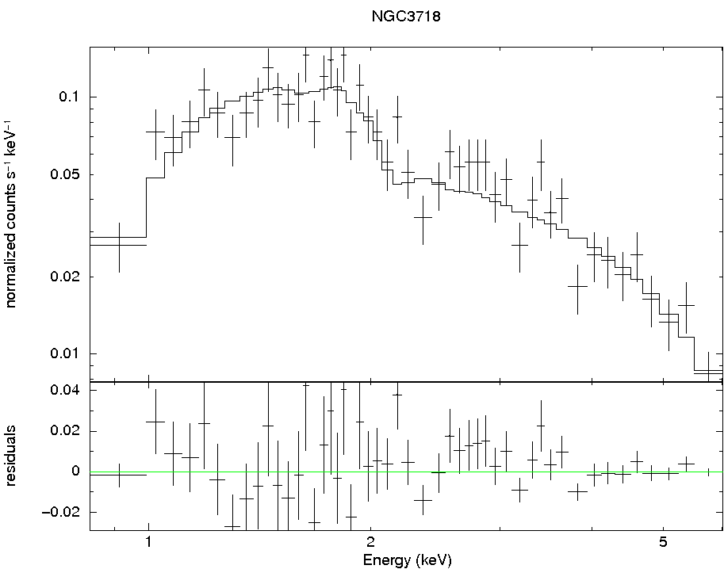
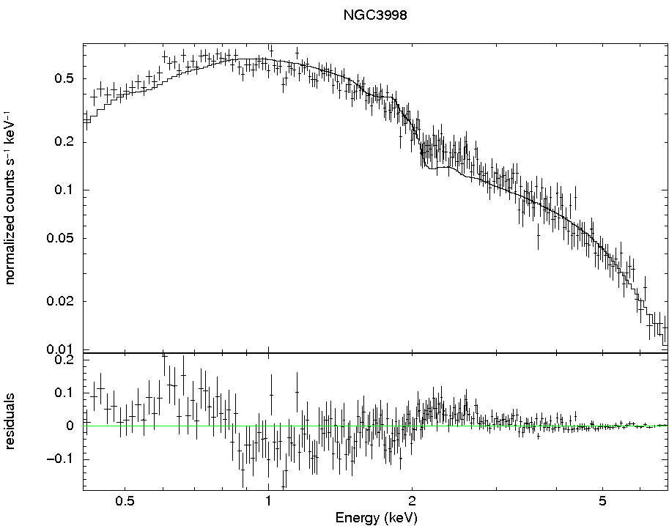
Γ = 1.9 ± 0.1
Γ = 2.0 ± 0.2
Γ = 1.6 ± 0.2
Γ = 1.46 ± 0.02

Slide 4
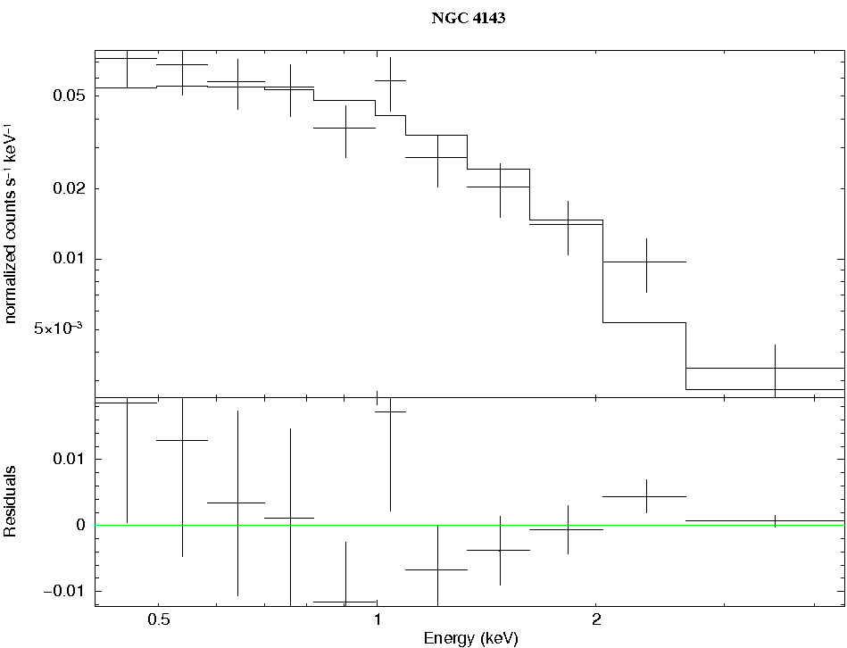
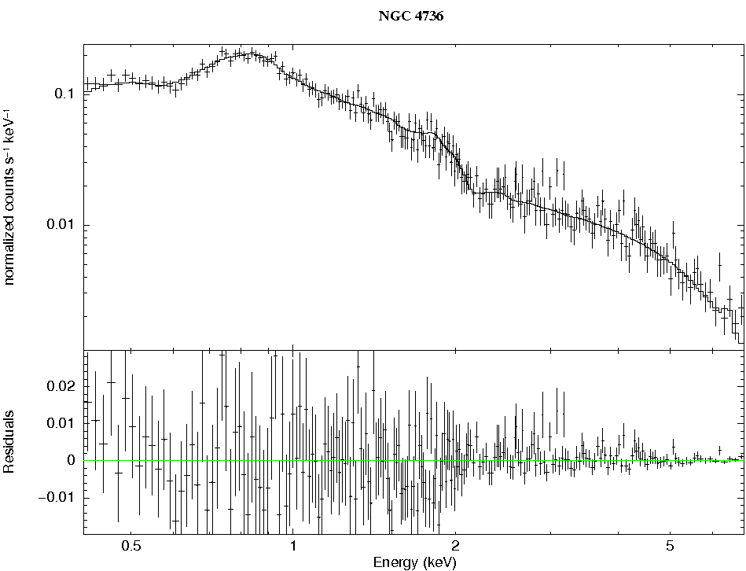
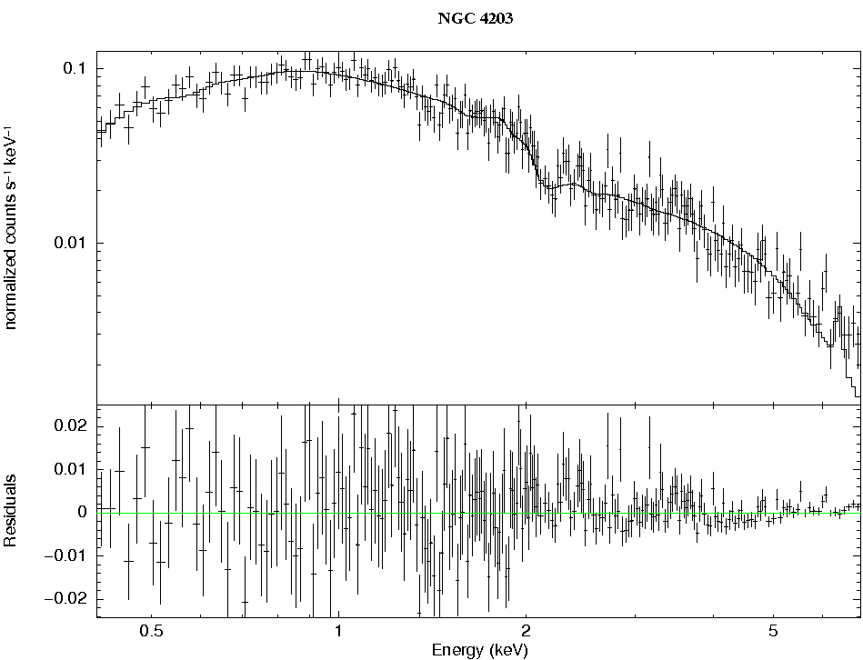
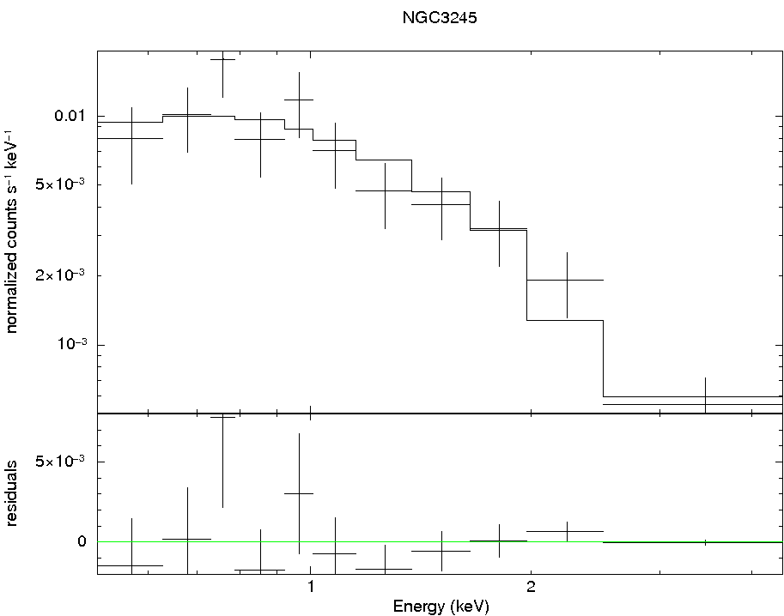
Γ = 2.1 +0.3-0.2
Γ = 1.5 ± 0.1
Γ = 1.5 ± 0.2
Γ = 1.92 +0.67 -0.31

