Slide 1
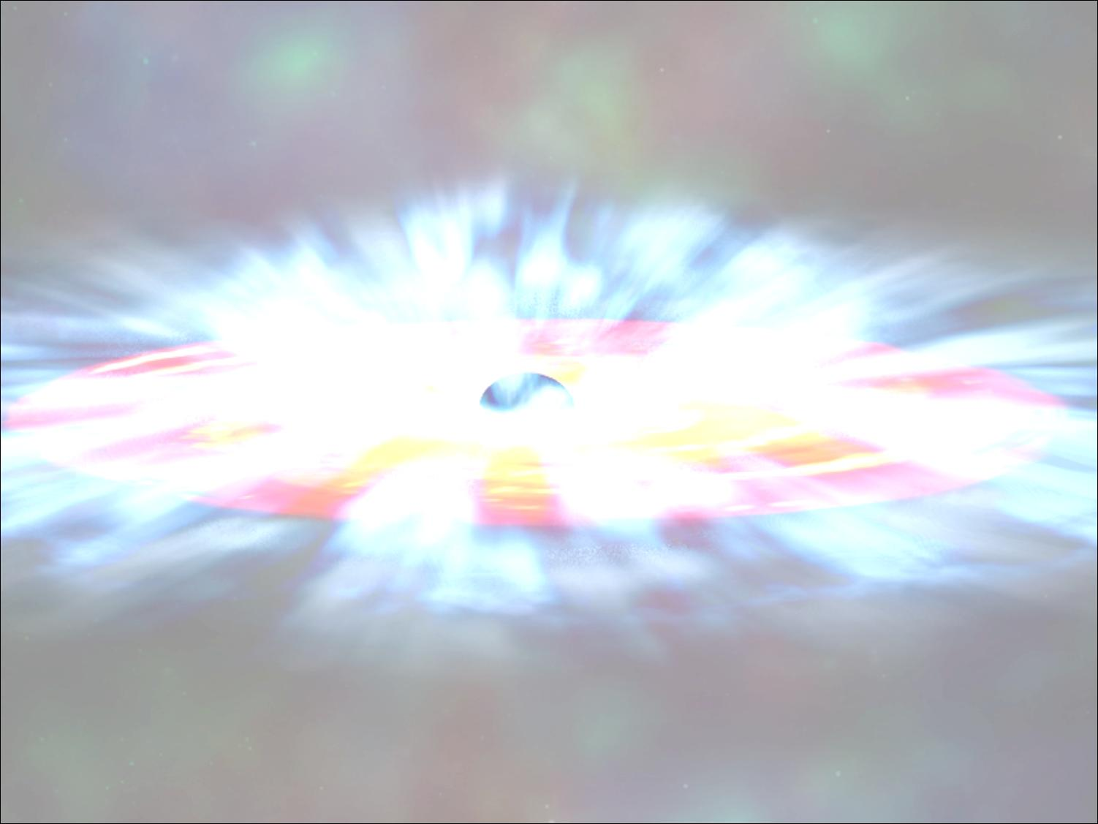
A Monte Carlo code for
accreting sources
Francesco Tamborra
supervisor: Giorgio Matt
in collaboration with Stefano Bianchi

Slide 2
Outline
The physics of AGN
The Monte Carlo approach
The code
Some preliminary results
Future developments
WORK IN PROGRESS

Slide 3
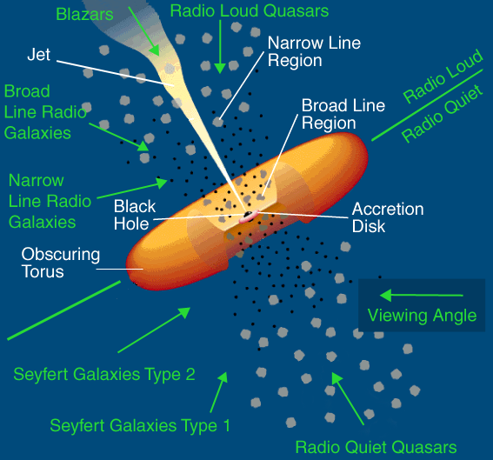
The physics of AGN – The Unified Model
The Unified Model
Antonucci, 1993
L ≈ 10⁴² - 10⁴⁸ erg/s
SMBH ≈ 10⁶ - 10⁸ M☼
L = η·M_{dot}·c²
η ≈ 0.06 – 0.4
(η_{pp} ≈ 0.007)

Slide 4
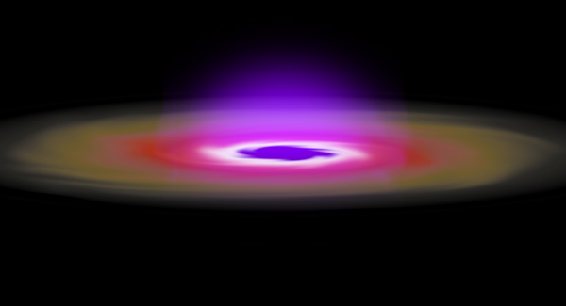
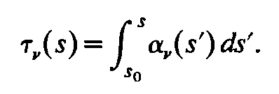
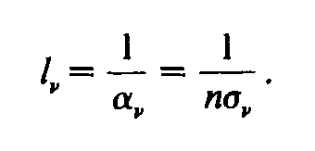
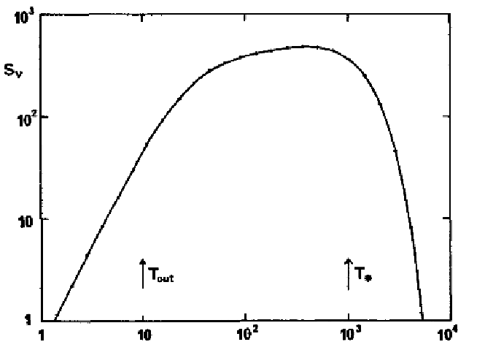

The physics of AGN – The accretion disc
Optically thick, geometrically thin disc
Shakura & Sunyaev, 1973

Slide 5
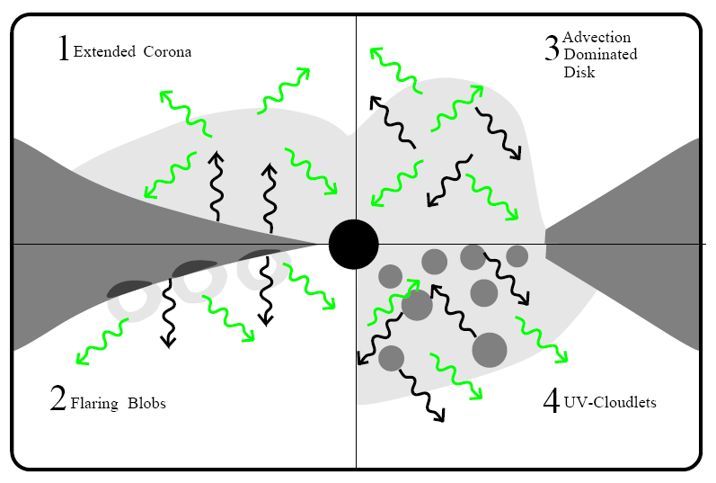
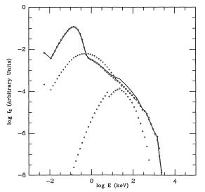
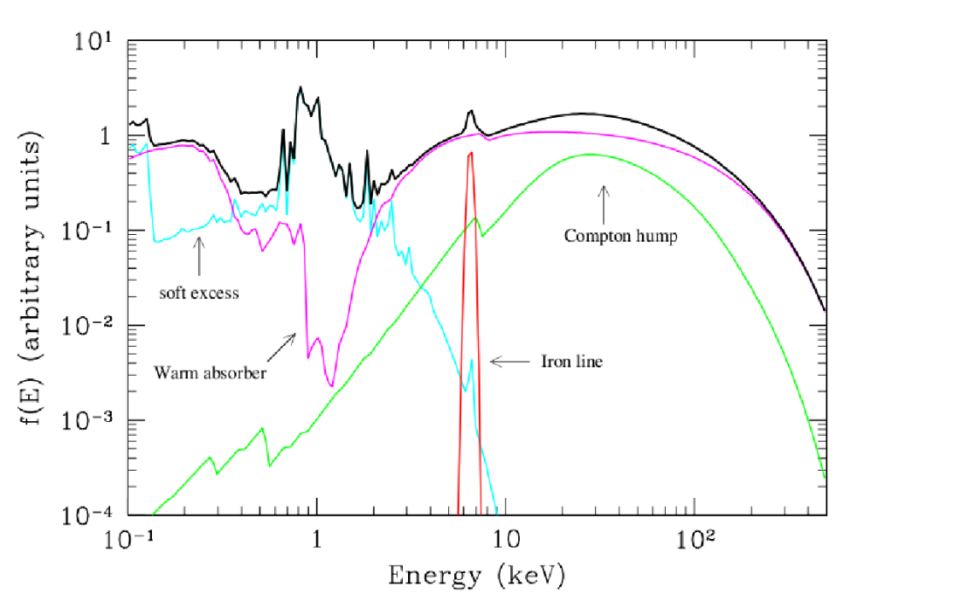
The physics of AGN – The X-rays production
Haardt & Maraschi, 1991
τ = 0.1
kT_{e} ≈ 250 KeV
kT_{BB} = 50 eV

Slide 6
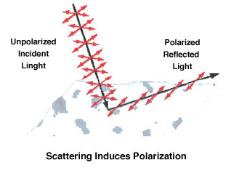
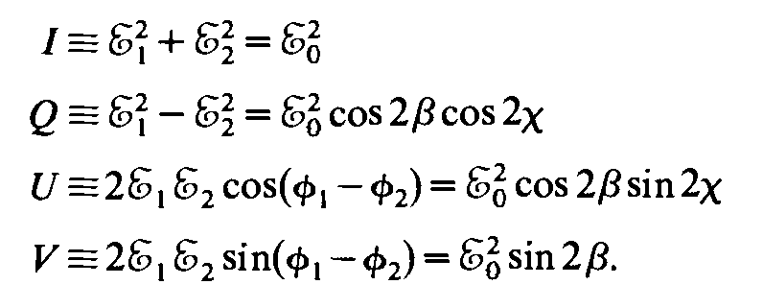

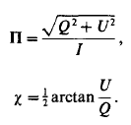
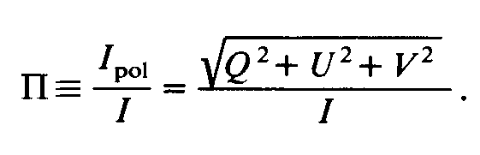
The physics of AGN – The polarization
Stokes parameters
Degree of polarization & polarization angle for linearly polarized photons
Degree of polarization

Slide 7
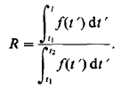
The Monte Carlo approach
by inversion
by rejecton method (von Neumann)
t(R)
calculate the maximum of the distribution, f_{max}
extract a random value, t_{r1,} between t₁ and t₂
extract a random number, r₂, between 0 and 1
IF (r₂*f_{max}) < f(t_{r1}) THEN
accept t_{r1} as a realization of f(t)
ELSE
reject and repeat the sampling
f(t)
f_{max}
f(t_{r1})
t₁
t_{r1}
t₂
t

Slide 8

The Code
main.pro
ShakSun.pro
Chandra.pro
Init_Direction.pro
Renorm.pro
Stokes.pro
ControllerDisc.pro
MFP.pro
Controllers.pro
MaxRel.pro
Lorentz.pro
CrossSec.pro
InvComp.pro
Sdriection.pro
vector oriented, image processing
modular
fully special-relativistic

Slide 9
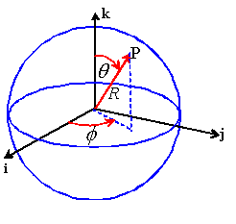
The Code – Initial parameters
Input parameters:
The geometry:
M_{BH} = 10⁸ M☼
M_{dot} ≈ 10⁻⁸ M☼ / yr
τ = (0.1 – 10)
(n_{e} = τ/ Rc_{max} · σ_{T})
kT_{e} = (50 – 250) KeV
R_{S}=6r_{G} Schw. BH
R_{S}=2r_{G} Kerr BH
(r_{G}=G M_{BH} /c²)
R=0
Rc_{max}
Rd_{max}
R_{S}=Rd_{min}=Rc_{min}
photons loop
Initial position:
φ_{0(d)} є [0, 2π]
θ_{0(d)} = π/2
R_{0(d)} є [Rd_{min}, Rd_{max}] *

Slide 10
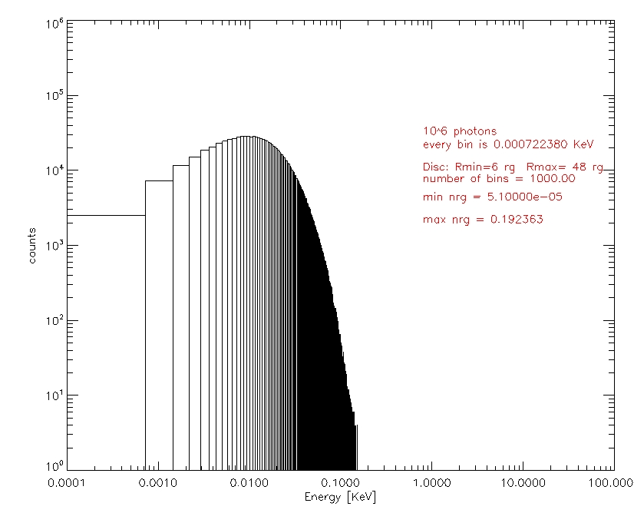
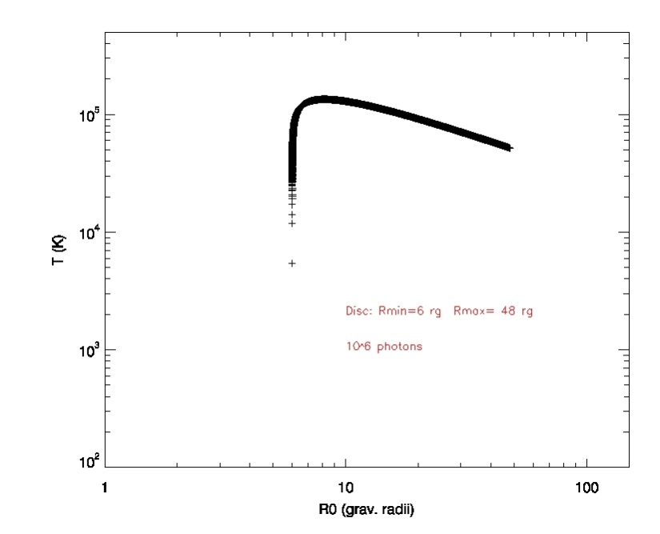
The Code – Initial energy
ShakSun.pro
,R₀=Rd_{min}
T_{max}=(49/36)Rd_{min}

Slide 11
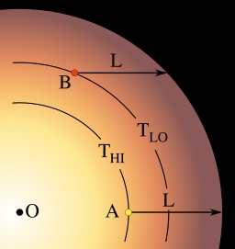
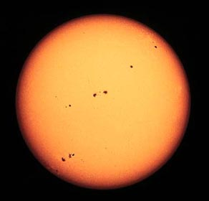
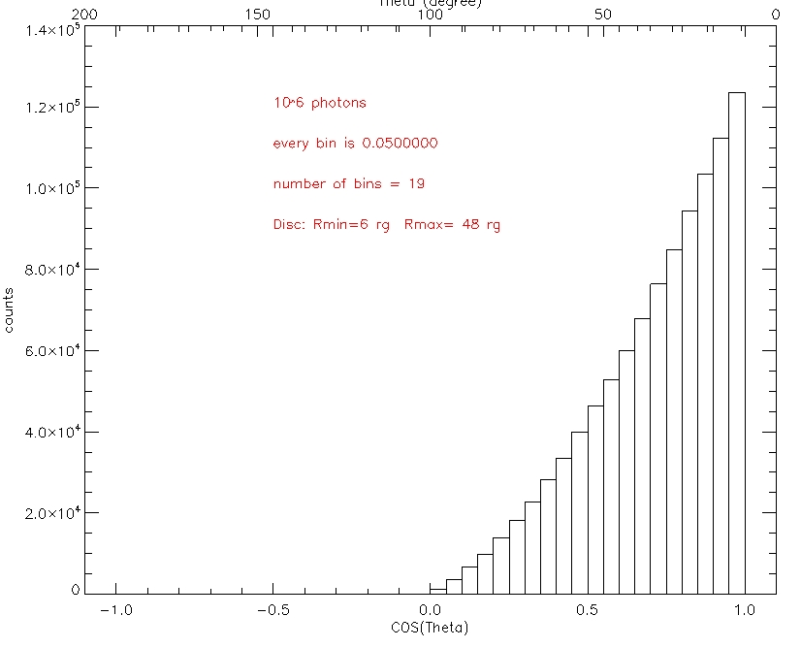
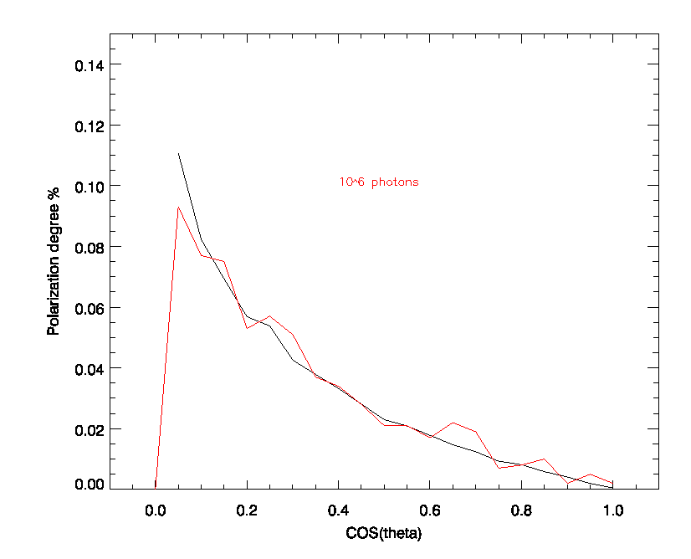
The Code – Initial direction
Chandra.pro
Init_Direction.pro
φ_{d(d)} = ran·2π
θ_{d(d)} extracted according to Chandrasekhar limb darkening law
F(μ) ≈ μ·(1 + 2.06·μ)
μ = cos(θ_{d(d)} )

Slide 12
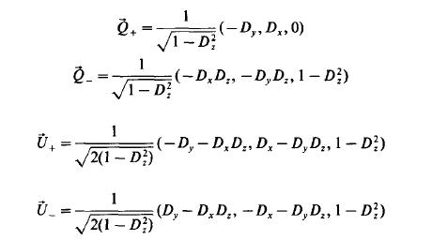
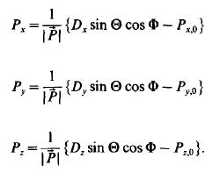


The Code – Initial polarization
Stokes.pro
Matt et al., 1996
IF ran < pol THEN
ELSE
random polarization
Stokes parameters for the j-th photon
Angel, 1969

Slide 13

The Code – Controllers & Relativistic Maxwell-Boltzmann distribution
ControllerDisc.pro
scattering loop
MaxRel.pro
β = 1 – (1 / γ²)
β_{x}, β_{y}, β_{z}
Poutanen & Vilhu, 1993

Slide 14
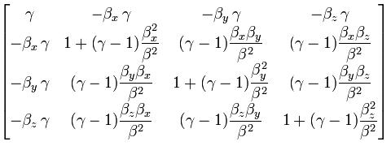

The Code – Lorentz boost
Lorentz.pro
Λ =
k_{0(d)} = (2πν/c² , k_{x}, k_{y}, k_{z})
k_{0(e)} = Λ k_{0(d)}
(ν, θ_{d}, φ_{d})_{(e)}
p_{0(d)} = (0 , p_{x}, p_{y}, p_{z})
p_{temp(e)} = Λ p_{0(d)}
p_{j(e)} = p_{temp} _{j+1(e)} – (p_{temp} _{0(e)} · k_{j+1(e)} / k_{0(e)} )
Connors et al., 1980

Slide 15
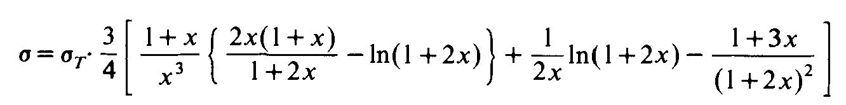
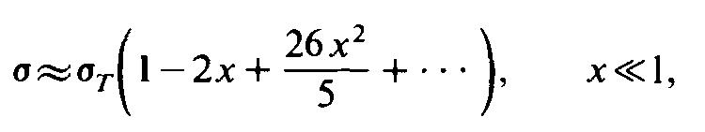
The Code – Cross Section & Mean Free Path
CrossSec.pro
Klein-Nishina total cross section
, x = hν_{(e)} / m_{e}c²
MFP.pro
starting point
arrival point
l = (σ_{KN} · n_{e})⁻¹
φ_{0(d)}
φ’_{(d)}
P = e^{-s/l}
s, θ_{d(d)} , φ_{d(d)}
θ_{0(d)}
θ’_{(d)}
R_{0(d)}
R’_{(d)}

Slide 16
The Code – Controllers
Controllers.pro
the photon can:
fall in the BH
fall on the disc
fall on the disc, in future
escape
continue its travel in the corona

Slide 17


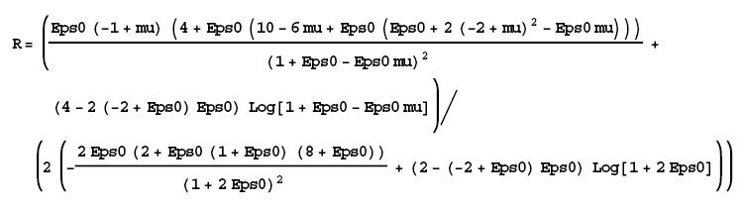
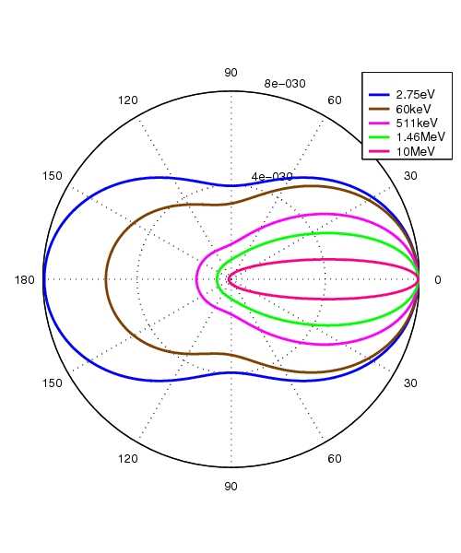

The Code – Inverse Compton
InvComp.pro
θ_{scatt}
φ_{scatt}

Slide 18
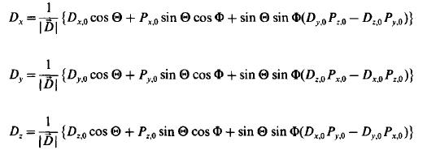

The Code – final direction
Sdriection.pro
(in the RF of the electron!!)
IF ran < Π_{p} THEN
Matt et al., 1996
ELSE
random polarization
Angel, 1969

Slide 19
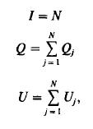
The Code – Anti Transformation & Binning
Lorentz.pro
k’_{(d)} = Λ k’_{(e)}
-β_{x}, -β_{y}, -β_{z}
p’_{temp(d)} = Λ p’_{(e)}
p’_{j(d)} = p’_{temp} _{j+1(d)} – (p’_{temp0(d)} · k’_{j+1(d)} / k’_{0(d)} )
binning:
energy
θ
φ
Q_{j}
U_{j}

Slide 20
Some preliminary results
M_{BH} = 10⁸ M☼
kT_{e} = 100 KeV
τ = 1
Rc_{max}= 24 r_{g}
Rd_{min}=Rc_{min}=6 r_{g}
Rd_{max}= 48 r_{g}
N_{ph}=10⁶
fallen in the BH
fallen on the disc
fallen on the disc, later
escaped w/o scatterings
0,4%
9,5%
9,7%
74,6%
total number of scatterings ≈ 3 · 10⁵

Slide 21
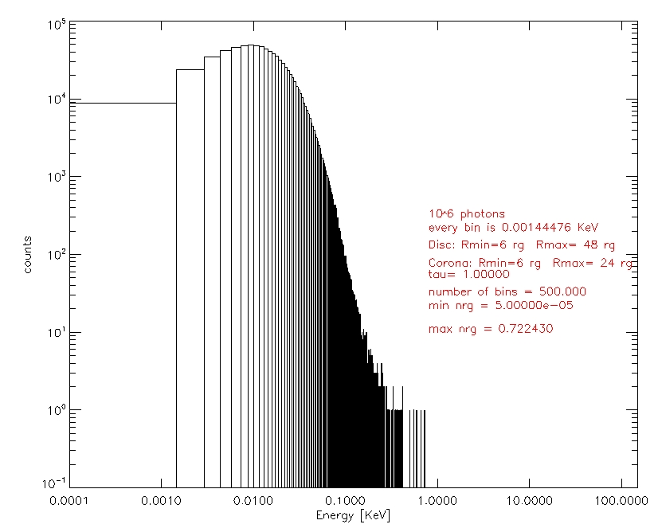
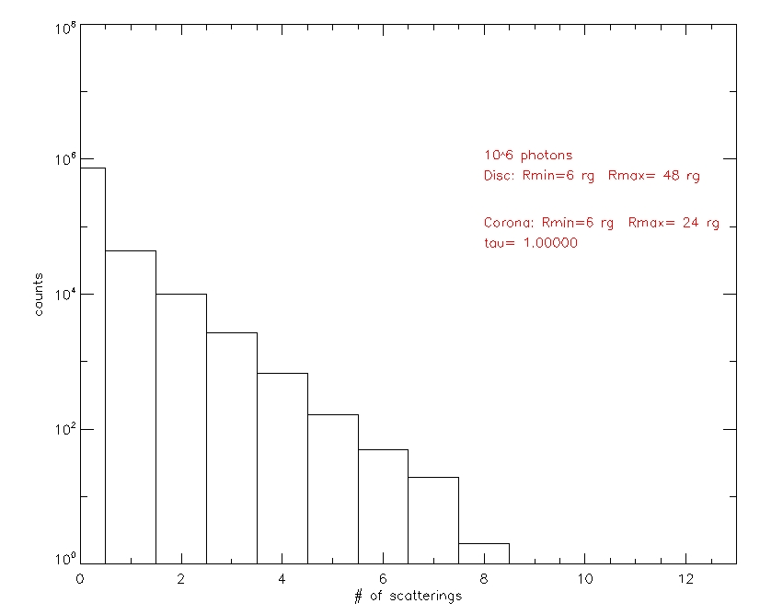
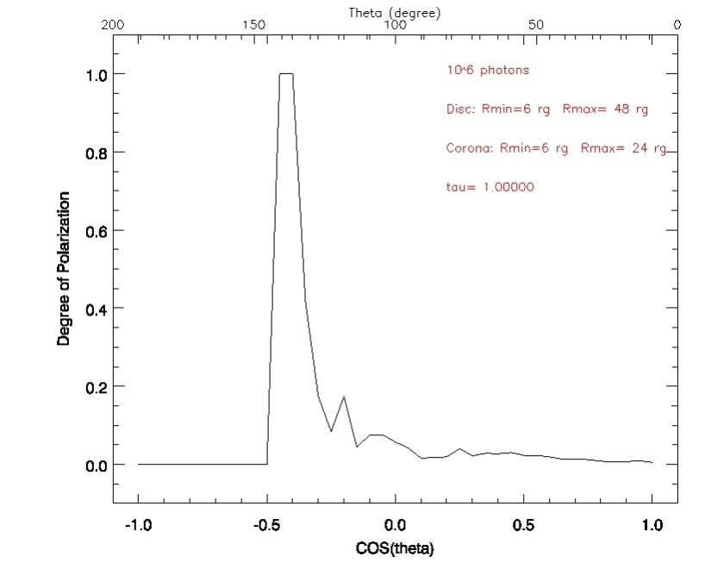
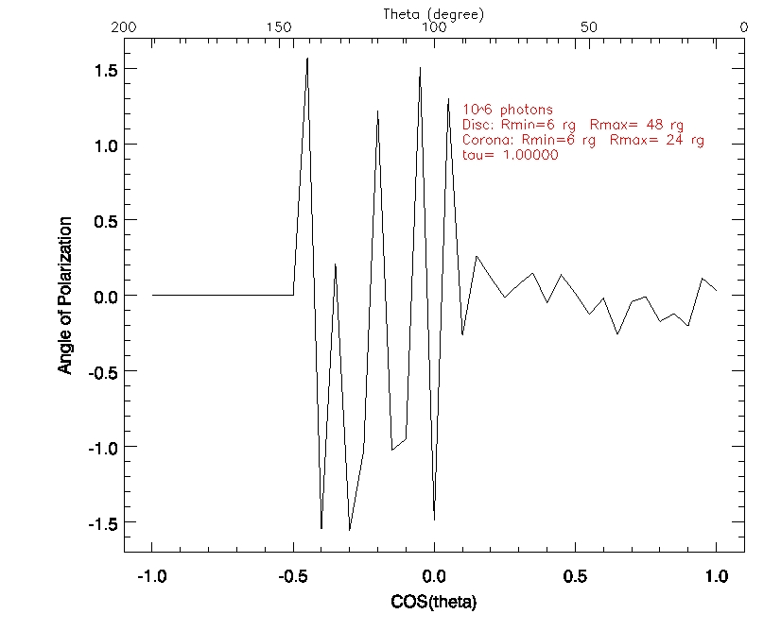
Some preliminary results

Slide 22
Some preliminary results
M_{BH} = 10⁸ M☼
kT_{e} = 100 KeV
τ = 10
Rc_{max}= 24 r_{g}
Rd_{min}=Rc_{min}=6 r_{g}
Rd_{max}= 48 r_{g}
N_{ph}=10⁶
fallen in the BH
fallen on the disc
fallen on the disc, later
escaped w/o scatterings
0,9%
40%
2,7%
53,2%
total number of scatterings ≈ 9 · 10⁵

Slide 23
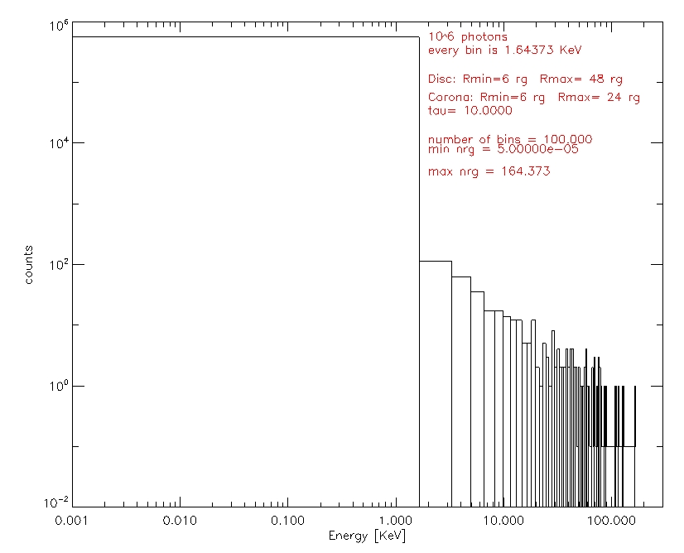
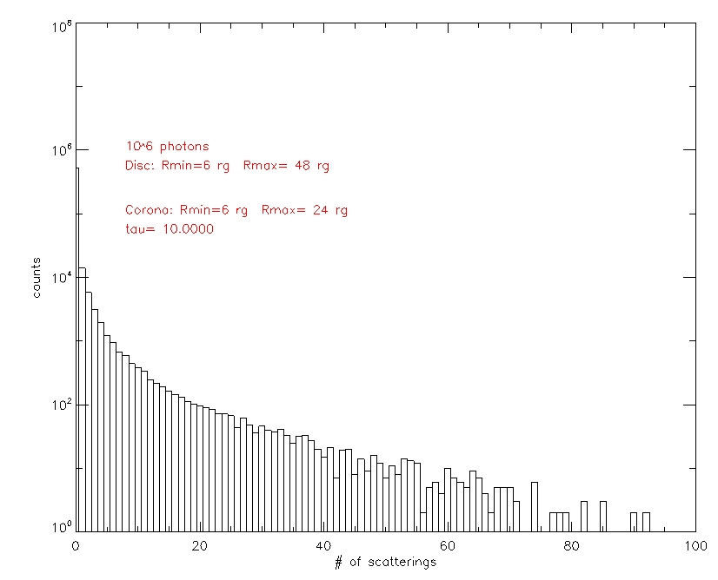
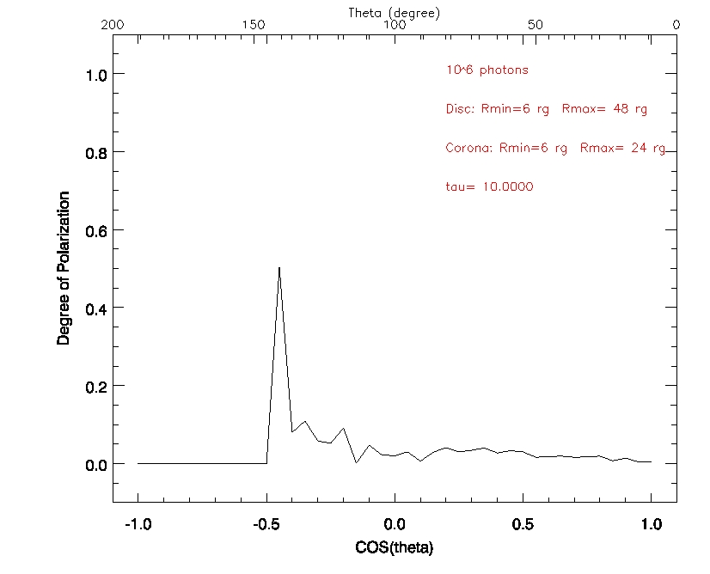
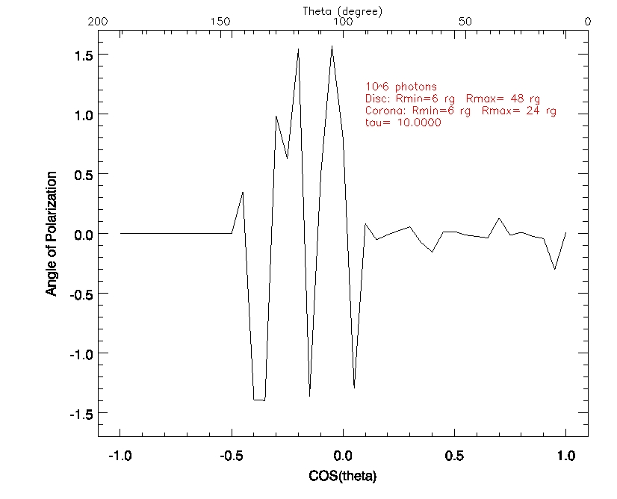
Some preliminary results

Slide 24
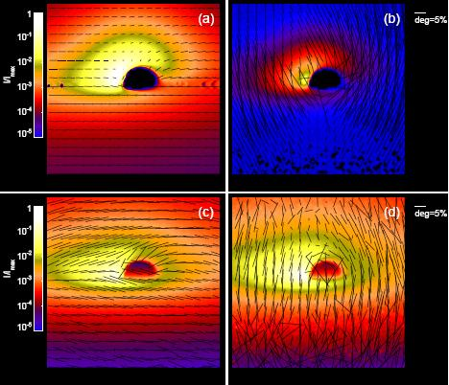
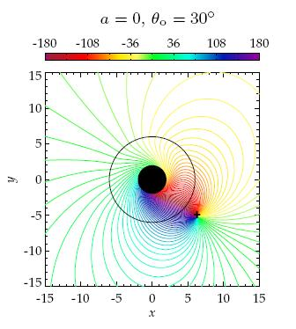
Previous work
Schnittman & Krolik, 2009
٧
Polarization
General relativity
Thomson scattering
Maxwell-Boltzmann distribution (?)
٧
X
X
Schnittman, Krolik 2010
Future developments
finish it!
include reflection from the disc
include general relativity (spin)
ray-tracing code

Slide 25
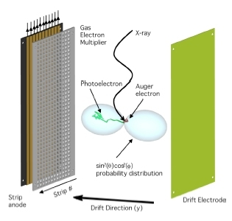

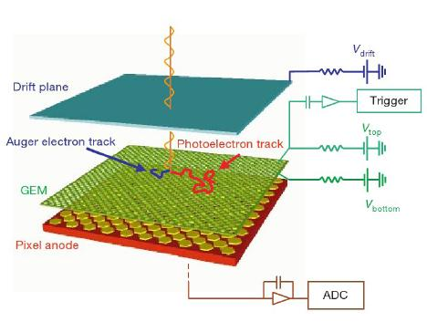
Observations
launch scheduled in 2014
Time Projection Chamber
Gas Pixel Detector

