Slide 1
VELLORE INSTITUTE OF TECHNOLOGY | BCSE302L - DATABASE SYSTEMS
Campus Lost and Found System
Review II – Database Implementation
Student Name: Arahat Gaikwad
Registration Number: 24BYB0182
Degree & Branch: B.Tech Computer Science and Engineering
School: School of Computer Science Engineering and Information Systems (SCORE)
Evaluation Review: Review II – Database Implementation (10 Marks)

Slide 2
Review II Evaluation Agenda
DATABASE IMPLEMENTATION CRITERIA (10 MARKS)
1. DDL & Constraints
Weightage: 2 Marks
Creation of 7 normalized tables (3NF) with PK, FK, CHECK, UNIQUE, NOT NULL, and DEFAULT rules.
2. DML & Population
Weightage: 1 Mark
Meaningful campus data with 10+ records/table (72+ total rows) and INSERT, UPDATE, DELETE tests.
3. SQL Queries
Weightage: 2 Marks
16 comprehensive queries covering multi-table joins, aggregations, subqueries, and window ranking.
4. Procedures & Functions
Weightage: 2 Marks
Business operations: PROC_SUBMIT_CLAIM, PROC_VERIFY_CLAIM, and 2 stored analytical functions.
5. Cursor & Triggers
Weightage: 2 Marks
Explicit Cursor batch scan for aging items + 2 automated triggers for status progression & security.
6. Technical Viva
Weightage: 1 Mark
Execution demonstration, schema rationale, atomic transactions, and relational defense.

Slide 3
Relational Architecture Recap
7 NORMALIZED TABLES IN THIRD NORMAL FORM (3NF)
7 Core Normalized Entities (3NF)
9 Foreign Key Mappings (1 : N)
• LOCATION: location_id (PK), location_name, building
• STUDENT: student_id (PK), name, email (UK), phone
• ADMIN: admin_id (PK), name, email (UK)
• ITEM: item_id (PK), item_name, description, category, date_reported, status, location_id (FK), reported_by_student_id (FK)
• LOST_REPORT: lost_report_id (PK), item_id (FK), student_id (FK), date_lost, details
• FOUND_REPORT: found_report_id (PK), item_id (FK), student_id (FK), date_found, details
• CLAIM: claim_id (PK), item_id (FK), claimant_student_id (FK), claim_date, proof_description, claim_status, admin_id (FK)
1. STUDENT -> ITEM (1:N via reported_by_student_id)
2. LOCATION -> ITEM (1:N via location_id)
3. STUDENT -> LOST_REPORT (1:N via student_id)
4. ITEM -> LOST_REPORT (1:N via item_id)
5. STUDENT -> FOUND_REPORT (1:N via student_id)
6. ITEM -> FOUND_REPORT (1:N via item_id)
7. STUDENT -> CLAIM (1:N via claimant_student_id)
8. ITEM -> CLAIM (1:N via item_id)
9. ADMIN -> CLAIM (1:N via admin_id)
Normalization Justification (3NF):
• 1NF: Atomic values; no repeating groups.
• 2NF: No partial key dependencies; non-keys fully dependent on PK.
• 3NF: No transitive dependencies; reports separated from claims to prevent null bloat.

Slide 4
DDL & Integrity Constraints (2 Marks)
DATA INTEGRITY RULES & DOMAIN SPECIFICATIONS
Keys & UNIQUE
NOT NULL & CHECK
DEFAULT Values
PRIMARY KEY
Every table has an immutable ID column uniquely identifying each row (location_id, student_id, item_id, etc.).
FOREIGN KEY
9 links enforce referential integrity with ON DELETE CASCADE enabled on all report and claim child tables.
UNIQUE
Student email and admin institutional email cannot be duplicated across records.
NOT NULL
Names, emails, item names, categories, statuses, dates, and proof descriptions must always have a valid value.
CHECK (status)
Item status is strictly restricted to:
'LOST', 'FOUND', 'CLAIMED', or 'RETURNED'.
CHECK (claim_status)
Claim status is strictly restricted to:
'PENDING', 'APPROVED', or 'REJECTED'.
Claim Status
DEFAULT 'PENDING' for all initial submissions.
Date Reported
DEFAULT SYSDATE automatically logs timestamp.
Claim Date
DEFAULT SYSDATE automatically logs timestamp.
Item Status
DEFAULT 'LOST' upon initial reporting.

Slide 5
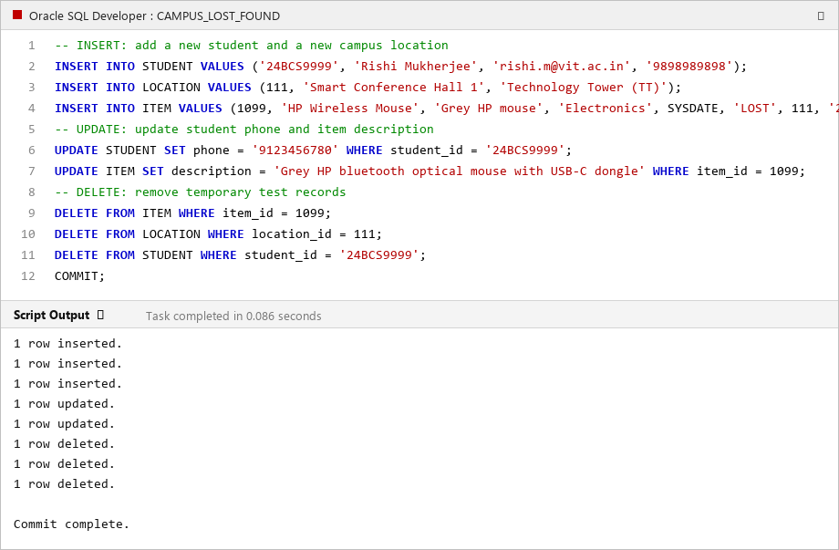
DML & Data Population (1 Mark)
10+ RECORDS PER TABLE (72+ TOTAL ROWS)
Dataset & DML Verification
Oracle SQL Developer Execution Proof
• Minimum Requirement Satisfied: 10+ records populated per table.
• Total Records Populated: 72+ records across 7 tables.
Table Population Breakdown:
1. LOCATION (10 rows): SJT 401, TT 214, Library, PRP, Foodys, MB, Hostels
2. STUDENT (10 rows): Registered students with valid VIT emails
3. ADMIN (10 rows): Security officers and library staff
4. ITEM (12 rows): Electronics, ID Cards, Keys, Books, Accessories
5. LOST_REPORT (10 rows): Detailed missing article filings
6. FOUND_REPORT (10 rows): Handed-in discovered items
7. CLAIM (10 rows): Ownership claims (PENDING, APPROVED, REJECTED)
DML Transaction Verification (FR15):
✔ INSERT: Registered student '24BCS9999' and filed lost mouse #1099
✔ UPDATE: Updated student phone and claim review notes
✔ DELETE: Safely purged duplicate claim #499 and temporary test item

Slide 6
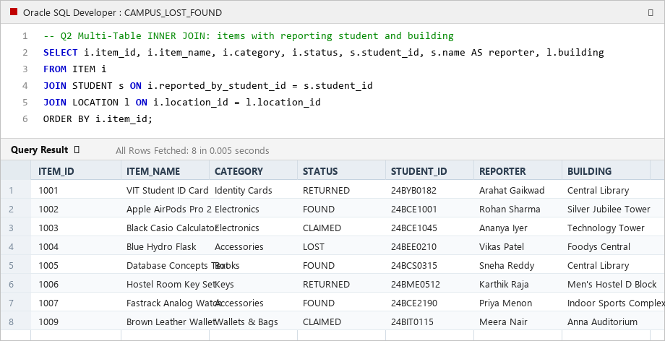
SQL Queries: Complex Joins (2 Marks)
MULTI-TABLE INNER & OUTER JOINS
Query 2: 3-Table Inner Join
Query Result Grid in Oracle SQL Developer
SELECT i.item_id, i.item_name, i.category, i.status,
s.student_id, s.name AS reporter, l.building
FROM ITEM i
JOIN STUDENT s ON i.reported_by_student_id = s.student_id
JOIN LOCATION l ON i.location_id = l.location_id
ORDER BY i.item_id;
Query Purpose & Relational Rationale:
• Simultaneously links 3 relational tables (ITEM, STUDENT, and LOCATION).
• Solves the scattered record challenge by presenting item details along with the reporting student's identity and campus building origin.
Additional Joins in System:
• Query 3 (LEFT OUTER JOIN): Preserves all items, highlighting items with zero submitted claims.
• Query 12 (4-Table Join): Audits approved claims linking claimant, item, building, and approving security officer.

Slide 7
SQL Queries: Aggregations & Grouping (2 Marks)
GROUP BY, HAVING HOTSPOTS & WINDOW FUNCTIONS
Query 4: Category Breakdown
Query 5: Campus Hotspots (HAVING)
Query 15: Window Ranking (DENSE_RANK)
SELECT category, COUNT(item_id) AS total,
SUM(CASE WHEN status='LOST' THEN 1 ELSE 0 END) AS lost,
SUM(CASE WHEN status='FOUND' THEN 1 ELSE 0 END) AS found
FROM ITEM GROUP BY category ORDER BY total DESC;
Operational Significance:
Uses GROUP BY with conditional aggregation to compute total volume, lost count, and found count across each item category in one atomic scan.
SELECT l.building, COUNT(i.item_id) AS incidents
FROM LOCATION l
JOIN ITEM i ON l.location_id = i.location_id
GROUP BY l.building
HAVING COUNT(i.item_id) >= 2;
Operational Significance:
Uses the HAVING clause to filter aggregated groups, pinpointing high-loss campus buildings (e.g. SJT and Central Library with >= 2 incidents).
SELECT category, COUNT(*) AS total_items,
DENSE_RANK() OVER (ORDER BY COUNT(*) DESC) AS cat_rank
FROM ITEM GROUP BY category;
Operational Significance:
Uses the DENSE_RANK() analytical window function to rank categories by incident volume, identifying Electronics and Accessories as the most lost items.

Slide 8
SQL Queries: Subqueries & Set Operators (2 Marks)
NESTED SUBQUERIES & UNIFIED CAMPUS FEED
Query 6: Subquery with IN & NOT IN
Query 7: Subquery with NOT EXISTS
SELECT student_id, name, email FROM STUDENT
WHERE student_id IN (SELECT student_id FROM LOST_REPORT)
AND student_id NOT IN (SELECT claimant_student_id FROM CLAIM);
Purpose: Isolates students who have reported lost items but have never submitted any claim in the system.
SELECT item_id, item_name, category, status
FROM ITEM i
WHERE NOT EXISTS (SELECT 1 FROM CLAIM c WHERE c.item_id = i.item_id);
Purpose: Identifies items in the central catalog that currently have zero claims submitted against them.
Query 8: Correlated Subquery
Query 9: Set Operator (UNION ALL)
SELECT i.item_id, i.item_name, i.status,
(SELECT COUNT(*) FROM CLAIM c WHERE c.item_id = i.item_id) AS total_claims
FROM ITEM i ORDER BY total_claims DESC;
Purpose: Correlates outer ITEM rows with inner CLAIM counts to dynamically calculate competing claims volume per item.
SELECT 'LOST', i.item_name, lr.date_lost, s.name FROM LOST_REPORT lr JOIN ITEM i ON ...
UNION ALL
SELECT 'FOUND', i.item_name, fr.date_found, s.name FROM FOUND_REPORT fr JOIN ITEM i ON ...
ORDER BY event_date DESC;
Purpose: Combines lost reports and found reports into a single, unified chronological activity feed for campus security.

Slide 9
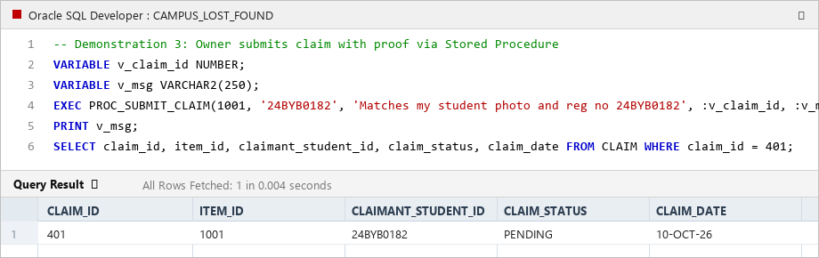
PL/SQL Stored Procedures (2 Marks)
PROCEDURAL BUSINESS LOGIC & CONFLICT RESOLUTION
Business Procedures Implemented
Execution Proof: PROC_SUBMIT_CLAIM
1. PROC_SUBMIT_CLAIM (FR7, FR10):
• Parameters: p_item_id, p_claimant_id, p_proof, OUT p_new_claim_id, OUT p_result_msg
• Business Rules Enforced:
- Validates student registration in STUDENT table.
- Validates item existence in ITEM table.
- Blocks claim if item is already in 'RETURNED' status.
- Prevents duplicate pending claims by the same student.
- Inserts new claim in 'PENDING' status and returns ID.
2. PROC_VERIFY_CLAIM (FR8, FR9):
• Parameters: p_claim_id, p_admin_id, p_decision ('APPROVED'/'REJECTED'), OUT p_result_msg
• When APPROVED:
- Updates CLAIM status to 'APPROVED' and sets admin_id.
- Updates parent ITEM status to 'RETURNED'.
- Conflict Resolution: Automatically REJECTS all competing pending claims filed for that same item.

Slide 10
PL/SQL Stored Functions (2 Marks)
AGING CALCULATIONS & STUDENT PROFILE ANALYTICS
Function 1: FUNC_CALCULATE_UNCLAIMED_DAYS
Function 2: FUNC_GET_STUDENT_ACTIVITY
CREATE OR REPLACE FUNCTION FUNC_CALCULATE_UNCLAIMED_DAYS (p_item_id NUMBER)
RETURN NUMBER AS
v_date DATE; v_status VARCHAR2(20); v_days NUMBER;
BEGIN
SELECT date_reported, status INTO v_date, v_status FROM ITEM WHERE item_id = p_item_id;
IF v_status = 'RETURNED' THEN
SELECT MIN(claim_date) INTO v_claim_date FROM CLAIM WHERE item_id = p_item_id AND claim_status = 'APPROVED';
v_days := ROUND(v_claim_date - v_date, 1);
ELSE
v_days := ROUND(SYSDATE - v_date, 1);
END IF;
RETURN GREATEST(v_days, 0);
END;
Operational Purpose:
Satisfies FR11: Computes the exact number of days an item has been sitting unresolved in the system using date arithmetic. Returns 0 if claimed same-day, and handles exceptions safely.
CREATE OR REPLACE FUNCTION FUNC_GET_STUDENT_ACTIVITY (p_student_id VARCHAR2)
RETURN VARCHAR2 AS
v_lost NUMBER := 0; v_found NUMBER := 0; v_claims NUMBER := 0; v_name VARCHAR2(100);
BEGIN
SELECT name INTO v_name FROM STUDENT WHERE student_id = p_student_id;
SELECT COUNT(*) INTO v_lost FROM LOST_REPORT WHERE student_id = p_student_id;
SELECT COUNT(*) INTO v_found FROM FOUND_REPORT WHERE student_id = p_student_id;
SELECT COUNT(*) INTO v_claims FROM CLAIM WHERE claimant_student_id = p_student_id;
RETURN v_name || ' [' || p_student_id || '] -> Lost: ' || v_lost || ' | Found: ' || v_found || ' | Claims: ' || v_claims;
END;
Operational Purpose:
Satisfies FR1 & FR13: Generates a dynamic, consolidated text summary of a student's system engagement across all report and claim tables in one call.

Slide 11
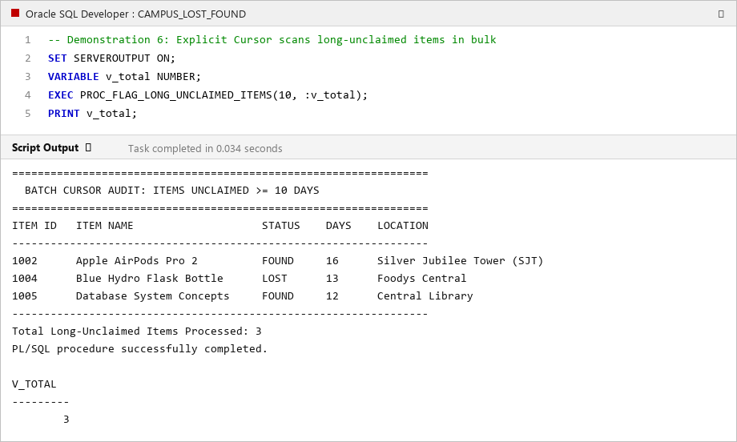
PL/SQL Explicit Cursor (2 Marks)
BATCH MULTI-RECORD AUDIT (FR12)
Explicit Cursor Architecture
Execution Proof: Cursor Batch Output
Procedure: PROC_FLAG_LONG_UNCLAIMED_ITEMS
Explicit Cursor Lifecycle:
1. DECLARE:
CURSOR cur_unclaimed_items IS
SELECT item_id, item_name, status, date_reported, building
FROM ITEM i JOIN LOCATION l ON i.location_id = l.location_id
WHERE i.status IN ('LOST', 'FOUND')
AND (SYSDATE - i.date_reported) >= p_days_threshold;
2. OPEN: Allocates cursor context area in PGA memory.
3. FETCH: Advances row pointer into v_item_rec record structure.
4. %NOTFOUND: Checks termination condition to exit loop cleanly.
5. CLOSE: Releases memory context area back to database engine.
Administrative Purpose (FR12):
Allows campus security to scan thousands of records in bulk, computing days unresolved and printing an automated batch audit report for disposal or auction.

Slide 12
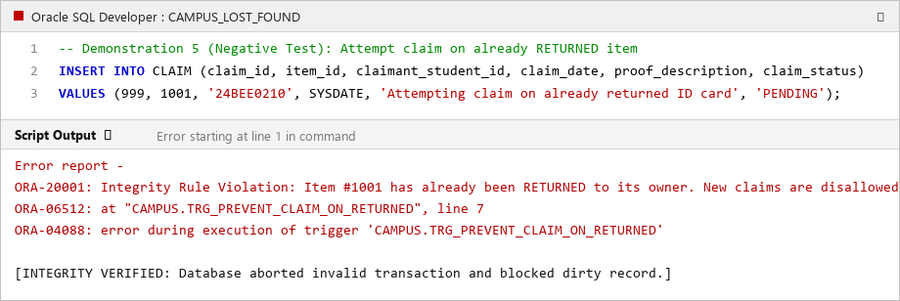
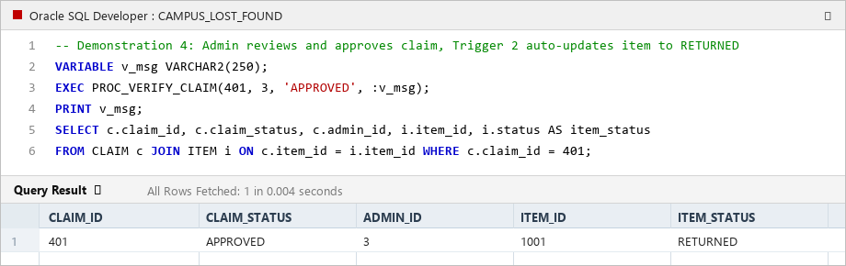
PL/SQL Database Triggers (2 Marks)
EVENT-DRIVEN DATABASE AUTOMATION & INTEGRITY
Trigger 1: TRG_PREVENT_CLAIM_ON_RETURNED
Trigger 2: TRG_AUTO_UPDATE_ITEM_STATUS
• Timing: BEFORE INSERT ON CLAIM (Row-Level)
• Logic: Checks if ITEM.status = 'RETURNED'. If yes, raises ORA-20001.
• Result: Immediately aborts fraudulent claims on returned items.
• Timing: AFTER UPDATE OF claim_status ON CLAIM (Row-Level)
• Logic: When :NEW.claim_status = 'APPROVED', updates ITEM.status to 'RETURNED'.
• Result: Synchronizes child claim and parent item state atomically.

Slide 13
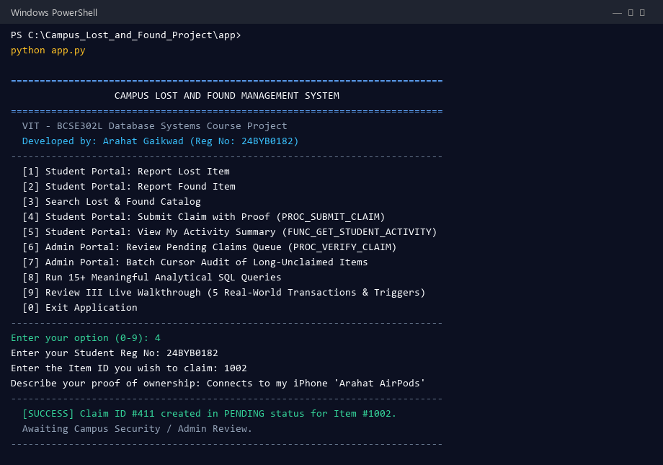
Integrated System Demonstration
INTERACTIVE APPLICATION & DATABASE CONNECTIVITY
3-Tier System Architecture
Python Terminal Session (Windows PowerShell)
Integrated System Features:
1. Multi-Tier Architecture:
• Presentation Layer: Interactive menu-driven console with dedicated student and admin portals.
• Data Access Layer (database.py): Unified abstraction layer managing transactions, commits, and error handling.
• Database Engine: Compatible with Oracle Database 19c/21c via python-oracledb and embedded relational engine.
2. Complete Transaction Cycle Demonstrated:
User Operation -> SQL/PLSQL -> Database Processing -> Update -> Result
3. Real-Time Operations:
• Option 1 & 2: Report Lost & Found Items
• Option 4: Submit Claim with Proof (PROC_SUBMIT_CLAIM)
• Option 6: Adjudicate Claims Queue (PROC_VERIFY_CLAIM)
• Option 7: Bulk Cursor Audit (PROC_FLAG_LONG_UNCLAIMED_ITEMS)
• Option 8: Run all 16 SQL Queries live

Slide 14
Summary & Review III Readiness
DELIVERABLES CHECKLIST & NEXT STEPS
Review II Deliverables Completed (10/10)
Review III Transition & Q&A
✔ DDL & Relational Schema: 7 Normalized Tables in 3NF with PK, FK, CHECK, UNIQUE, NOT NULL & DEFAULT.
✔ Data Population: 10+ records populated per table (72+ total rows) with INSERT/UPDATE/DELETE tests.
✔ SQL Queries: 16 Meaningful queries covering Inner/Left Joins, Group By, Having, Subqueries, Sets & Window ranking.
✔ Stored Procedures: PROC_SUBMIT_CLAIM and PROC_VERIFY_CLAIM for robust transaction processing.
✔ Stored Functions: FUNC_CALCULATE_UNCLAIMED_DAYS and FUNC_GET_STUDENT_ACTIVITY.
✔ Explicit Cursor: PROC_FLAG_LONG_UNCLAIMED_ITEMS with complete Open, Fetch, Loop, and Close lifecycle.
✔ Database Triggers: TRG_PREVENT_CLAIM_ON_RETURNED and TRG_AUTO_UPDATE_ITEM_STATUS.
Review III: Integrated System & Final Demonstration
1. End-to-End Real-World Transactions:
Demonstration of 6 complete transactions following the official flow:
User Operation -> SQL/PLSQL -> Database Processing -> Update -> Result
2. Live Interactive Demonstration:
Automated walkthrough mode (Option 9 in app.py) answering all 5 evaluation questions live on screen.
3. Complete Technical Documentation:
Word reports generated for both Review II and Review III.
Thank You!
Arahat Gaikwad (24BYB0182) | SCORE, VIT Vellore
Ready for Questions and Live Demonstration.

