Slide 1

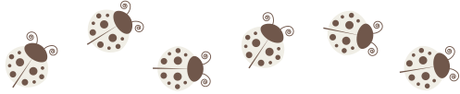
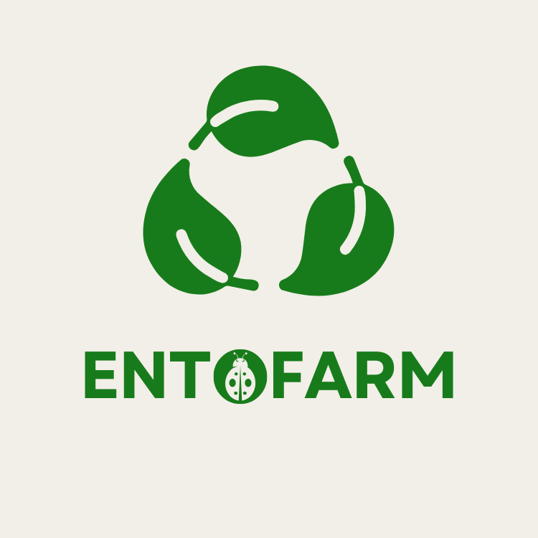


EntoFARM
2024-2-EL01-KA210-SCH-000285053
Let's Start

Slide 2







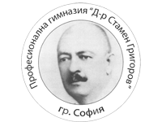


The EntoFARM team

Slide 3

Introduction to EntoFARM
Enhance environmental awareness and knowledge of circular economy.
Engaging students in STEM fields like agriculture, environmental science, and biotechnology.
Providing resources and training for teachers.
Teach about insect farming as a practical sustainability solution.

Slide 4
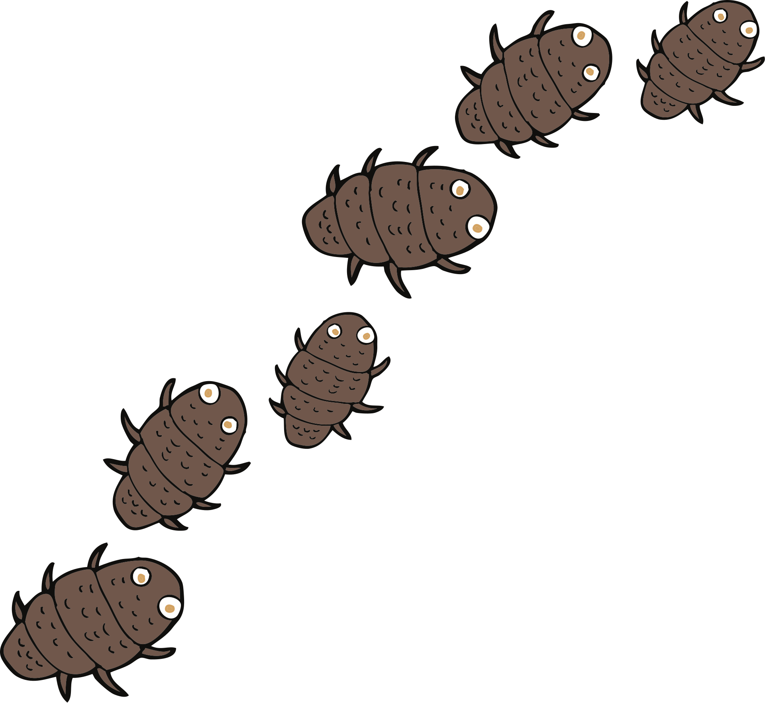

Why Insect Farming?
Sustainable alternative to traditional agriculture.
Reduces food waste by converting organic waste into valuable protein.
Low environmental footprint and high nutritional value.
Hands-on, engaging way to teach circular economy concepts.

Slide 5





Key Activities
Development of an educational toolkit for teachers.
Pilot implementation of insect farms in schools with student participation.
Students creating a documentary about their learning experiences.
University visits for students to experience and learn about advanced agricultural research.
Webinars and training sessions for teachers.

Slide 6

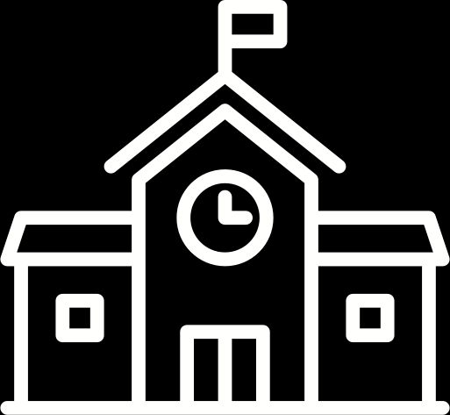


Get Involved!
Teachers:
Incorporate EntoFARM into your curriculum and attend training sessions.
Schools:
Implement EntoFARM and collaborate with universities.
Students:
Participate in hands-on insect farming and make a documentary about it.
Community:
Support the project and adopt sustainability practices.

Slide 7


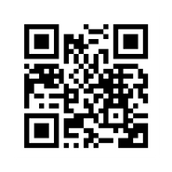
THANK YOU!
ANY QUESTIONS?
Scan for more!

