Slide 1
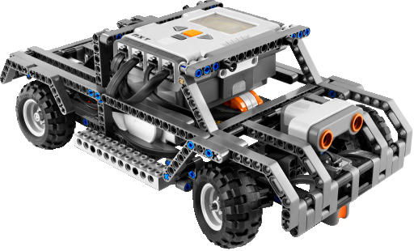


Helper Line
Main Line
overtaker
overtakee

