Slide 1

Fraunhofer FOKUS Institute for Open Communication Systems

Slide 2
Overview
What is OAuth?
Differences between OAuth 1.0(a) and OAuth 2.0
Concept

Slide 3
What is OAuth? I
OAuth is an open standard for authorization
Provides a method for clients to access server resources on behalf of a resource owner
R.O. could be a different client or an end-user
Provides a process for end-users to authorize third-party access to their server resources without sharing their credentials
Instead of using the resource owner's credentials, the client obtains an access token
Access Token:
A string denoting a specific scope, lifetime, and other access attributes. Access tokens are issued to third-party clients by an authorization server with the approval of the resource owner. The client uses the access token to access the protected resources hosted by the resource server.
Notes:
- Stellt Methoden für Klienten zur Verfügung, mit welchen auf Ressourcen im Auftrag vom R.O. zugegriffen werden kann
- Stellt Prozess für Endnutzer zur Verfügung, um 3rd Parties zugriff auf Ressourcen zu gewähren, ohne credentials zu teilen

Slide 4
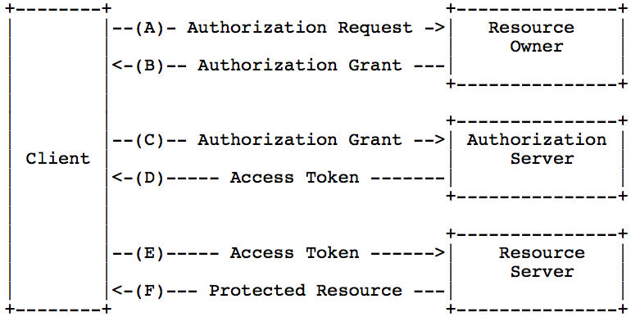
What is OAuth? II

Slide 5
What is OAuth?
- Apache Oltu (http://oltu.apache.org/index.html)
- Spring Security OAuth (http://static.springsource.org/spring-security/oauth/)
- beide machen auf den ersten Blick einen reifen und guten Eindruck, könnten verwendet werden
- Konzept
Figure 1 - Protocol Flow
für uns interessant
Figure 2 (getrennt Resource Server und Auth. Server)
dazu beachten:.
two flows necessary
1) Client Registration (each client!)
two types of clients
1) public (incapable of maintaining the confidentiality of their credentials)
2) confidential (capable of maintaining the confidentiality of their credentials)
- The authorization server MUST require the use of TLS
- SSO with OAuth 2.0 (Ausblick)
2) Figure 3 oder Figure 4 oder Figure 5 (siehe Eran Hammer)Op

Slide 6
Differences between OAuth 1.0(a) and OAuth 2.0
OAuth 2.0 is not backward compatible to OAuth 1.0(a)
New OAuth Flows allow better support for non-browser based applications
OAuth 2.0 no longer requires client applications to have cryptography
OAuth delegates security to HTTPS!
There is no additional security layer on top of SSL
OAuth 2.0 signatures are much less complicated (no more special parsing, sorting, or encoding)
Again, security relies on SSL
OAuth 2.0 Access tokens are "short-lived"
OAuth 2.0 has a clean separation of roles between the server responsible for handling OAuth requests and the server handling user authorization
… many more!
Notes:
1)
This is a main criticisim against OAuth from client applications that were not browser based. For example, in OAuth 1.0, desktop applications or mobile phone applications had to direct the user to open their browser to the desired service, authenticate with the service, and copy the token from the service back to the application. The main criticism here is against the user experience. With OAuth 2.0, there are now new ways for an application to get authorization for a user.
2)
This hearkens back to the old Twitter Auth API, which didn't require the application to HMAC hash tokens and request strings. With OAuth 2.0, the application can make a request using only the issued token over HTTPS.
4)
Typically, OAuth 1.0 Access tokens could be stored for a year or more (Twitter never let them expire). OAuth 2.0 has the notion of refresh tokens. While I'm not entirely sure what these are, my guess is that your access tokens can be short lived (i.e. session based) while your refresh tokens can be "life time". You'd use a refresh token to acquire a new access token rather than have the user re-authorize your application.

Slide 7
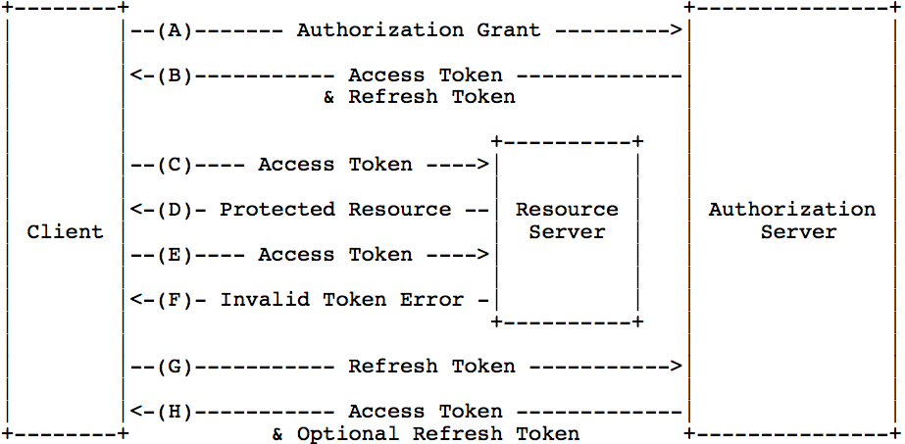
Concept I
Notes:
The resource server MUST validate the access token and ensure that it has not expired and that its scope covers the requested resource. The methods used by the resource server to validate the access token (as well as any error responses) are beyond the scope of this specification but generally involve an interaction or coordination between the resource server and the authorization server

Slide 8
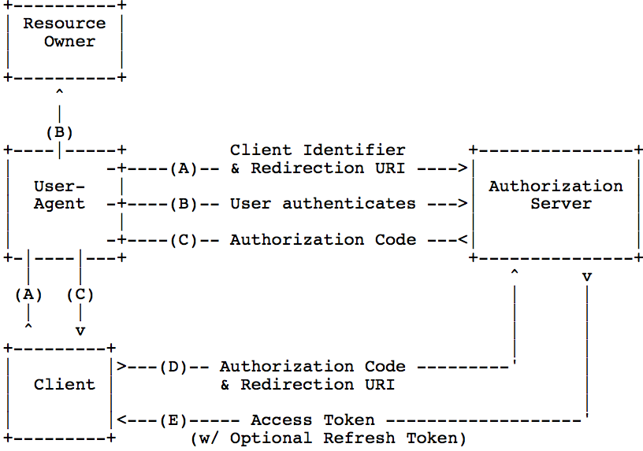
Concept II
Notes:
The flow illustrated in Figure 3 includes the following steps:
(A) The client initiates the flow by directing the resource owner's
user-agent to the authorization endpoint. The client includes
its client identifier, requested scope, local state, and a
redirection URI to which the authorization server will send the
user-agent back once access is granted (or denied).
(B) The authorization server authenticates the resource owner (via
the user-agent) and establishes whether the resource owner
grants or denies the client's access request.
(C) Assuming the resource owner grants access, the authorization
server redirects the user-agent back to the client using the
redirection URI provided earlier (in the request or during
client registration). The redirection URI includes an
authorization code and any local state provided by the client
earlier.
(D) The client requests an access token from the authorization
server's token endpoint by including the authorization code
received in the previous step. When making the request, the
client authenticates with the authorization server. The client
includes the redirection URI used to obtain the authorization
code for verification.
(E) The authorization server authenticates the client, validates the
authorization code, and ensures that the redirection URI
received matches the URI used to redirect the client in
step (C). If valid, the authorization server responds back with
an access token and, optionally, a refresh token.

Slide 9
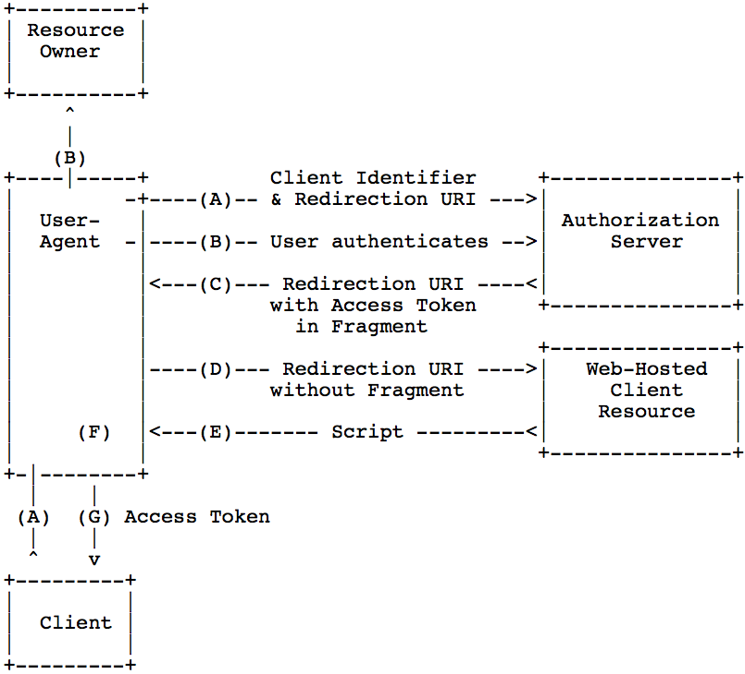
Concept II

Slide 10
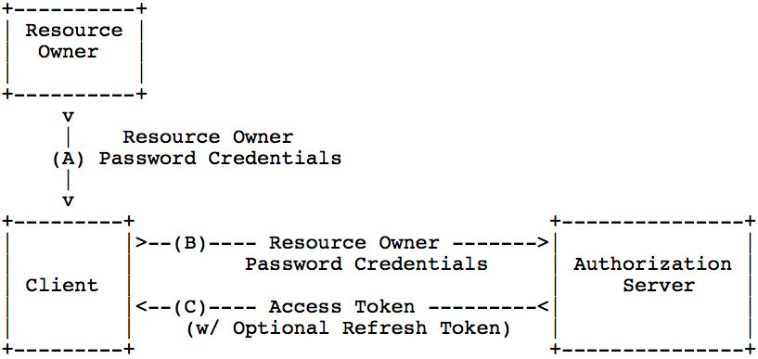
Concept II

