Slide 1

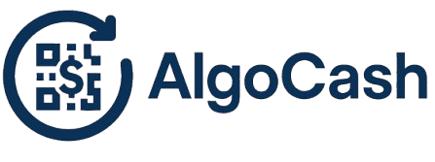
Problem Statement
AlgoCash turns digital money into cash-like QR notes — enabling instant, secure, and even offline payments on Algorand.
Imagine a payment system that works without internet.
Just like handing over a paper note — scan a QR, transfer value instantly.
Current digital payments fail in offline, gift, or trustless scenarios.
Opportunity: Digital cash that is:
Portable like physical money
Transferable via QR codes
Verifiable on blockchain when redeemed
01

Slide 2
Project Features:
Digital Cash Minting – Users deposit ALGO and mint secure, encrypted notes.
QR Code Integration – Each note becomes instantly shareable.
Double-Spend Prevention – Notes marked as “USED” on redemption.
Multiple Denominations – 1, 2, 5, 10 ALGO notes for flexibility.
Liquidity Pool – Automated fund management ensures smooth withdrawals.
Clean User Interfaces – Full-featured management app + lightweight public claim site.
02

Slide 3
How It Works
Smart Contract (Algorand TEAL):
Stores encrypted codes, tracks note status, prevents reuse.
Backend (Node.js + TypeScript):
Liquidity pool monitoring, contract scripts, automation.
Frontend (React + Tailwind):
Full management dashboard for minting and tracking notes.
Claim Site (React mini-app):
Scan QR → Enter wallet → Claim instantly.
Blockchain Layer (Algorand):
Fast, low-fee, secure, immutable transactions.
03

Slide 4
Business Model & GTM (Go-To-Market)
Revenue Streams:
Small transaction/withdrawal fees.
Branded partnerships (events, merchants, gift cards).
API/SDK licensing for third-party integration.
Target Markets:
Events & Ticketing – secure QR-based ticket redemption.
Retail & Loyalty – ALGO notes as gift cards or loyalty points.
Micro-payments – content creators & small transactions.
Go-To-Market Strategy:
Launch on Algorand TestNet → MainNet.
Partner with Algorand ecosystem projects & events.
Early adoption through hackathons, dev communities, and pilot merchants.
04

Slide 5
Future Plans
Dynamic QR Codes:
Generate one-time or variable-value QR codes for flexible payments.
NFC / RFID Payment Cards:
Physical cards linked to Algorand notes, allowing tap-to-pay for different amounts.
Universal QR Device:
A single portable device that can generate and display secure QR codes for all transactions.
Mobile App Integration:
Native iOS/Android app for minting, storing, and redeeming notes offline.
Multi-Asset Support:
Extend beyond ALGO to support other Algorand Standard Assets (ASAs).
05

Slide 6
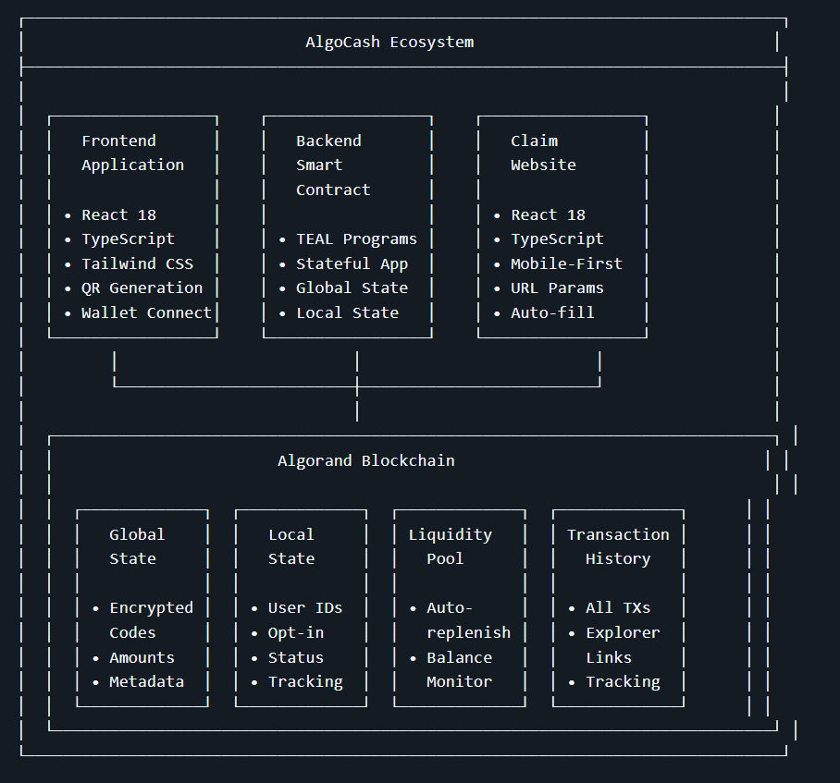

Slide 7
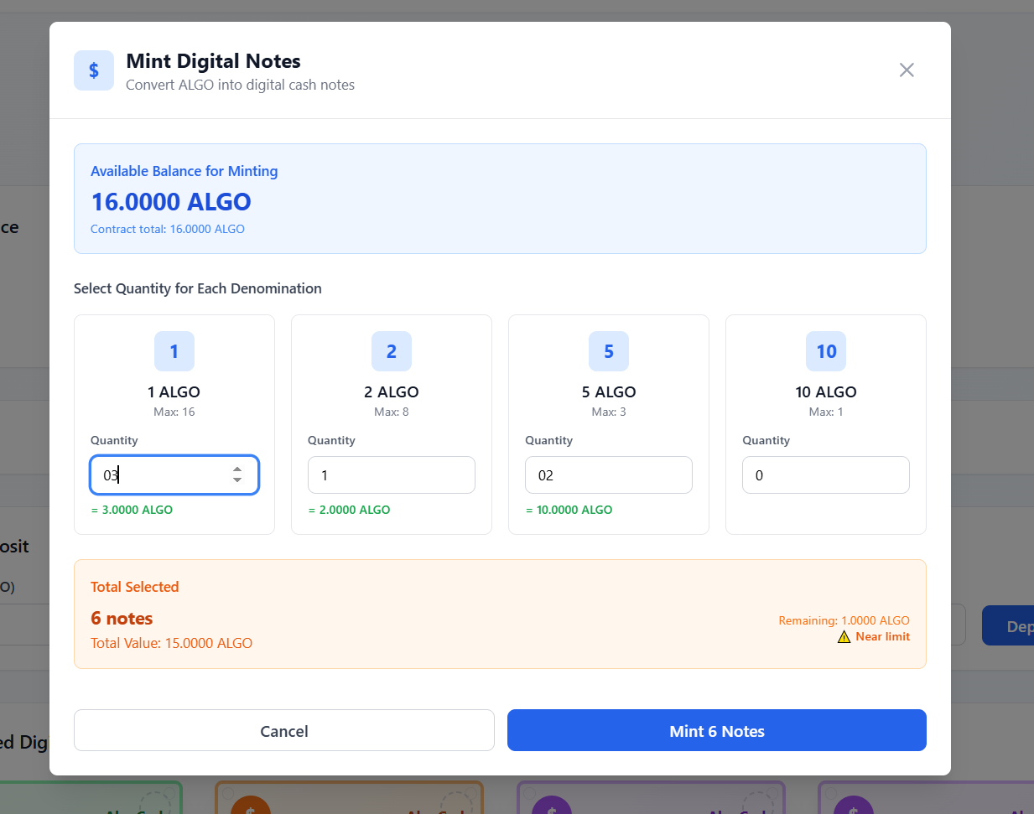
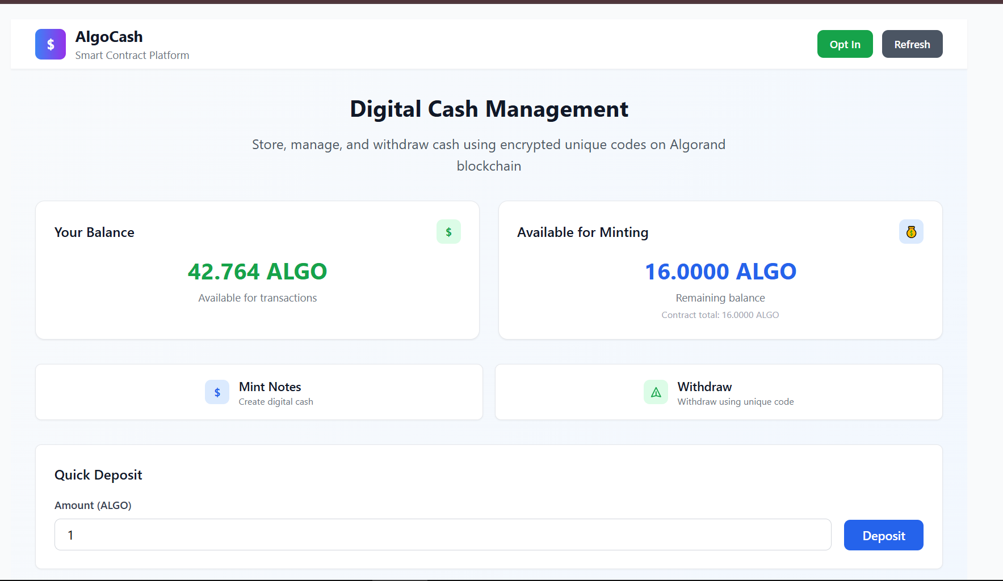
Demo

Slide 8
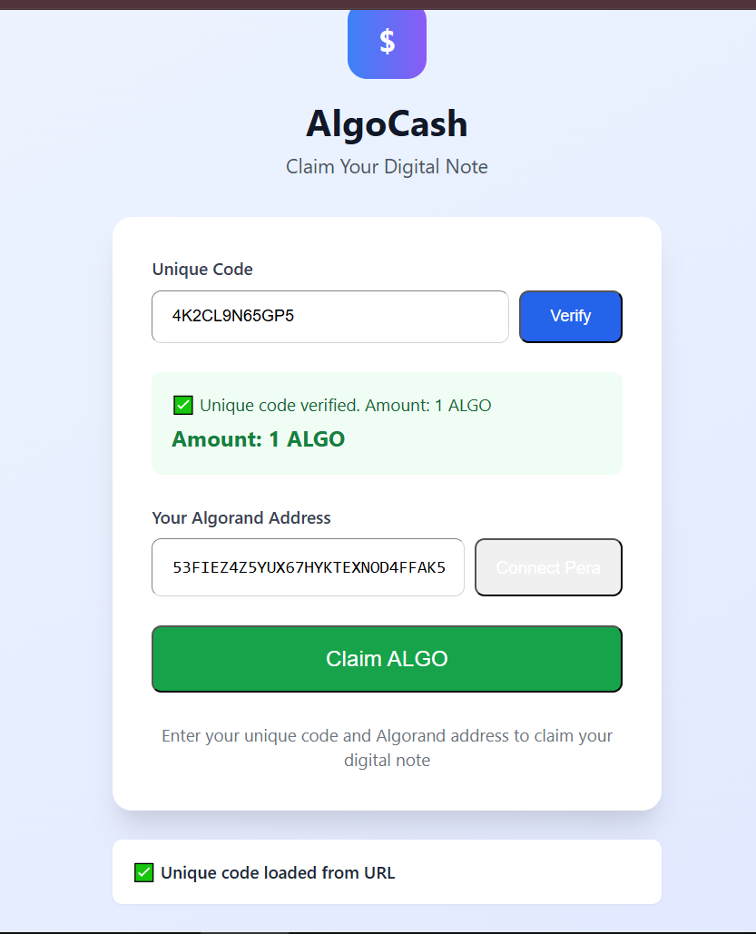
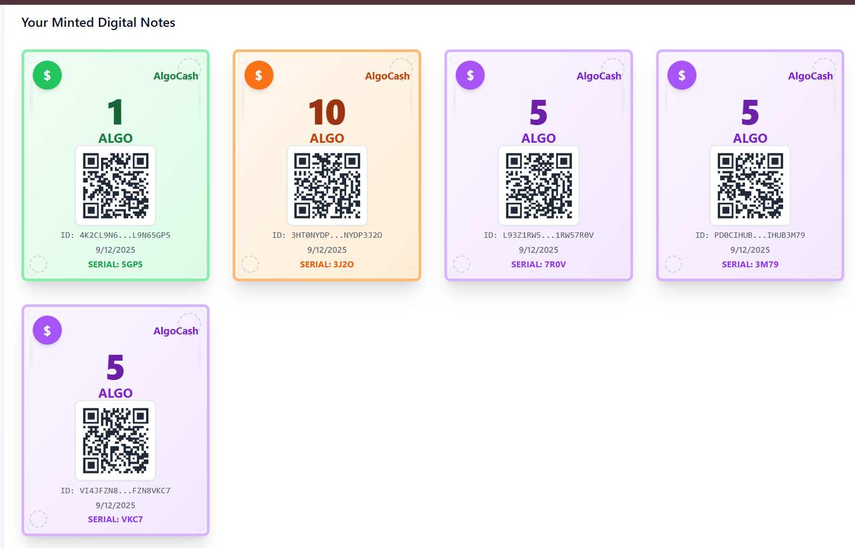
Demo

Slide 9
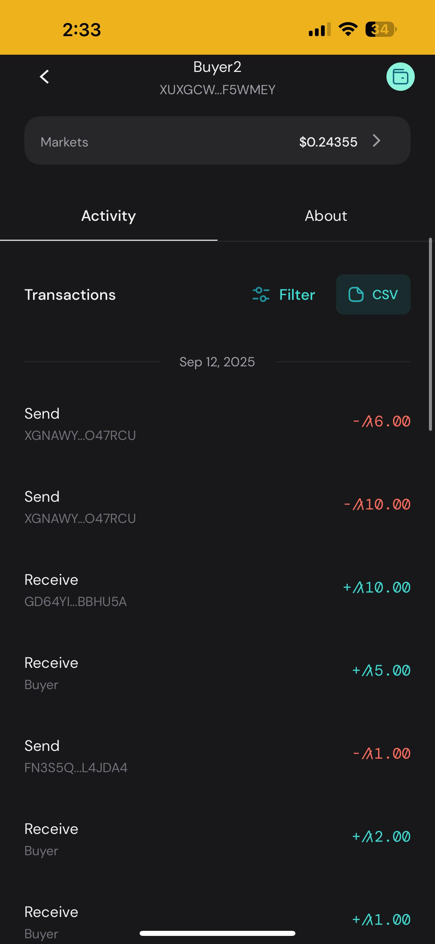
Demo

Slide 10
Thank
You
AlgoCash
-
05

