Slide 1
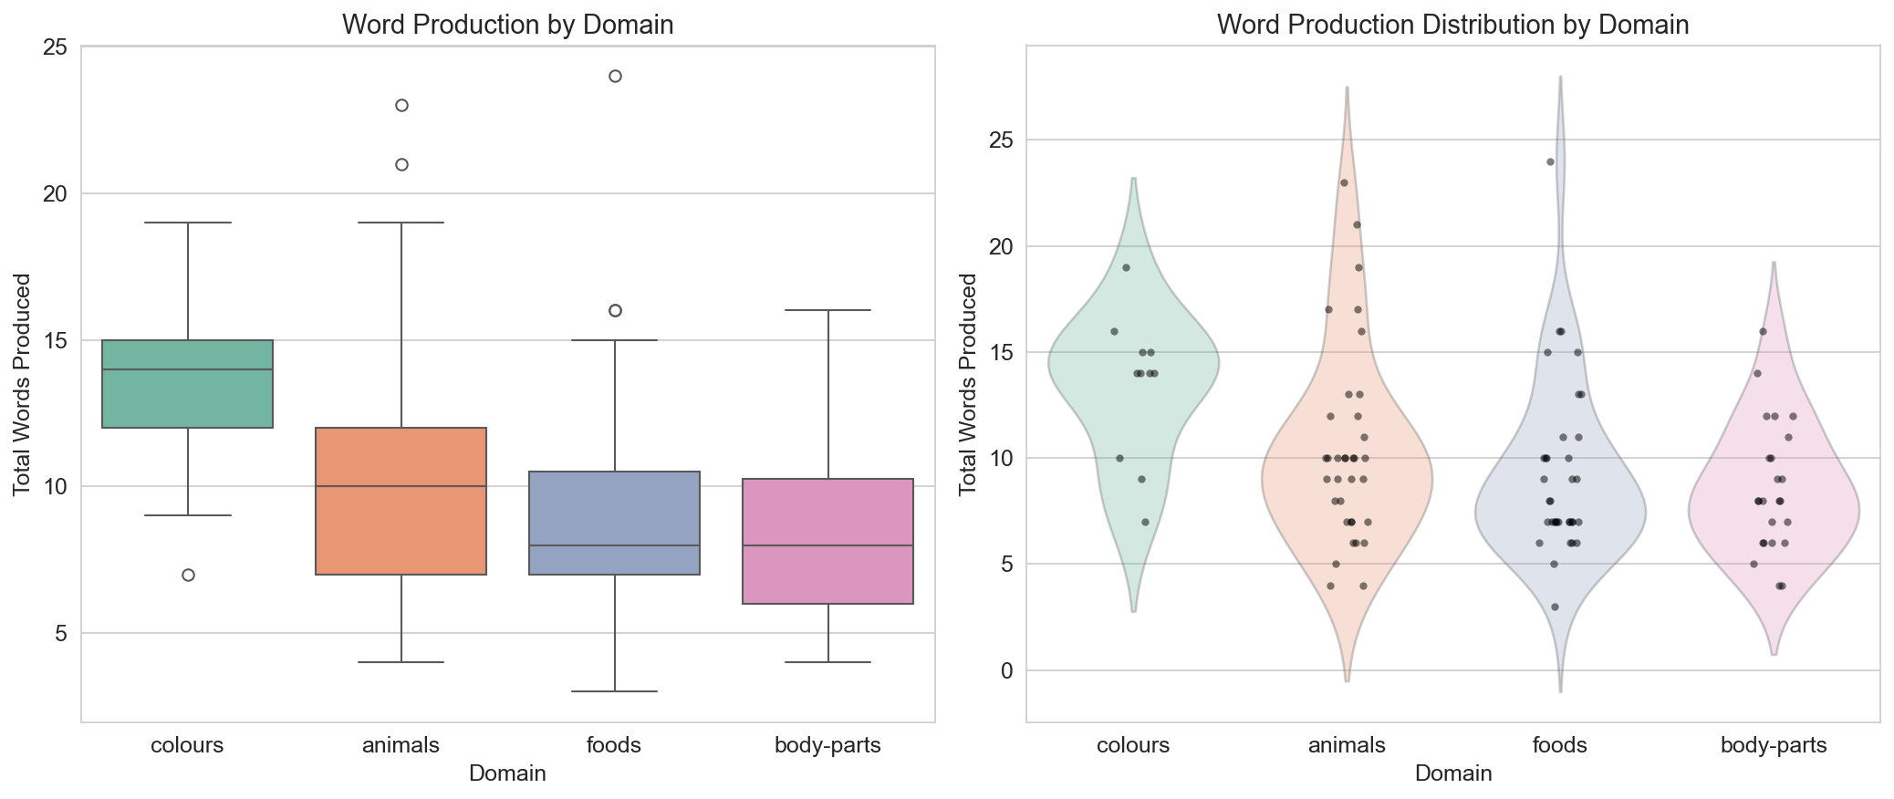
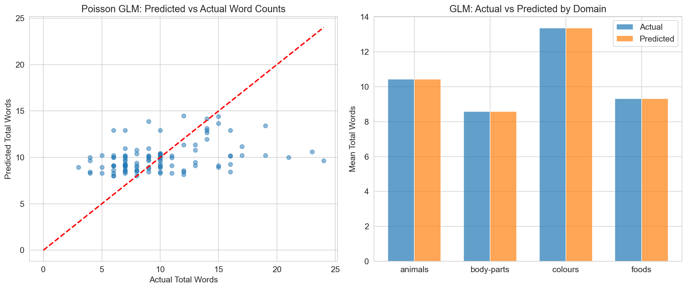
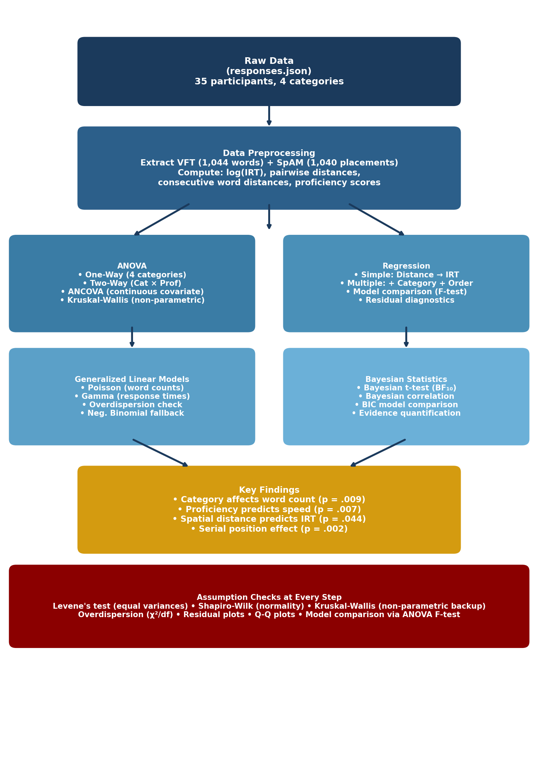
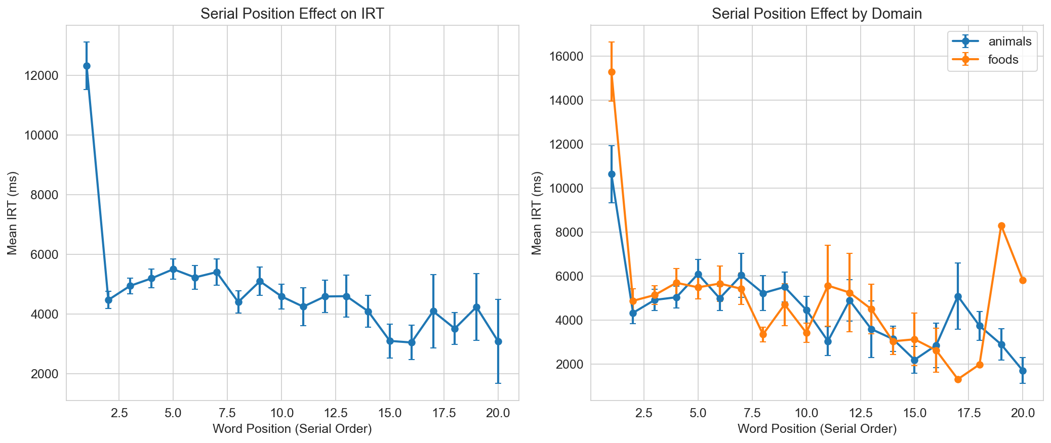
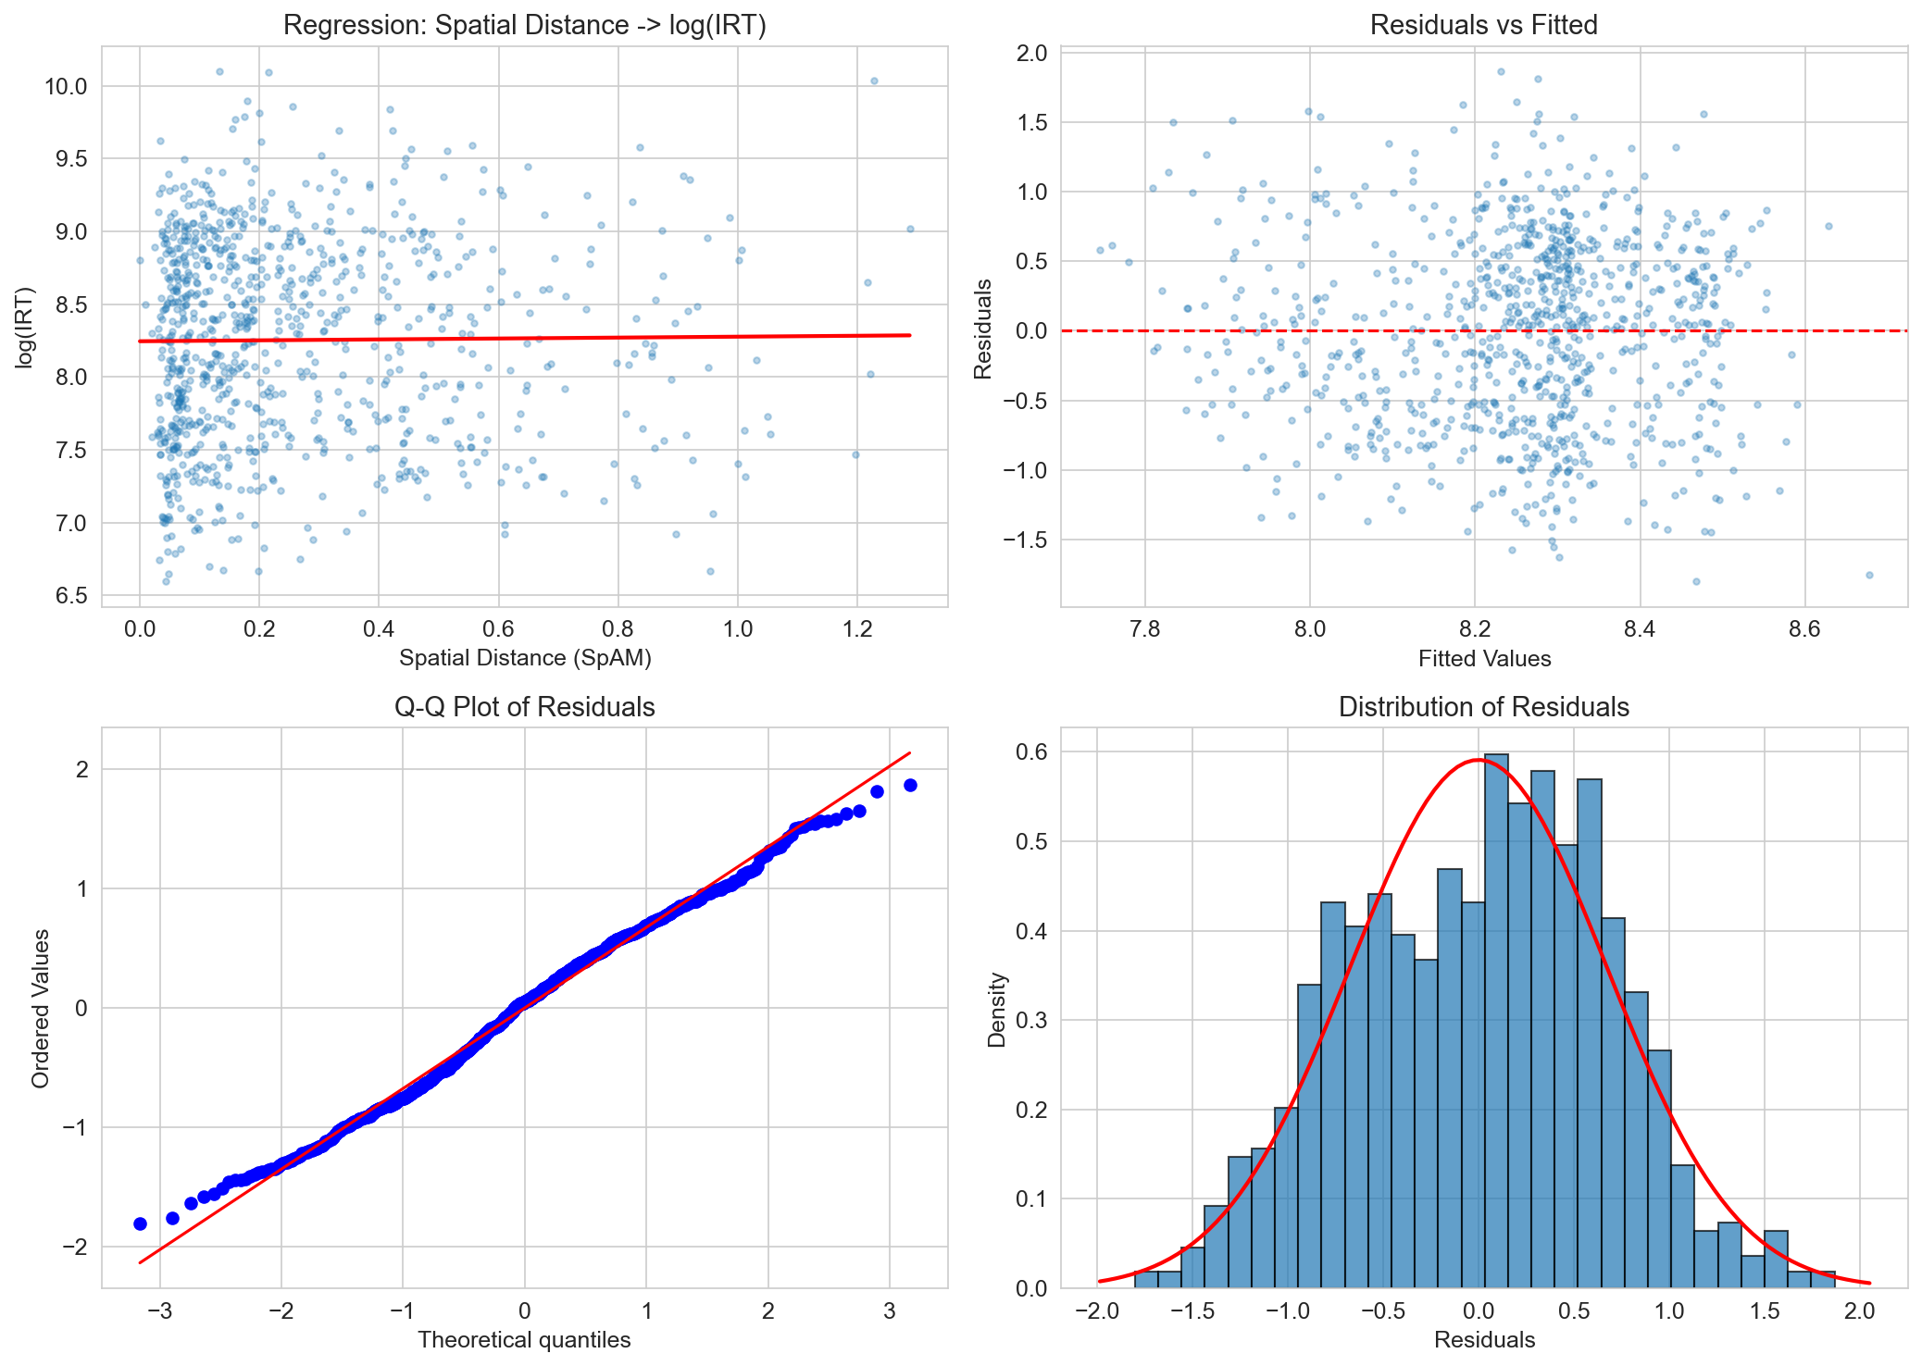
Team Name - Rockers
BRSM PROJECT POSTER PRESENTATION SP 2026
Hindi Fluency and Semantic Organization: Advanced Statistical Analysis
BRSM Spring 2026 | IIIT Hyderabad | Verbal Fluency Task + Spatial Arrangement Method
ABSTRACT
RESULTS
CONCLUSIONS
This study investigates lexical retrieval and semantic organization in Hindi speakers using the Verbal Fluency Task (VFT) and Spatial Arrangement Method (SpAM). We analyzed data from 35 participants across four semantic categories (Animals, Foods, Colours, Body Parts), collecting 1,044 word responses and 1,040 spatial placements.
Using ANOVA, Multiple Regression, Generalized Linear Models, and Bayesian statistics, we found:
• Word production differs across categories (p = .009)
• Hindi proficiency predicts retrieval speed but not word count (ANCOVA p = .007; Bayesian BF₁₀ = 0.091)
• Spatial distance predicts IRT after controlling for category (β = 0.202, p = .044)
• Serial position effect: within-cluster acceleration (β = −0.017, p = .002)
These findings highlight how choosing the right statistical methods can reveal effects that simpler analyses miss.
1. ANOVA — Word Production Across Categories
One-Way ANOVA: F(3,101) = 4.05, p = .009, η² = .107 (medium effect)
• Colours (M=13.4) > Body Parts (M=8.6): p = .008, Hedges' g = 1.47
• Colours (M=13.4) > Foods (M=9.3): p = .022, Hedges' g = 1.01
• Welch's ANOVA: F(3,39.6) = 5.44, p = .003
• Kruskal-Wallis (non-parametric): H = 13.10, p = .004
Colours is a smaller, bounded category allowing near-exhaustive retrieval.
4. Generalized Linear Models
Poisson GLM (word counts are integers, not continuous):
• Colours: 28% more words than Animals (p < .001)
• Body Parts: 19% fewer words than Animals (p < .001)
• Mild overdispersion (φ = 1.61); Neg. Binomial gave same results.
Gamma GLM (IRT is always positive & right-skewed):
• Hindi Proficiency: β = −0.091, p = .025
Each 1-point increase → 8.7% faster retrieval
• Total Words: β = −0.027, p = .045 (more fluent = faster)
• Colours domain: 29% faster than Animals (p = .007)
GLMs found effects OLS missed by correctly modeling data distribution.
1. Category matters for word production.
Colours produces significantly more words than Body Parts (p=.008) and Foods (p=.022). Bounded categories allow near-exhaustive retrieval.
2. Proficiency predicts speed, not quantity.
ANCOVA (p=.007) and Gamma GLM (p=.025) recovered a proficiency→speed effect that Report 1 missed. Bayesian analysis (BF₁₀=0.091) confirms proficiency does NOT predict word count.
3. Spatial distance predicts IRT after controls.
Simple correlation (p=.750) masked a suppression effect. Controlling for category reveals the true relationship (β=0.202, p=.044).
4. Serial position drives retrieval dynamics.
Within-cluster acceleration (β=−0.017, p=.002): ~1.7% speedup per position.
5. Statistical model choice matters.
Poisson/Gamma GLMs found effects that ordinary regression missed by correctly modeling count data and skewed response times.
METHODOLOGY
Data: N = 35 participants; 4 categories; 1,044 word responses; 1,040 SpAM placements. Tasks administered online via jsPsych.
Preprocessing: Extracted VFT (words + IRT) and SpAM (x,y coordinates) from JSON. Computed pairwise distances, consecutive word distances, log-transformed IRT, and Hindi proficiency composites (average of reading & writing ratings).
Significance level: α = 0.05 for all tests. Tools: Python (scipy, statsmodels, pingouin).
2. ANCOVA — Proficiency Effect Recovered
Report 1 found proficiency → IRT was NOT significant (p = .060).
ANCOVA keeps proficiency as a continuous variable (not dichotomized):
• Category: F(3,100) = 3.28, p = .024, η² = .090
• Hindi Proficiency: F(1,100) = 7.60, p = .007, η² = .071
Higher proficiency → faster retrieval. Category-level variance was hiding this effect in Report 1.
TEAM CONTRIBUTIONS
Deban Kumar Shahi (2024201048)
ANOVA analyses, regression modeling, assumption testing, model diagnostics.
Md Fraz Uddin (2024201064)
Python pipeline, figures, GLM & Bayesian analyses, report & poster.
Suraj Lalwani (2024201071)
Data extraction from JSON, SpAM metrics, preprocessing pipelines.
5. Serial Position Effect
β = −0.017, t = −3.18, p = .002
Each position → ~1.7% faster retrieval.
Pattern: startup → within-cluster acceleration → slowdown at ~position 12.
3. Regression — Spatial Distance Predicts IRT
Simple regression (no controls): β = 0.031, p = .750 (NOT significant)
After controlling for category:
β = 0.202, p = .044 (SIGNIFICANT)
Adding serial position: β_dist = 0.225, p = .025; β_order = −0.017, p = .002
Model comparison: F(4) = 12.35, p < .001
→ Category was a confounding variable masking the real effect.
REFERENCES
[1] Lezak et al. (2012). Neuropsychological Assessment. Oxford UP.
[2] Troyer et al. (1997). Clustering and switching in verbal fluency. Neuropsychology, 11(1), 138–146.
[3] Koch et al. (2016). Spatial arrangement method. Behavior Research Methods, 48, 442–456.
[4] Jeffreys, H. (1961). Theory of Probability. Oxford UP.
[5] Dautriche et al. (2016). Wordform similarity. Cognitive Science, 41, 2149–2169.
6. Bayesian Analysis
• Bayesian t-test (IRT by proficiency group): BF₁₀ = 1.02
→ Inconclusive with dichotomized groups.
• Bayesian correlation (spatial dist vs IRT): BF₁₀ = 0.064
→ Strong evidence for NO simple effect.
• BIC model comparison (proficiency → word count): BF₁₀ = 0.091
→ Strong evidence proficiency does NOT predict quantity.
Takeaway: Proficiency affects SPEED but NOT QUANTITY.
BRSM Spring 2026 • IIIT Hyderabad • Hindi Verbal Fluency & Semantic Organization
Md Fraz Uddin(2024201064), Suraj Lalwani(2024201071) and Deban Shahi(2024201048)
GitHub: github.com/fraz-uddin07/BRSM_GRP_52

