Slide 1

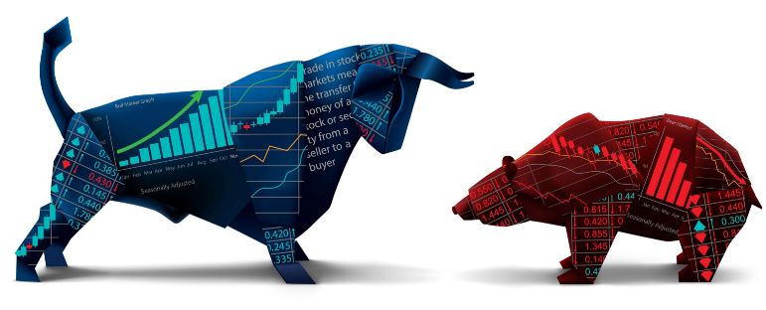
Stock Market
Portfolio Optimization
Sectors
history
Team: Coogle
services
teams
timeline
about

Slide 2

history
MESSAGE FROM
focus
team
about
report
timeline
Coogle:
Pani Maddi, David Frazier, John Hernandez, Cody Sifford
This presentation is on portfolio optimization in the stock market, while also forecasting potential bankruptcies.

Slide 3
Project Description
Back Testing of the S&P 500
Markowitz Model
Portfolio Returns
Sharpe Ratios
Optimizing your Portfolio:
Review the Stock Performance
Real-Time Data
Thousands of Simulations
Natural Language Processing
Do’s and Do Not’s
focus
team
history
report
Plots
project

Slide 4



Sectors
Stocks
Report
1
2
3
focus
Portfolio Tips
Analysis
Dashboard
Agenda
report
team
timeline
about
Keys/Trends
Interactive Charts
Visualizations

Slide 5









Portfolio Optimization
RE-INVEST DIVIDENDS
Invest Early
focus
Sectors
report
team
timeline
AVOID POTENTIAL BANKRUPTIES FROM
YOUR PORTFOLIO
about
Take Advantage of Roth IRA
ETF INVEST IN DIVERSIFIED
BACKTESTING MODELS
POTENITAL TRADING STRATEGIES USING NLP
HIGH BETA STRATEGY
MARKOWITZ MODEL FOR OPTIMIZATION

Slide 6
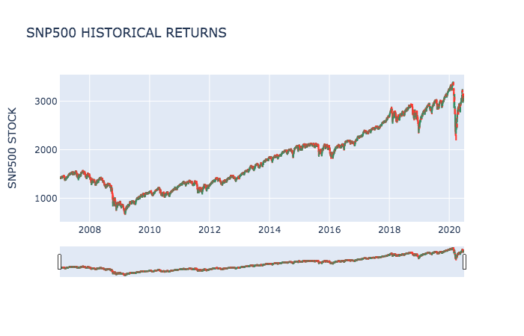
report
history
focus
about
Translating the past 12 years we see definite trends in the market

Slide 7
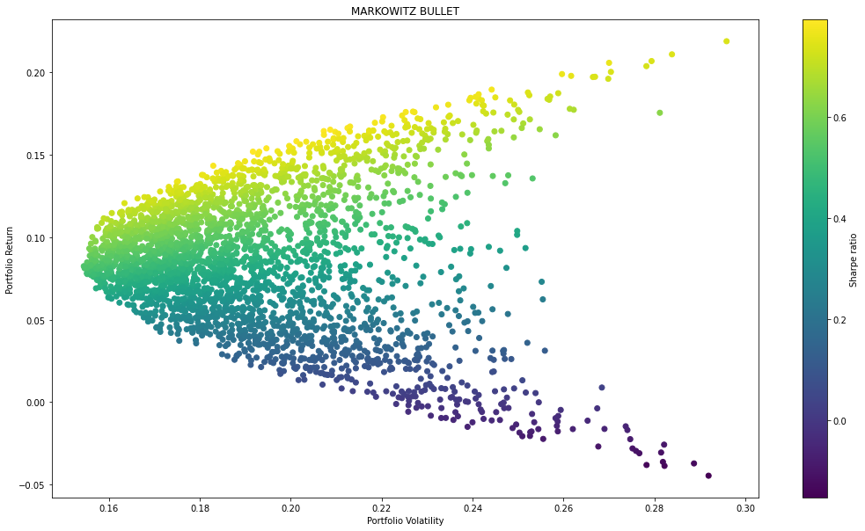
Markowitz Model
focus
history
report
S&P 500
timeline
about

Slide 8
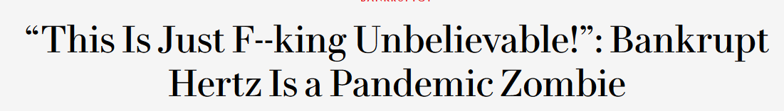
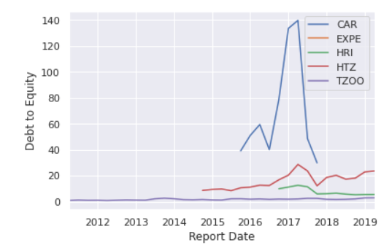
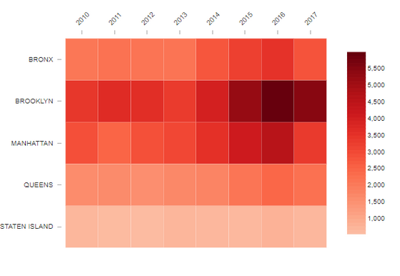
Debt/Equity:
Harbinger of Rental Car Rigor Mortis?
report
history
focus
timeline
about
D/E
HTZ (Hertz) went bankrupt on May 22, 2020.

Slide 9
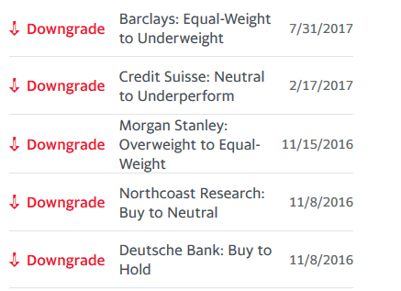
What to expect!
report
history
focus
about
There is a 95% chance that an initial investment of $10,000 in the portfolio over the next 252 * 3 trading days will end within in the range of $59174.2629724814 and $224573713.05374104

Slide 10






Markowitz Plots
Stocks
focus
Correlation
Beta
team
sectors
report
timeline
about
Heatmap
3-D Learning

Slide 11
Dashboard Demo
S
T
D
focus
sectors
report
team
timeline
about
500
1,000’s
$ From
S&P 500
Simulating Stocks
Dividends

