Slide 1
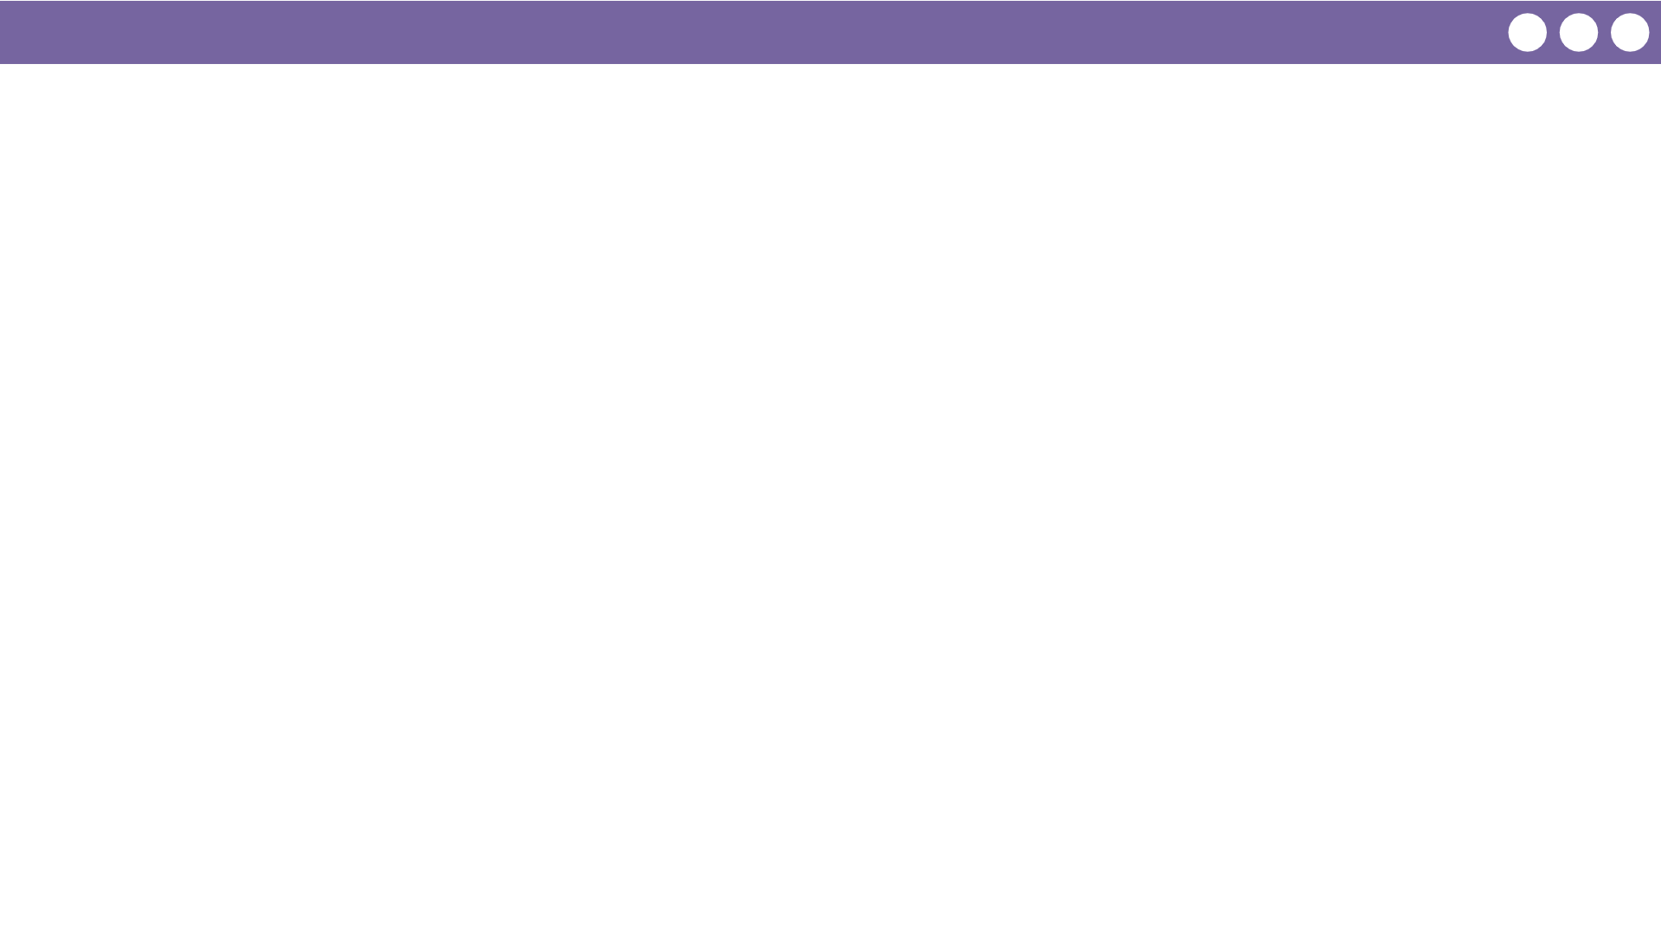
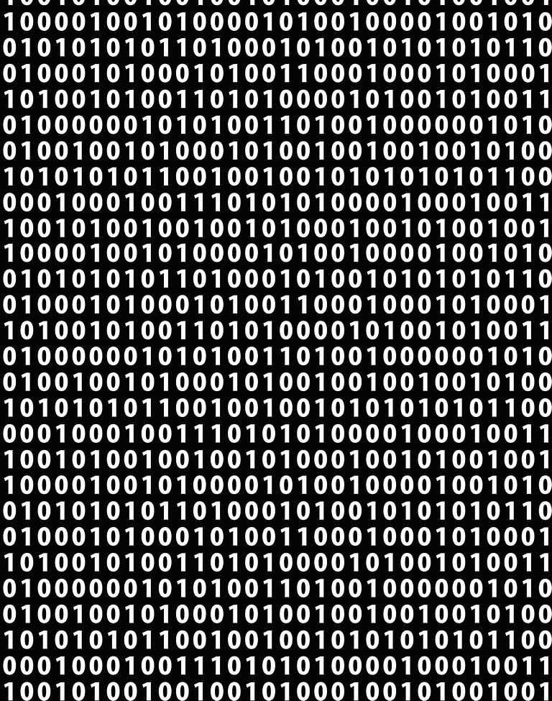
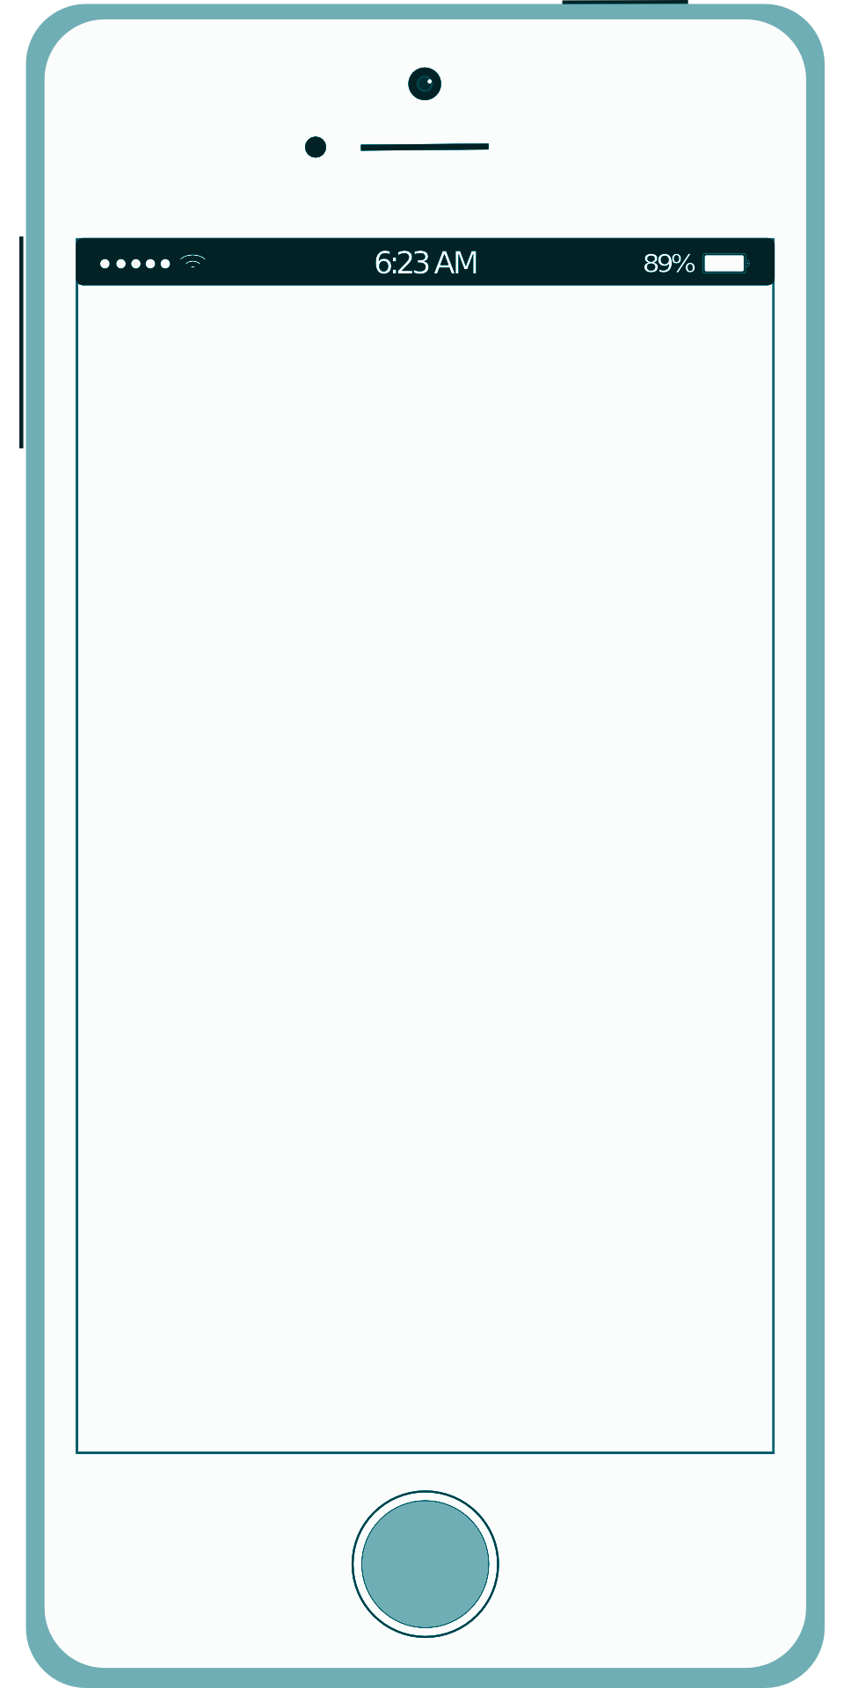
Unit 1 Lesson 6 - Wrap Up
Abstraction
We don't have to think about this layer when we send a text message… but every message is really just zeroes and ones!
ASCII
104 111 119 39 115 32 105 116 32 103 111 105 110 103 63
how's it going?
TEXT
ASCII
BINARY

