Slide 1
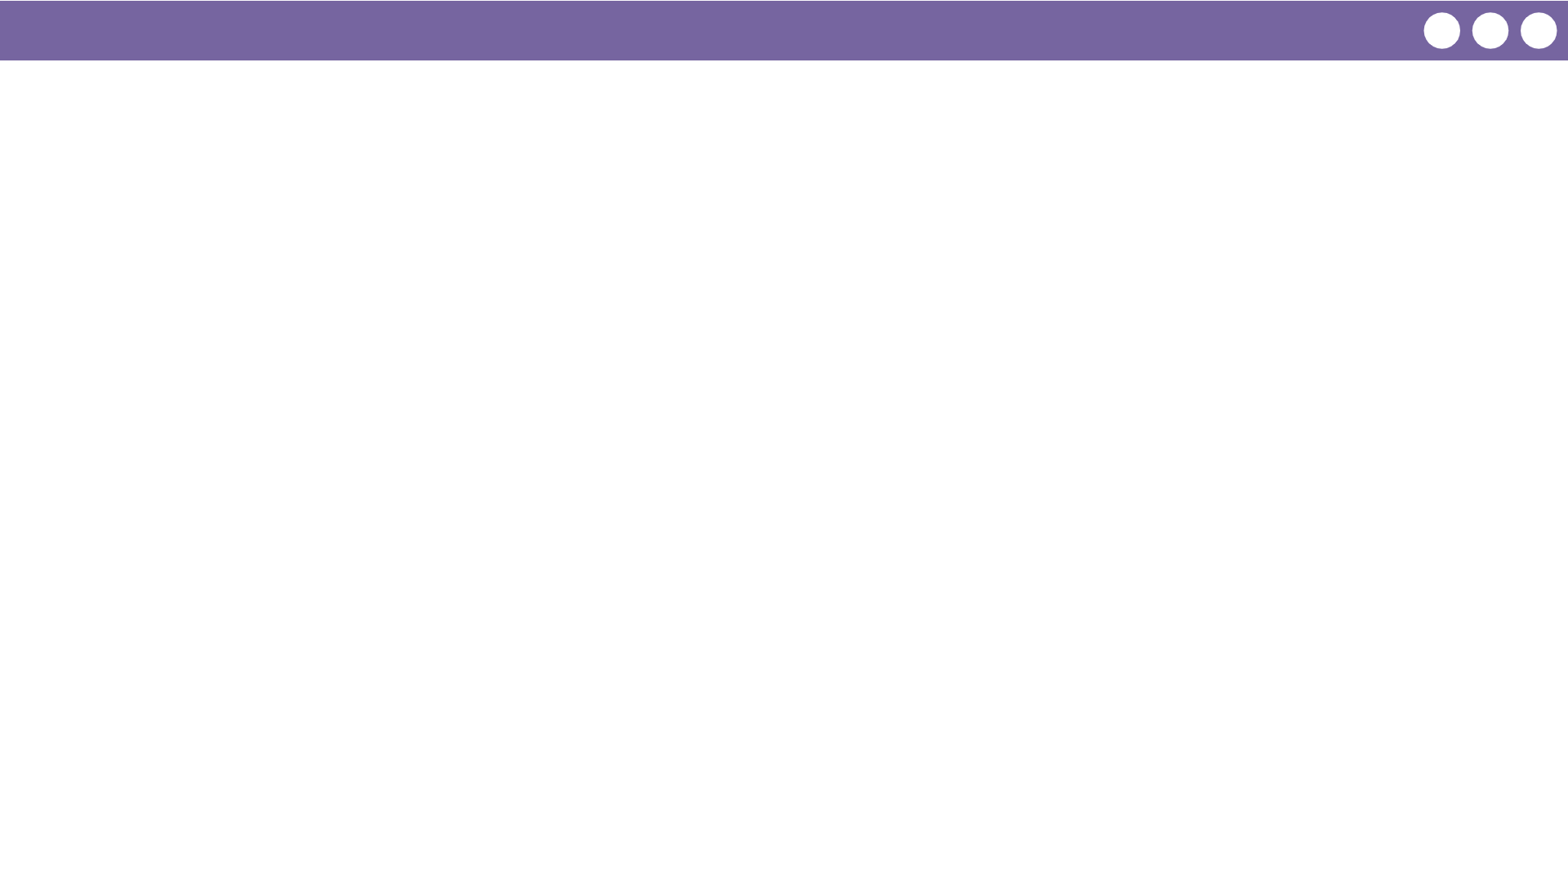
Unit 1 Lesson 6 - Wrap Up
Prompt:
What is another example of an abstraction from your everyday life? Something where you don’t completely understand how it works but you can still use it with confidence?

