Slide 1

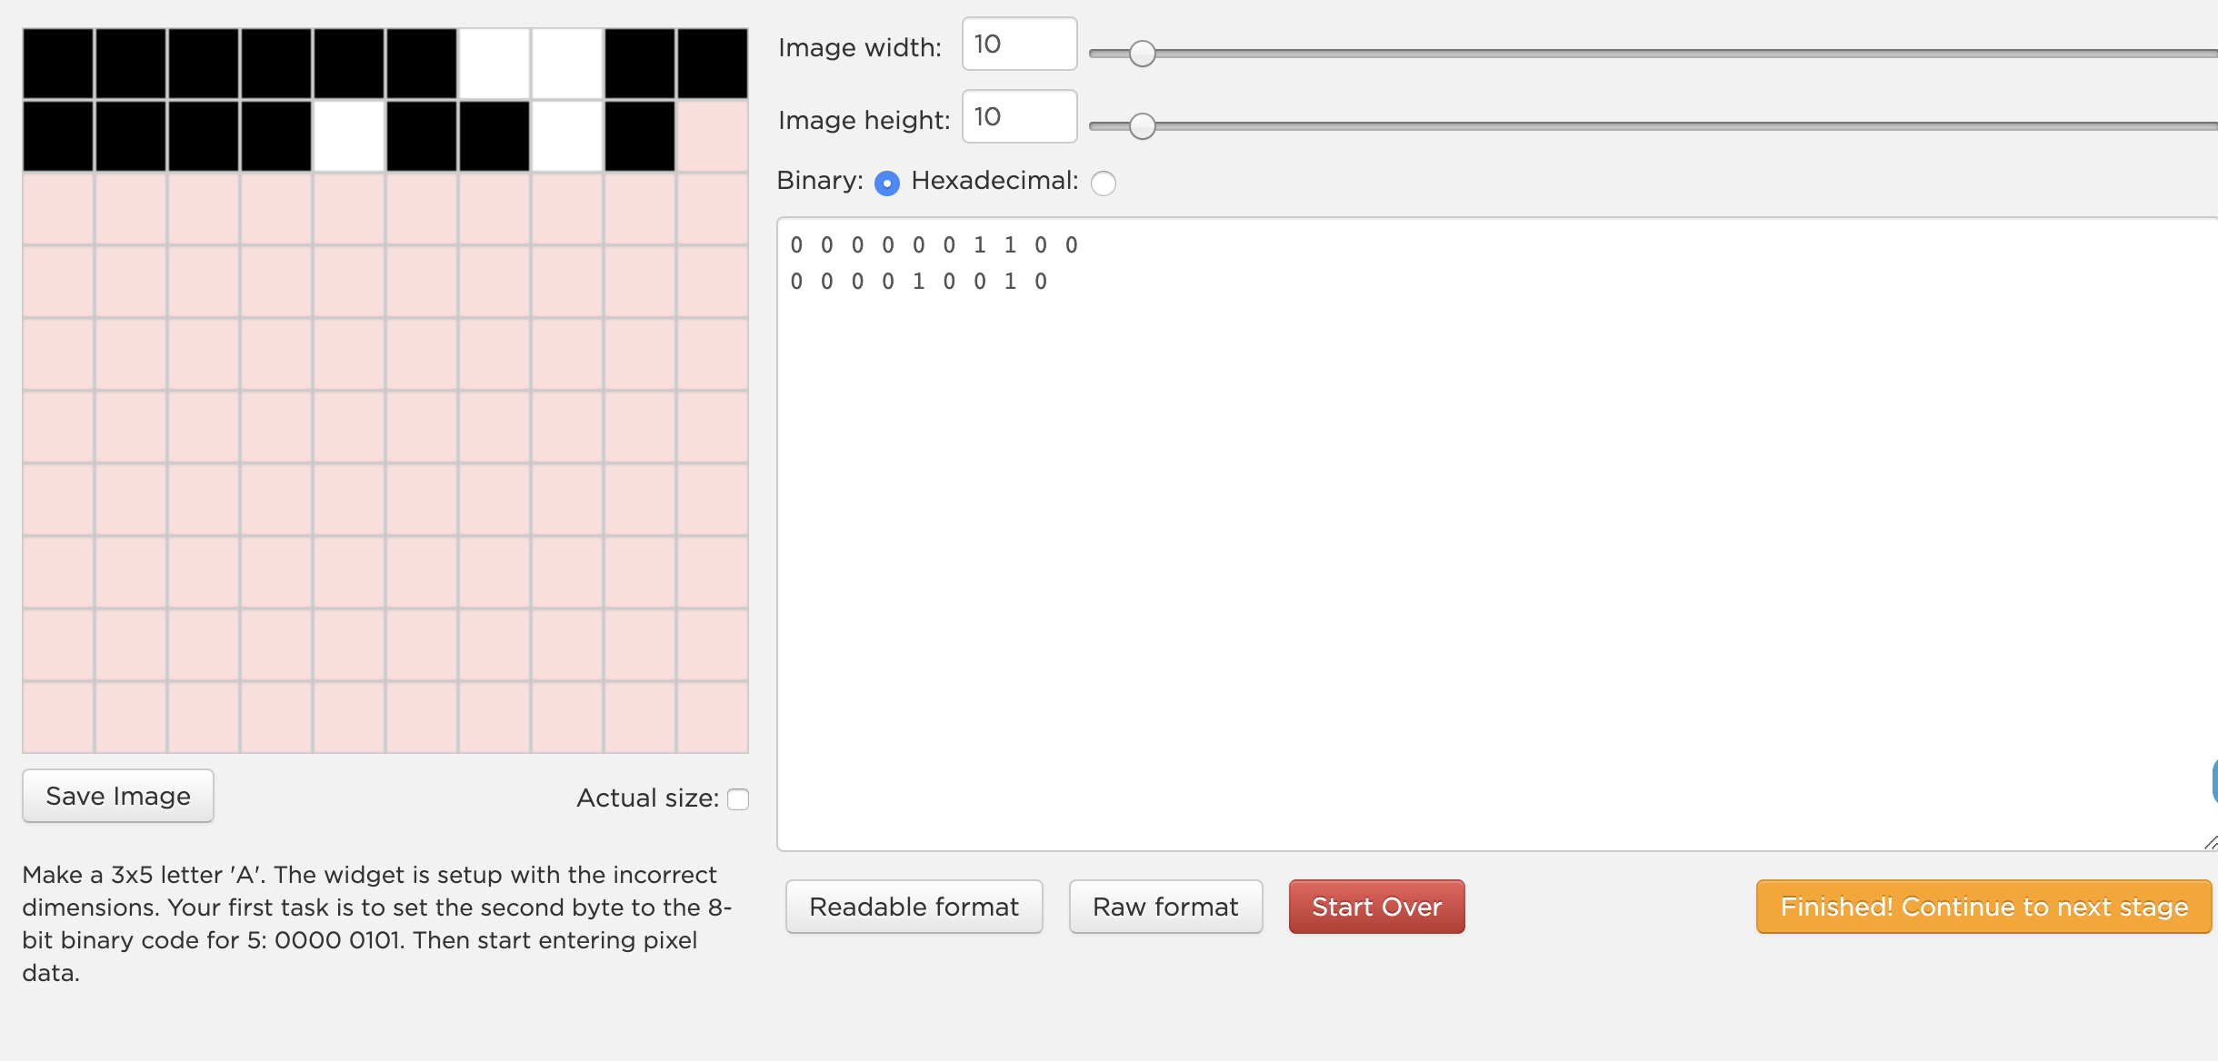
Unit 1 Lesson 7 - Activity
Pixelation Widget: B&W
Levels 1&2

