Slide 1

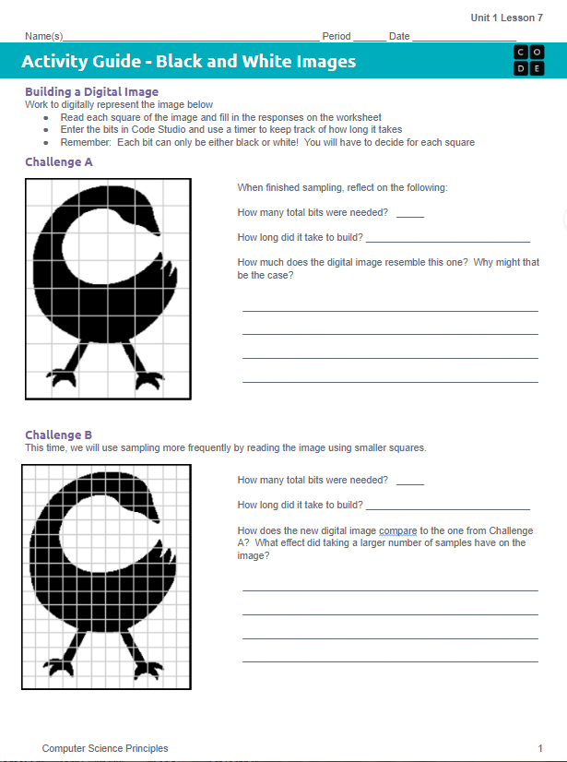
Unit 1 Lesson 7 - Activity
Do This: Challenges A (Level 3) & B (level 4)
Read values from Challenge A (black or white for each square) and input the values into the widget.
After Challenge A, answer the questions on the activity guide
Repeat for Challenge B.
Answer the questions in the activity guide after each challenge.

