Slide 1

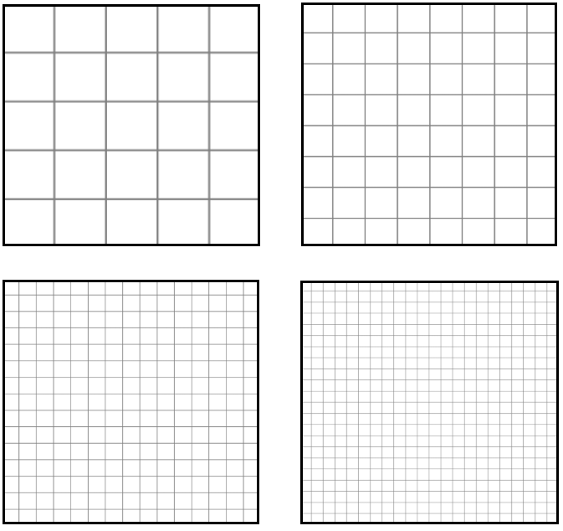
Unit 1 Lesson 7 - Activity
Do This: Challenge C
Select your favorite company logo.
Decide how you are going to sample this logo - use one of the grids in your Activity Guide. Draw the logo.
Recreate the logo in the Pixelation Widget on Level 5.
Show it to a classmate. Do they recognize the logo? Make adjustments if needed.
For example: You may need to increase the sampling.

