Slide 1

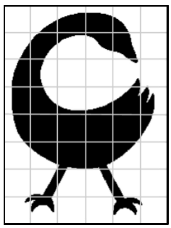
Unit 1 Lesson 7 - Wrap Up
Prompt: In Challenges A and B, you and your partner practiced sampling the same image twice. The second time, we did a more frequent sampling by using smaller squares.
What are the pros and cons of sampling an image more frequently?

