Slide 1

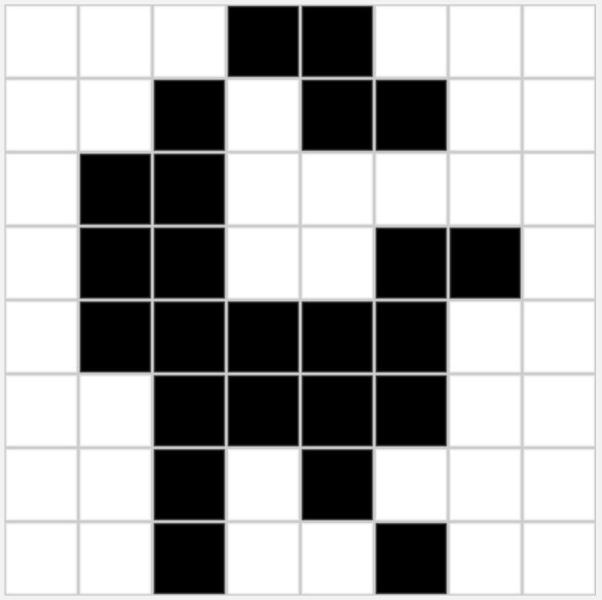

Unit 1 Lesson 7 - Wrap Up
Sampling: A process for creating a digital representation of analog data by measuring the analog data at regular intervals called samples.
image
sound
samples

