Slide 1
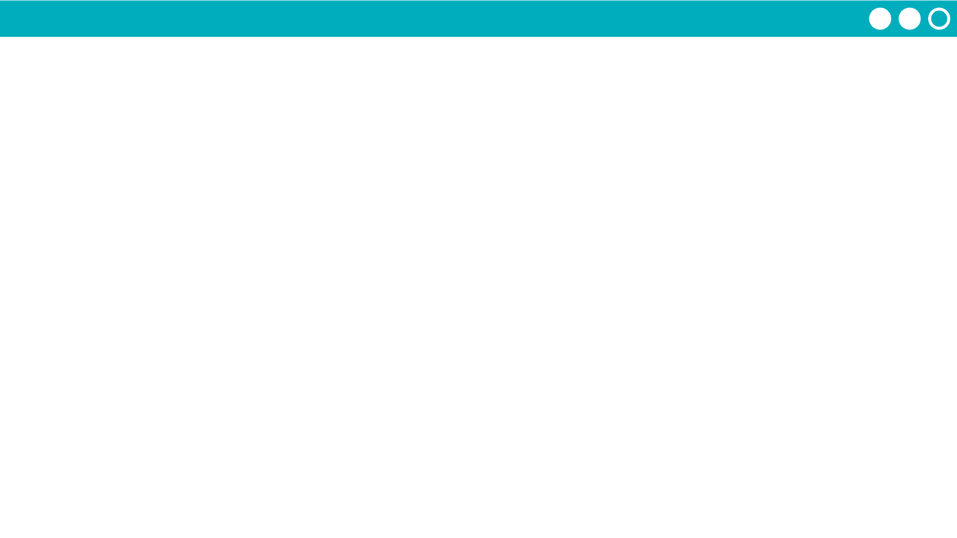
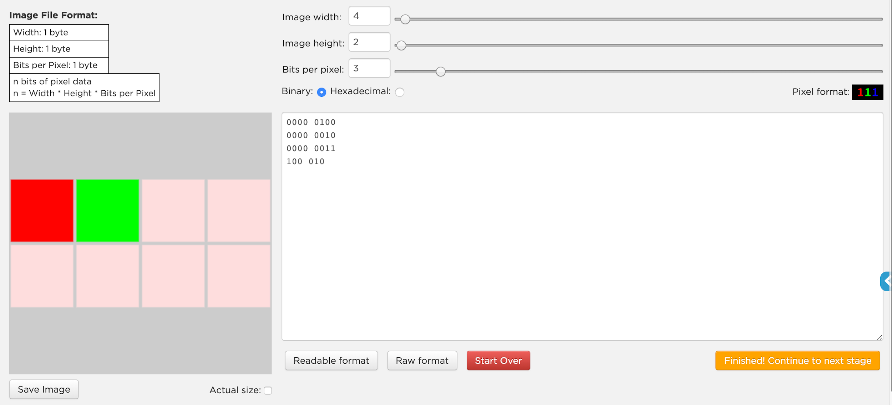
Unit 1 Lesson 8 - Activity
Pixelation Widget: Color
Levels 1-5

