Slide 1

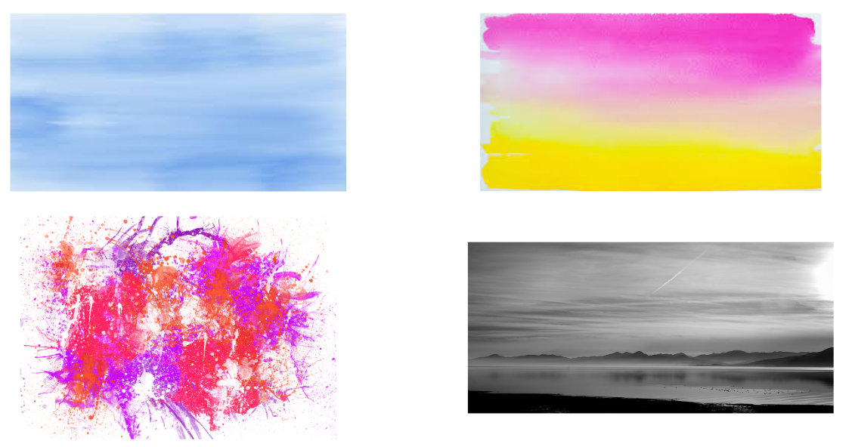
Unit 1 Lesson 8 - Activity
Levels 6-7
Try your best to match the colors using the widgets and reproduce the gradient. Don’t worry if it doesn’t match exactly!
Image 1
Image 2
Image 3
Image 4

