Slide 1

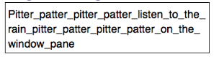

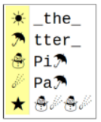
Unit 1 Lesson 9 - Activity
Text Compression

